Slide 1

Rheumatoid arthritis
CHIEF Dr. Sundaram MD.
Assistant Professor Dr.P.KRISHNARAJAN MD.
Dr.S.SUGADEV MD.
Presentor -Anees Fathima

Slide 2
Definition
Chronic systemic autoimmune inflammatory disease
Predominantly affects synovial joints
Leads to synovitis, cartilage damage, and bone erosion
Extra-articular systemic manifestations possible

Slide 3
Epidemiology
Prevalence ~0.5–1% worldwide
Female predominance (≈3:1)
Incidence increases between 25 and 55 years of age
Peak onset: 30–50years
Genetic predisposition (HLA-DRB1 shared epitope)
Environmental factors: smoking, infections

Slide 4
Pathogenesis
Autoimmune activation against synovial antigens -ENTHESITIS
Role of T cells(IL-17)
→ neutrophil recruitment, B cells, macrophages
-Neutrophils Release PAD enzymes.
NET formation produces citrullinated proteins.
Sustains chronic inflammation.

Slide 5
Autoimmune activation
⬇
Synovial inflammation (TNF-α, IL-1, IL-6)
⬇
Synovial hyperplasia + angiogenesis+dense inflammatory infiltrate
⬇
Granulation tissue formation
PANNUS(aggressive invasive tissue )
⬇
Cartilage degradation (MMPs)
⬇
RANKL Osteoclast activation → bone and articular Cartilage erosion
⬇
Fibrosis → ankylosis

Slide 6
Histopathology of pannus formation
Proliferative Aggressive Neovascularized synovium that nibbles cartilage.
Villous synovial hypertrophy
Proliferating fibroblast-like synoviocytes
Macrophages
Lymphoplasmacytic infiltrate
Neovascularization
Fibrin deposition
Invasive granulation tissue

Slide 7
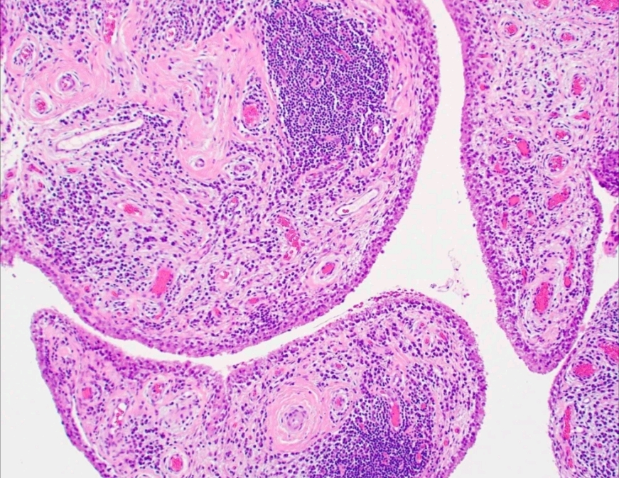

Slide 8
Core Concept of RA Autoimmunity
Autoimmune disease driven by loss of tolerance to modified self-proteins.
Central mechanism:
Post-translational protein modification.
Modified proteins become neoantigens.
Autoantibody formation precedes clinical disease.

Slide 9
Genetic Factors
HLA-DRB1 shared epitope.
PTPN22.
PAD2/PAD4 polymorphisms.
Increased presentation of citrullinated peptides.
Strong link with ACPA-positive RA.
Environmental Triggers
Smoking (strongest).
Periodontal disease (P. gingivalis).
Infection.
Mucosal inflammation.
Concept:
Mucosal origin of RA autoimmunity.
Sites:Lung,Oral mucosa,GI tract.

Slide 10
Sequence:
Genetic predisposition.
Environmental exposure.
PAD activation.
Hypercitrullination.
ACPA → Immune complexes
Epitope spreading.
Cytokine rise
Clinical RA.
Autoantibodies appear years before symptoms.

Slide 11
Clinical Features – Articular
Symmetrical inflammatory polyarthritis
Small joints: MCP, PIP, wrists, MTP
Morning stiffness > 1 hour
Swelling, warmth, tenderness
Joint deformities in chronic disease

Slide 12
ACR/EULAR Classification Criteria
Joint involvement
Serology (RF, anti-CCP)
Acute phase reactants (ESR/CRP)
Duration of symptoms ≥ 6 weeks
Score ≥6 suggests definite RA

Slide 13
1. Joint Involvement (0–5 points)
1 medium to large joint → 0 points
2–10 medium to large joints → 1 point
1–3 small joints (± large joints) → 2 points
4–10 small joints (± large joints) → 3 points
10 joints (at least one small joint) → 5 points
2. Serology (0–3 points)
Negative RF AND negative ACPA → 0 points
Low-positive RF OR low-positive ACPA → 2 points
High-positive RF OR high-positive ACPA → 3 points
3. Acute Phase Reactants (0–1 point)
Normal CRP AND normal ESR → 0 points
Abnormal CRP OR abnormal ESR → 1 point
4. Duration of Symptoms (0–1 point)
<6 weeks → 0 points
≥6 weeks → 1 point

Slide 14
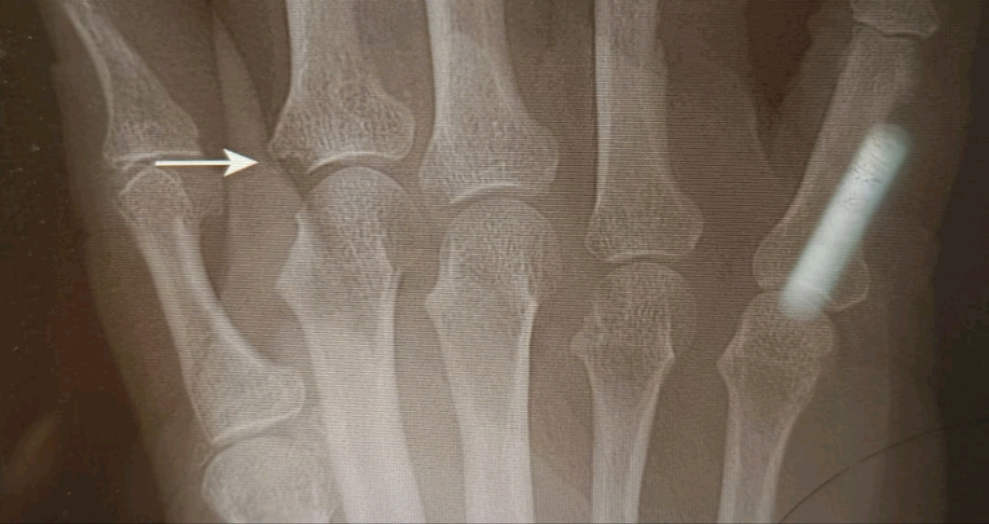
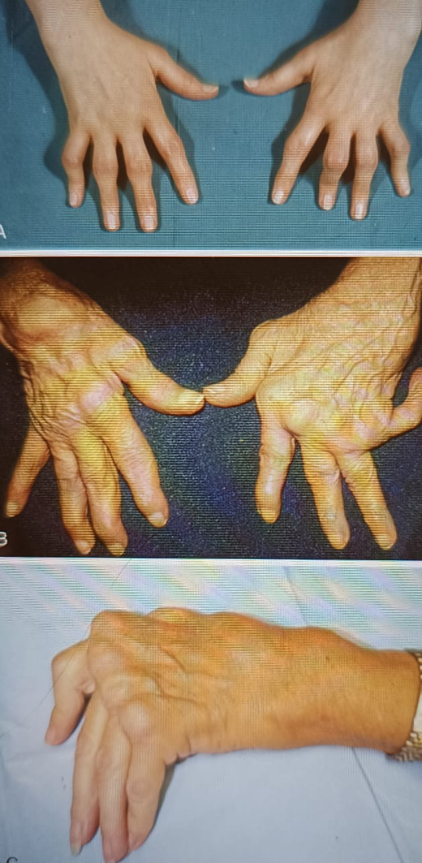
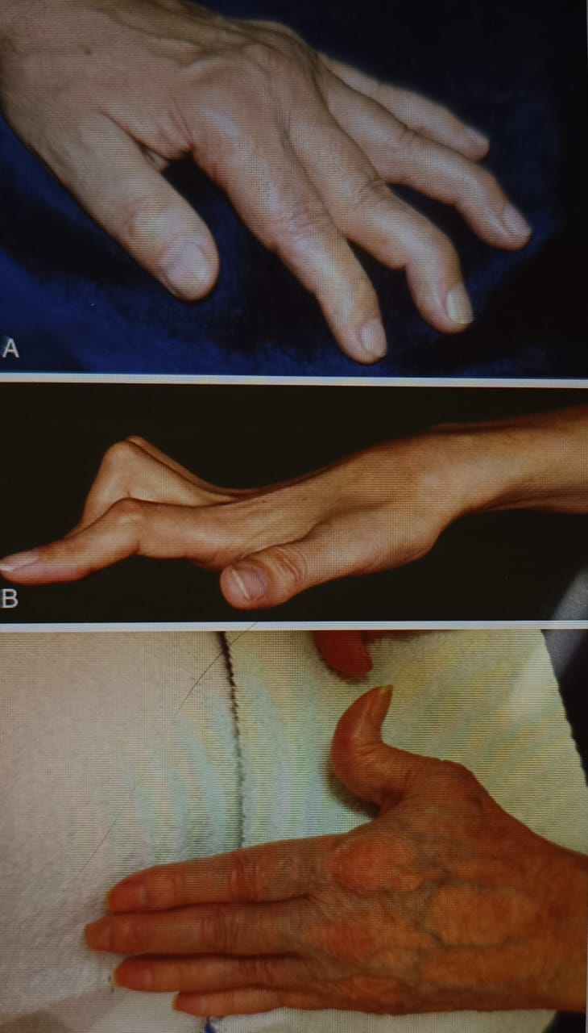
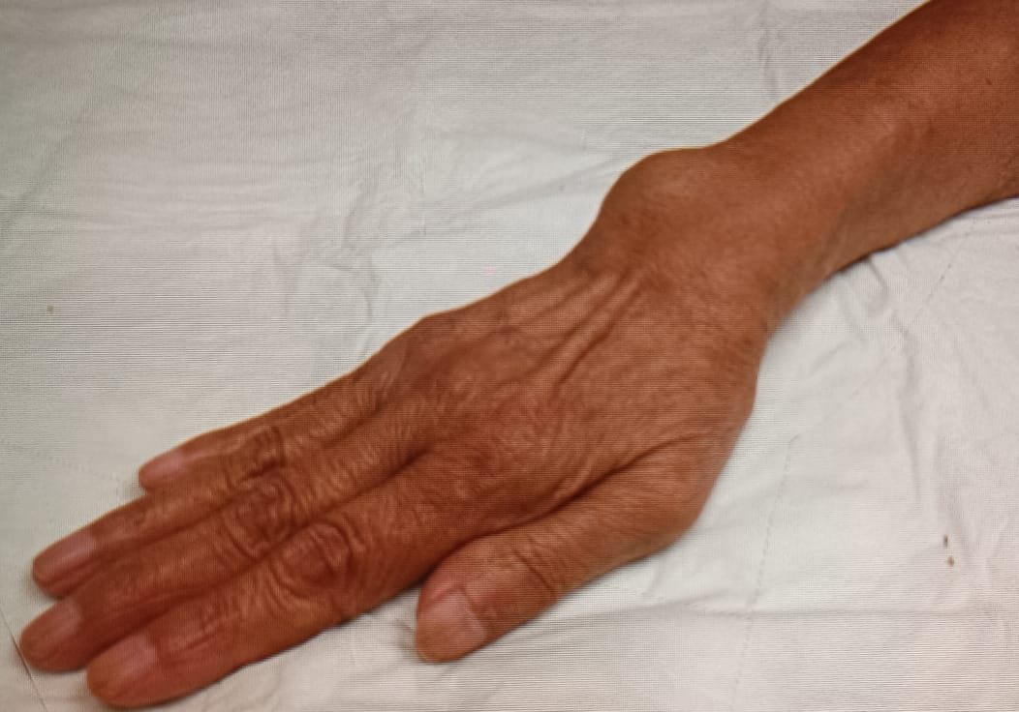
Small joints: MCP, PIP, MTP (2–5), thumb IP, wrists
Medium–large joints: Shoulders, elbows, hips, knees, ankles
DIP joints, first CMC, and first MTP are excluded

Slide 15
Extra-articular Manifestations
Rheumatoid nodules
Interstitial lung disease and pleural involvement
Vasculitis
Anemia of chronic disease
Ocular involvement (scleritis, episcleritis)

Slide 16
Systemic
• Fever
• Weight loss
• Fatigue
• Susceptibility to infection
Hematological
• Anaemia
• Thrombocytosis
• Eosinophilia
Lymphatic
• Felty syndrome
• Splenomegaly
• Nodules
• Sinuses
• Fistulae
Musculoskeletal
• Muscle wasting
• Tenosynovitis
• Bursitis
• Osteoporosis

Slide 17
Ocular
• Episcleritis
• Scleritis
• Scleromalacia
• Keratoconjunctivitis sicca
Vasculitis
• Digital arteritis
• Ulcers
• Pyoderma gangrenosum
• Mononeuritis multiplex
• Visceral arteritis
Cardiac
• Pericarditis
• Myocarditis
• Endocarditis
• Conduction defects
• Coronary vasculitis
• Granulomatous aortitis

Slide 18
Neurological
• Cervical cord compression
• Compression neuropathies
• Peripheral neuropathy
• Mononeuritis multiplex
Pulmonary
• Nodules
• Pleural effusions
• Pulmonary fibrosis
• Obliterative bronchiolitis
• Caplan syndrome
• Bronchiectasis
• Pneumothorax

Slide 19
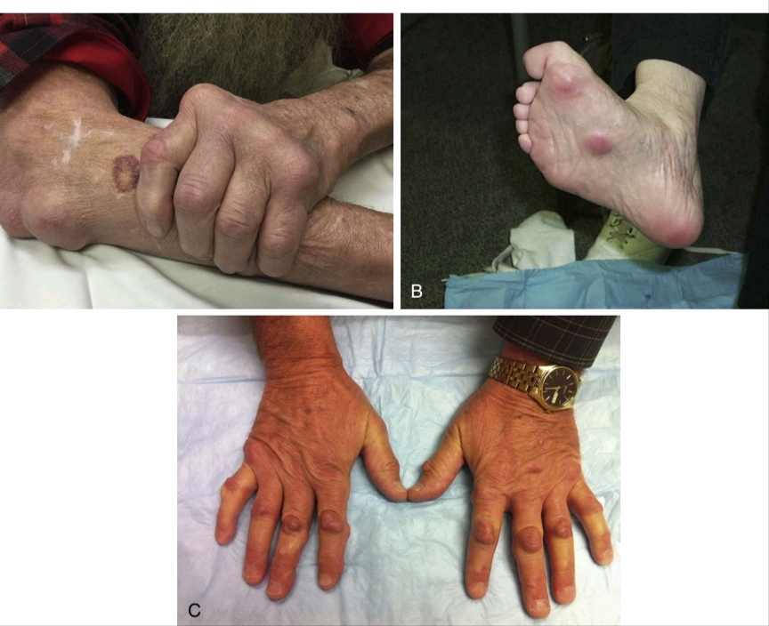
Rheumatoid nodules
Firm, non tender subcutaneous granulomatous lesions with overlying normal skin
Seen in seropositive RA (RF / anti-CCP positive).
Associated with Severe disease,Long-standing RA and smoking
Pressure points:Extensor surface of forearm (olecranon region),Elbows ,Fingers ,Achilles tendon and Occiput.
Pathology -Palisading granuloma pattern
Central Fibrinoid necrosissurrounded by
Palisading histiocytes (epithelioid macrophages)with an
Outer zone of Granulation tissue with inflammatory cells.
Methotrexate therapy can cause accelerated nodulosis

Slide 20
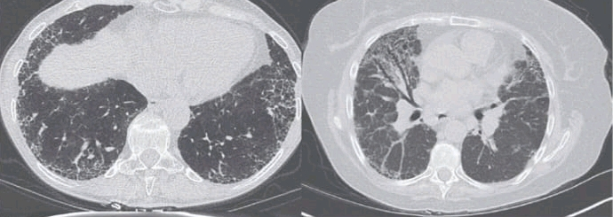
Rheumatoid Arthritis–Associated Interstitial Lung Disease (RA-ILD)
More common in Male Smokers with Seropositive RA and long-standing disease.
UIP – Usual Interstitial Pneumonia (IPF)(MOST COMMON)
NSIP – Nonspecific Interstitial Pneumonia
Subpleural fibrosis.
Honeycombing with posterior Basal predominance.
More inflammatory.
Better prognosis.
Bilateral symmetric Ground-glass changes with fine reticulation and traction bronchiectasis with Subpleural sparing .

Slide 21
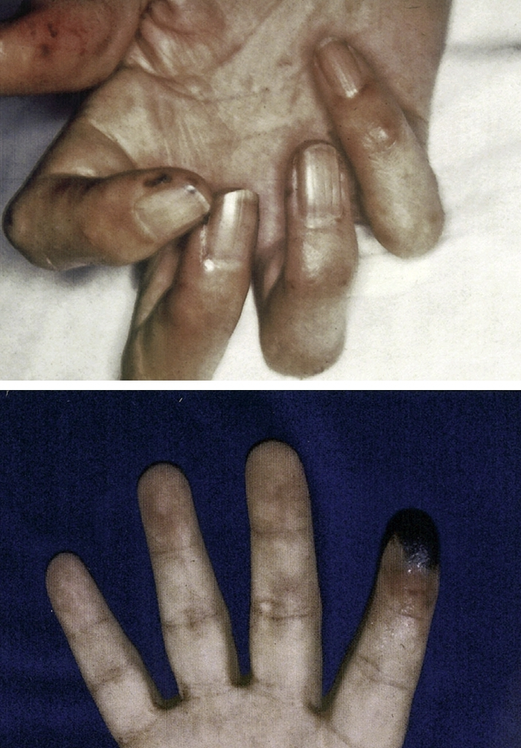
RA Pleural effusion
Usually small, unilateral.
Pleural fluid:Low glucose,Low pH and High LDH.
Rheumatoid Lung Nodules
Subpleural nodules which may cavitate and mimic tb /malignancy
Pulmonary Hypertension
Secondary to ILD or vasculopathy.
Vasculitis in RA -sensorimotor polyneuropathy like mononeuritis multiplex
benign nail-fold infarcts to a deep, erosive, scarring pyoderma gangrenosum

Slide 22
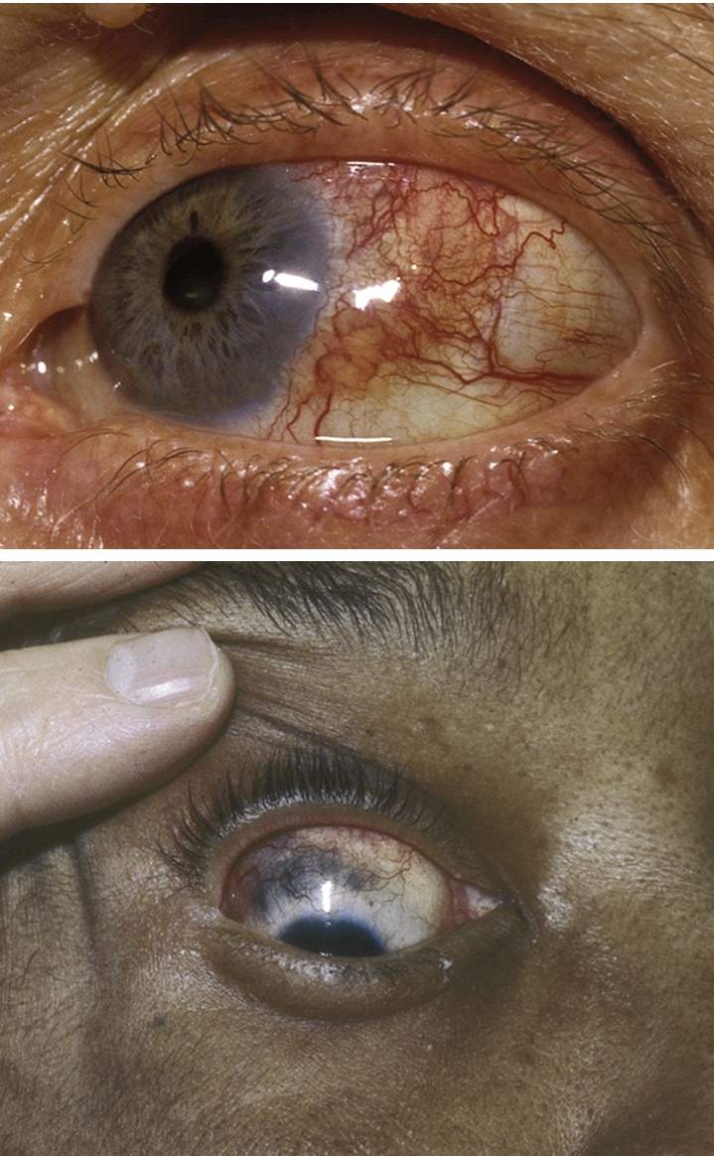
Ocular Manifestations
Keratoconjunctivitis Sicca (Dry Eye) -MOST COMMON ocular manifestation.
Cause:secondary Sjögren syndrome.
Presents with Dryness ,Gritty sensation ,Burning and Photophobia.
Pathology:Lacrimal gland autoimmune destruction → decreased tear production.
Episcleritis Mild inflammation of episclera
Presents with Red eye and Mild discomfort with Sectoral redness
Usually benign and self-limited.
Scleritis
Serious manifestation associated with severe RA.
Types: Diffuse anterior scleritis ,Nodular scleritis and Necrotizing scleritis
Often associated with systemic vasculitis. Presents with deep boring eye
Pain aggravated by touching , redness , photophobia ,and areas of dusky discoloration indicating Impeding scleromalacia perforans, an
ocular emergency .
Peripheral Ulcerative Keratitis (PUK) - severe complication.
Presents with Corneal thinning and Ulceration near limbus
Risk of perforation.
Mechanism:Immune-mediated vasculitis.

Slide 23
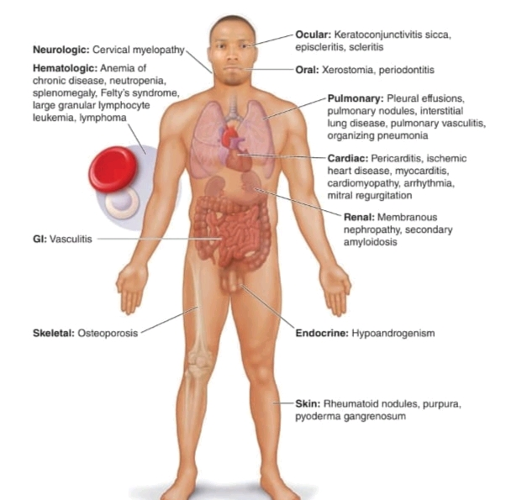

Slide 24
Investigations
Rheumatoid factor (RF) IgM antibody against IgG
Anti-CCP antibodies (high specificity) CCP-2= CLINICAL STANDARD
ESR and CRP elevated
CBC for anemia and inflammation
Imaging: X-ray, ultrasound, MRI

Slide 25
Categories of RA Autoantibodies
Citrullination-associated antibodies (ACPA)
Antibodies to chemically modified proteins
Nonspecific autoantibodies.

Slide 26
Anti-Citrullinated Protein Antibodies (ACPA)
Targets:
Clinical importance:
Vimentin
Fibrinogen
Collagen type II
α-enolase
Histones.
Specificity ~95%.
Present years before symptoms.
Predict erosive disease.

Slide 27
Anti-PAD Antibodies
Other Chemically Modified Antigens
Anti-PAD4:
Severe disease.
Progressive joint damage.
RA-associated ILD.
Anti-PAD3/PAD4 cross-reactive:
Enhance PAD activity.
Promote hypercitrullination.
Anti-CarP antibodies
Seen in ACPA-negative RA.
Predict severe disease
Anti-MAA antibodies
Anti-RA33
Rheumatoid Factor (RF)
IgM against IgG Fc.
Sensitive but nonspecific.
Amplifies immune complexes.
Enhances complement activation.

Slide 28
Seronegative rheumatoid arthritis
Seronegative RA refers to patients with clinical rheumatoid arthritis who lack Rheumatoid Factor and Anti-CCP antibodies (ACPA) ,But still fulfill clinical and imaging criteria for RA.
20–30% of RA patients are seronegative.
May represent True RA subtype or Early RA before seroconversion or Misclassified spondyloarthritis
Important Differential Diagnosis-
Psoriatic arthritis
Reactive arthritis
Ankylosing spondylitis
Undifferentiated inflammatory arthritis
Viral arthritis
Crystal arthritis

Slide 29
LORA( Late or Elderly onset rheumatoid arthritis )
Rheumatoid arthritis with disease onset after age ≥60 years.
Often acute or subacute onset with Prominent systemic inflammatory symptoms
Greater involvement of large proximal joints
Seronegative disease more frequent
Rheumatoid nodules less common.
PMR-like symptoms

Slide 30
Rheumatoid arthritis variants
Palindromic Rheumatism
Recurrent episodes of acute arthritis.
Sudden onset and complete resolution.
No joint damage between attacks.
Caplan Syndrome
RA + pneumoconiosis (coal workers)
Rheumatoid nodules in lungs.
Occupational exposure history
RS3PE Syndrome
(Remitting Seronegative Symmetrical Synovitis with Pitting Edema)
Elderly patients.
Sudden onset symmetrical synovitis.
Dorsal hand/foot pitting edema.
Seronegative.
Good steroid response.
Felty Syndrome
Rheumatoid arthritis (Severe seropositive)
Splenomegaly
Neutropenia (Infection risk)

Slide 31
Salient features
Chronic autoimmune synovitis → pannus → cartilage and bone erosion.
Symmetrical small-joint inflammatory arthritis with morning stiffness.
Anti-CCP highly specific; RF sensitive.
UIP/IPF - basal honeycombing
NSIP-Bilateral symmetric Ground-glass changes with fine reticulation and traction bronchiectasis with Subpleural sparing .

Slide 32
Resources
Harrison’s Principles of InternalMedicine
Kelley’s Rheumatology

