Slide 1
OBSTRUCTING LYMPHOMA
By
III MEDICAL UNIT

Slide 2
COMPLAINTS
A 24 year old female presenting with complaints of
facial puffiness for 7 days
swelling of the both upper limb for 4 days
shortness of breath for 2days

Slide 3
HISTORY OF PRESENTING ILLNESS
Patient was apparently normal before 7 days, then developed facial puffiness which is gradual in onset, progressive, associated with pain over floor of the mouth and not relieved by medication.
H/o shortness of breath present for past 2 day, sudden in onset, progressive associated with orthopnea and not relieved by medication.
H/o swelling of both upper limb for the past 4 days.
H/o dry cough +
No h/o hemoptysis
No h/o hoarseness of voice

Slide 4
No h/o dysphagia
No h/o fever
No h/o night sweats
No h/o trauma
No h/o abdominal distension
No h/o abdominal pain
No h/o jaundice
No h/o chest pain / palpitation
No h/o loss of weight
No h/o loss of appetite
No h/o reduced urine output
No h/o seizure / headache
No h/o altered sensorium
No h/o blurring of vision

Slide 5
PAST HISTORY:
N/k/c/o DM /HTN/CAD/CKD/BA/epilepsy/ thyroid disorders/TB
No h/o previous surgeries/ procedures
PERSONAL HISTORY :
Married since 1 year.
Irregular menstrual cycle,
Normal bladder and bowel habits
FAMILY HISTORY:
No signifiant family history

Slide 6
GENERAL EXAMINATION
Patient is
conscious
oriented
tachypnoeic+
afebrile
facial puffiness +
conjuctival congestion +
no proptosis
not icteric
no cyanosis
no clubbing
no pedal edema

Slide 7
B/L cervical lymphadenopathy + ( Level V)
largest lymph node of size 3*3 cm in left side of neck
B/L axillary lymphadenopathy + (right >left)
lymph node size 2*2cm
Hard in consistency
Not well defined
Non tender
Not matted
No discharging sinuses

Slide 8
Bilateral arm edema +,
tender, non pitting
Dilated veins present over left shoulder girdle
PEMPERTON SIGN POSITIVE
Anterior d’Espine sign negative
Supraclavicular dullness present.
L/E of oral cavity: no tonsillar enlargement
Thyroid : Normal
Vitals : BP 100/60mmHg
pulse 140/min
spo2 85% in Room air
RR 40/min

Slide 9
SYSTEMIC EXAMINATION
RESPIRATORY SYSTEM:
Trachea shifted to left side.
Accessory muscles are acting
Expiratory stridor present.
Air entry reduced on right side infra mammary , axillary, infra axillary, infra scapular area.
VF, VR reduced in the above mentioned area
Stony dullness on percussion present in the above mentioned area.

Slide 10
SYSTEMIC EXAMINATION
CVS: S1 , S2 +
muffled
apical impulse could made out
jvp elevated, non pulsatile in nature.
P/A: Soft, non tender, non distended
no organomegaly
bowel sounds present
no free fluid

Slide 11
CNS: conscious
oriented
b/l pupil equally reacting to light
no evidence of horner syndrome
ECG : low voltage complex
sinus tachycardia +
FUNDUS EXAMINATION:
Early papilledema +
No evidence of hemorrhage
No Roth spots

Slide 12
INVESTIGATIONS
Blood profile:
Total count | 1o900
Differential count | 79/11/10
Hemoglobin | 10.9
PCV | 36
Platelet | 3.11 lakhs
Urea | 22 mg/dl
Creatinine | 1.1 mg/dl
RBS | 156mg
Phosphorus | 5.6mg
Uric acid | 7.9mg
Serum calcium | 8mg
Total bilirubin | 0.5
Indirect bilirubin | 0.3
Direct bilirubin | 0.2
SGOT | 28
SGPT | 21
ALP | 112
Total protein | 6.8
Albumin | 3.7
Globulin | 3.1
Na+/k+ | 137/4.2
ESR | 88mm

Slide 13
VCTC non reactive
HCV Negative
HbsAG Negative
Bleeding time: 3 mins 30 secs
Clotting time 5 mins
THYROID FUNCTION TEST :
s/o EUTHYROID state

Slide 14
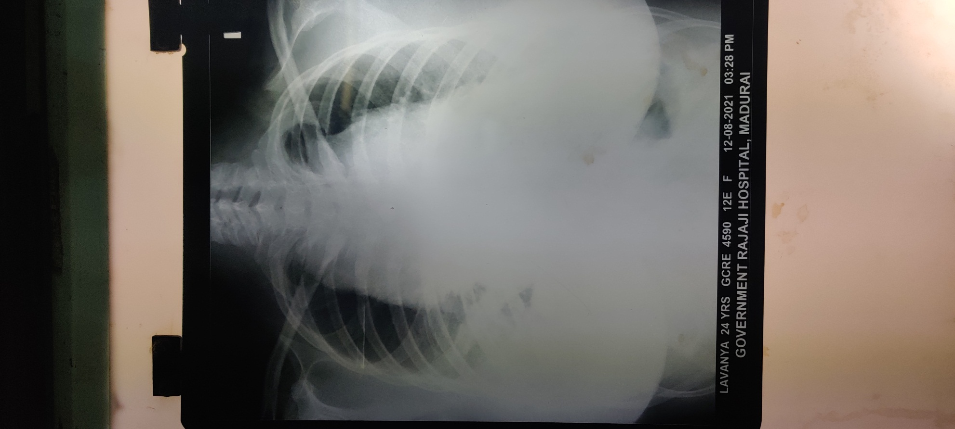
CHEST XRAY

Slide 15
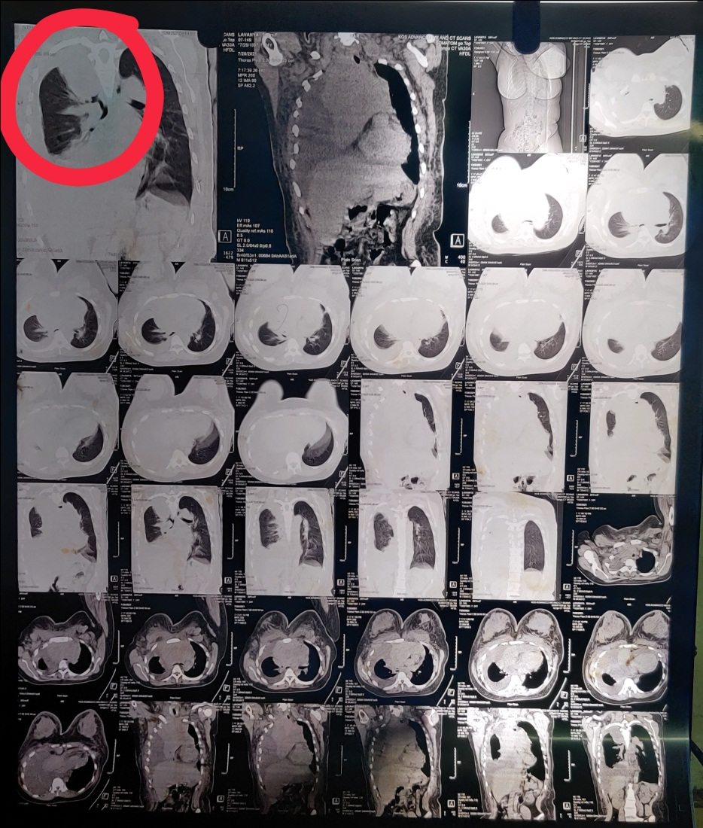

Slide 16
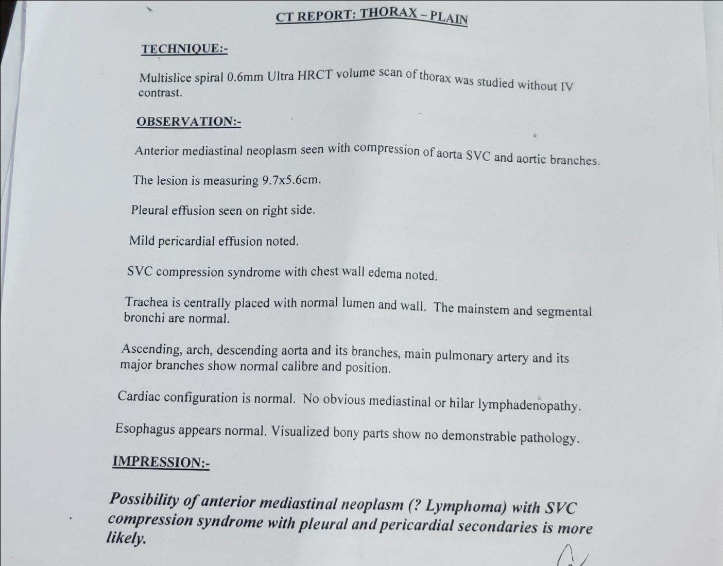

Slide 17
CARDIO THORACIC OPINION:
advise right ICD insertion
Pleural fluid analysis:
SUGAR | 20mg
PROTEIN | 3500mg
TOTAL CELL COUNT | 2800
CHOLESTEROL | 40mg
TRIGLYCERIDES | 36mg
ADA | 4
MALIGNANT CELLS | NEGATIVE

Slide 18
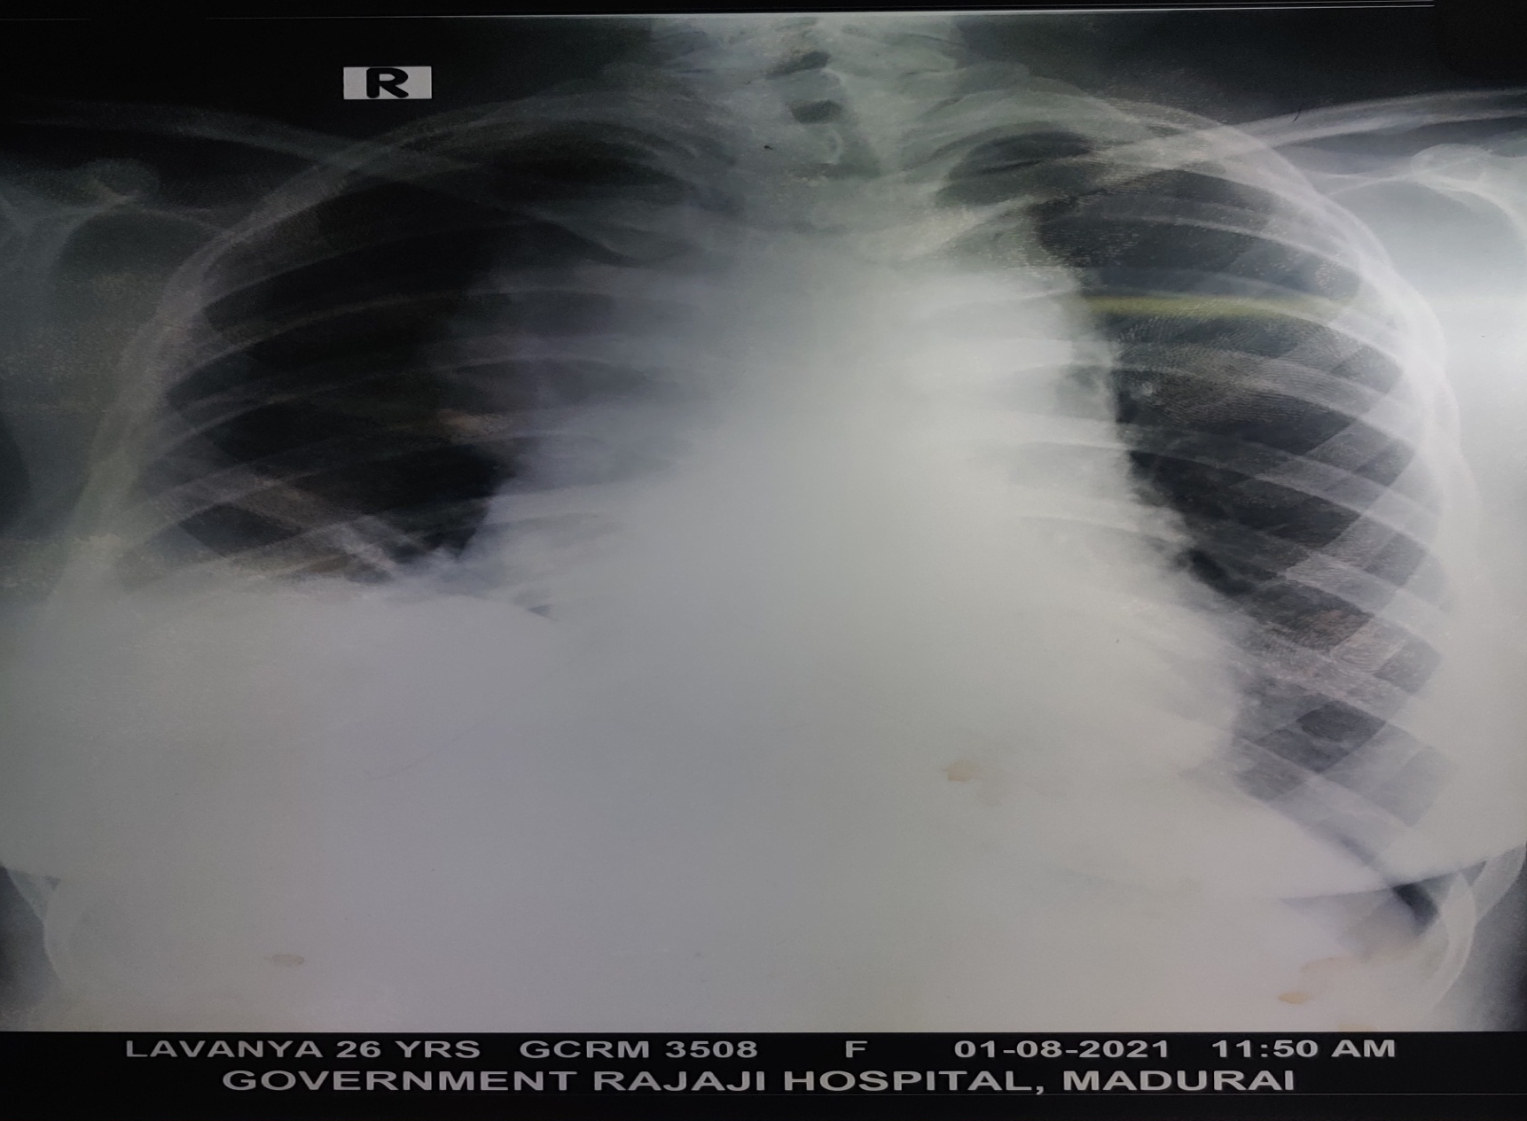
CHEST XRAY AFTER ICD

Slide 19
USG ABDOMEN: No organomegaly
Right moderate pleural effusion
No free fluid in abdomen
ECHO: Normal cardiac dimension
Mild pericardial effusion
No doppler evidence of cardiac tamponade
Normal biventricular function

Slide 20
PERIPHERAL SMEAR STUDY
RBCs shows normochromic , normocytic and hypochromic microcytes
WBCs count normal in number.
Atypical cells not seen.
Neutrophils 82%
Lymphocytes 10%
Eosinophils 06%
Platelet normal in number and morphology.

Slide 21
BONE MARROW STUDY
Normocellular marrow
Erythropoiesis show normoblastic and micro normoblastic maturation.
Leucopoiesis show normal pattern of maturation with blasts less than 3%
Megakaryocytes seen.

Slide 22
CECT CHEST
Well defined soft tissue mass lesion in the right hemithorax causing obstruction of right superior mediastinal structure and widening of mediastinum.
The mass causing compression over trachea and shift the trachea to left side.
SVC and right brachiocephalic vein appears narrow and opacified.
Right main bronchus, upper lobe bronchus and right atrium appears to the narrowed and compressed.
Minimal pericardial effusion present.
Multiple enlarged posterior group of lymph nodes present.

Slide 23
INITIAL TREATMENT
Back rest / Nasal o2 @ 2l/min
Inj. Hydrocortisone 100mg iv bd
Iv antibiotics
Nebulisation
ICD insertion for right pleural effusion

Slide 24
PROVISIONAL DIAGNOSIS
ANTERIOR MEDIASTINAL MASS FOR EVALUATION WITH SUPERIOR VENA CAVA SYNDROME/ RIGHT MODERATE PLEURAL EFFUSION

Slide 25
POSSIBLE DIFFERENTIAL DIAGNOSIS
GERM CELL TUMORS
THYMIC LYMPHOMA
MEDIASTINAL LYMPHOMA

Slide 26
Serum alfa feto protein: 0.1 ng/ml (0.0-8.5)
Serum Beta HCG : 0.1 mIU/ml (0.0-5.0)
Serum LDH : 1717U/L (225 – 450)

Slide 27
CT GUIDED BIOPSY
Biopsied section shows sheets of small lymphoid cells that have hyperchromatic enlarged nuclei, scanty cytoplasm.
They are seen infiltrating adipose tissue and skeletal muscles.
Crushed artefact and nuclear molding seen.
Impression : possibilites are
1.Lymphoblastic lymphoma
2. Thymoma
3. Small cell carcinoma

Slide 28
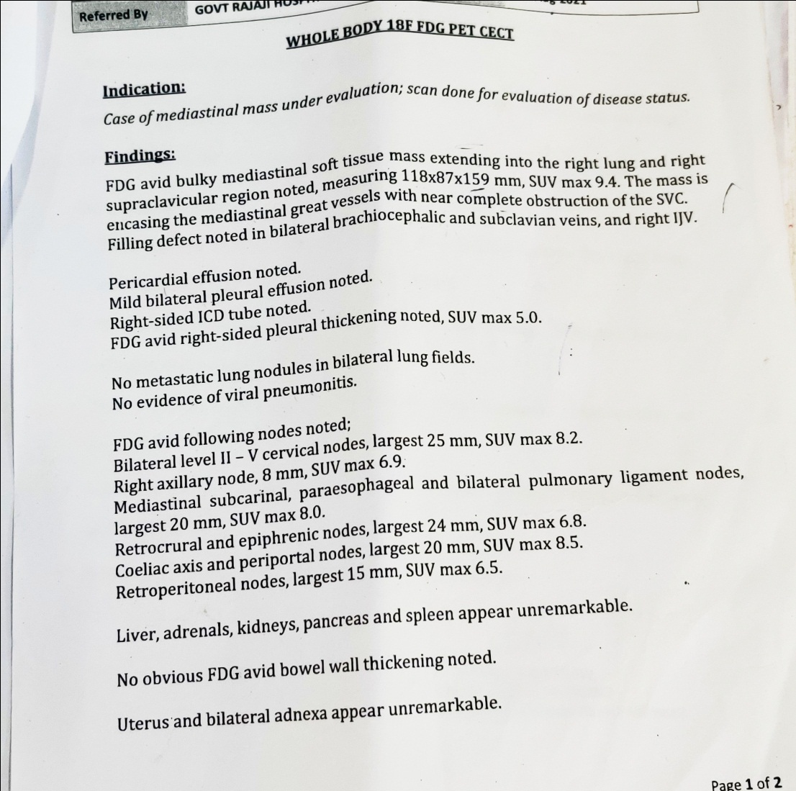
WHOLE BODY 18F FDG PET CECT

Slide 29
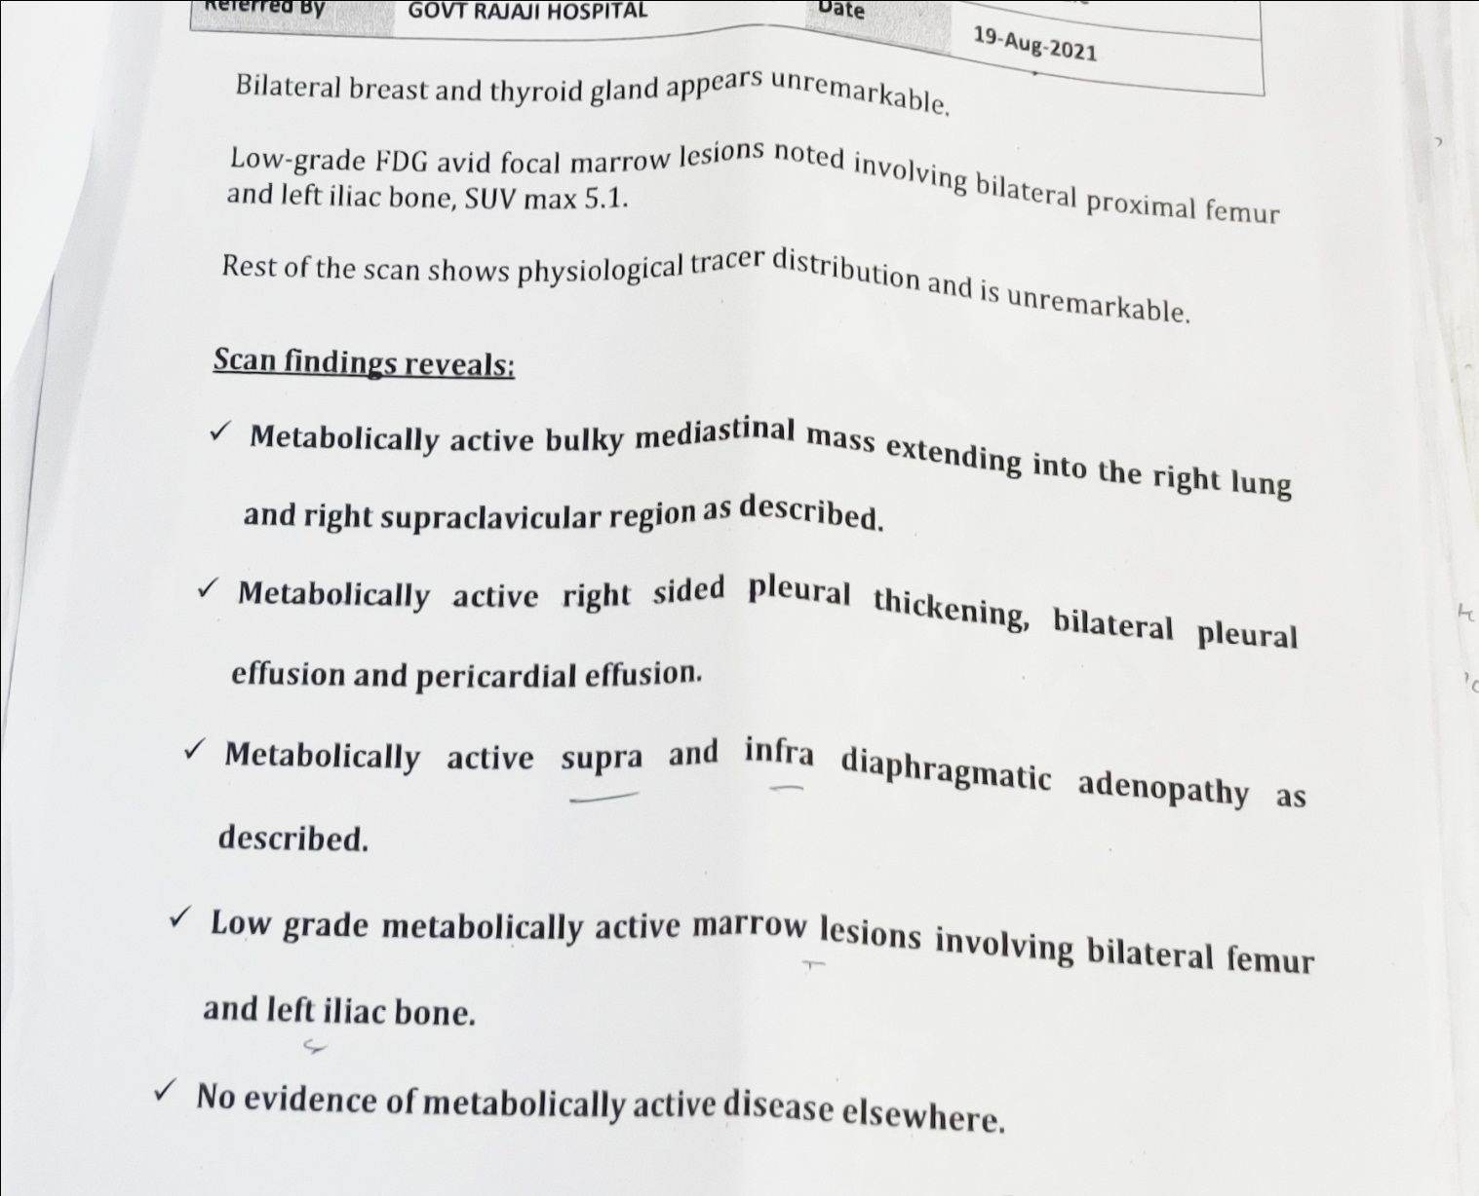

Slide 30
IMMUNO HISTOCHEMISTRY STUDY
CD3 : POSITIVE
PAX5 : NEGATIVE
Ki67 : 60%
CK : NEGATIVE
DIAGNOSIS : T-CELL NON HODGKIN LYMPHOMA

Slide 31
TREATMENT
Patient underwent 5 cycles of radiation therapy followed by patient symptomatically relieved.
Facial and left arm swelling reduced.
Pleural effusion resolved
ICD removed
patient then given with 1st cycle of chemotherapy
CHOP REGIMEN
Inj. cyclophosphamide 1gm,
Inj. adiramycin 75mg
Inj. vincristin 2mg
T. prednisolone D1-D5

Slide 32
Tdt : POSITIVE (50% T LYMPHOID CELLS)
FINAL DIAGNOSIS:
T-CELL ACUTE LYMPHOBLASTIC LYMPHOMA

Slide 33
Patient is now on INDUCTION THERAPY OF STANDARD BFM REGIMEN which include
T. Prednisolone 90mg
Inj. Vincristine 2mg
Inj . Daunorubicin
Inj. L.Asparaginase 10,000U
Inj. IT Methotrexate 12mg

Slide 34
AIM OF PRESENTATION
To discuss about the superior vena cava syndrome – clinical presentation and management.
To discuss about various clinical presentation of Acute lymphoblastic lymphoma.

Slide 35


