Slide 1
VII MEDICAL UNIT
CHIEF : PROF.DR. K. SENTHIL MD
ASSOCIATE PROF : DR. K. MURALIDHARAN MD
ASST PROF : DR. V. MANIKANDAN MD
DR. C. RAMANAN MD
DR. S. SARAVANA MADAV MD

Slide 2
A 27 yrs old male, coolie, was brought with chief complaints of
Weakness of left UL & LL x 4 days
Abdominal pain & abdominal distension x 4 days

Slide 3
History of presenting illness
Patient was brought with c/o inability to use left UL & LL x 4 days; sudden onset; non progressive
Patient didn’t seek any medical advice for 4 days for the weakness and was brought after 4 days only
H/o abdominal pain – diffuse, dull aching
H/o abdominal distension

Slide 4
No h/o sensory disturbance
No h/o bowel and bladder incontinence
No history suggestive of cranial nerve involvement
No h/o seizures, vomiting, headache, LOC
No h/o diarrhoea
No h/o leg swelling, puffiness of face
No h/o breathlessness
No h/o reduced urine output

Slide 5
Past history
Not a k/c/o HTN, DM, seizure disorder, renal disorder
No h/o similar illness in the past
Personal history
Consumes mixed diet
Alcoholic
Denies h/o smoking, substance abuse

Slide 6
Family history
Born to parents of 3rd degree consanguinity
No h/o similar complaints in any of the family members

Slide 7
On examination
Awake
Obeying oral commands
No pallor, icterus, cyanosis, clubbing, PE, GLN
BP – 100/70 mmHg
PR – 80/min
SpO2 – 98%

Slide 8
CVS – S1 S2 + , no murmur
RS – BAE + ,
AE reduced on left lower fields
no added sounds
P/A – soft,distended
shifting dullness +
diffuse tenderness +
no organomegaly
BS +

Slide 9
CNS
GCS – E4 V4 M6
Cranial nerves and sensory system examination were normal
 | Right | Left
Power | 5/5 in both UL & LL | 0/5 in both UL & LL
Tone | Normal | Increased
DTR | ++ | +++
Plantar | Flexor | Extensor

Slide 10
Initial evaluation
Tc – 10,800
Hb – 11.1
PCV – 33
Platelet – 3.3 lakhs
Urea – 28
Creatinine – 0.9
LFT - WNL
Na⁺ - 135
K⁺ - 3.6
Ca²⁺ - 9.8
PT – 19.4 sec
INR – 1.4
APTT – 49.8 sec (control – 32 sec)

Slide 11
MCV – 88.0 fL
MCH – 30.4 pg
MCHC – 34.6 g/dL
RDW – 17.5%
RBC – normochromic, normocytic
WBC – count increased, neutrophilia
DC – 80/16/4
No hemoparasites

Slide 12
VCTC – non reactive
Viral marker - negative
RPR – non reactive
TFT - euthyroid
Cholesterol – 139
TGL – 143
HDL – 25
LDL – 98
Total proteins – 4.88
Albumin – 2.0
Globulin – 2.88
Sr amylase – 507 U/L

Slide 13
CT Brain
Subacute infarct noted in right perisylvian, adjacent frontal and temporal cortical and subcortical regions

Slide 14
USG abdomen :
Liver, spleen, kidney appears normal
moderate free fluid noted
diffuse peritoneal thickening with omental calcifications noted
CT chest
Rt UL and Lt LL fibrotic strands noted
Lt LL peripheral minimal GGO
CORADS 3 – 5% lung involvement
Left minimal pleural effusion

Slide 15
COVID RT-PCR – negative

Slide 16
Ascitic fluid analysis
Protein – 3.2 g/dL
Sugar – 87 mg/dL
Amylase – 4800 U/L
ADA – 12.7 U/L
Cells – 250; N-43%; L-57%
Pleura fluid analysis
Protein – 1.8 g/dL
Sugar – 74 mg/dL
Amylase – 869 U/L
Cholesterol – 85 mg/dL
TGL – 58 mg/dL

Slide 17
CT abdomen plain
Pancreas – appears enlarged, especially tail
Pancreatic and peripancreatic inflammatory changes noted in distal body and tail with focal intraparenchymal collection
Tiny calcifications noted in greater omentum
Gross free fluid in abdomen +
Diffuse omental inflammatory changes +

Slide 18
CECT abdomen
Visualised thorax –filling defect in apex of RV, p/o intraventricular thrombus
Splenic artery thrombosis with large splenic infarct
Focal pancreatitis in tail of pancreas
Atheromatous wall calcifications at bifurcation of abdominal aorta, right common iliac and inferior mesentric artery origin
IMA not opacified

Slide 19
ECHO
All chambers and valves are normal
EF – 60 %
No evidence of thrombus in RA, RV and MPA
IVC – heterogenous echogenic mass seen – p/o thrombus

Slide 20
Carotid artery doppler
Right
Left
Intimal thickness of CCA 0.08 cm
Minimal atheromatous plaque formation with calcification in the posterior wall
Intimal thickness of CCA 0.11 cm
Minimal atheromatous plaque formation with calcification involving the posterior wall CCA and carotid bulb

Slide 21
B/L lower limb doppler
Arterial doppler – b/l normal triphasic flow and wave pattern demonstrated
Venous doppler – b/l no evidence of DVT

Slide 22
Provisional diagnosis
CVA – ischaemic stroke
Splenic infarct with splenic artery thrombosis
Acute pancreatitis with ascites and left mild pleural effusion
IVC Thrombosis
Early atheromatous changes
Hypercoagulable state – involving both artery and vein; predominantly arterial

Slide 23
Treatment given
NPO
Adequate hydration
Inj Ceftriaxone 1gm iv bd
Inj. Pantoprazole 40 mg iv bd
T. Aspirin 150 mg OD
T. Atorvostatin 10 mg 4 HS
Inj Heparin 5000 U iv QID
T. Acitrom 2 mg 0 – 0 – 1 – 0

Slide 24
Neurologist opinion
MGE opinion
To continue anti platelets and statins
Conservative management
Inj Octreotide 100 mcg sc TDS
To do MRCP

Slide 25
Surgery and SGE opinion
Rheumatology opinion
Advised Conservative management for pancreatitis and splenic infarct
Advised
β2 glycoprotein antibody
Protein C, S levels
Anti thrombin III
Factor V Leiden mutation

Slide 26
Vascular surgeon opinion
Ophthal opinion
Inj Heparin 5000 u iv bd
To continue other line of management
Fundus examination was normal

Slide 27
MRI brain
Multiple subacute infarct noted involving cortical and subcortical regions of right frontal lobe, insular cortex, caudate nucleus, lentiform nucleus, posterior limb of internal capsule, thalamus, hippocampus and right crus of midbrain
Right frontal lobe showing areas of hemorrhagic transformation
MRA/MRV-normal

Slide 28
Neurology review
T. Clopidogrel 75 mg OD can be started
To continue statin and other line of management

Slide 29
ANA – Negative
APLA – cardiolipin IgG &IgM – negative
β2 glycoprotein IgG &IgM- negative
IgA – 20.96 (< 20.0)
Covid IgG antibody – 159
Homocysteine – 20.9 µmol/L ( 4.4 – 10.8)

Slide 30
Patient was discharged and advised routine follow up
Patient presented with seizures (GTCS), right hemiplegia with GCS 5/15 after 1 month
Repeat CT showed recurrent ischaemic stroke
Further evaluation

Slide 31
CT brain
Gliotic foci noted in right frontoparietal region – chronic infarct
Abnormal area of hypodensity noted in left capsuloganglionic region with midline shift m/s 6mm – subacute infarct involving left MCA territory

Slide 32
Tc – 12,900
HB – 10.8
PCV – 34%
Platelet – 5.4 lakhs
Sr amylase – 41 U/L
Cholesterol – 129
TGL – 97
CRP – 102.9

Slide 33
PT – 31.1 sec
INR – 2.2
APTT – 180 sec
D-dimer – 3.44 mg/L (<0.5)
Fibrinogen – 234.2 mg/dL (150 – 300)

Slide 34
ECHO
All chambers and valves are normal
LVEF – 60 %
Grade I LV diastolic dysfunction
No clot
IVC – no thrombus
PA - normal

Slide 35
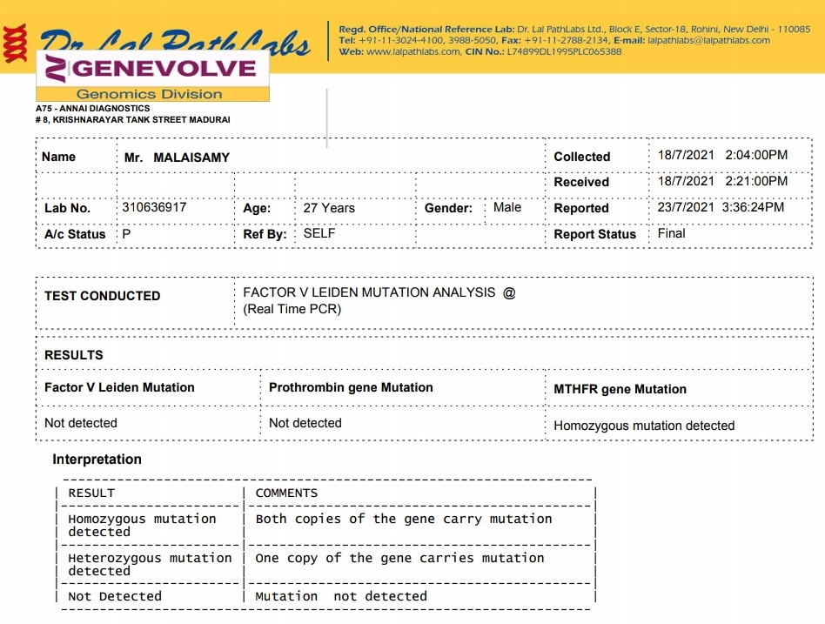

Slide 36
Final diagnosis
Acute pancreatitis/ recurrent ischaemic stroke/splenic artery thrombosis with splenic infarct/ hypercoagulable state/ multiple large arterial atheromatous calcification

Slide 37
Risk factors
Etiology
Pancreatitis
Alcoholic
Homozygous MTHFR mutation (C677T)
Mild hyperhomocystinemia
Dyslipidemia
Asymptomatic covid
? Paradoxical embolus
? Inherited thrombophilia

Slide 38
Pending investigations
TEE to r/o PFO
Lipoprotein A

Slide 39
After 6 months
Factor II, VIII, IX, XI level
Lupus anticoagulant
Protein C, protein S
Antithrombin III
TAFI levels
TFPI levels

Slide 40
Aim of presentation
To emphasis the approach to hypercoagulable state

Slide 41
THANK YOU

