Slide 1
A CASE OF Unusual cause OF VISION LOSS
DR.J.SANGUMANI MD
DR.K.S.RAGHAVAN MD, D.DIAb
DR.P. SUDHA MD

Slide 2
CHIEF COMPLAINTS
A 58y old male admitted with chief complaints of loss of vision of both eyes for past 4 days

Slide 3
H/O PRESENTING ILLNESS
H/O blurring of vision for past 2 months
Sudden loss of vision for past 4 days
H/o hearing loss for past 1 year in Left ear and for past 6 months in Right ear, for which he was provided with Hearing aid for Right ear

Slide 4
No h/o dizziness or unsteadiness
No h/o ringing in ears
No h/o numbness of face
No h/o inability to close eyelids
No h/o diplopia
No h/o dysphagia
No h/o headache
No h/o vomiting
No h/o fever
No h/o loss of consciousness
No h/o seizures

Slide 5
Past History:
Not a k/c/o DM, HT, Heart disease, Thyroid illness, Liver disease,PTB, epilepsy.
Personal History:
Chronic Alcoholic and Chronic smoker
Family History:
Parents - non consanguinous marriage
No simillar complaints in family members.
No significant illness in siblings.

Slide 6
General examination:
Conscious
Obeys oral commands
Afebrile
No pallor
No icterus
No cyanosis
No clubbing
No pedal edema
No generalised lymphadenopathy
Conjuntival Congestion +
Vitals :
PR – 82/min
BP – 120/80 mmHg
No external markers of TB/HIV

Slide 7
Systemic Examination:
CNS -
conscious
obeys oral commands
speech,language – normal
memory - intact
TONE - N N
POWER - 5/5 5/5
DTR - + +
B/L PLANTAR – FLEXOR
sensory system - normal

Slide 8
CRANIAL NERVES
OPTIC NERVE :
VISUAL ACUITY : B/L LIGHT PERCEPTION +
B/L PUPIL 3mm ERTL
BOTH DIRECT AND INDIRECT LIGHT REFLEX +
FUNDUS : B/L PAPILLOEDEMA
VESTIBULOCOCHLEAR NERVE :
B/L SENSORINEURAL HEARING LOSS
NO NYSTAGMUS

Slide 9
OTHER CRANIAL NERVES : NORMAL
CEREBELLUM : NORMAL
NO NECK STIFNESS
OTHER SYSTEM EXAMINATIONS - NORMAL

Slide 10
LAB INVESTIGATIONS
CBC
HB | 16.5
TC | 5100
DC | 62/26/12
PCV | 45
PLT | 1.98
RBS | 84
UREA | 29
CREATININE | 0.8
Na + | 131
K+ | 31

Slide 11
LAB INVESTIGATIONS
LFT
BILI TOTAL | 1.6
DIRECT | 0.6
INDIRECT | 1.0
SGOT | 15
SGPT | 10
ALP | 51

Slide 12
ECG – WNL
CXR PA VIEW – NORMAL STUDY
USG ABD – NO SIGNIFICANT ABNORMALITY DETECTED

Slide 13
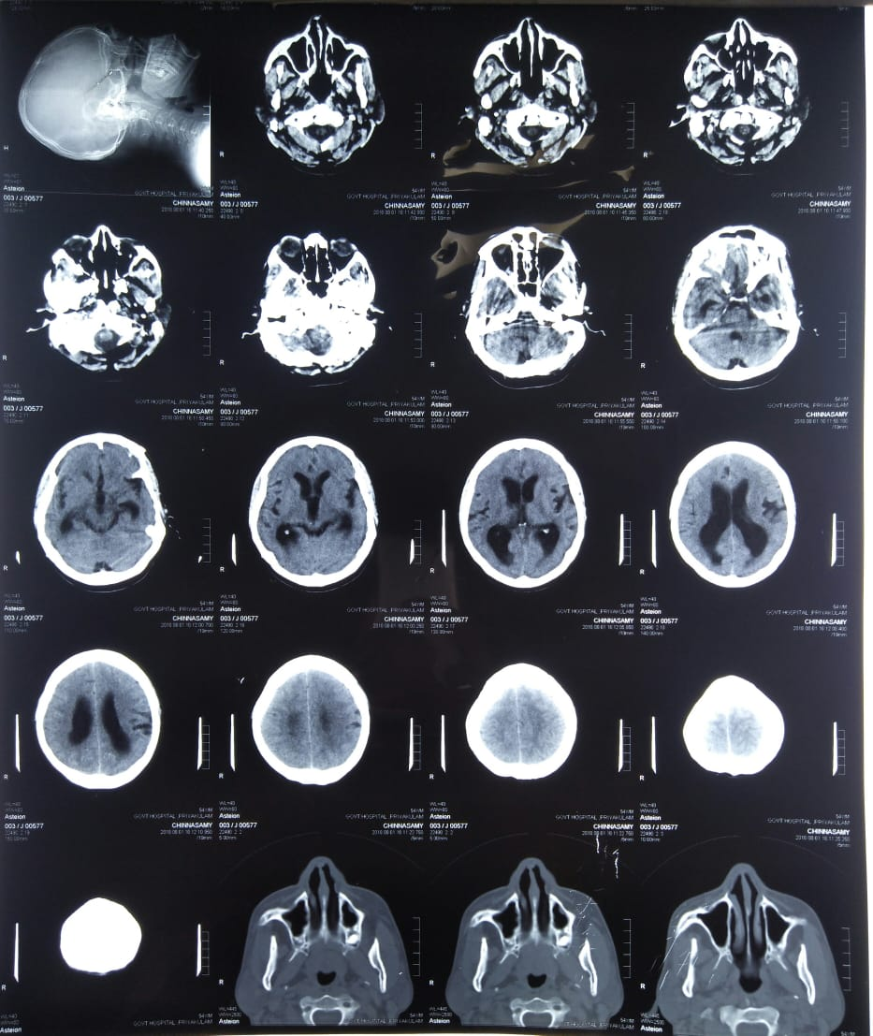
CT-BRAIN PLAIN

Slide 14
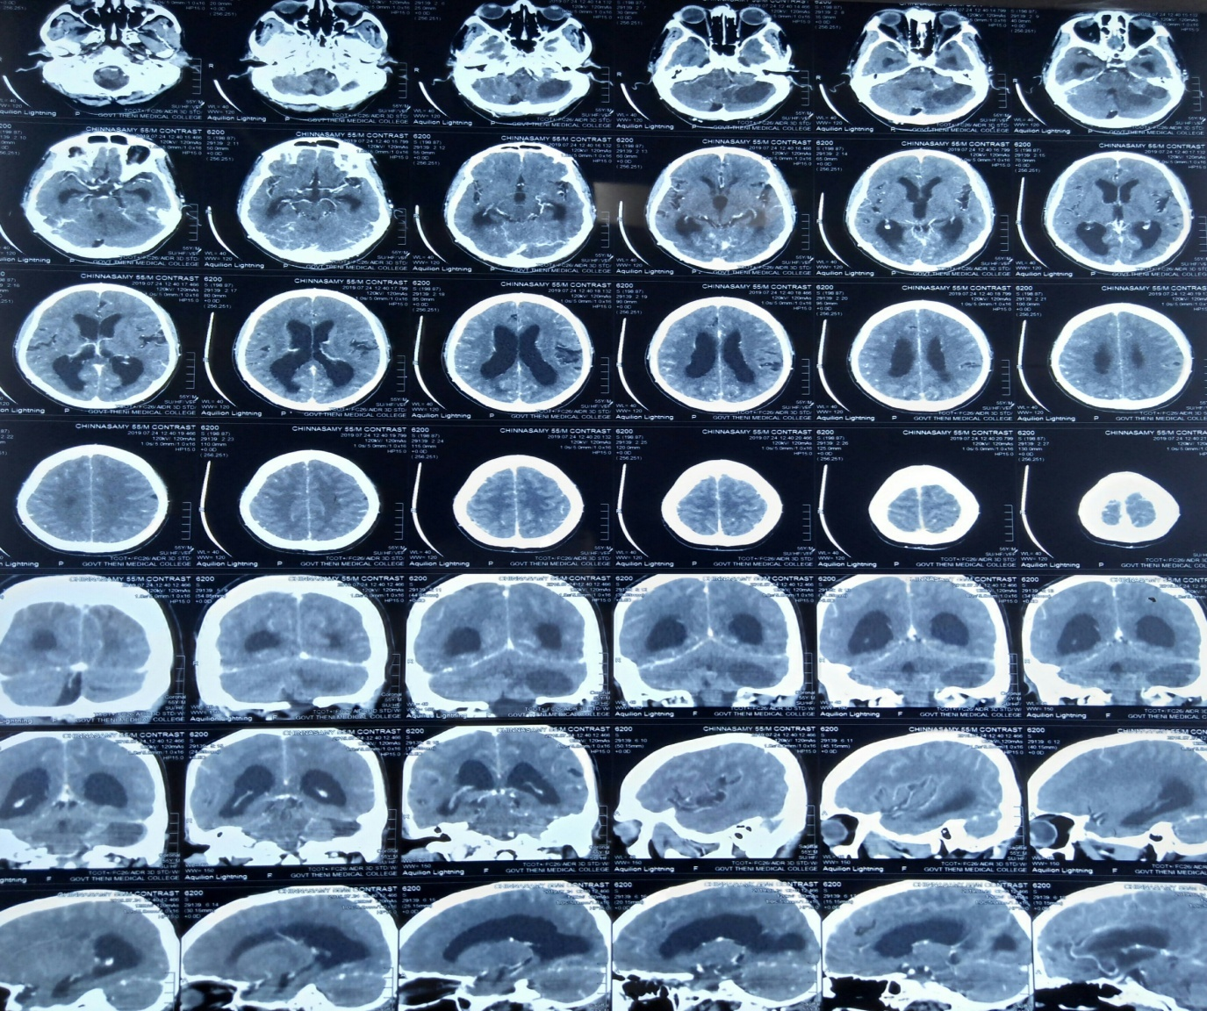
CT BRAIN CONTRAST

Slide 15
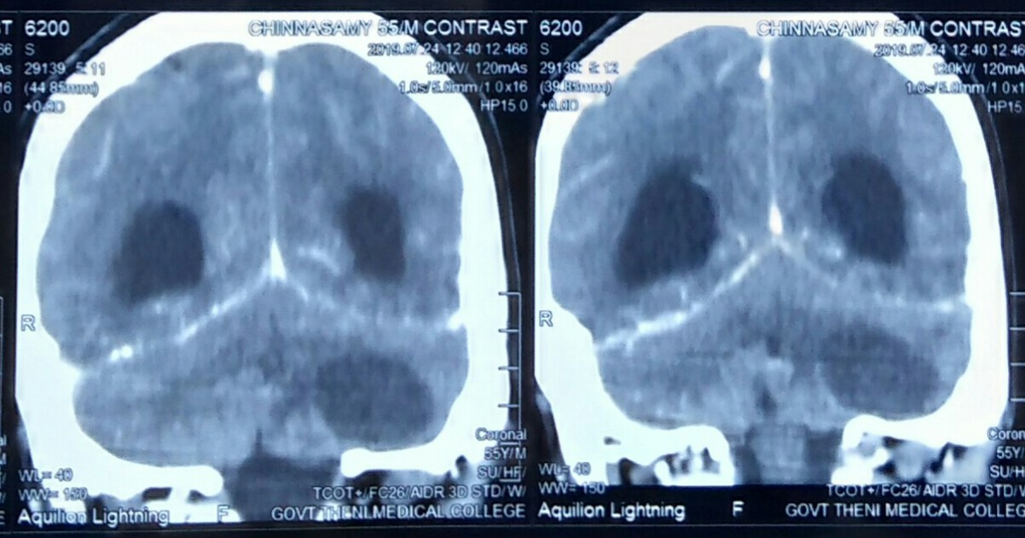

Slide 16
PROVISIONAL DIAGNOSIS
? LEFT CEREBELLAR INFARCT WITH OBSTRUCTIVE HYDROCEPHALUS
? POSTERIOR FOSSA SOL

Slide 17
NEUROLOGIST OPINION
? LEFT CEREBELLAR INFARCT WITH OBSTRUCTIVE HYDROCEPHALUS
SUGGESTED :
MRI BRAIN WITH MRA/MRV
LIPID/COAGULATION PROFILE
CARDIAC EVALUATION/CV DOPPLER
NEUROSURGEON OPINION
OPHTHAL OPINION

Slide 18
OPHTHALMOLOGIST OPINION :
 | RIGHT EYE | LEFT EYE
VA | PL + | PL +
LIDS | NORMAL | NORMAL
CONJUCTIVA | NORMAL | NORMAL
CORNEA | CLEAR | CLEAR
ANTERIOR CHAMBER | ND | ND
IRIS | CPN | CPN
PUPIL | RTL | RTL
LENS | LC+ | LC+

Slide 19
FIELDS AND COLOUR VISION COULD NOT BE TESTED DUE TO POOR VISION
FUNDUS | RIGHT EYE | LEFT EYE
MEDIA | CLEAR | CLEAR
DISC | BLURRING OF DISC MARGINS | BLURRING OF DISC MARGINS
C:D | NOT MADE OUT | NOT MADE OUT
VESSELS | NOT MADE OUT | NOT MADE OUT
AV | NOT MADE OUT | NOT MADE OUT
MACCULA | NOT MADE OUT | NOT MADE OUT
FR | DULL | DULL

Slide 20
IMPRESSION
(BE) ESTABLISHED PAPILLEDEMA

Slide 21
ENT OPINION
EXAMINATION OF EAR
EAR | RIGHT | LEFT
PINNA | NORMAL | NORMAL
EAC | NORMAL | NORMAL
TM | INTACT | INTACT

Slide 22
EXAMINATION OF NERVES
FIFTH NERVE – B/L CORNEAL REFLEX PRESENT
SEVENTH NERVE-B/L EYELID CLOSURE NORMAL
EIGHTH NERVE- COULD NOT BE ASSESSED

Slide 23
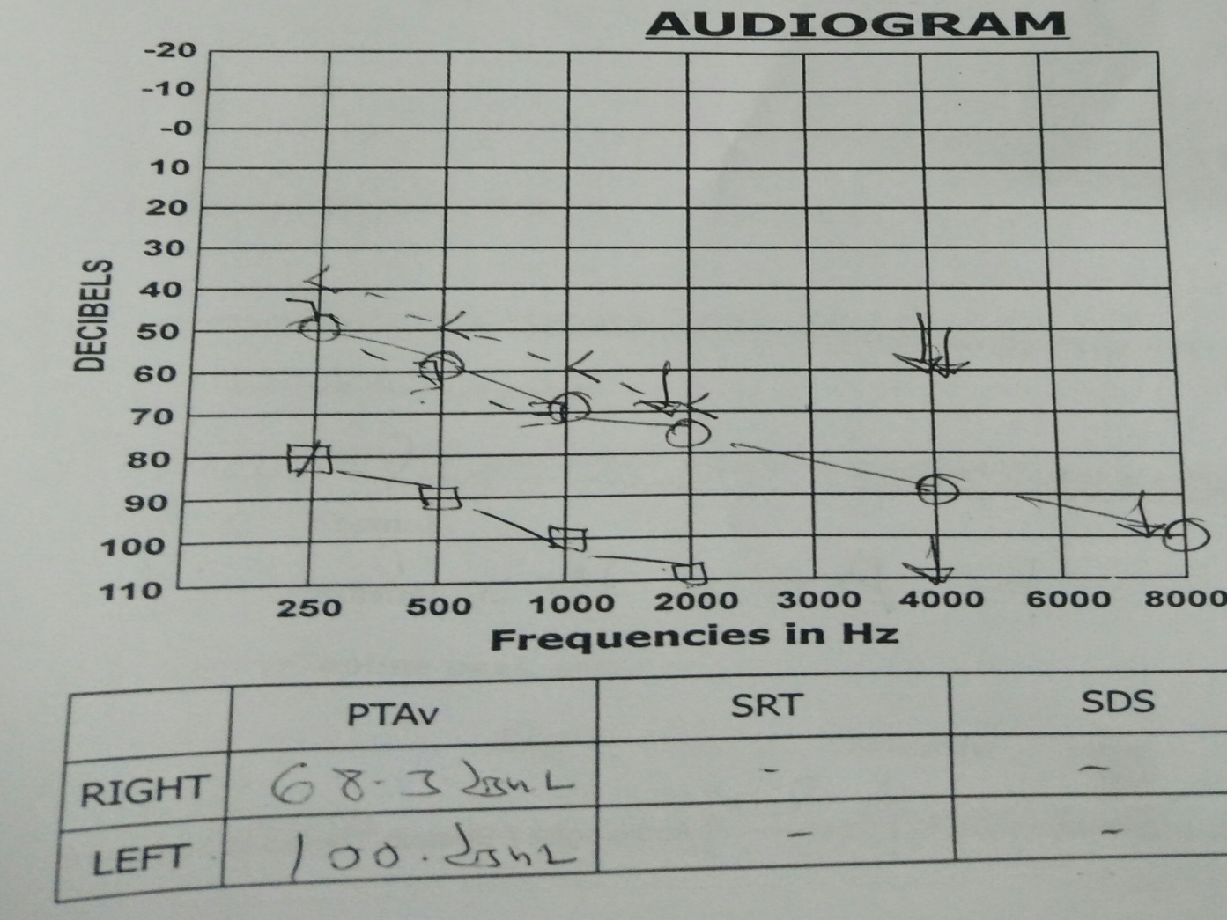

Slide 24
IMPRESSION
BILATERAL SENSORINEURAL HEARING LOSS

Slide 25
DUE TO ABSENCE OF CEREBELLAR SIGNS AND SUSPICION OF POSTERIOR FOSSA SOL WE PROCEEDED TO MRI BRAIN WITH CONTRAST.

Slide 26
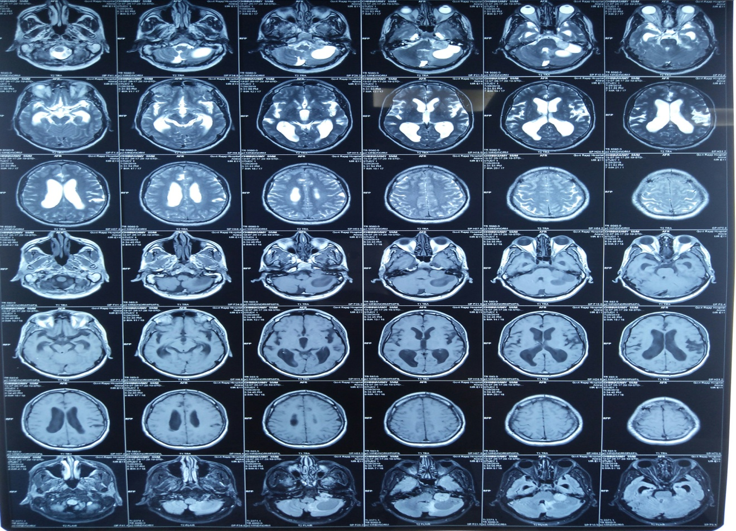
MRI BRAIN PLAIN

Slide 27
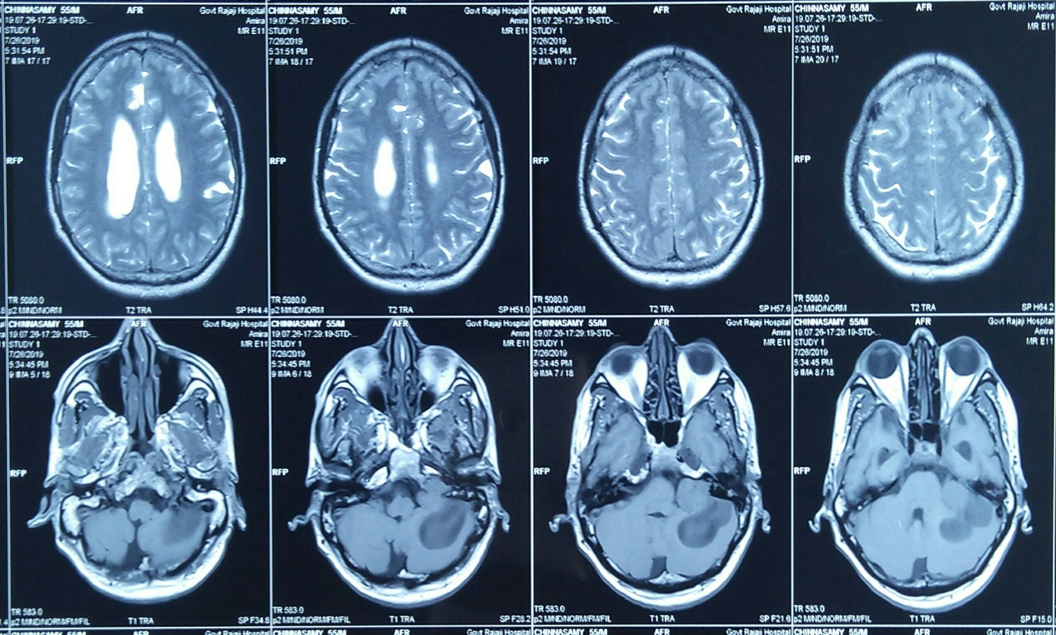

Slide 28
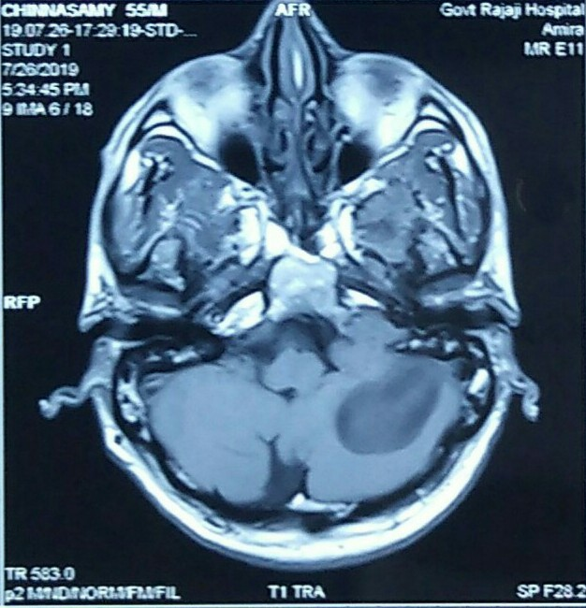

Slide 29
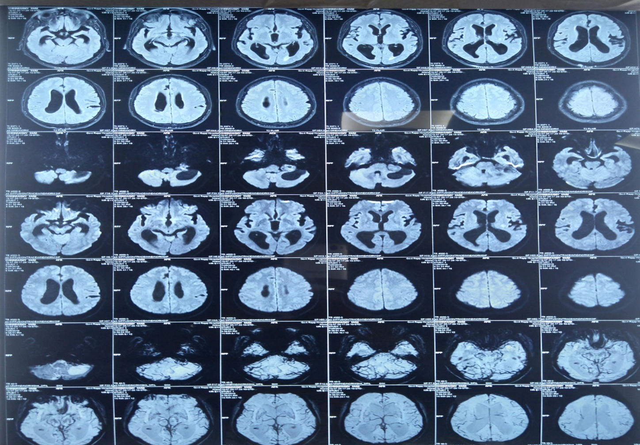
MRI BRAIN - CONTRAST

Slide 30
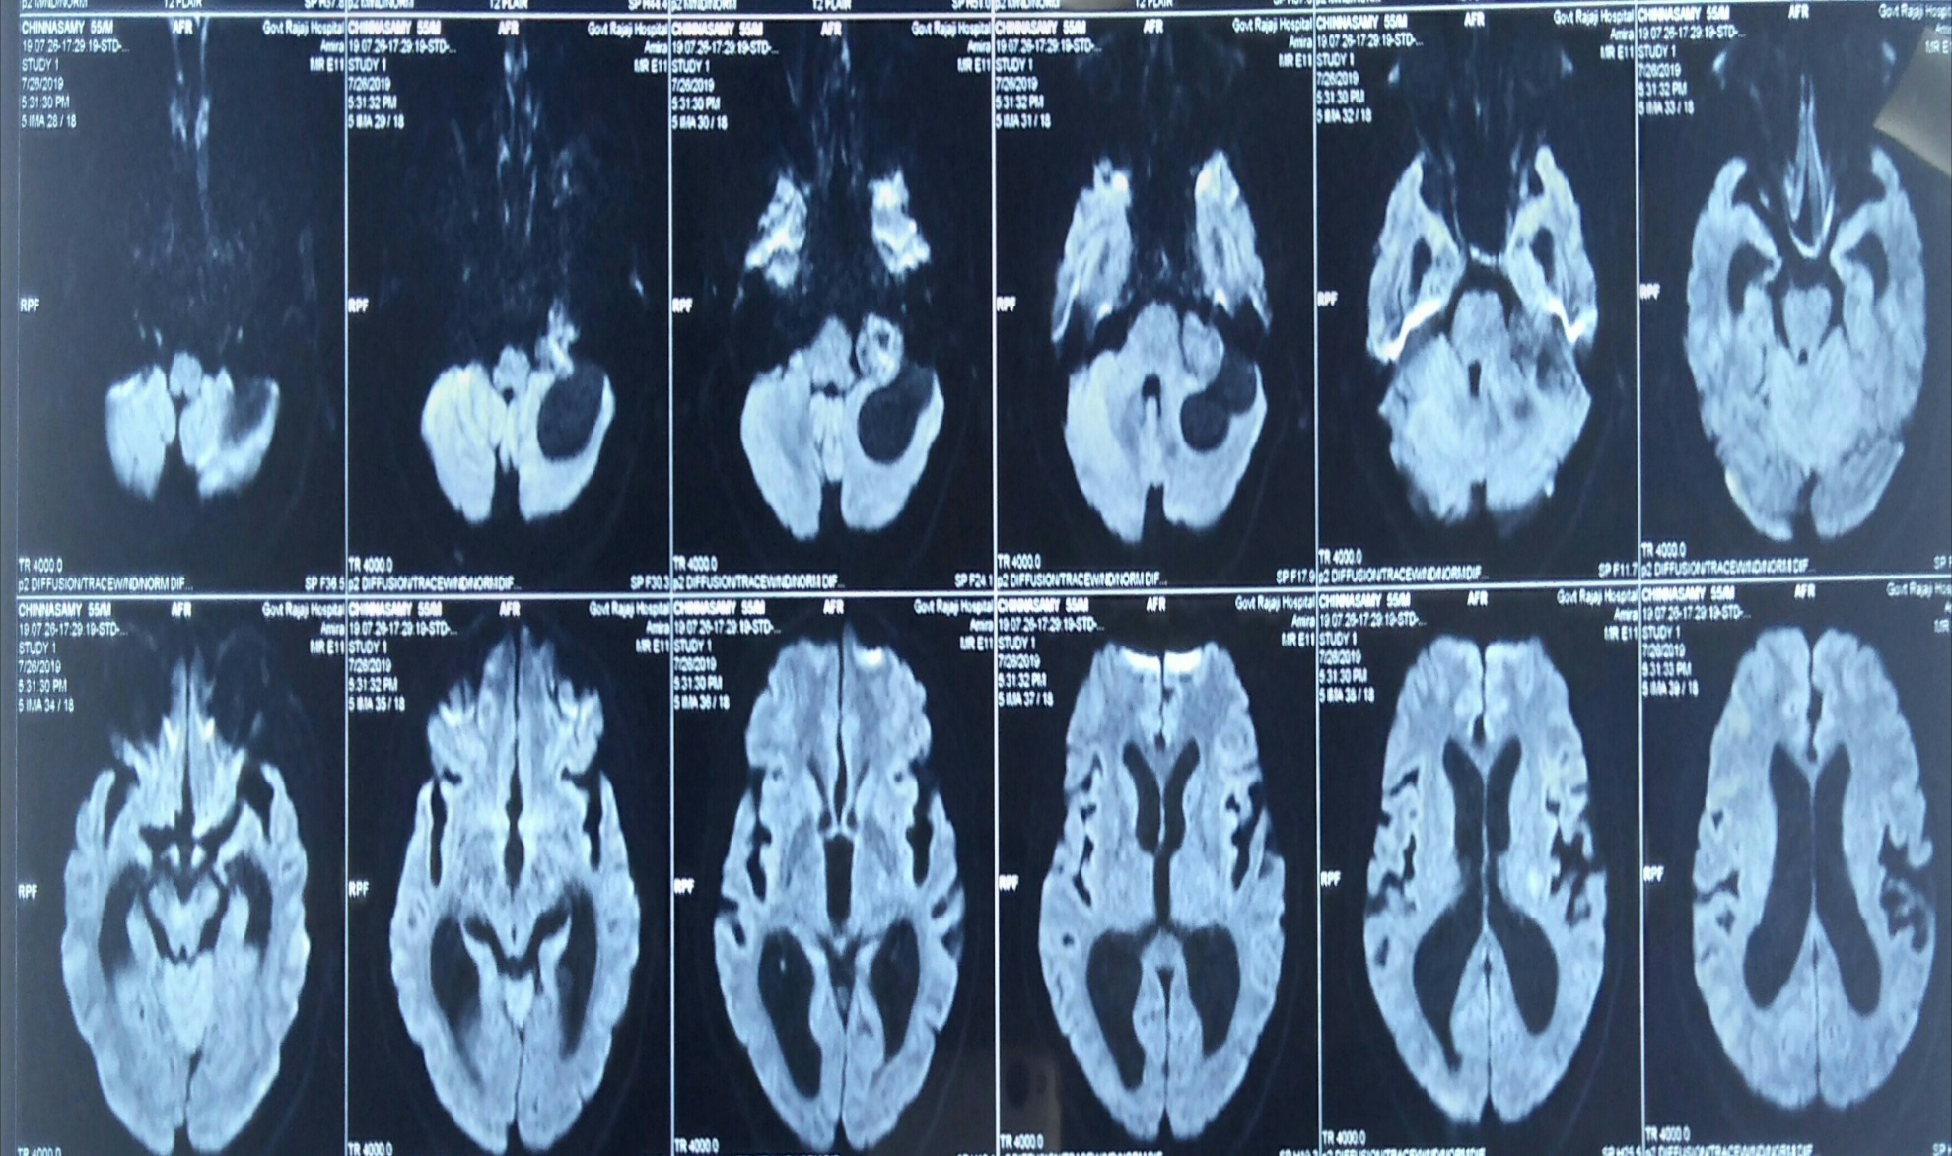

Slide 31
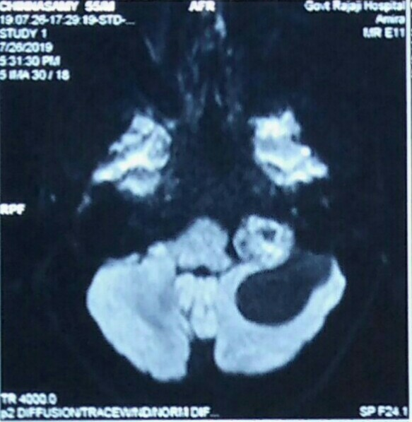

Slide 32
MRI BRAIN (PLAIN AND CONTRAST)
Evidence of 7.1 x 4.9 x 4.8 cm measuring T1 hypo, T2/FLAIR mixed intense mass lesion with cystic and solid components showing few areas of diffusion in DWI and blooming in SWI noted in left cerebello-pontine angle causing compression of left cerebello-pontine cistern.The lesion shows homogenous contrast enhancement.
POSIBILITY OF ACOUSTIC SCHWANNOMA TO BE CONSIDERED

Slide 33
All ventricles appear dilated – Moderete hydrocephalus
No midline shift is noted
MRA : Normal
MRV : Normal
MRS : Choline peak noted

Slide 34
NEUROSURGEON OPINION OBTAINED
Patient transferred to neurosurgery ward
Right VP shunt done
VISION NOT IMPROVED

Slide 35
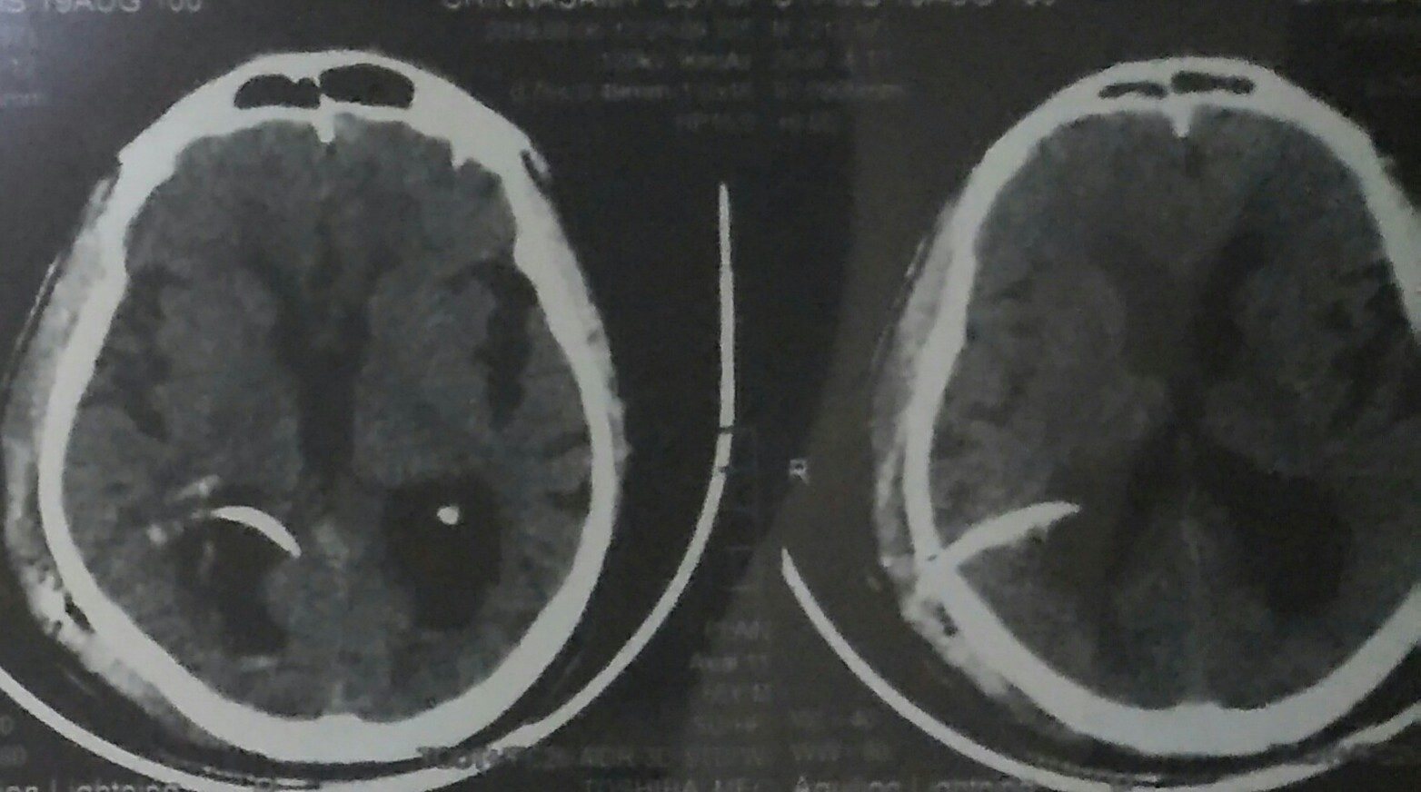
CT BRAIN AFTER RIGHT VP SHUNT

Slide 36
PLAN
CRANIOTOMY AND EXCISION

Slide 37

THANK YOU

