Slide 1
BY 3RD MEDICAL UNIT CHIEF DR. DAVID PRADEEP KUMAR MD MRCP ASST PROFS: DR. RAMKUMAR MD DR. NASEEMA BANU MD DR. NABIL FAYAS MD PRESENTOR: DR. SNEHA SRINIVASAN
SKIN MANIFESTATIONS OF INTERNAL MALIGNANCY & INFECTIONS

Slide 2
Skin & Internal Malignancy
Multisystem and haematopoietic tumours that involve skin
Direct tumour spread
Genodermatoses with malignant potential (Genetically determined syndromes )
Paraneoplastic disorders

Slide 3
MULTISYSTEM AND HAEMATOPOIETIC TUMOURS INVOLVING SKIN
Diagnosis can be made by histological studies from skin lesions

Slide 4
DIRECT TUMOUR SPREAD

Slide 5
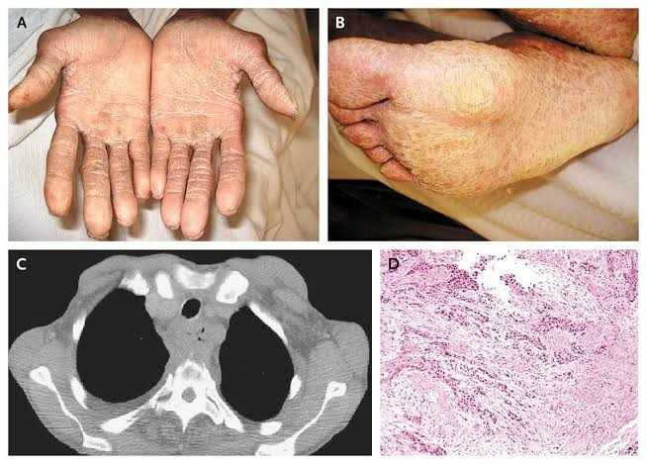
GENODERMATOSES ASSOCIATED WITH INTERNAL MALIGNANCY
GORLIN SYNDROME
Basal cell carcinoma, mandibular odontogenic keratocysts and dyskeratotic pits of palms and soles
HOWEL EVAN SYNDROME
Palmoplantar keratoderma with oesophageal carcinoma

Slide 6
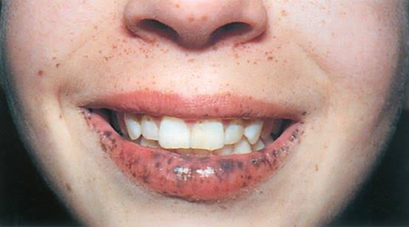
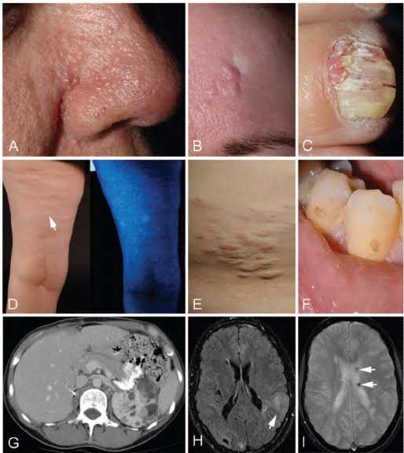
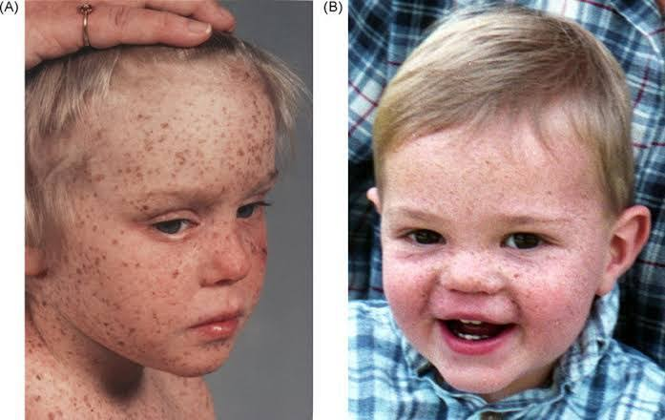
TUBEROUS SCLEROSIS COMPLEX (Bourneville disease)
PEUTZ JEGHERS SYNDROME
XERODERMA PIGMENTOSA

Slide 7
NEUROFIBROMATOSIS TYPE 1 AND 2 (Von Recklinghausen disease)
PTEN HAMARTOMA TUMOUR SYNDROME (COWDEN DISEASE)
ASSOCIATION
Breast, thyroid carcinoma
COMMONEST MALIGNANCY:
Malignant neurofibrosarcoma
CNS malignancy: Astrocytoma

Slide 8
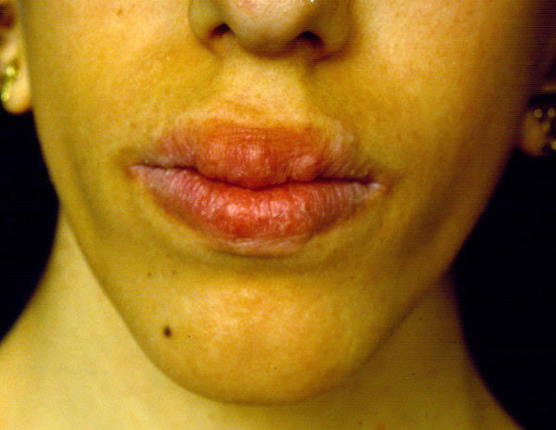
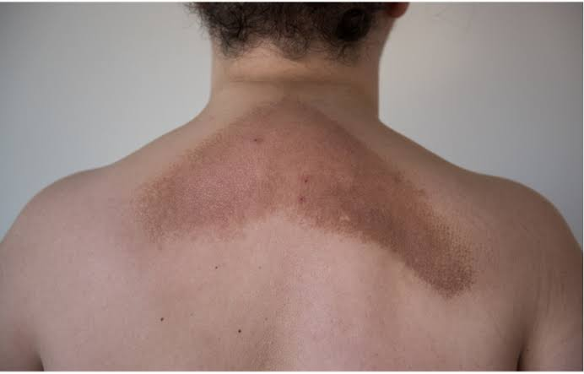
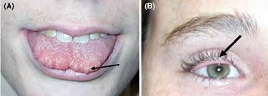
MULTIPLE ENDOCRINE NEOPLASIA Type 1 ( Wermer syndrome)- Angiofibromas, lipomas and caféu lait spots Type 2A ( Sipple syndrome) – No lipomas or mucosal neuromas Type 2B – Mucoasal neuromas
Type 2 B
Type 2 A

Slide 9
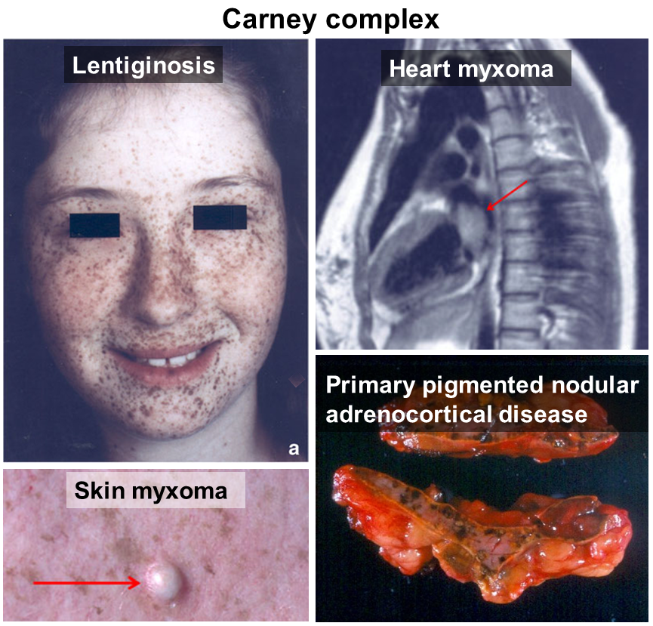
CARNEY COMPLEX/MYXOMA SYNDROME
NAME SYNDROME
(Naevi, atrial myxomas , myxoid neurofibromas and ephelides )
LAMB SYNDROME
(Lentigines, atrial myxomas, mucocutaneous myxomas and blue naevi)

Slide 10
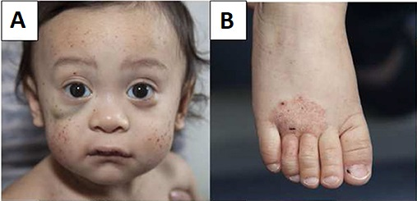
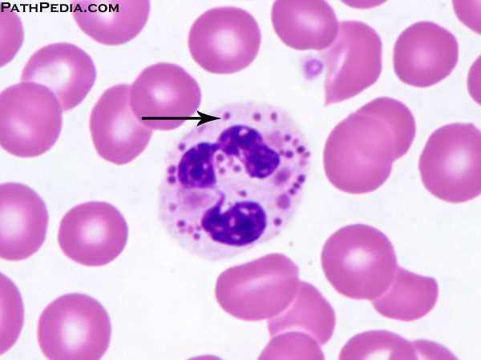
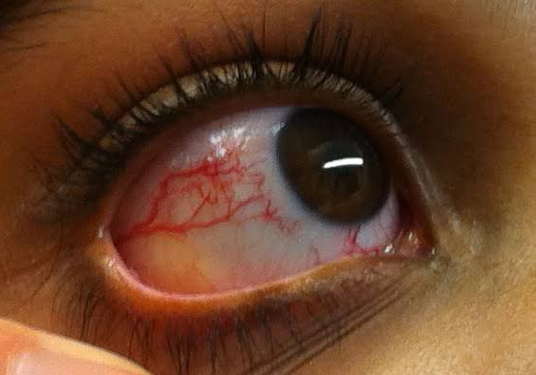
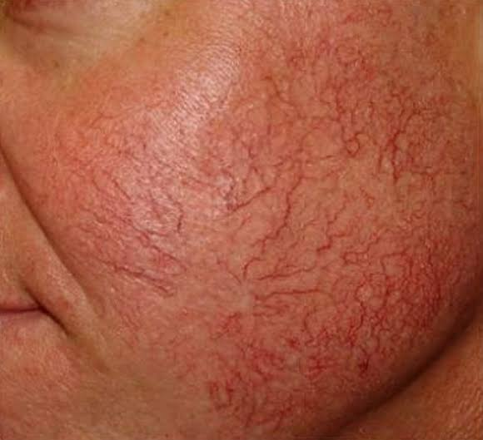
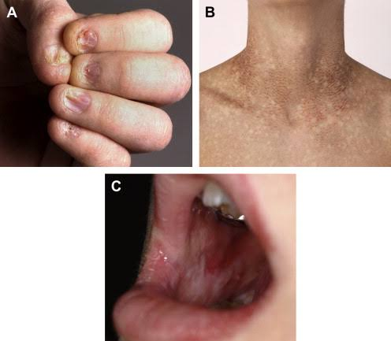
IMMUNODEFICIENCY AND NEOPLASIA SYNDROMES
WISKOTT ALDRICH SYNDROME
CHEDIAK HIGASHI SYNDROME
ATAXIA TELENGIECTASIA
DYSKERATOSIS CONGENITA

Slide 11
PARANEOPLASTIC SKIN MANIFESTATIONS IN MALIGNANCY
Malignancy and cutaneous picture should follow a parallel course
Specific tumour type
Statistical and genetic association

Slide 12
ACANTHOSIS NIGRICANS
Rapid , Symmetrical hyperpigmented, rugose, velvety plaques and pruritic
Benign- obesity and insulin resistance
Malignant – Commonest site – GIT( most frequent – Gastric adenocarcinoma )
PATHOGENESIS
Tumour cells producing TGF alpha or cytokines activating IGF receptors
AREAS- Axillae, other flexures, areolar area and nape of neck and mucosal surfaces

Slide 13
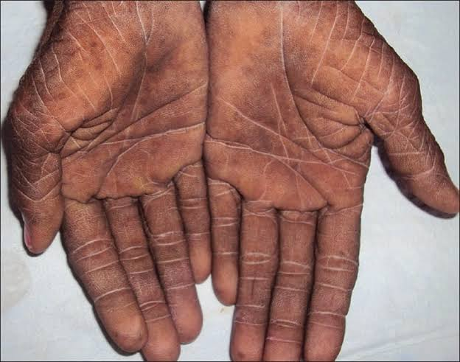
ACANTHOSIS PALMARIS
Tripe palms / Pachydermatoglyphy
Thickened skin of palms and soles causing velvety or pitted honeycomb pattern
Association with neoplasia 90 %
Acanthosis palmaris occuring alone (male, clubbing) – Bronchial carcinoma
Acanthosis palmaris along with acanthosis nigricans – Gastric Carcinoma

Slide 14
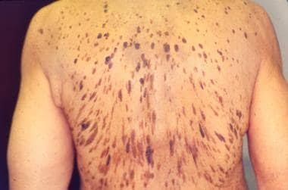
SIGN OF LESER TRELAT
Sudden eruptive development of numerous seborrhoeic keratoses with or without pruritis
Association – most common Gastric Adenocarcinoma
Ca Breast, Malignant Hemangiopericytoma , malignant melanoma, renal carcinoma, transitional cell Ca of bladder ,HIV, acromegaly

Slide 15
FLORID CUTANEOUS PAPILLOMATOSIS
Widespread pruritic eruption of warty papules
Resembles disseminated HPV infection
ASSOCIATION- Gastric adenocarcinoma

Slide 16
ACQUIRED ICHTHYOSIS
Sudden onset of extensive ichthyosis with generalized eczema and prominent fissuring
ASSOCIATION- Hodgkins lymphoma(70%)
Other lymphoreticular tumours
PITYRIASIS ROTUNDA
Fixed annular scaly dermatosis
ASSOCIATION- Hepatocellular carcinoma
PARANEOPLASTIC PIGMENTATION (Ectopic ACTH syndrome)
Due to production of ACTH like hormones from tumour
Greater prominence over pressure points
ASSOCIATION – Small cell bronchial carcinoma(50%)
Also from GIT tumours, ovarian cancer, thymoma, carcinoid syndrome and APUD tumours

Slide 17
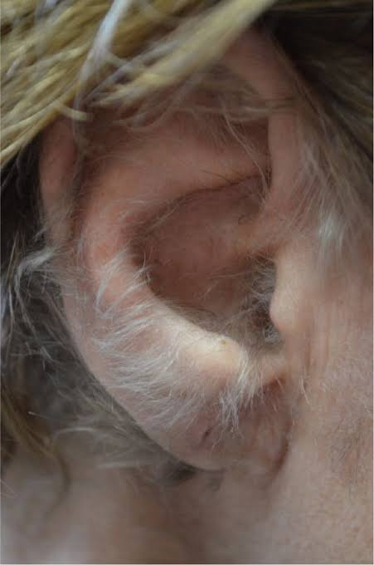
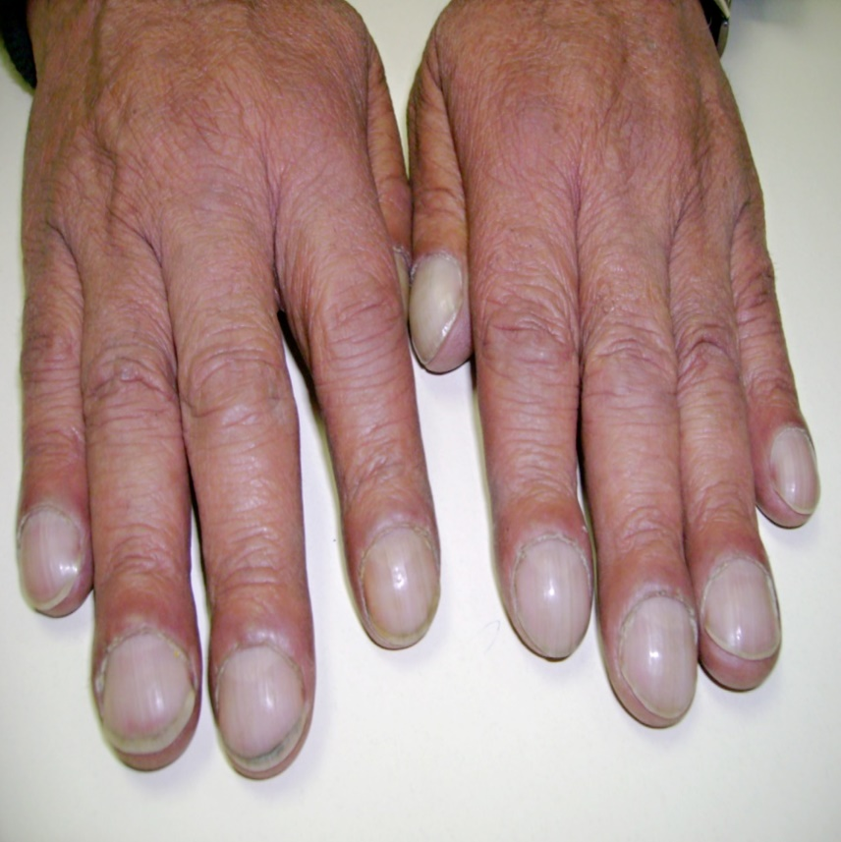
HAIR, NAIL AND SKIN APPENDAGES
PARANEOPLASTIC HYPERTRICHOSIS LANUGINOSA ACQUISITA
CLUBBING OF NAILS
ASSOCIATION- Bronchogenic tumour
Resolution of clubbing after tumor resection
HYPERTROPHIC OSTEOARTHROPATHY
ASSOCIATION – Mesothelioma
Association with AN,tongue papilla hypertrophy and glossitis
Male – Lung > Colorectal
Female – Colorectal > Lung, breast

Slide 18
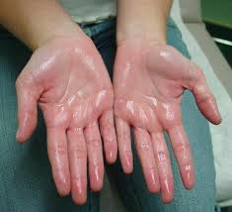
HYPERHIDROSIS
NOCTURNAL HYPERHIDROSIS
Pheochromocytoma, lymphoma, carcinoid syndrome, thyrotoxicosis
LOCALIZED HYPERHIDROSIS – POEMS syndrome
HYPERHIDROSIS WITH AUTONOMIC DYSREFLEXIA- spinal cord lesion above T6
Paroxysomal unilateral hyperhidrosis of face and neck – Ipsilateral thoracic tumour infiltrating sympathetic trunk

Slide 19
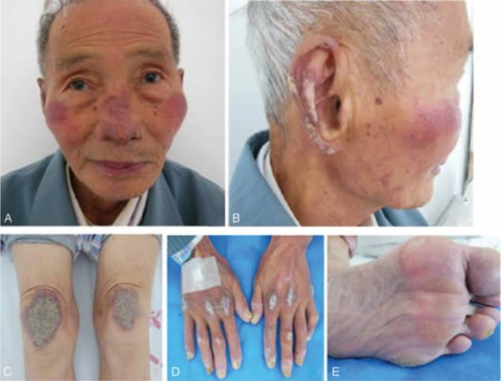
DERMATOSIS ASSOCIATED WITH INTERNAL MALIGNANCY
BAZEX SYNDROME
(Acrokeratosis paraneoplastica)
Violaceous erythema and scalings on peripheries becoming hyperkeratotic
Helices of ears, tip of nose, hands and feet (distal portions of legs)
Face- Eczematous or lupus erythematosus like
Acral – Psoriasiform
ASSOCIATION – Upper respiratory or GIT squamous cell carcinoma , cervical lymph node mets
Course parellels with underlying neoplasm

Slide 20
MIGRATORY ERYTHEMAS
ERYTHEMA GYRATUM REPENS
Mobile, concentric, palapble, erythematous wave like bands (wood grain appearance) with peripheral scaling
Lesion migrates 1cm daily
ASSOCIATION: Lung cancer

Slide 21
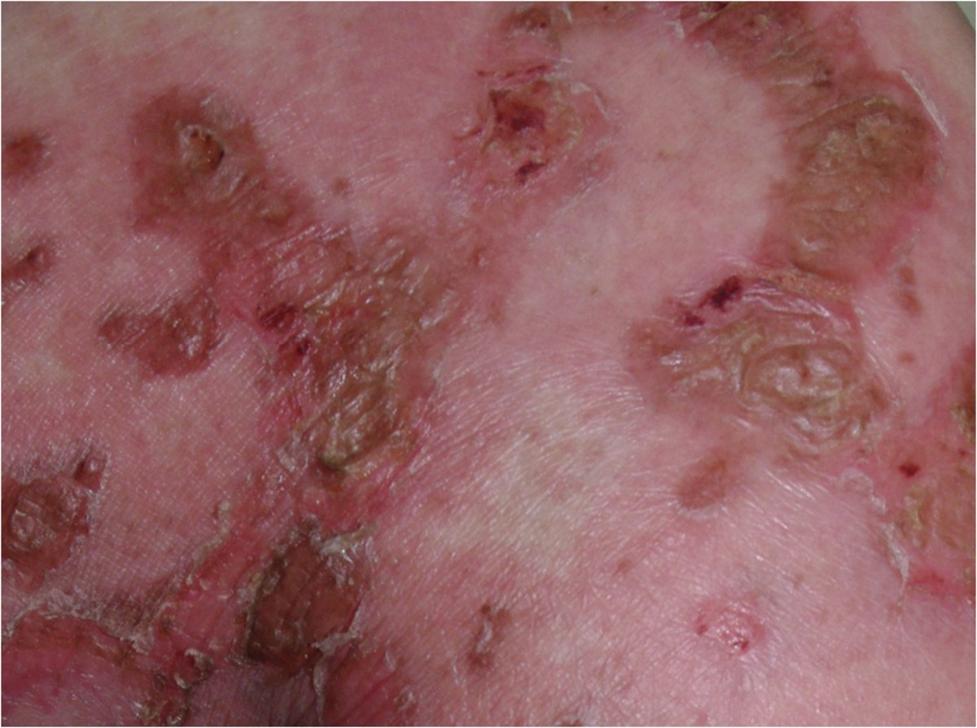
NECROLYTIC MIGRATORY ERYTHEMA
Painful migratory rash with irregular polycyclic inflammatory erythematous patches
Blisters turn into superficial epidermal necrolysis
Predilection for anogenital region and trunk
ASSOCIATION:Glucagon secreting alpha cell tumour of pancreas

Slide 22
DERMATOMYOSITIS
Maglinancy association stronger with dermatomyositis than polymyositis
ASSOCIATION : Lung, breast, gynaecological tumours,colorectal and nasopharyngeal carcinoma
Amyopathic dermatomyositis less likely with malignancy
Old age, male sex, cutaneous necrosis, dysphagia increases risk
Associated arthritis and ILD decreases risk
Anti NXP2 (Nuclear matrix protein 2) and Anti TIF(Transcription Intermediary Factor) in cancer associated dermatomyositis

Slide 23
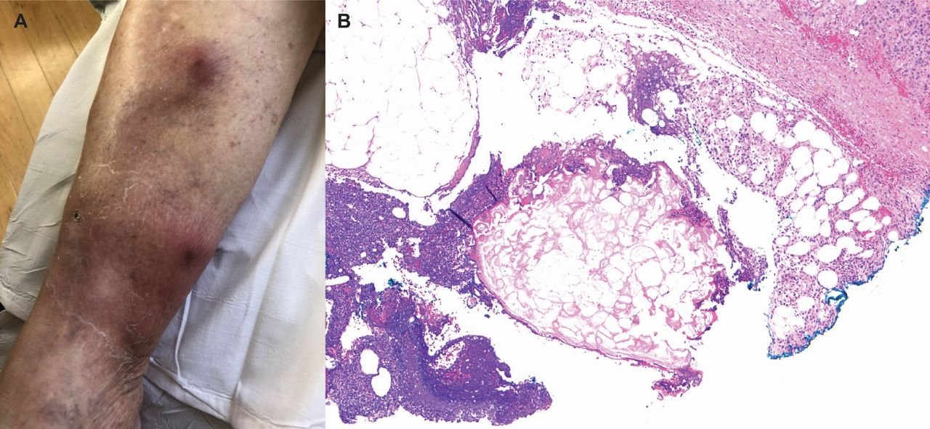
FASCITIS AND PANNICULITIS SYNDROME
ASSOCIATION: Acinar cell carcinoma of pancreas
(Panniculitis, polyarthritis and eosinophilia)

Slide 24
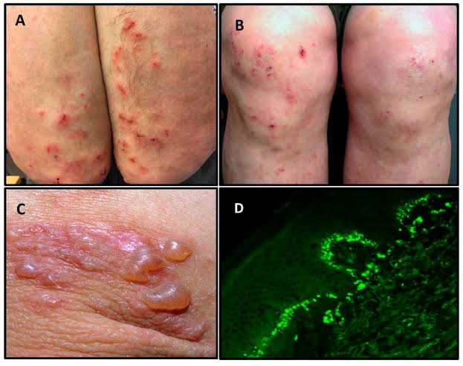
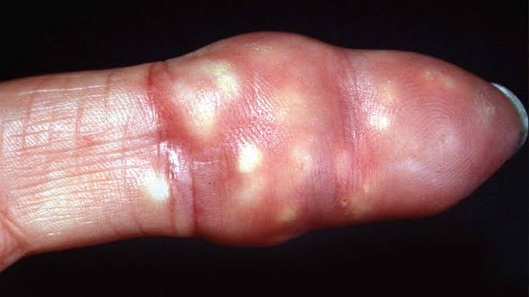
DERMATITIS HERPETIFORMIS:
ASSOCIATION: Small bowel Lymphoma and gluten sensitive enteropathy
PORPHYRIA CUTANEA TARDA AND VARIEGATE PORPHYRIAS:
ASSOCIATION: Hepatocellular carcinoma
CALCINOSIS CUTIS
ASSOCIATION: Carcinoma of esophagus ,myeloma, breast cancer

Slide 25
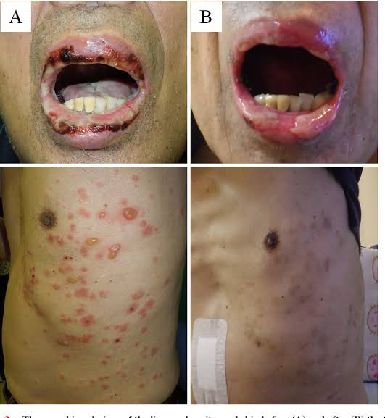
BULLOUS DISORDER ASSOCIATED WITH INTERNAL MALIGNANCY
PARANEOPLASTIC PEMPHIGUS
ASSOCIATION: Thymoma, Hodgkins lymphoma, CLL, Castleman tumour
Autoantibodies to 250, 230, 210,190 and 170kDA(bullous pemphigoid antigen)

Slide 26
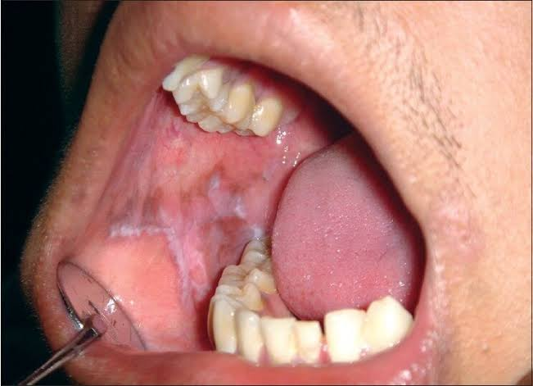
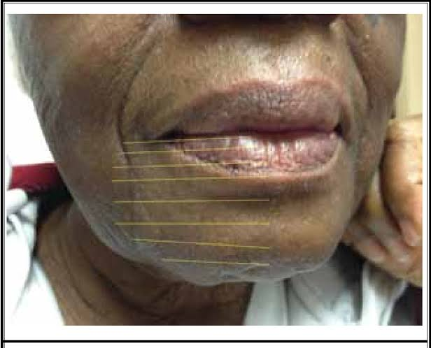
Other dermatological disorders
LICHEN PLANUS: Oral squamous cell carcinoma
EXFOLIATIVE DERMATITIS: Mycosis Fungoides or its leukemic variant (Sezary syndrome)
INSECT BITE LIKE REACTON: Hematological malignancy(CLL)
MENTAL NEUROPATHY: (NUMB CHIN SYNDROME)
Breast, thyroid, renal, lung and melanoma
Feature of mets ( poor prognosis)
PYODERMA GANGRENOSUM AND NEUTROPHILIC DERMATOSES
ASSOCIATION: Myeloproliferative disorder
LICHEN PLANUS
PYODERMA GANGRENOSUM
MENTAL NEUROPATHY

Slide 27
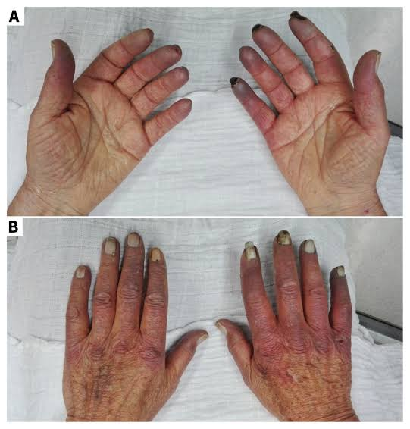
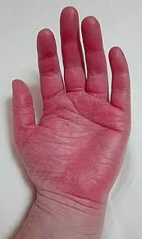
VASCULAR DISORDER ASSOCIATED WITH INTERNAL MALIGNANCY
CHILblAIN LIKE LESIONS
Leukemia and myeloproliferative disorder
Persistent and refractory to calcium channel blockers
FLUSHING
Carcinoid tumour
Mastocytosis
Phaeochromcytoma
Medullary carcinoma of thyroid
RAYNAUD PHENOMENON AND DIGITAL ISCHEMIA:
(Paraneoplastic acral vascular syndrome)
Solid tumours, reticuloendothelial neoplasm, polycythemia vera and myeloma liinked cryoglobulinemia
ERYTHROMELALGIA:
Polycythemia vera or essential thrombocythaemia

Slide 28
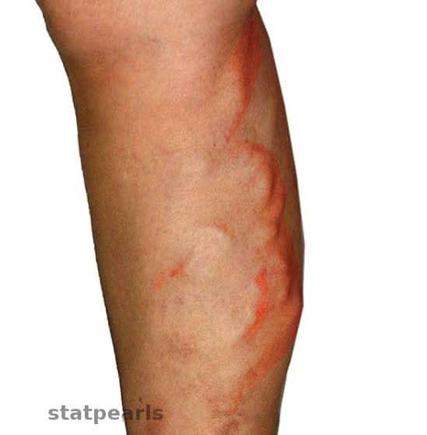
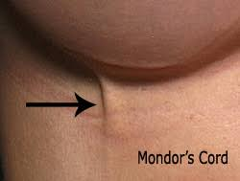
MIGRATORY THROMBOPHLEBITIS
Recurrent and migratory (Trousseau sign)
Pancreatic carcinoma in half of cases, stomach, colon and lung
DEEP VEIN THROMBOSIS
Adenocarcinoma of GIT, urogenital tract, breast or lung
Mucin causing non enzymatic activation of factor X to Xa initiating thrombotic cascade
Mondor disease
Thrombophlebitis of thoracic or epigastric veins
Association with breast cancer

Slide 29
TUBERCULOSIS
PAPULAR TUBERCULID AFTER BCG
SCROFULODERMA
LUPUS VULGARIS AT BCG SITE
WARTY TUBERCULOSIS

Slide 30
LUPUS VULGARIS
LUPUS VULGARIS
TUBERCULOUS GUMMA
LICHEN SCROFULOSORUM
PAPULONECROTIC TUBERCULID
ERYTHEMA INDURATUM OF LEGS

Slide 31
SYPHILIS
SECONDARY SYPHILIS- MACULOPAPULAR RASH
PRIMARY SYPHILIS- PENILE CHANCRE
ORAL LESIONS

Slide 32
TERTIARY SYPHILIS- GUMMA
CONDYLOMATA LATA OF SECONDARY SYPHILIS

Slide 33
HIV
SEBORRHOEIC DERMATITIS
PLANTAR PSORIASIS
EOSINOPHILIC FOLLICULITIS
GRAULOMA ANNULARE

Slide 34
CHRONIC VERRUCOUS HERPES ZOSTER
TINEA CORPORIS
HPV- MYRMECIA OF GREAT TOE
NORWEGIAN SCABIES

Slide 35
CYTOMEGALOVIRUS VASCULITIS
NODULAR PRURIGO LIKE ERUPTION IN CMV
CRYPTOCOCCOSIS
BACILLARY ANGIOMATOSIS

Slide 36
SQUAMOUS CA AND MELANOMA
KAPOSI SARCOMA
HAIRY LEUKOPLAKIA

Slide 37
THANK YOU

