Slide 1
CLINICO PATHOLOGICAL CONFERENCE
4 TH MEDICAL UNIT
PROFESSOR: DR.S.PEER MOHAMED M.D.,
ASST PROFs: DR.M.SATHEESH KUMAR M.D.,
DR.C.VIGNESH M.D.,
DR.V.P.PRIYA M.D.

Slide 2
CHIEF COMPLAINTS
A 25 years old female came to GRH Madurai with
c/o swelling in bilateral parotid region for 1 month
c/o multiple swellings in scalp for 1 month

Slide 3
HOPI
Patient was apparently normal 1 month back and then she developed
swelling in bilateral parotid and submandibular region, acute onset, progressively increased in size, associated with pain
H/o multiple swellings and scaly lesions in scalp associated with itching and pain
H/o difficulty in opening of mouth
H/o low grade fever for 3 days , 1 month back

Slide 4
HOPI
No H/o throat pain
No H/o difficulty in swallowing
No H/o cough
No H/o difficulty in breathing
No H/o decreased salivation and lacrimation
No H/o abdominal pain and distension
No H/o loss of weight and loss of appetite
No H/o chest pain, palpitation
No H/o bleeding manifestations
No H/o skin rashes, hair loss, joint pain, early morning stiffness
No H/o myalgia
No H/O loss of sensation over face
Able to close eyes and feel taste sensation
No H/o loss of forehead wrinkling and drooling of saliva
No H/o altered sensorium

Slide 5
PAST HISTORY
Not a K/C/O DM/SHTN/ THYROID DISORDER/ TB/ EPILEPSY
No h/o similar illness in past.
No h/o chronic drug intake.

Slide 6
PERSONAL HISTORY
Mixed diet
Normal bowel and bladder habit
No h/o any substance abuse
No h/o similar illness in family members

Slide 7
MENSTRUAL HISTORY
Regular menstrual cycles 4/28
Married since 4 years
P1L1, LCB 3 years back, antenatal period insignificant

Slide 8
ON EXAMINATION
Patient conscious, oriented
Moderately built and nourished
No pallor
No icterus
No cyanosis
No clubbing
No pedal oedema

Slide 9
HEAD AND NECK EXAMINATION
Scalp region – multiple crusted plaques and nodules of varying size 1*1 to 4*4 cm
Bilateral parotid region
Right side- hard oval mass in parotid region 4*4 cm , tenderness +, restricted mobility, lifting the ear lobe.
Left side – hard oval mass in parotid region 5*6 cm , tenderness +, restricted mobility, lifting the ear lobe
3 to 4 lymph nodes of varying size largest measuring 2*2 cm present in bilateral submandibular region.
Other lymph nodes such as post auricular, supra clavicular, axillary, epitrochlear, inguinal and popliteal were not palpable.

Slide 10
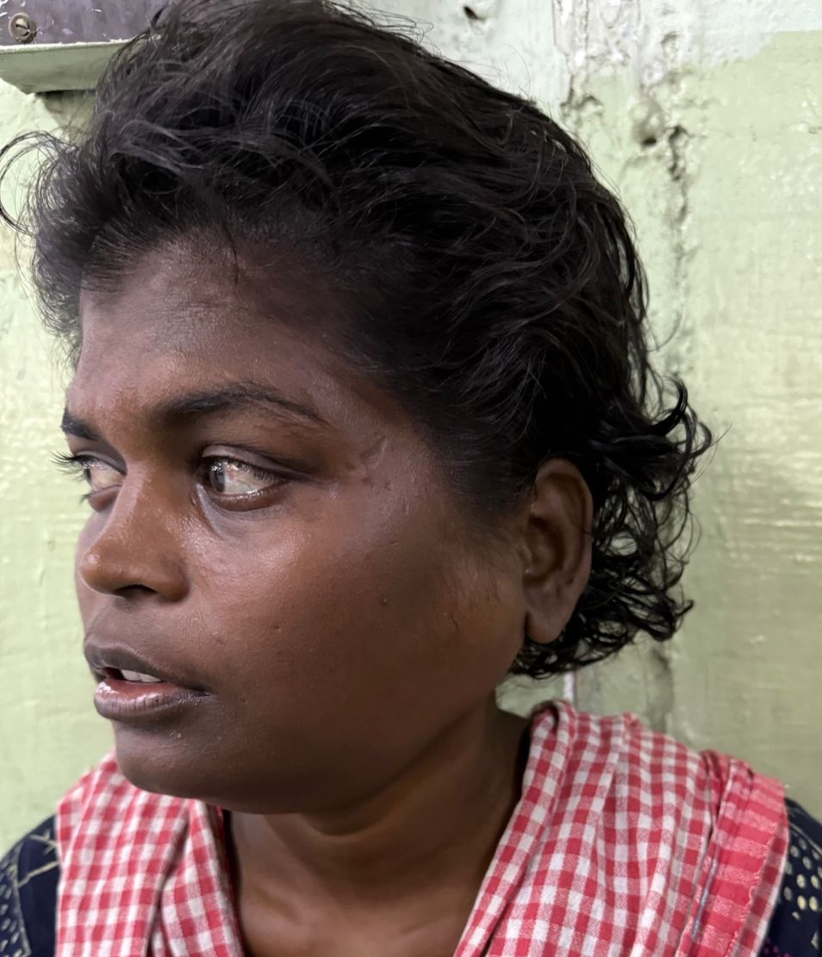

Slide 11
VITALS
BP- 100/60 mmHg
PR- 84/min, regular rhythm ,
normal volume and character,
felt equally in all palpable peripheral vessels,
no radio radial and radio femoral delay
RR- 12/min
SPO2- 99% RA

Slide 12
SYSTEMIC EXAMINATION
CVS- S1 S2 +, No murmurs
RS- BAE+, NVBS, No added sounds
ORAL CAVITY – Floor of mouth normal
Bilateral tonsillar enlargement +
P/A- Soft, BS+, No palpable organomegaly
CNS- NFND
Fundus – normal

Slide 13
INVESTIGATIONS
CBC | 10/1/25
TC | 10,000
RBC | 3.76
HB | 9.5
MCV | 82.7
MCHC | 30.5
PLT | 1,80,000

Slide 14
INVS | 10/1/25
RBS | 87
UREA | 14
Creatinine | 0.4
Total Bilirubin | 0.9
SGOT | 18
SGPT | 17
ALP | 239
TOTAL PROTEIN | 5.8
ALBUMIN | 3.0
GLOBULIN | 2.8
INVS | 10/1/25
Sr.CALCIUM | 11.2
Sr.NA+ | 139
Sr.K+ | 3.9
ESR | 69
CRP | 89
Sr. URIC ACID | 8.1
TSH | 4.06

Slide 15
VCTC - NEGATIVE
HbsAg -Negative
AntiHCV Ab - Negative
URINE PARAMETERS
URINE ALBUMIN | NIL
URINE SUGAR | NIL
URINE DEPOSITS | 1-2 PUS CELLS

Slide 16
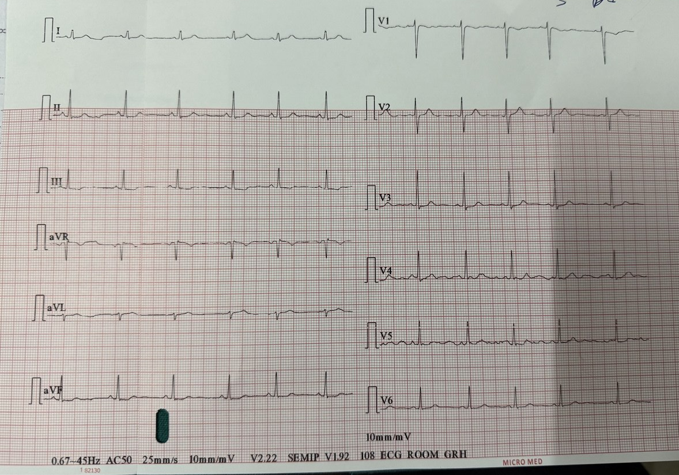
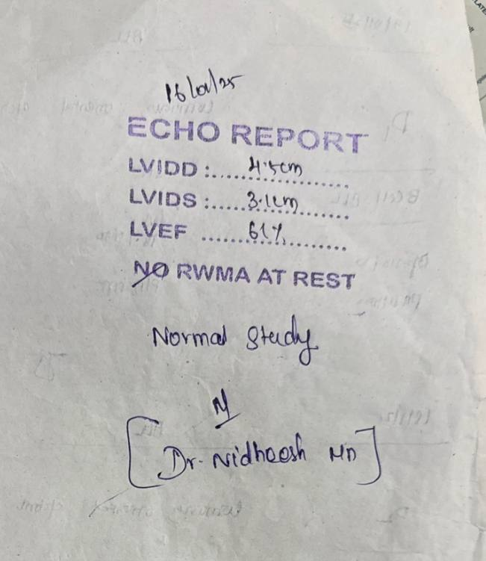
ECG:
90/min,
Normal sinus rhythm,
No ST- T changes
ECHO:
NORMAL STUDY

Slide 17
CHEST X RAY

Slide 18
DERMATOLOGY OPINION
DERMATOLOGICAL EXAMINATION:
Diffuse ill defined skin coloured infiltrated plaques with peau d orange appearance of varying size ranging from 4*5cm over the forehead
Multiple crusted plaques and nodules of varying size from 1*1cm to 4*4cm over the scalp
Palms ,soles, hair, skin and genitalia normal
IMPRESSION: ? SCLEREDEMA
ADVICE: ENT opinion
Rheumatology opinion
To do peripheral smear, thyroid profile
PLAN: Skin biopsy

Slide 19
SURGEON OPINION
ADVICE
USG NECK and PAROTID
FNAC OF BILATERAL PAROTID GLANDS

Slide 20
ENT opinion
Local examination of oral cavity:
Mouth opening reduced due to pain
Floor of mouth normal
Local examination of oropharynx:
Bilateral grade 2 tonsillar enlargement +
ADVICE: IV Antibiotics
watch for respiratory distress

Slide 21
OPTHALMOLOGY OPINION
IMPRESSION: Bilateral grade 1 hypertensive retinopathy at present
SCHIRMER TEST: Moisture on the filter paper more than 10mm in both eyes

Slide 22
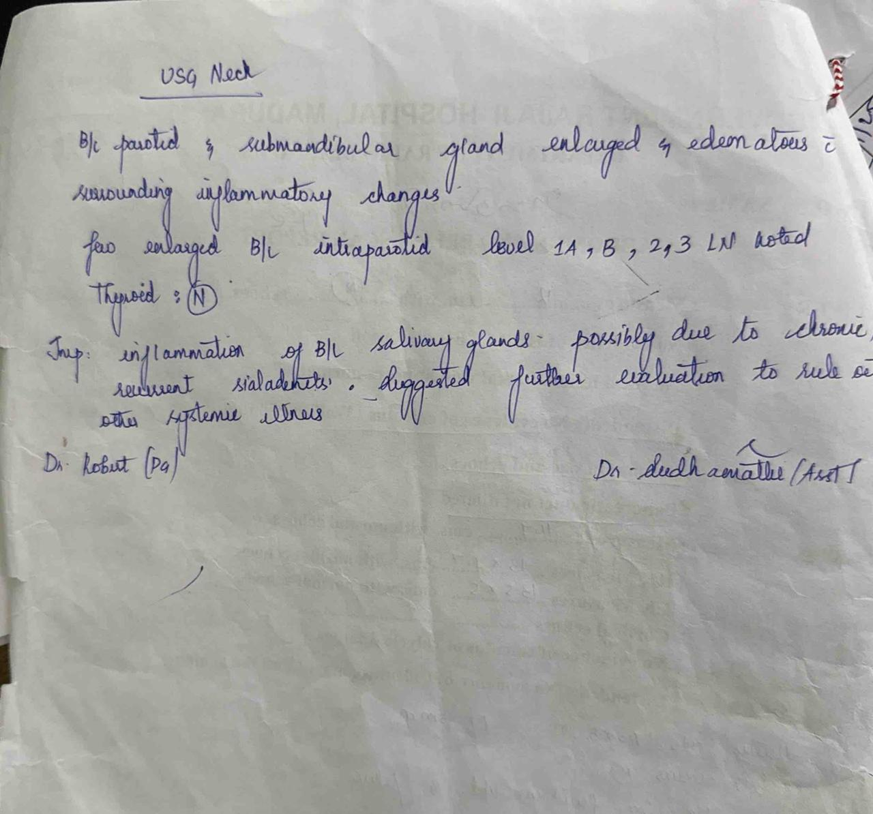
USG NECK
IMPRESSION:
Inflammation of bilateral salivary glands possibly due to chronic recurrent
sialadenitis ..suggested further evaluation to rule out other systemic disease

Slide 23
USG ABDOMEN
IMP- NORMAL STUDY
NO ORGANOMEGALY
NO LYMPH NODE ENLARGEMENT

Slide 24
CT NECK
BILATERAL PAROTID GLAND APPEARS TO BE DIFFUSELY ENLARGED IN SIZE [L>R] WITH MINIMAL INFLAMMATORY FAT STRANDING NOTED
BILATERAL PAROTITIS WITH SIALADENITIS AND CERVICAL LYMPHADENOPATHY

Slide 25
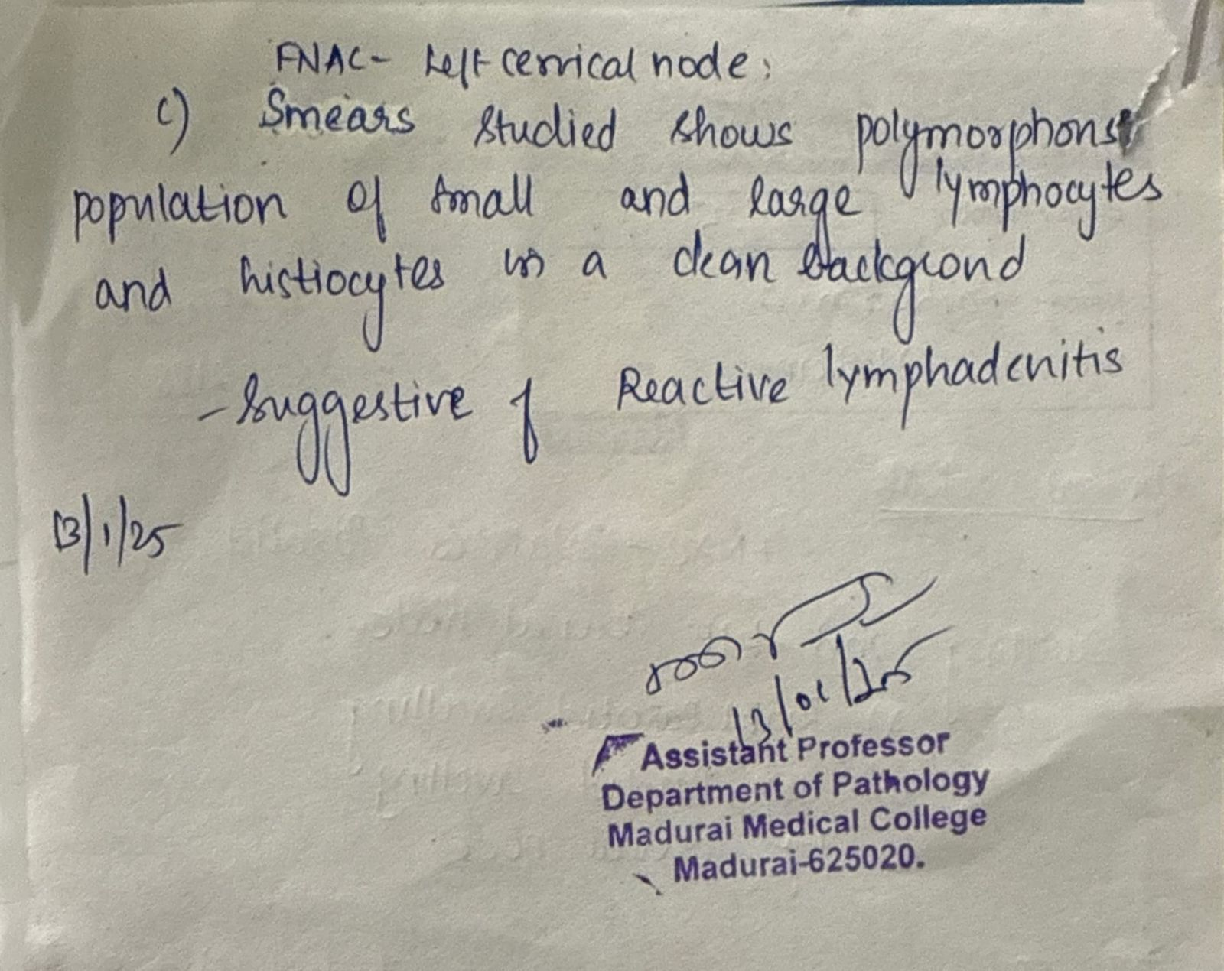
FNAC
IMP –BILATERAL CHRONIC LYMPHOCYTIC SIALADENITIS WITH REACTIVE LYMPHADENITIS

Slide 26
DERMATOLOGY REVIEW
Biopsy – Shows structure of skin with epidermis with focal thinning and underlying dermis show dense collagen formation with few adnexal structures, perivascular chronic inflammation
IMP – ?SCLEREDEMA(POST INFECTIOUS)
RESOLVED

Slide 27
DISCUSSION……

