Slide 1
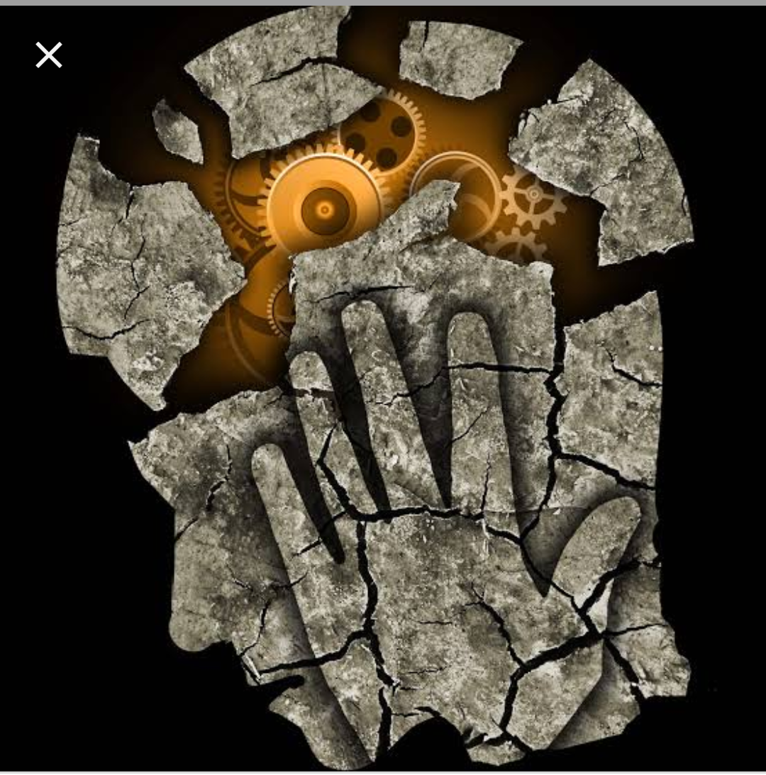
NEUROLOGICAL MANIFESTATION OF SYSTEMIC DISEASE
III MEDICINE UNIT
CHIEF:PROF.DR.BAGIALAKSHMI M.D
ASST PROF: DR.SARAVANAN M.D
DR.RAJKUMAR M.D
DR.PON SENTHILKUMAR M.D

Slide 2
RHEUMATOLOGICAL DISORDERS:
SYSTEMIC LUPUS ERYTHEMATOSUS: due to
Disease process
Immunosuppression – infections
Side effects of therapies
DISEASE PROCESS:
Due to inflammation
Vascular occlusion

Slide 3
Presentation:
Cognitive dysfunction ( problems of reasoning and recognizing) -50 %
Severe headache
Seizures antiseizure medications and immunosuppressants.
Psychosis (diff from glucocorticoid induced)
Stroke 10%
Movement disorders -2-5%
Aseptic meningitis/myelopathy <1%

Slide 4
CHOREA IN RHEUMATIC FEVER:
Long latency period (even 6 months)
In the absence of other manifestation
Common in females
Affects the head in the form of (darting movements of the tongue) and upper limb.
Emotional lability and obsessive compulsive traits.
Treatment:
Carbamazepine and sodium valproate
Steroids –rapid reduction in chorea
0.5 mg/kg/day.

Slide 5
VASCULITIS SYNDROMES:
GRANULOMATOSIS WITH POLYANGITIS:
Granulomatous vasculitis of upper and lower respiratory tract with glomerulonephritis.
Nervous system involvement due to disseminated vasculitis of small arteries and veins
Cranial neuritis
Mononeuritis multiplex
Cerebral vasculitis/granuloma.
Diagnosis: tissue diagnosis (PULMONARY) and as an adjunctive antiproteinase 3 ANCA.

Slide 6
MICROSCOPIC POLYANGIITIS:
Necrotising vasculitis affecting the small vessels.
Mononeuritis multiplex.
Predominant ANCA associated: antimyeloperoxidase antibodies.
EOSINOPHILIC GRANULOMATOSIS WITH POLYANGIITIS:(churg strauss)
Granulomatous inflammation involving small and medium vessels
Asthma,peripheral and tissue eosinophilia,extravascular granulomas and vasculitis of multiple organ.
Mononeuritis multiplex.
LAB Diagnosis :eosinophilia >1000 cells
antimyeloperoxidase ANCA.

Slide 7
POLYARTERITIS NODOSA:
necrotizing vasculitis of medium and small sized vessels. (especially renal)
23% -CNS involvement
Seizures
Cerebrovascular accident
Altered mental status.
Diagnosis: no serological tests available.
Tissue diagnosis
Angiographic diagnosis: aneurysms of visceral vasculature/ stenotic lesion of the vasculature.

Slide 8
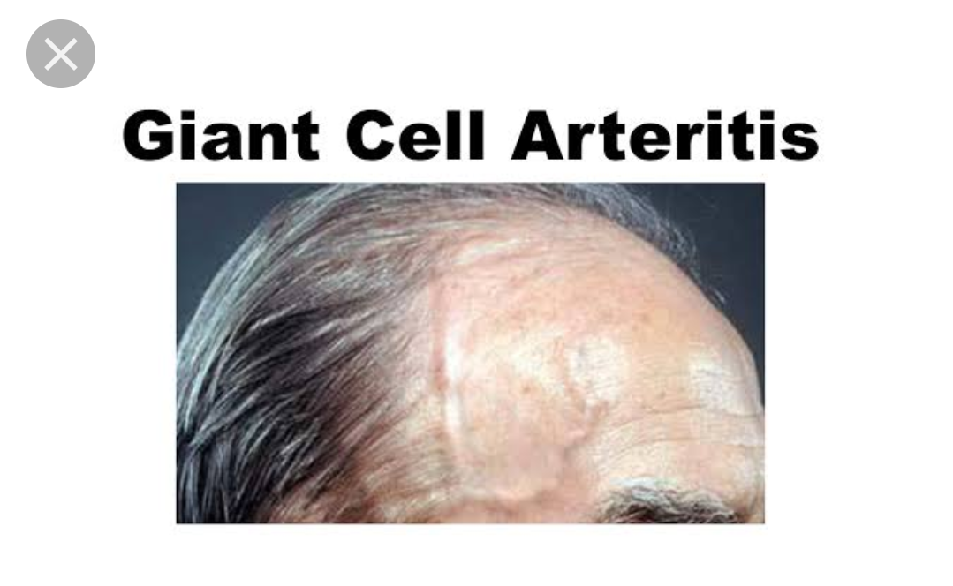
GIANT CELL ARTERITIS:
inflammation of medium and large sized
arteries (branches of carotid artery particularly temporal artery)
Headache,scalp pain,claudication of jaw,tongue.
Tender and thickened temporal artery.
Dreaded complication –ischemic optic neuropathy
leading to blindness.
Diagnosis by temporal artery biopsy (3-5 cm).

Slide 9
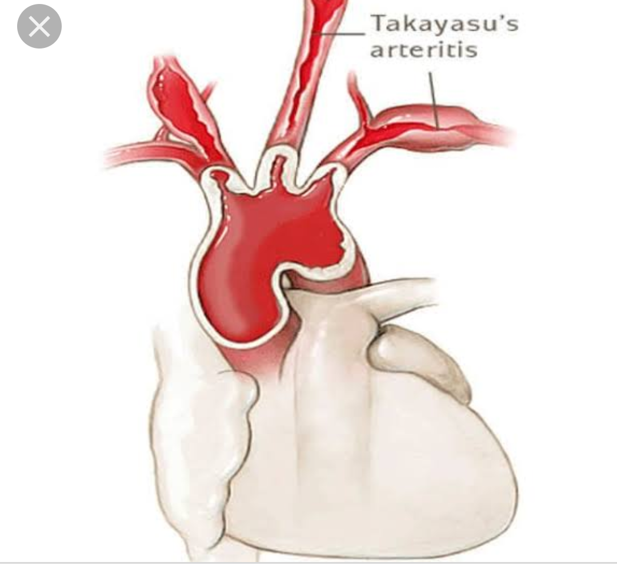
TAKAYASU ARTERITIS:
Inflammatory and stenotic diseases of medium and large sized arteries with strong predilection for aortic arch and its branches.
Common carotid artery involvement in 58 %.
Visual disturbances
Syncope
Transient ischemic attacks
Stroke
Seizures.
Diagnosis by arteriography-irregular vessel wall,stenosis,post stenotic dilation,aneurysm formation,occlusion and increased collaterals.

Slide 10
BEHCET’ S SYNDROME:
Neurological involvement in 5-10%
80 % -characterized by brain stem involvement.(CNS BEHCET’S SYNDROME)
Csf analysis: raised IL-6.
Cerebral vein thrombosis in superior sagittal and transverse sinus
raised intracranial tension
MRI sensitive for CNS behcet syndrome.
Treated with prednisolone 1 mg/kg/day and azathioprine 2-3 mg/kg/day.

Slide 11
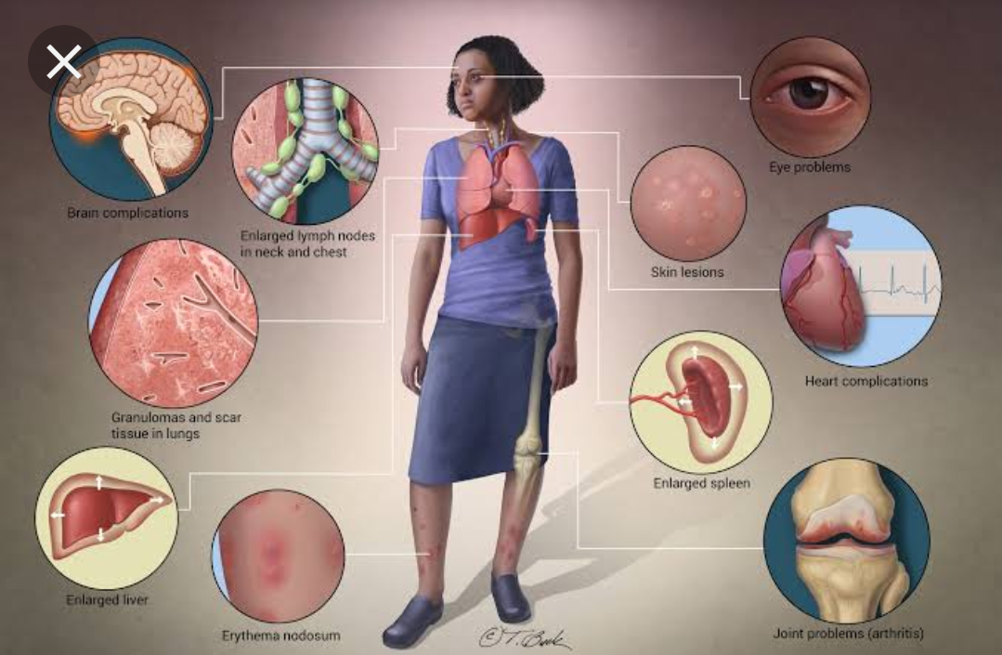
SARCOIDOSIS:
Inflammatory disease characterized by non caseating granuloma.
Neurological involvement in 5-10 %
Cranial nerve involvement( optic neuritis and
facial nerve involved usually)
Basilar meningitis
Myelopathy
Diabetes insipidus
Seizures and cognitive changes.
Optic neuritis occur in association with anterior and posterior uveitis.
CSF: lymphocytic meningitis, mild increase in protein with normal glucose.

Slide 12
Close DD:
Multiple sclerosis:
MRI: multiple enhancing white matter abnormalities +.
Differentiated with extra neurological symptoms.
Glucocorticoid –main stay of therapy for sarcoidosis.
Add cytotoxic agents if steroids are ineffective or not tolerated.

Slide 13
Endocrine disorders:
Hypothyroidism:
Carpal tunnel syndrome-impairment of muscle function and stiffness
Cramps and muscle pain +.
Patient have pseudomyotonia on examination
Impaired memoey and concentration,
reversible cerebellar ataxia and dementia
Psychosis
myxoedema coma

Slide 14
Myxoedema coma:
Reduced level of consciousness with seizures +other hypothyroid features
Hypothrermia
Usually in elderly
Precipitating factors:
Pnuemonia
Cardiac failure
MI
GI bleeding
Sepsis
CVA,hypoglycemia and hyponatremia.

Slide 15
Treatment:
Levothyroxine 500 $µg$–loading dose
Levothyroxine 50-100 µg daily for several days.
Alternative:
Liothyronine T3- 10-25 µg BD/TDS
Hashimoto encephalopathy:
Steroid responsive syndrome with TPO antibodies,myoclonus and slow wave activity in EEG.

Slide 16
Thyrotoxicosis:
Hyperactivity
Nervousness easy fatiguability
Irritability
Insomnia and impaired concentration
Fine tremors
Proximal myopathy without fasciculations
Hypokalemic periodic paralysis

Slide 17
Neurological manifestation in HIV:
Both CNS AND PNS affected.
50 % -clinically apparent disease
90 %-neuropathological changes in autopsy
Direct invasion ( perivascular macrophages,monocytes,glial cells)
Oppurtunistic infection
Hiv associated neoplasm.

Slide 24
HIV ENCEPHALOPATHY /AIDS DEMENTIA COMPLEX:
CD4 count <200 cell
Subcortical areas of brain and spinal cord affected.
Part of HIV associated neurocognitive impairment spectrum.
Asymptomatic minor cognitive+ motor AIDS dementia
dysfunction complex

Slide 27
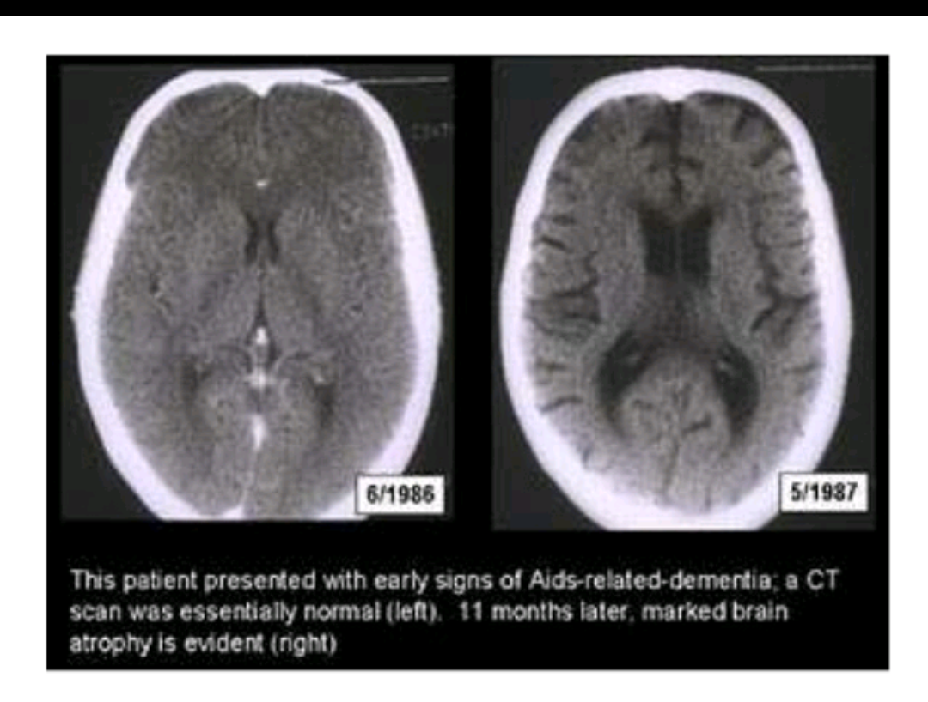
Investigation:;
MMSE
CT/MRI: diffuse cerebral atrophy
CSF:normal sugar
mild protein elevation
lymphocytic pleocytosis
No correlation between csf hiv burden
and disease severity.
Treatment: HAART
Psychological support and assisted living

Slide 28
CRYPTOCOCCAL MENINGITIS:
AIDS defining illness
With CD4 <100 cells
Onset-subacute
Signs of meningeal irritation present
Pulmonary involvement
Gastroenteritis
prostatitis

Slide 29
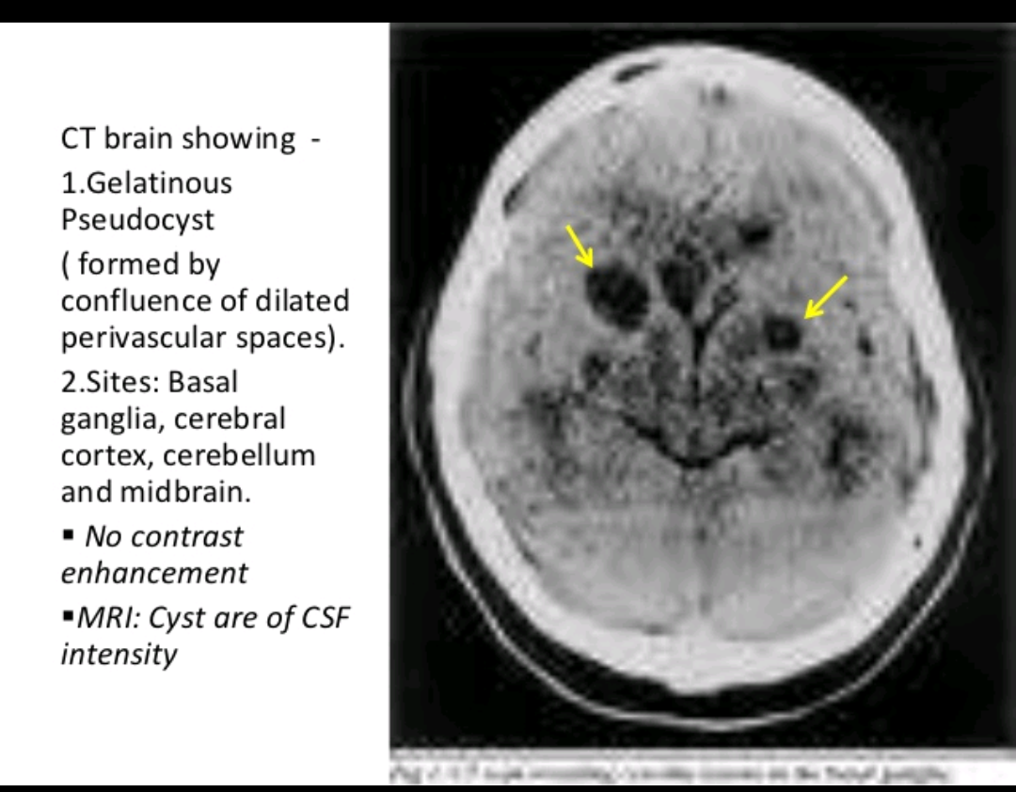
Investigation:
CT/MRI:
Hydrocephalus,gelatinous pseudocysts,cryptococcomas
CSF:reduced sugar
elevated protein,mononuclear pleocytosis
Gold standard:fungal csf culture for cryptococcus
Csf cryptococcal antigen 95 % sensitivity
India ink smear- non specific

Slide 31
TOXOPLASMOSIS:
CD4 <100
Most common cause of focal intracranial mass lesion in AIDS patients.
Ten times more coomon in people with antibodies to toxoplasma.
fever
headache focal deficit

Slide 32
Investigation:
CT/MRI: multiple lesion in multiple location
ring enhancement seen
Ig G antibody to toxoplasma
Brain biopsy-confirmatory

Slide 34
PROGRESSIVE MULTIFOCAL LEUKOENCEPHALOPATHY:
Caused by JC virus.
Lesions:small foci of demyelination that coalesce in subcortical white matter.
Areas:occipital and parietal lobe,cerebellum and brain stem.
Spinal cord rarely.
Presentation: seizures
visual field defects
aphasia
ataxia and occasionally sensory deficit.

Slide 35
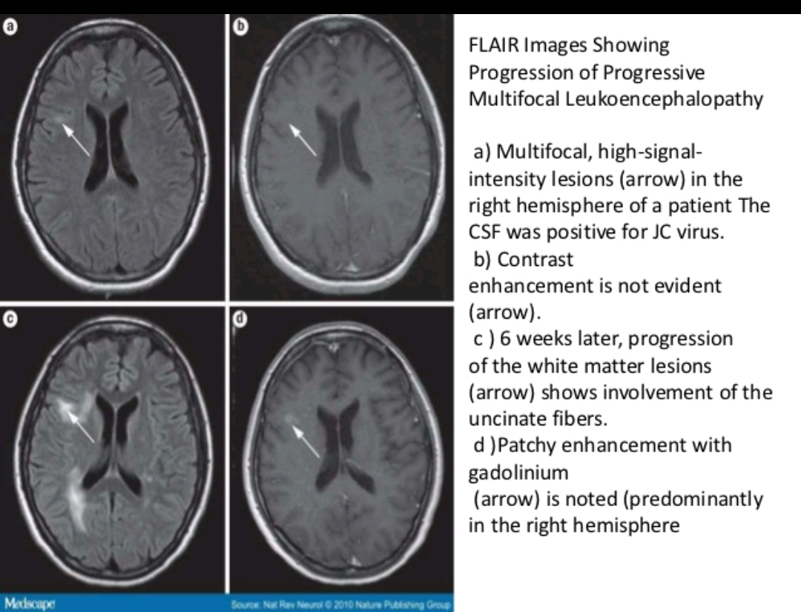
CT/MRI:
Multiple non enhancing white matter lesions,
may coalesce ,with predilection for parietal
and occipital lobe
Csf:JC Virus DNA by CSF PCR
Brain biopsy rarely
No specific terapy.

Slide 36
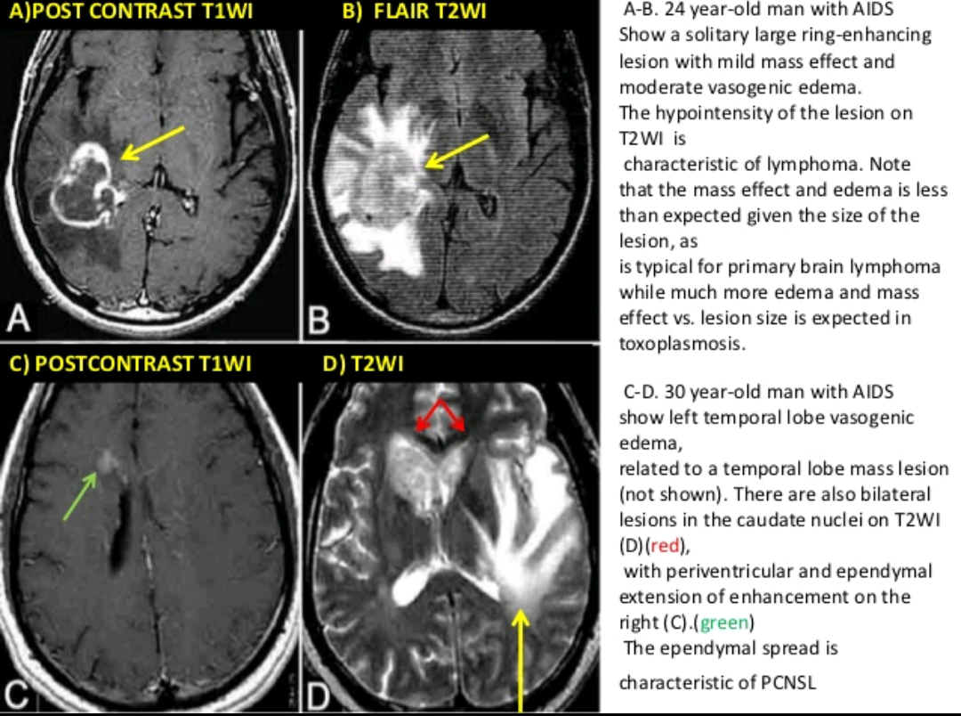
PRIMARY CNS LYMPHOMA:
B cell origin.
Fever,headache and focal neurological deficit.
Close dd: toxoplasmosis
MRI >CT:
Single or multiple lesion
Deep location adjacent to lateral ventricle.
Posterior fossa predilection
Subependymal extension
Mass effect and edema is less than expected.
CSF flow cytometry: unhelpful
Treatment: HAART,corticosteroid,radiotherapy.

Slide 37
Vacuolar myelopathy:;
m/c spinal cord dysfunction in AIDS.
Coexist with hiv encephalopathy and distal sensory polyneuropathy.
Subacute onset
Gait disturbance and imbalance
Spasticity,sphincter dysfunction
EXAMINATION:spastic paraparesis ,hyperreflexia
Loss of proprioception and vibration sense.
MRI; cord swelling with intramedullary enhancement
Csf: rule out HSV,VZV,CMV
treated with HAART.

Slide 40
CNS TUBERCULOSIS:
5-10 % extrapulmonary and 1 % all tb cases
Immunocompromised: atypical mycobacteria like MAC,mycobacteria intracellulare common
Tubercular meningitis
TUBERCULOMA
Tubercular abscess
Tubercular encephalopathy
vasculopathy

Slide 41
TB MENINGITIS:
Commonest,70-80 %
30 % mortality and >25 % neurological sequelae
Meningeal signs with cranial nerve involvement seen (6 th nerve commonly involved)
Complications:
Hydrocephalus (communicating and non communicating)
Ocular-papilloedema,optic atrophy,vision loss
Hypothalamic pituitary syndrome-hyponatremia,diabetes insipidus,persistent pyrexia.
Cranial nerve palsies
Abnormal movement
seizures

Slide 43
Csf analysis: high cell count upto 1000 cells/µl
lymphocytic pleocytosis
high protein(>100)
low sugar
culture-gold standard
Treated with ATT and steroids.(8 weeks)
Start with 0.4 mg/kg/day then tapered weekly.

Slide 44
TUBERCULOMA:
Firm,avascular 2-8 cm,spherical granulomatous mass
<20 yrs –infratentorial >20 yrs-supratentorial
Solitary>multiple
Low grade fever,headache,vomiting,seizure/progressive focal deficit

Slide 45
TUBERCULAR BRAIN ABSCESS:
Encapsulated collection of pus with viable bacilli without granuloma.
More in elderly and immunocompromised
Solitary,uni/multiloculated
Partial seizures and focal deficit

Slide 46
TUBERCULAR ENCEPHALOPATHY:
Seen in infants and children
Convulsion,stupor and coma,neurological deficit
Csf –normal study
MRI: demyelinatin and diffuse brain edema
Good response to corticosteroids

Slide 47
SPINAL TB:
Paradiscal type common
Lower thoracic and upper lumbar commonly involved
Backpain,stiffness
Deformities-gibbus,kyphosis
Cold abscess,paraplegia
Tubercular arachnoiditis:;
Mixed picture of spinal cord/nerve involvement is present
Subacute paraparesis,radicular pain and bladder dysfunction
Diagnosed by myelography:poor flow with contrast and multiple filling defects seen

Slide 49
CEREBRAL MALARIA:
Dreaded manifestation of severe falciparum malarial infection
Coma is a characteristic and ominous feature –gradual or sudden following convulsion
Focal neurologic signs –unusual
Signs of meningeal irritation-absent
Fundus- retinal hemorrhages,papilloedema,discrete retinal opacification,cotton wool spots
Generalised tonic clonic convulsions +
Incidence of epilepsy increased in people recovering form the illness
treated with inj artesunate 2.4 mg/kg iv stat followed by the same dose @ 12 and 24 hrs.

Slide 50
NEUROSYPHILIS:
due to early invasion or after months to years of asymptomatic involvement
Aymptomatic neurosyphilis:
Csf abnormalities: mononuclear pleocytosis,increased protein and csf VDRL reactivity.
Even in early syphilis with such findings-treat as neurosphilis
More common in HIV infected individuals
RpR titre >-1:32 associated with neurosyphilis regardless of clinical stage or hiv infection status.

Slide 51
Symptomatic neurosyphilis:
Meningeal,meningovascular and parenchymatous syphilis (general paresis and tabes dorsalis)
Latency-1 year for meningeal
10 yrs-meningovascular
20 yrs-general paresis,25-30 yrs- tabes dorsalis
Meningeal syphilis- meningeal signs,cranial nerve involvement,seizures and altered mental status
Meningovascular:stroke syndrome involving the middle cerebral artery of young adult
Follows a subencephalitic prodrome (headache,insomnia and psychological abnormalities)

Slide 52
General paresis:abnormalities of
P-personality
A-affect
R-reflexes(hyperactive)
E-eye(argyl Robertson pupil)
S-sensorium
I-intellect
S-speech
Tabes dorsalis:
Demyelination of posterior column,dorsal root.dorsal root ganglia- ataxia,foot drop,bladder disturbance,impotence,loss of positional sense.
Treated with-aqueous crystalline penicillin G(18-24 mu/day given as 3-4 mu q4hrlyor continuous infusion)

Slide 53
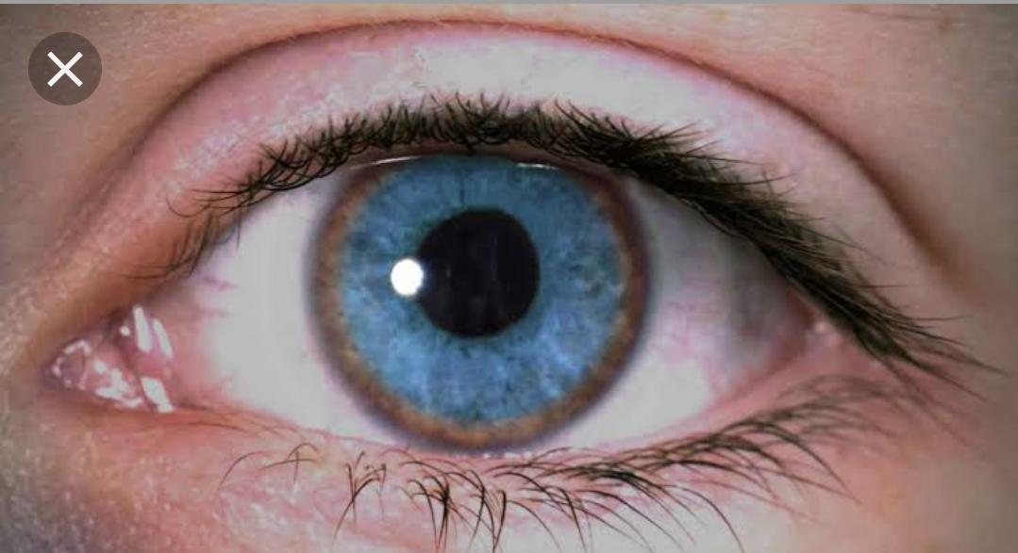
WILSON’S DISEASE:
Usually occur in early 20’s.
Dystonia,dysarthria
Incoordination,dysphagia
Tremor-wing beating tremor
Autonomic disturbance:orthostatic hypotension,sweating abnormalities,bowel,bladder and sexual dysfunction
Sensory dysfunction and muscular weakness-not a feature
Preceded by behavioural disturbanceand loss of emotional control
Treated with tetrathiomolybdate and zinc
Improvement after 6-24 months of treatment

Slide 54
ACUTE INTERMITTENT PORPHYRIA:
Peripheral neuroparhy due to axonal degeneration and affect mainly motor neurons
Affect the proximal muscle on shoulder and arm
As neuropathy advance deep tendon reflex become absent
Progress to respiratory failure and death if delay in diagnosis.
Seizures-neurological effect per se/hyponatremia
Safe drug:clonazepam

Slide 55
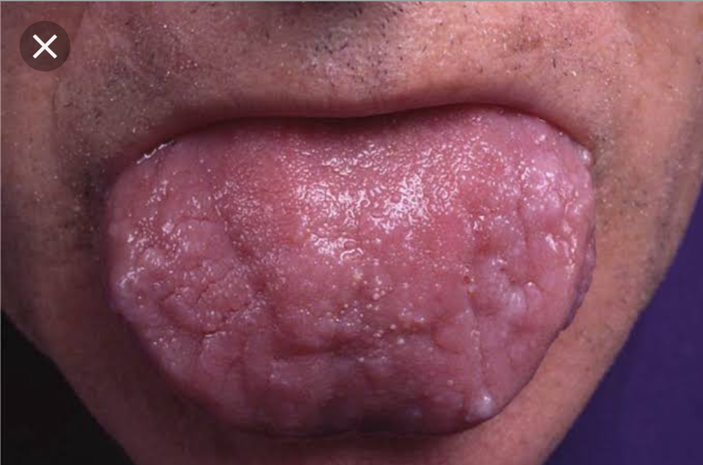
Acquired neuropathies:
AL AMYLOIDOSIS:
Deposition of light chain (lambda more common than kappa)
Seen in multiple myeloma,waldenstrom macroglobulinemia,lymphoma and other lymphoproliferative disorders.
30 % polyneuropathy-painful dysesthesia and burning sensation in foot
Slowly progressive and eventually weakness
develops along with large fiber sensory loss.
nerve biopsies-axonal degeneration and amyloid
deposition in globular or diffuse pattern
Chemotherapy rarely improves neuropathy.

Slide 56
DIABETIC NEUROPATHY:
Distal symmetric sensory and sensorimotor polyneuropathy(DSPN)
Manifest as sensory loss in beginning in toes that progress to involve the legs,fingers and arms
May develop sensory loss in the trunk associated with tingling and burning sensation.
Nerve biopsy-axonal degeneration,endothelial hyperplasia and perivascular inflammation

Slide 57
Diabetic autonomic neuropathy:
Seen in combination with DSPN
Abnormal sweating,dysfunctional thrrmoregulation,dry eyes and dry mouth,pupillary abnormalities
Cardiac arrhythmias,postural hypotension,gi abnormalities(gastroparesis,chronic diarrhea,constipation.
Genitourinary dysfunction( impotence,retrograde ejaculation,incontinence)

Slide 58
Diabetic radiculoplexus neuropathy (diabetic amyotrophy or bruns garland syndrome)
Present with severe pain in the lowback,hip and thigh in one leg
Rarely both legs ath the same time
Atrophy and weakness of proximal and distal muscles follow then
Accompanied or heralded by weight loss
Possibility of thoracic or cervical radiculopathy in some cases
Csf:elevated protein with normal cell count
Treated with glucorticoids.
Gradual improvement occurs naturally yet with residual weakness

Slide 59
Diabetic mononeuropathies/polyneuropathies:
Most common:median neuropathy at wrist,ulnar neuropathy at elbow
Cranial nerve mononeuropathy:
Third nerve palsy followed by sixth nerve palsy.
Third nerve palsy is pupillary sparing.
First line drugs:
Tricyclic antidepressants:amitriptyline
or nortriptyline 10-100 mg qhs
Gabapentin 300-1200 mg tds
Pregabalin 50-100 mg tds
Sceond line:
Carbamazepine 200-400 mg tds
Phenytoin 200-400mg qhs

Slide 60
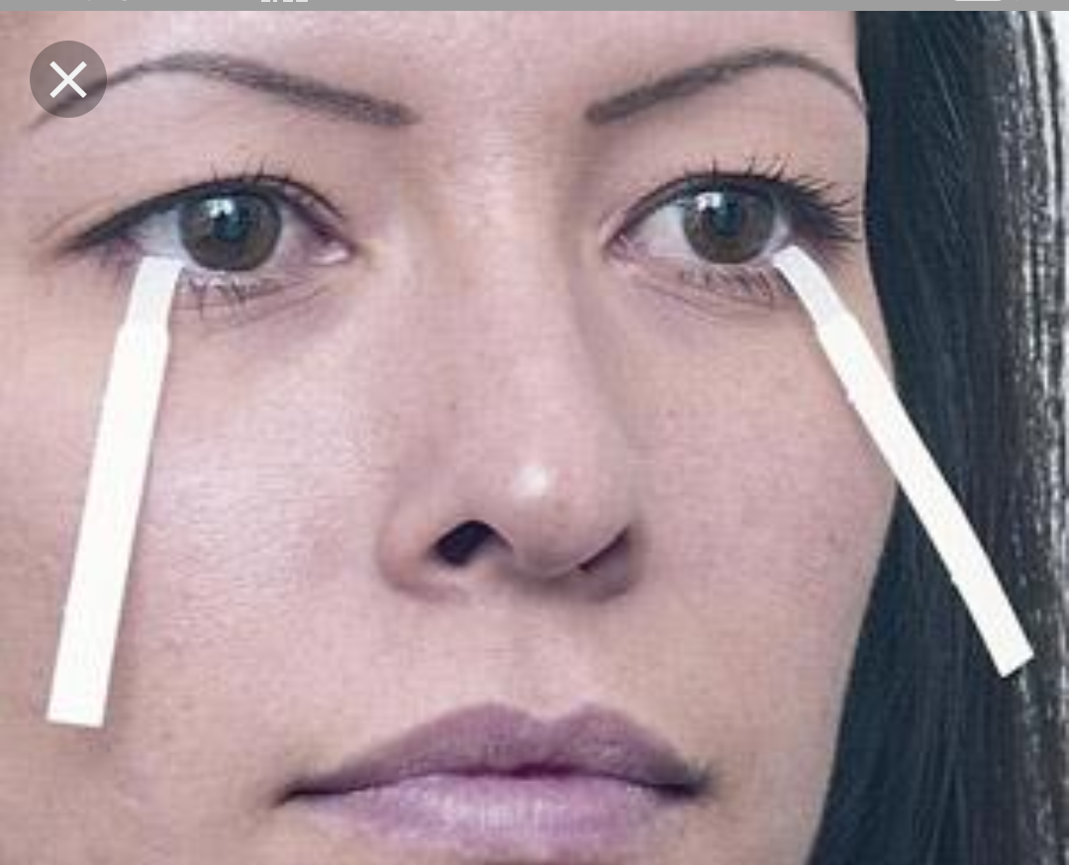
Sjogren’s syndrome:
Sicca complex of xerophthalmia,xerostomia and dryness of other mucous membrane complicated by neuropathy
Most common is sensorimotor neuropathy characterized by sensory loss in distal extremities.
Pure cranial neuropathy particularly trigeminal nerve can be involved
Examination:severe vibratory and proprioceptive loss leading to sensory ataxia
Patients may have ANA,SS-A/RO AND SS-A LA.
No specific treatment for neuropathy.

Slide 61
RHEUMATOID ARTHRITIS:
Peripheral neuropathy occurs in 50%-vasculitic in nature
Mononeuropathy multiplex/generalized symmetric pattern of involvement
Neuropathy responds to immunomodulating therapies.
CELIAC DISEASE OR GLUTEN INDUCED ENTEROPATHY/NON TROPICAL SPRUE:
Ataxia and neuropathy occur in 10 %.
In form of generalized sensorimotor polyneuropathy,pure motor neuropathy,multiple mononeuropathy,autonomic neuropathy,neuromyotonia.
May be secondary to vit B 12/ vit E deficiency
Does not respond to a gluten free diet.

Slide 62
INFLAMMATORY BOWEL DISEASE:
Complicated by GBS,CIDP, generalized axonal sensory or sensorimotor polyneuropathy,small fiber neuropathy/mononeuropathy.
Autoimmune/vitamin deficiency/treatment related
UREMIC NEUROPTHY:
60 % sensorimotor polyneuropathy occurs –stabilized by hemodialysis or transplantation.
Rarely rapidly progressive motor and sensory disturbance similar to GBS can occur.
Mononeuropathies-carpal tunnel syndrome common
Ischemic monomelic neuropathy-complicating the av fistula

Slide 63
CRITICAL ILLNESS POLYNEUROPATHY:
Complicates the sepsis and multiorgan dysfunction
Present as inability to wean the patient from ventilator
Muscle stretch reflex –absent
Creatine kinase-normal
NCS –reduced amplitude
CMV: acute lumbosacral polyradiculopathy and multiple mononeuropathy in immunocompromised individuals
Hepatitis viruses:
Hep B and hep C –multiple mononeuropathy due to vasculitis,AIDP/CIDP.

