Slide 1
One Infection,many faces- A Diagnostic challenge
Unit Chief Prof Dr Syed Bahavudeen Hussaini M.D General Medicine., FICP
Assistant professor- Dr R Vinoth Kannan M.D General Medicine
Assistant professor- Dr V.P Priya M.D General Medicine
Dr Sathiyaseelan 1st Year Post graduate
General Medicine

Slide 2
Case History
A 45 year old male brought to GRH Madurai with complaints of Altered sensorium since one week and Abdominal pain since today morning
History of Presenting Illness:
Patient was apparently normal one week back after which patient developed
-H/o Altered sensorium since one week
-H/o Fever –Duration- 1 week
Low grade ,
Evening rise of temperature present
Not associated with chills and rigors
-H/o Abdominal pain since today morning
- H/o Nausea +
-No H/o Vomiting

Slide 3
No H/o Dyspnoea
- No H/o Dysuria
- No H/o Seizure, LOC, Giddiness
-No H/o Chest pain ,Dysnoea on exertion
- No H/o Limb weakness,
- No H/o Blood vomiting, Malena
Past history
Known case of T2dm recently Diagnosed
Not known case of Systemic Hypertension/ COPD / Bronchial asthma / CAD / CKD / Seizure disorder
Personal history
Chronic alcoholic – 25 years
Not a Smoker
Mixed diet/ Normal bowel and bladder habits
Occupation – Vada Master

Slide 4
Vitals
Bp – 110/80 mmhg
PR – 109 bpm
Rhythm – Regular
Character- Normal
Volume- Normal
No radio radial Delay
No Radiofemoral delay
Spo2 – 98 % in RA
CBG – High. more than 600 mg/dl
RR – 16 per minute
Temperature 101.4 F

Slide 5
On Examination
Patient Drowsy
Obeying oral commands
Pallor present
Icterus – Absent
Cyanosis- Absent
Clubbing- Grade 2
Lymph adenopathy – Absent
Pedal edema- Absent
Hydration- Fair
JVP – Not raised
Neck stiffness present
Kernig’s sign – Absent
Brudzinski’s sign - Absent

Slide 6
Oral cavity Examination
Dental caries present in 2nd and 3rd molar Right lower jaw
Systemic Examination
CVS – S1 S2 +, No murmur
RS – B/L Air entry +, No added sound
P/A – Soft , BS+ , No tenderness
CNS –Patient Drowsy
Obeying oral commands
Tone – Normal in all 4 limbs
Power – Moves all 4 limbs
DTR – present in all 4 limbs
Plantar – Bilateral Flexor
Pupils-Bilateral 3mm Reactive to light

Slide 7
Routine blood investigation taken
Patient started on
IV fluids ,
Inj Ceftriaxone 2gm iv bd
Inj Ranitidine 50 mg iv bd
Inj Ondansetron 2 cc IV bd
Insulin
CT Brain – Taken- Sulcal SAH noted in Right frontal lobe

Slide 8
Date | 24/4 | 28/4 | 5/5 | 10/5 | 16/5 | 1/06 | 17/06 | 29/06
HB | 9.4 | 8.3 | 8.0 | 7.8 | 8.3 | 8.5 | 8.8 | 9.4
Tc | 13000 | 11500 | 8400 | 8500 | 8300 | 8200 | 7500 | 7300
Pcv | 28 | 26 | 22 | 21 | 27 | 28 | 30.1 | 36
Rbc | 3.06 | 3.0 | 3.5 | 3.2 | 3.7 | 3.5 | 3.28 | 3.7
Platelet | 190000 | 238000 | 185000 | 197000 | 190000 | 220000 | 278000 | 215000
Rbs | High | 269 | 102 | 134 | 121 | 154 | 129 | 134
Urea | 20 | 24 | 22 | 26 | 19 | 18 | 15 | 27
Creatinine | 0.7 | 0.8 | 0.9 | 0.8 | 0.9 | 0.8 | 0.7 | 0.8

Slide 9
Date | 24/4 | 28/4 | 5/5 | 10/5 | 16/5 | 1/6 | 17/6 | 29/6
Fbs | - | 200 | 145 | 101 | 105 | 112 | - | 101
Ppbs | - | 250 | 157 | 120 | 134 | 145 | - | 128
Esr | 30 | - | - | - | - | - | - | 08
Crp | 120 | - | - | - | 70 | - | - | 41.9
Na+ | 120 | 131 | 139 | 143 | 141 | 140 | - | 141
K+ | 4.0 | 4.2 | 4.0 | 3.9 | 3.7 | 3.6 | - | 4.6

Slide 10
Date | 24/4 | 28/4 | 16/5 | 17/6 | 29/6
Bilirubin T | 0.7 | 0.4 | 0.4 | 0.8 | 0.4
Bilirubin Direct | 0.4 | 0.2 | 0.3 | 0.4 | 0.3
Bilirubin Indirect | 0.3 | 0.2 | 0.1 | 0.4 | 0.1
SGOT | 30 | 25 | 17 | 17 | 18
SGPT | 13 | 18 | 10 | 12 | 16
ALP | 155 | 171 | 143 | 156 | 116
PT |  | 11.5 | 20.8
INR |  | 0.90 | 1.65
APTT |  | 22.8 | 35.3

Slide 11
Neurologist opinion obtained
Alcohol use disorder/ Acute Meningoencephalitis
Advised
Inj Ceftriaxone 2mg iv bd
Inj Ampicillin 1gm IV qid
Inj Thiamine 300 mg in 100 ml NS IV od
Inj Dexamethasone 8mg iv bd
Neurosurgery opinion obtained
Nil emergency intervention needed at present

Slide 12
Urine acetone – Negative
Serum Lipid profile – Normal
Serum Amylase Lipase level – Normal
Urine Routine
Sugar – 4+
Albumin - Nil

Slide 13
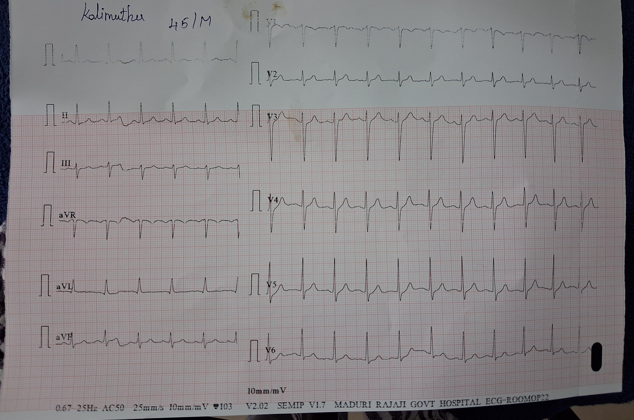

Slide 14
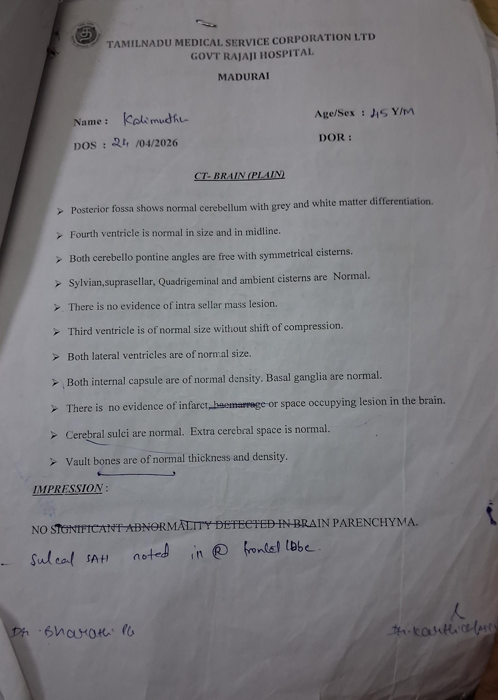
24.04.2026
CT Brain - Sulcal SAH noted in Right frontal lobe
MRI Brain - Normal

Slide 15
CT Abdomen plain taken
1) Left minimal pleural effusion with adjacent atelectasis of Left lower lobe Basal segment
2)Mild cardiomegaly
3) Areas of wedge shaped hypodensity noted more than 50 percentage of Surface area of spleen
General surgery opinion obtained
1) Continue the same line of management
2) CECT Abdomen and pelvis
3) Review with reports

Slide 16
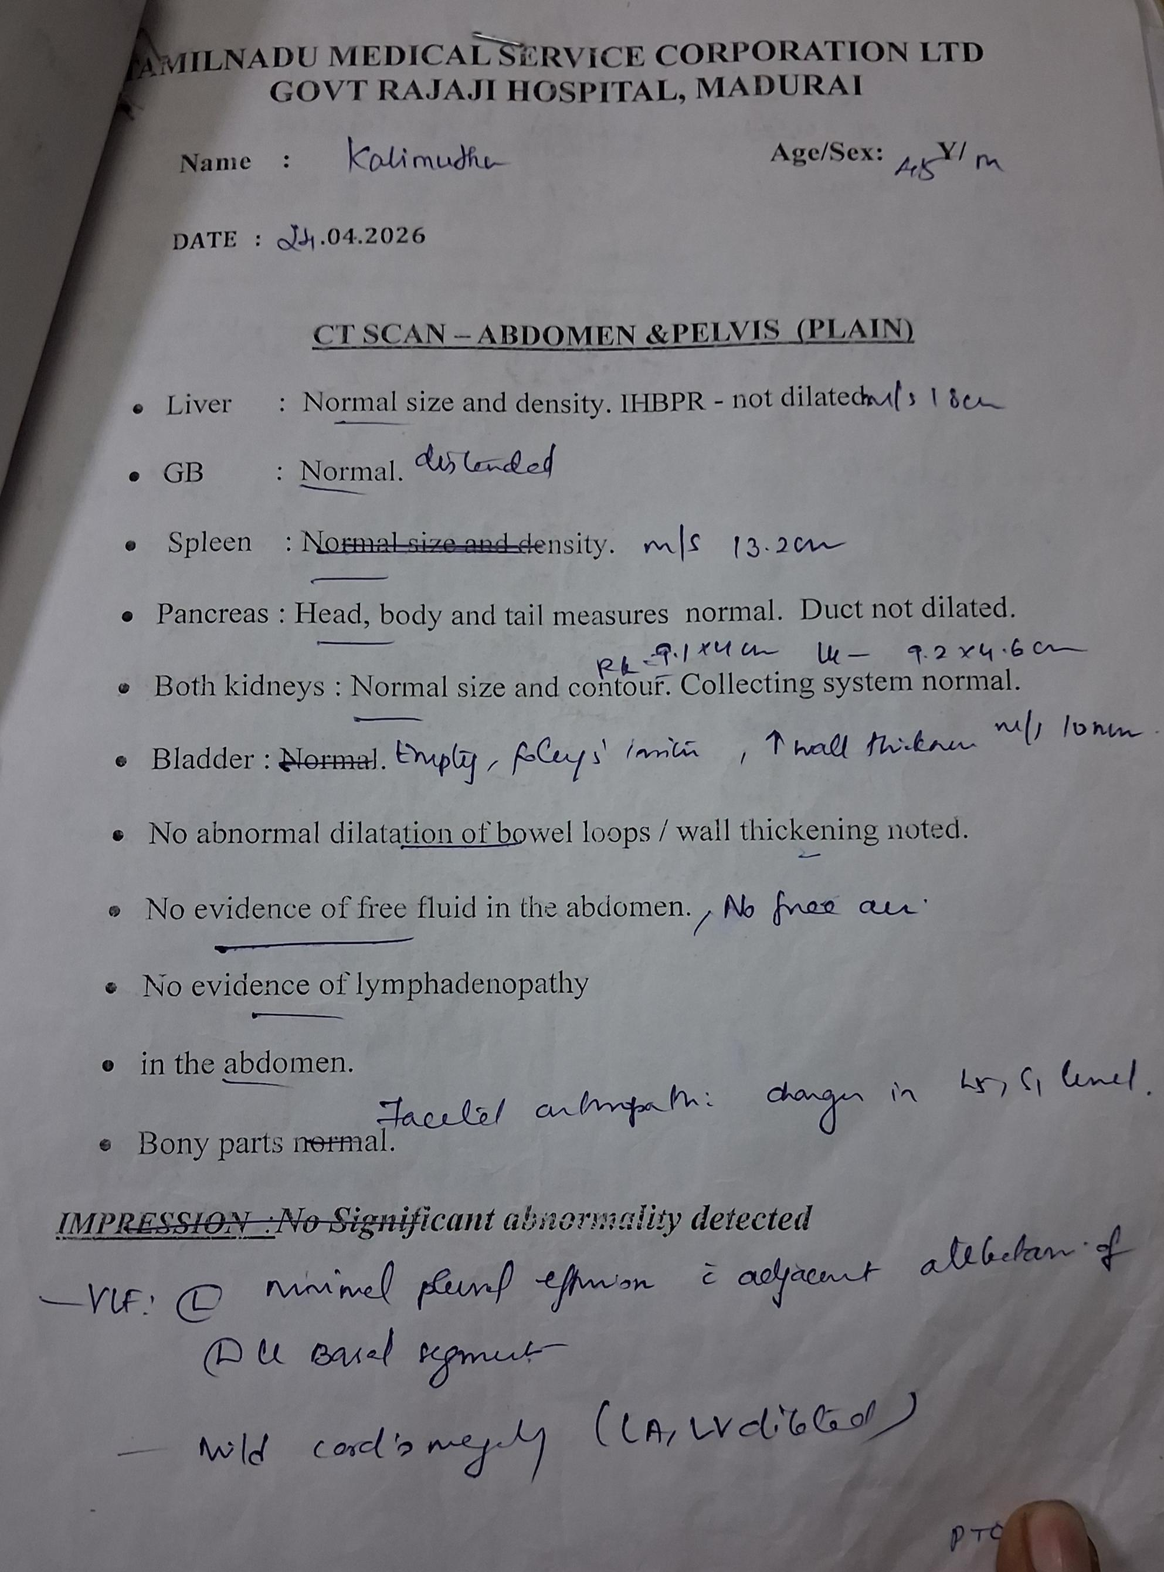
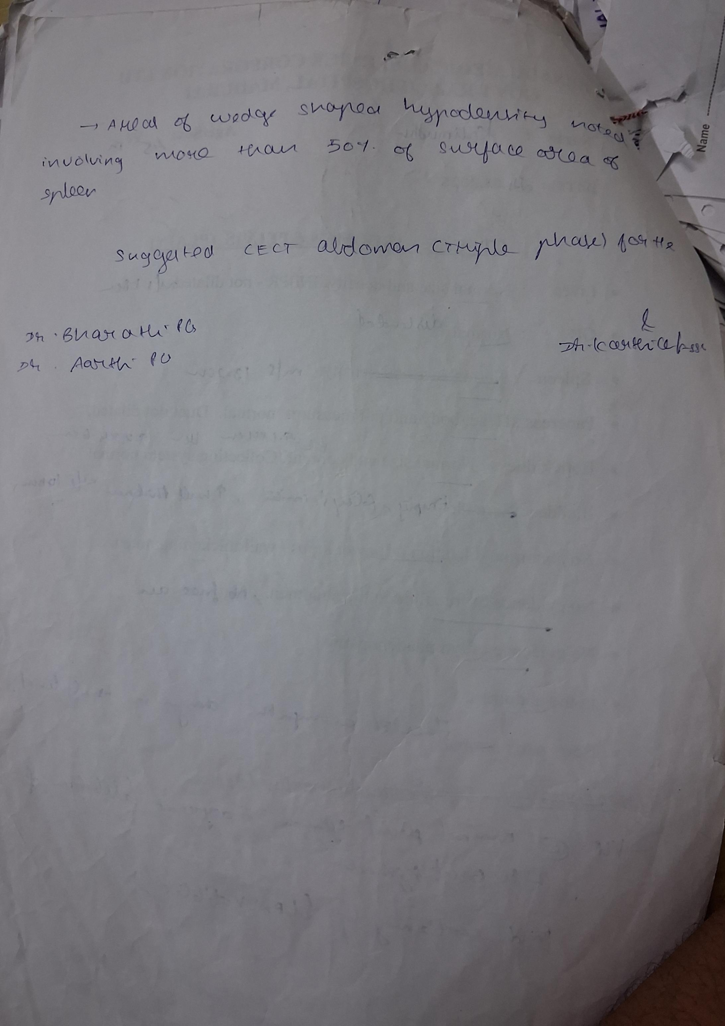
CT Abdomen and pelvis plain taken 24.04.26

Slide 17
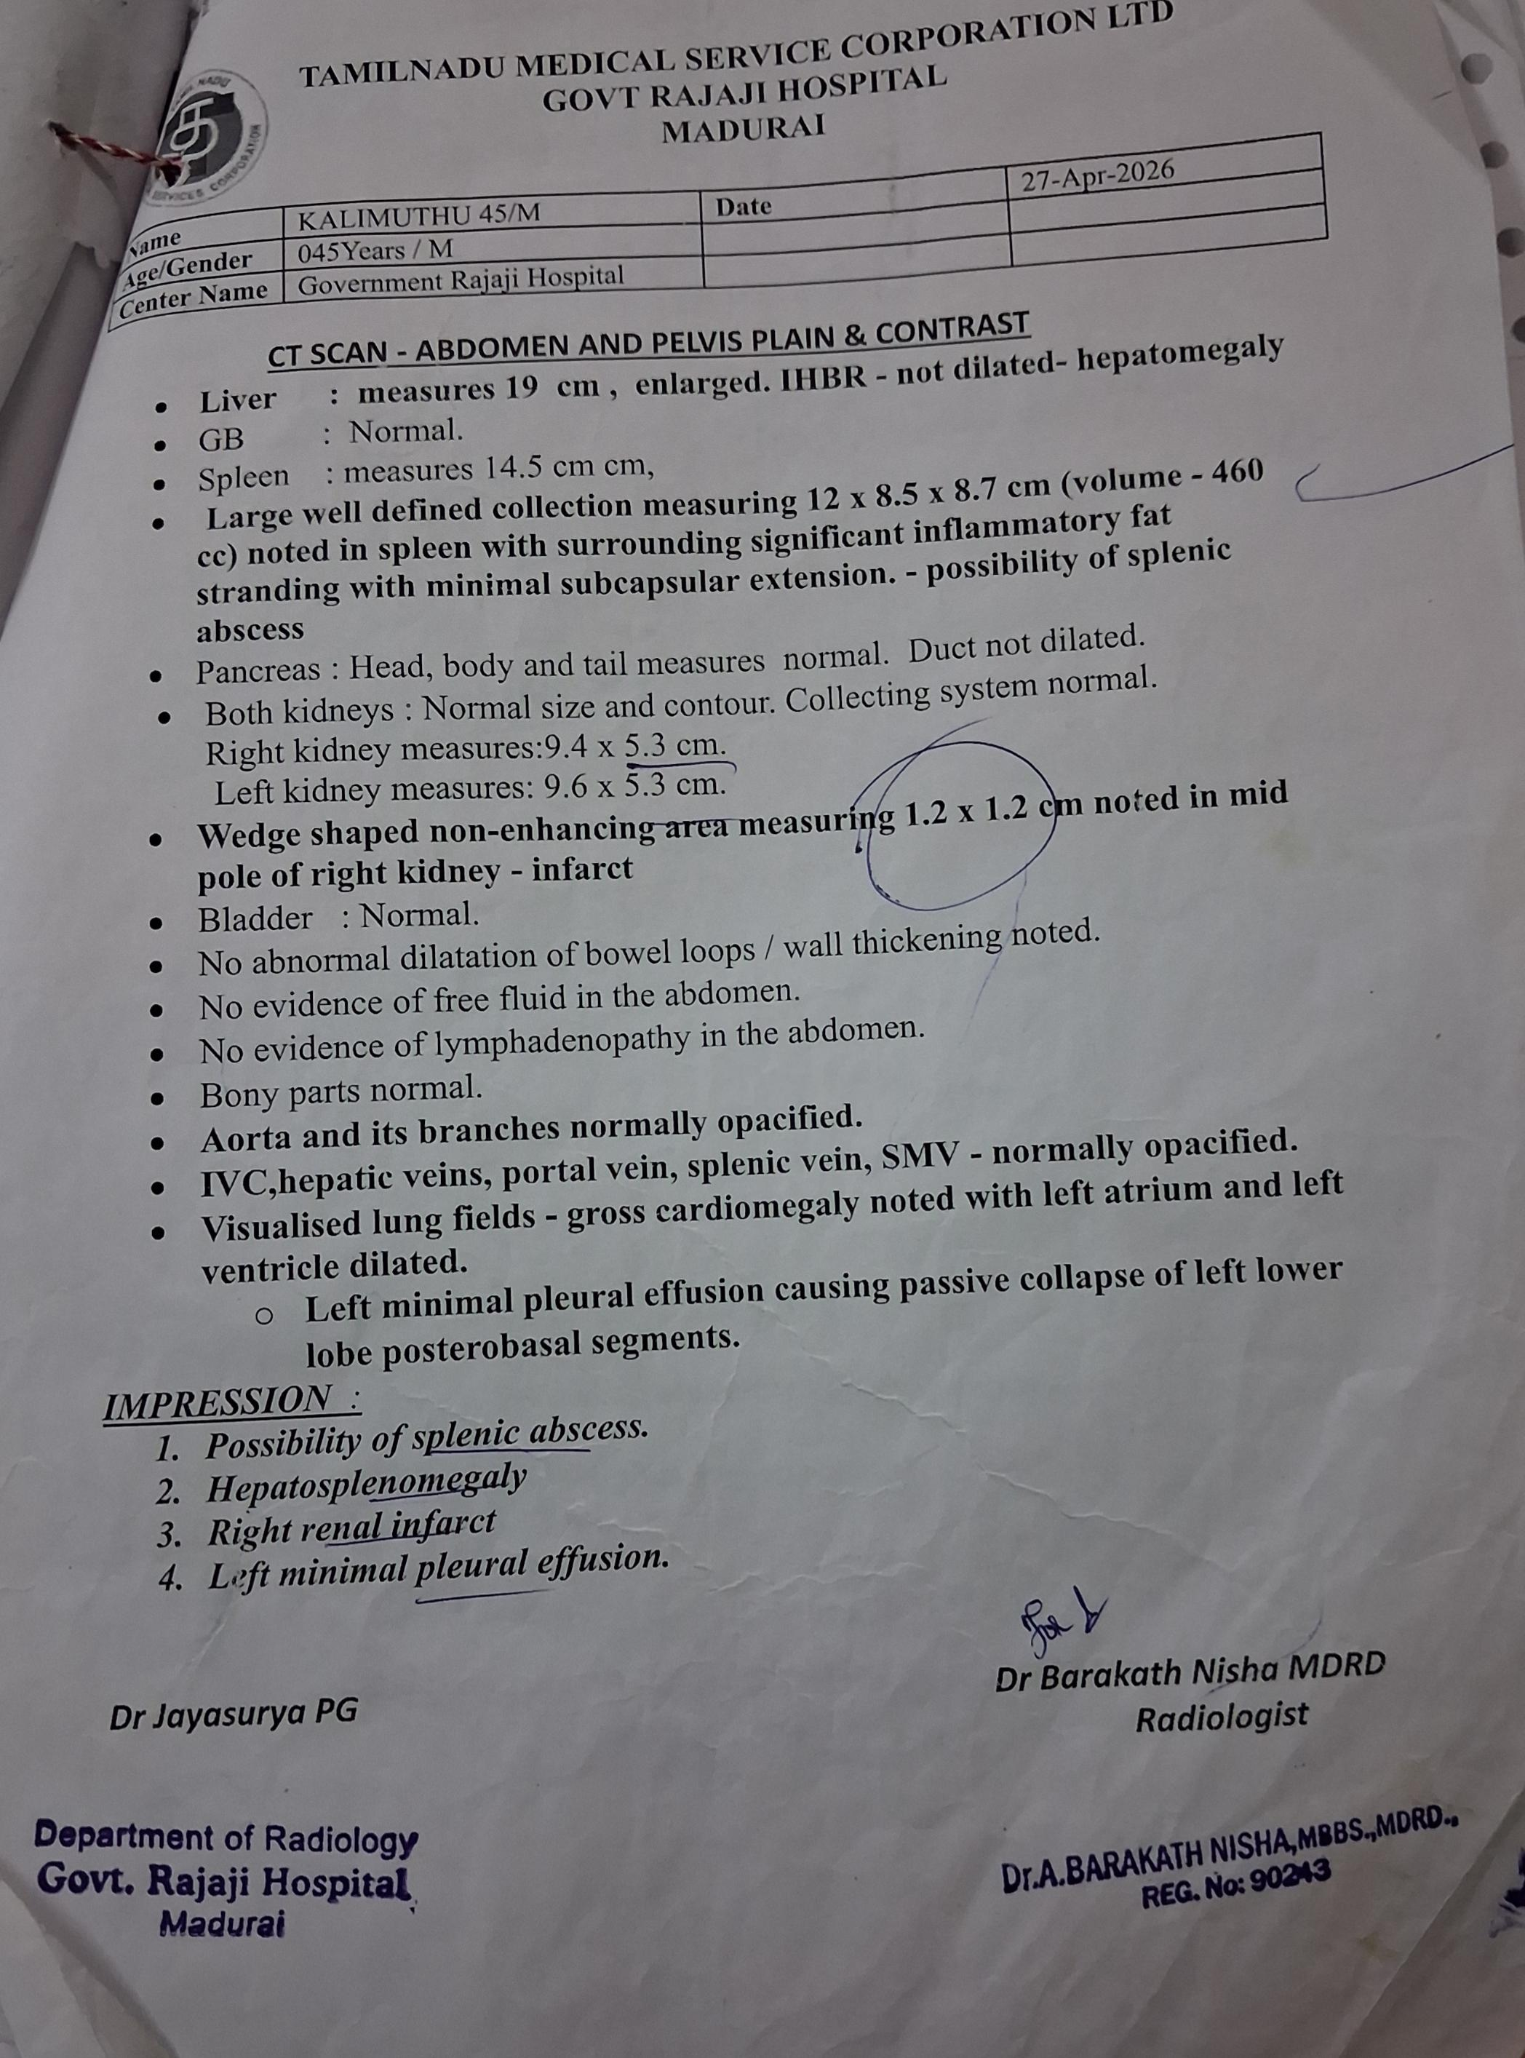
CECT ABDOMEN AND PELVIS ( CONTRAST ) taken 27.04.26
1) Possibility of Splenic abcess
2) Hepatosplenomegaly
3) Right renal infaract
4) Left minimal pleural effusion

Slide 18
General surgery review obtained regarding CECT Abdomen and pelvis – Renal infaract and Splenic abcess
Case shifted to Male surgical ward for further management
Radiologist did pigtail catheritisation to drain splenic abcess and pus send for culture and sensitivity
Around 50 ml of Pus along with blood collected
Again patient developed Breathlessness for which CT Chest done .

Slide 19
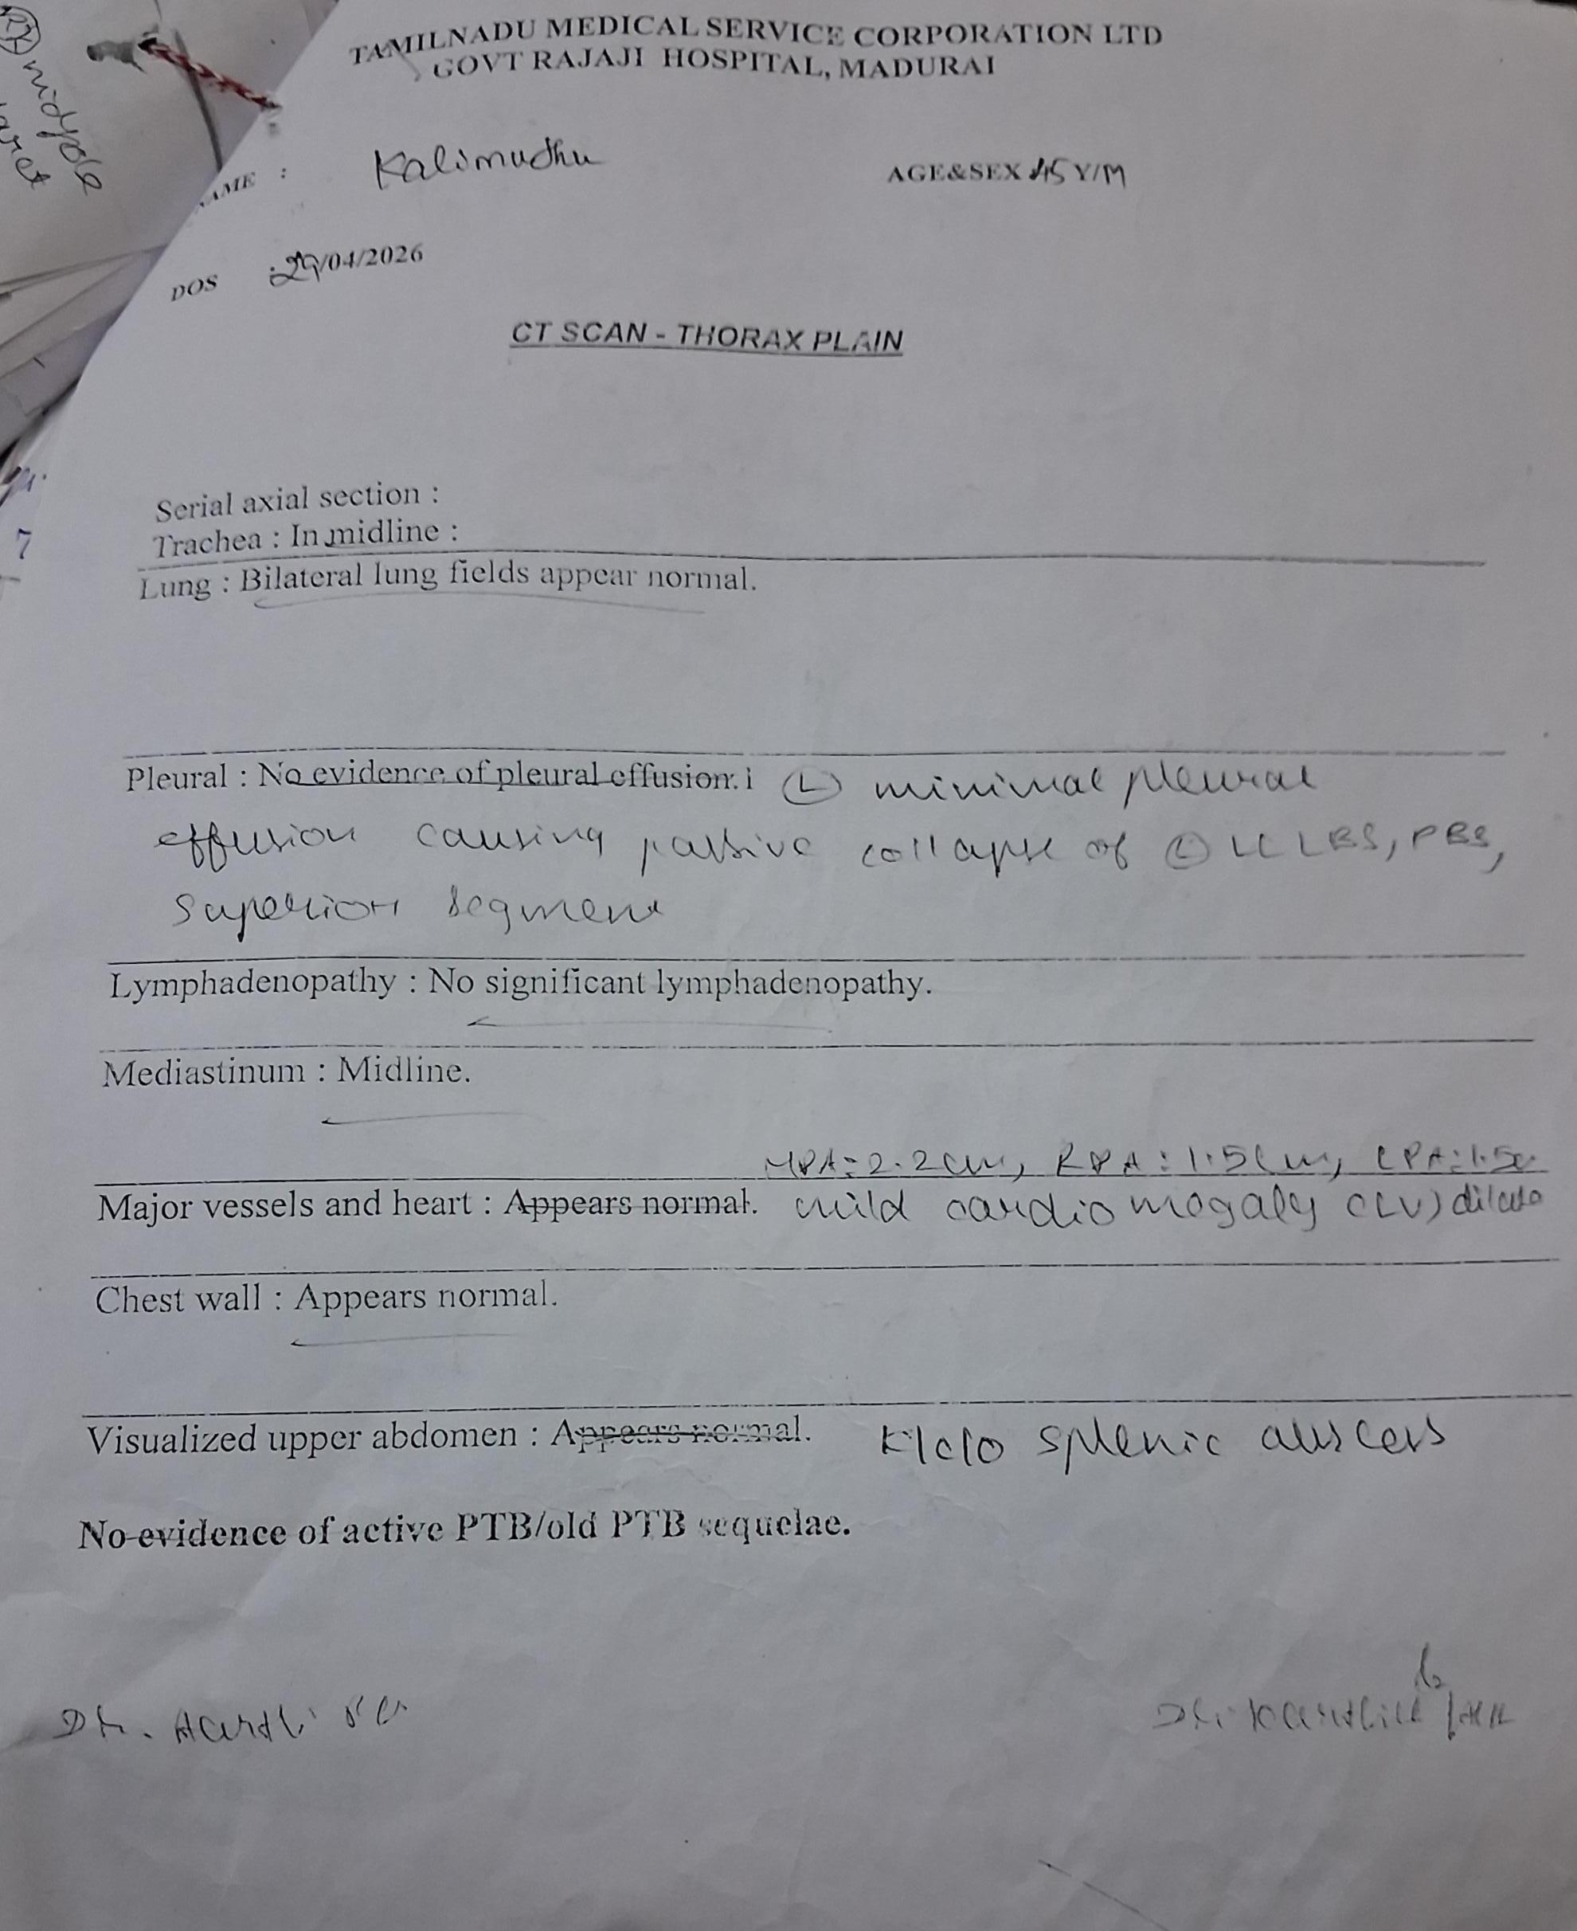
CT Chest done on 29.04.26
Left minimal pleural effusion causing passive collapse of left lower lobe, superior segment
K/c/o Splenic abcess
Splenic pus culture on 01.05.2026
No growth
Splenic pus CBNAAT on 5.5.26
MTB not detected

Slide 20
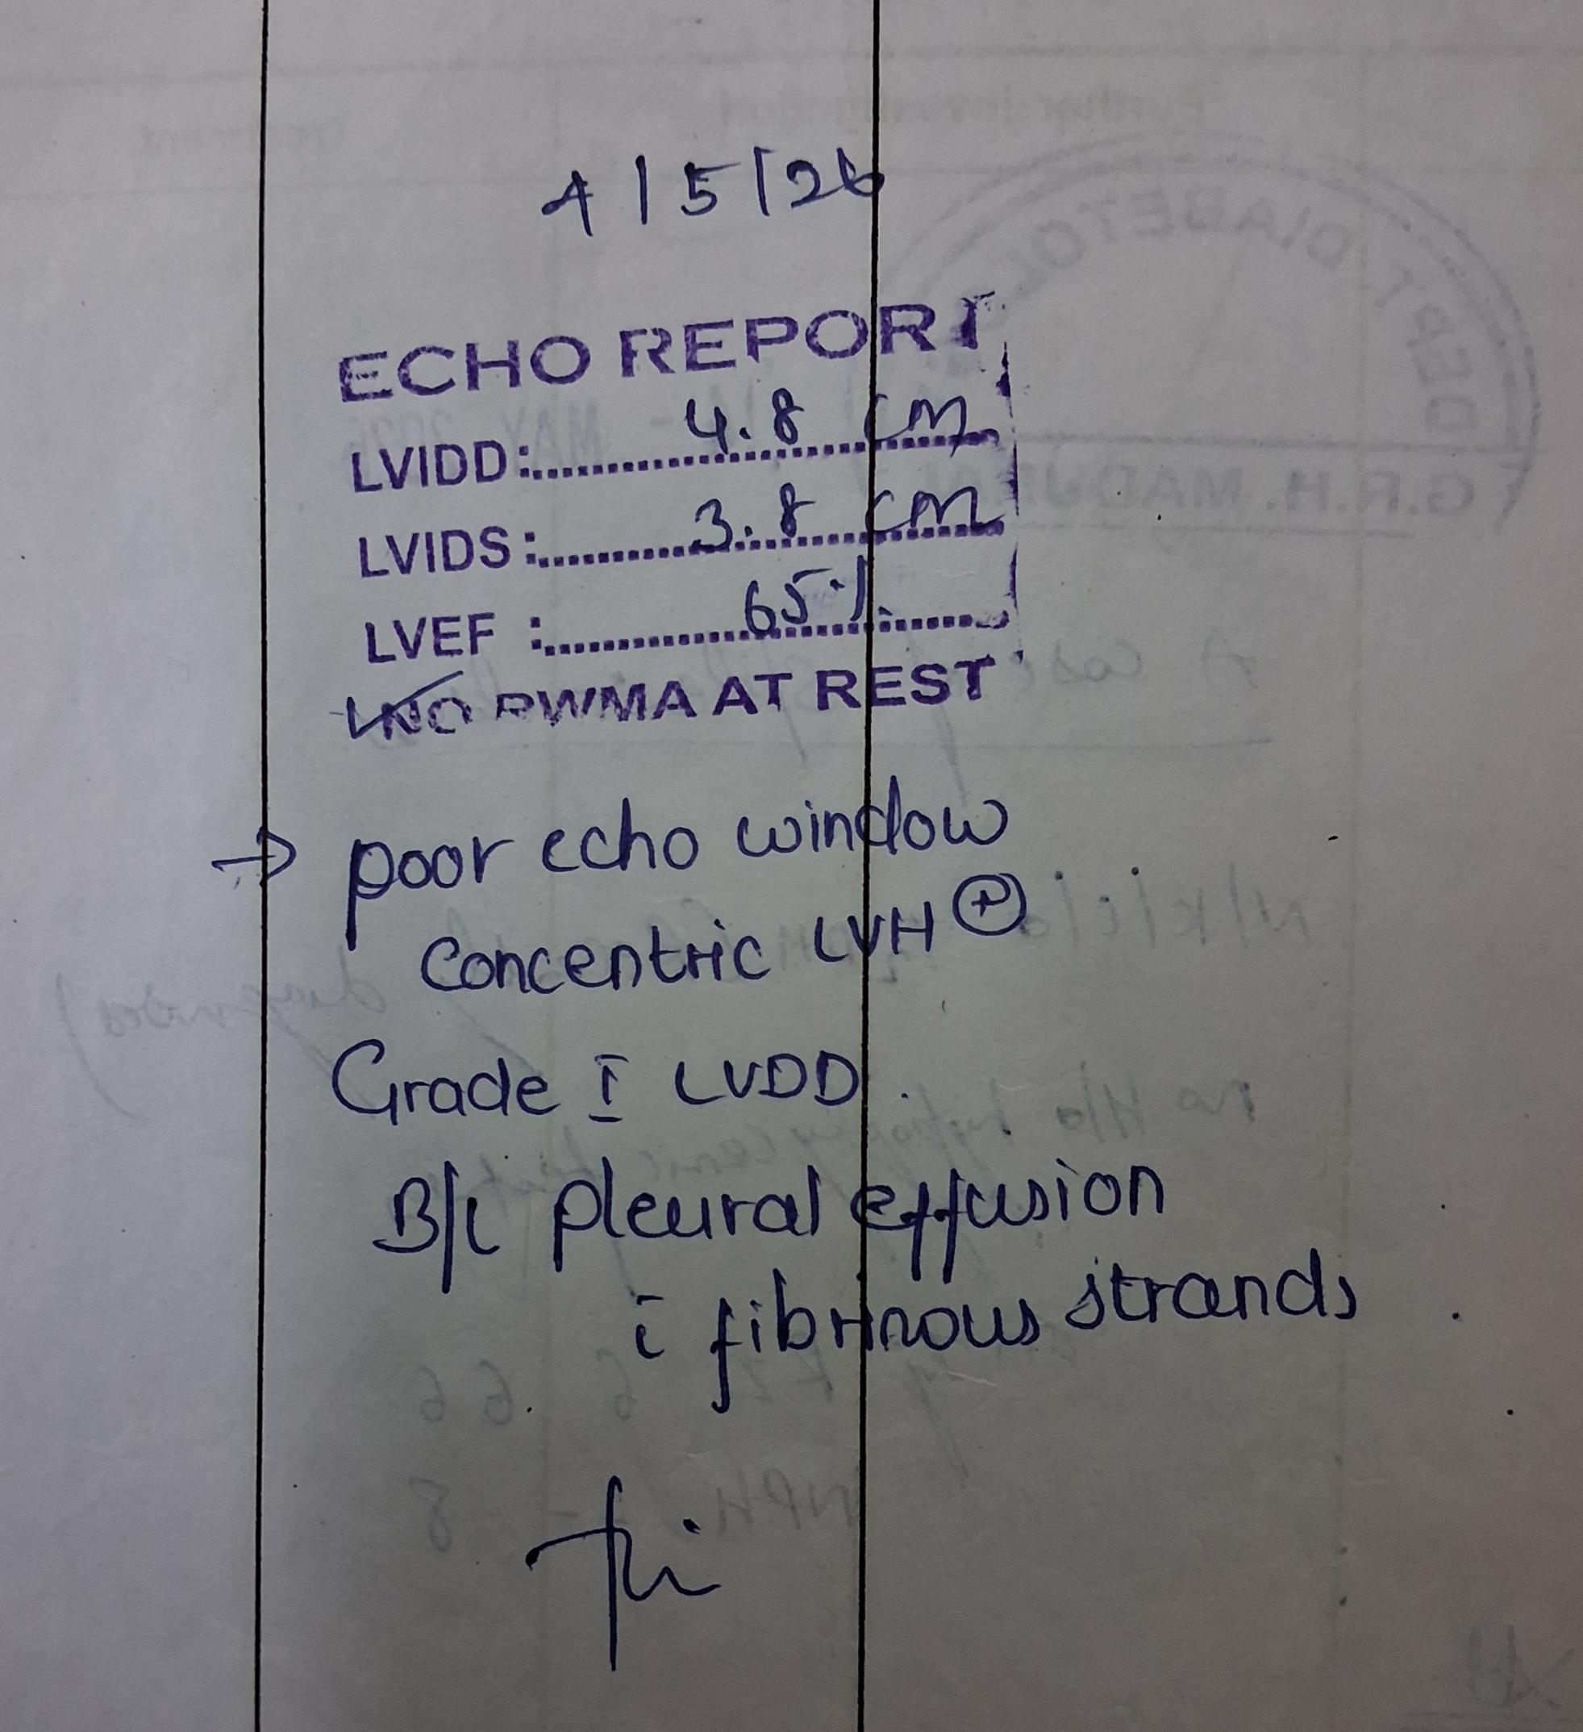
Echo taken on 4/5/26

Slide 21
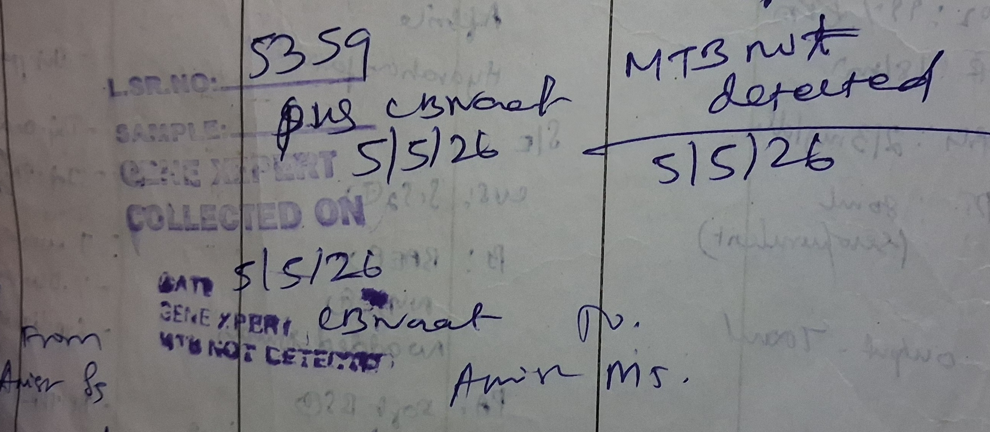

Slide 22
CT renal angiography
1 Congestive Hepatomegaly
2 Splenic abcess with Pigtail catheter insitu
3 Right renal infaract
4 Possibility of Median arcuate ligament syndrome
Surgical Gastroenterologist opinion obtained
1 Nil active surgical intervention at present

Slide 23
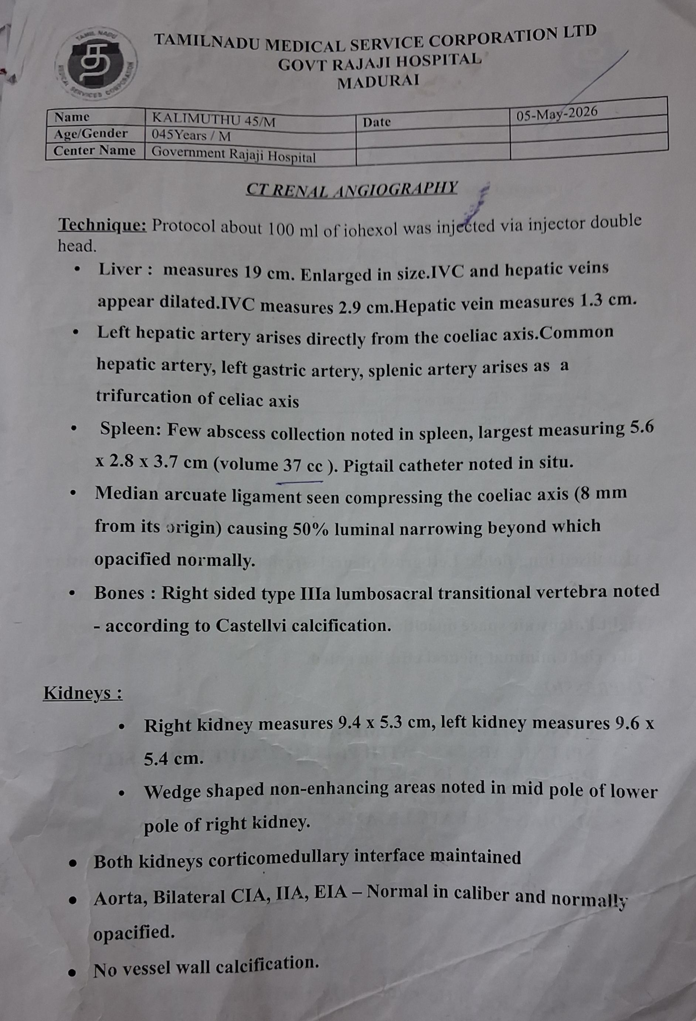
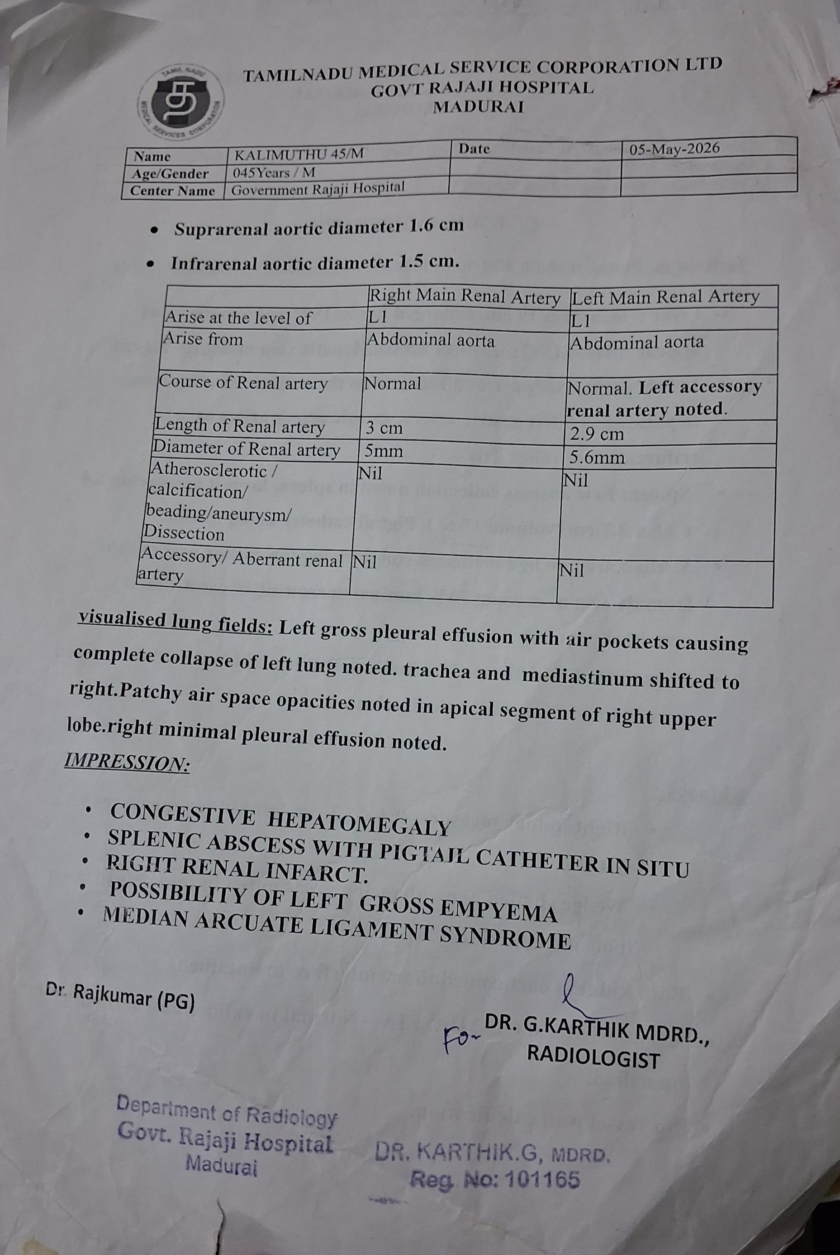
CT Renogram done on 05.05.26

Slide 24
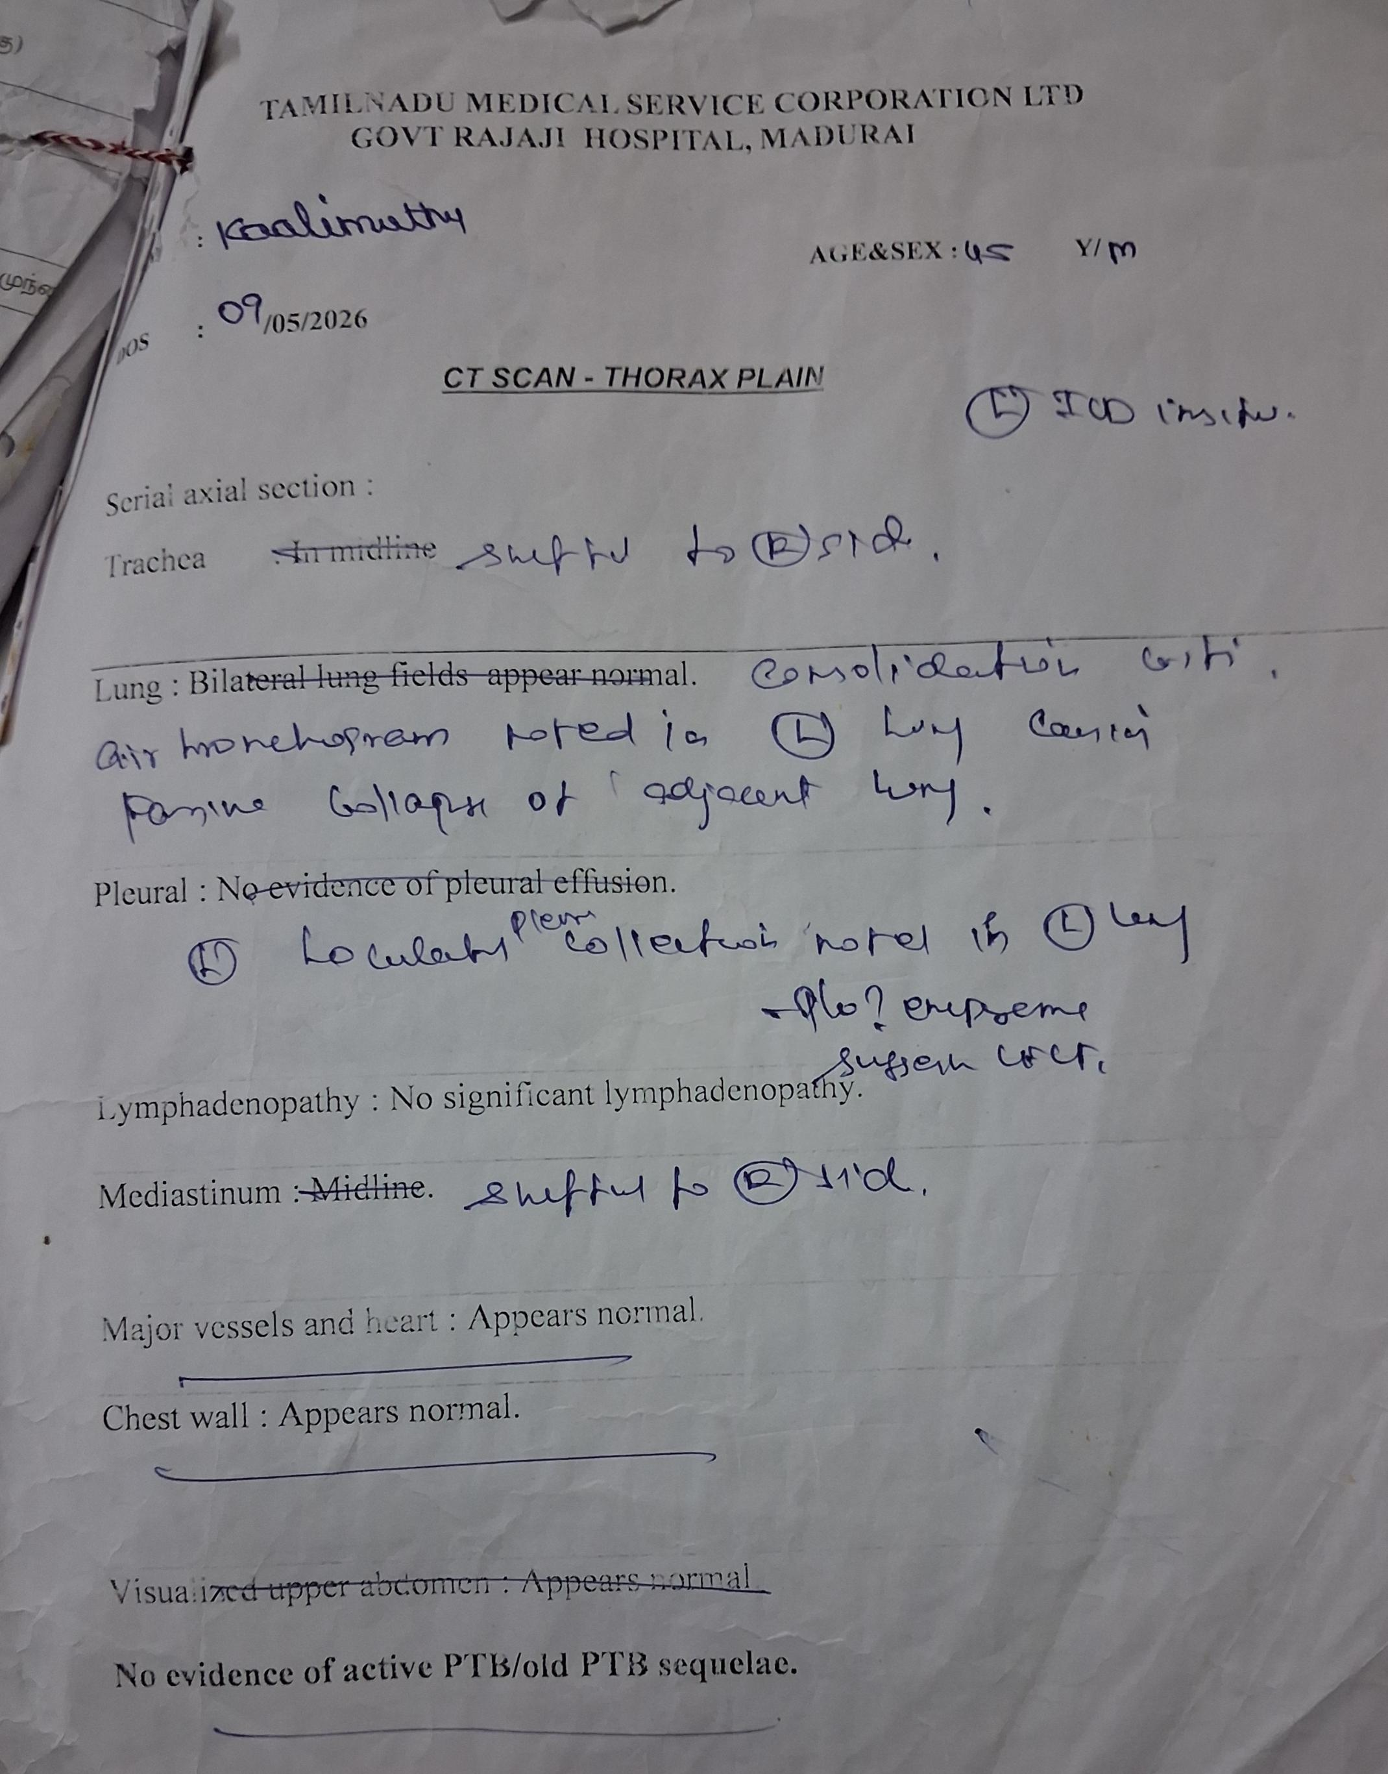
CT Chest taken on 9.5.26
CT Chest showed features of Emphyema
General surgeon asked for Medicine opinion,
Again patient taken to Medicine ward on 5/5/26
CVTS opinion obtained
Advised ICD
Intercostal drainage done on 7/5/26
Around 300 ml of frank pus is drained
Pleural fluid – Culture and sensitivity- No growth

Slide 25
12/5/26
CTS opinion obtained for ICD repositioning
ICD repositioned
ANA By ELISA – Negative
14/5/2026
Blood culture- No growth
19/5/26
ICD Drain less than 50 ml
CTS opinion obtained for ICD removal
And ICD Removed
20/5/26
USG Abdomen and pelvis – Multiple hypoechoeic areas mid and inferior pole of spleen with minimal fluid component – Splenic abcess

Slide 26
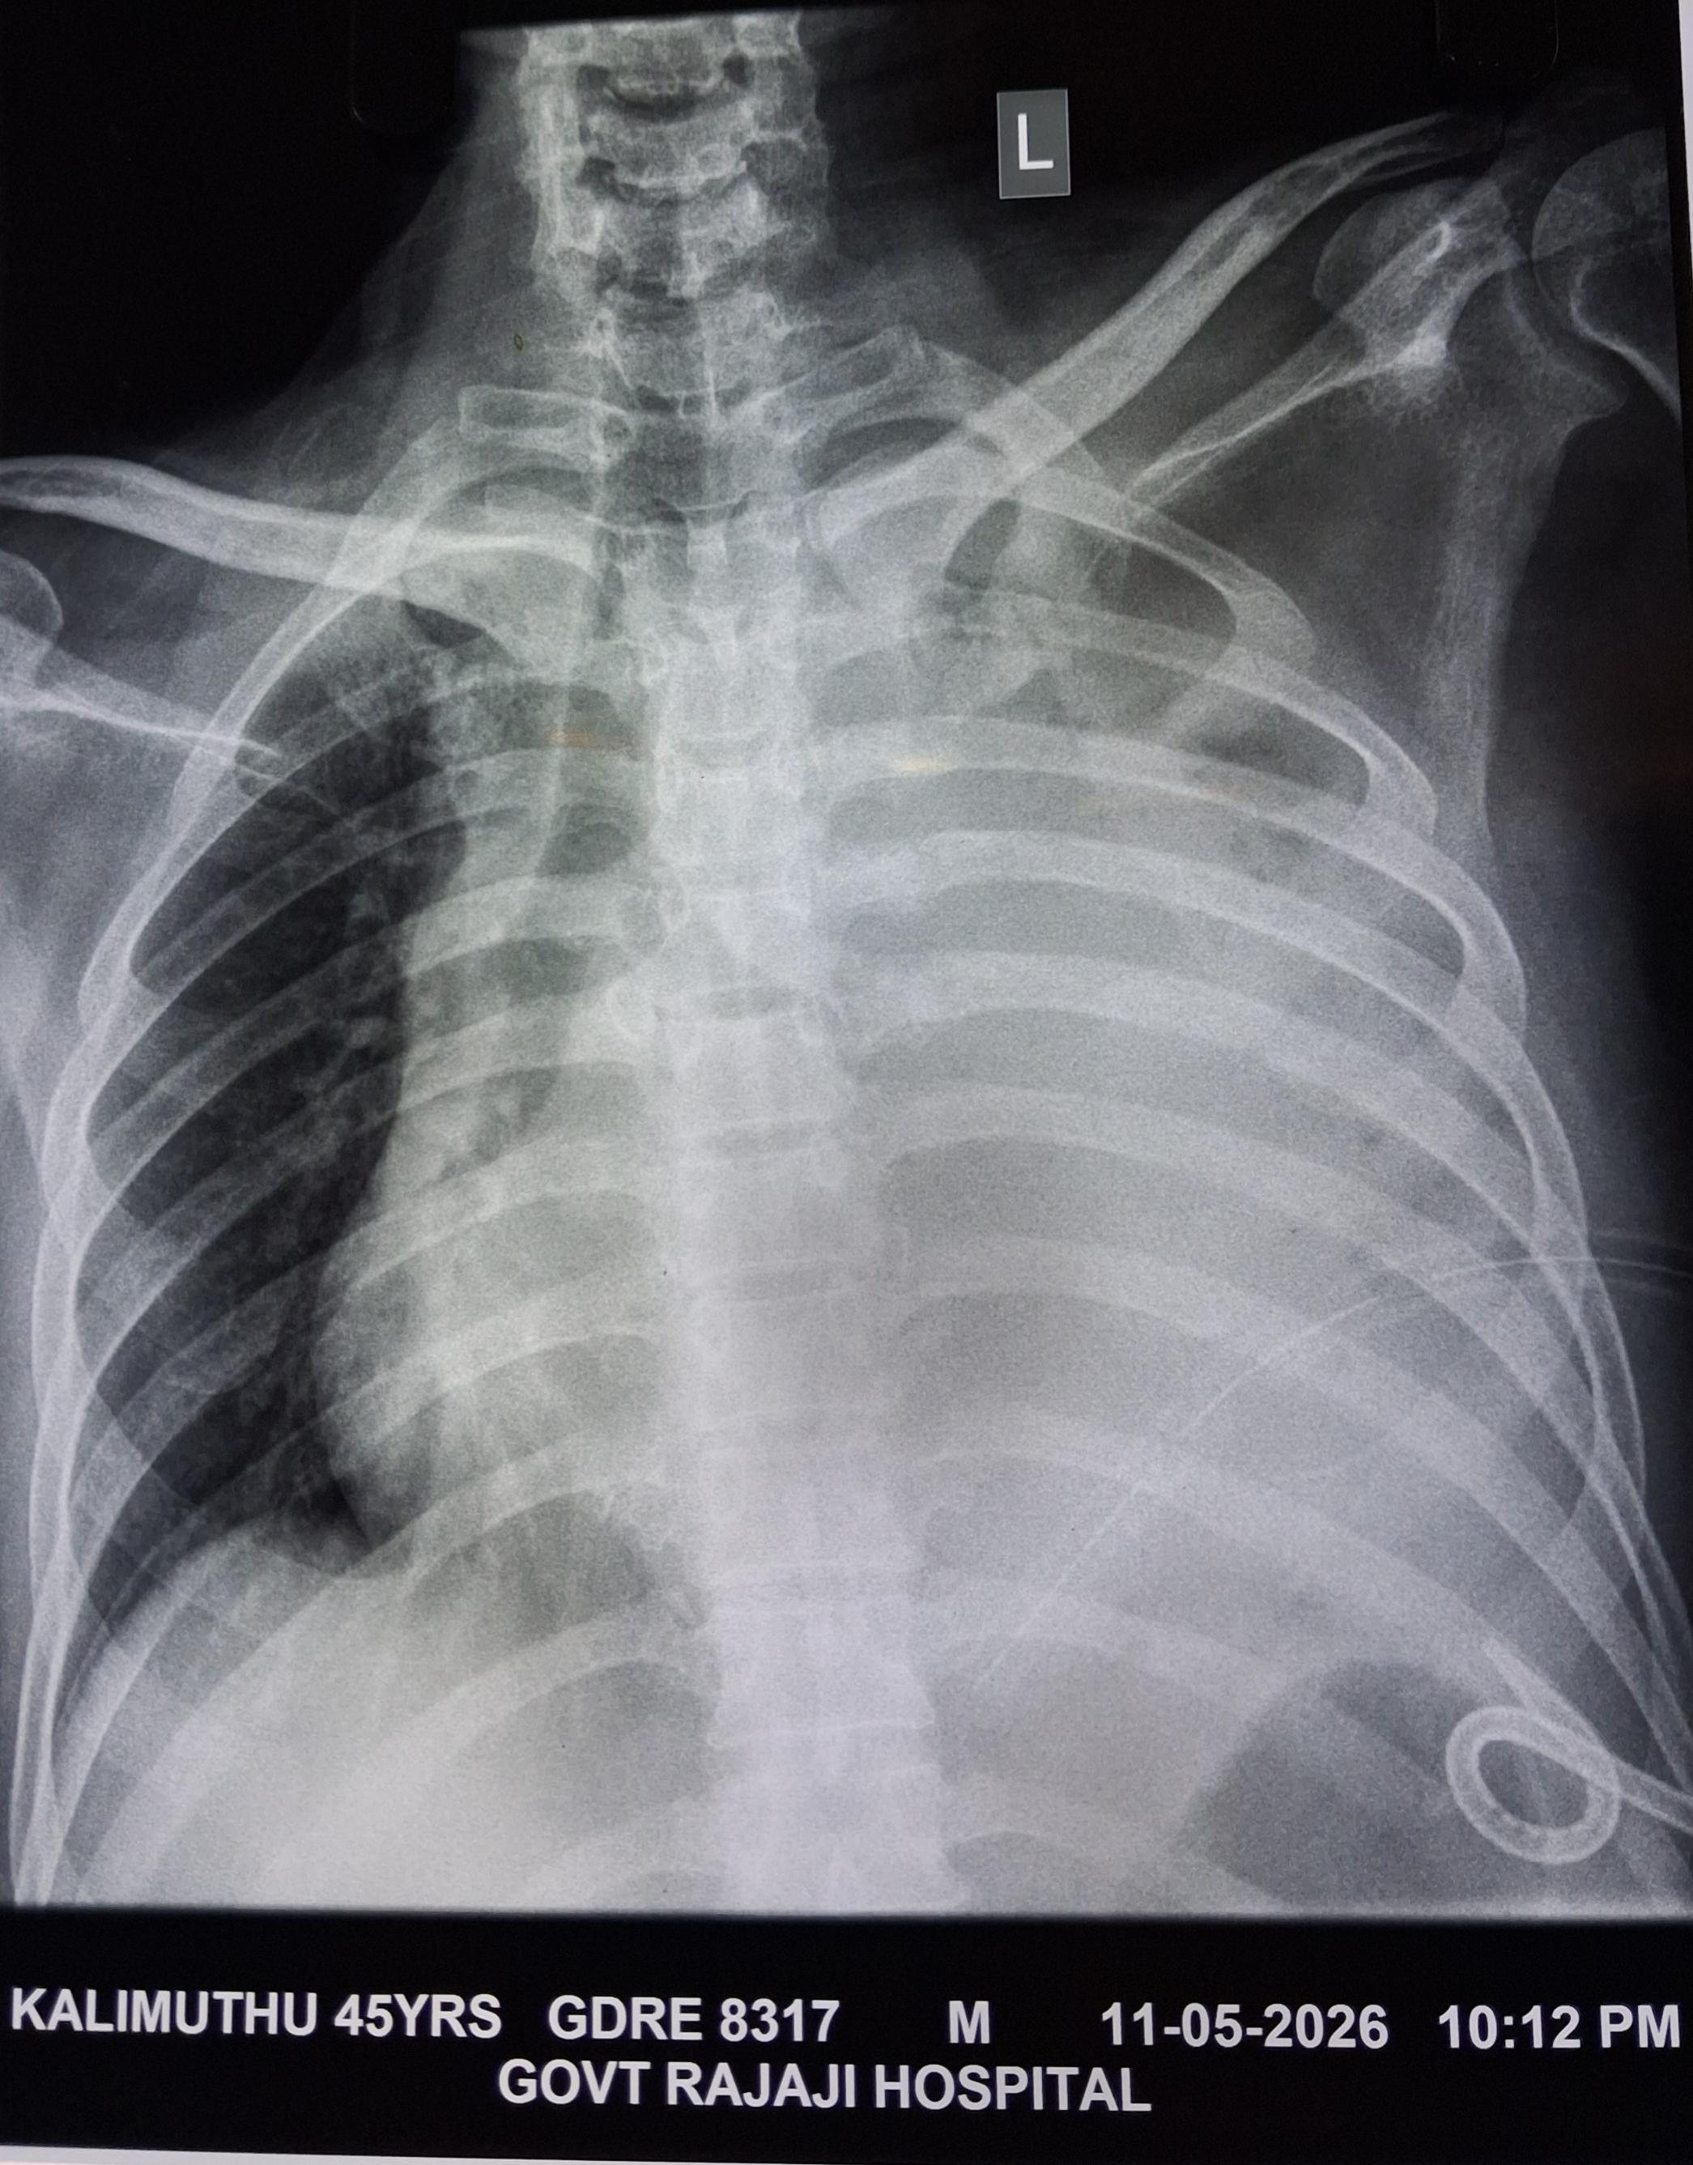
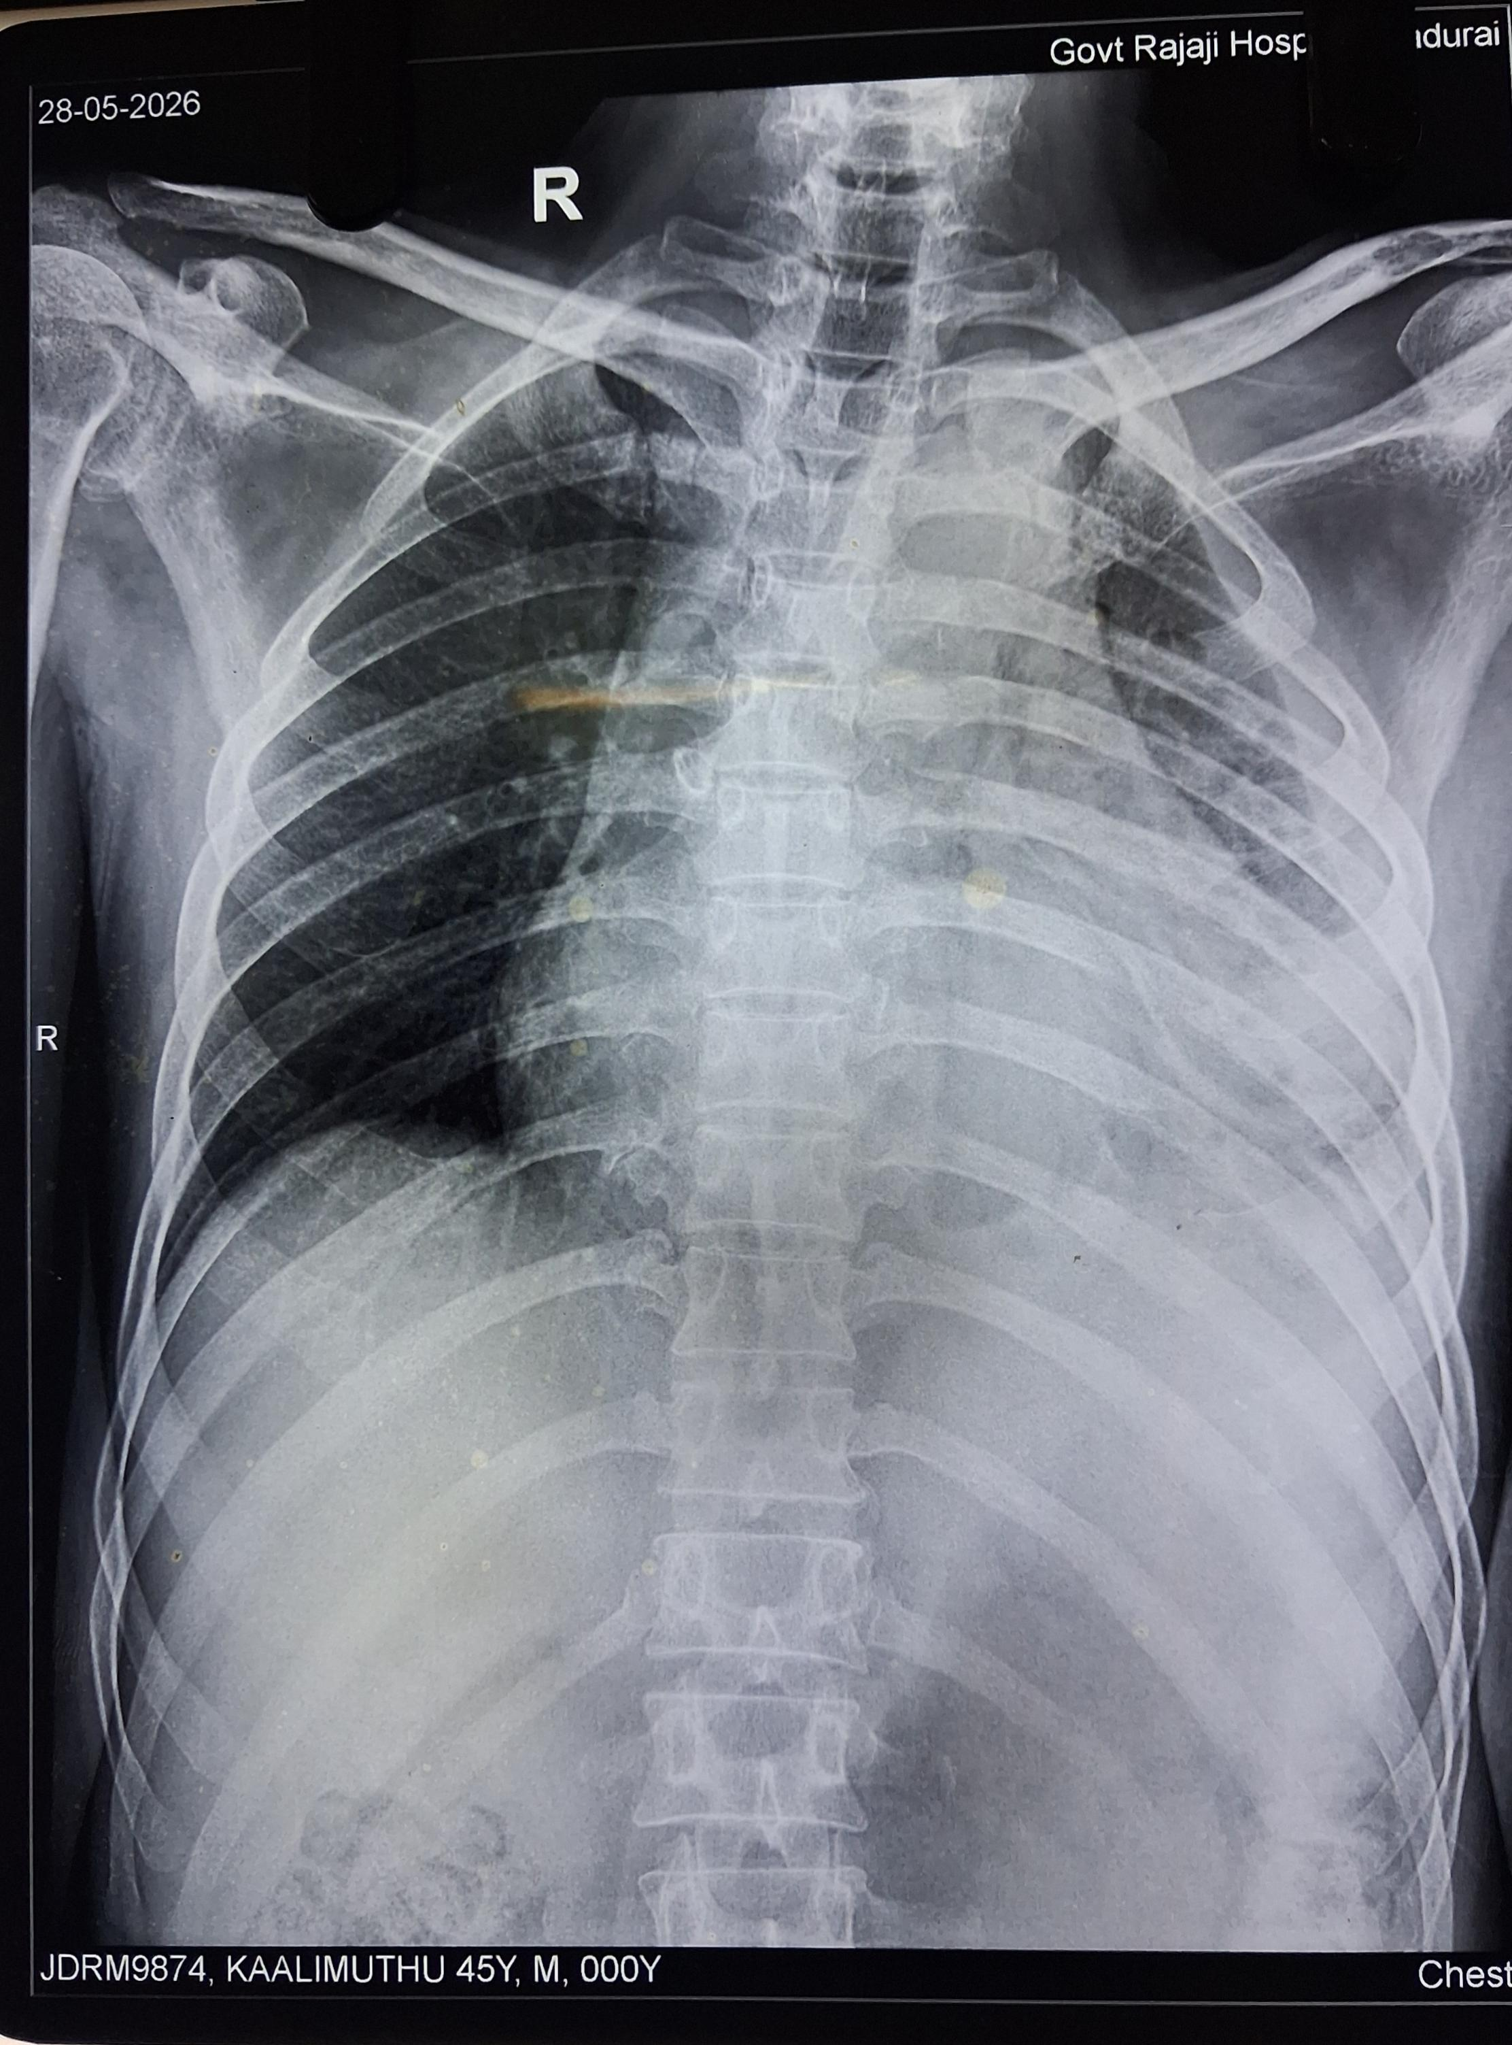
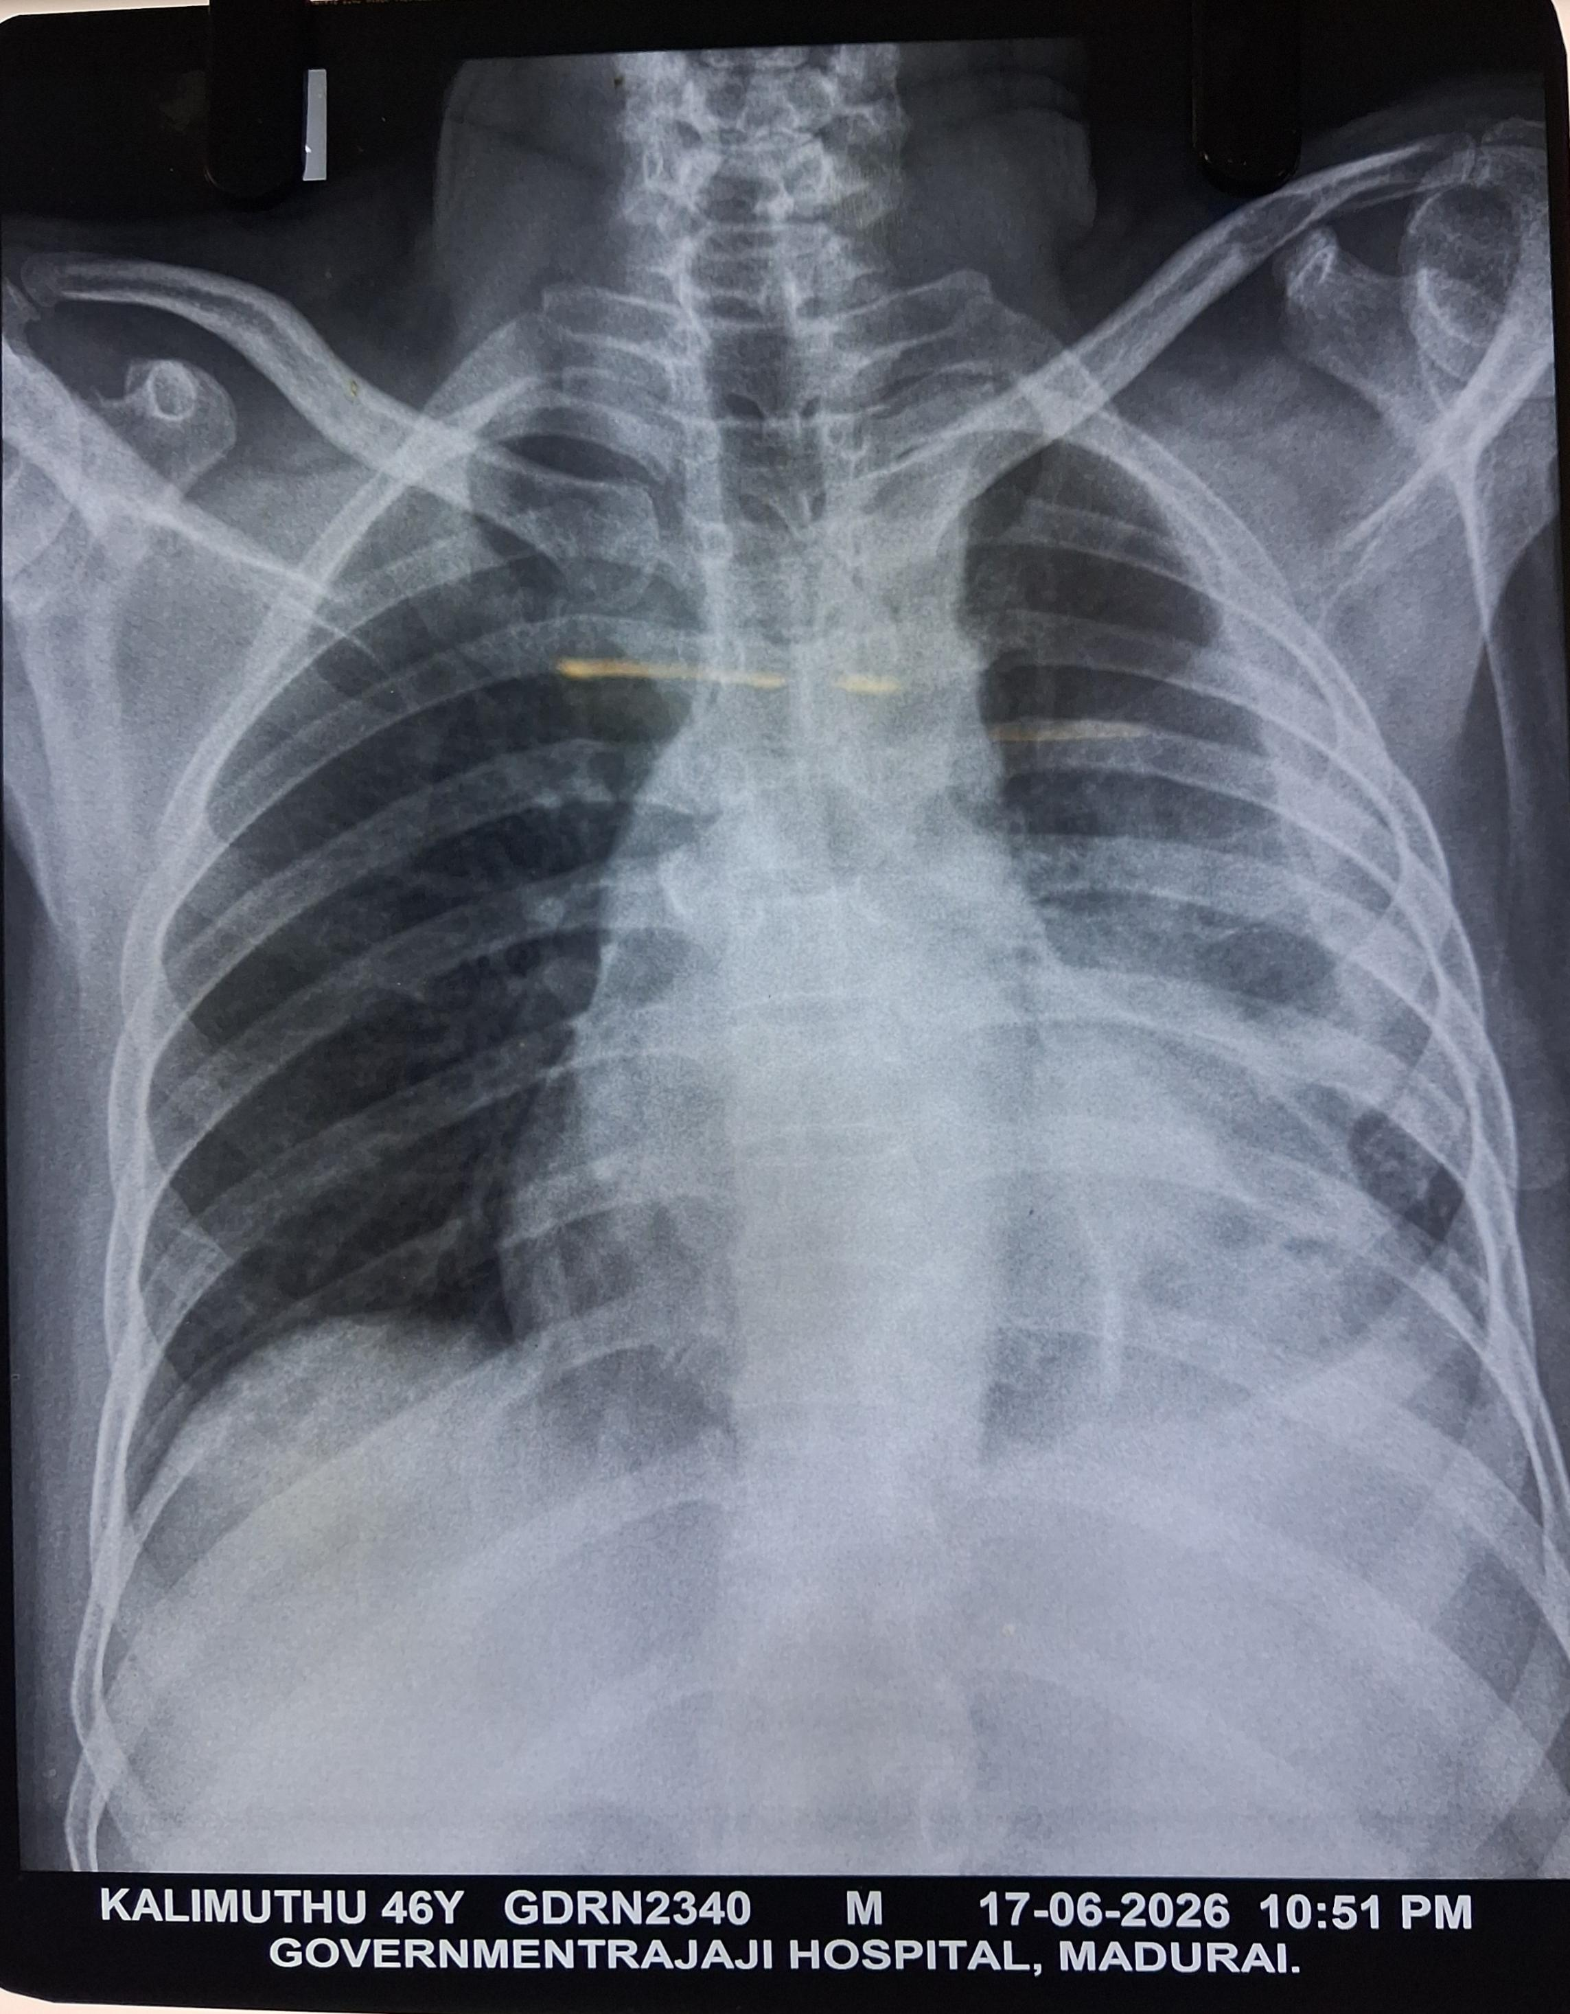

Slide 27
Ophthal opinion obtained
Normal Fundus
23/5/26
Surgery opinion obtained for Pigtail removal
Advised for USG guided pigtail removal
24/5/26
Pigtail removed on 24.5.26
12/6/26
Blood culture – Negative

Slide 28
Provisional Diagnosis
T2dm / Uncontrolled Hyperglycemia/ Acute Encephalopathy? Septic / Splenic abcess/ Left sided Emphyema

Slide 29
Let’s discuss...

