Slide 1
Journal club
by 5 th medical unit
chief : prof.dr.A.Senthamarai m.d
asst prof : dr.P.Sudha m.d
dr.M.J.Senthil kumar m.d
dr.S.sugadev m.d
presentor : dr . K.selvaprakash

Slide 2
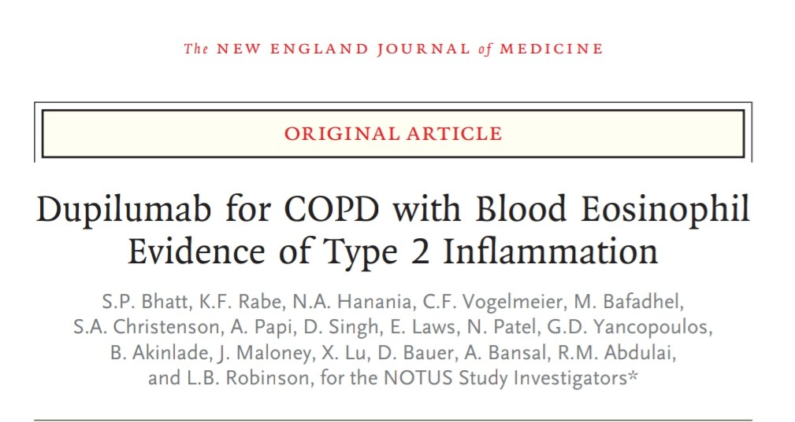
Published on May 20, 2024

Slide 3
Background
DUPILUMAB – a fully human monoclonal antibody which blocks the shared component for IL – 4 and 13 ; both are key drivers of type 2 inflammation , has shown efficacy and safety in a phase 3 trial involving patients with COPD and type 2 inflammation and with elevated risk of exacerbation

Slide 4
METHOD OF STUDY
International
Double blind
Randomized , placebo controlled trial
Done at 329 sites in 29 countries
52 week phase 3 trial
From July 2020 to may 2023

Slide 5
Inclusion criteria
Age – between 40 to 80 years (male or female)
Current / former smokers with history more than 10 pack years
Moderate to severe COPD
Post bronchodilator FEV1/FVC <0.70
Post bronchodilator FEV1 %predicted>30 ≤70
MMRC dyspnea scale ≥2
Symptoms and signs of chronic bronchitis(3 months in a year)

Slide 6
Documented history of high exacerbation risk (≥2 moderate or ≥1 severe exacerbation within 1 year prior to inclusion)
Background triple therapy (ICS + LABA + LAMA ) 3 months prior to randomization with a stable dose of medication ≥1 month prior to visit 1
NOTE ; DOUBLE THERAPY(LAMA + LABA )is allowed if ICS contraindicated
Evidence of Type 2 inflammation : blood eosinophils ≥300cells/µL at visit 1 (screening)

Slide 7
Exclusion criteria
COPD diagnosis of < 12 months prior to randomization
History of asthma
Significant pulmonary disease other than COPD (or) other lung or systemic disease with elevated peripheral eosinophil counts
Cor pulmonale or evidence of right heart failure
Treatment with O2 for >12 hrs/ day
Hypercapnia requiring BiPaP
Exacerbations / RTI ´s within 4 weeks prior to screening

Slide 8
History of active TB / untreated or incompletely treated TB
H/O systemic hypersensitivity / anaphylaxis to any biological therapy
H/O planned pneumonectomy or lung volume reduction surgery
Prior use / exposure to any other biological therapy or immunosuppressants
Any systemic illness or malignancy or cardiac disease
Pregnant / lactating females
H/O autoimmune disease or immunosuppressive use

Slide 9
TRIAL PROCEDURES
Eligible patients ; 2769
Patients excluded ; 1834(based on inclusion and exclusion criteria)
Finally 935 patients went randomization [470 dupilumab and 465 placebo] and received subcutaneous Dupilumab 300 mg every 2 weeks and followed up till 52 weeks

Slide 11
END POINTS AND ASSESSMENTS
PRIMARY END POINT: Annualized rate of moderate and severe exacerbations of COPD during 52 week trial period
MODERATE exacerbation : resulting in a treatment with systemic glucocorticoid , antibiotic agent or both
SEVERE Exacerbation : leading to hospitalization or an emergency medical care visit ( observation lasting >24 hours ) or that resulted in death

Slide 12
SECONDARY END POINTS ASSESSED
1. Change from baseline in the prebronchodilator FEV1 at 12 and 52 weeks
2.Change from baseline in the prebronchodilator FEV1 at 12 and 52 weeks among patients who had a fractional exhaled FENO level at baseline of 20 ppb or higher
3.Change from baseline to week 52 in the total score on SGRQ(St. George Respiratory Questionnaire) score range – 0 to 100[ lower the score , better quality of life]
4.MCID –[minimum clinically important difference – 4 points] - % of patients with a change of 4 points In SGRQ total score at week 52
5.Change from baseline to week 52 in [E-RS-COPD]Evaluating Respiratory symptoms in COPD total score (range 0 to 40) – lower the score ,less severe the respiratory symptoms

Slide 13
RESULTS
PATIENTS : Underwent randomization : 935
Assigned to dupilumab ; 470
Assigned to placebo : 465
721 patients included in analysis at week 52
Annualized rate of moderate and severe exacerbations
0.86% with dupilumab
1.30% with placebo
Rate ratio ; 0.66% [ p value <0.001 ]

Slide 14
Prebronchodilator FEV1 increased from baseline to week 12 with dupilumab – 139 ml
with placebo – 59 ml
Difference of 82 ml [p <0.001]
At week 52 weeks ; 62 ml [p<0.02]
BIOMARKERS of type 2 inflammation – FENO , total IgE and blood eosinophil counts were found to be reduced in the 52 week time period

Slide 15
SAFETY
Adverse events : similar in both groups { 66.7% in dupilumab group and 65.9% in the placebo group }
Most common : covid – 19, nasopharyngitis, headache
Serious adverse events : 13% in dupilumab and 15.9% in placebo groups
Persistent antidrug antibody response were observed in 14 patients in dupilumab group

Slide 16
CONCLUSIONS
In patients with COPD and type 2 inflammation as indicated by elevated blood eosinophil counts, Dupilumab was associated with fewer exacerbations and better lung function than placebo

Slide 17
STRENGTH OF THIS TRIAL
Adequately powered
Large , International trial
34% relative reduction in moderate or severe exacerbations with dupilumab as compared with placebo observed in this trial is clinically significant

Slide 18
LIMITATIONS
Done in predominant white population
Done during COVID – 19 pandemic ; which led to disruptions in health care and change in behaviors at times led to decreased exposure to viral respiratory infections
Decreased sample size due to early primary analysis for some week – 52end points

Slide 19
THANK YOU

