Slide 1
AN INTERESTING CASE OF SEIZURE
v mu
chief dR j.sangumani md.,d.diab(aus) asst professor dR r.sundaram md., DR K.S.RAGHAVAN MD.,
D.Diab
POST GRADUATE : DR.R.DINESH

Slide 2
CHIEF COMPLAINTS
19 yrs old male without any comorbid illness, was apparently normal 1 day before, came with Multiple episodes of convulsive movements involving left arm and face – 1 day
HISTORY OF PRESENTING ILLNESS
Now presents with Multiple episodes of tonic clonic movements left upper limb and left side face.
On and off
approx. 3 episodes
1 day
each episodes lasted 5 mins
not associated with loss of consciousness
no post ictal weakness/confusion
no involuntary micturition/defaecation/tongue bite

Slide 3
H/o headache + 3 days
involving whole cranium dull aching
not associated with nausea/vomiting/photophobia/blurring of vision/congestion of eyes
No h/o aura
No h/o altered sensorium
No h/o fever
No h/o double vision
No h/o head trauma
No h/o involuntary urination/defecation
No h/o vomiting

Slide 4
No h/o abnormal behaviour
No h/o memory/speech disturbance
No h/o dog bite
No h/o recent immunization
No h/o diarrhea
No h/o substance abuse

Slide 5
PAST HISTORY
No h/o seizure disorder/DM/HTN/asthma/TB/thyroid disorders.
No h/o drug intake
No h/o similar episodes in past
No h/o previous surgery
No h/o previous blood transfusions
TREATMENT HISTORY
Patient was referred from dindigul GH as simple partial seizure and treated with inj.phenytoin.

Slide 6
PERSONAL HISTORY
Not a smoker
Not an alcoholic
No bowel and bladder disturbances
Veg and non veg diet
FAMILY HISTORY
Non consanguineous marriage
No h/o similar illness in family members

Slide 7
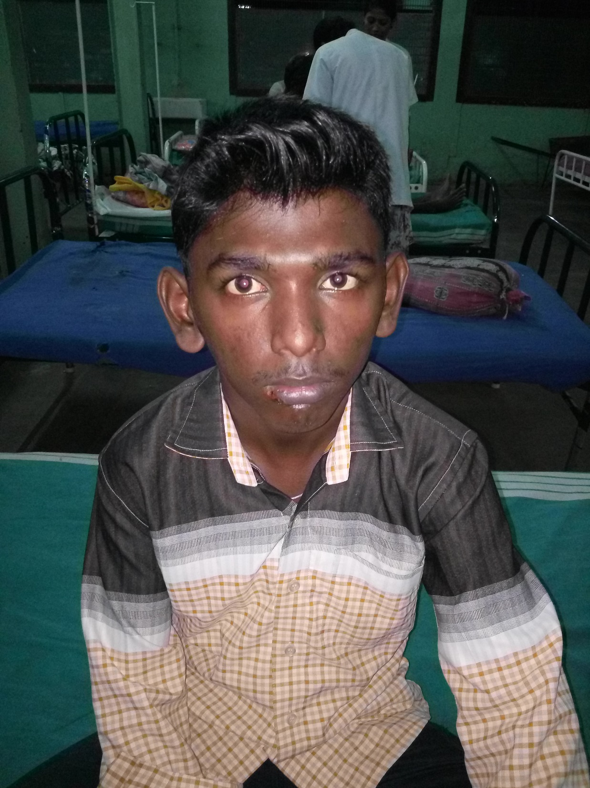
GENERAL EXAMINATION
Conscious
Oriented
Afebrile
No pallor
No cyanosis
No icterus
No clubbing
No pedal edema
No generalized lymphadenopathy
No neurocutaneous markers
Drooling of saliva +
Mask like face +

Slide 8
GENERAL EXAMINATION
Kayesher Fleischer ring +

Slide 9
ANTHROPOMETRY
Height-160cms
Weight-47kgs
BMI – 18.3 kg/m2
VITALS
Pulse rate – 84/min
normal in volume
regular rhythm
felt equally in all peripheral accessible vessels
no vessel wall thickening
no radial femoral/radioradial delay
Blood pressure – 110/80mmhg in left upper limb in sitting posture
SpO2 – 98% in room air
Respiratory rate – 19/min

Slide 10
SYSTEMIC EXAMINATION CNS
Conscious
Oriented
Memory normal
Sleep normal
Right handed

Slide 11
CNS
Cranial nerve examination - normal
Spino-Motor system
 | Right | left
BULK | NORMAL | NORMAL
TONE | Cog wheel rigidity | Cog wheel rigidity
POWER | 5/5 | 5/5
SUPERFICIAL REFLEX | + | +
DEEP TENDON REFLEX | + | +
PLANTAR | EXTENSOR | EXTENSOR

Slide 12
CNS
Sensory system found to be normal
Cerebellum – tandem walking impaired
finger nose test impared
finger nose finger impaired
no adysdiadokinesia
dysarthria +
Intentional tremors +
Gait normal

Slide 13
CNS
Spine and cranium normal
No signs of meningeal irritation
Autonomic nervous system normal
Fundus - normal
Other system examination
CVS – S1 S2 + no murmur
RS – BAE + no added sounds
Abdomen – soft
no tender
no organomegaly

Slide 14
PROVISIONAL DIAGNOSIS
Focal seizures involving left side
? wilsons disease
TREATMENT GIVEN
INJ.PHENYTOIN 100MG IV TDS
T.CARBMAZEPINE 200MG 1-1-1
T.RANITIDINE 150MG 1-0-1
T.BC 1 OD

Slide 15
INVESTIGATIONS
HB – 16gm%
TC – 9900 cells/mm3
DC – P83 L7 M9
ESR – 10mm in 1 hr
PLT – 2.20 lakhs/mm3
PCV – 43 %
RBS – 62mg/dl
Urea – 19mg/dl
Creatinine- 0.9mg/dl

Slide 16
INVESTIGATIONS
Na – 138 meq/l
K – 4.8 meq/l
Cl – 102 meq/l
Urine Alb – nil
sugar – nil
deposits – 0-2 pus cells +
Bilirubin 0.5mg/dl
Direct 0.3mg/dl
Indirect – 0.2mg/dl
SGOT – 26 IU/L
SGPT – 62 IU/L

Slide 17
INVESTIGATIONS
Proteins total 4.3 g/dl
Albumin – 2.0 g/dl
Globulin – 2.3 g/dl
Sr ceruloplasmin – 14.3 ug/dl
24hr Urine copper – 84 ug/dl
USG – liver size normal
surface normal
CT brain – b/l thalamic hypointensity

Slide 18
INVESTIGATIONS
MRI- hypointense signals in midbrain pons cerebellar peduncles caudate
Giant panda sign +
Suggestive of wilsons disease.

Slide 19
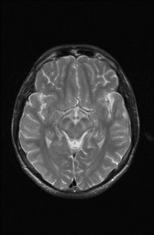
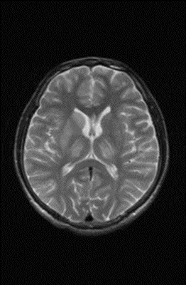

Slide 20
NEUROLOGIST OPINION
Conscious
Obeys commands
EOM full
Drooling of saliva +
Vacuum smile
Moves all 4 limbs
Cog wheel rigidity
Upper limb incoordination+
Plantar extensor
Striatal toe

Slide 21
NEUROLOGIST OPINION
Suggested Sr.ceruloplasmin
Ophthalmologist opinion
EEG
EEG – well formed 8-9 hz alpha waves in background.
no sharp/spike waves seen
NORMAL RECORD

Slide 22
OPHTHALMOLOGIST OPINION
Slit lamp examination – KF RING PRESENT
B/L fundus normal

Slide 23
MEDICAL GASTROENTEROLOGIST OPINION
OGD normal study
Tab.D penicillamine 250mg 1-0-1

Slide 24
LEIPZIG SCORING

Slide 25
CONCLUSION
WILSONS DISEASE
KF RING
Sr.CERULOPLASMIN
24 HR URINARY CERULOPLASMIN

