Slide 2
Myasthenia gravis (MG) is a neuromuscular disorder characterized by weakness and fatigability of skeletal muscles.
The underlying defect is a decrease in the number of available acetylcholine receptors (AChRs) at neuromuscular junctions due to an antibody-mediated autoimmune attack.
The hallmark of myasthenia gravis is muscle weakness that worsen after period of activity and improves after period of rest

Slide 3
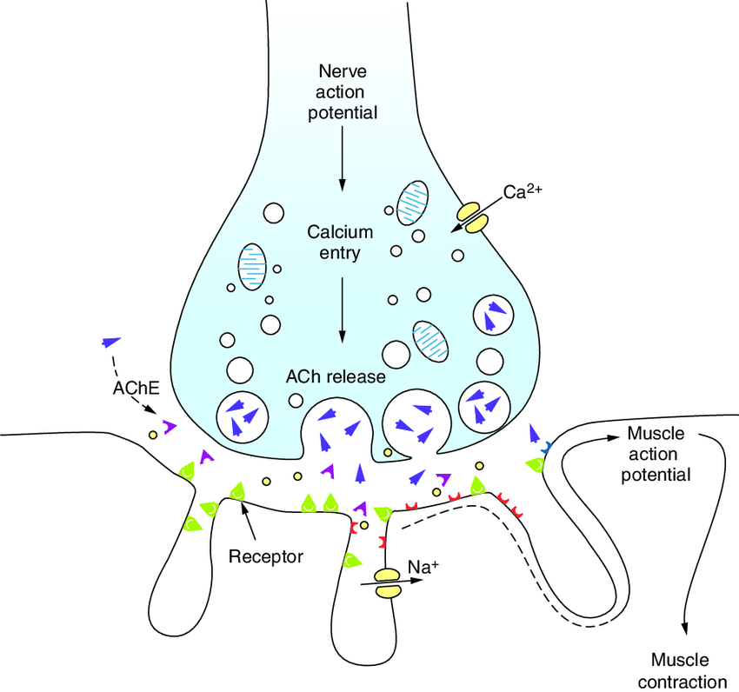
Presynaptic motor nerve terminal
ACh vesicles (quanta)
Synaptic cleft
Postsynaptic folds with dense AChRs

Slide 4
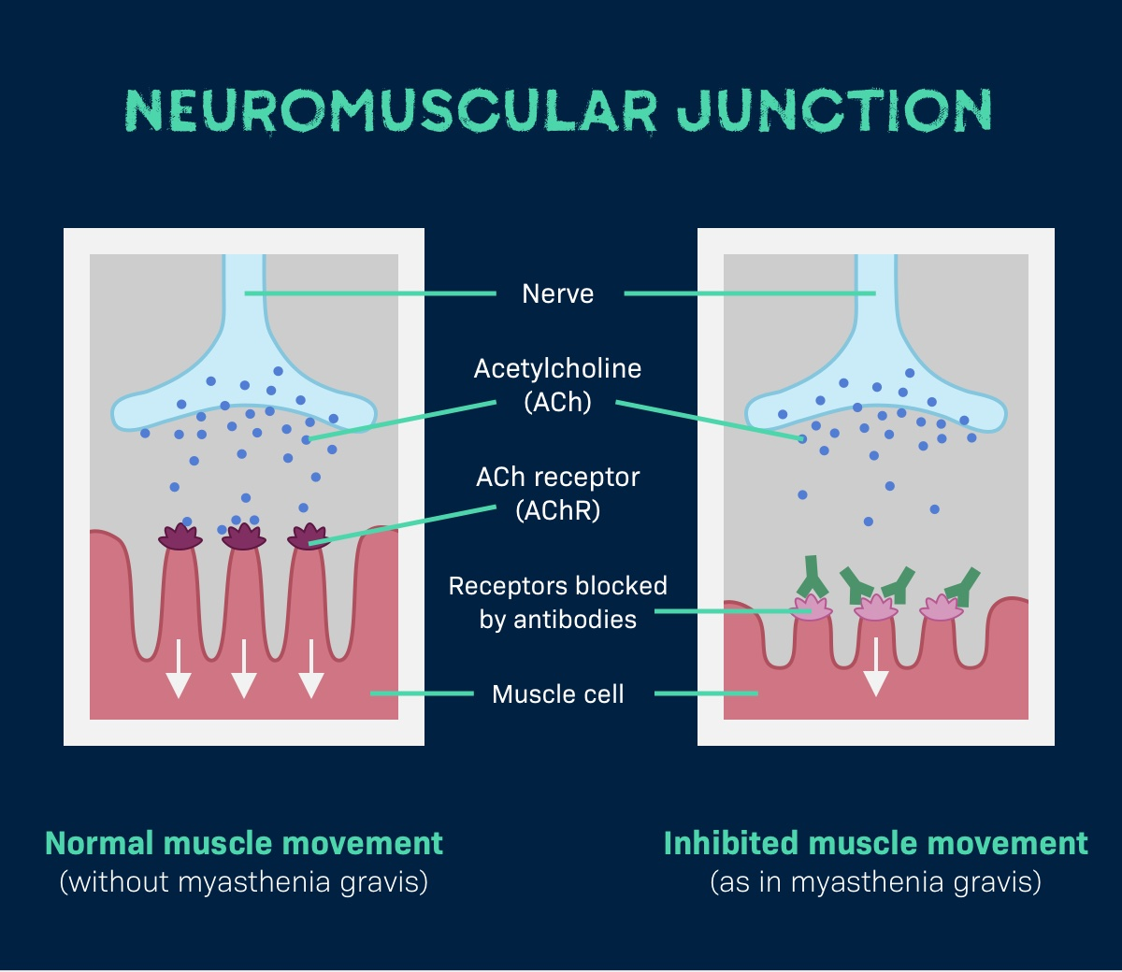
Normal | Myasthenia Gravis
Dense AChRs | ↓ AChRs
Deep folds | Flattened folds
Narrow cleft | Widened cleft

Slide 5
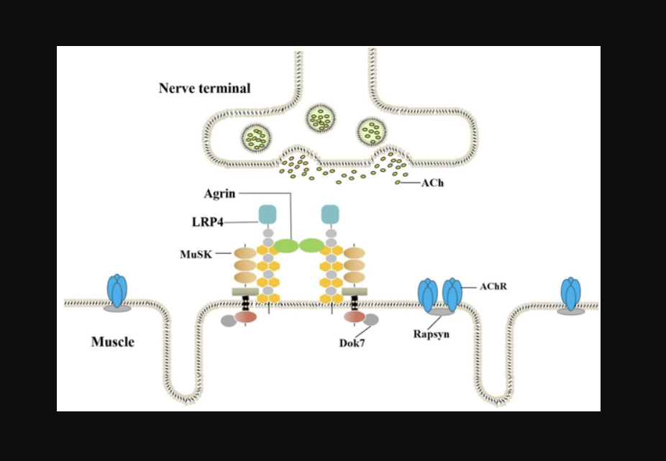
MUSK
Muscle-specific tyrosine kinase (MuSK) is a postsynaptic transmembrane protein that helps stabilize postsynaptic clustering of AChRs.
Agrin is released from the presynaptic motor nerve terminal
Agrin binds LRP4 on the postsynaptic muscle membrane
The agrin–LRP4 complex activates MuSK Activated MuSK recruits intracellular proteins:
    DOK7
    Rapsyn
These proteins cluster and stabilize acetylcholine receptors (AChRs) at the crests of postsynaptic folds

Slide 6
Decreased efficacy of Neuromuscular transmission:
Antibodies are directed toward the acetylcholine receptor
Decreased number of acetylcholine receptors at the post synaptic muscle membrane
postsynaptic folds are simplified or flattened
Therefore, although Ach is released normally, it produces small end-plate potentials that may fail to trigger muscle action potentials.
Presynaptic Rundown:
The amount of Ach released per impulse normally declines on repeated activity (termed presynaptic rundown).

Slide 7
Decreased efficiency of NMT
Presynaptic rundown…
Myasthenia
Gravis
Muscle weakness
Normal presynaptic rundown

Slide 8
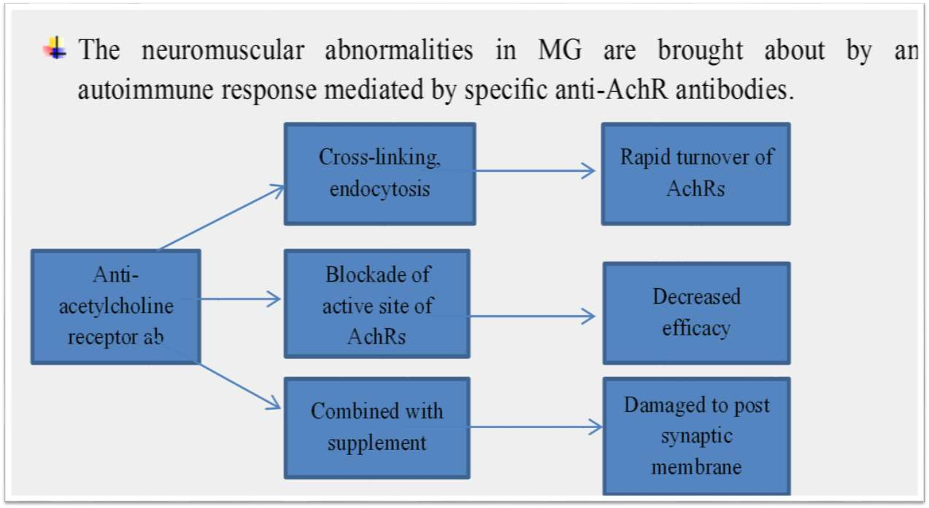
Complement

Slide 9
The pathogenic antibodies are IgG, and are T cell dependent.
Anti-MuSK antibodies
Impair MuSK–LRP4 binding → loss of AChR clustering → ↓ functional AChRs
Present in ~10% of MG (≈ 40% of AChR-negative generalized MG)
IgG4 subtype → does NOT activate complement → no response to complement inhibitors.
Anti-LRP4 antibodies (1–3%)
IgG1, complement-mediated injury; may interrupt agrin-induced MuSK activation
Notes:
Thus, immunotherapeutic strategies directed against either the antibody-producing B cells or helper T cells, directly reducing the pathogenic antibodies, or blocking complement-mediated destruction of the AChRs are all effective in anti-AChR-positive MG.

Slide 10
The primary source of Treg cells is the thymus, MG is antibody-mediated but also T-cell dependent
Thymic abnormalities (~75% in AChR-positive MG):
Hyperplasia (~65%) with germinal centers
Thymoma (~10%)
Myoid cells in thymus
Bear AChRs on their surface. May serve as a source of autoantigen and trigger the autoimmune reaction within the thymus gland.
Notes:
Tregs are critical in suppressing activation of other immune cells that have escaped negative selection in the thymus. Because these other cells have not been deleted by negative selection or suppressed in the periphery, they attack “self” antigens. Deficiency or dysfunction of Tregs contributes to the pathogenesis not only of MG but of many other autoimmune diseases.

Slide 11


MG has an incidence ranging from 6.3 to 29 per million and a prevalence ranging from 100 to 361 per million.
It affects individuals in all age groups, but peak incidence occurs in women in their twenties and thirties and in men in their fifties and sixties.
Overall, women are affected more frequently than men, in a ratio of ~3:2.

Slide 12
CLINICAL FEATURES
Cardinal features are weakness and fatigability of muscles.
Myasthenic weakness often worsens during repeated use (fatigue) and/or late in the day and may improve following rest or sleep.
Exacerbations and remissions may occur, particularly during the first 1–3 years after disease onset.
In ~85% of patients, myasthenic weakness becomes generalized, affecting facial, bulbar, axial, or limb muscles in addition to ocular muscles.
If weakness remains restricted to ocular muscles for 3 years, future generalization is unlikely, and these patients are said to have ocular MG.

Slide 13



In more than half the people who develop MG, their first signs and symptoms involve eye problems:
Drooping of one or both eyelids (ptosis) Asymmetrical or alternating ptosis is characteristic
Double vision (diplopia)
Blurred vision, which may come and go
Sparring of pupillary reflex

Slide 14


› Chewing. Weakness in chewing is most noticeable after prolonged effort or chewing hard or tough foods like meat.
› Facial expressions. Family members may note "lost smile-Snarling expression"
› Speaking. a nasal timbre caused by weakness of the palate or a dysarthric “mushy” quality due to tongue weakness. Hoarseness can occur from laryngeal weakness .
› Swallowing. weakness of the palate, tongue, or pharynx, giving rise to nasal regurgitation or aspiration of liquids or food.
Bulbar, neck, and ventilatory weakness can be especially prominent in MuSK antibody–positive MG. Weakness in neck extensor muscles can lead to head drop

Slide 15
Limb weakness in MG is often proximal and may be asymmetric. Nonetheless, some patients manifest with mainly distal weakness (finger and wrist drop or foot drop).
Deep tendon reflexes are typically preserved.
Sensory symptoms, sensory loss, and pain are absent.
If ventilatory weakness necessitates intubation or noninvasive ventilation to avoid intubation, the patient is said to be in MG crisis. All other worsening is termed exacerbation.

Slide 16
Investigations
Ice-Pack Test
Application of a pack of ice over a ptotic eye for 2 min often results in improvement if the ptosis is due to an NMJ defect.
A lid rise of 2 mm following this cooling is considered a positive result.
Anticholinesterase Test
Edrophonium was most commonly used historically for diagnostic testing because of the rapid onset (30 s) and short duration (~5 min) of its effect, with an objective endpoint such as ptosis typically measured. Edrophonium is no longer used due to potential for side effects and lack of availability.
Notes:
Drugs that inhibit the enzyme acetylcholinesterase allow ACh to interact repeatedly with the limited number of AChRs in MG, producing improvement in muscle strength

Slide 17
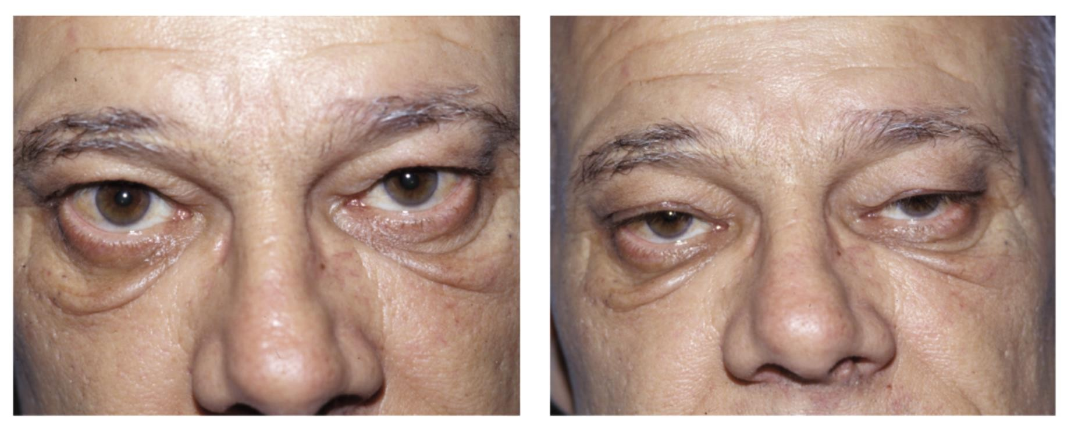
Fatigable Ptosis with Sustained Upgaze
Have patient look up for 2 minutes
Compare MRD1 and/or palpebral fissure height before and after
Does not exclude nonmyasthenic causes of ptosis
Figure from Walsh and Hoyt’s Clinical Neuro-Ophthalmology, The Essentials, 3rd Edition, p. 374

Slide 18
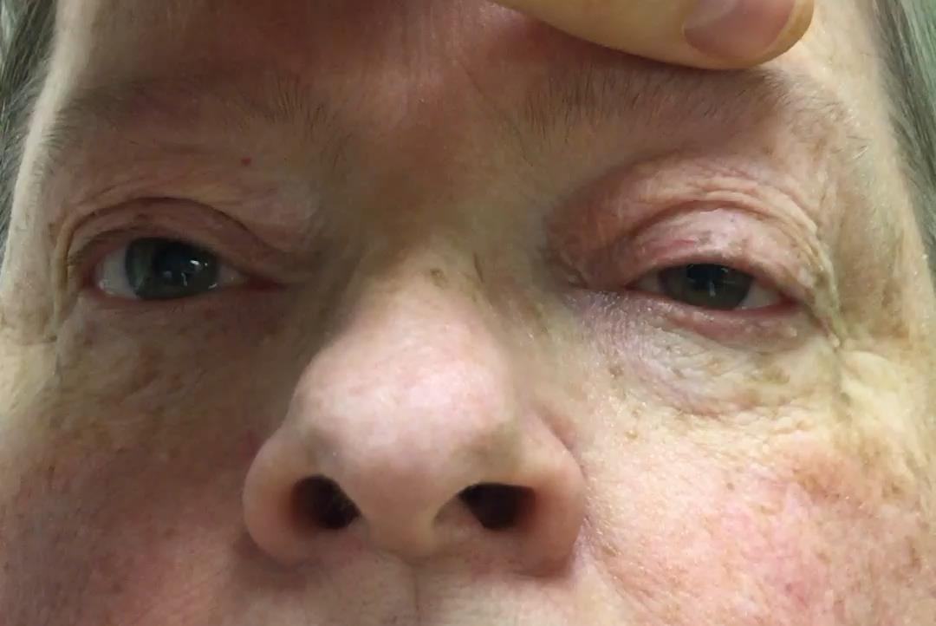
Manually elevating one eyelid causes the contralateral eyelid to become more ptotic
Explained by Hering law of equal innervation
Manual eyelid elevation decreases effort needed to keep eyelid open ipsilaterally, results in relaxation of contralateral levator
Can also be see in congenital ptosis and other non-MG causes of ptosis
Enhancement of Ptosis

Slide 19
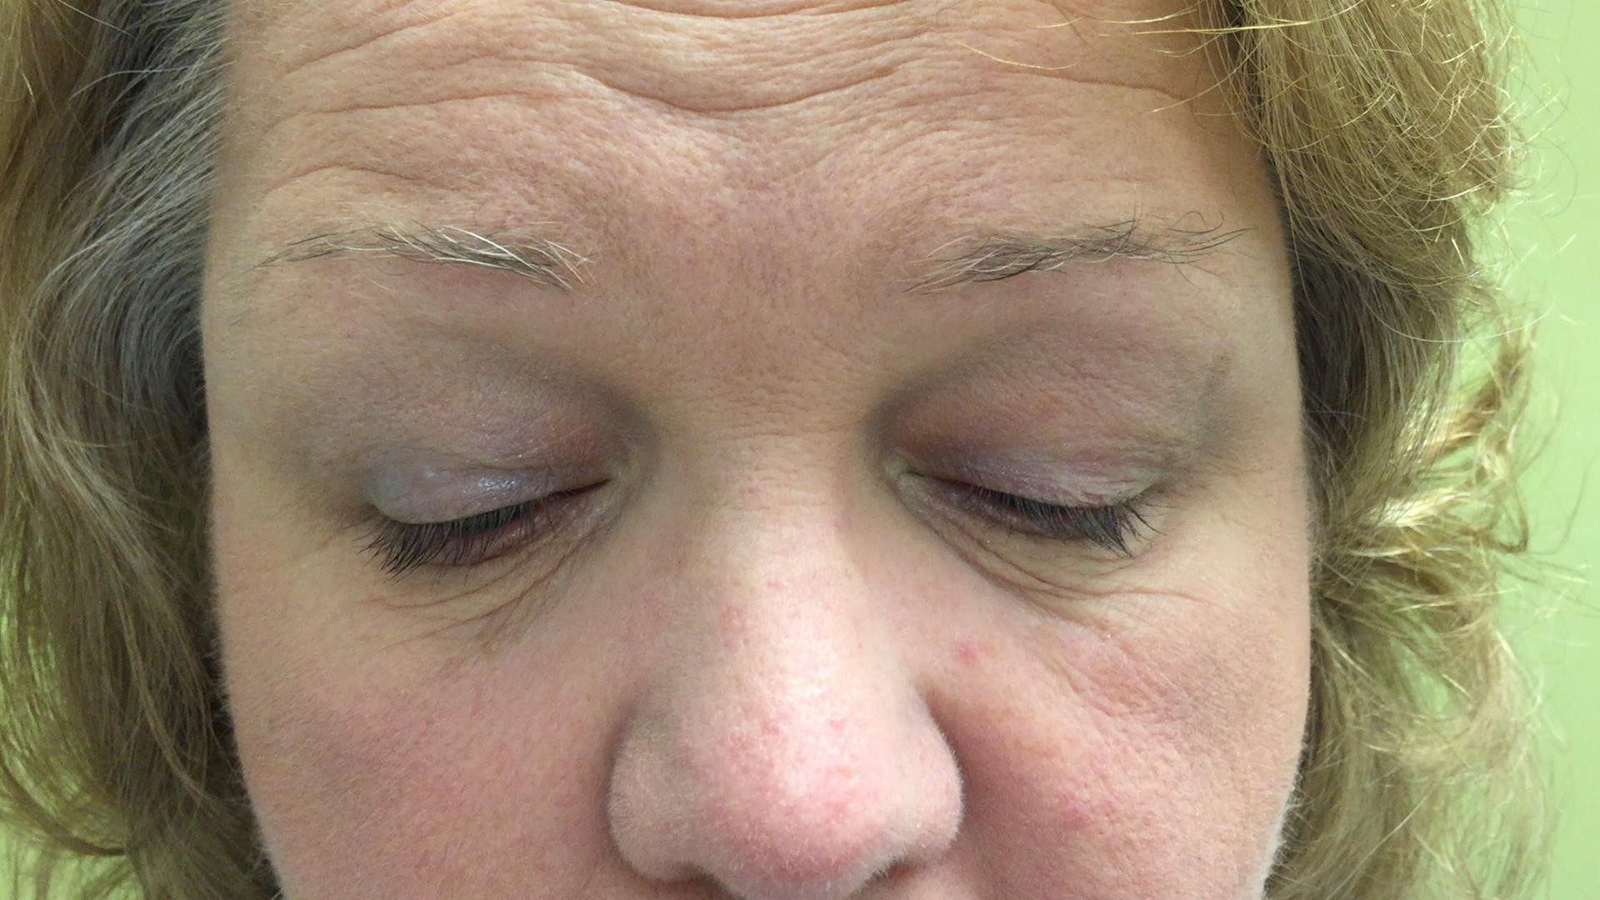
Elicit by having the patient look down for about 10-15 seconds, then a vertical saccade to primary position
The ptotic lid “overshoots”, followed by settling in the ptotic
position
Caused by easy fatiguability and rapid recovery of myasthenic muscle
Cogan’s Lid
Twitch

Slide 20
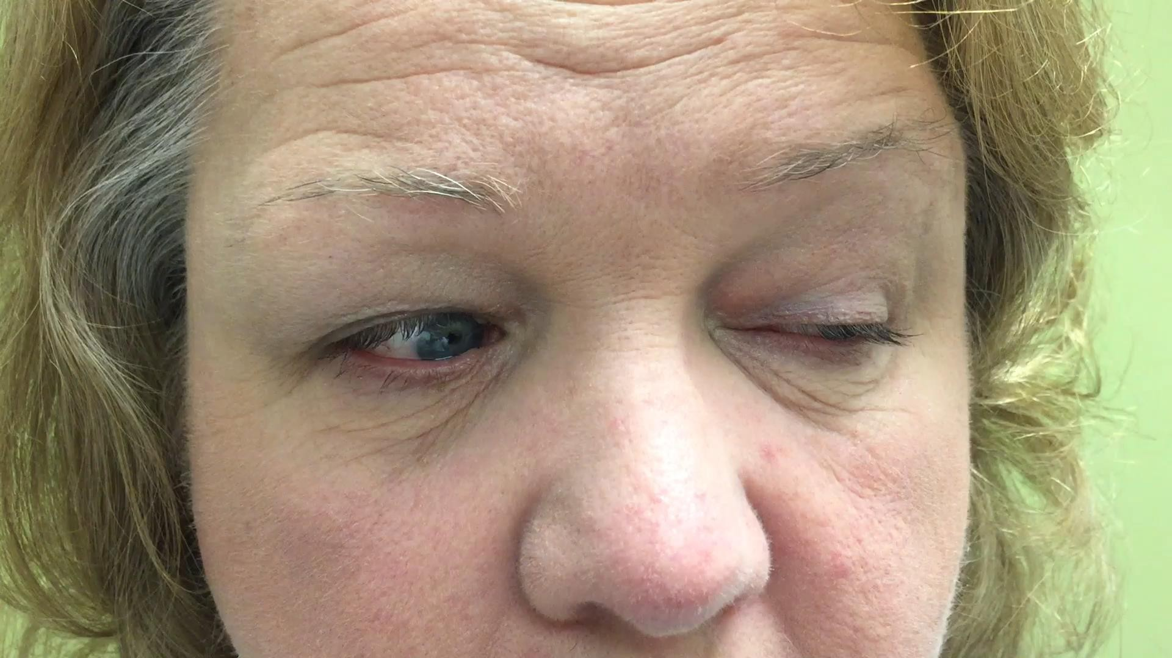
Common pattern of eye movement abnormality in MG
Can be distinguished from INO by convergence testing
Pseudo INO
Adduction improves with convergence in true INO
Adduction does NOT improve with convergence in pseudo INO from MG
Note slowing of the end of the adducting saccade in left eye, characteristic of MG

Slide 21
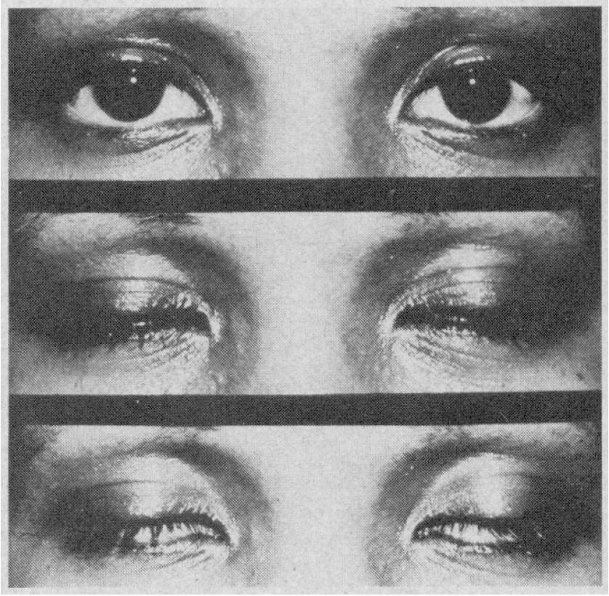
“Peek” sign
Orbicularis weakness in MG causes eyelid closure weakness
On gentle voluntary eyelid closure, the lids initially appose without sclera visible (B)
Within two seconds, the palpebral fissure widens, exposing sclera (C)
Seen in 3/25 myasthenia patients and only 1/50 patients with other neuromuscular disorders with facial weakness
Can be the only sign of MG in some patients
A
B
C

Slide 22

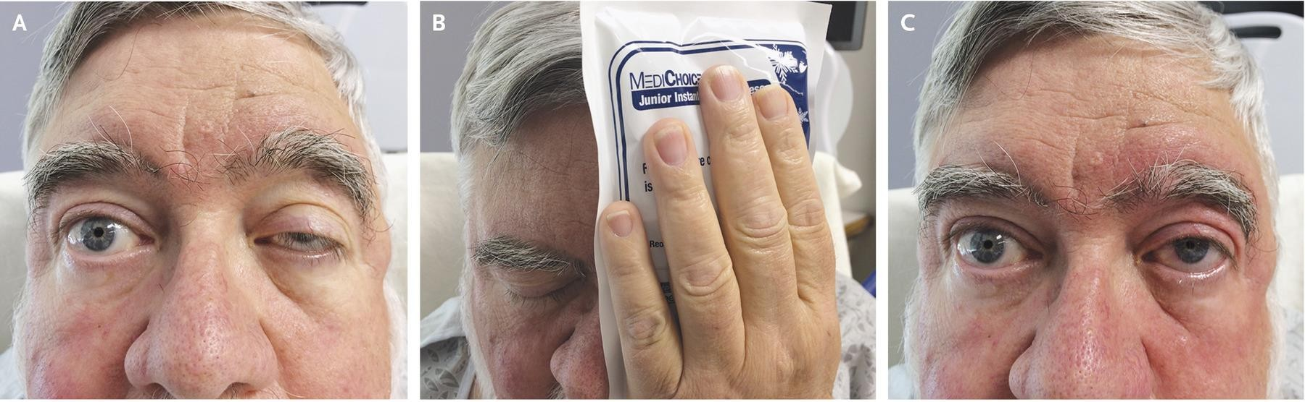
Ice Pack Test
Reduced muscle temperature is thought to inhibit acetylcholinesterase activity
Place ice pack on patient’s eyelids for two minutes
  Significant improvement of ptosis is suggestive of MG
  Ocular misalignment usually does not change, but may with longer ice duration
  May be uncomfortable for the patient
For MG-related ptosis, sensitivity 92% and specificity 79%
High negative predictive value of 94% makes ice pack test useful in helping rule out MG-related ptosis
Liu and Chen. N Engl J Med 2016;375:e39.

Slide 23
Investigations
For quantitative estimation of MG weakness and assessing change in clinical
status, a validated quantitative MG (QMG) score is available. It is simple to use,
objective and can be performed by the bedside (Barnett et al. 2012 and Bedlack
et al. 2005). Following clinical parameters have been included in QMG score:
• Double vision on lateral gaze for 60 s
• Ptosis on upgaze holding for 60 s
• Eyelid closure
Swallowing ½ cup of water
• Speech after counting aloud from 1 to 50
• Both arms outstretched at 90 degrees for 240 s
• Forced vital capacity
• Bilateral hand grip for 45 s
• Head lifted at 45 degrees for 120 s
• Both legs outstretched at 45–50 degrees in supine position for 100 s

Slide 24
Electrodiagnostic Testing:
Repetitive nerve stimulation may provide helpful diagnostic evidence of MG. Medications that inhibit acetylcholinesterase should be stopped 12–24 h or for as long as possible before testing.
It is best to test weak muscles or proximal muscle groups
Electrical stimulation is delivered at a rate of two or three per second to the appropriate nerves, and action potentials are recorded from the muscles.
in myasthenic patients, there is a rapid reduction of >10% in the amplitude of the evoked responses.
If repetitive nerve stimulation is normal and/or symptoms are exclusively ocular, single-fiber electromyography (EMG), a specialized more sensitive test typically done at MG referral centers, is performed.

Slide 25
AUTOANTIBODIES ASSOCIATED WITH MG:
Anti-AChR antibodies are detectable in the serum of
~85% of all myasthenic patients
~50% of patients with weakness confined to the ocular muscles.
Negative test does not exclude the disease.
Antibodies to MuSK are present in up to 40% of AChR antibody–negative patients with generalized MG
MuSK antibodies are rarely present in AChR antibody–positive patients or in patients with MG limited to ocular muscles.
A small proportion of MG patients without antibodies to AChR or MuSK have antibodies to LRP4. low specific. Checked only if MG by phenotype and electrodiagnostic testing but absent AChR and MuSK antibodies.

Slide 26
AUTOANTIBODIES ASSOCIATED WITH MG:
Antibodies against Agrin and anti-striated muscle antibodies directed against titin and other skeletal muscle components have been identified in some patients.
They are not pathogenic, and their presence does not confirm the diagnosis of MG.

Slide 27
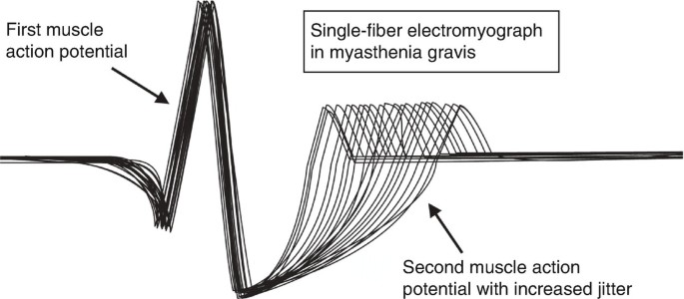
SINGLE FIBRE ELECTROMYOGRAPHY (EMG)
Records action potentials from two muscle fibers of the same motor unit
Assesses neuromuscular transmission stability
Key Abnormalities
↑ Jitter → increased variability in inter-potential interval
Blocking → failure of impulse transmission to one fiber
Most sensitive test for MG (>90%), But non specific
Also Abnormal in
  Antibodies are negative
  Ocular MG
  Early or Mild Disease
Motor neuron Disease
Neuropathies
Myopathies

Slide 28
DIFFERENTIAL DIAGNOSIS
Nonautoimmune congenital myasthenia
Drug-induced myasthenia
Lambert-Eaton myasthenic syndrome (LEMS)
Hyperthyroidism (Graves’ disease)
Botulism
Intracranial mass lesions
Oculopharyngeal dystrophy
Mitochondrial myopathy (Kearns-Sayre syndrome, progressive external ophthalmoplegia).
Treatment with immune checkpoint inhibitors (ICIs) for cancer

Slide 29
CONGENITAL MYASTHENIC SYNDROMES (CMS)
A rare heterogeneous group of disorders of the NMJ that are not autoimmune but rather are due to mutations in >30 identified genes.
Mutations in the genes encoding for rapsin, COLQ, DOK7, agrin, and GFPT together accounting for ~40%
These disorders share many of the clinical features of autoimmune MG, including weakness and fatigability of proximal or distal extremity muscles and often involving extraocular and eyelid muscles similar to the distribution in autoimmune MG.
CMS is most often suspected when symptoms of myasthenia began in infancy or childhood; however, some patients initially present in adulthood.
As in autoimmune MG, repetitive nerve stimulation is often associated with a decremental response. Some forms of CMS (e.g., acetylcholinesterase deficiency, prolonged open channel syndrome) have a feature of after-discharges that are not seen in MG.
Notes:
Virtually any component of the NMJ may be affected. Alterations in function of the presynaptic nerve terminal, in the various subunits of the AChR, acetylcholinesterase, or the other molecules involved in end-plate development or maintenance, have been identified in the different forms of CMS.

Slide 30
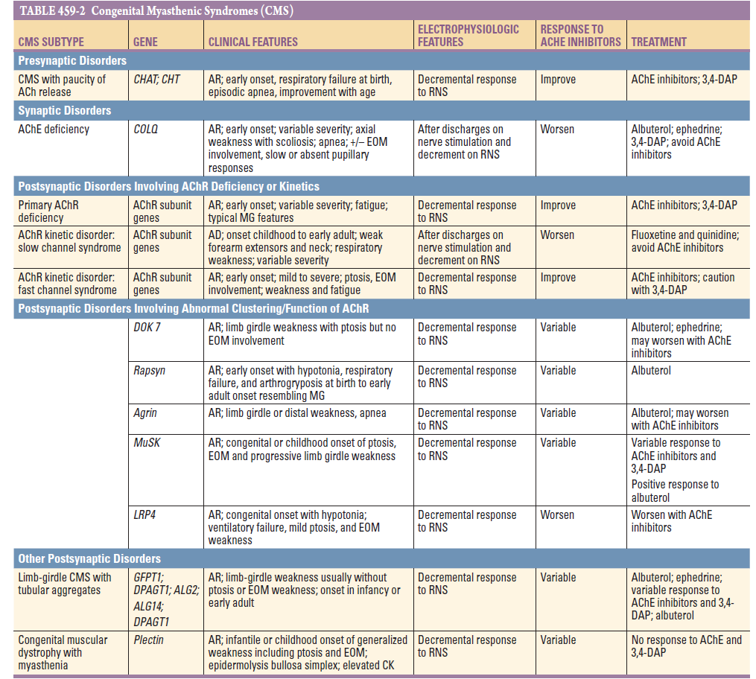

Slide 31
LAMBERT EATON SYNDROME
LEMS is caused by autoantibodies directed against P/Q-type calcium channels at the presynaptic motor nerve terminals detected in ~85% of LEMS patients
The proximal muscles of the lower limbs are most commonly affected, although other muscles may be involved as well.
Cranial and bulbar weakness, including ptosis of the eyelids, diplopia, dysarthria, and dysphagia may occur but are not typically the presenting or prominent symptoms.
Depressed or absent reflexes and experience autonomic symptoms such as dry mouth, orthostasis, and impotence
Nerve stimulation produces an initial low-amplitude compound muscle action potential and, at low rates of repetitive stimulation (2–3 Hz), a decremental response as seen in MG; however, at high rates (20–50 Hz) or following brief exercise, incremental responses occur.

Slide 32
LAMBERT EATON SYNDROME
In older adults, LEMS is associated with malignancy, most commonly small-cell lung cancer (SCLC), and virtually all of these patients have P/Q-type calcium channel autoantibodies.
The tumor cells may express calcium channels that stimulate the autoimmune response.
Initial management requires comprehensive evaluation for malignancy and reassessment if the initial malignancy evaluation is negative.
Treatment
3,4-DAP acts by blocking potassium channels, which results in prolonged depolarization of the motor nerve terminals, thus enhancing ACh release.
Pyridostigmine prolongs the action of ACh, allowing repeated interactions with AChRs.
If symptoms are severe or life-threatening or if symptomatic therapy is insufficient, immunomodulatory therapy including IVIg or plasma exchange can be used.

Slide 33
BOTULISM
Caused by ingestion of improperly prepared food containing toxin.
Due to potent bacterial toxins produced by any of eight different strains of Clostridium botulinum.
The toxins enzymatically cleave specific proteins essential for the release of ACh from the motor nerve terminal, thereby interfering with neuromuscular transmission
Autonomic findings include paralytic ileus, constipation, urinary retention, dilated or poorly reactive pupils, and dry mouth.
Nerve stimulation studies reveal reduced compound muscle action potential (CMAP) amplitudes that increase following high-frequency repetitive stimulation.
Treatment includes ventilatory support and aggressive inpatient supportive care (e.g., nutrition, deep-vein thrombosis prophylaxis) as needed.

Slide 34
Hyperthyroidism Abnormalities of thyroid function (hyper- or hypothyroidism) may increase myasthenic weakness. Diplopia resembling that in MG may occasionally be due to an intracranial mass lesion that compresses nerves to the extraocular muscles (e.g., sphenoid ridge meningioma), but magnetic resonance imaging (MRI) of the head and orbits usually reveals the lesion.
Progressive external ophthalmoplegia is a rare condition resulting in weakness of the extraocular muscles and often symmetric ptosis, which may be accompanied by weakness of the proximal muscles of the limbs and other systemic features.
Most patients with this condition have mitochondrial disorders that can be detected by genetic testing or with muscle biopsy

Slide 35
Treatment with immune checkpoint inhibitors (ICIs) for cancer may also result in autoimmune MG.Most common with (Nivolumab,pembrolizumab,iplimumab.)
Myositis and myocarditis are also often found in combination with MG as a complication of ICIs
Symptoms typically begin after the first or second cycle of treatment, with ptosis, diplopia, bulbar, neck, extremity weakness, and respiratory weakness.
Patients usually improve when the ICI is discontinued and a short course of glucocorticoids is given, with intravenous immunoglobulin (IVIg) or plasma exchange depending on severity
With fulminant disease, the fatality rate remains high, mainly due to the concurrent myocarditis.

Slide 36
A. THERAPEUTIC MANAGEMENT:
Cholinesterase inhibitors.
Immunotherapy
    For Immediate improvement – Ivig or Plasmapheresis
    Intermediate Term: glucocorticoids, cyclosporine or tacrolimus, rituximab, and the newer complement inhibitors and FcRn antagonists
    Long Term: azathioprine and mycophenolate mofetil
B. SURGICAL MANAGEMENT: Thymectomy

Slide 37
ANTICHOLINESTERASE
Produces at least partial improvement in most myasthenic patients, although improvement is complete in only a few.
Patients with anti-MuSK MG generally obtain less benefit from anticholinesterase agents than those with AChR antibodies and may actually worsen.
Initial dose: 30–60 mg three to four times daily.
Onset 15–30 min and lasts for 3–4 h, but individual responses vary.
The frequency and amount of the dose should be tailored to the patient’s individual requirements throughout the day. Maximum dose exceeds 360–480 mg daily.
Overdosage with anticholinesterase medication may cause increased weakness and other side effects.
In some patients, muscarinic side effects of the anticholinesterase medication (diarrhea, abdominal cramps, excess salivation, nausea) may limit the dose tolerated.
Atropine/diphenoxylate or loperamide is useful for the treatment of gastrointestinal symptoms

Slide 38
THYMECTOMY
Two separate issues should be distinguished:
(1) surgical removal of thymoma, and
(2) thymectomy as a treatment for MG.
Surgical removal of a thymoma is necessary because of the possibility of local tumor spread, although most thymomas are histologically benign
A large international study (the MGTX trial) of extended transsternal thymectomy in non thymomatous, AChR antibody–positive, generalized MG demonstrated that participants who underwent thymectomy had improved strength and function, required less prednisone and fewer additions of second-line agents (e.g., azathioprine), and had fewer hospitalizations for exacerbations lasting at least 5 years.
Importantly, patients with ocular myasthenia, MuSK-positive, and seronegative MG were all excluded from the MGTX study; retrospective and anecdotal evidence suggests that these patients may not benefit from thymectomy.
Thymectomy should never be carried out as an emergency procedure, but only when the patient is adequately prepared. If necessary, treatment with IVIg or plasmapheresis may be used before surgery to maximize strength in weak patients

Slide 39
IMMUNOTHERAPY
The choice of immunotherapy should be guided by the relative benefits and risks for the individual patient and the urgency of treatment. It is helpful to develop a treatment plan based on short-term, intermediate-term, and long-term objectives.
    For Immediate improvement – IVIG or Plasmapheresis
    Intermediate Term: glucocorticoids, cyclosporine or tacrolimus, rituximab, and the newer complement inhibitors and FcRn antagonists
    Long Term: azathioprine and mycophenolate mofetil

Slide 40
GLUCOCORTICOID THERAPY
Produce improvement in myasthenic weakness in the great majority of patients.
To minimize adverse side effects, prednisone should be given in a single morning dose rather than in divided doses throughout the day.
Initial dose 15–25 mg/d. The dose is increased stepwise, (usually by 5 mg/d at 7- to 14-day intervals), until there is marked clinical improvement or a dose of 50–60 mg/d is reached.
The full effect of a particular dose of prednisone often takes 2–3 weeks to observe.
In patients with more severe weakness and those already in the hospital and/or intubated, starting at a high dose is reasonable, typically after pretreatment with IVIg or plasma exchange to protect against early steroid-associated worsening.
Patients are maintained for about a month on the dose that controls their symptoms, and then the dosage is slowly tapered (no faster than 10 mg a month until on 20 mg daily and then by 2.5–5 mg every 1–3 months until on 10 mg daily, and more slowly thereafter) to determine the minimum effective dose.

Slide 41
MYCOPHENOLATE MOFETIL
widely used because of its presumed effectiveness and relative lack of side effects.
A dose of 1–1.5 g bid is recommended
Moa-inhibition of purine synthesis by the de novo pathway.
Since lymphocytes have only the de novo pathway, but lack the alternative salvage pathway that is present in all other cells, mycophenolate inhibits proliferation of lymphocytes but not proliferation of other cells.
It does not kill or eliminate preexisting autoreactive lymphocytes, and therefore, clinical improvement may be delayed for many months to a year, until the preexisting autoreactive lymphocytes die spontaneously.
The advantage of mycophenolate lies in its relative paucity of adverse side effects. The primary side effect is diarrhea or other GI symptoms. Rare side effects are development of leukopenia and very small risks of malignancy or progressive multifocal leukoencephalopathy inherent in nearly all immunosuppressive treatments..

Slide 42
AZATHIOPRINE
Azathioprine has long been used for MG, and a randomized, clinical trial demonstrated that it was effective in reducing the dosage of prednisone necessary to control MG symptoms.
the beneficial effect can take a year or more to become evident.
Approximately 10–15% of patients are unable to tolerate azathioprine because of idiosyncratic reactions consisting of flulike symptoms (e.g., fever and malaise, abdominal pain), bone marrow suppression, or abnormalities of liver function.
An initial dose of 50 mg/d is given for about a week to test for these side effects.
If this dose is tolerated, it is increased by 50 mg weekly to 150 mg daily.
Some patients require additional increases to reach a dose of ~2–3 mg/kg of total body weight or until the white blood count falls to 3000–4000/μL.
Allopurinol should never be used in combination with azathioprine because the two drugs share a common degradation pathway

Slide 43
CALCINEURIN INHIBITORS
The calcineurin inhibitors cyclosporine and tacrolimus are effective in MG and work more rapidly than azathioprine and mycophenolate.
However, both, and cyclosporin in particular, are associated with more frequent severe side effects including hypertension, nephrotoxicity, and drug interactions.
The usual dose of cyclosporine is 4–5 mg/kg per d, and the average dose of tacrolimus is 0.07–0.1 mg/kg per d, given in two equally divided doses.
CYCLOPHOSPHAMIDE
For the rare refractory MG patient, a course of high-dose cyclophosphamide may induce long-lasting benefit.
At high doses, cyclophosphamide eliminates mature lymphocytes but spares hematopoietic precursors (stem cells), because they express the enzyme aldehyde dehydrogenase, which hydrolyzes cyclophosphamide.

Slide 44
RITUXIMAB
Rituximab is a monoclonal antibody that binds to the CD20 molecule on B lymphocytes.
It is widely used for the treatment of B-cell lymphomas and has also proven successful in the treatment of several autoimmune diseases including rheumatoid arthritis, pemphigus, and some IgM-related neuropathies.
Rituximab can induce prolonged remissions in MuSK antibody–positive MG, with 1 g IV on two occasions 2 weeks apart.
Periodically, a repeat course needs to be administered; some MuSK patients can go up to 2–3 years between infusions.

Slide 45
COMPLEMENT INHIBITORS
Currently, three complement inhibitors are U.S. Food and Drug Administration (FDA) approved for AChR antibody–positive generalized MG based on positive clinical trial results.
Most patients who will improve on these agents will do so within the first 12 weeks, and improvement is appreciated in many within the first 1–4 weeks
Action by inhibiting the cleavage of C5 in the terminal complement cascade.
Eculizumab,Ravulizumab are monoclonal antibodies given intravenously; ravulizumab has a longer effect.
Zilucoplan is a subcutaneously administered macrocyclic peptide inhibitor of C5. can be coadministered with plasma exchange, IVIg, or FcRn antagonists.
Reassess efficacy at 12 weeks in patients treated with C5 inhibitors and decide whether or not to continue treatment.
Complement inhibition increases the risk of meningococcal infection.

Slide 46
NEONATAL FC RECEPTOR (FCRN) ANTAGONISTS
FcRns on endothelial cells salvage IgG and albumin from degradation by lysosomes, leading to longer IgG half-lives.
Blocking the FcRn results in increased catabolism of IgG, thereby reducing IgG (and pathogenic antibody) levels.
The potential benefits over plasma exchange include the ease of administration, increased availability, and reduced risk in patients with coagulopathies or limited peripheral venous access.
Effective within the first 3 months of treatment, again often within the first month
Efgartigimod and rozanolixizumab
Efgartigimod can be given intravenously or subcutaneously,
Rozanolixizumab is given via a subcutaneous and approved for both anti-AChR and anti- MuSK generalized myasthenia.
Side effects are somewhat variable and include increased risk of respiratory and urinary infections, headaches (including aseptic meningitis with rozanolixizumab), and hypoalbuminemia

Slide 47
PLASMAPHERESIS AND INTRAVENOUS IMMUNOGLOBULIN
Plasma, which contains the pathogenic antibodies, is mechanically separated from the blood cells, which are then returned to the patient.
A course of five or six exchanges (3–4 L per exchange) is generally administered over a 10- to 14-day period.
Plasmapheresis produces a short-term reduction in anti-AChR antibodies, with clinical improvement in many patients.
Most useful as a temporary treatment in severely affected patients or to improve the patient’s condition prior to surgery (e.g., thymectomy).
The indications for the use of IVIg are the same as those for plasma exchange: to produce rapid improvement to help the patient through a difficult period of myasthenic weakness or prior to surgery.
The usual dose is 2 g/kg, which is typically administered over 2–5 days.
Improvement occurs in ~70% of patients, beginning during treatment or within a week and continuing for weeks to months.
Adverse reactions are generally not serious but may include headache, fluid overload, and rarely aseptic meningitis, renal failure, hemolytic anemia, and embolic or thrombotic events.

Slide 48
MYASTHENIC CRISIS
Myasthenic crisis is defined as an exacerbation of weakness sufficient to endanger life; it usually includes ventilatory failure caused by diaphragmatic and intercostal muscle weakness.
The possibility that deterioration could be due to excessive anticholinesterase medication (“cholinergic crisis”) is unlikely given that very high doses of cholinesterase inhibitors are rarely used but is considered in the differential.
The most common cause of crisis is intercurrent infection. This should be treated immediately because the mechanical and immunologic defenses of the patient can be assumed to be compromised.
The myasthenic patient with fever and early infection should be treated like other immunocompromised patients. Early and effective antibiotic therapy, ventilatory assistance, and pulmonary physiotherapy are essentials of the treatment program.
Plasmapheresis or IVIg is frequently helpful in hastening recovery.

Slide 49
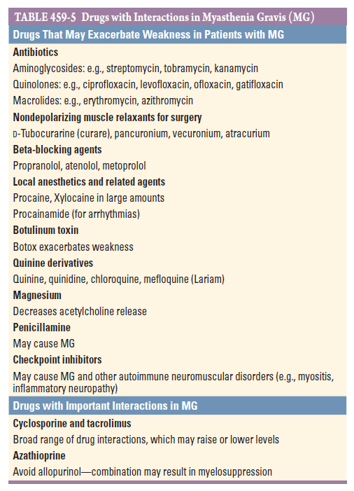

Slide 50
Thank You For Listening
☺ ☺ ☺

