Slide 1
POLYCYTHEMIA
VII MEDICAL UNIT
Chief:Prof.Dr.K.Senthil.MD
Associate prof:Dr.K.Muralidharan.MD
Assistant prof:Dr.V.Manikandan.MD
Dr.C.Ramanan.MD
Dr.S.Saravana Madhav M.D,.DTCD
Presentor:Dr.M.VINAY NAIK(PG)

Slide 2
CHIEF COMPLAINTS
A 31 Years old male patient RANJITH KUMAR r/o Bodi referred from Theni medical college as a case of Neurotoxic Snake bite over left index finger on 29/08/2021 , in view of polycythemia and blurring of vision

Slide 3
HOPI
Alleged h/o Snake bite over left index finger under alcohol influence while working in field
Presented 3 days after snake bite in view of
- Pain and paraesthesia of Lt hand
- Defective vision in right eye(sudden,painless)

Slide 4
H/o drooping of both eyelids+
H/o swelling over bite site
No h/o vomiting
No h/o diplopia
No h/o Abdominal pain No h/o Breathlessness
No h/o loss of consciousness
No h/o any Bleeding manifestations

Slide 5
No h/o Pain abdomen
No h/o reduced urine output
No h/o Breathing difficulty
No swelling of legs
No h/o Erythromelalgia
No h/o Tinnitus, Vertigo

Slide 6
PAST HISTORY
SHTN diagnosed -1 month, Not on drugs
Not a known case of DM, EPILEPSY, PTB, ASTHMA, CAD.
No h/o previous hospital admissions

Slide 7
PERSONAL HISTORY:
- Mixed diet
- Alcoholic
- coolie (Agriculture worker)
- Smoker 1 cigarette per day for 1 year stopped 2 years back
- Tobacco chewer

Slide 8
TREATMENT HISTORY:
20 vials ASV given in Theni medical college (Ptosis resolved)
No h/o OTC drugs usage
FAMILY HISTORY :
Second born son of Non consanguinous marriage , No h/o similar illness in family members

Slide 9
GENERAL EXAMINATION
O/E Pt concious
oriented
Afebrile
Polycythemic
No Clubbing
No icterus
No cyanosis
No generalised lymphadenopathy
JVP not elevated

Slide 10
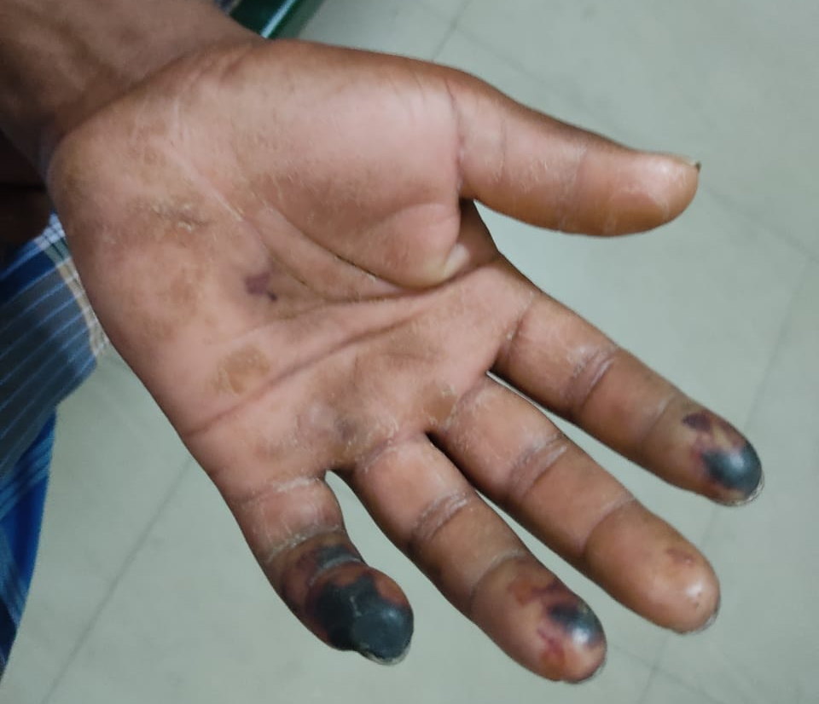
LOCAL EXAMINATION :
BLACKISH discolouration of left index finger and litter finger at distal end
Lt hand : cold and clammy skin

Slide 11
VITALS
BP- 170/120 mmhg (Rt UL) supine
170/114 mmhg (Lt UL)
160/112 mmhg (Rt LL)
160/110 mmhg (Lt LL)
BP- 160/116 in Rt UL sitting position
PR- 90/ min - Rt radial artery
- Regular, N volume
- No Radio femoral delay
left RADIAL artery and Ulnar pulsation feeble
Spo2 – 98 % RA

Slide 12
CVS – S1 S2 +, No Murmur
Apical impulse: Lt 5th ICS 0.5 cm medial to Mid Clavicular line
RS- BAE + , NVBS +
PA - Soft ,BS +
No Hepatosplenomegaly
No Renomegaly, No renal Bruit
CNS – Conscious ,oriented

Slide 13
Visual acuity: RE- Perception of light
LE- 6/6
No Ptosis
Pupils-ERTL
EOM- Full
No Nystagmus
Corneal,conjunctival reflex: Normal
Jaw Jerk-Present
Gag and Palatal reflex- Maintained
No facial asymmetry

Slide 14
Motor:
Bulk, Tone – Normal in all 4 limbs
Power- 5/5 in all 4 limbs
Plantar- Bilateral Flexor
Single breath count > 20 sec
Sensory, ANS ,cerebellum– Normal
Spine and Cranium –Normal

Slide 15
INVESTIGATIONS
IX | 31/08 | 02/08 | 05/09 | 07/09 | 09/09 | 12/09 | 15/09 | 22/09
TC | 13300 | 14200 | 12800 | 14800 | 9800 | 12200 | 13000 | 10300
DC | 75/12/13 | 72/13/15 | 70/15/15 | 73/16/11 | 51/32/17 | 49/36/15 | 55/30/15 | 68/16/16
HB | 22.4 | 19.4 | 21.1 | 22.1 | 18.5 | 17.2 | 17.9 | 15.4
PCV | 65.8 | 58.9 | 63 | 60.6 | 59 | 50 | 54 | 44.2
PLT | 3.18 | 3.50 | 1.96 | 2.63 | 3.18 | 4.41 | 5.74 | 6.21
MCV | 88.4 | 88.6 | 85 | 85.6 | 89.8 | 85 | 88.4 | 81.1
RDW | 15.4% | 15.8% | 15% | 16.0% | 15% | 16.3% | 16% | 13.6%

Slide 16
Blood urea | 23 | Sr TGL, sr Chol | 189 , 237
creatinine | 0.8 | Sr Total protein | 5.2- 2.2,3.0
RBS | 70 | Ur spot PCR | 5.5
Sr uric acid | 4.9 | VCTC , VM | NONREACTIVE
CPK | 81 | Sr Ca, po4 | 9.2 , 3.5
Sr TSH | 0.79 | Sr Fibrinogen | 667(200-400)
ANA ( IF) | Negative | B/L CV doppler | Normal

Slide 17
TB/DB/IB | 0.8/0.2/0.6 | D dimer | 3813 ng/ml
AST/ALT/ALP | 82/53/40 | PT,INR | 25,1.8( after Acitrom)
FBS | 78 | Sr EPO | 8.09 (4.3-29)
ESR | 05 | Blood c/s | No Growth
CRP | 6.3 | C3 C4 | 134 (90-180) 42.7 (10-40)
 |  | 24 hrs urine protein- 8325 mg/day (15/9/21) | 24 hrs urine protein- 9344 mg/day (18/9/21)

Slide 18
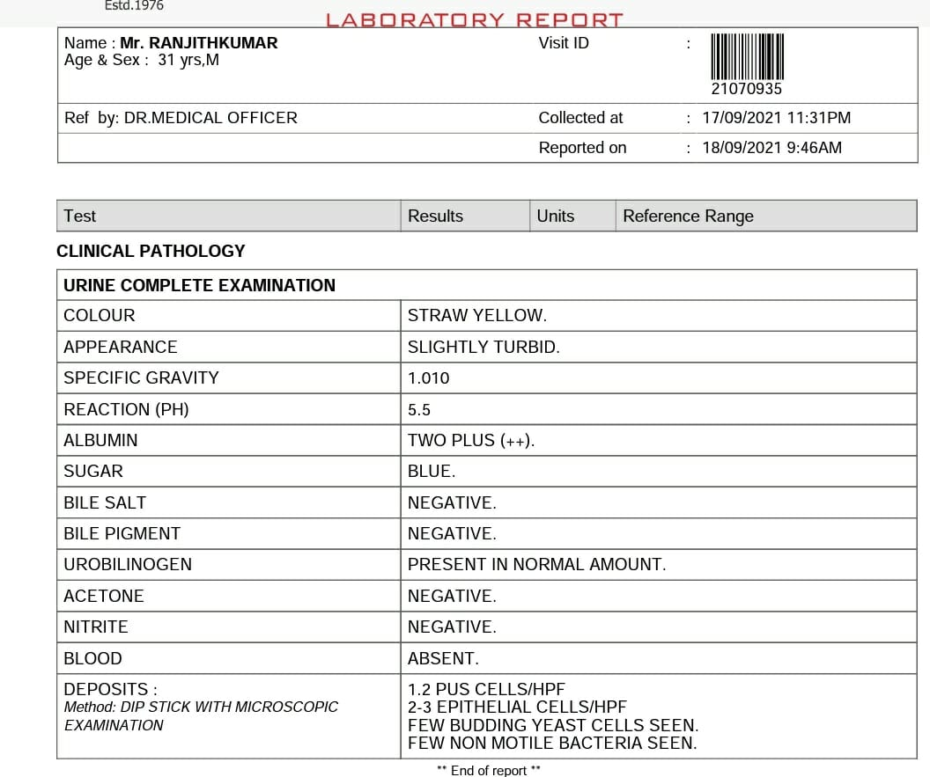
URINE ROUTINE

Slide 19
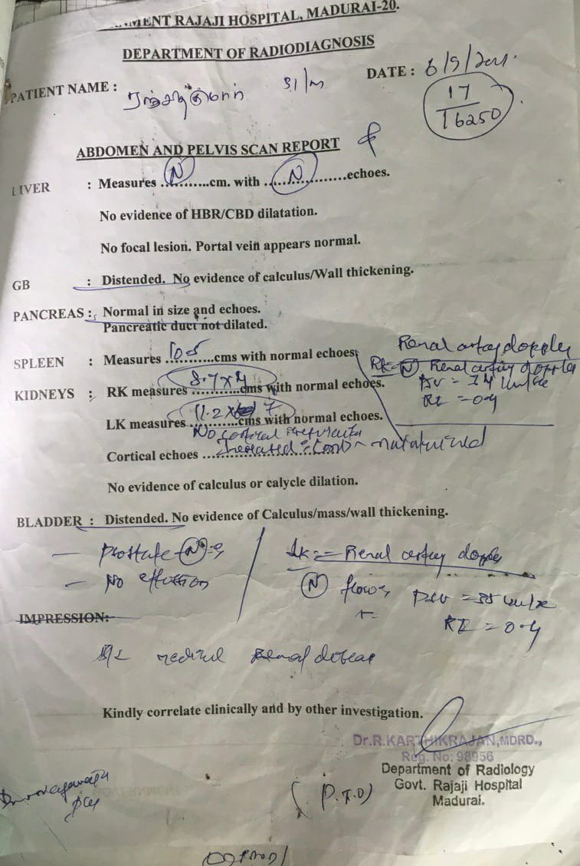
Usg abd

Slide 20
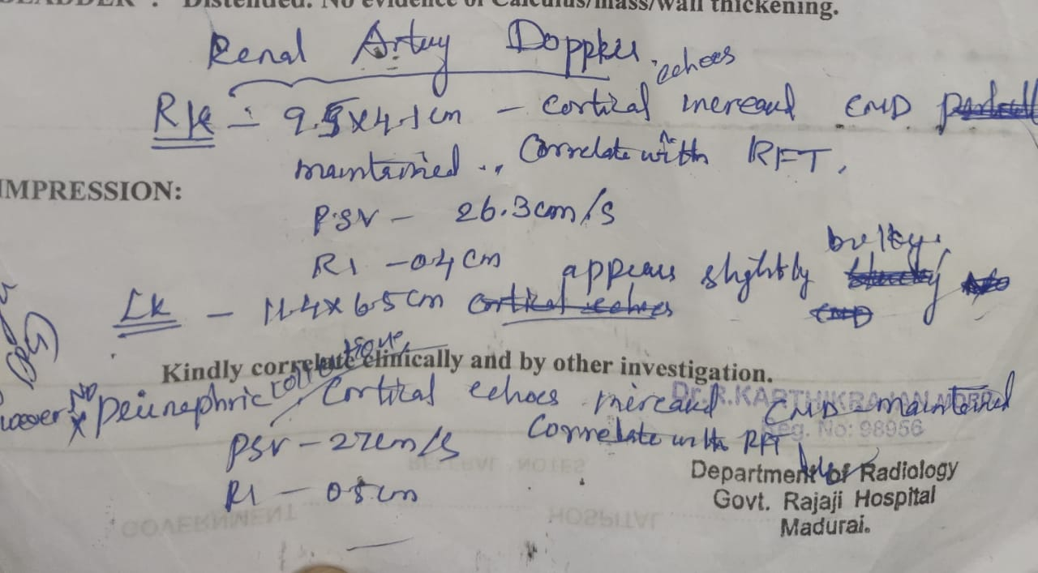
RENAL ARTERY DOPPLER

Slide 21
MRI BRAIN:
Multiple small acute infarcts, aplasia of Rt Transverse sinus
2D ECHO: Normal
CT Renal Angiogram- No evidence of RAS
CT CHEST –Normal
CECT ABDOMEN AND PELVIS- normal

Slide 22
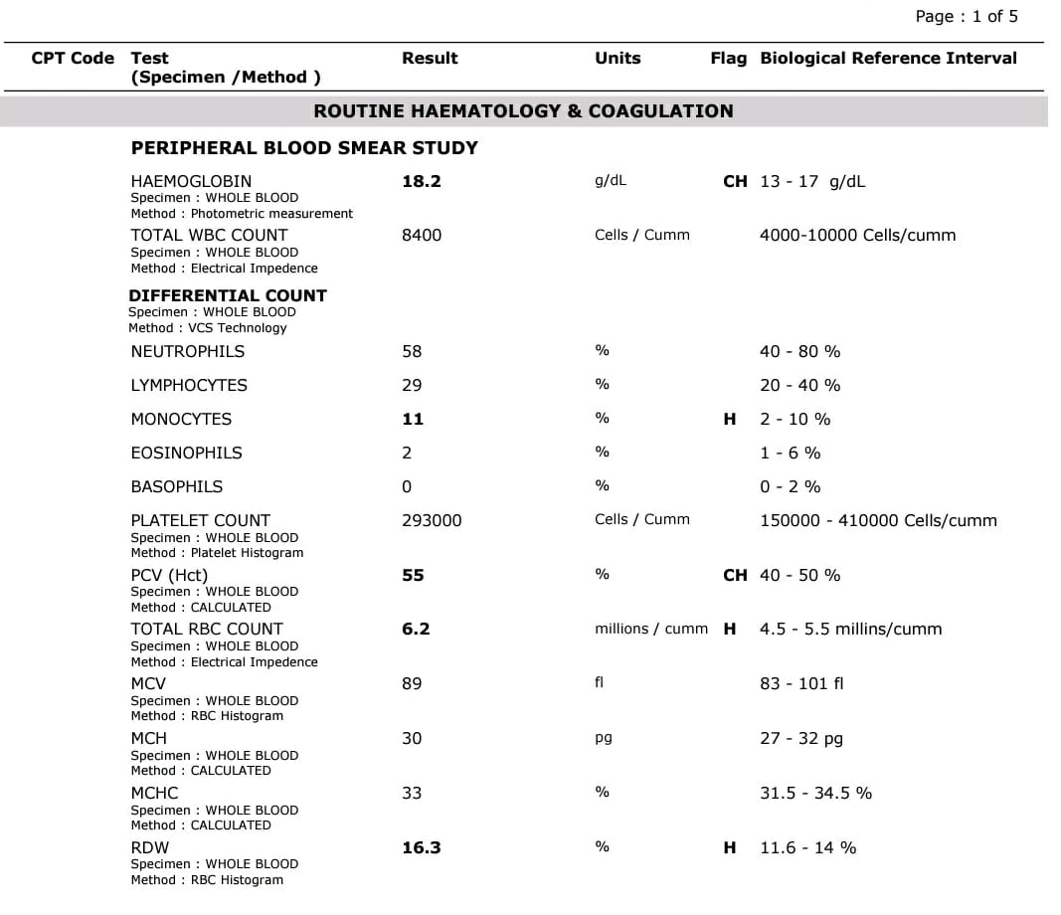

Slide 23
PERIPHERAL SMEAR

Slide 24
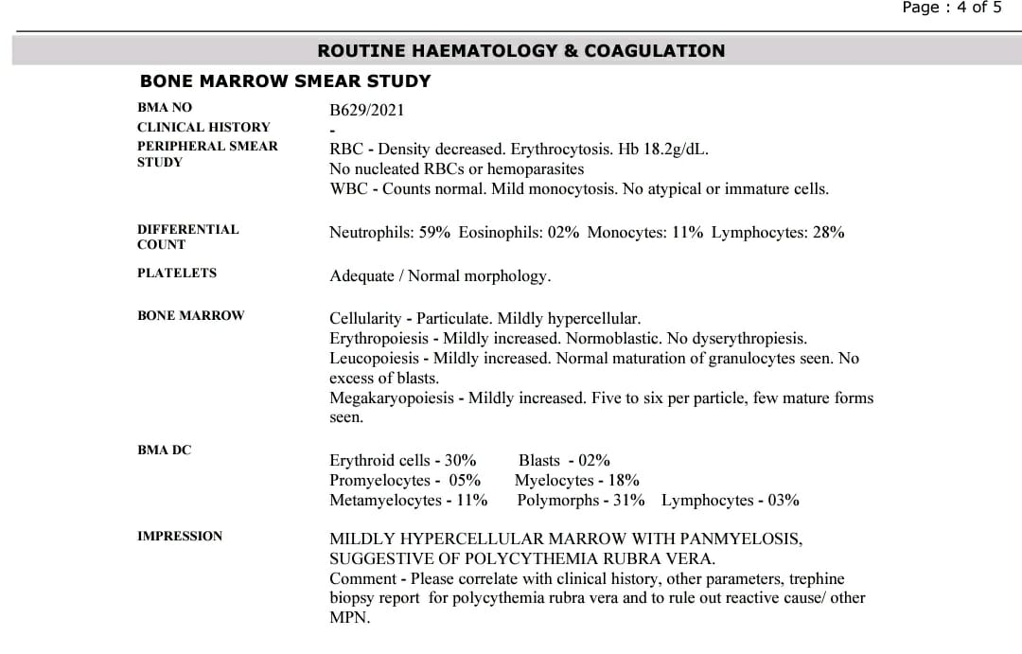
BONE MARROW SMEAR

Slide 25
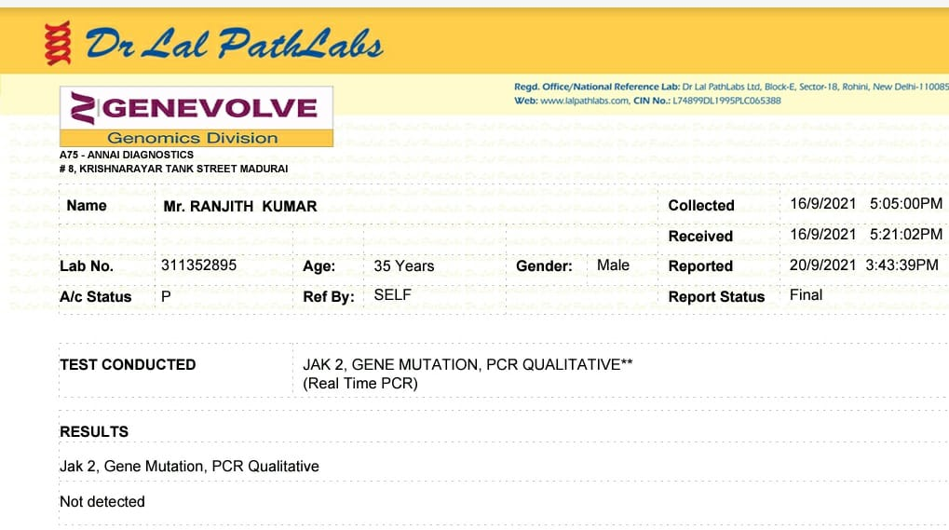
JAK 2 MUTATION

Slide 26
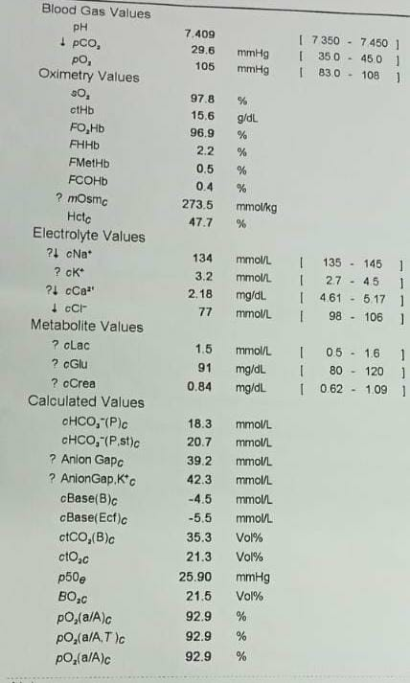
ABG

Slide 27
ARTERIAL DOPPLER
Arterial THROMBUS noted in middle 1/3rd of lt Ulnar artery ,distal 1/3rd of lt radial artery with monophasic flow

Slide 28
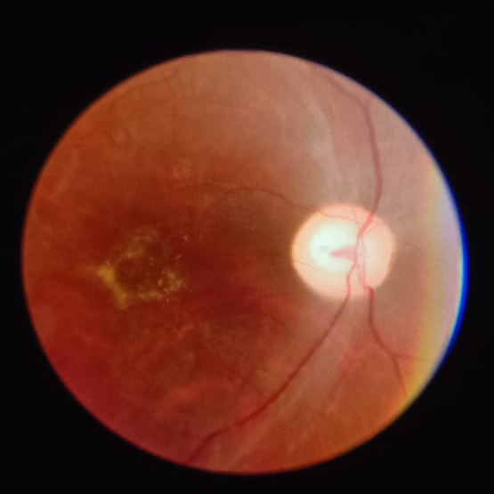
ophthalmology opinion
IMP- RIGHT EYE CRAO
ADVICE- continue other line of management

Slide 29
VASCULAR SX OPINION:
Advise: INJ Heparin 5000U IV QID
T.ASPIRIN 75MG 0D
T.ATORVASTATIN 20MG HS
NEPHROLOGY OPINION:
Plan- renal biopsy

Slide 30
TREATMENT GIVEN
INJ HEPARIN 5000U IV QID
INJ CEFTRIAXONE 1G IV BD
INJ TRAMADOL 50MG IM (SOS)
T. ASPIRIN 75MG OD
T.ATORVASTATIN 20 MG HS
T.AMLODIPINE 10MG OD
T.ENALAPRIL 2.5 MG BD
T.CILASTAZOLE 50MG BD
PHLEBOTOMY DONE 3 TIMES(14/9, 18/9, 23/9)

Slide 31
WHAT NEXT ?

Slide 32
Medical oncology opinion
IMP- POLYCYTHEMIA VERA WITH EXTENSIVE AV THROMBOSIS
PHLEBOTOMY 350ML every 2 days
Cap. Hydroxyurea 500mg 1-0-1 and maintain the dose to 1500mg/day after a week if TC is normal

Slide 33
DIFFERENTIAL diagnosis
1.Nephrotic Syndrome induced secondary polycythemia
2.Exon 12 variety of Polycythemia
3.Familial (Chuvash) Polycythemia

Slide 34
Nephrotic Syndrome induced polycythemia
Wait and watch after treatment for Nephrotic Syndrome

Slide 35
POLYCYTHEMIA VERA
POINTS FAVOURING-EXON 12
POINTS AGAINST
Isolated Erythrocytosis
Normal EPO
Young age onset
Arterial thrombosis
Panmyelosis in Bonemarrow
No splenomegaly
No Basophilia
No aquagenic Pruritis
JAK 2 mutation negative (95% common)

Slide 36
FAMILIAL POLYCYTHEMIA
points favouring:
-Borderline Hb for his own brother- (15.6gm/dl),
father- (10.5gm/dl)
-Ruled out other major causes of polycythemia
Points against:
- Non consanguinous marriage
- Arterial thrombosis

Slide 37
PENDING INVESTIGATONS
Renal biopsy
Exon 12 Mutation
VHL mutation (last priority)

Slide 38
THANK YOU

