Slide 1
CLINICO PATHOLOGICAL CONFERENCE
By Vth medical unit,
CHIEF.PROF.DR.S.PEER MOHAMED M.D,
ASST PROF DR.M.SATHEESHKUMAR M.D,
DR.C.VIGNESH M.D,
DR.V.PRIYA M.D.
)

Slide 2
REFERRAL DETAILS :-
A 31 year old female admitted in Virudhunagar medical college for easy fatiguability , abdominal pain and anemia (Hb – 6.2).
Treated with 2 packed red cell transfusion & referred to Madurai medical college in view of pleural effusion & ascites.

Slide 3
HOPI :-
H/O weight loss- 3 months
H/O easy fatiguability for 20 days
H/O breathlessness on exertion for 20 days
H/O intermittent low grade fever -20 days
H/O loss of appetite-10 days
H/O abdominal pain -4 days
No H/O vomiting
No H/O chest pain
No H/O dyspnoea
No H/O abdominal distension

Slide 4
Past history :
N/K/C/O T2DM,SHTN,BA,TB,epilepsy and thyroid disorders.
Obstetric history :
P2L1D1
IUD at 7th months of GA during 1st pregnancy
Menstrual history :
LMP – 3 months back.
Till 3 months back, normal menstrual cycle-secondary amennorhea-hypothyroid

Slide 5
General examination :-
Patient conscious & oriented
Pallor +
No icterus
No cyanosis
No clubbing
No pedal edema
Cervical and inguinal lymphadenopathy +

Slide 6
Vitals :-
BP – 110/70
PR – 84/min
SpO2 – 99% IN RA
RR – 14/min
Anthropometry :-
Height – 136 cm
Weight – 32kg
BMI – 17.3 Kg/m2

Slide 7
Systemic examination :-
CVS – S1,S2 + , NO Murmur
RS – B/LAE +, no added sounds.
P/A – Soft, BS+,
Spleen palpable 2cm below costal margin
Liver palpable 2cm below costal margin
CNS - NFND

Slide 8
INV | 7/1/24 | 15/1/24 | 18/1/24 | 20/1/24
WBC | 7800 | 7000 | 6900 | 8200
HB | 11.1 | 12 | 12.4 | 12.2
PLT | 2.13L | 2.3L | 2.87L | 3.1L
UREA | 15 | 19 | 23 | 17
CREATININE | 0.6 | 0.9 | 0.8 | 0.9
Na+ | 132 | 137 | 140 | 138
K+ | 3.6 | 3.5 | 3.9 | 3.4
LFT | 7/1/24 | 14/1/24
T.B | 0.7 | 0.8
D.B | 0.4 | 0.5
I.B | 0.3 | 0.3
OT | 120 | 36
PT | 150 | 39
ALP | 183 | 191
FLP | 7/1/24 | 18/1/24
S.CHOL | 257 | 262
S.TGL | 442 | 382
S.HDL | 35 | 28
S.LDL | 134
S.VLDL | 88

Slide 9
Other Investigations :-
ESR = 22
CRP = POSITIVE
S.LDH = 738
S.Ferritin = > 1000
S.TSH = 21.52 ( HYPOTHROID )
TOTAL T4 = 7.09(5.2-12.7mcg/dl)
T.Protein = 4.6
S.Albumin = 2.4
S.globulin = 2.4
URINE C/S = no growth
URINE R/E :-
Albumin = nil
Sugar = nil
Dep = 0-2 pus cells
Spot pcr - 30MG/G
ECHO :-
EF – 60%
NO RWMA
NORMAL STUDY
VCTC:NON –REACTIVE
VIRAL MARKERS: HBSAG-NEGATIVE
HCV-NEGATIVE

Slide 10
ANA :-

Slide 11
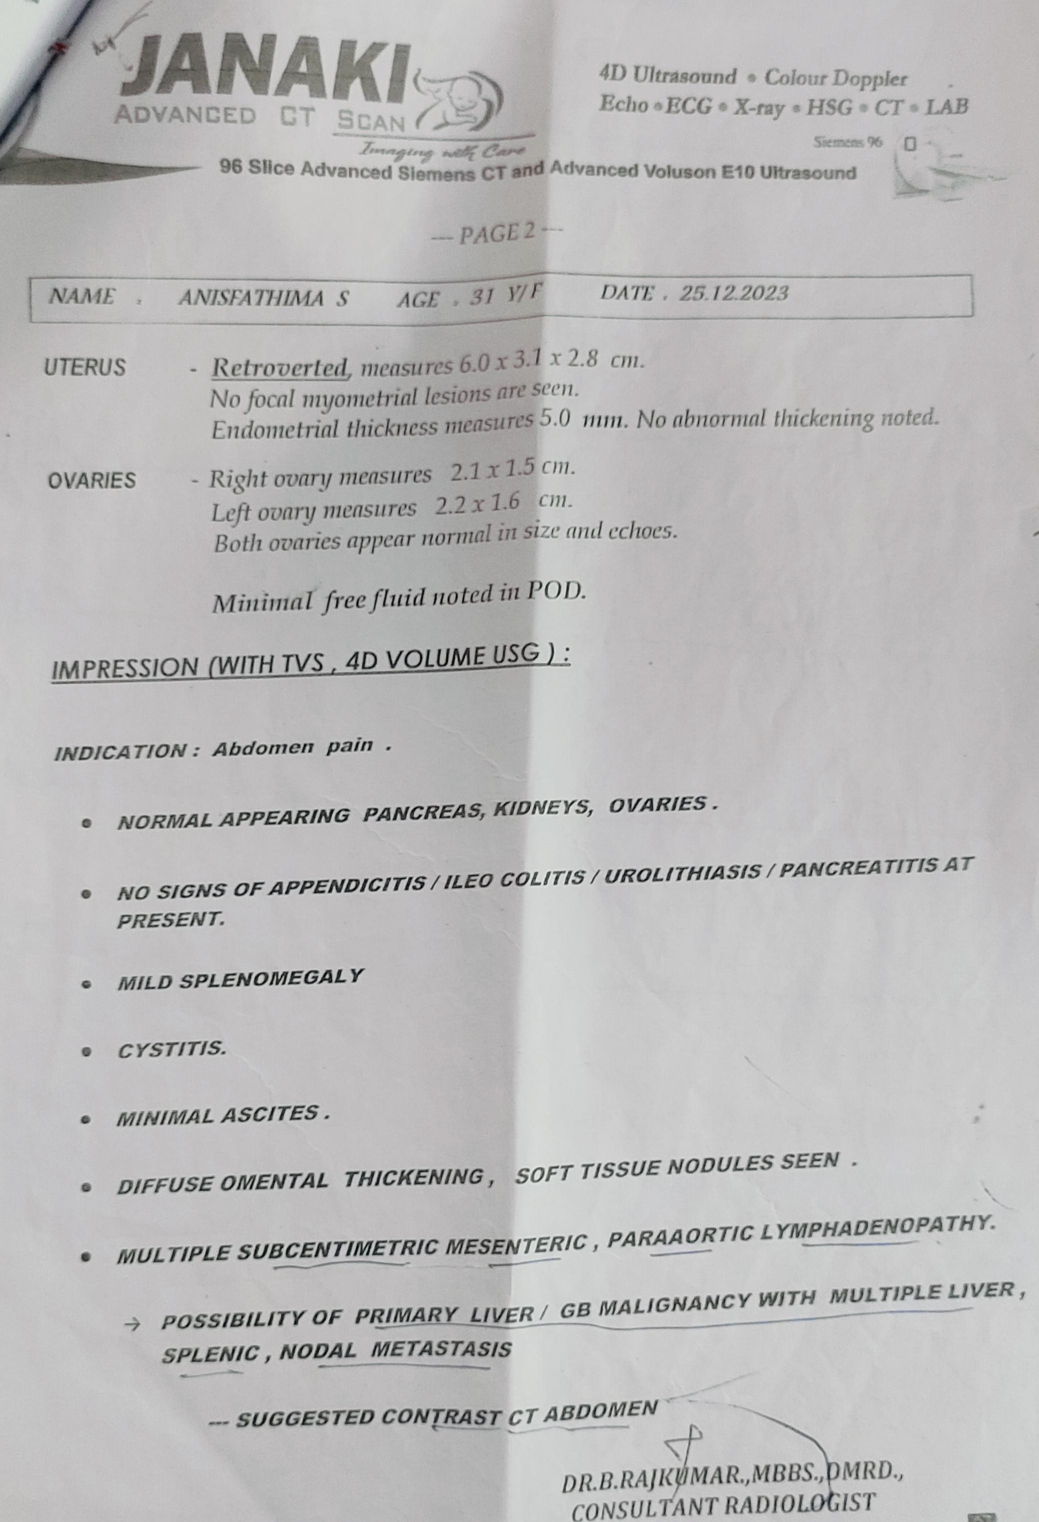
USG abdomen & pelvis (25/12/23) :-

Slide 12
USG FINDINGS
MULTIPLE ILLDEFINED HETEROECHOIC NODULES IN LIVER
MILD SPLENOMEGALY
MINIMAL ASCITIES
DIFFUSE OMENTAL THICKENING AND SOFT TISSUE NODULES SEEN
MULTIPLE SUBCENTIMETRIC MESENTRIC AND PARAORTIC LYMPHADENOPATHY
POSSIBILITY OF PRIMARY LIVER/GB MALIGNANCY WITH MULTIPLE LIVER SPLENIC AND NODAL METASTASIS

Slide 13
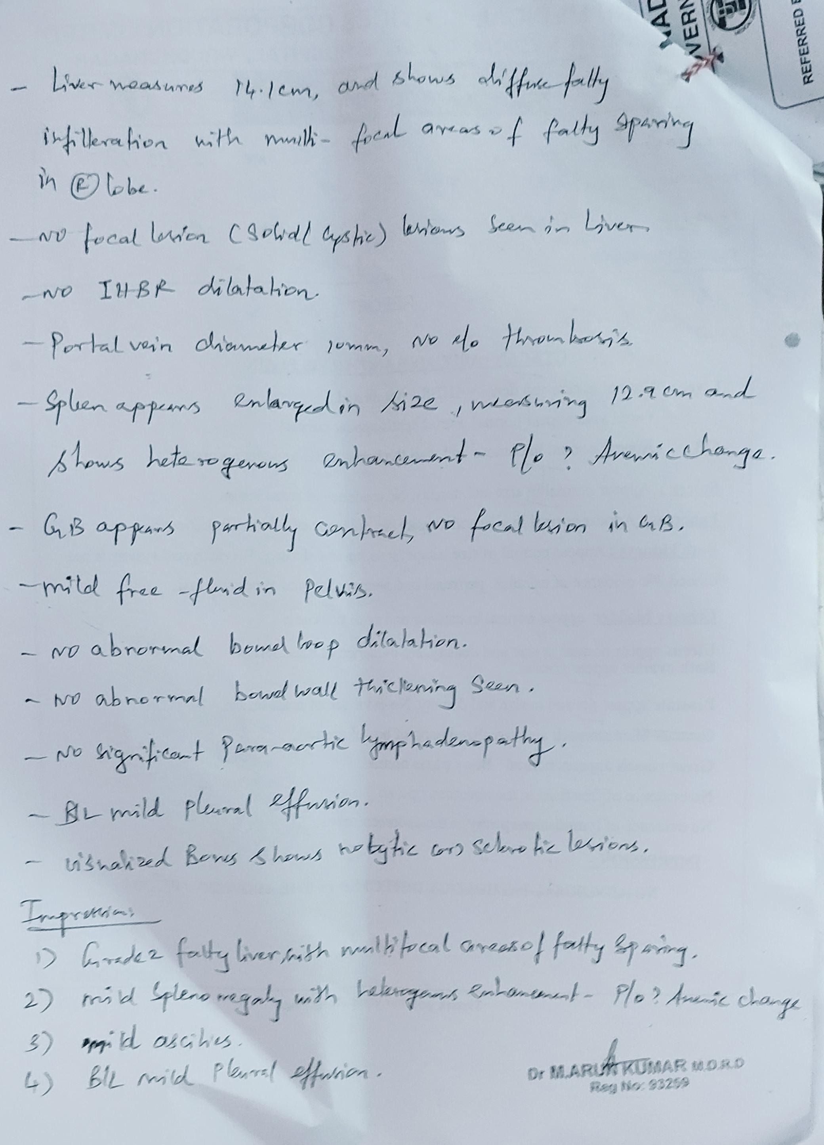
CT ABDOMEN (29/12/23) :-

Slide 14
CT ABDOMEN:
GRADE2 FATTY LIVER WITH MULTIFOCAL AREAS OF FATTY SPARING
MILD SPLENOMEGALY WITH HETEROGENOUS ENHANCEMENT
MILD ASCITES
B/L MILD PLEURAL EFFUSION

Slide 15
CT ABDOMEN(9/01/24):
Fatty liver with focal areas of sparing
Mild splenomegaly with multiple
Illdefined hypodense lesion with no
Contrast enhancement –
P/O gamma gandy bodies
b/l minimal pleural effusion R>L with
Resolving consolidation changes in
Rt middle lobe

Slide 16
CT CHEST (2/1/24)

Slide 17
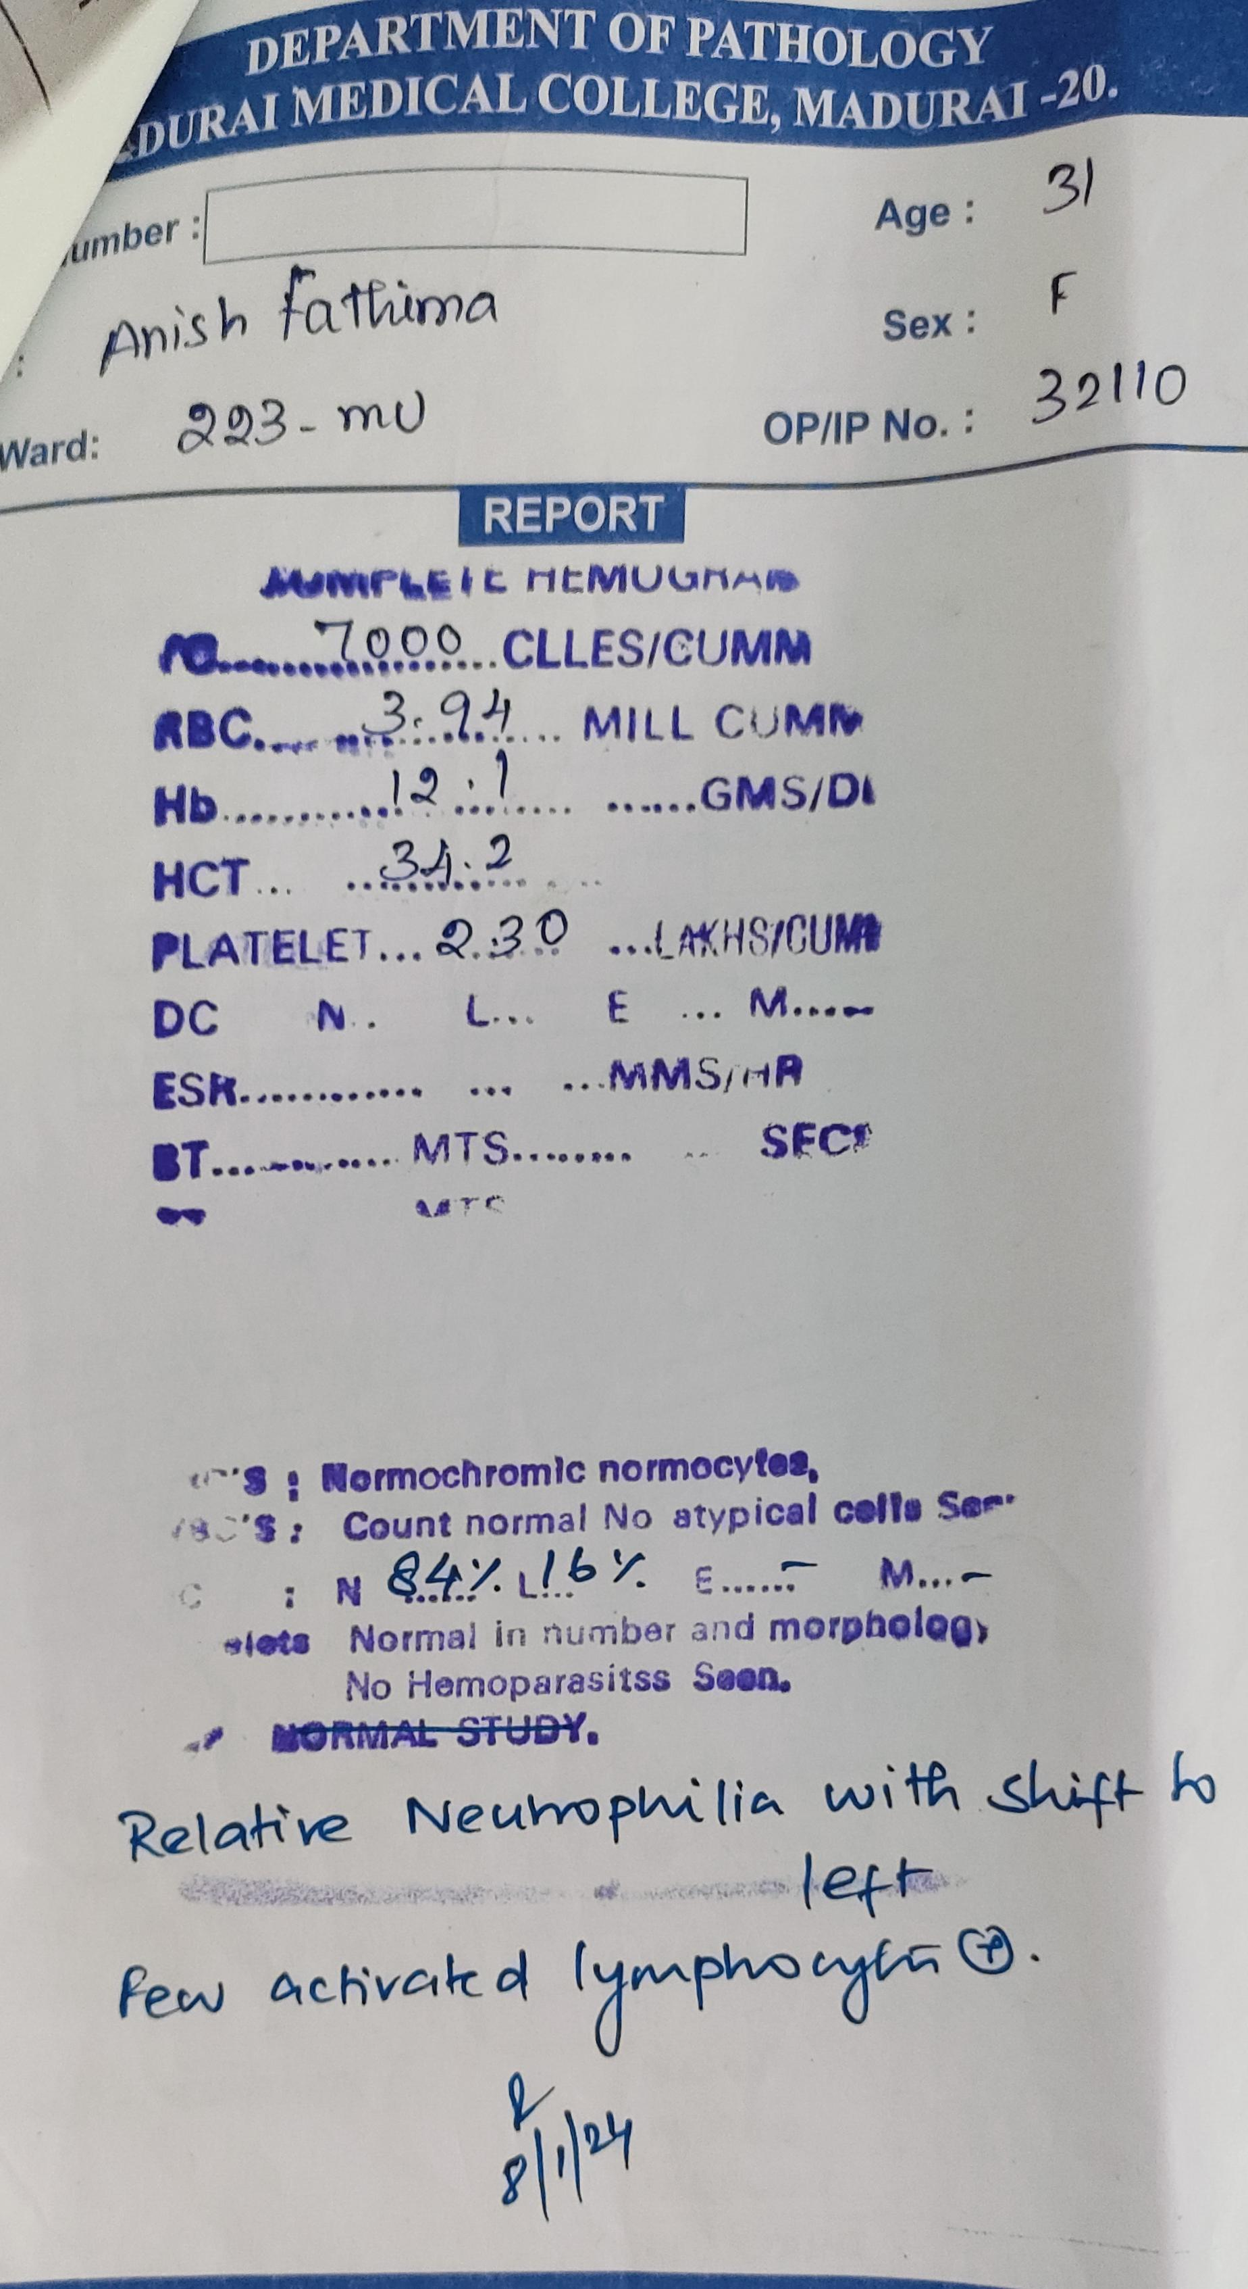
Peripheral smear :-

Slide 18
Bone marrow biopsy (11/1/24) :-
Bone marrow biopsy shows
Scattered epithelioid granuloma
(favouring tuberculosis)

