Slide 1
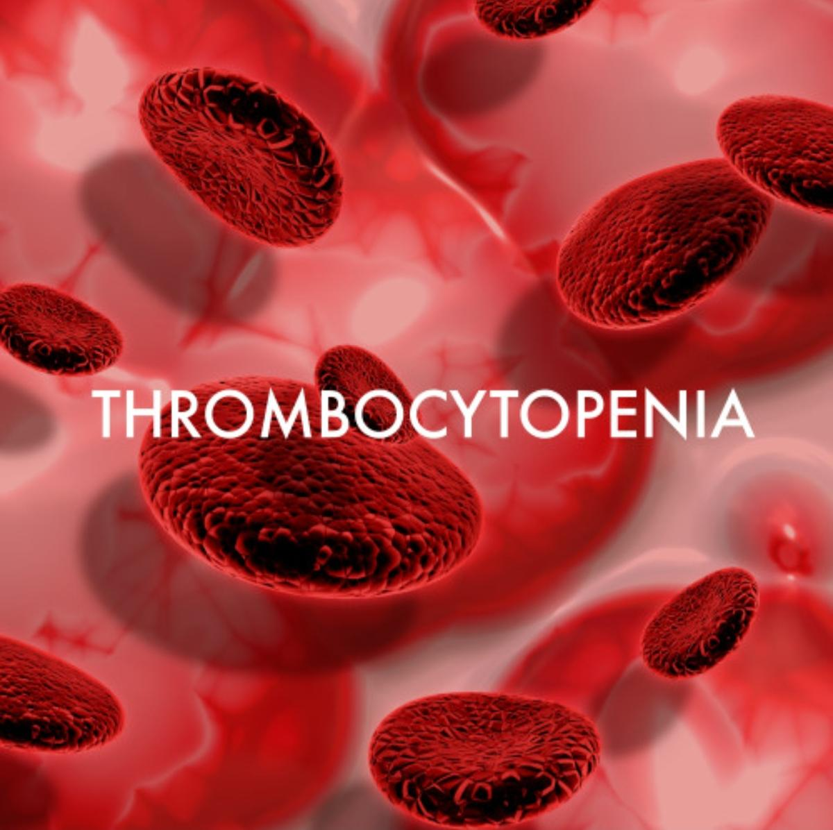

Slide 2
THROMBOCYTOPENIA
BY SEVENTH MEDICAL UNIT
CHIEF-DR.K SENTHIL MD
ASSOCIATE PROFESSOR:DR.MURALIDHARAN MD
ASSISTANT PROFESSORS:
DR.NASEEMA BANU
DR.JENEFIN PONPUSHPA
PRESENTOR:DR.SATHIYA PRIYA
(1ST YEAR POSTGRADUATE )

Slide 3
Platelets are produced from MEGAKARYOCYTES ,multinucleate hematopoietic cells located in bone marrow
Life span of Platelet 7 to 10 days
NORMAL VALUE:
1,50,000 to 4,50,000/microlitre
Mild :more than 70,000
Moderate:20,000 to 70,000
Severe: less than 20,000
Functions:
primary hemostasis
Formation of Platelet plug at the sites of injury

Slide 4
CAUSES OF THROMBOCYTOPENIA:
Decreased bone marrow production
Increased Platelet destruction
Spleenic sequestration

Slide 5
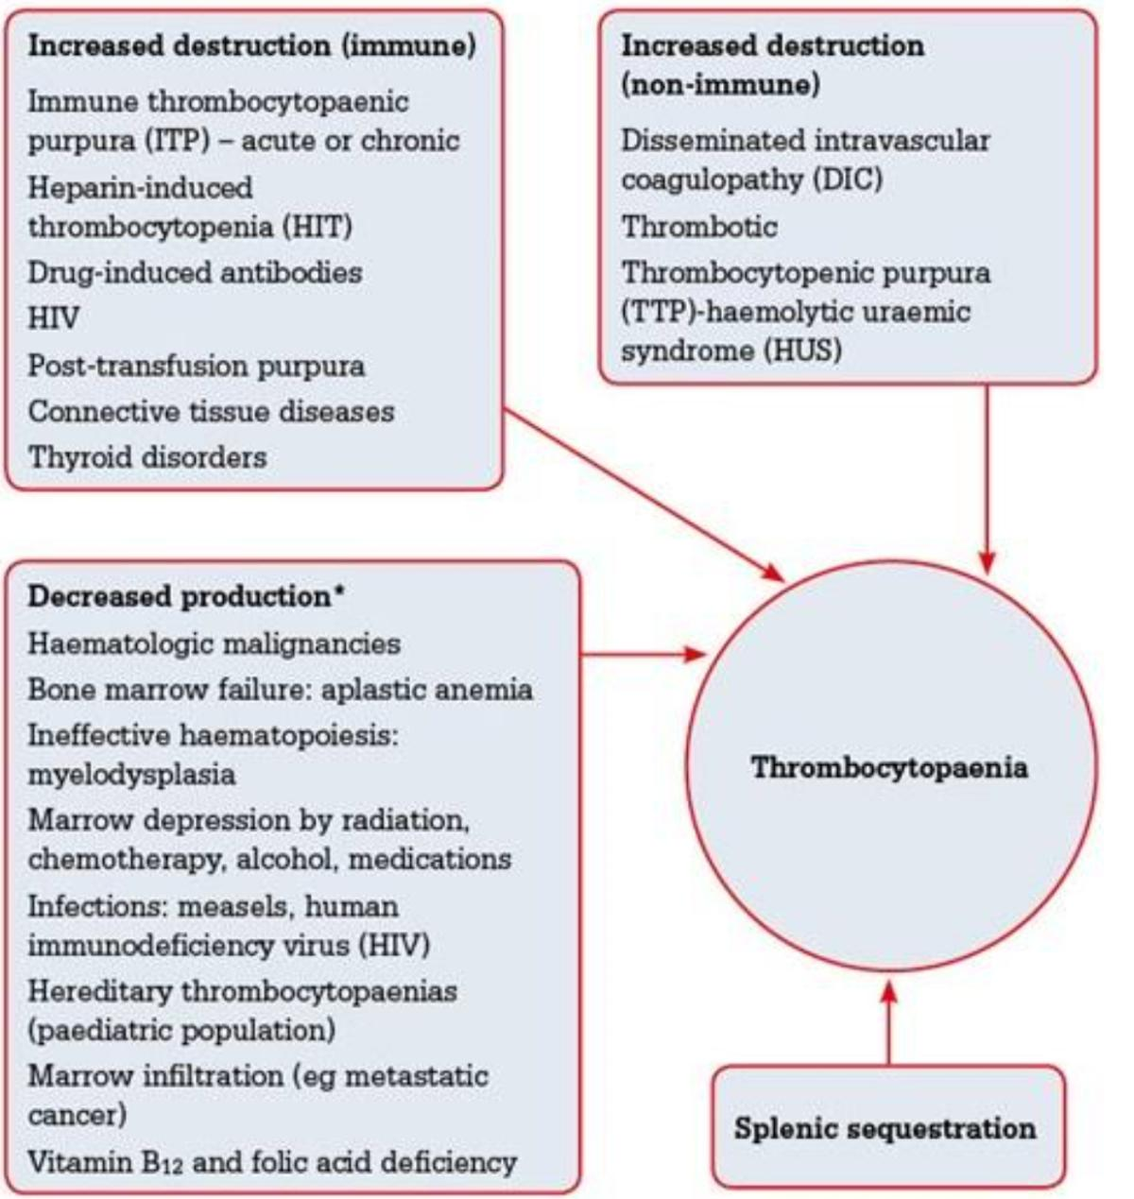

Slide 6
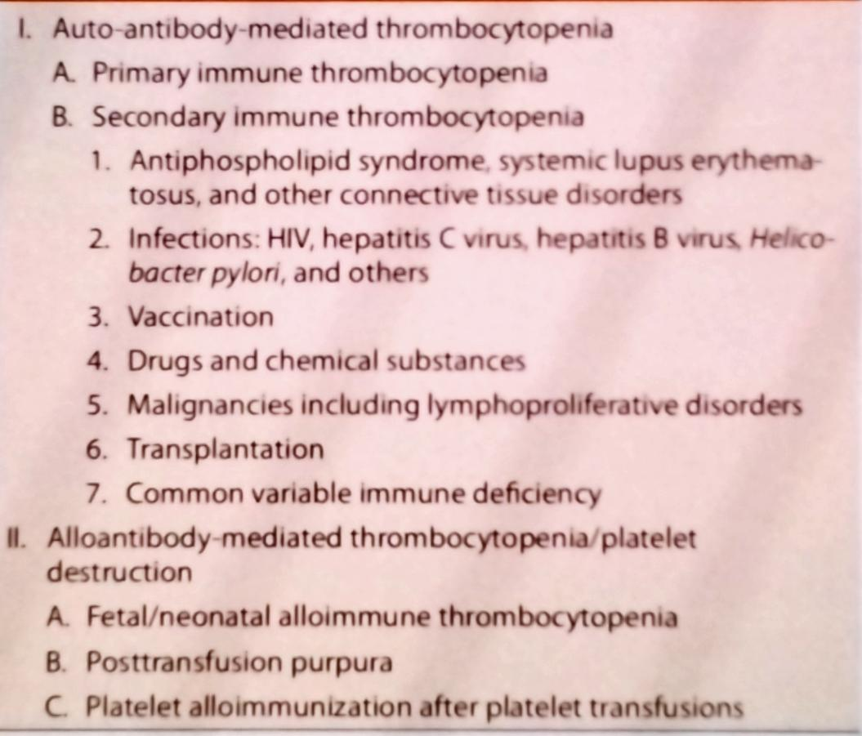
ITP:

Slide 7
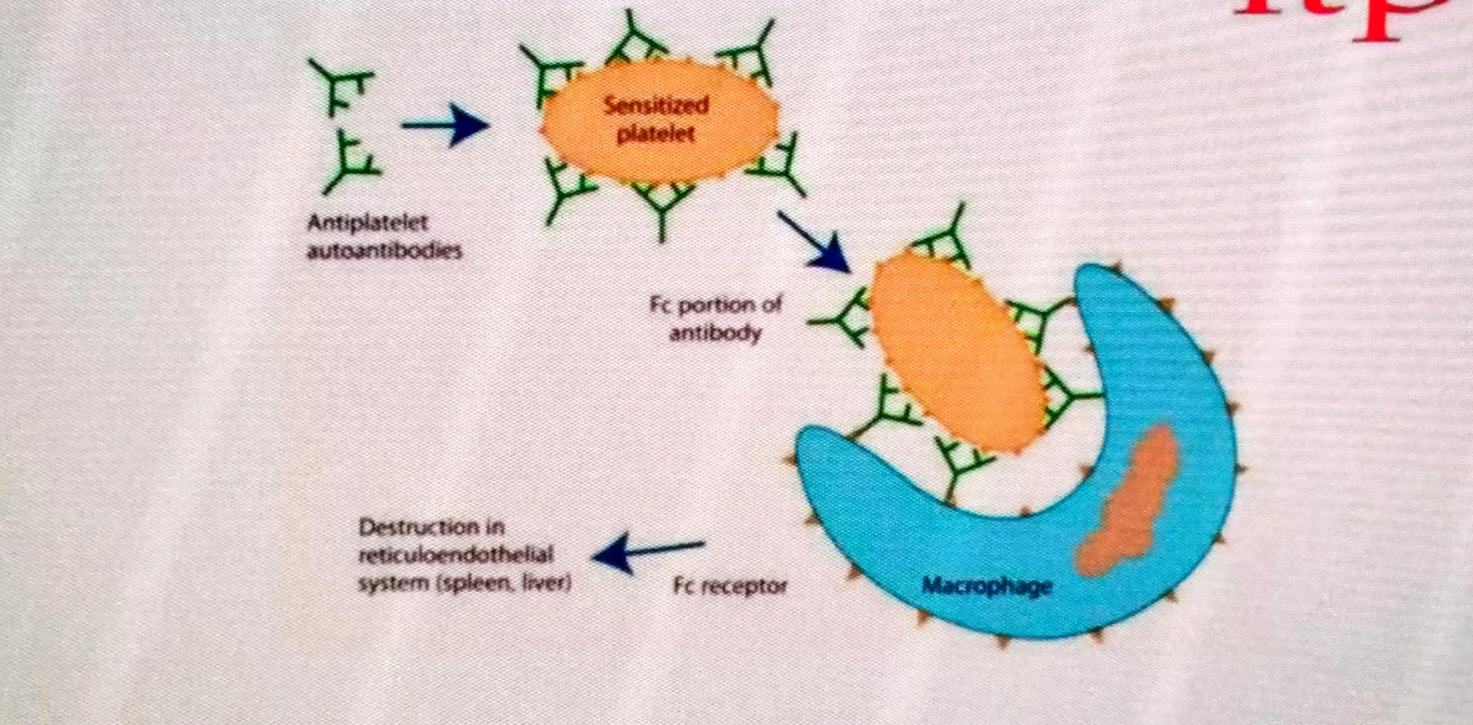
PATHOPHYSIOLOGY:

Slide 8
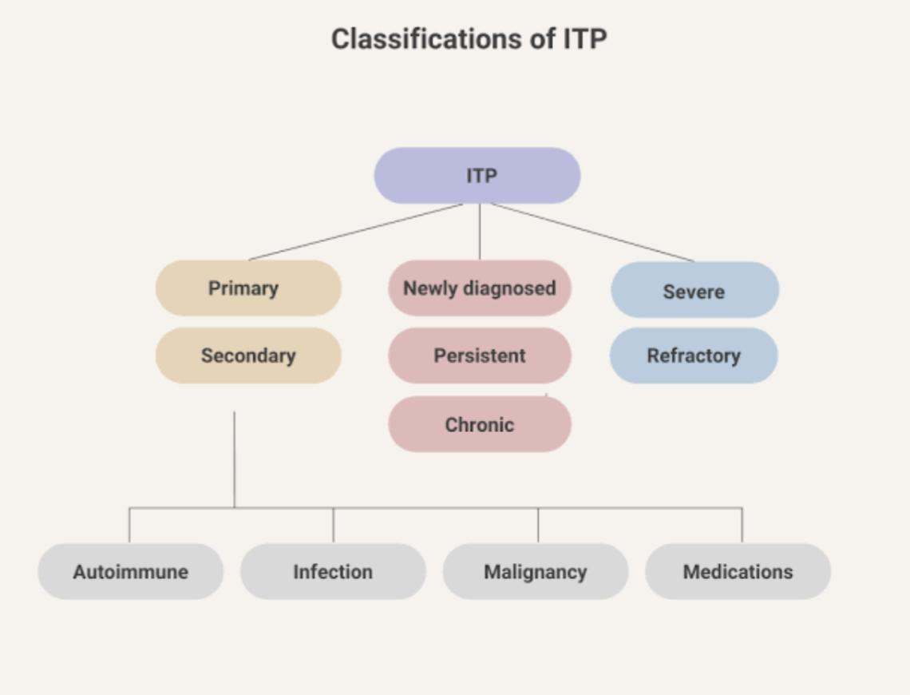
CLASSIFICATION OF ITP:

Slide 9
Clinical features of ITP :
 | ACUTE | CHRONIC
AGE | 2-4yrs | 15-40yrs
Sex | None | Females more than males
Prior infection | Common | Unusual
Spontaneous remission | 83% | 2%
Response to splenectomy | 71% | 66%
Onset of bleeding | Sudden | Gradual
Duration | 2-6 week | Months to years
Platelet count | Less than 20,000 | 30,000 to 80,000

Slide 10
SIGNS AND SYMPTOMS
EASY FATIGUABILITY
EASY BRUISING
PETECHIAE
EPISTAXIS
GUM BLEEDING
HEMATURIA
PROLONGED BLEEDING FROM WOUND SITE
HEAVY MENSTURAL BLEEDING

Slide 11
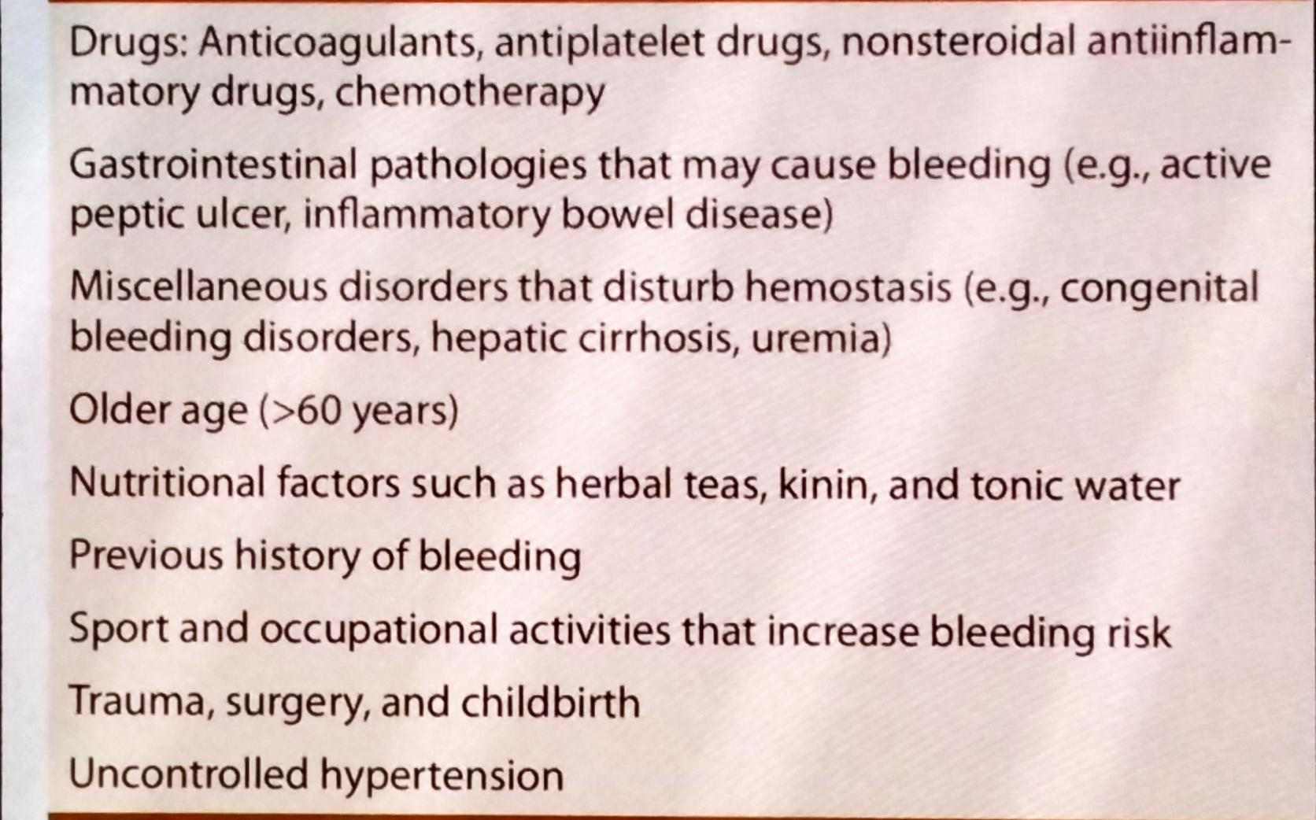
CONDITIONS THAT INCREASE THE BLEEDING RISK IN ITP:

Slide 12
LABORATORY FINDINGS IN ITP:
ISOLATED THROMBOCYTOPENIA
NO SPLEENOMEGALY
INCREASED MEGAKARYOCYTES
NO OTHER CAUSES
PLATELET AUTOANTIBODY
HB and WBC should be normal
Secondary causes of ITP:
HIV,HCV,HBV,H.PYLORI,ANA
If anemia present DCT performed to rule OUT
EVANS SYNDROME,

Slide 13
BONE MARROW INDICATIONS IN ITP: Abnormal WBC count or unexplained anemia suggestive of malignancy
Cell lines other than Platelets affected
Before starting Steriod
leukemia

Slide 14
TREATMENT:
Observation only for Platelet >30,000 with no bleeding
GLUCOCORTICOIDS:
Initial treatment for patients with ITP
MECHANISM :
Inhibits phagocytosis of antibody coated platelets by macrophages
Decreasing autoantibody production
Improving marrow Platelet production

Slide 15
Oral PREDNISOLONE preferred as the first line therapy
Dose- 1 to 2 mg/kg/day
Responds to prednisone therapy within 3 weeks
If the patients doesn’t responds to prednisone therapy other drugs like methylprednisolone, dexamethasone can be used
Dexamethasone 40mg/day for 4 consecutive days for one course and with same dose for 4 courses given every 2 weeks .
High dose methylprednisolone therapy has also found to be effective .
Side effects of steroids:
Facial swelling
Weight gain
hyperglycemia
Osteoporosis
Cataracts
Bone necrosis

Slide 16
IVIG:
Mechanism:
Blockade of macrophage Fc receptor
decreases autoantibody production
Dosage:2gm/kg administered either as 0.4g/kg/Day for 5 days or 1gm/ kg for 2 days
If need to increase Platelet count rapidly IVIG combined with glucocorticoids
Adverse effects:
Aseptic Meningitis
Hepatitis, Renal failure
Alloimmune hemolysis
Thrombosis

Slide 17
RITUXIMAB:
Monoclonal antibody against CD20
It rapidly depletes B Cells in patients with autoimmune diseases
Dosage:100 to 375mg/m2 weekly infusion for 4 weeks
Adverse effects:
Infections
HBV reactivation
ANTI (Rh)D:
Used as second line therapy if glucocorticoid contraindicated
It is not effective in Rh negative patients and after splenectomy
DOSAGE::50 to 75mcg/kg Iv infusion over 5 minutes
Side effects:
Hemolytic anemic
Anaphylactic reaction

Slide 18
Splenectomy:
Decrease antibody production and Platelet destruction
85% of patients with persistent or chronic ITP responds well to splenectomy
Side effects:
bacterial infections
Bleeding
Thrombosis
Splenectomy not recommended in pts with Hepatitis, HIV,CVID .
Post splenectomy sepsis is a major cause in mortality in ITP
To minimize the risk patient should be immunized 2 weeks before splenectomy with pneumococcal,H.influenza B,meningococcal vaccine

Slide 19
TPO RECEPTOR ANTAGONIST:
ELTROMBOPAG:
Binds to TPO receptor triggers megakaryocytes growth ad and increase Platelet production
Oral dose of 25 to 75 mg
Recent study reveals 50mg daily for 6 weeks f/B 4 weeks off therapy over 3 cycles
Interfere with statins ,Liver function abnormality
ROMIPLASTIN:
Subcutaneous dose of 1 to 3mcg/ kg
If Platelet count does not reach to safe level by 4 weeks of theraphy ,it should be discontinued
safe in renal and hepatic
Not safe in pregnancy
SIDE EFFECTS:
Thrombosis, Nasopharyngitis
Myelofibrosis

Slide 20
OTHER AGENTS ARE:
CYCLPHOSPHAMIDE
CYCLOSPORINE
DAPSONE
VINCA ALKALOIDS
AZATHIOPRINE:
Oral dosage of 50 to 250mg/day upto 4 months
safe to use in pregnancy
Side effects: marrow suppression, Malignancy

Slide 21
ITP IN PREGNANCY:
Most common in 1st and 2nd pregnancy
MECHANISM:
IGg antibody against Platelet glycoprotein leads to destruction of Reticuloendothelial system
Risk of maternal bleeding and fetal thrombocytopenia common
When to treat:
count <30,000 with bleeding manifestation
Observe :count > 30,000 ,no bleeding manifestation
1st line treatment:IVIG and steroids
Other agents: AZATHIOPRINE Safe in pregnancy
Rituximab and cyclophosphamide are contraindicated
During vaginal delivery Platelet should be >50,000
In C section Platelet count should be >70,000

Slide 22
HEPARIN INDUCED THROMBOCYTOPENIA:
Immune mediated disorder where antibodies activate Platelets results in thrombocytopenia + thrombosis
HIT increases the risk of bleeding
HIT develops after exposure to heparin for 5 to 14 days

Slide 23
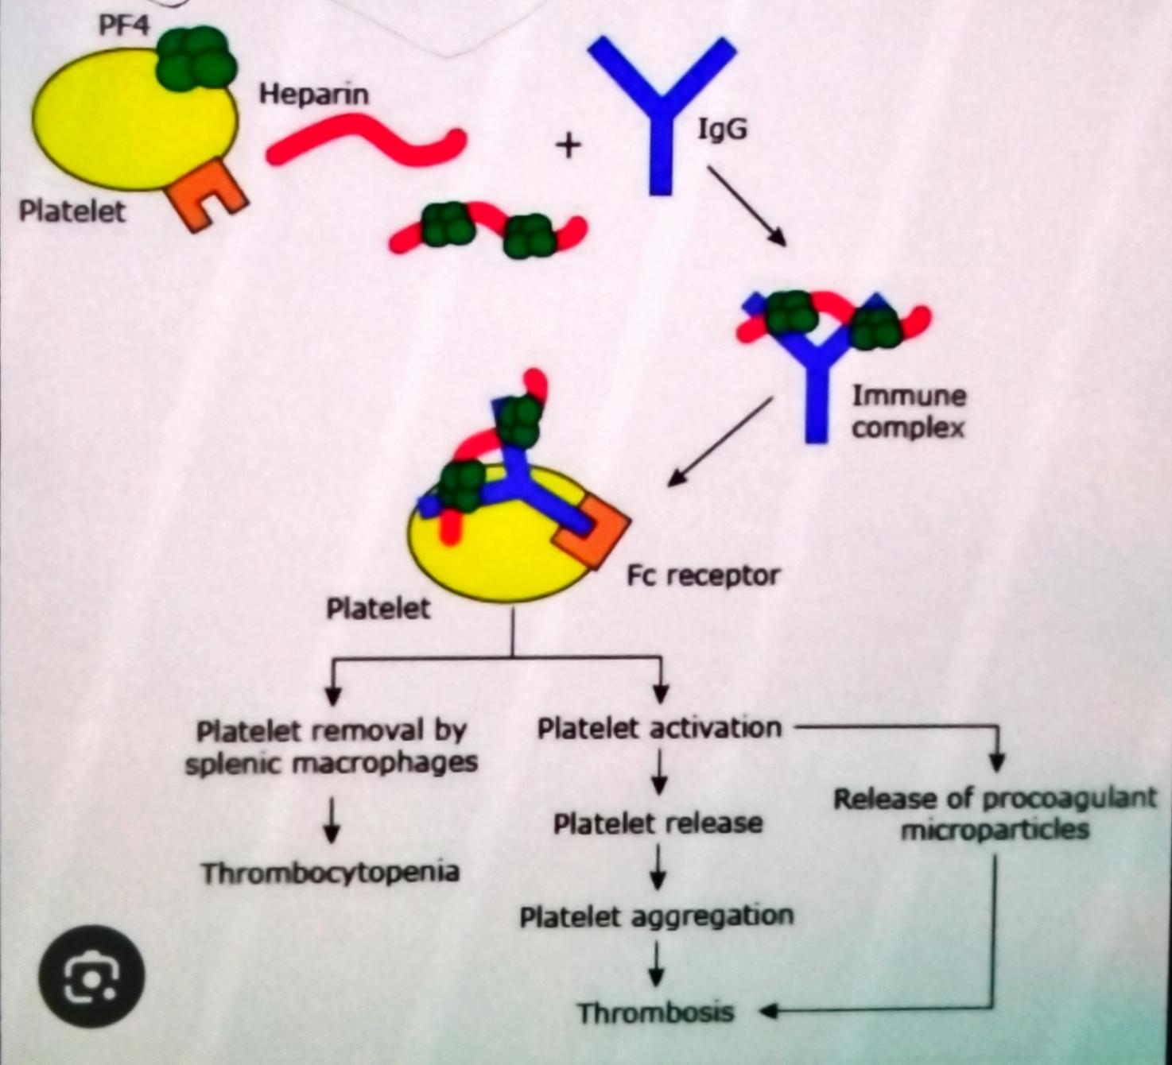
PATHOPHYSIOLOGY:

Slide 24
Heparin induced thrombocytopenia risk factors:
Patient specific factors:
Heparin specific factors:
Surgical >medical
Major trauma >minor trauma
Female >male
UFH>LMWH
Duration:5 days>shorter course

Slide 25
TYPES OF HIT
 | TYPE 1(NON IMMUNE) | TYPE 2(IMMUNE)
ONSET | 1-4 days | 5-14 days
Severity of thrombocytopenia | Mild (1 lakhs) | Moderate (60,000)
Thrombosis | No | Yes
Management | Observation | Anticoagulant

Slide 26
CLINICAL DIAGNOSIS
1.TIMING:
Rapid onset:within 90days of exposure results in fall in count after reexposure
Delayed onset:After 10-14 days
2.Platelet fall less than 50%
3.Thrombosis

Slide 27
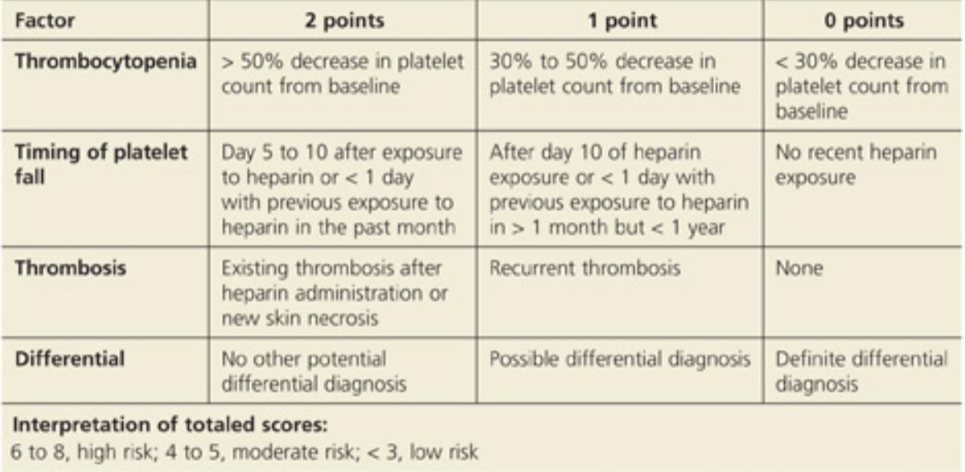
4T’S SCORE OF HIT

Slide 28
IMMUNOASSAY:
ANTIPF4 HEPARIN ANTIBODIES
LABORATORY DIAGNOSIS
FUNCTIONAL ASSAY:
SEROTONIN RELEASE ASSAY
HIPA

Slide 29
TREATMENT:
Immediate withdrawal of Heparin
Initiating direct thrombin inhibitors like
ARGATROBAN
BIVALIRUDIN
Warfarin should not be used as initial anticoagulant in HIT increases the risk of limb gangrene
Warfarin should be initiated only once the Platelet count improved
Warfarin should be overlapped with DTI For 5 days
Platelet transfusion increase the risk of thrombosis
Transfusion considered in severe bleeding

Slide 30
Duration of anticoagulant in HIT:
ISOLATED HIT:4 WEEKS
HIT associated with Thromboembolism:3 to 6 months

Slide 31
Heparin reexposure should be avoided in patients with history of HIT
Exceptions to this rule is use of Heparin in cardiovascular surgery
Patients with negative immunologic and functional assay safely receive UFH during surgery
Functional assay become negative after 50 days after Heparin cessation
Immunological assay become negative after 100 days
Bivalirudin is recommended over Heparin in patients with history of HIT for percutaneous vascular procedures.

Slide 32
HEMODIALYSIS:
10% patients on HD develop antiPF4 Heparin antibodies
Heparin is contraindicated in patients with HIT
Alternative saline flushing,argatroban,vitamin k antagonist can be used.
PREGNANCY:
HIT in pregnancy is rare
Initiation of non Heparin anticoagulant like Danaparoid,fondaparinux advised.

Slide 33
THROMBOTIC THROMBOCYTOPENIC PURPURA(TTP):
PENTAD:
MAHA
Thrombocytopenia
Renal failure
Fever
Neurologic findings
2 types of TTP :
Congenital :Mutation in ADAMTS13
Acquired: autoantibodies against ADAMTS13
Mechanism:
VWF ultra large multimers are cleared by ADAMTS13
Deficiency of ADAMTS13 leads to Platelet aggregation
ADAMTS13 Activity <10% diagnostic of TTP

Slide 34
LABORATORY DIAGNOSIS:
TREATMENT :
THERAPEUTIC PLAMA EXCHANGE
RITUXIMAB –Decreases relapse and duration of plasma exchange
CAPLACIZUMAB-ANTIVWF NANOBODY
Used in ADAMTS13 activity <10%
ANEMIA
THROMBOCYTOPENIA
Increase in LDH
Decrease in haptoglobin
Renal impairment
LFT,PTINR –Normal

Slide 35
HEMOLYTIC UREMIC SYNDROME:
Most common cause of sudden Kidney injury in children
Age:most common in 1to 5 yrs of age
Develop after 5 to 10 days after Diarrhea
2 types:
TYPICAL: Infection related –SHIGA toxin,HIV
SHIGA Most common- E.coli
ATYPICAL: Complement deficiency
FACTOR H,I deficiency
TRIAD:
MAHA
THROMBOCYTOPENIA
RENAL FAILURE

Slide 36
INVESTIGATIONS:
TREATMENT:
PLASMA THERAPY
DIAYLSIS
ECULIZUMAB –Monoclonal antibody against C5 used for atypical HUS
PERIPHERAL SMEAR SHOWS-schistiocytes
Urine analysis
Stool culture
Clinical features:
Oliguria
Dysentery

Slide 37
DIC:
Excessive activation of coagulation leads to Thrombosis and consumption of clotting factors resulting in both clotting and bleeding
ETIOLOGY:
Infective causes
Severe tissue injury
systemic illness
CLINICAL FEATURES:
Bleeding, Ecchymosis, Thrombosis.
Lab diagnosis-PT/APTT- INCREASED,
Platelet,Antithrombin,Fibrinogen -decreased
TREATMENT –Treat underlying cause
FFP replacement ,cryo transfusion
Platelet transfusion to maintain Platelet 30,000 to 50,000

Slide 38
THROMBOCYTOPENIA IN PREGNANCY:
2nd most hematological findings after anemia
 | PREGNANT SPECIFIC | NOT PREGNANT SPECIFIC
ISOLATED THROMBOCYTOPENIA | Gestational | ITP Drug induced
THROMBOCYTOPENIwith systemic illness | Severe pre-eclampsia HELLP,AFLP | TTP HUS,SLE APLA

Slide 39
GESTATIONAL THROMBOCYTOPENIA
Occurs in 2nd and 3rd trimester
No maternal bleeding risk
Platelet returns to normal within 2 to 12 weeks postpartum
 | GT | ITP
ONSET | 2nd and 3rd trimester | Any time
PLATELET COUNT | >50,000 | <100000
Neonatal thrombocytopenia | Absent | Present
Normal Platelet in postpartum | Present | Absent

Slide 40
INHERITED CAUSES:
VON WILLEBRAND DISEASE:
Most common inherited bleeding disorder
Forms Bridge between Platelets and endothelial components
Contributes to fibrin clot formation
CLINICAL FEATURES:
Easy bruising
prolonged bleeding from mucosal surfaces
Skin bleeding
Laboratory diagnosis:
Normal Platelet count, Normal coagulation profile
Treatment:
DESMOPRESSIN – Used in type 1 VWD
SIDE EFFECTS::Hyponatremia
In type 3 VWD:VWF REPLACEMENT can be given

Slide 41
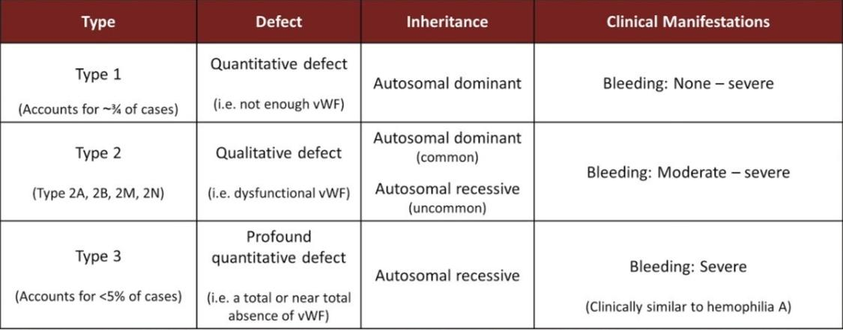

Slide 42
BERNARD SOULIER DISEASE
GLANZMANSTHROMBOSTHENIA
AUTOSOMAL RECESSIVE
Deficiency of GP1b (Platelet adhesion)
Platelet-large in size
Lab values:
Bleeding time increased
coagulation profile normal
RISTOCETIN ADHESION TEST :Negative
AUTOSOMAL RECESSIVE
Deficiency of GP2b/3a(Platelet aggregation)
Platelet-small in size
Most common cause of umbilical cord bleeding
Lab values:
Bleeding time increased
PT increased
APTT-Normal
RISTOCETIN ADHESION TEST:POSITIVE
BERNARD SOULIER
GLANZMANTHROMBOSTHENIA
BERNARD ER
GLANZMANTHROMBOSTHENIA

Slide 43
DRUG INDUCED THROMBOCYTOPENIA:
Mechanism:
Drug dependent antibodies that react with specific Platelet surface antigens and result in thrombocytopenia
More common with quinine and sulfonamides
Thrombocytopenia occurs after 21 days of exposure and resolves in 7 to 10 days after drug withdrawal.
Thrombocytopenia caused by Gp11b/111a inhibitory drugs like abciximab it occurs within 24 hours of exposure.

Slide 44
Ceftriaxone
Ceftriaxone
piptaz
Heparin
Quinine
Ciprofloxacin
Penicillin
vancomycin
Ibuprofen
Aspirin
Phenytoin
sulfonamides
DRUGS CAUSING
THROMBOCYTOPENIA:

Slide 45
THANK YOU

