Slide 1
Cardiac arrythmias
Department of General Medicine

Slide 2
Definition of Arrhythmia:
The Origin, Rate, Rhythm, Conduct velocity and sequence of heart activation are abnormal.

Slide 3
Cardiac arrhythmias are often a manifestation
of structural heart disease but may also occur because of abnormal conduction ordepolarisation in an otherwise healthy heart.
The sinus node acts as a pacemaker and its intrinsic rate is regulated by the autonomic nervous system;
vagal activity decreases the heart rate and sympathetic activity increases heart rate through cardiac sympathetic nerves and circulating catecholamines.

Slide 4
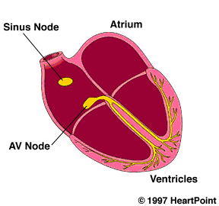
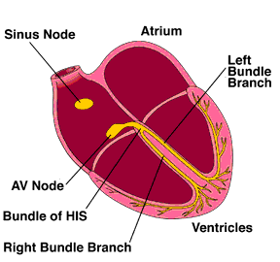
Normal heartbeat and atrial arrhythmia
Normal rhythm
Atrial arrhythmia
AV septum

Slide 5
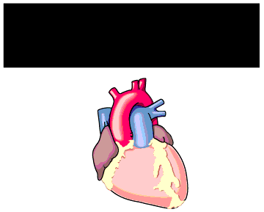
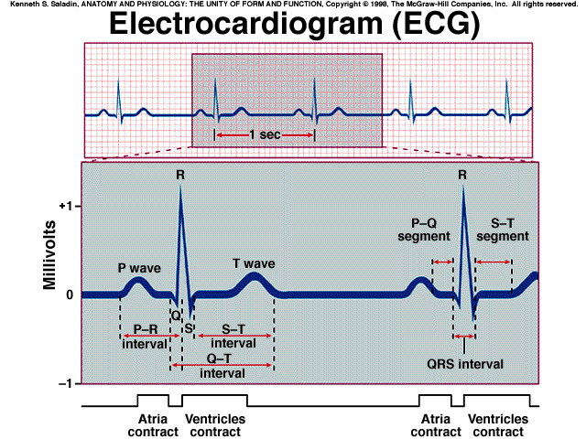
Heart Physiology
P - atria depolarization
QRS - ventricle depolarization
PR - conduction A-V
T - ventricle repolarization
QT - duration ventricle of repolarization

Slide 6
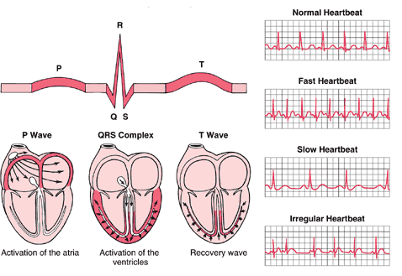

Slide 7
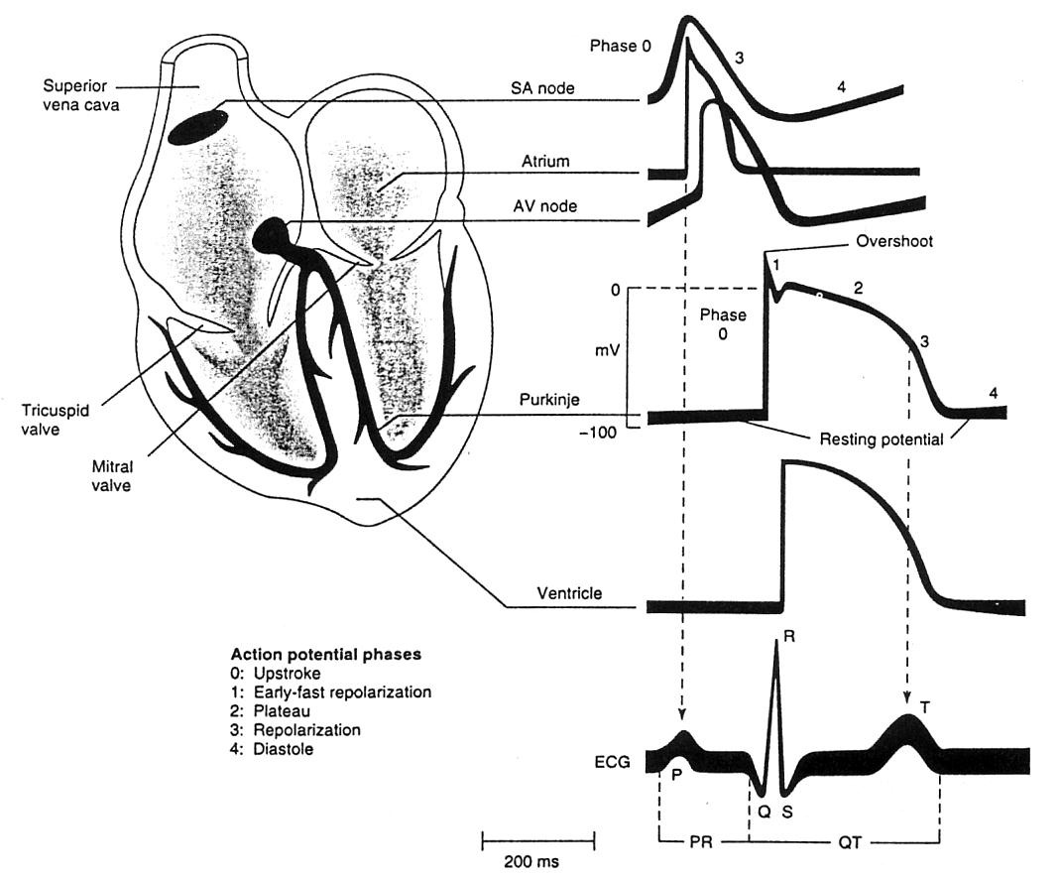
Heart Physiology
Closed system
Pressure driven
Supply nutrients/O₂
Remove metabolites
P - atria depol.
QRS - ventricle depol.
PR - conduction A-V
T - ventricle repol.
QT - duration
ventricle
repolarization

Slide 8
Classification of arrhythmia
1. Characteristics:
a. flutter – very rapid but regular contractions
b. tachycardia – increased rate
c. bradycardia – decreased rate
d. fibrillation – disorganized contractile activity
2. Sites involved:
a. ventricular
b. atrial
c. sinus
d. AV node
e. Supraventricular (atrial myocardium or AV node)

Slide 9
ARRHYTHMIAS
Brady (HR < 60/mt)
Tachy (HR> 100/mt)
SND
AVND
Wide QRS(≥120ms)
Narrow QRS(<120ms)
IVCD
ASYSTOLE
Notes:
Occasionally, supraventricular tachycardia can mimic ventricular tachycardia and present as a broad-complex
tachycardia due to coexisting bundle branch block or the presence of an additional atrioventricular connection (accessory pathway,

Slide 10
Three main mechanisms of tachycardia:
Increased automaticity
Re-entry
Triggered activity
Notes:
spontaneous depolarisation of an ectopic focus in the atria, atrioventricular junction or ventricles, often in response to catecholamines. Single depolarisations lead to atrial, junctional or ventricular premature (ectopic) beats.
Repeated depolarisation leads to atrial, junctional or ventricular tachycardia
RENTRY = tachycardia is initiated by an ectopic beat and sustained by a re-entry circuit. Most tachyarrhythmias are caused by re-entry.
Triggered activity=This can cause ventricular arrhythmias in patients with coronary artery disease. It is a form of
secondary depolarisation arising from an incompletely repolarised cell membrane. Arrhythmias may be supraventricular (sinus, atrial or junctional) or ventricular in origin

Slide 11
3 Major Mechanisms of Arrhythmia
reentry (most common)
automaticity
triggered activity

Slide 12
Rate of discharge
SA node 70-80 bpm
AVnode 40-60 bpm
AV bundle 15-40 bpm

Slide 13
Mechanisms of Cardiac Arrhythmias
Result from disorders of impulse formation, conduction, or both
Causes of arrhythmias
Cardiac ischemia
Excessive discharge or sensitivity to autonomic transmitters
Exposure to toxic substances
Unknown etiology

Slide 14
Disorders of impulse formation
No signal from the pacemaker site
Development of an ectopic pacemaker
May arise from conduction cells (most are capable of spontaneous activity)
Usually under control of SA node → if it slows down too much conduction cells could become dominant
Often a result of other injury (ischemia, hypoxia)
Development of oscillatory after depolariztions
Can initiate spontaneous activity in nonpacemaker tissue
May be result of drugs (digitalis, norepinephrine) used to treat other cardiopathologies

Slide 15
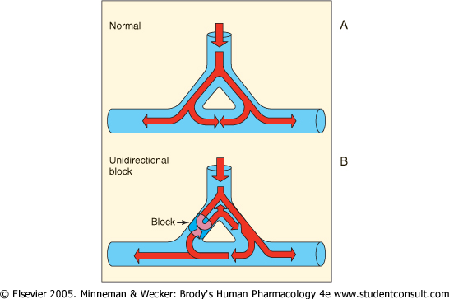
Disorders of impulse conduction
May result in
Bradycardia (if have AV block)
Tachycardia (if reentrant circuit occurs)
Reentrant circuit
Notes:
15

Slide 16
Pathogenesis and Inducement of Arrhythmia
Some physical condition
Pathological heart disease
Other system disease
Electrolyte disturbance and acid-base imbalance
Physical and chemical factors or toxicosis

Slide 17
ARRTHYMIAS AND ECTOPIC BEATS

Slide 18
Recognizing and Naming Beats & Rhythms
Atrial Escape Beat
QRS is slightly different but still narrow,
indicating that conduction through the
ventricle is relatively normal
normal ("sinus") beats
sinus node doesn't fire leading to a period of asystole (sick sinus syndrome)
p-wave has different shape indicating it did not originate in the sinus node, but somewhere in the atria. It is therefore called an "atrial" beat

Slide 19
Recognizing and Naming Beats & Rhythms
Junctional Escape Beat
QRS is slightly different but still narrow,
indicating that conduction through the
ventricle is relatively normal
there is no p wave, indicating that it did not originate anywhere in the atria, but since the QRS complex is still thin and normal looking, we can conclude that the beat originated somewhere near the AV junction. The beat is therefore called a "junctional" or a “nodal” beat

Slide 20
Recognizing and Naming Beats & Rhythms
QRS is wide and much different ("bizarre") looking than the normal beats. This indicates that the beat originated somewhere in the ventricles and consequently, conduction through the ventricles did not take place through normal pathways. It is therefore called a “ventricular” beat
Ventricular
Escape Beat
there is no p wave, indicating that the beat did not originate anywhere in the atria
actually a "retrograde p-wave may sometimes be seen on the right hand side of beats that originate in the ventricles, indicating that depolarization has spread back up through the atria from the ventricles

Slide 21
The “Re-Entry” Mechanism of Ectopic Beats & Rhythms
Electrical Impulse
Cardiac Conduction Tissue
Fast Conduction Path
Slow Recovery
Slow Conduction Path
Fast Recovery
Tissues with these type of circuits may exist:
in microscopic size in the SA node, AV node, or any type of heart tissue
in a “macroscopic” structure such as an accessory pathway in WPW

Slide 22
The “Re-Entry” Mechanism of Ectopic Beats & Rhythms
Premature Beat Impulse
Cardiac Conduction Tissue
Repolarizing Tissue (long refractory period)
Fast Conduction Path
Slow Recovery
Slow Conduction Path
Fast Recovery
1. An arrhythmia is triggered by a premature beat
2. The beat cannot gain entry into the fast conducting pathway because of its long refractory period and therefore travels down the slow conducting pathway only

Slide 23
The “Re-Entry” Mechanism of Ectopic Beats & Rhythms
Cardiac Conduction Tissue
Fast Conduction Path
Slow Recovery
Slow Conduction Path
Fast Recovery
3. The wave of excitation from the premature beat arrives at the distal end of the fast conducting pathway, which has now recovered and therefore travels retrogradely (backwards) up the fast pathway

Slide 24
The “Re-Entry” Mechanism of Ectopic Beats & Rhythms
Cardiac Conduction Tissue
Fast Conduction Path
Slow Recovery
Slow Conduction Path
Fast Recovery
4. On arriving at the top of the fast pathway it finds the slow pathway has recovered and therefore the wave of excitation ‘re-enters’ the pathway and continues in a ‘circular’ movement. This creates the re-entry circuit

Slide 25
Clinical features in common
Rapid palpitation
Dizziness,
Chest discomfort
Breathlessness.
Extreme tachycardias syncope because the heart is unable to contract or relax properly at extreme rates.
Bradycardias reﬂect low cardiac output, including fatigue, lightheadedness and syncope.
Extreme bradycardias or tachycardias can precipitate
sudden death or cardiac arrest.

Slide 26
Investigations
The ﬁrst-line investigation is a standard 12-lead ECG
If arrhythmias are intermittent and the resting ECG is normal, an attempt should be made to capture the abnormal rhythm using an ambulatory ECG or a patient-activated ECG.
Electrophysiological studies
Echocardiography

Slide 27
Sinus Rhythms
Normal Sinus Rhythm
Heart Rate | Rhythm | P Wave | PR Interval (sec.) | QRS (Sec.)
60 - 100 | Regular | Before each QRS, Identical | .12 - .20 | <.12

Slide 28
Sinus Rhythms
Normal Sinus Rhythm
Sinus Node is the primary pacemaker
One upright uniform p-wave for every QRS
Rhythm is regular
Rate is between 60-100 beats per minute

Slide 29
Sinus Rhythms
Sinus Bradycardia
Heart Rate | Rhythm | P Wave | PR Interval (sec.) | QRS (Sec.)
<60 | Regular | Before each QRS, Identical | .12 - .20 | <.12

Slide 30
Sinus Rhythms
Sinus Bradycardia
One upright uniform p-wave for every QRS
Rhythm is regular
Rate less than 60 beats per minute
SA node firing slower than normal
Normal for many individuals
Identify what is normal heart rate for patient

Slide 31
Sinus bradycardia
This may occur in healthy people at rest and is a common ﬁnding in athletes
Symptomatic sinus bradycardia may occur acutely during an MI and can be treated with intravenous atropine (0.6–1.2 mg).
Patients with recurrent or persistent symptomatic sinus bradycardia should be considered for pacemaker implantation

Slide 32
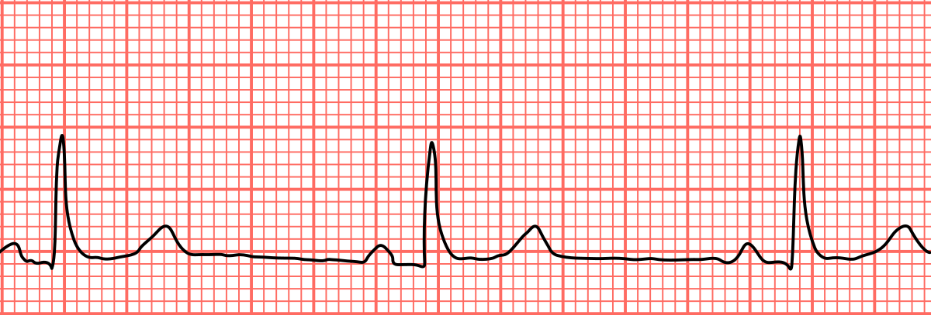

Slide 34
Sinus Rhythms
Sinus Tachycardia
Heart Rate | Rhythm | P Wave | PR Interval (sec.) | QRS (Sec.)
>100 | Regular | Before each QRS, Identical | .12 - .20 | <.12

Slide 35
Sinus Rhythms
Sinus Tachycardia
One upright uniform p-wave for every QRS
Rhythm is regular
Rate is greater than 100 beats per minute
Usually between 100-160 (>160 SVT)
Can be high due to anxiety, stress, fever, medications (anything that increases oxygen consumption)

Slide 36
Sinus tachycardia
Sinus tachycardia is usually due to an increase in sympathetic activity associated with exercise, emotion and pregnancy.
Healthy young adults can produce a rapid sinus rate, up to 200/min, during intense exercise.
Sinus tachycardia does not require
treatment but sometimes may reflect an underlying disease

Slide 39
Sinus arrhythmia
cyclical alteration of the heart rate during respiration, with an increase during inspiration and a decrease during expiration.
Sinus arrhythmia is a normal phenomenon and can be quite pronounced in children.
Absence of this normal variation may be a
feature of diabetic neuropathy, autonomic involvement in patients with diseases of peripheral nerves or increased sympathetic drive.
Sinus arrhythmia does not require treatment

Slide 40
Sinus Arrhythmia

Slide 41
Sinus Rhythms
Sinus Arrhythmia
Heart Rate | Rhythm | P Wave | PR Interval (sec.) | QRS (Sec.)
Var. | Irregular | Before each QRS, Identical | .12 - .20 | <.12

Slide 42
Sinus Rhythms
Sinus Arrhythmia
One upright uniform p-wave for every QRS
Rhythm is irregular
Rate increases as the patient breathes in
Rate decreases as the patient breathes out
Rate is usually 60-100 (may be slower)
Variation of normal, not life threatening

Slide 43
Sick sinus syndrome

Slide 44
Sick sinus syndrome can occur at any age but is most common in older people.
It is caused by fibrosis, degenerative changes or ischaemia of the SA
Palpitation, dizzy spells or syncope, due to intermittent tachycardia, bradycardia, or pauses with no atrial or ventricular activity (SA block or sinus arrest)

Slide 45
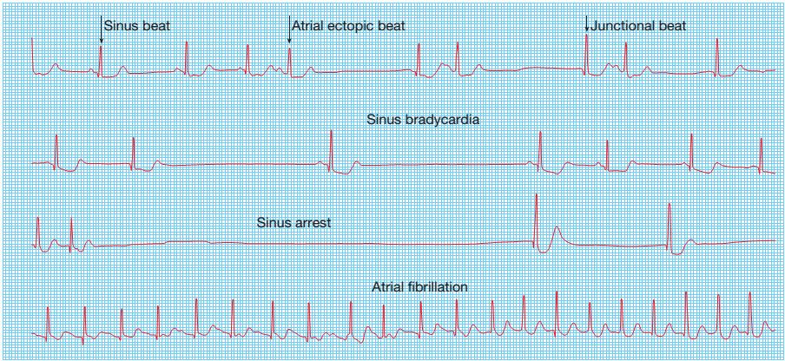
A permanent pacemaker may benefit patients with troublesome
symptoms
Atrial pacing may prevent episodes of atrial fibrillation.

Slide 46
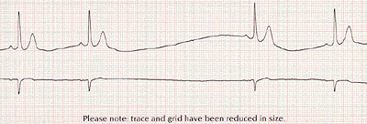
Sinus Rhythms
Sinus Arrest
Heart Rate | Rhythm | P Wave | PR Interval (sec.) | QRS (Sec.)
NA | Irregular | Before each QRS, Identical | .12 - .20 | <.12

Slide 47
Sinus Rhythms
Sinus Arrest
Stop of sinus rhythm
New rhythm starts
One dropped beat is a sinus pause
Beats walk through
Sinus Pause

Slide 48
Atrial ectopic beats
usually cause no symptoms but can give
the sensation of a missed beat or an abnormally strong beat.
In most cases these are of no consequence, although very frequent atrial ectopic beats may herald the onset of atrial fibrillation.
Treatment is rarely necessary but β-blockers can be used if symptomatic.

Slide 49
The ECG shows a premature but otherwise normal QRS complex; if visible, the preceding P wave has a different morphology because the atria activate from an abnormal site

Slide 50
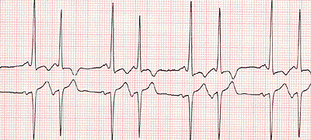
Atrial Rhythms
Premature Atrial Contraction (PAC)
Heart Rate | Rhythm | P Wave | PR Interval (sec.) | QRS (Sec.)
NA | Irregular | Premature & abnormal or hidden | .12 - .20 | <.12

Slide 51
Atrial Rhythms
Premature Atrial Contraction (PAC)
One P-wave for every QRS
P-wave may have different morphology on ectopic beat, but it will be present
Single ectopic beat will disrupt regularity of underlying rhythm
Rate will depend on underlying rhythm
Underlying rhythm must be identified
Classified as rare, occasional, or frequent PAC’s based on frequency

Slide 52
Atrial Rhythms
Atrial Tachycardia
Heart Rate | Rhythm | P Wave | PR Interval (sec.) | QRS (Sec.)
140 – 250 | Irregular | Abnormal and present but may be hidden on ST segment or T wave | Not measure-able | <.12 but may be wide

Slide 53
Atrial tachycardia
Atrial tachycardia may be a manifestation of increased atrial automaticity, sinoatrial disease or digoxin toxicity.
It may respond to β-blockers, which reduce automaticity, or class I or III anti-arrhythmic drugs
The ventricular response in rapid atrial tachycardias may be controlled by AV node-blocking drugs.
Catheter ablation can be used to target the ectopic site and should be offered as an alternative to anti-arrhythmic drugs in patients with recurrent atrial
tachycardia.

Slide 54
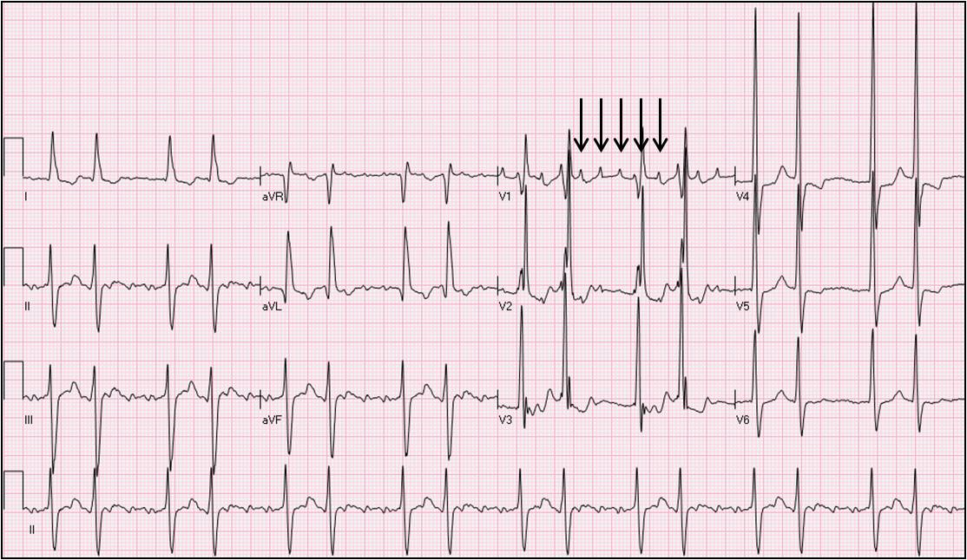
It produces a narrow-complex tachycardia with abnormal P-wave morphology, sometimes associated with AV block if the atrial rate is rapid

Slide 55
Atrial ﬂutter
Atrial ﬂutter is characterised by a large (macro) re-entry circuit, usually within the right atrium encircling the tricuspid annulus.
The atrial rate is approximately 300/min, and is usually associated with 2 : 1, 3 : 1 or 4 : 1 AV block (with corresponding heart rates of 150, 100 or 75/min).
Rarely, in young patients, every ﬂutter wave is conducted, producing a rate of 300/min and, potentially, haemodynamic compromise
Carotid sinus pressure or intravenous adenosine may help to establish the diagnosis by temporarily increasing the degree of AV block and revealing ﬂutter waves

Slide 56
Atrial Flutter

Slide 57
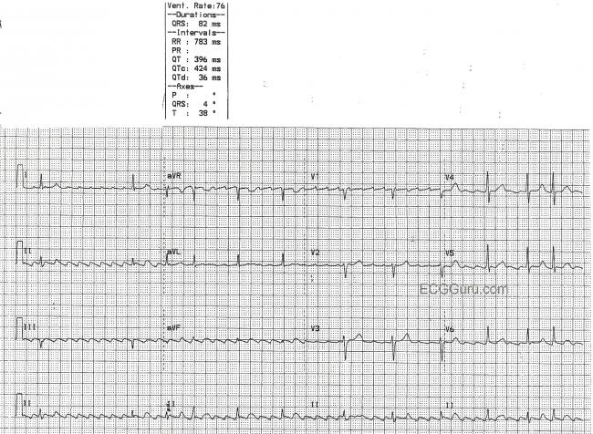

Slide 58
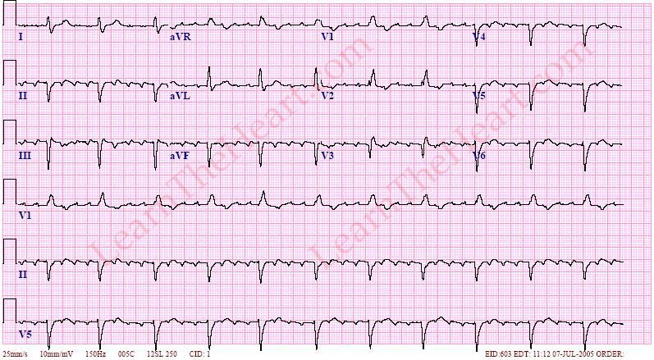

Slide 59
Atrial Rhythms
Atrial Flutter
Heart Rate | Rhythm | P Wave | PR Interval (sec.) | QRS (Sec.)
Atrial=250 – 400 VentricularVar. | Irregular | Sawtooth | Not Measur-able | <.12

Slide 60
Atrial Rhythms
Atrial Flutter
More than one p-wave for every QRS complex
Demonstrate a “sawtooth” appearance
Atrial rhythm is regular. Ventricular rhythm will be regular if the AV node conducts consistently. If the pattern varies, the ventricular rate will be irregular
Rate will depend on the ratio of impulses conducted through the ventricles

Slide 61
Atrial Rhythms
Atrial Flutter
Atrial flutter is classified as a ratio of p-waves per QRS complexes (ex: 3:1 flutter 3 p-waves for each QRS)
Not considered life threatening, consult physician is patient symptomatic
Digoxin, β-blockers or verapamil
(DC) cardioversion. Following cardioversion, β-blockers or amiodarone can be used to prevent recurrent episodes of atrial ﬂutter.
Catheter ablation is a highly effective treatment, offering a greater than 90% chance of complete cure, and is the treatment of choice for patients with persistent symptoms
Anticoagulation

Slide 62
Atrial fibrillation
The prevalence rises with age, affecting 1% of those aged 60–64 years, increasing to 9% of those aged over 80 years.
It is associated with signiﬁcant morbidity and a twofold increase in mortality. This is mainly because of its association with underlying heart disease but also because of its association with systemic embolism and stroke.

Slide 63
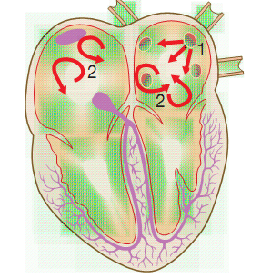
PATHOGENESIS
AF is a complex arrhythmia characterised by both abnormal automatic ﬁring and the presence of multiple interacting re-entry circuits looping around the atria.
Episodes of AF are initiated by rapid bursts of ectopic beats arising from conducting tissue in the pulmonary veins or from diseased atrial tissue.

Slide 64
Atrial Rhythms
Atrial Fibrillation
Heart Rate | Rhythm | P Wave | PR Interval (sec.) | QRS (Sec.)
Var. | Irregular | Wavy irregular | NA | <.12

Slide 65
Atrial Rhythms
Atrial Fibrillation
No discernable p-waves preceding the QRS complex
The atria are not depolarizing effectively, but fibrillating
Rhythm is grossly irregular
If the heart rate is <100 it is considered controlled a-fib, if >100 it is considered to have a “rapid ventricular response”
AV node acts as a “filter”, blocking out most of the impulses sent by the atria in an attempt to control the heart rate

Slide 66
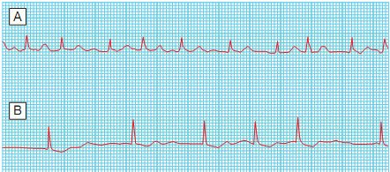
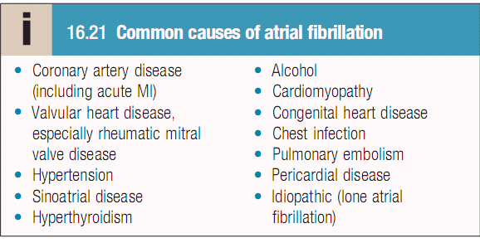

Slide 67
Atrial Rhythms
Atrial Fibrillation (con’t)
Often a chronic condition, medical attention only necessary if patient becomes symptomatic
Patient will report history of atrial fibrillation.

Slide 68
Investigations
ECG
ECHOCARDIOGRAHY
THYROID FUNCTION TEST

Slide 70
MANAGEMENT
Paroxysmal AF
Beta-blockers are normally used as ﬁrst-line therapy if symptoms are troublesome, since they reduce the ectopic ﬁring that normally initiates the arrhythmia.
Catheter where anti-arrhythmic drug therapy is ineffective

Slide 71
PERSISTANT AF
RHYTHM CONTROL
Drugs, Cardioversion(Attempts to restore and maintain sinus rhythm are most successful if AF has been present for less than 3 months, the patient is young and there is no important structural heart disease.)
Catheter ablation
RATE CONTROL
Drugs CCB,Beta blockers,acemakers, catheter ablation(ace and ablate strategy)

Slide 72
PERMANENT AF

Slide 73
Rhythm control in AF :
Cardiac condition | First line drug | Second line drug
Structurally normal heart with out CAD | Flecainide | Sotalol, amidarone
Adrenergic AF with out structural HD | Beta blockers | Sotalol
CAD with preserved LV function | Dofetilide , sotalol | Amidarone
Heart failure | Amidarone , dofetilide | --
HTN with LV wall thickness < 1.4 cm | Flecainide | Amidarone
HTN with LV wall thickness ≥ 1.4 cm | Amidarone

Slide 74
Rate control in AF:
1. Minimal or no symptoms of heart failure with paroxysmal and persistent AF
2. Permanent AF
3. PIAF(2000), RACE(2002) ,STAF(2002) , AFFIRM(2002) , HOTCAFÉ(2004) showed no difference in rate and rhythm control
With accessory pathway | Amidarone (IIa)
With out accessory pathway | Metaprolol , proponolol , esmolol, diltiazem, verapamil(I)
Heart failure with out accessory pathway | Digoxin (I) Amidarone(IIa)

Slide 75
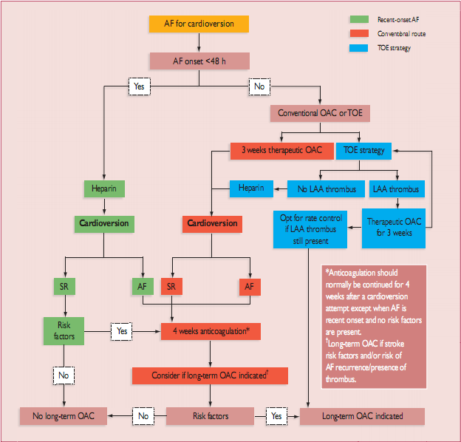
Cardio version in AF

Slide 76
Supraventricular tachycardia
usually narrow-complex tachycardias and are characterised by a re-entry circuit or automatic focus involving the atria.
The three principal types
Atrioventricular nodal re-entrant tachycardia (AVNRT),
Atrioventricular re-entrant tachycardia (AVRT) and
Atrial tachycardia.

Slide 77
Atrioventricular nodal re-entrant tachycardia
AVNRT is caused by re-entry in a circuit involving the AV node and its two right atrial input pathways:
a superior ‘fast’ pathway and an inferior ‘slow’ pathway
This produces a regular tachycardia with a rate of 120–240/min.
It tends to occur in the absence of structural heart disease and episodes may last from a few seconds to many hours.
Palpitations,chest discomfort, lightheadedness or breathlessness. Polyuria, mainly due to the release of ANP, is sometimes a feature.

Slide 78
Management
Treatment is not always necessary. However, an acute episode
may be terminated by carotid sinus pressure or by the Valsalva
manœuvre.
Adenosine (3–12 mg rapidly IV in incremental doses until tachycardia stops) or verapamil (5 mg IV over 1 min) will restore sinus rhythm in most cases.
Intravenous β-blocker or ﬂecainide can also be used. In rare cases, when there is severe haemodynamic compromise, the tachycardia should be terminated by DC cardioversion
In patients with recurrent SVT, catheter ablation is the most effective therapy and will permanently prevent SVT in more than 90% of cases.
Alternatively, prophylaxis with oral β-blocker, verapamil or ﬂecainide may be used but commits predominantly young patients to long-term drug therapy and can create difﬁculty in female patients, as these drugs are normally avoided during pregnancy.

Slide 79
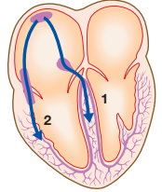
Atrioventricular re-entrant tachycardia
Abnormal band of conducting tissue that connects the atria and ventricles.
This so-called accessory pathway comprises rapidly conducting fibres that resemble Purkinje tissue
In about 50% of cases, this pathway conducts only in the retrograde direction (from ventricles to atria) and thus does not alter the appearance of the ECG in sinus rhythm. This is known as a concealed accessory pathway.
In the rest, the pathway also conducts in an antegrade direction (from atria to ventricles), so AV conduction in sinus rhythm is mediated via both the AV node and the accessory pathway, distorting the QRS complex

Slide 80
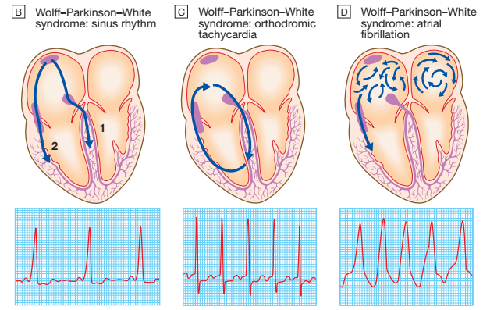

Slide 81
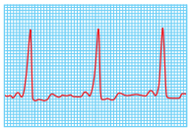
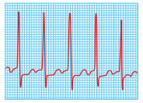
Premature ventricular activation via the pathway shortens the PR interval and produces a ‘slurred’ initial deflection
of the QRS complex, called a delta wave
As the AV node and accessory pathway have different conduction speeds and refractory periods, a re-entry circuit can develop, causing tachycardia when associated with symptoms, the condition is known as Wolff–Parkinson–White syndrome.
The ECG during this tachycardia is almost indistinguishable from that of AVNRT
AVRT
AVNRT

Slide 82
Management
Carotid sinus pressure or intravenous adenosine can terminate the tachycardia.
DC cardioversion.
Catheter ablation is first-line treatment in symptomatic patients and is nearly always curative.
Prophylactic antiarrhythmic drugs, such as flecainide or propafenone can be used to slow conduction in, and prolong the refractory period of, the accessory pathway

Slide 83
Ventricular premature beats
Ectopic beats in patients with otherwise normal hearts are more prominent at rest and disappear with exercise.
Sometimes VPBs are a manifestation of subclinical coronary artery disease or cardiomyopathy but also may occur in patients with established heart disease following an MI.
Most patients with VPBs are asymptomatic but some present with an irregular heart beat, missed beats or abnormally strong beats, due to increased cardiac output of the post-ectopic sinus beat.
On examination the pulse is irregular, with weak or missed beats as a result of the fact that the stroke volume is low because left ventricular contraction occurs before filling is complete

Slide 84
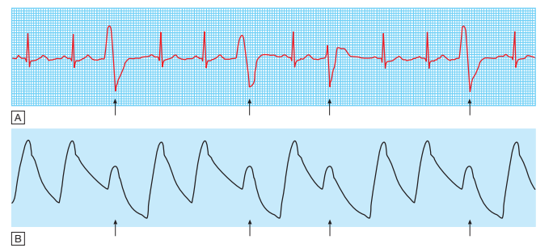
broad and bizarre complexes because the ventricles are activated sequentially rather than simultaneously. The complexes may be unifocal (identical beats arising from a single ectopic focus) or multifocal (varying morphology with multiple foci,)

Slide 85
Couplet’ and ‘triplet’ are the terms used to describe two or three successive ectopic beats.
A run of alternating sinus and ventricular ectopic beats is known as ventricular ‘bigeminy’.
The significance depends on the presence or absence of underlying heart disease

Slide 86
Management
Treatment may not be necessary, unless the patient is highly symptomatic, in which case β-blockers or, in some situations, catheter ablation can be used
Persistent, frequent VPBs (over 10/ hr) in patients who have survived the acute phase of MI indicate a poorer long-term outcome.
Heart failure of any cause is associated with VPBs. they again indicate an adverse prognosis

Slide 87
Ventricular tachycardia
Acute MI, chronic coronary artery disease and cardiomyopathy.
Extensive ventricular disease, impaired left ventricular function and ventricular aneurysm.
VT may cause haemodynamic compromise or degenerate into ventricular fibrillation
VT is caused by abnormal automaticity or triggered activity in ischaemic tissue, or by re-entry within scarred ventricular tissue.
Patients may complain of palpitation or symptoms of low cardiac output, including dyspnoea, lightheadedness and syncope.

Slide 88
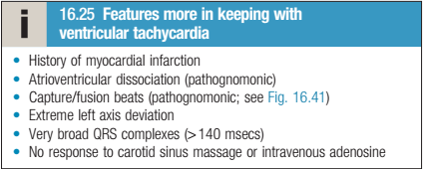
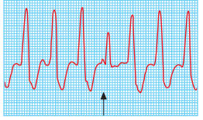
The ECG showstachycardia and broad, abnormal QRS complexes with a rate of more than 120/min It may be difficult to distinguish VT from SVT with bundle branch block or pre-excitation (WPW syndrome) on ECG but features in favour of VT are listed below

Slide 89
Patients recovering from MI sometimes have periods of idioventricular rhythm (‘slow’ VT) at a rate only slightly above the preceding sinus rate and below 120/min.
These episodes often reflect reperfusion of the infarct territory and may be a good sign.
They are usually self-limiting and asymptomatic, and do not require treatment.
Other forms of sustained VT require treatment, often as an emergency

Slide 90
Management
Synchronised DC cardioversion is the treatment of choice if systolic BP is less than 90 mmHg. If the arrhythmia is well tolerated, intravenous amiodarone may be given as a bolus, followed by a continuous infusion
Intravenous lidocaine can be used but may depress left ventricular function, causing hypotension or acute heart failure. Hypokalaemia, hypomagnesaemia, acidosis and hypoxia should be corrected if present.
Beta-blockers are effective at preventing VT by reducing ventricular automaticity

Slide 91
VT is associated with haemodynamic compromise, the use of an implantable cardiac defibrillator is recommended
Rarely, surgery with resection of a ventricular aneurysm or catheter ablation can be used to interrupt the arrhythmia focus or circuit in patients with VT associated with a myocardial infarct scar

Slide 92
Torsades de pointes
Form of polymorphic VT is a complication of prolonged ventricular repolarisation (prolonged QT interval).
The ECG shows rapid irregular complexes that seem to twist around the baseline as the mean QRS axis changes .
The arrhythmia is usually non-sustained and repetitive, but may degenerate into ventricular fibrillation.
During periods of sinus rhythm, the ECG will usually show a prolonged QT interval (>0.44 sec in
men, >0.46 sec in women when corrected to a heart rate of 60/min)

Slide 93
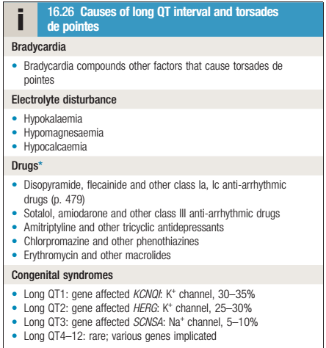

Slide 94
Management
Intravenous magnesium (8 mmol over 15 mins, then 72 mmol over 24 hrs) should be given in all cases.
If this is ineffective atrial pacing should be tried, since it can suppress the arrhythmia
through rate-dependent shortening of the QT interval.
Intravenous isoprenaline is a reasonable alternative to pacing but should be avoided in patients with the congenital long QT syndromes.

Slide 95
Identify and treat the underlying cause or stop medications that predispose to the arrhythmia.
Inherited syndrome -Beta-blockers are effective at preventing syncope in patients
with congenital long QT syndrome.
Certain high-risk genotypes, should be considered for an implantable defibrillator.
Left stellate ganglion block may be of
value in patients with resistant arrhythmias.

Slide 96
Brugada syndrome
genetic disorder that may present with polymorphic VT or sudden death.
It is characterised by a defect in sodium channel function and an abnormal ECG
(right bundle branch block and ST elevation in V1and V2 but not usually prolongation of the QT interval).
Known effective treatment is an implantable defibrillator

Slide 97
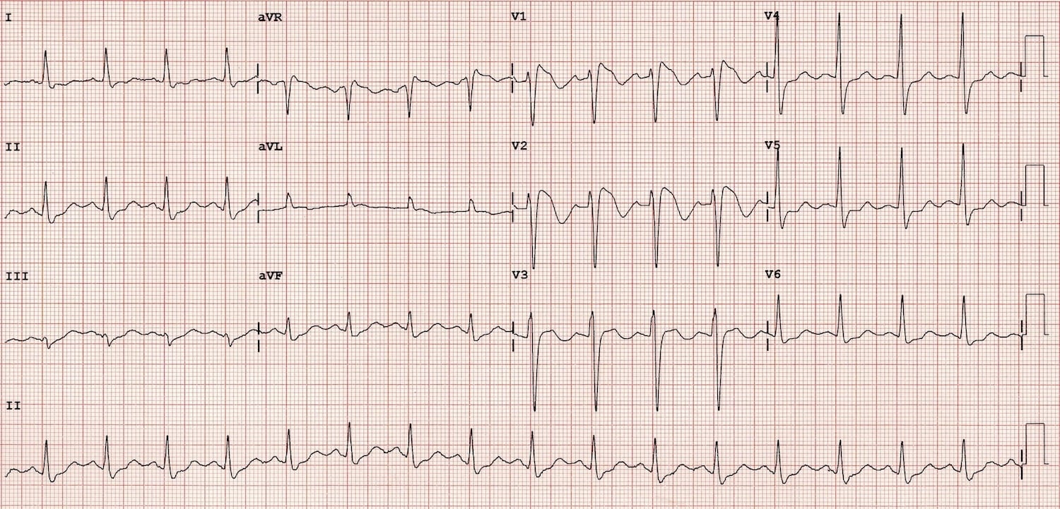

Slide 98
Atrioventricular block
Result of disease affecting the AV node. AV block can be intermittent, however, and may become evident only when the conducting tissue is stressed by a rapid
atrial rate.
Atrial tachyarrhythmias are often associated with AV block

Slide 99
First-degree atrioventricular block
In this condition, AV conduction is delayed and so the PR interval is prolonged (>0.20 sec). It rarely causes symptoms
and does not usually require treatment

Slide 100
Second-degree atrioventricular block
Here dropped beats occur because some impulses from the atria fail to conduct to the ventricles. Two subtypes are recognised.
In Mobitz type I second-degree AV block progressive lengthening of successive PR intervals, culminating in a dropped beat. The cycle then repeats itself. This is known as the Wenckebach phenomenon due to impaired conduction in the AV node itself.

Slide 101
In Mobitz type II second-degree AV block the PR interval of the conducted impulses remains constant but some P waves are not conducted.
This is usually caused by disease of the His–Purkinje system and carries a risk of asystole

Slide 102
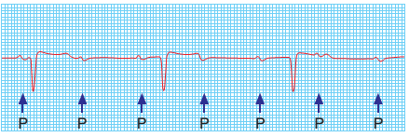
Third-degree atrioventricular block
In third-degree AV block, conduction fails completely and the atria and ventricles beat independently. This is known as AV
Ventricular activity is maintained by an escape rhythm arising in the AV node or bundle of His (narrow QRS complexes) or the distal Purkinje
tissues (broad QRS complexes).
Distal escape rhythms tend to be slower and less reliable. Complete AV block produces a slow (25–50/min), regular pulse that does not vary
with exercise,

Slide 104
MANAGEMENT
Acute inferior MI is often complicated by transient AV block because the right coronary artery (RCA) supplies the AV node. There is usually a reliable escape rhythm and, if the patient remains well, no treatment is required.
Symptomatic second- or third-degree AV block may respond to atropine (0.6 mg IV, repeated as necessary) or, if this fails, a temporary pacemaker. In most cases, the AV block will resolve within 7–10 days.
Second- or third-degree AV heart block complicating acute anterior MI indicates extensive ventricular damage involving both bundle branches and carries a poor prognosis.
If the patient presents with asystole, intravenous atropine (3 mg) or intravenous isoprenaline (2 mg in 500 mL 5% dextrose, infused at 10–60 mL/hr) may help to maintain the circulation until a temporary pacing electrode can be inserted.

Slide 105
RIGHT BUNDLE BRANCH BLOCK

Slide 106
LEFT BUNDLE BRANCH BLOCK

Slide 107
Principles of management of cardiac arrhythmias

Slide 108
Anti-arrhythmic drugs: principles of use
Many arrhythmias are benign and do not require specific treatment
• Precipitating or causal factors should be corrected if possible
• If drug therapy is required, it is best to use as few drugs as possible
• In difficult cases, programmed electrical stimulation (electrophysiological study)
• When managing life-threatening arrhythmias, it is essential to
ensure that prophylactic treatment is effective
• Patients on long-term anti-arrhythmic drugs should be reviewed
regularly and attempts made to withdraw therapy if the factors that
precipitated the arrhythmias are no longer operative
• For patients with recurrent supraventricular tachycardia, radiofrequency ablation is often preferable to long-term drug therapy

Slide 109
Class I: membrane-stabilising agents (sodium channel blockers)
Class II: β-adrenoceptor antagonists (β-blockers)
Class III: drugs whose main effect is to prolong the action potential
Class IV: slow calcium channel blockers

Slide 110
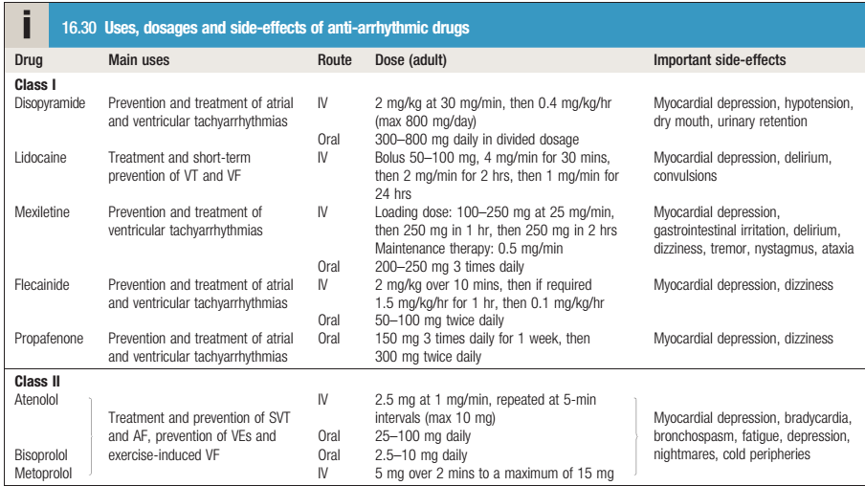

Slide 111
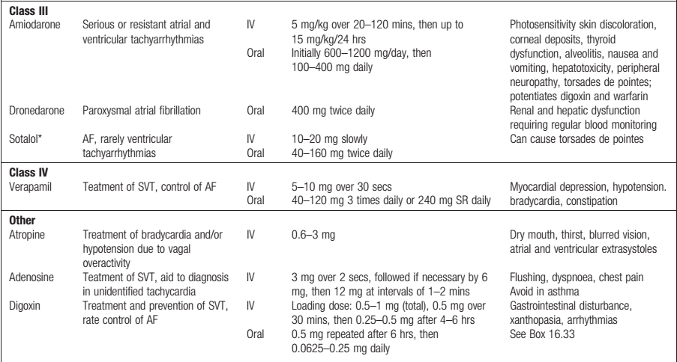

Slide 112
Non-pharmacological treatments
Electrical cardioversion
Temporary pacemakers
Permanent pacemakers
Implantable cardiac defibrillators
Cardiac resynchronisation therapy
Catheter ablation therapy

Slide 113
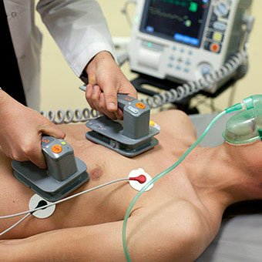

Slide 114
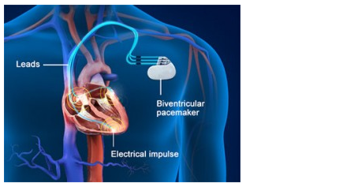
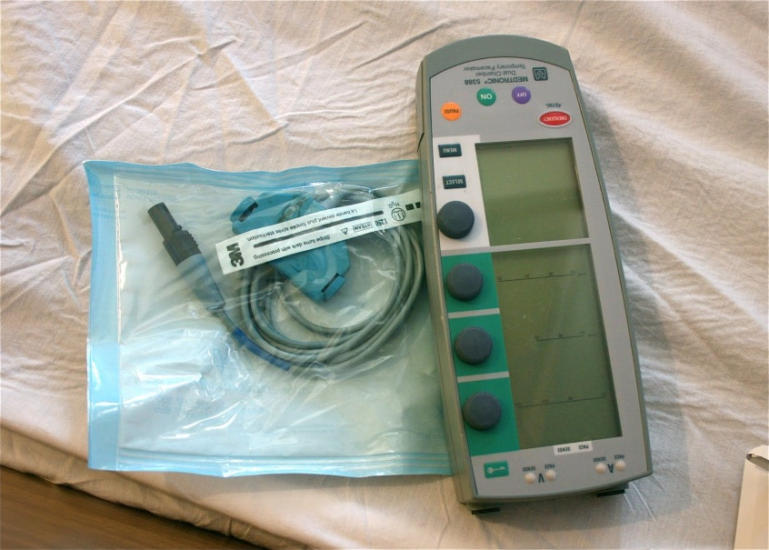
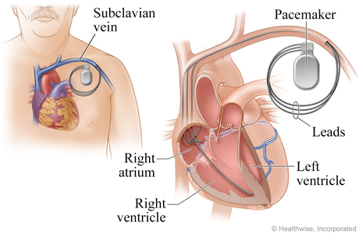
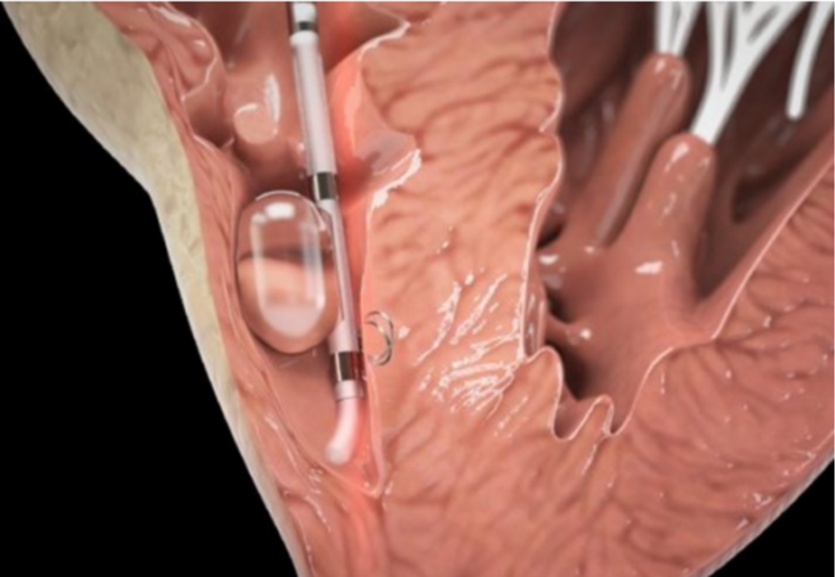

Slide 115
