Slide 1
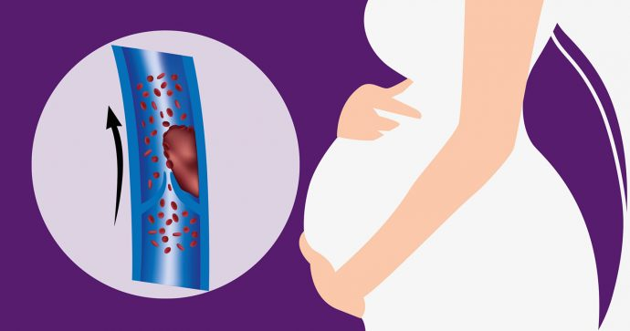
GRAVID UTERUS GRAVID VEINS

Slide 2
1st medical unit
CHIEF AND HOD:PROF.DR.M.NATARAJAN.MD
ASST PROFESSORS:
DR.PALANIKUMARAN.MD.D.DIAB DR.VASANTHAKALYANI .MD DCP DR.SURESHKUMAR.MD DR.VIGNESH MD.
PRESENTOR : M.ARAVIND KUMAR

Slide 3
Chief complaints:
A 31 year old female brought to GRH ,MADURAI OG CASUALTY with complaints of
Swelling of right lower limb for 4 Days Pain over right lower limb for 3 Days.

Slide 4
H/o PRESENTING ILLNESS:
H/o swelling of right lower limb for 4 days
Sudden onset progressive Swelling extends upto thigh
Associated with severe pain Pain aggravated on moving the limb.
H/o fever for past 5 days High grade,associated with chills and rigor
Releived by medications.

Slide 5
No H/o dyspnea /cough /hemoptysis No h/o Chest pain/ syncope/palpitation No H/o abdominal pain/vomiting/diarrhoea No H/o Hematuria/oliguria No H/o headache /seizure/altered sensorium

Slide 6
A Big Past.....
3 weeks prior to admission the Patient has delivered a female baby (wt:2.8 kg) by LSCS She was undergoing treatment for primary infertility and she conceived in this pregnancy by IN VITRO FERTILIZATION.
During 1st trimester she was diagnosed to have hypothyroidism and she was started on Thyroxine 100 micrograms od.
During 2 nd trimester she developed fever ; cough.
Covid 19 RT PCR swab : positive . MRI CHEST : negative.

Slide 7
Throughout her pregnancy she was on Inj.enoxaparin 40 microgram od.
She underwent periodical Doppler imaging and echocardiogram which all are were normal.
Enoxparin was stopped 12 hours prior to LSCS . It was restarted and Patient was discharged with enoxaparin post partum.
Patient had skipped two doses of enoxaparin prior to admission

Slide 8
Personal history:
Takes mixed diet Normal bladder and bowel habits.
Attained menarche at 14 years of age.
Regular menstrual cycles.
Married at 21 years of age.
No previous H/o conception/abortions On treatment of for past 7 years for primary infertility.
Spouse status : not known

Slide 9
General examination;
On examination she was conscious
oriented afebrile
No pallor No pedal edema No cyanosis/clubbing/generalized lymphadenopathy.
Vitals:
Bp:120/80mmHg
PR:92/min Spo2:98 percent in room air.

Slide 10
Systemic examination:
Cvs: S1S2 (+).No murmur Rs:Bilateral air entry present.NVBS(+)
CNS: conscious oriented .NFND.
LOCAL EXAMINATION OF RIGHT LOWER LIMB:
SWELLING (+) UPTO GROIN. WARMTH(+)
TENDERNESS(+)

Slide 11
Investigations:
Cbc
Hb | 8.9 | 9.0 | 10.9 | 10.3
Tc | 15,600 | 15,300 | 15,900 | 8800
Pcv | 38% | 32% | 35% | 32%
Platelets | 3.2 lakhs | 3.72 lakhs. | 5 .22 lakhs | 4.46 lakhs

Slide 12
RFT:
Urea:20
Creatinine:1.0
LFT: NORMAL Igm Dengue : Positive Peripheral smear :Negative for malarial and filarial parasites. Blood culture and sensitivity: No growth Urine culture sensitivity:CONS (VANCOMYCIN AND LINEZOLID SENSITIVE)

Slide 13
USG abdomen and pelvis: normal.
Venous Doppler of Right lower limb:
Common femoral vein;superficial femoral vein;popliteal vein; perforator vein shows echogenic thrombosis without demonstrable flow
Great saphenous vein,short saphenous vein show extensive thrombosis.
Thrombosis extends into Right external iliac vein , Inferior vena cava with partial peripheral flow .
Echo: Normal Lv function .Normal valves.No shunt lesions.EF:60%

Slide 14
Vctc :Non reactive Viral markers : negative:
Vdrl: non reactive
ANA (IF method): Negative in 1:100 dilution.
Apla profile : negative Igm leptospirosis: negative Igm scrub :negative Widal: negative

Slide 15
Treatment given:
Limb elevation Elastic crepe bandage.
IV antibiotics T.thyroxine 100 microgram 1od. Inj.Heparin 5000 iu iv qid overlapped with Acitrom.
Inj.iron sucrose.

Slide 16
Vascular surgeon opinion:
To continue heparin and overlap with acitrom. To avoid vitamin k rich foods Limb elevation Cardiac evaluation PT INR MONITORING.

Slide 17
10 days later....Double trouble!
Patient began to develop swelling and pain in left lower limb .The swelling initially began in the leg then rapidly extended to involve whole left lower limb upto groin .High grade fever continued to persist for the 2nd week.
Venous Doppler of left lower limb: Echogenic thrombus noted in the following veins.(common femoral vein,Superficial femoral vein,deep femoral vein,popliteal vein,anterior tibial vein ,posterior tibial vein)

Slide 18
Coagulation profile :
Right lower limb Dvt
 | During admission | After anticoagulation
PT | 12 sec | 32 sec | 30 sec | 18 sec
INR | 0.9 | 2.3 | 2.0 | 1.3
Left lower limb Dvt

Slide 19
Day 42 post partum.
Patient transferred to medicine Ward for persisting fever for 3 weeks and Bilateral lower limb Dvt.

Slide 20
Patinet started on T .RIVORAXABAN 15 mg bd.
Antibiotics were continued .
Fever decreased within 3 days.
Graded Compression stockings .

Slide 21
What next?

