Slide 1
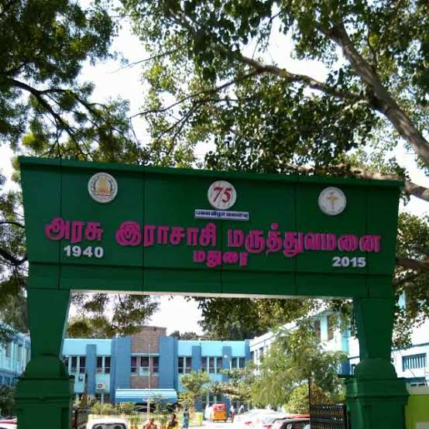
DEPARTMENT OF CARDIOLOGY
HEAD OF DEPARTMENT :
PROF DR. S. BALASUBRAMANIAN MD DM
ASSOCIATE PROFESSOR :
DR. G.SELVARANI MD DM
ASSISTANT PROFESSORS :
DR . G.S. SIVAKUMAR MD DM
DR. R. R. SARAVANAN MD DM FNB
DR. RAMESH MD DM
DR. NAGASUNDHAR MD DM
DR. S.SATHISH KUMAR MD DM
DR. T.R .HEMANATH MD DM
DR. NIZAMUDEEN MD DM
DR. M. SARAVANAN MD DM
DR. B. RAJESH MD DM

Slide 2
AN INTERESTING CASE OF MITRAL VALVE PROLAPSE
DR. M. ILAMARAN
DM POST GRADUATE
DEPT OF CARDIOLOGY
GOVT RAJAJI HOSPITAL

Slide 3
58 male admitted on 02.09.21
Old PTB , known seizure disorder
C/o of Shortness of breath – 10 days duration
C/o fever 3 days after admission

Slide 4
HOPI
H/ O dyspnoea since 10 days gradual onset progressive in nature , initially class II NYHA , NYHA class III at the time of admission. Aggravated by exertion relieved by rest. No H/O orthopnoea or PND
H/O fever 3 days after admission , high grade intermittent fever , associated with chills and rigors
No H/O chest pain , palpitation ,syncope ,presyncope
No H/O oliguria ,pedal edema, abdominal distension

Slide 5
HOPI
No H/o hemoptysis
No H/o hoarseness of voice
No H/o bluish discolouration of skin/ mucosa
No H/o recurrent respiratory tract infections
No H/o vomitting/abdominal pain/diarhoea
No H/o loss of weight /loss of appetite
No H/o weakness of limbs

Slide 6
Past History
Known PTB completed 4 years back
Known seizure disorder on T.phenytoin100mg 1-0-2, T.SVP 200mg 1-0-1
No H/o rheumatic heart disease
No H/o previous similar episodes
Not a known case of DM2,SHT,bronchial asthma

Slide 7
Personal history
Takes mixed diet
Smoker /non alcoholic
No h/o drug abuse

Slide 8
General examination
Pt conscious , oriented ,febrile ( T-101 F), pallor, no jaundice, no cyanosis, no clubbing, no generalised lymphadenopathy
No markers of RHD/ atheroscelorosis/CHD
Ht -165 cm, weight , 60kg. BMI- 22
Pr- 54/mt regular large volume, felt in all peripheral vessels , no R-R delay, no R-F delay , no vessel wall thickening
Bp- 130/70 mmhg in Rt UL . 140/80 mm Hg in rt LL
Spo2 – 98% in RA
RR – 21/mt abdomino thoracic

Slide 9
Examination of CVS – Inspection
JVP not elevated
Chest wall bilateral symmetrical
Trachea appears in midline
Apical impulse seen in left 6th ICS lateral to mid clavicular line
Prominent supra sternal pulsations seen
No other visible scar/sinus/pulsations

Slide 10
Examination of CVS – Palpation
Trachea in midline confirmed
AI – left 6th ICS 1/2inch lateral to MCL hyperdynamic in nature
parasternal heave –GRADE1

Slide 11
Examination of CVS – Percussion
Right heart border corresponds to right border of sternum
Left heart border – corresponds to cardiac apex
Left second intercostal space is resonant
Traube’s space is resonant

Slide 12
Examination of CVS – Auscultation
Mitral area : S1, S2 heard , high pitched mid systolic click followed by mid systolic murmur of grade 4/6 heard , radiating to axilla . Click occurs early & the intensity& duration of murmur increases on standing.
Tricuspid area : S1, S2 heard , same murmur is heard
Pulmonary area : S1, S2 heard , P2 loud .
Aortic area : S1, S2 heard no murmur

Slide 13
RS : B/l air entry + . No added sounds
P/A : soft
CNS : no focal neurological deficit

Slide 14
CBC – TC 9300.
DC : P79%/L10%/M11 %
Hb : 7.2 gm % → 9.8gm%
Platelets : 66000/mm3
ESR : 115mm/hr
Blood C/S : 4.09.21- negative
RBS : 161mg%
Urea / Cr : 74 mg% / 1.9mg%
Repeat U/Cr: 32mg% /1.3mg% - 14.09.21
CPK : 87 IU/L ;CPK (MB): 22 IU/L.
Na+ /K+ = 135meq/l / 3.0 meq/l
Repeat K += 2.9 meq/l
14.09.21 K += 3.7 meq/l
Peripheral Smear : Thrombocytopenia /reactive neutrophilia

Slide 39
THANK YOU

