Slide 1
CPC

Slide 2
47 yr old male patient Daily worker by occupation from kanniyakumari came to GRH with chief complaints of
Blood in vomiting FOR X 2 DAYS
BLACK COLOURED STOOLS X 2 DAYS

Slide 3
HOPI
PATIENT WAS APPARENTLY NORMAL 2 DAYS BACK AND THEN HE had
COMPLAINTS OF
HEMETEMESIS X 2 DAYS - 4 EPISODES with EACH EPISODE AROUND
20-30 MI OF BLOOD
h/o ABDOMINAL PAIN
H/O MALENA +
H/O LEFT SIDED CHEST PAIN +
h/o easy fatigability +
NO H/O ABDOMINAL DISTENTION
NO H/O HEMATOCHEZIA
NO H/O GUM BLEED
NO H/O LOOSE STOOLS
NO H/O FEVER

Slide 4
No H/O OF NSAID INTAKE
No H/O OF YELLOWISH DISCOLOURATION OF EYES
No H/O OF PEDAL EDEMA
No H/O OF OLIGURIA
No H/O OF DYSPNEA
No H/O OF SKIN RASHES
No H/O OF JOINT PAIN
No H/O OF GIDDINESS
No H/O OF WEAKNESS OF LIMB
No H/O OF HEMATURIA
No H/O OF EPISTAXIS

Slide 5
PAST HISTORY
IN 2008 PATIENT HAD A H/O MELENA AND H/O ABDOMINAL PAIN . OGD SCOPY DONE AND FEATURES SUGG. OF GASTRIC ULCER and esophagitis. Thrombocytopenia was corrected with platelet transfusions.
Patient TREATED CONSERVATIVELY AND DISCHARGED.
IN 2014 Patient ADMITTED IN KIMS WITH SIMILAR C/O MELENA
ROUTINE INVESTIGATION DONE – CBC → PERSISTANT THROMBOCYTOPENIA
UREA- 18 CREATININE – 1.1
URINE – RBCS PRESENT WITH ALBUMIN 2+
URINE PCR – 0.19
STOOL OCCULT BLOOD – POSITIVE
USG- HEPATOSPLENOMEGALY WITH CHOLELITHIASIS

Slide 6
PERIPERAL SMEAR – MICROCYTIC HYPOCHROMIC ANEMIA WITH THROMBOCYTOPENIA
RETICULOCYTE COUNT – 4.3%
LDH – 474
DCT – NEGATIVE
SR. FERRITIN – 820 ng/ml
BONE MARROW – ERYTHROID HYPERPLASIA WITH NORMAL MEGAKARYOCYTES
PATIENT DIAGNOSED AS ? TMA AND TREATED CONSERVATIVELY .PATIENT GENERAL CONDITON IMPROVED AND DISCHARGED
After few years She developed secondary hypertension
Later he was diagnosed as a case of chronic kidney disease and was on regular treatment with nephrologists

Slide 7
IN 2015
AGAIN PT. HAD H/O MELENA AND H/O HEMATURIA
HB | 10.3 | 9.8
UREA | 19 | 45
CREATININE | 1.5 | 2.0
LDH | 1018 | 1092
URINE RBC | 16 | 22
URINE PROTINE | 3+ | 1+
C3 | LOW
C4 | NORMAL
PT | 1.8
INR | 1.07
APTT | 25

Slide 8
PERIPERAL SMEAR – BURR CELLS, SCHISITIOCYTES, ANISOPOIKILOCYTOSIS
OGD-SCOPY – GASTRIC ERYTHEMA +
3*2 CM ULCER PRESENT BELOW THE GASTRO ESOPHAGEAL JUNCTION
DUODENAL AND SUBMUCOSAL EROSIONS SEEN DUE TO THROMBOCYTOPENIA
PATIENT WAS TREATED WITH CRYO PRECIPITATE. PATIENT CONDITION IMPROVED AND DISCHARGED.

Slide 9
AT MARCH 2024 PATIENT WAS ADMITTED IN DINDIGUL GH WITH
C/O VOMITING, ABDOMINAL PAIN, MELENA
PLATELET – 50,000
UREA – 53 CREATININE – 1.3
USG – FATTY LIVER WITH GRADE II MEDICAL RENAL DISEASE
CE-CT – JEJUNAL DIVERTCULITIS
MRI – CHOLELITHIASIS , OMENTAL FAT STRANDING
MRCP – pancreatitis
PATIENT WAS REFERRED TO MADURAI GH FOR FUTHER MANAGEMENT

Slide 10
H/O RECURRENT UGI BLEED PRESENT WITH H/O TRASFUSION OF BLOOD PRODUCTS ON MONTHLY BASIS PRESENT
K/C/O SHTN X 15 YRS ON TREATMENT .
NO a k/c/o CAD / T2DM / PTB / EPILEPSY / THYROID DISORER / BRONCHIAL ASTHMA

Slide 11
PERSONAL HISTORY ;
NOT A SMOKER AND ALCOHOLIC
CONSUMES MIXED DIET
NORMAL BOWEL AND BLADDER HABBIT
FAMILY HISTORY
H/O SIMILAR ILLNESS PRESENT IN YOUNGER SISTER .

Slide 12
ON ADMISSION;
CONSCIOUS
ORIENTED
AFEBRILE
PALLOR +
NO ICTERUS , CYANOSIS , CLUBBING , PEDAL EDEMA , NO GENERALIZED LYMPHADENOPATHY
VITALS BP – 140/ 100 MMHG at sitting position
PULSE – 86/ MIN
SPO2 – 98 @ ra

Slide 13
SYSTEMIC EXAMINATION
CVS – S1 , S2 PRESENT
NO MURMUR
RS - B/L AE + , NO ADDED SOUNDS
P/A – SOFT , BS +
EPIGASTRIC TENDERNESS +
cns – NO Focal neurological deficit

Slide 14
DAY | 1 | 2 | 3 | 4 | 5
TC | 8,500 | 13200 | 13500 | 22,700 | 15,600
DC | 76/14/9 | 77/14/8 | 85/9/4 | 85/8/7 | 92/5/2
Hb | 7.2 | 6.1 | 6.7 | 7.3 | 5.2
PCV | 22.3 | 25.6 | 20.5 | 23.8 | 14.2
PLT | 7000 | 32000 | 85000 | 85000 | 96000

Slide 15
DAY | 1 | 2 | 3 | 4
UREA | 104 | 143 | 107 | 80
CREATININE | 5.0 | 5.4 | 4.5 | 4.3
SODIUM | 138 | 143 | 148 | 141
POTASSIUM | 4.2 | 3.6 | 4.0 | 3.0

Slide 16
TOTAL BILIRUBIN – 1.7
D/ID-0.7/0.4
OT/PT- 16/9
ALP-69
S.LDH-890
S.AMYLASE-89
VCTC/ VIRAL MARKERS – NEGATIVE
ESR – 80 mm/hr
Q CRP- 10.8. C3 – Normal
ANA- negative C4 – Normal
ADAMtS 13 level -
D- Dimer -
PT | 17.1 | 18.1 | 20.8 | 17.5 | 19.9
INR | 1.3 | 1.40 | 1.6 | 1.35 | 1.5
APTT | - | 24.8 | 27.7 | 25.1 | 26.5

Slide 17
Urine routine: Albumin +
Sugar – nil
Deposits – 6-8 deposits
PERIPHERAL SMEAR
RBC – SHOWS ANISOPOIKILOCYTOSIS WITH HYPOCHROMIC MICROCYTES,ELONGATED CELLS, SCHISTOCYTES SEEN. HEMOPARASITES NOT SEEN.
WBC COUNT INCREASED WITH NEUTROPHILIC LEUCOCYTOSIS.
PLATELET COUNTS DIMINISHED
IMPRESSION:
MICROCYTIC HYPOCHROMIC ANEMIA[ FEW SCHISTOCYTES SEEN WITH NEUTROPHILIC LEUCOCYTOSIS AND THROMBOCYTOPENIA.

Slide 18
URINE C/S- E.COLI GROWN IN CULTURE
BLOOD C/S – NON FERMENTATIVE GRAM NEGATIVE BACILLI SEEN.

Slide 19
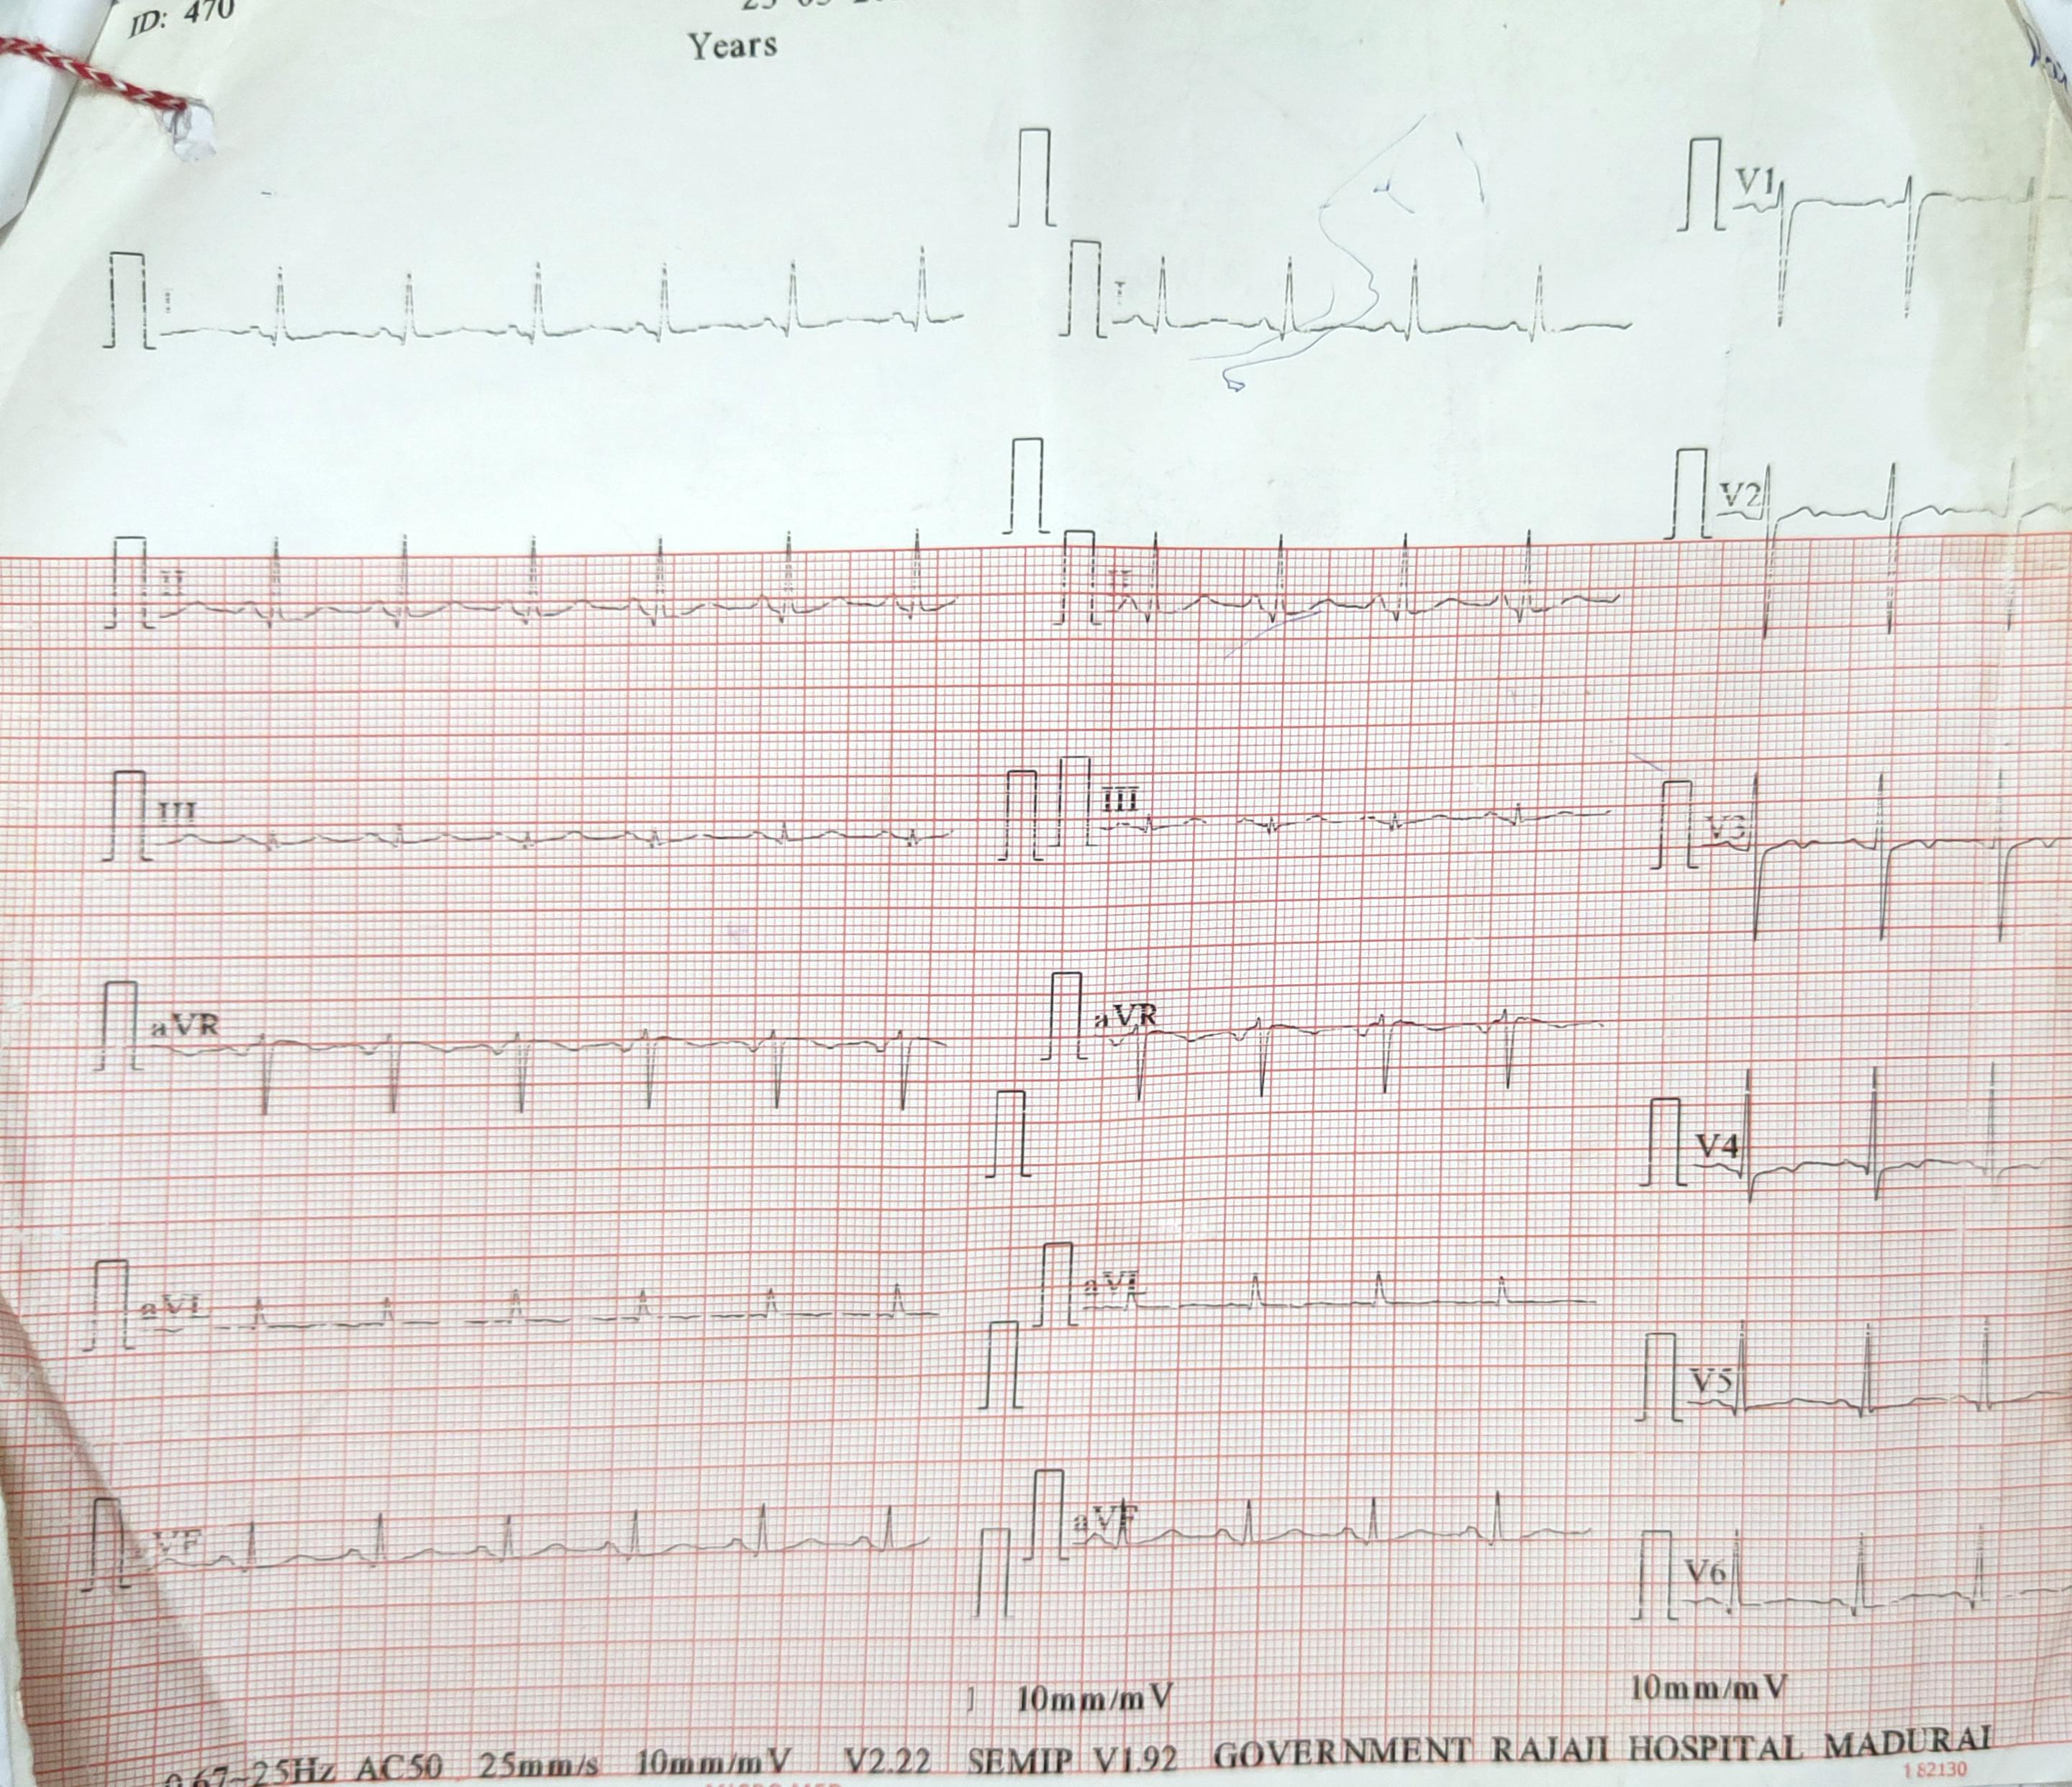
Echo :
No RWMA
Normal LV function
LV EF – 60 %

Slide 20
MEDICAL GASTROENTROLOGY OPINION :
DIAGNOSIS : MODERATE UGI BLEED / TTP / JEJUNAL DIVERTICULOSIS/
CKD / COAGULOPATHY
ADVICE :
- INJ . PANTOPRAZOLE 80 MG IV STAT F/B 8 MG / HR INFUSION
- ADEQUATE HYDRATION
- CORRECTION OF COAGULOPATHY BY FFP / BLOOD PRODUCTS TRASFUSION
- SERIAL LFT / RFT / PT INR MONITORING

Slide 21
RHEUMATOLOGY OPINION :
A CASE OF TTP ON TREATMENT
ADVICE :
ANA BY IF METHOD
HAEMATOLOGIST FOLLOW UP
MGE REVIEW :
- INJ . PANTOPRAZOLE 80 MG IV STAT F/ B 8 MG IV INFUSION
- OGD DATE FIXED.

Slide 22
NEPHROLOGY OPINION :
DIAGNOSIS : HTN / TTP / RENAL FAILURE – NON OLIGURIC / UGI BLEED F/E
ADVICE :
- t. nahco3 1-1-1
- 4 units of platelet / 2 units of ffp transfusion
- conservative management / seial rft monitoring
to do
1. peripheral smear with retic count / ldh
2. anti factor h ab testing
3. c3, c4 , genetic study for complement factor gene defect and
congenital ttp
4. screening of children

Slide 23
TREATMENT GIVEN
NPO
RYLES TUBE ASPIRATION
IV FLUIDS
INJ.PANTOPRAZOLE 80mg iv stat f/b 8mg/hr infusion
Inj.transexamic acid 500mg iv tds
Inj.cefotaxime 1gm iv bd
T.amlodipine 5mg 2-0-0
T.nahco3 500mg tds
T.caco3 300mg 1-0-1
W/f bleeding manifestations
i/o chart
Platelet transfusion

Slide 24
discussion
Discussion on the thrombocytopenia - congenital conditions
Discussion on thrombotic microangiopathy
Role of ffp and cryoprecipitate in this patient
Etiopathogenesis of gastric ulcer and esophagitis
Cause for chronic kidney disease
Further workup for his recurrent thrombocytopenia
management – adding few another drugs for treatment

