Slide 1
ECG FOR DISCUSSION
III MEDICAL UNIT
CHIEF: DR. DAVID PRADEEP KUMAR
ASSISTANT PROFESSORS: DR. NASEEMA BANU
DR. RAMKUMAR
DR. NABIL FAYAS

Slide 2
56 yr, male
h/o palpitations
k/c/o R CVA 2019, residual UL weakness, embolic from
RHD- severe mitral stenosis
Atrial fibrillation on anticoagulants
Vitals:
BP- 100/60 mm hg in left arm, supine position
PR- 150/ min, regular, normal volume

Slide 3
General examination :
Pt conscious, afebrile
No pallor, pedal edema, icterus, cyanosis, clubbing,
significant lymphadenopathy
Systemic examination:
CVS: S1 S2, tachycardia, no murmur
RS: B/L AE, no added sounds
P/A: soft, bowel sounds heard
CNS: R hemiparesis residual UL weakness

Slide 4
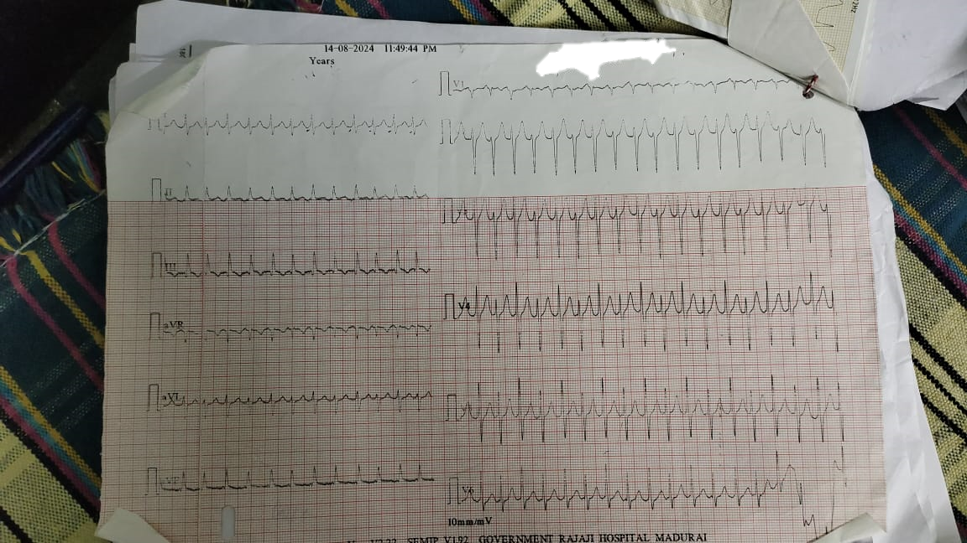
On admission

Slide 5
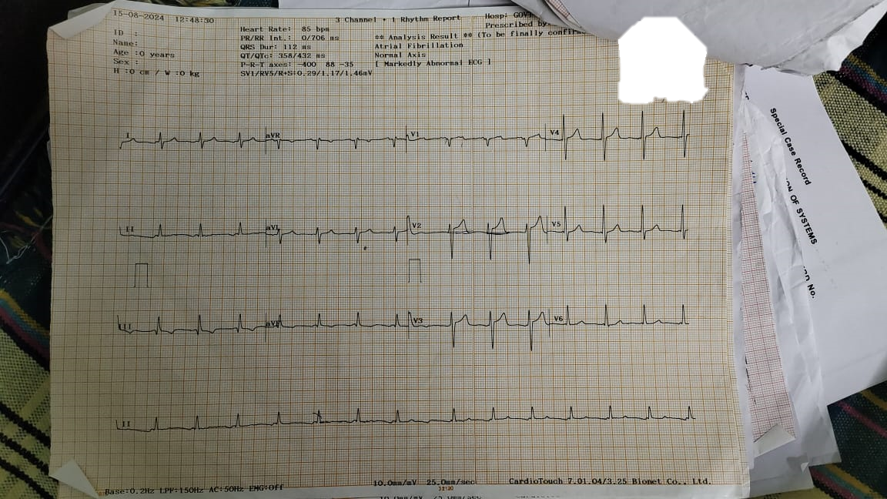
After IV Digoxin

Slide 6
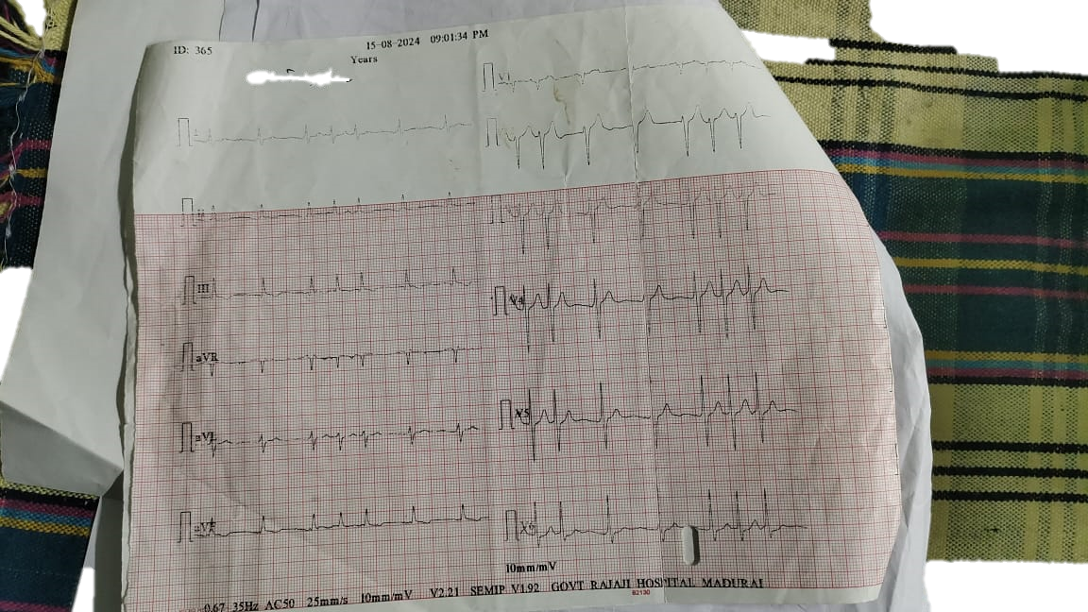
On Digoxin, Metoprolol

Slide 7
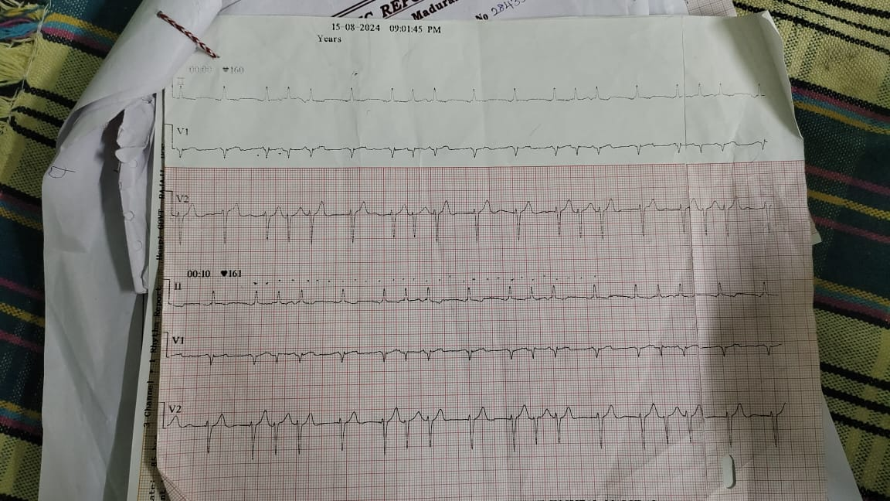
Rhythm strip in ward

