Slide 1
TWO INTERESTING CASES OF CNS TUBERCULOSIS
II MEDICAL UNIT
CHIEF
PROF DR.R.BALAJINATHAN M.D
ASST.PROF
DR.V.N.ALAGA VENKATESAN M.D
DR.P.V.BALAMURUGAN M.D.
DR.R.PANDICHELVAN M.D

Slide 2
CASE 1: A CASE OF TUBERCULOMA BRAIN WITH HAEMORRHAGIC MENINGOENCEPHALITIS

Slide 3
CASE SUMMARY
39 yr old male Mr. P admitted with chief complaints of
HEADACHE – 10 days
FEVER – 4 days
ALTERED SENSORIUM – one day

Slide 4
History of presenting illness
Patient was apparently normal 10 days back then he had
Headache – 10 days
holocranial
relieved with analgesics
associated with vomiting- projectile, immediately after taking
food , contained food particles, not blood stained .
Fever – 4 days
high grade
intermittent
not associated with chills and rigor
Altered sensorium since one day

Slide 5
No H/O seizures
No H/O weakness of limbs
No H/O involuntary micturition/defeacation
No H/O deviation of angle of mouth
No H/O cough with expectoration
No H/O abdominal pain
No H/O oliguria, swelling of legs
No H/O bleeding manifestations
No H/O contact with open case of tuberculosis

Slide 6
Past history:
Not a known case of PTB/SHTN/BA/COPD/RHD/DM,
No H/O similar illness in the past,
No H/O TIA episodes in the past .
Personal history :
Takes mixed diet
Occassional alcoholic past 5 yrs
Chronic smoker past 5 yrs
Family history : No H/O similar illness in the family members.

Slide 7
EXAMINATION
General examination
unconscious
GCS 5/15
responding to painful stimuli
afebrile
not anemic
anicteic
no cyanosis/ no clubbing
no pedal edema
no generalised lymphadenopathy

Slide 8
vitals
Pulse : 96/min , regular, normal volume pulse felt in all accessible peripheral vessels
Blood pressure: 180/100 mm hg in right upper arm , supine posture
SpO2: 98% with room air
Respiratory rate: 18/min
Temperature: 99`F

Slide 9
SYSTEMIC EXAMINATION
CENTRAL NERVOUS SYSTEM
Unconscious
higher mental functions could not be tested
RIGHT LEFT
III,IV ,VI no ptosis ptosis+
eye deviated to left
pupils 3mm dilated
RTL not reacting to light
fundus normal normal

Slide 10
No fascial asymmetry
Uvula in midline
Spinomotor : RIGHT LEFT
Bulk N N
Tone increased increased
Power could not be tested
DTR 2+ 2+
Plantar withdrawal withdrawal
Gaze preference to left
Signs of Meningeal irritation +

Slide 11
Cardiovascular system :
S1 S2 heard
no murmur
Respiratory system:
B/L air entry +
B/L coarse creps+
Abdomen:
soft, bowel sounds +
no organomegaly

Slide 12
INVESTIGATIONS
CBC:
Hb:8.1 gm/ dl
TC : 14400 cells / cu.mm
DC: P 82%, L 9% M 9%
ESR: 42 mm/ hr
PLT : 3.79 lakh
PCV :27%
RBS :85 mg/ dl
Urea :34 mg/ dl
Creatinine:0.9 mg/dl
LFT:
T. bilirubin:0.4
D. bilirubin:0.2
I. bilirubin :0.2
SGOT :19
SGPT:16
CXRAY : AP VIEW ,
NORMAL

Slide 13
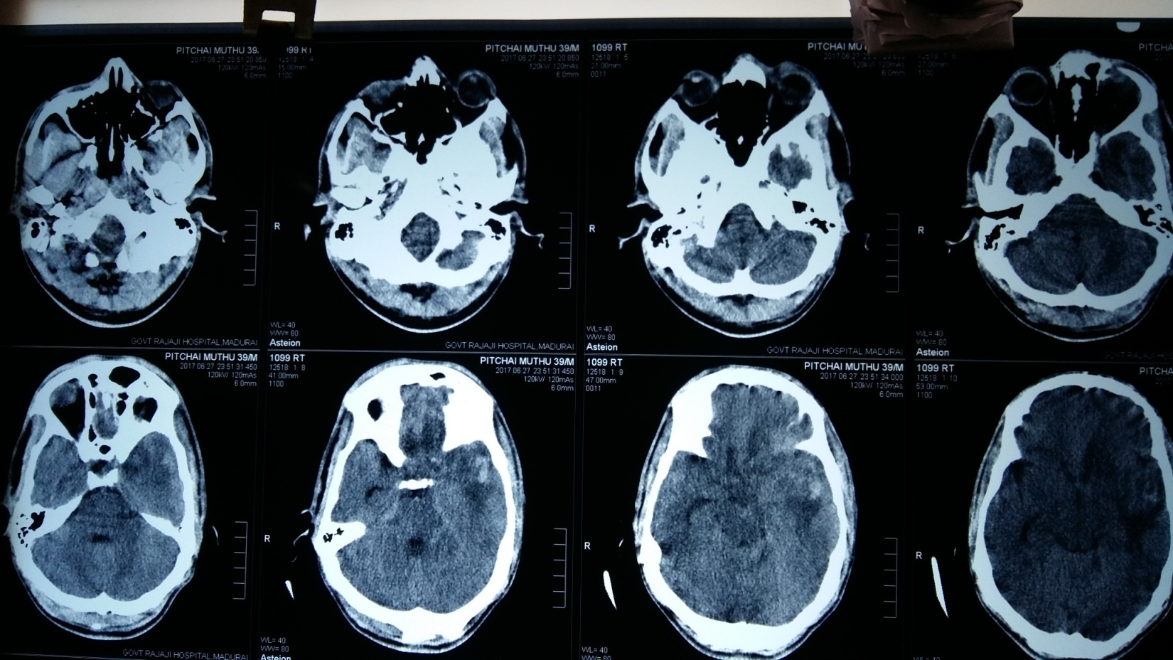

Slide 14
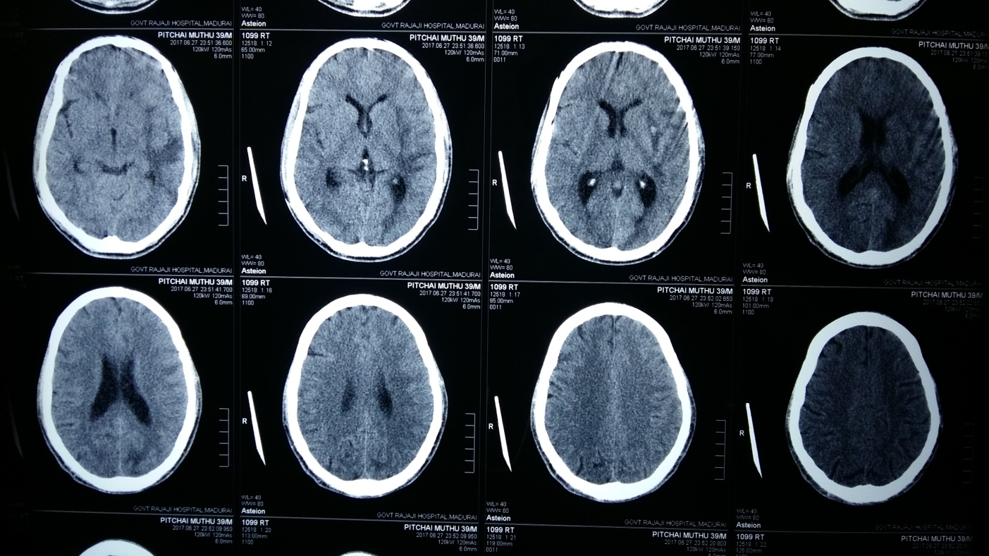

Slide 15
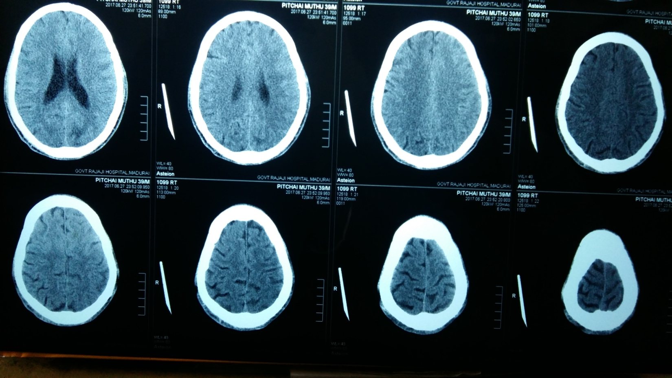

Slide 16
Provisional Diagnosis: SHTN/ALTERED SENOSORIUM FOR EVALUATION
ACUTE MENINGOENCEPHALITIS WITH III CRANIAL NERVE PALSY
?TB MENINGITIS
ASPIRATION PNEUMONITIS

Slide 17
Treatment given
RTF ~1.5 L/ day
Inj. Ceftriaxone 2 gm iv bd
Inj. Ampicillin 2 gm iv qid
Inj. Dexamethasone 8 mg iv tds
Inj. Mannitol 100ml iv tds
T. Amlodipine 2.5 mg 4od
Inj. Ranitidine 50 mg iv bd
BP/ PTR/ I/O chart

Slide 18
CSF analysis
Sugar : 35 mg/dl
Protein: 160 mg /dl
Globulin : positive
Lymphocytes: 26
Polymorphs:10
RBC : present

Slide 19
NEUROLOGIST OPINION
Unconscious
Not responding to oral commands
Responds to pain
Left eye ptosis +
Left pupil dilated not RTL
Moves all four limbs
B/L plantar withdrawal
Neck stiffness +
DIAGNOSIS:
ACUTE MENINGOENCEPHALITIS / TBM

Slide 20
TREATMENT SUGGESTED
Inj. Ceftriaxone 2 gm iv bd
Inj. Ampicillin 2 gm iv qid
Inj. Dexamethasone 8 mg iv tds
To continue others
ATT under CAT I
Review

Slide 21
Thoracic medicine opinion
Thoracic medicine opinion obtained on 28/06/17 and patient was registered under category I ATT

Slide 22
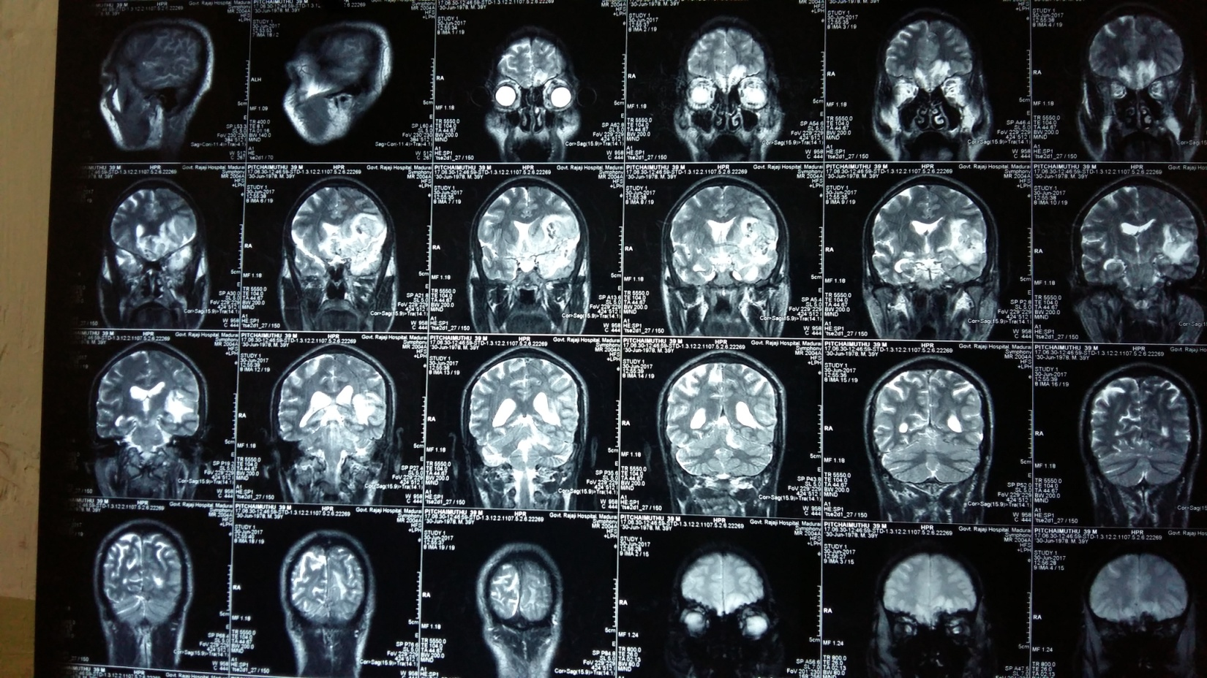

Slide 23
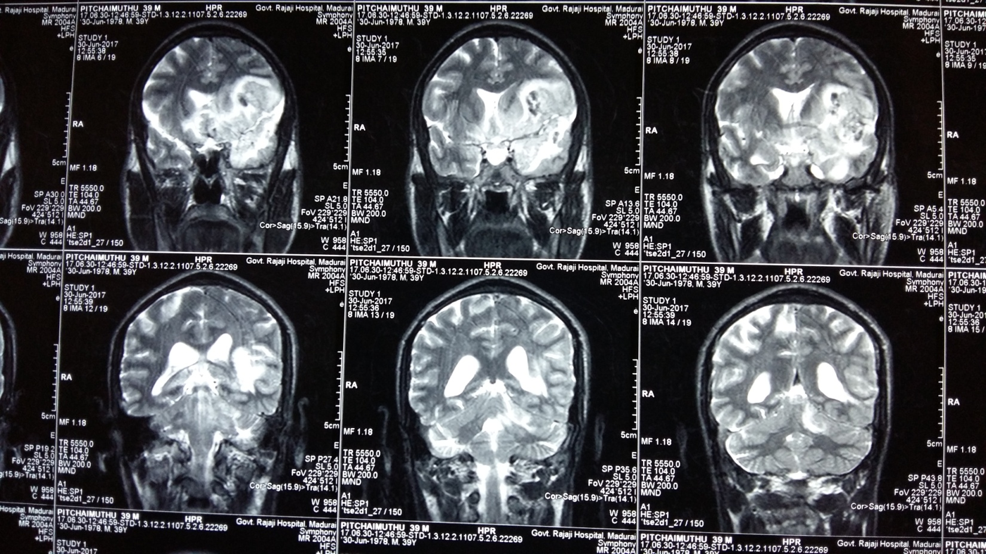
MRI BRAIN

Slide 24
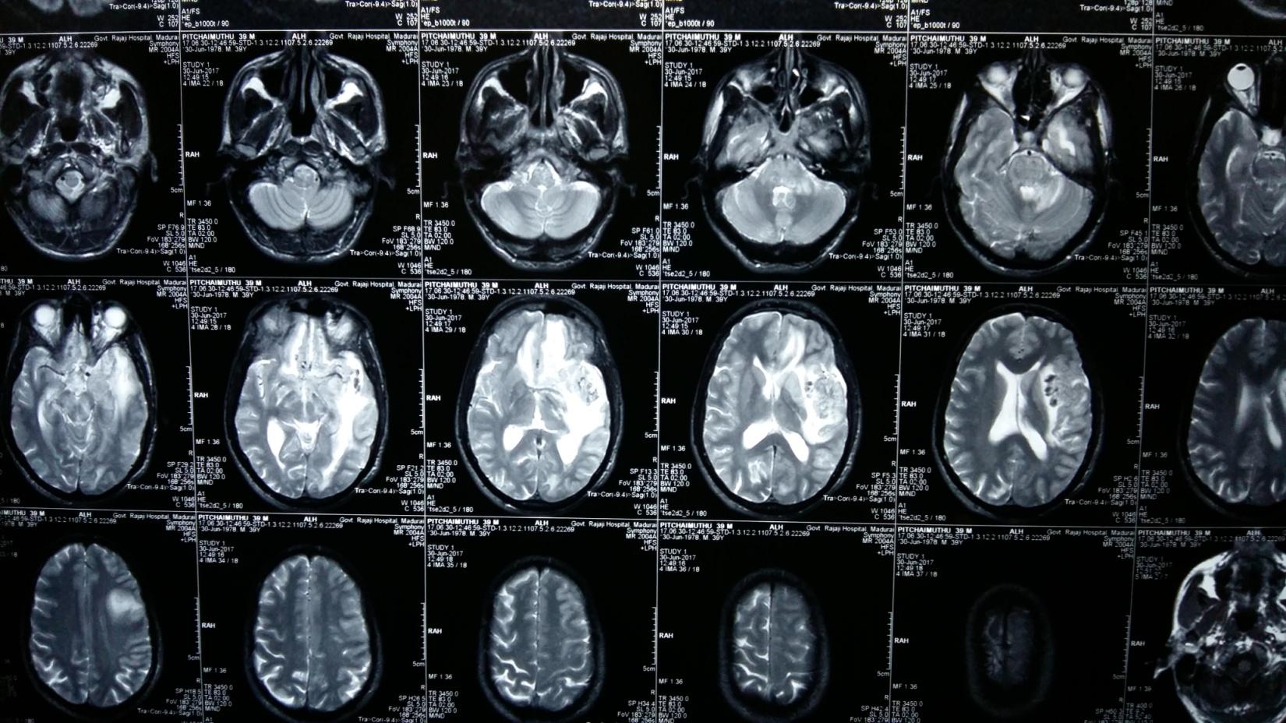

Slide 25
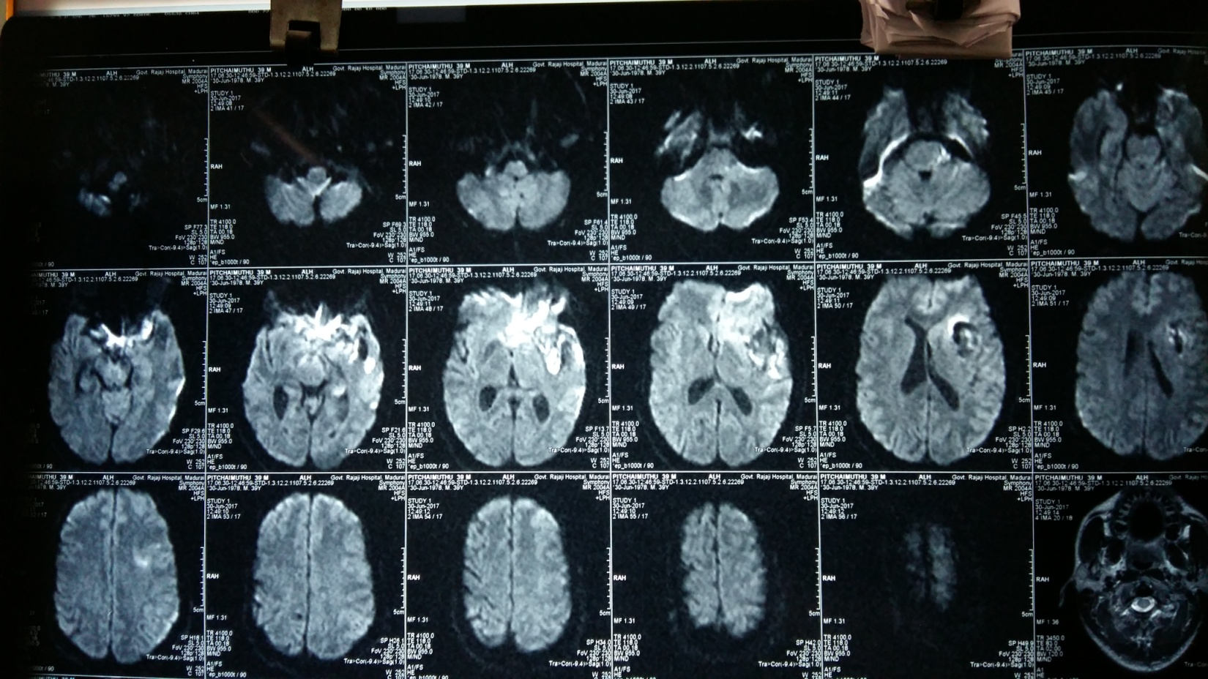

Slide 26
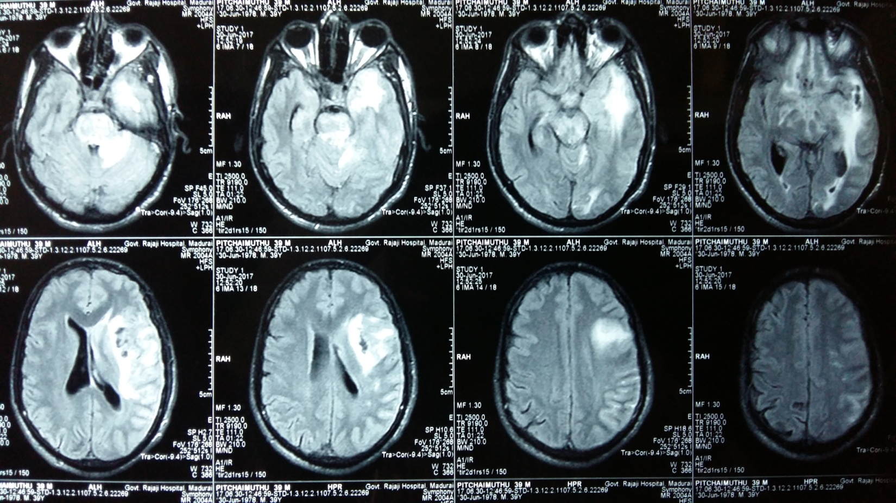

Slide 27
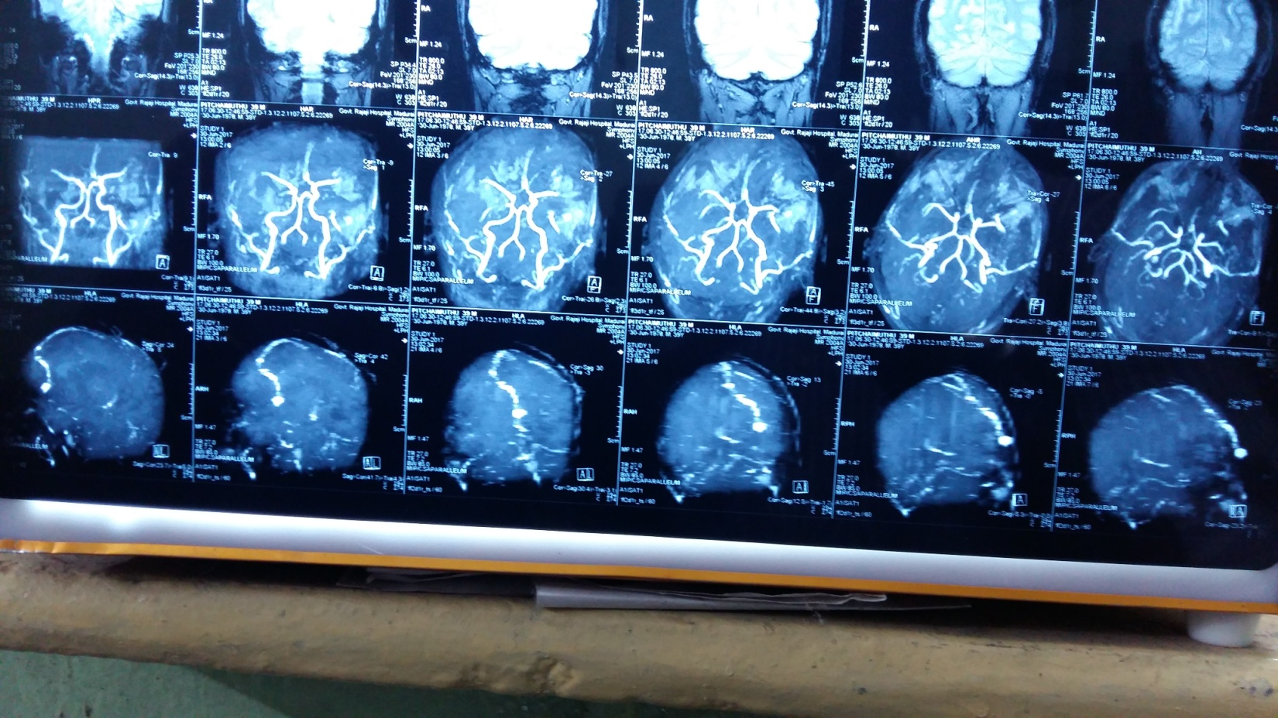
MRA and MRV

Slide 28
MRI REPORT
Evidence of T1 hypointensive with hyperintensive foci,T2/FLAIR hyperintensity noted in Lt fronto-parieto-temporal region with perilesional edema causing mass effect in the foci of effacement of ipsilateral lateral ventricle .
On contrast ,Lt cerebral hemisphere shows leptomeningeal enhancement Lt sylvian fissure is effaced due to edema and shows enhancement on contrast .
Single ring enhancing lesion noted in Lt occipito-cortical region – suggestive of TUBERCULOMA
IMP:HAEMORRHAGIC MENINGOENCEPHALITIS is more likely… suggested follow up …

Slide 29
Patient showed improvement after ATT ….
Patient attenders want of AMA and further course of the patient and the response to ATT COULD NOT BE ELICITED……

Slide 30
AIM OF THE PRESENTATION
Rarity of the case of tuberculoma brain with haemorrhagic meningoencephalitis …..
Differrent manifestation of NEUROTUBERCULOSIS

Slide 31
THANK YOU

