Slide 1
Uncommon manifestation of an autoimmune disease
CHIEF PROF DR.BAGIALAKSHMI MD
ASST PROF DR.SARAVANAN MD
ASST PROF DR.PONSENTHIL KUMAR MD
ASST PROF DR.SATHEESH KUMAR MD
PRESENTOR SALMANKHAN.A

Slide 2
HISTORY
18 years female
c/o swelling of joints of both hands and feet - past 3 months
PRESENTING ILLNESS
patient was apparently normal before 3 months,admitted now with
c/o swelling of joints of both hands &feet for 3 months.
insidious in onset, not associated with pain

Slide 3
h/o redness of eyes
h/o periorbital puffiness,insidious onset,no diurnal variation.
h/o oral ulcer
h/o purpuric rashes in extremities
h/o recurrent joint pain
h/o hair loss
h/o difficulty in climbing the stairs

Slide 4
h/o myalgia
no h/o photosensitivity
no h/o dysuria
no h/o difficulty in holding the slippers
no h/o blurring of vision
no h/o seizure
no h/o palpitations & dyspnoea

Slide 5
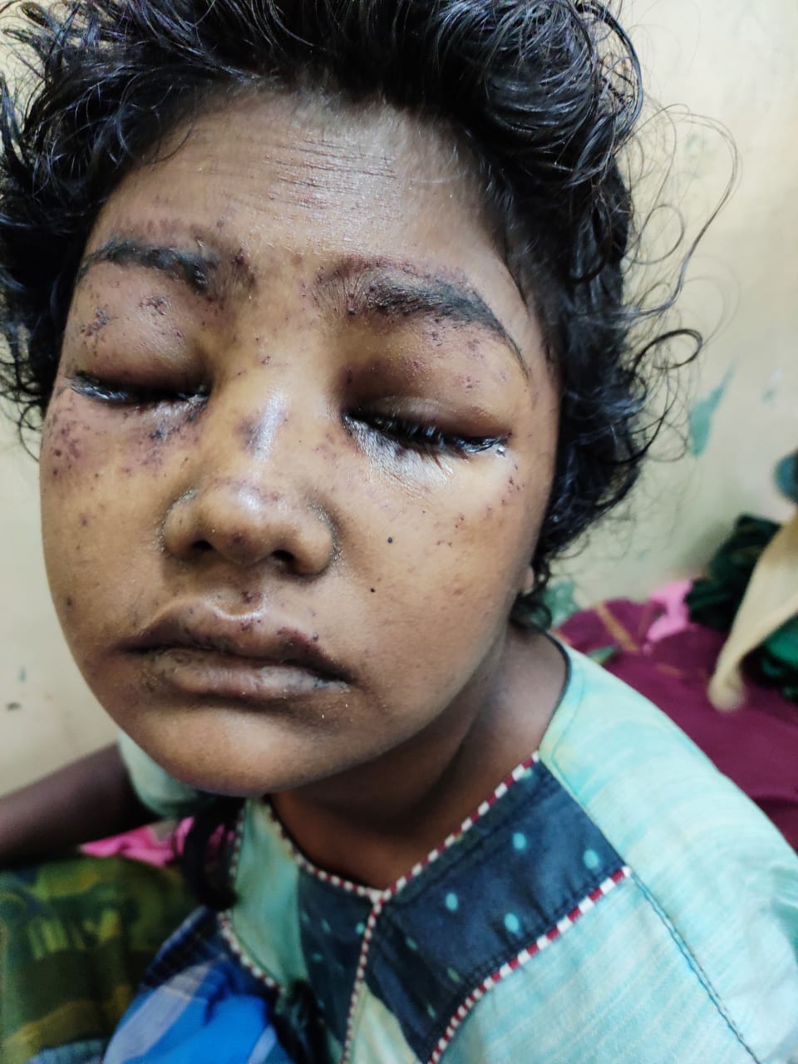

Slide 6
PAST HISTORY
no h/o similar illness in the past
no h/o dm/sht/ba/epilepsy/ptb/hiv
no h/o steroid intake
no h/o previous surgery.

Slide 7
PERSONAL H/O
mixed diet
bladder& bowel habits normal
no known drug allergy
MENSTRUAL HISTORY
4/30 regular cycles
no h/o menorrhagia

Slide 8
GENERAL EXAMINATION
conscious
oriented
afebrile
pallor
discharge from eyes&ears
periorbital puffiness
punctate erythematous papules over the palms,soles,trunk.

Slide 9
oral ulcer
palatal erosion
no cyanosis
no clubbing
no generalised lymphadenopathy
b/l nonpitting pedal edema

Slide 10
Vitals
Pulse-96/min,regular in rhythm,no specific character,felt equally in all accessible peripheral vessels.
Bp-110/70 mm hg
Spo2-98% in room air
Temp-99f

Slide 11
SYSTEMIC EXAMINATION
Cvs-S1S2 heard
No murmur
Rs-BAE,no added sounds
P/a-soft,bs heard.
Cns-conscious,oriented
Tone-normal in all 4 limbs

Slide 12
Power-5/5 in both upper limbs
4/5 in both lower limbs
DTR-normal
B/L plantar-flexor

Slide 13
DIFFERENTIAL DIAGNOSIS
1.SLE
2.DERMATOMYOSITIS
3.REITERS DISEASE

Slide 14
INVESTIGATIONS
HB-10.3gms
TC-11,100CELLS
DC-P73%/L18%/E9%
PCV-31%
PLT-1.5 lakh
RBS-91 mg/dl
Urea-18mgs%
Creatinine-0.7mgs%
Absolute Eosinophil count-120cells/cumm
Reticulocyte count-0.65%

Slide 15
Total bilirubin 0.5mg/dl
Direct bilirubin-0.2mg/dl
Indirect bilirubin-0.3mg/dl
SGOT-30U/L
SGPT-36U/L
ALP-37U/L
Sr NA-129Meq/l
Sr K-5.3Meq/l

Slide 16
Urine Routine
Albumin-loaded
sugar-nil
Dep-2-3 pus cells
CPK 82.2 u/l
CPK MB-63u/l
Urine spot PCR 0.9
24 hours urine protein-35mg

Slide 17
USG ABDOMEN&PELVIS
1.Fatty liver
2.B/L medical renal disease
Right kidney -11.9*4.8cm.increased echoes.
CMD maintained.
Left kidney-11*4.7cm.Inreased echoes.CMD maintained.
3.Minimal to moderate ascites
RENAL DOPPLER
Right renal artery-normal flow;RI-0.57
Left renal artery-normal flow;RI-0.55
B/L reanal vein-normal flow&wave form.

Slide 18
Chest xray-Normal.
ECG-92/min,Normal Axis,Sinus Rhythm
VCTC,Hep B,C-NEGATIVE.
TSH-2.99MIU
Blood c/s-no growth.
Urine c/s-moderate Ecoli growth.
sensitive to ampicillin,norflox,nitrofurantoin.
Peripheral smear-Hypochromic microcytic anaemia.

Slide 19
TREATMENT GIVEN
Ivf 2NS@50ml/Hr
Inj.Dexamethazone 4mg Iv Bd
Inj.Ceftriaxone 1g Iv Bd
Inj.Metronidazole 500mg Iv Tds
T.Ca+vitd3 1od
T.Serratiopeptidase 10mg 16th Hrly
T.Ranitidine 150 Mg 1 Bd

Slide 20
DERMATOLOGIST OPINION
IMPRESSION
1.Mixed Connective Tissue Disorder
2.R/O Dermatomyositis
3.Acute Lupus Erythematosis
4.?Overlap
ADVICE
1.Suppotive Care
2.Plenty Of Oral Fluids
3.Rheumatology Opinion.

Slide 21
OPTHALMOLOGIST OPINION
IMPRESSION
?Acute cattarrhel conjuctivitis
Fundus Examination.
BE media clear
Disc-normal
C:D=0.3:1
A:V=2:3
Macula –normal.
ADVICE.
1.Lid hygeine.
2.lubricant 4th hrly
3.continue other line of management

Slide 22
RHEUMATOLOGIST OPINION
IMP-
SLE /?DERMATOMYOSITIS/?OVERLAP SYNDROME
Advise
ANA reflex status
Renal&Cardiac evaluation
inj.Dexa 4mg iv bd
T.chloroquine 1hs
T.calcium+vit D 1od

Slide 23
NEPHROLOGY OPINION
IMP- ?SLE/R/O LUPUS NEPHRITIS
ADVICE
24 Hours urine protein
ANA profile
Cardiac Evaluation.
REVIEW
24 hours urine protein-35mg/day
IMPRESSION
no evidence of lupus nephritis at present

Slide 24
Cardiologist Opinion
Suggest ECHO
ECHO Shows-Normal study.

Slide 25
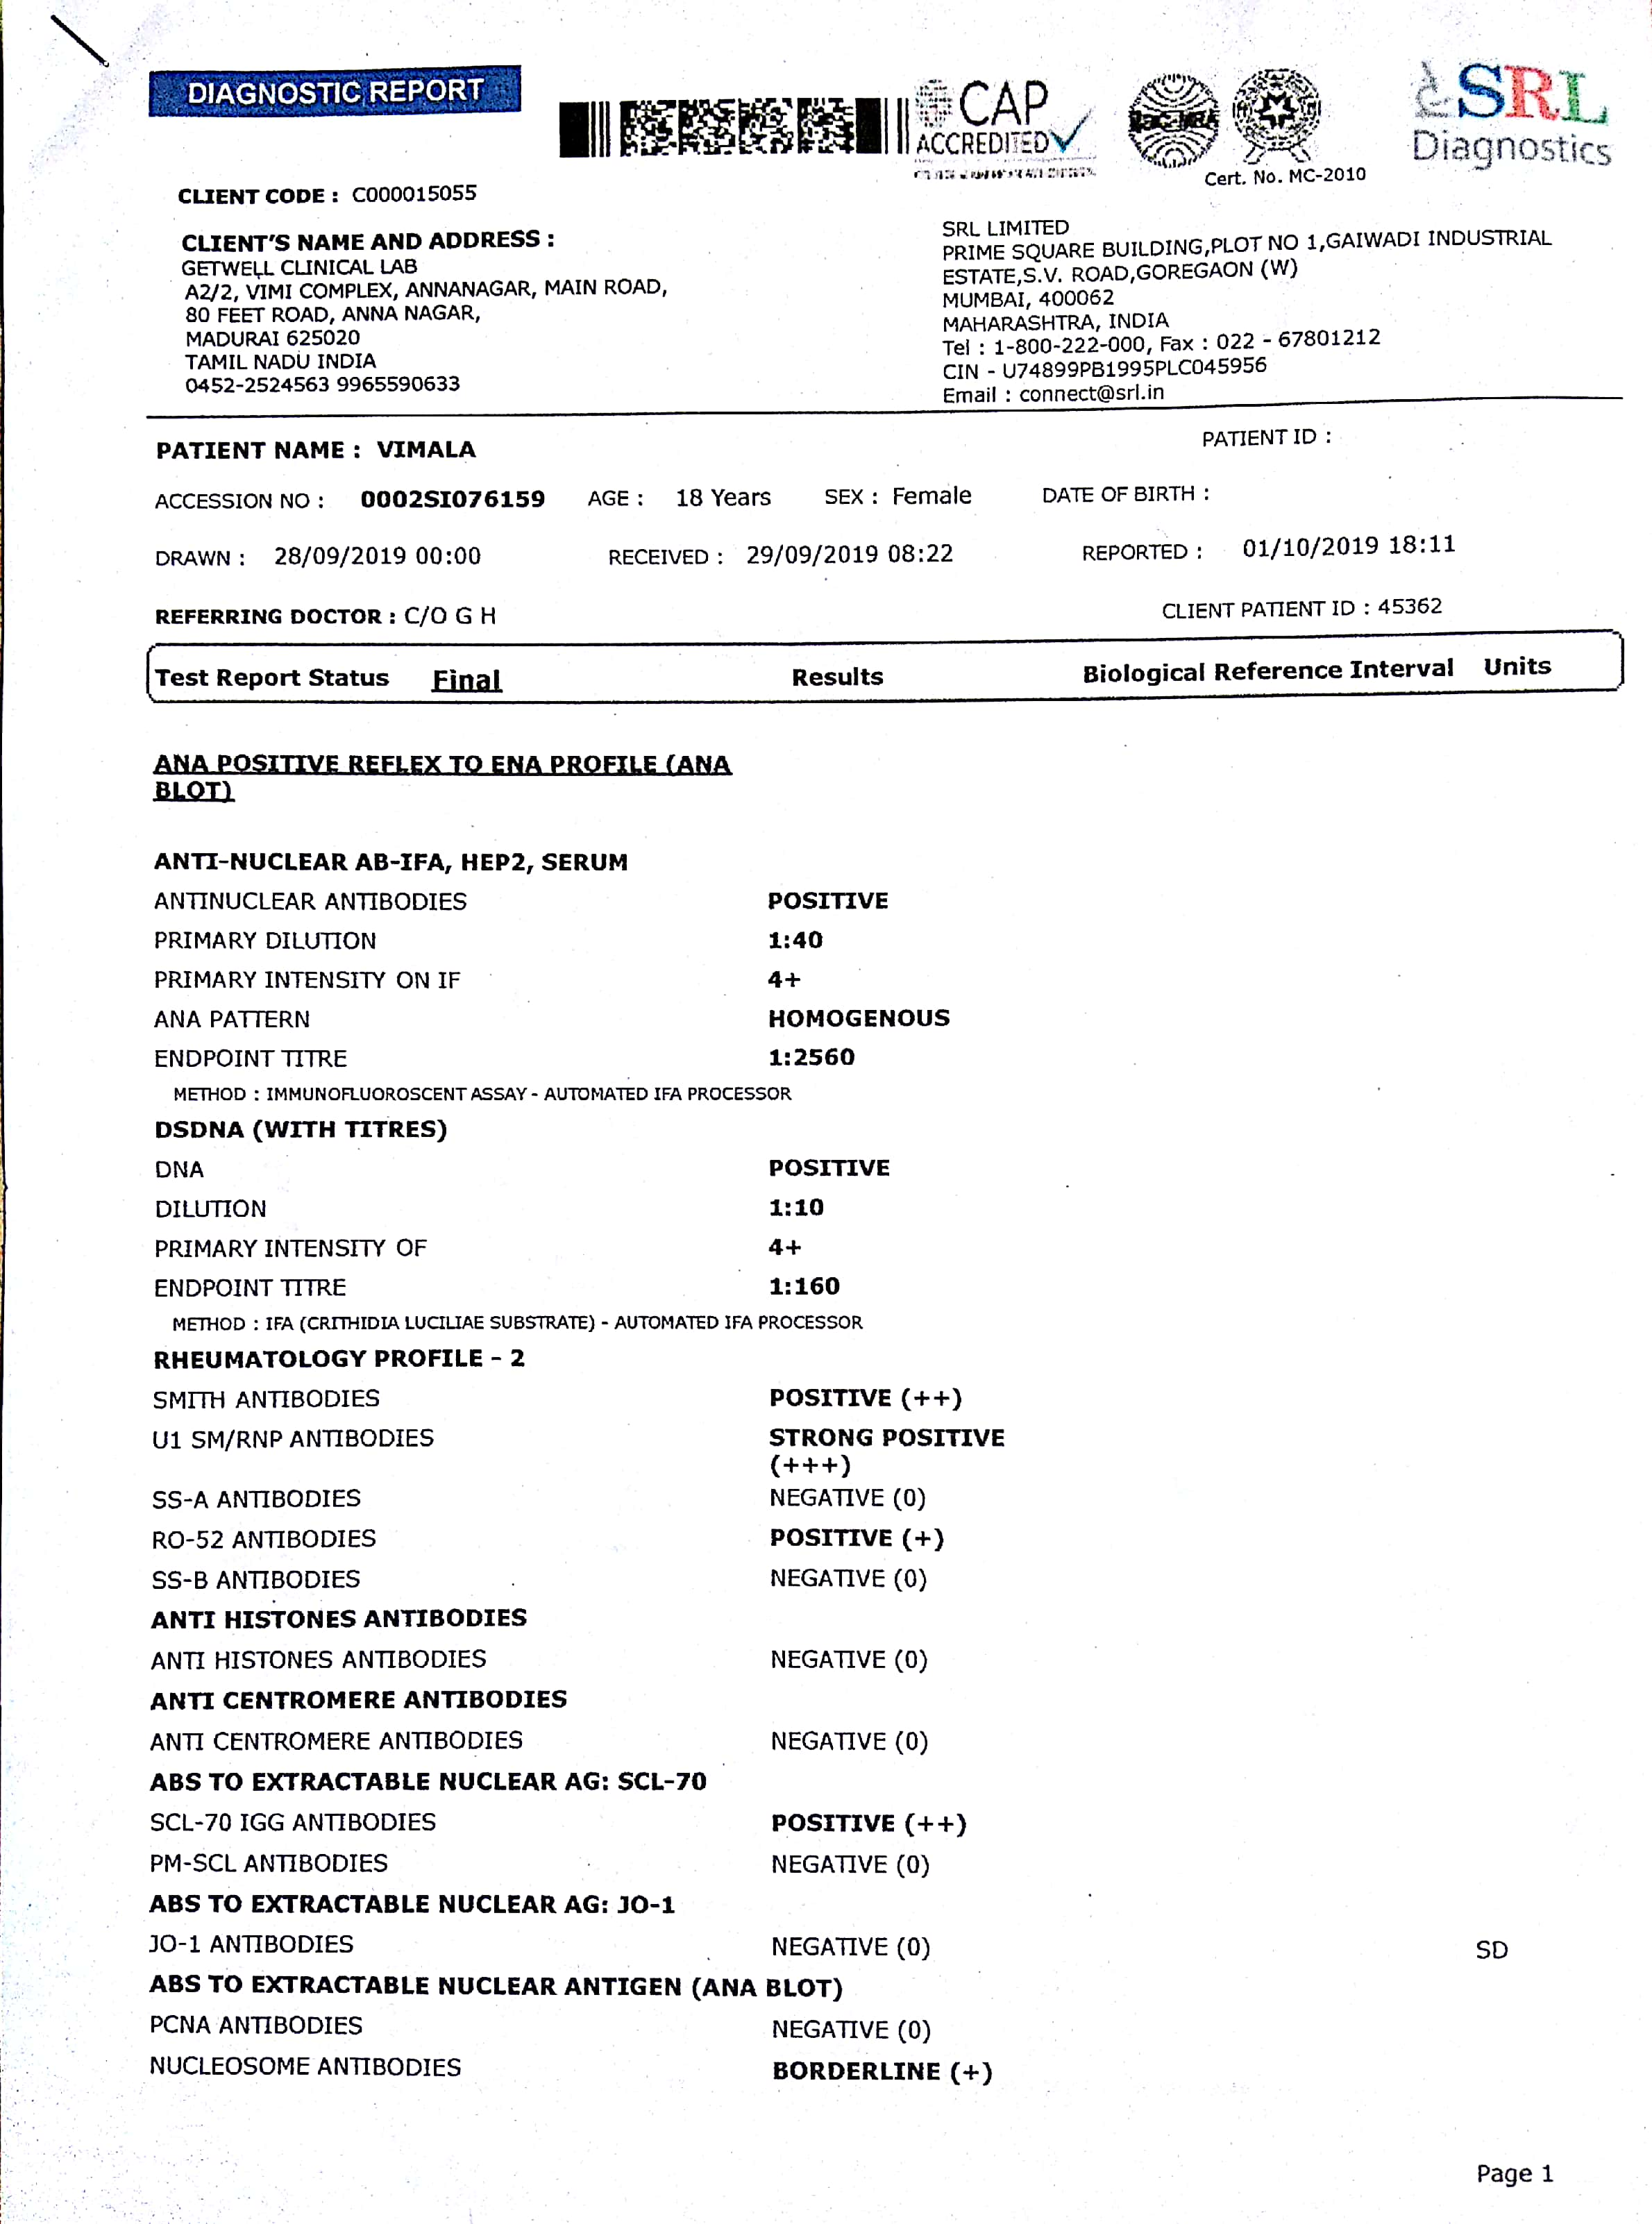

Slide 26
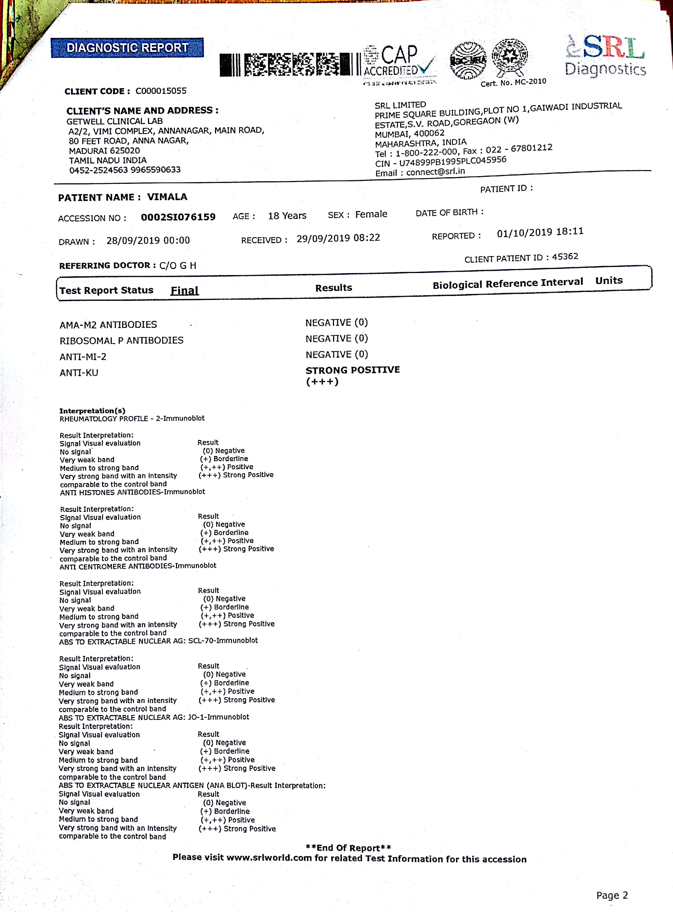

Slide 27
FINAL DIAGNOSIS
SLE Dermatomyositis OVERLAP SYNDROME

Slide 28
DISCHARGE ADVICE
T.prednisolone 5mg 6 od
T.calcium+vitamin D3 1bd
T.Hydroxychloroquine 200mg 1hs
C.omeprazole 20mg 1bd
T.paracetamol 500mg 1od
T.serratiopeptidase 10mg 1bd
Moxifloxacin eye drops 2drops 4th hrly
Carboxymethylcellulose eye drops 2drops 4th hrly
T.cetrizine 10mg 1hs.

Slide 29
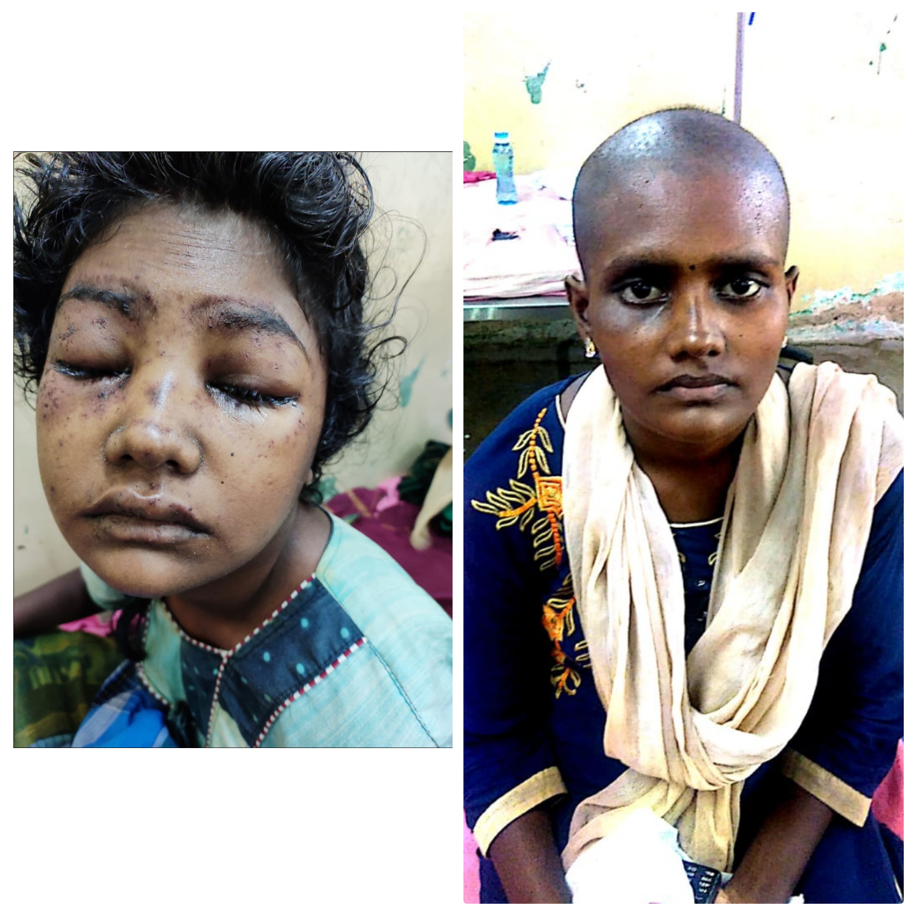

Slide 30
AIM OF PRESENTATION
To discuss the various presentations of SLE

Slide 31
THANK YOU

