Slide 1

AN INTERESTING CASE OF INFECTIVE ENDOCARDITIS from IMCU 1
PRESENTER : Dr. SHYAMALA. K 2nd yr PG

Slide 2
.
A 30 yr old male was brought to GRH Madurai with complaints of Fever- high grade intermittent for 3 weeks
H/o headache for 3 weeks
H/o left sided chest pain not radiating associated with palpitations for 15 days
H/o breathlessness at rest NYHA Class 4 for
H/o nausea +
H/o hematuria 3 days
No h/o other Bleeding manifestations
No h/o cough with expectoration
No h/o vomiting, loose stools
No h/o yellow skin and urine
No h/o seizures, LOC, altered sensorium

Slide 3
PAST HISTORY
Pt is a known case of RHD - severe MR, severe AR since 6 yrs of age, on irregular follow up
H/o Recurrent hosp admissions for breathlessness (pulmonary edema)
Recently pt got admitted in CTVS dept, GRH Madurai and was operated
DVR - MILTONIA BI LEAFLET MITRAL AND AORTIC VALVE REPLACEMENT done on 22.01.26

Slide 4
.
Pt was discharged with
Tab. Linezolid 600mg bd
Tab. Ciprofloxacin 500mg bd
Tab. Paracetamol 500mg tds
Tab. Ranitidine 150mg bd
Tab. Aspirin 75mg od
Tab. Digoxin 0.25mg od (Days 5/7)
Tab. Metoprolol 25mg bd
Tab. Acitrome 2mg and 3mg on alternate days
Tab. Penicillin 250mg bd
Tab. BCT 1 od

Slide 5
.
H/o re-admission in CTVS dept (31.1.26 - 9.2.26) with similar complaints of fever and headache
He was evaluated for the same:
CT Brain normal on 31.1.26
Blood culture and sensitivity on 5.1.26 showed no growth
Urine culture and sensitivity showed no growth
Dengue IgM negative
Hence, pt was discharged

Slide 6
PERSONAL HISTORY
Unmarried male
Chronic smoker and alcohol 10 yrs
No other substance abuse
On mixed diet

Slide 7
GENERAL EXAMINATION
Thin built and malnourished
Conscious
Febrile
Tachypnoeic
Dyspnoeic
Pallor +
No pedal edema
No icterus
No cyanosis

Slide 8
.
No clubbing
No lymphadenopathy
Midline sternotomy surgical scar present, healthy, no discharge
No external markers of TB or HIV
VITALS
BP: 90/60 mmhg
Pulse: 120/min
Spo2: 98% in RA

Slide 9
SYSTEMIC EXAMINATION
CVS : S1S2 +, PSM at AA, prosthetic valve click and systolic murmur in MA+
RS : BAE+ with bilateral basal crepts
PA : Soft, BS+, hepatomegaly +
CNS : Conscious, oriented, no focal neurological deficit

Slide 10
PROVISIONAL DIAGNOSIS
RHD/Moderate MR/Status post DVR/ ?PROSTHETIC VALVE ENDOCARDITIS

Slide 11
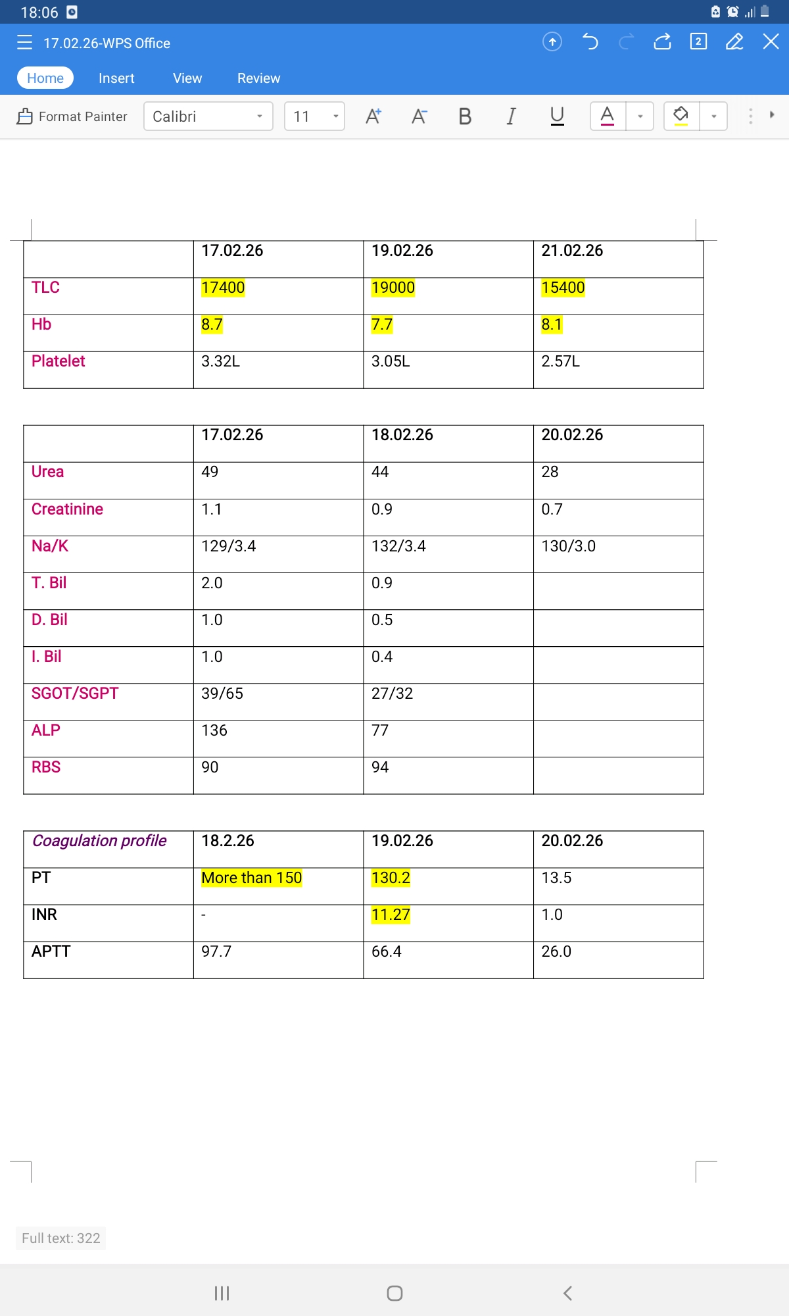
INVESTIGATIONS

Slide 13
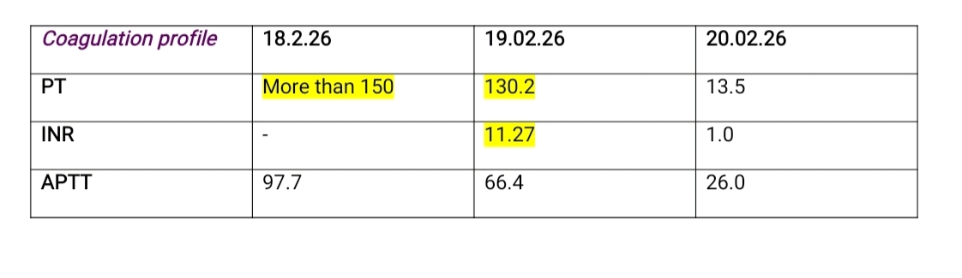

Slide 14
.
ABG Normal
Sr. LDH : 748 U/L
Sr. Procalcitonin : 18.11ng/mL

Slide 15
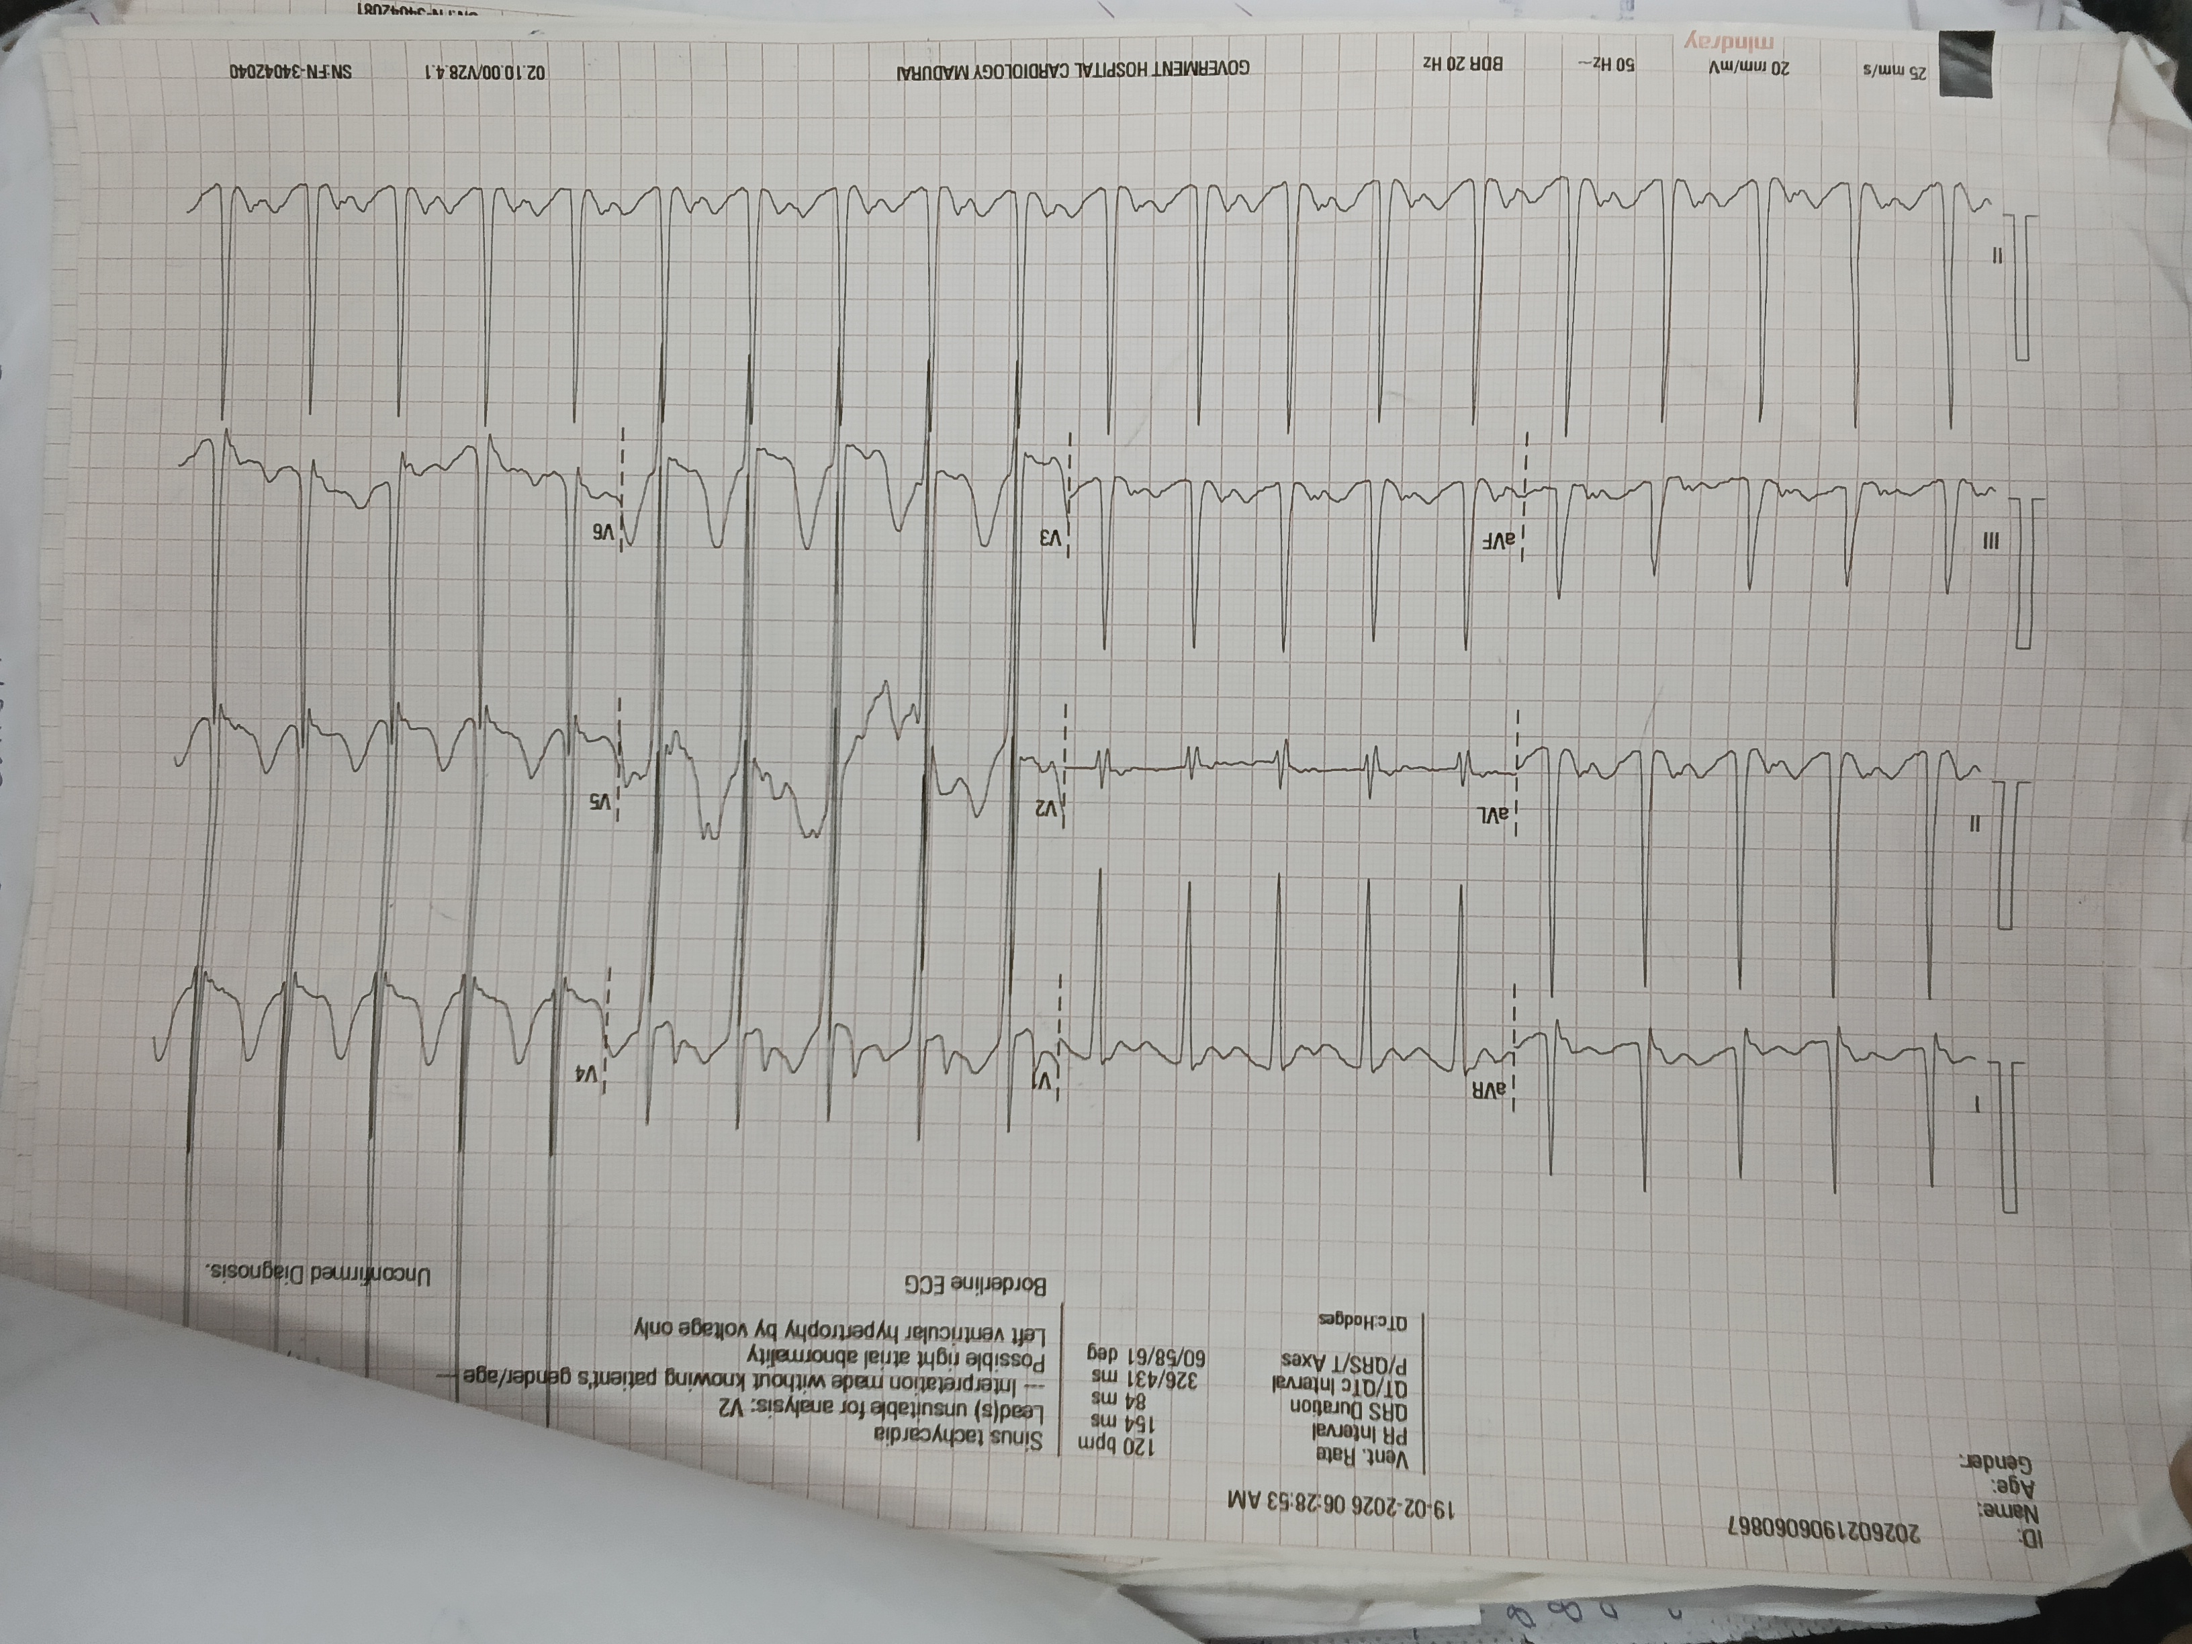

Slide 16
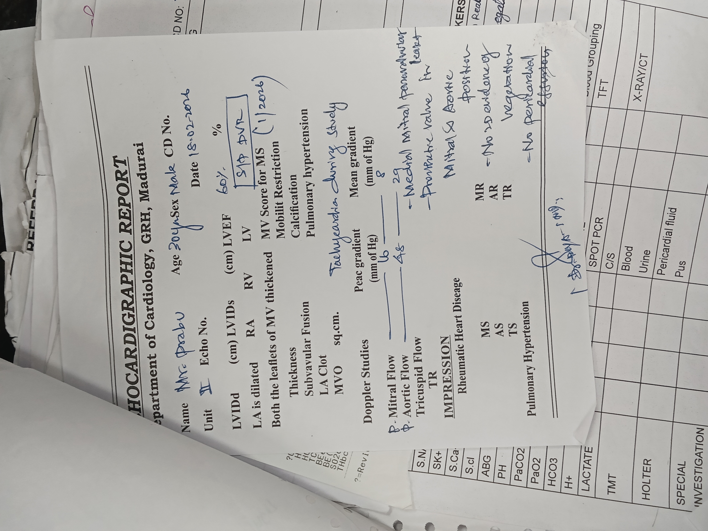

Slide 17
CARDIOLOGY OPINION
Screening Echo in triage revealed
Tachycardia during the study
Prosthetic valve in mitral and aortic position
Medial Mitral paravalvular leak present
No evidence of vegetation
No pericardial effusion

Slide 18
.
IMPRESSION: Paravalvular leak, ?Prosthetic valve endocarditis
ADVICE:
Blood culture and sensitivity
CT brain
Transfusion

Slide 19
TREATMENT GIVEN
Nasal O2 at 4 to 6L/min
Inj. Vancomycin 1gm iv infusion bd
Inj. Gentamicin 80mg iv bd
Cap. Rifampicin 300mg 1 tds
Cap. Omeprazole 20mg 1 bd
Inj. Nor adrenaline @ 0.2mg/kg/min iv infusion
Tab. Digoxin 0.25mg 1 od
Tab. Acitrome 2mg od
Tab. Spironolactone 25mg 1 od
1 PRBC transfusion & 4 FFP transfusion done

Slide 20
.
Pt was taken over by CTVS to CTVS ICU for further management

Slide 21


