Slide 1
THE MASTER’S ROLE IN PANCYTOPENIA
By first medical unit
CHIEF : PROF.DR.M.NATARAJAN M.D.,
ASSISTANT PROFESSORS: DR.V.PALANIKUMARAN M.D.,D.Diab
Dr.d.vasanthakalyani m.d.,d.c.p
Dr.m.sureshkumar m.d.,
Presentor : dr.ragupathi

Slide 2
CHIEF COMPLAINTS
Mrs. Nallathangaal, 45 years old female presented to our hospital with chief C/O Loose stools for past 1 week
Abdominal pain for 1 week

Slide 3
HISTORY OF PRESENTING ILLNESS
Patient was apparently normal before one week, then she developed Loose stools – 5-6 episodes/day
watery consistency
not blood stained
a/w abdominal pain
H/O loss of appetite +
H/O easy fatiguability +
H/O breathlessness on exertion +
No H/O vomiting
No H/O fever

Slide 4
HISTORY OF PRESENTING ILLNESS
No H/O giddiness
No H/O chest pain / palpitations
No H/O reduced urine output
No H/O yellowish discoloration of eyes

Slide 5
PAST HISTORY
She is N/K/C/O – HTN/ DM/ TB/ BA/ CAD/ Thyroid / Seizure disorder
No previous Blood transfusions
No H/O any surgeries

Slide 6
FAMILY HISTORY
No relevant family history

Slide 7
PERSONAL HISTORY
Consumes mixed diet
Bowel and bladder habits were normal
No adverse social habits

Slide 8
TREATMENT HISTORY
H/O multiple hospitalizations for intercurrent illness present.
For which she was treated with IV Fluids and supportive management.

Slide 9
MENSTRUAL & OBSTETRIC HISTORY
P4L4A0 – FTNVD
LCB – 25 years back
Sterilization not done
Amenorrhea for past 25 years
LMP – not known
History S/O post-partum hemorrhage +
H/O lactational failure for last child +

Slide 10
GENERAL EXAMINATION
Conscious
Oriented
Thin built
Poorly nourished
Pallor +
Dehydration +
No pedal edema
No clubbing
No cyanosis

Slide 11
No generalised lymphadenopathy
Dry , Fine wrinkled skin +
Slowing of expression +
Absent axillary hair
Absent pubic hair
B/L Breast atrophy +

Slide 12
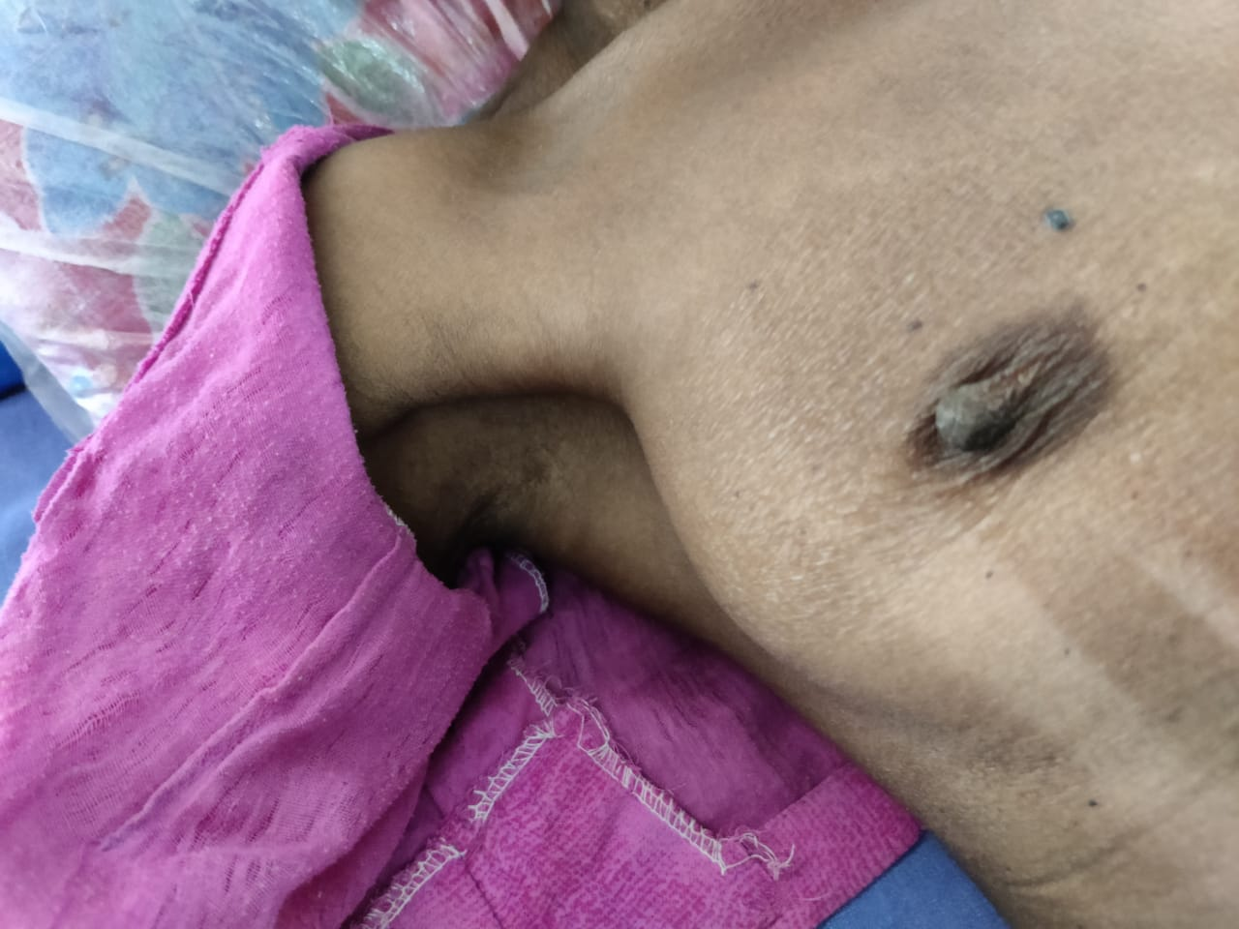

Slide 13
VITALS
Blood pressure
Sitting – 80/50 mmHg
Standing – 70/50 mmHg
Pulse
Rate – 96/min
Low volume pulse
Felt in all peripheral vessels
SpO2 – 99% room air

Slide 14
SYSTEMIC EXAMINATION
CVS- S1S2+
RS – B/L air entry equal, NVBS +
P/A – Soft, BS+
CNS – Conscious, oriented
Moves all 4 limbs
Pseudomyotonic jerk +
NFND

Slide 15
INVESTIGATIONS
 | ON DAY OF ADMISSION
TOTAL COUNT | 3100 cells/cumm
DIFFERENTIAL COUNT | 57/38/5
HB MCV/ RDW | 4.4 gm% 82.3 / 15.8%
PCV | 15%
PLATELET | 59,000 cells/cumm
RANDOM BLOOD SUGAR | 69 mg%
UREA | 60 mg%
CREATININE | 1.7 mg%
SODIUM | 129 mEq/L
POTASSIUM | 4.5 mEq/L

Slide 16
PERIPHERAL SMEAR
Anisopoikilocytosis of RBCs, with normochromic normocytes & hypochromic microcytes
WBCs count Just Normal
Thrombocytopenia
IMP: Hypochromic microcytic anemia with thrombocytopenia

Slide 17
PROVISIONAL DIAGNOSIS
ACUTE DIARRHOEAL DISEASE
TO R/O SHEEHAN SYNDROME
PANCYTOPENIA F/E

Slide 18
USG ABDOMEN & PELVIS
LIVER – 9.9cm Normal echoes
SPLEEN – 9.5cm with Normal echoes
B/L KIDNEYS – 7*3.2 cm with Normal echoes
UTERUS- Thinned out- 6.3*1 cm- ? hypoplastic
OVARIES – not visualised - ? hypoplastic

Slide 19
ENDOCRINOLOGIST OPINION
Impression : Central Hypocortisolism / acute adrenal crisis / Central Hypogonadism /? Central Hypothyroidism
Suggested :
FT4/ TSH/ Sr. cortisol
LH/ FSH
Estradiol

Slide 20
NAME | RESULT | REFERENCE
TSH | 0.999 | 0.270-5.10 uIU/ml
FT4 | 1.67 | 0.93-1.70 ng/dl
CORTISOL | 16.98 | 6.27-18.0ug/dL
LH | 0.609 | 2.4-12.6 mIU/ml
FSH | 0.380 | 3.5-12.5 mIU/ml
PROLACTIN | 0.608 | 4.79-23.3 ng /ml
ESTRADIOL | 26.88 | 12.4- 233 pg/ml

Slide 21
MRI BRAIN - PITUITARY

Slide 22
MRI BRAIN - PITUITARY

Slide 23
FINAL DIAGNOSIS
HYPOGONADOTROPIC HYPOGONADISM
RELATIVE CENTRAL HYPOCORTISOLISM
SHEEHAN SYNDROME
? SHEEHAN SYNDROME INDUCED PANCYTOPENIA

Slide 24
TREATMENT GIVEN
IV FLUIDS - NS 2 pints/day
Inj. Hydrocortisone 100mg iv tds
Inj. Pantoprazole 40mg iv bd
Cap. Bifilac bd
ORS

Slide 25
PROGRESS
 | ON ADMISSION | AFTER | TREATMENT
TOTAL COUNT | 3100 | 3500 | 4000 | 8600
HB | 4.4 | 6.3 | 6.4 | 5.9
PCV | 15 | 20 | 21 | 20
PLATELET | 59,000 | 64000 | 81,000 | 1.03 lakh cells
RBS | 69 |  | 169
UREA | 60 |  | 36
CREATININE | 1.7 |  | 1.5
SODIUM | 129 |  | 132
POTASSIUM | 4.5 |  | 3.7
Counts started increasing without Blood products

Slide 28
AIM OF PRESENTATION
To Insist the Importance of History taking
Importance of General Physical Examination
To disuss The Rare cause of Pancytopenia

Slide 29
THANK YOU

