Slide 1
SYSTEMIC LUPUS ERYTHEMATOSUS
Unit chief- Dr Prof V N Alaguvenkatesan MD
Associate professor (Chief in charge) - Dr Muralidharan MD
Assistant professor - Dr K Mahalakshmi MD
-Dr Karthik PandianMD
Presentor - Dr Aravind MG

Slide 2
DEFINITION
Systemic lupus erythematosus is a chronic, relapsing-remitting, multisystem autoimmune disease characterized by the production of a broad array of autoantibodies, immune complex formation, and inflammation leading to variable involvement of the skin, joints, kidneys, hematopoietic system, serosal membranes, and central nervous system

Slide 3
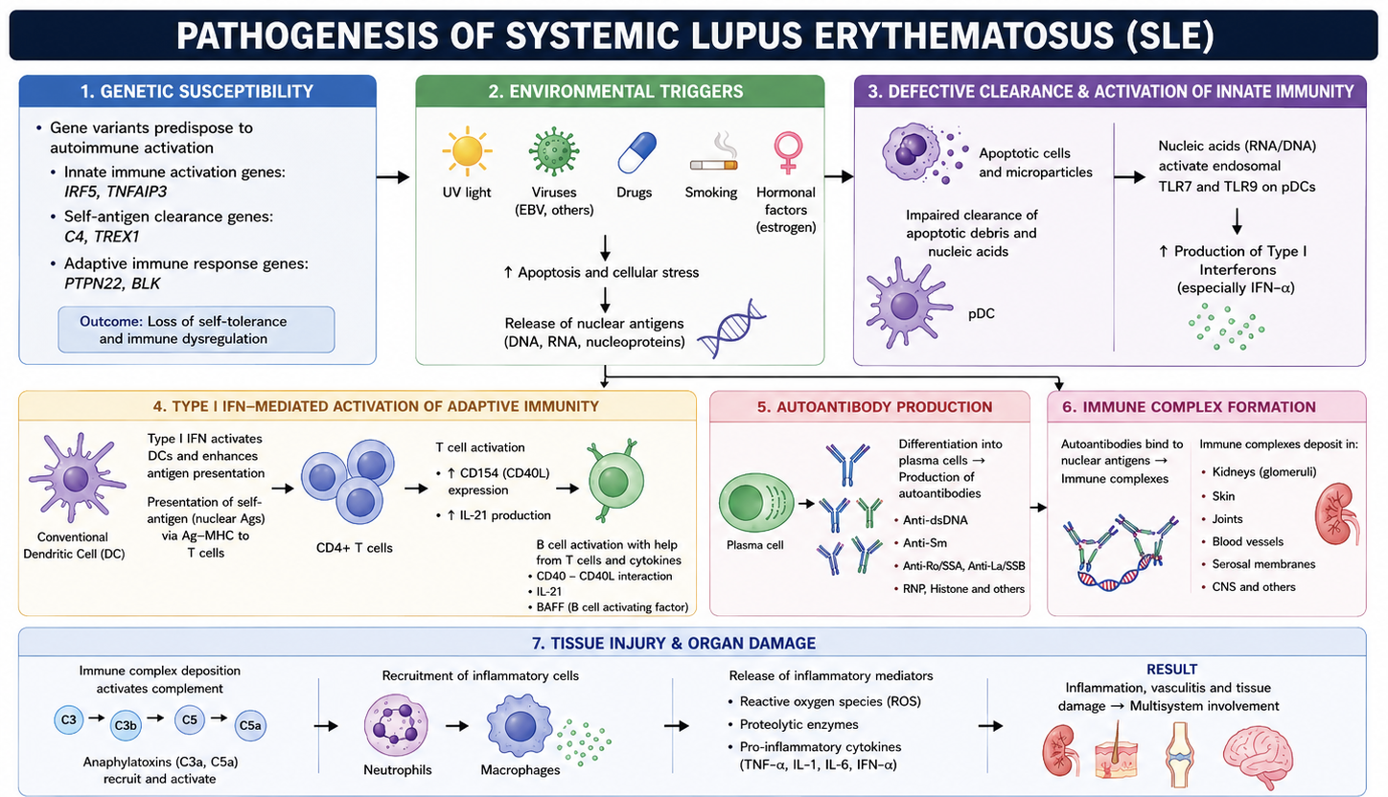

Slide 4
CLINICAL FEATURES

Slide 5
Mucocutaneous involvement
Musculoskeletal involvement
Renal involvement
Pleuropulmonary involvement
Cardiovascular involvement
Neuropsychiatric involvement
Gastrointestinal involvement
Occular involvement
Hematologic involvement
Lymphadenopathy and splenomegaly

Slide 6
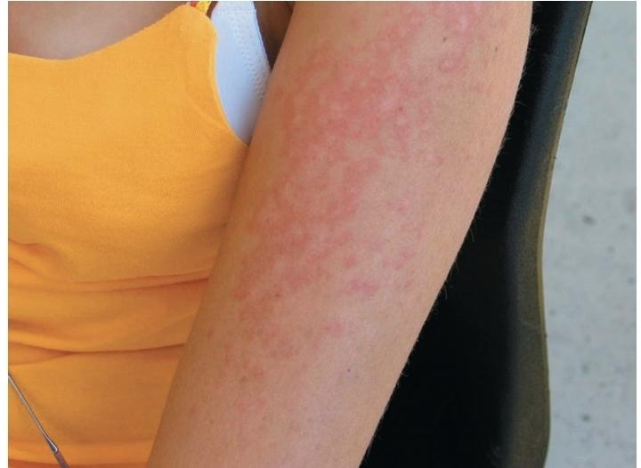
Mucocutaneous involvement
LE specific lesions
1. ACLE
Localised
Generalised
2. Subacute CLE
Annular SCLE
Papulosquamous SCLE

Slide 7
3. Chronic CLE
Classic discoid LE (DLE): (a) localized; (b) generalized
Hypertrophic DLE
Verrucous DLE
Lupus panniculitis
Profundus Mucosal DLE
LE tumidus
Chilblain LE
Lichenoid DLE (DLE-lichen planus overlap)

Slide 8
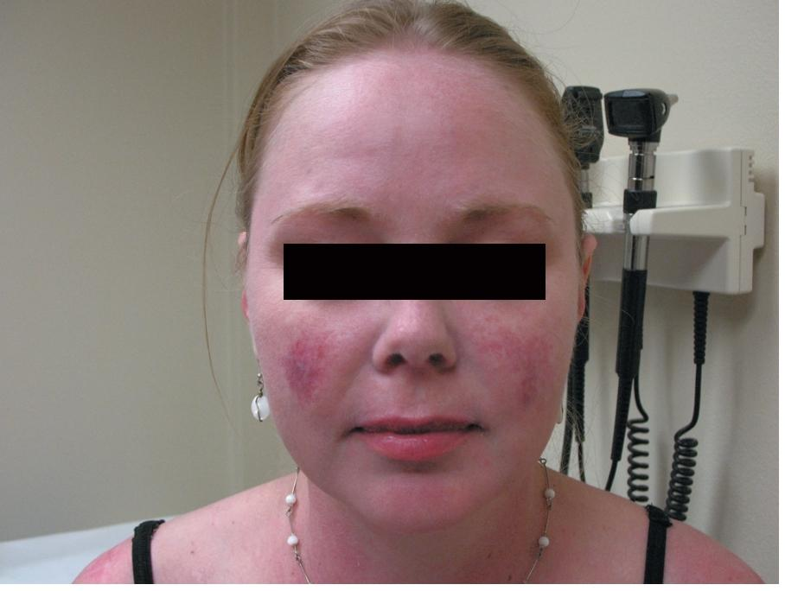
ACLE
The hallmark feature of ACLE is localized to the malar region (“butterfly rash”) and is characterized by confluent, macular, or papular erythema that last days to weeks, and appearing symmetrically on the cheeks and bridge of the nose
Induration and scaling may occur
The malar rash of SLE can be mimicked
by a variety of other facial rashes, includ
ing acne, rosacea, seborrheic dermatitis,
perioral dermatitis, atopic dermatitis, and
erysipelas.

Slide 9
SCLE
Nonscarring, photosensitive lesions that can take one of two distinct forms: (1) papulosquamous lesions that resemble psoriasis
(2) annular polycyclic lesions with peripheral scale and central clearing
SCLE has a predilection for the back, neck, shoulders, and extensor surfaces of the arms and usually spares the central face.
associated with the presence of anti-SS-A/Ro antibody
angiotensin-converting enzyme inhibitors, terbinafine, hydrochlorothiazide, and calcium channel blockers
SCLE has been implicated as a paraneoplastic syndrome

Slide 10
CCLE
variety of subtypes of photosensitive lesions that can lead to skin atrophy and scar and that may persist for several months or years.
Discoid lupus (DLE) is the most common subtype of CCLE (raised, erythematosus plaques with adherent scales that commonly occur on the patient’s scalp, face, and neck)
Follicular plugging is a characteristic finding and a raised, erythematous border denotes the actively expanding component.
Hypertrophic LE consists of chronic, indurated lesions that are covered by hyperkeratotic, multilayered scales. - resembles SCC

Slide 11
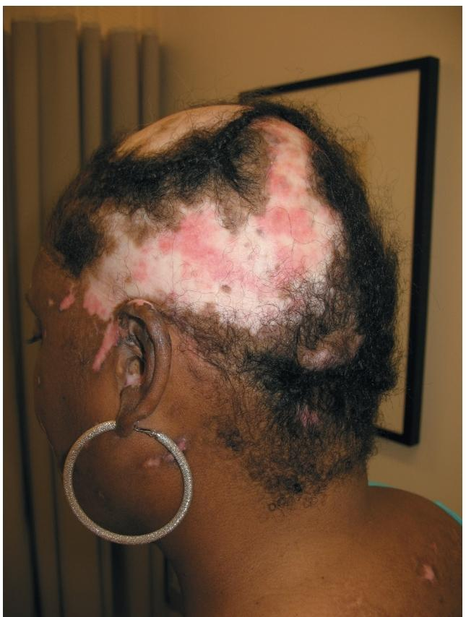
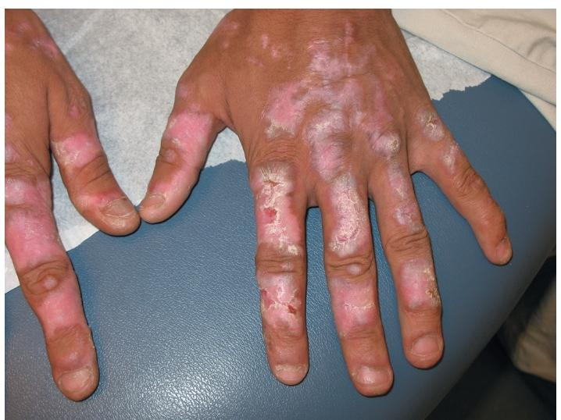

Slide 12
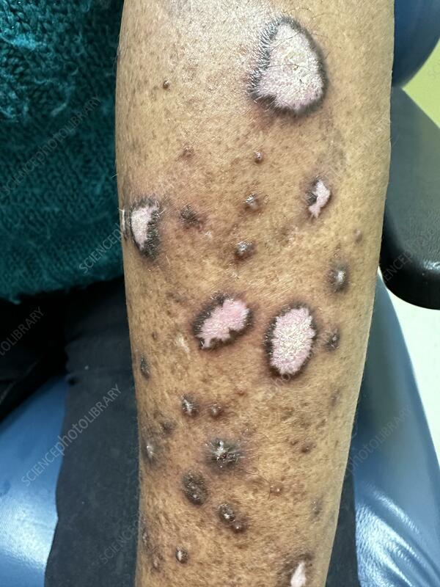
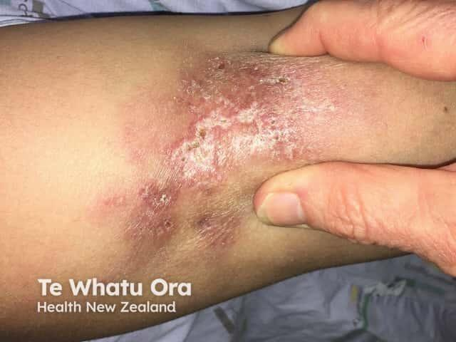

Slide 13
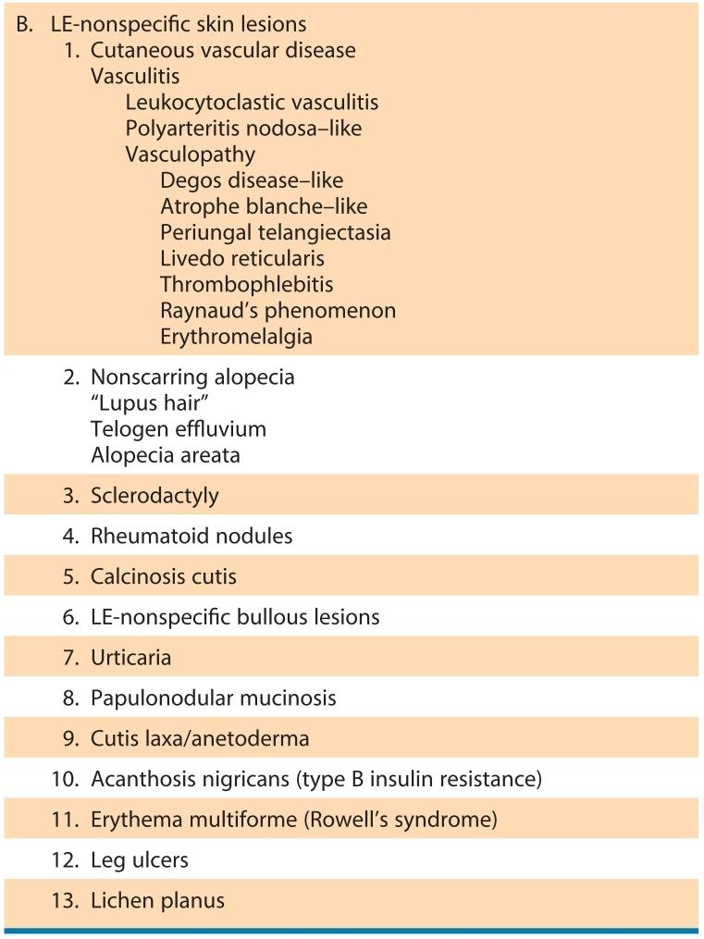

Slide 14
Musculoskeletal involvement
ARTHRITIS
90% of patients at some point during the course of their disease
Severity of involvement can range from mild joint pain to deforming arthritis.
Lupus arthritis is characterized by a symmetric, inflammatory arthritis that predominantly affects the knees, wrists, and small joints of the hands.
Hand deformities can occur as a result of ligamental and/or joint capsule laxity and joint subluxation. - jaccoud’s like arthropathy
A subset of patients with SLE who also meet classification criteria for RA have historically been referred to as “rhupus”.

Slide 15
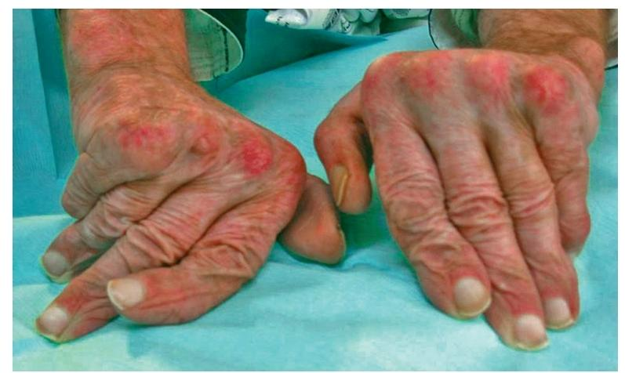
ulnar drift at the metacarpophalangeal joints, swan neck and boutonnière deformities, and hyperextension at the interphalangeal joint of the thumb, closely resemble the deformities seen in rheumatoid arthritis

Slide 16
Musculoskeletal involvement
AVN
The most commonly affected sites include the femoral heads, tibial plateaus, and femoral condyles, but smaller joints can be involved as well.
often bilateral, and associated with joint effusions.
The use of high doses of glucocorticoids is a well-known risk factor for AVN
Myositis
Myositis usually involves the proximal upper and lower extremities
myositis secondary to SLE from drug-induced myopathies caused by glucocorticoids, antimalarial agents, colchicine, or statins.
And also from thyroid disease, electrolyte abnormalities, and infectious myositis.

Slide 17
Renal involvement
Renal involvement is one of the most serious manifestations of SLE and is a major cause of morbidity and mortality.
Up to 90% of patients show evidence of renal involvement on biopsy, clinically significant lupus nephritis develops in approximately 50% of patients.
Kidney disease usually appears within the first 3–5 years after diagnosis, although it may occur at any stage of the disease.
Since renal involvement may initially be asymptomatic, regular screening is essential for early detection and treatment.

Slide 18
The clinical presentation of lupus nephritis is highly variable, ranging from asymptomatic urinary abnormalities to rapidly progressive renal failure.
Patients may present with microscopic hematuria, proteinuria, hypertension, edema, nephrotic syndrome, declining renal function, or rapidly progressive glomerulonephritis.
Constitutional symptoms and active systemic lupus manifestations often coexist.
Early renal disease may be clinically silent, periodic screening of urine and renal function is mandatory.

Slide 19
Types of Renal involvement
Glomerulonephritis is characterized by immune complex deposition and inflammatory cell infiltration into the glomerulus. The pattern of glomerular injury is primarily related to the site of immune complex deposition.
Tubulointerstitial disease has been observed in as many as 66% of SLE renal biopsy specimens and is characterized by inflammatory cell infiltrates, tubular damage, and interstitial fibrosis.
Renal vascular lesions in SLE include “lupus vasculopathy,” thrombotic microangiopathy (TMA), vasculitis, and nonspecific vascular sclerosis.
Lupus vasculopathy is defined as the presence of immunoglobulin and complement containing thrombi within the glomerular capillary or arteriolar lumina. Inflammatory changes to the vascular wall are absent.
TMA is characterized by the presence of fibrin thrombi within the glomerular capillary or arteriolar lumina and may be associated with the presence of antiphospholipid antibodies-should prompt the evaluation of APSN

Slide 20
Laboratory evaluation
Urinalysis is the cornerstone of screening and monitoring lupus nephritis.
Typical findings include proteinuria, microscopic hematuria, dysmorphic red blood cells, red cell casts, white cell casts, and pyuria without infection.
Quantification of proteinuria is best performed using a 24-hour urinary protein estimation or a spot urine protein-to-creatinine ratio.
Serum creatinine and estimated GFR should be monitored serially to assess renal function.
Serologically, elevated anti-dsDNA antibody titers and reduced complement levels (C3 and C4) often correlate with disease activity.

Slide 21
Indications for renal biopsy
(1) increasing serum creatinine without compelling alternative causes
(2) confirmed proteinuria of greater than or equal to 1 g/24 hours
(3) proteinuria greater than 0.5 g/24 hours plus hematuria
(4) proteinuria greater than 0.5 g/24 hours plus cellular casts
biopsy is highly recommended for patients who meet any of the following criteria
Before renal biopsy, ultrasonography is recommended to assess kidney size and structure and to rule out renal vein thrombosis.

Slide 22
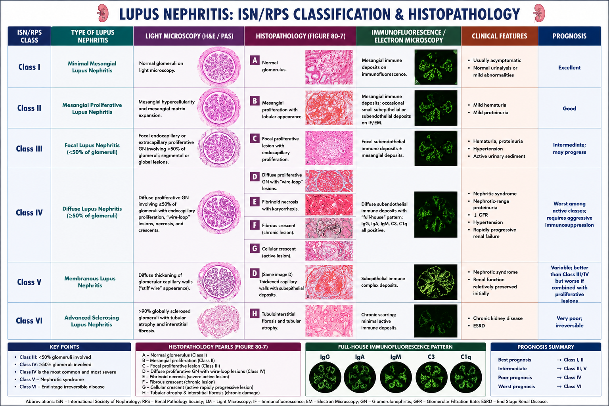

Slide 23
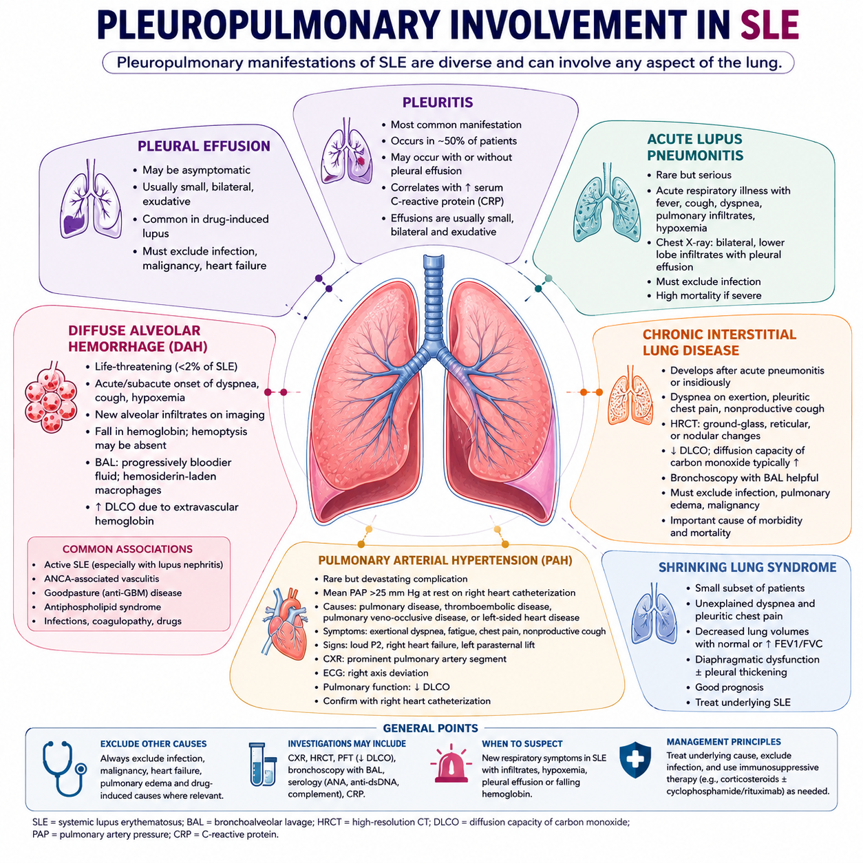

Slide 24
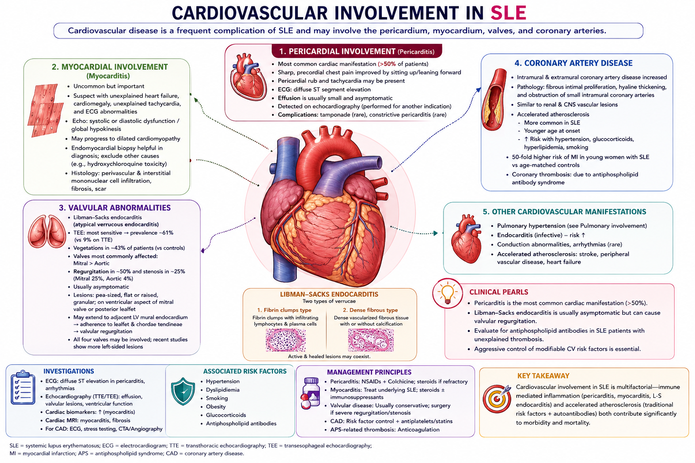

Slide 25
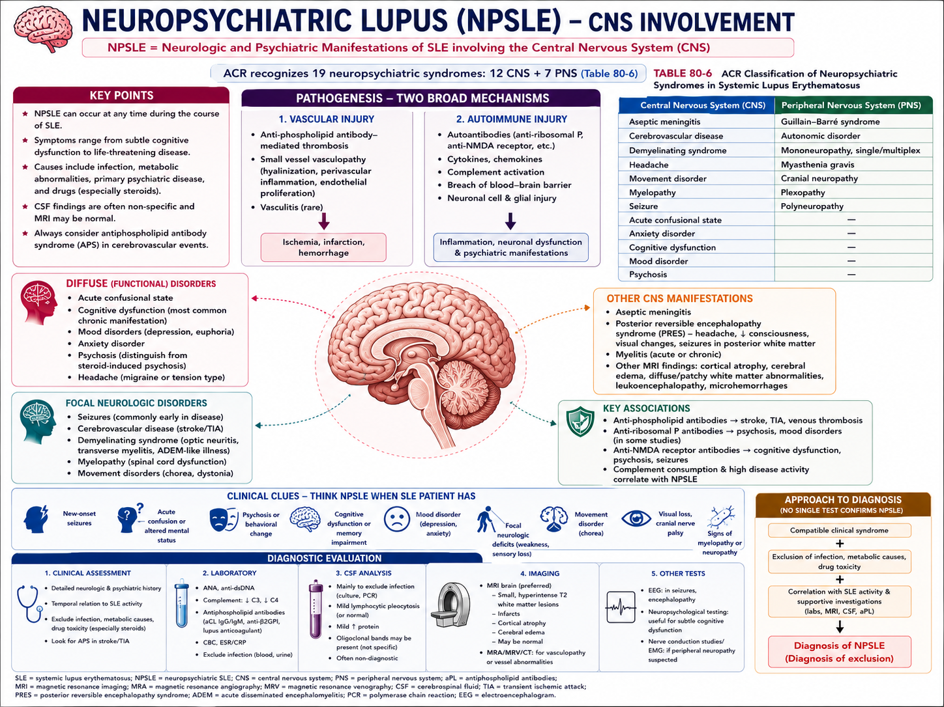

Slide 26
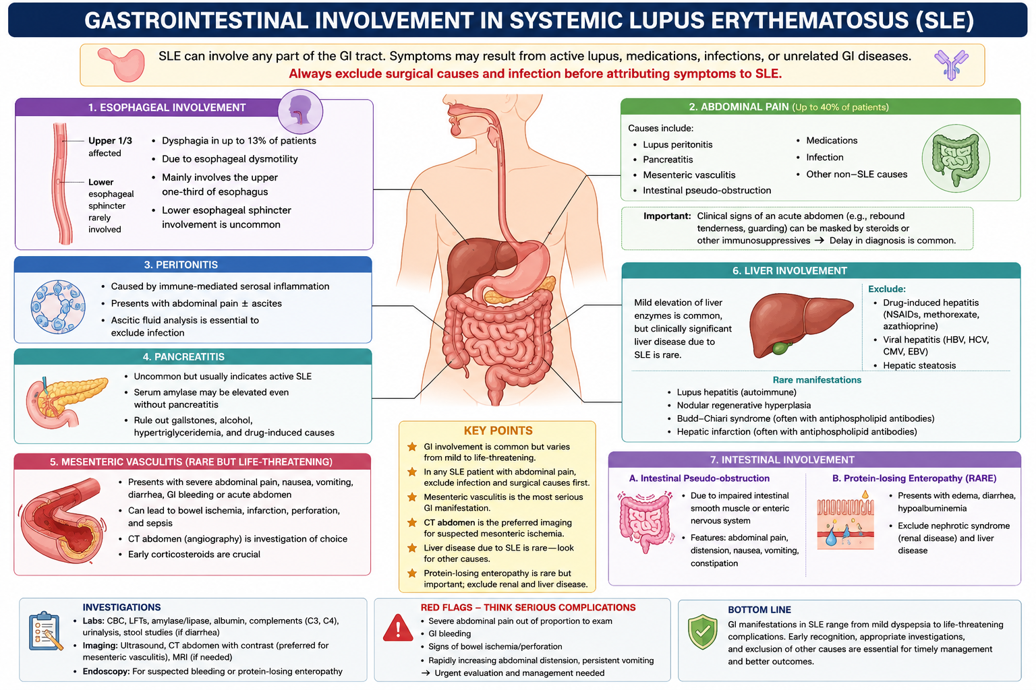

Slide 27
DIAGNOSIS

Slide 28
1. Entry criterion (mandatory):
Positive ANA (antinuclear antibody) ≥1:80 (or equivalent positive test) at least once.
If ANA is negative, SLE is not classified.

Slide 29
2. Additive scoring system:
After a positive ANA, assign points for clinical and immunological features.
A feature is counted only if it is best explained by SLE.
Only the highest-scoring item within each domain counts.
Features do not have to occur at the same time.
Diagnosis/classification requires:
At least one clinical criterion and Total score ≥10 points.

Slide 30
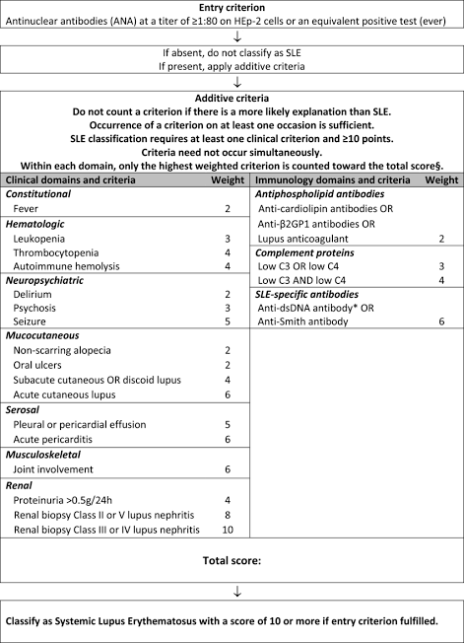

Slide 31
Autoantibodies in Systemic Lupus Erythematosus (SLE)
Autoantibodies are the hallmark of SLE and are central to its pathogenesis
Target self-antigens, mainly nuclear and phospholipid components.
Form immune complexes, causing complement activation, inflammation, and tissue injury.
Some are highly specific for SLE, while others occur in multiple autoimmune diseases.
Autoantibodies may be detectable years before clinical disease and their repertoire expands over time (epitope spreading).

Slide 32
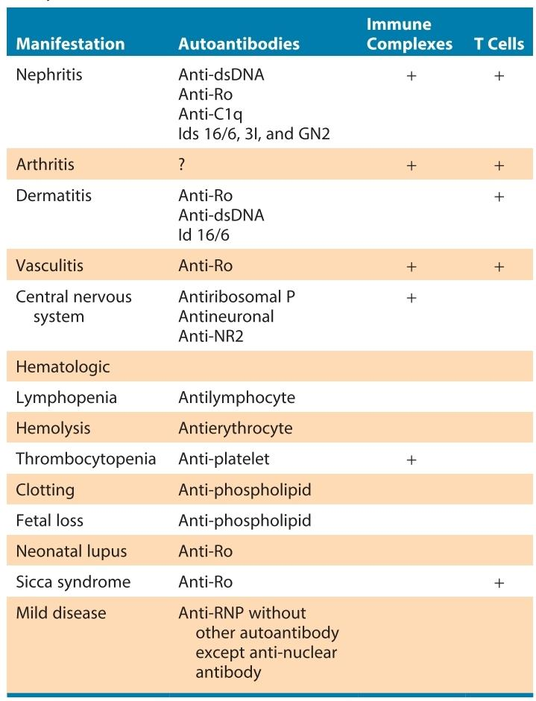

Slide 33
TREATMENT

Slide 34
Glucocorticoids
Glucocorticoids are the mainstay for rapid control of active SLE because they suppress both innate and adaptive immune responses.
Low-dose therapy (≤7.5 mg/day prednisolone equivalent) is used for mild disease .
In moderate to severe SLE, prednisolone 0.5–1 mg/kg/day is given, preferably along with steroid-sparing immunosuppressive agents, and the dose is gradually tapered after disease control.
In severe, rapidly progressive disease or major organ involvement, intravenous methylprednisolone pulse therapy (500–1000 mg/day for 1–3 days) may be used before oral steroids.
Long-term glucocorticoid use should be minimized because of dose-dependent adverse effects

Slide 35
Hydroxychloroquine
Hydroxychloroquine (HCQ) is recommended for all patients with SLE, unless contraindicated,
It reduces disease activity, decreases flares, lowers glucocorticoid requirements, prevents irreversible organ damage, and improves long-term survival.
It is generally well tolerated
long-term use carries a small risk of BULLS EYE RETINOPATHY, necessitating regular ophthalmologic screening.

Slide 36
CYCLOPHOSPHAMIDE
Cyclophosphamide (CYC) is a potent immunosuppressant used in severe, life-threatening, or organ-threatening systemic lupus erythematosus (SLE).
It suppresses both T- and B-lymphocyte function.
It is primarily indicated for proliferative lupus nephritis (Class III/IV), severe CNS lupus, pulmonary hemorrhage, myocarditis, severe vasculitis, severe hematological disease, and other refractory major organ involvement.
In lupus nephritis, cyclophosphamide slows renal scarring, preserves renal function, and reduces progression to end-stage renal disease.

Slide 37
The usual induction regimen consists of 0.5–1 g/m² IV every 4 weeks for 6 months, followed by maintenance immunosuppression (commonly azathioprine or mycophenolate mofetil).
Dose adjustment is required in renal impairment, and treatment is guided by white blood cell counts, which are checked 10–14 days after each pulse.
Adequate hydration and frequent voiding are essential to prevent hemorrhagic cystitis, and Mesna may be used in high-risk patients for uroprotection. Antiemetics are routinely administered before infusion.
The major adverse effects include bone marrow suppression, leukopenia, alopecia, hemorrhagic cystitis, gonadal toxicity causing infertility or premature ovarian failure, teratogenicity, and an increased long-term risk of bladder carcinoma and other malignancies hence other safer agent used for long term maintenance therapy.

Slide 38
Azathioprine
Azathioprine (AZA) is an antimetabolite immunosuppressive drug that inhibits purine synthesis, thereby reducing lymphocyte proliferation.
The usual dose is 2–2.5 mg/kg/day given orally.
Used as steroid sparing agent
It is used mainly as a maintenance therapy after induction treatment in lupus nephritis (LN).
Preferred immunosuppressant during pregnancy
It is considered safe for long-term use, with only a slight increase in the risk of malignancy.
Common adverse effects include gastrointestinal upset, mild liver enzyme elevation, leukopenia, thrombocytopenia, and bone marrow suppression.

Slide 39
Mycophenolate mofetil (MMF)
Mycophenolate mofetil (MMF) is an antimetabolite that selectively inhibits IMPDH, blocking de novo guanosine synthesis in lymphocytes.
It has excellent oral bioavailability, reaches peak plasma levels within 1–2 hours, and has a half-life of about 17 hours
It is a first-line induction and maintenance therapy for proliferative lupus nephritis (Class III/IV).
MMF has a better safety profile than cyclophosphamide, with lower risks of leukopenia, amenorrhea, and alopecia, making it preferable in patients wishing to preserve fertility.
MMF is teratogenic and is contraindicated during pregnancy.
MMF is also effective in extrarenal SLE, particularly for skin, musculoskeletal, hematological, and mucocutaneous manifestations.

Slide 40
Calcineurin inhibitors
Cyclosporine A
Inhibits calcineurin, preventing T-cell activation.
Also reduces antigen presentation and autoantibody production.
Uses : Proliferative lupus nephritis (Class III/IV),Membranous lupus nephritis (Class V), Extrarenal SLE.
Adverse effects : Nephrotoxicity,Hypertension , paresthesias ,Hyperkalemia and hypomagnesemia , Hyperuricemia , Gingival hyperplasia, Hirsutism .

Slide 41
Tacrolimus (TAC)
Mechanism of action - Calcineurin inhibitor similar to cyclosporine but 10–100 times more potent.
Use: Proliferative lupus nephritis, Membranous lupus nephritis and refractory lupus nephritis. Often combined with MMF as multitarget therapy.
Produces a rapid reduction in proteinuria.

Slide 42
BIOLOGICAL THERAPY
Biological agents are targeted therapies used in moderate-to-severe or refractory SLE, especially in patients with persistent disease activity despite standard treatment.
Rituximab
Anifrolumab- monoclonal antibody against Type I interferon receptor (IFNA
Belimumab-monoclonal antibody against B-lymphocyte stimulator (BAFF/BLyS).
Targeted immune suppression with fewer long-term steroid-related complications
Reduces disease activity and frequency of flares

Slide 43
RITUXIMAB
Rituximab (RTX) is a chimeric mouse-human monoclonal antibody that targets the cell membrane protein CD20.
Mainly reserved for refractory SLE, including ; Refractory lupus nephritis, Severe neuropsychiatric SLE, Autoimmune hemolytic anemia, Thrombocytopenia, Arthritis, severe extra renal involvement.
375 mg/m² IV weekly for 4 weeks. Premedication with corticosteroids, antihistamines, and antipyretics is recommended.
Adverse Effects- Infusion reaction.Reactivation of hepatitis ,Hypogammaglobulinemia with repeated course, Progressive multifocal leukoencephalopathy (PML)

Slide 44
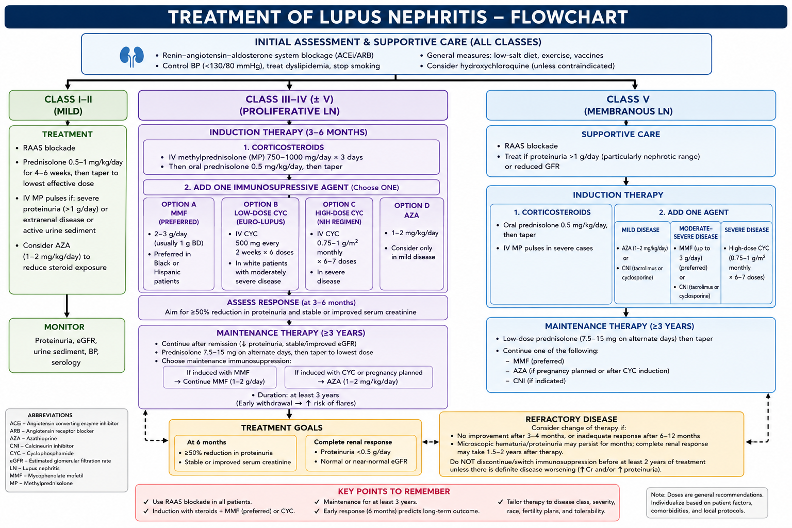

Slide 45
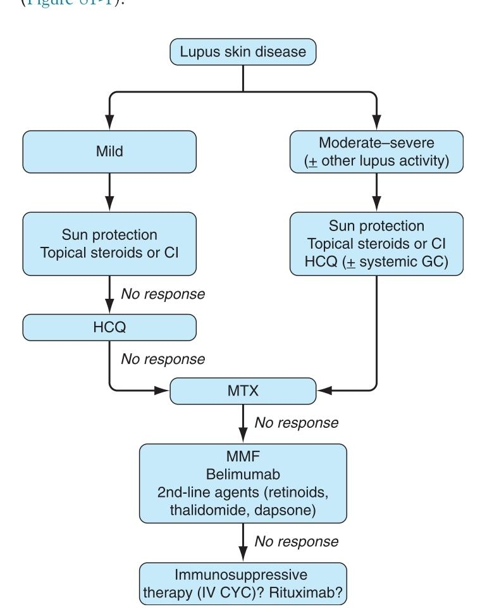
Mucocutaneous or joint involvement
Topical GCs reduce redness and scaling
Topical calcineurin inhibitors (tacrolimus,
pimecrolimus) are a useful alternative,
especially for the face, because they
cause less atrophic and rosacea-like
effects than topical steroids.
MTX has shown efficacy in refractory
subacute cutaneous lupus erythematosus
(CLE) and DLE

Slide 46
Newer biologic Therapies
Ocrelizumab
Anti-CD20 monoclonal antibody.
Development stopped because of increased serious infections.
Epratuzumab
Anti-CD22 monoclonal antibody.
Showed modest improvement in disease activity.
Safety profile similar to placebo.
Atacicept
Blocks BLyS and APRIL pathways.
Development halted because of fatal infections.
Blisibimod
Inhibits soluble and membrane-bound BAFF.

Slide 47
THANK YOU

