Slide 1
A CASE OF VITAMIN B12 DEFICIENCY WITH PROTEINURIA – IMERSLUND GRASBECK SYNDROME
MEDICINE UNIT 3
CHIEF prof. DR M NATARAJAN md
ASSISTANT PROFESSORS
DR p s ARUL RAJA murugan md dm
DR B PALANIKUMAR md
Presented by dr g. sumathi 1st yr pg

Slide 2
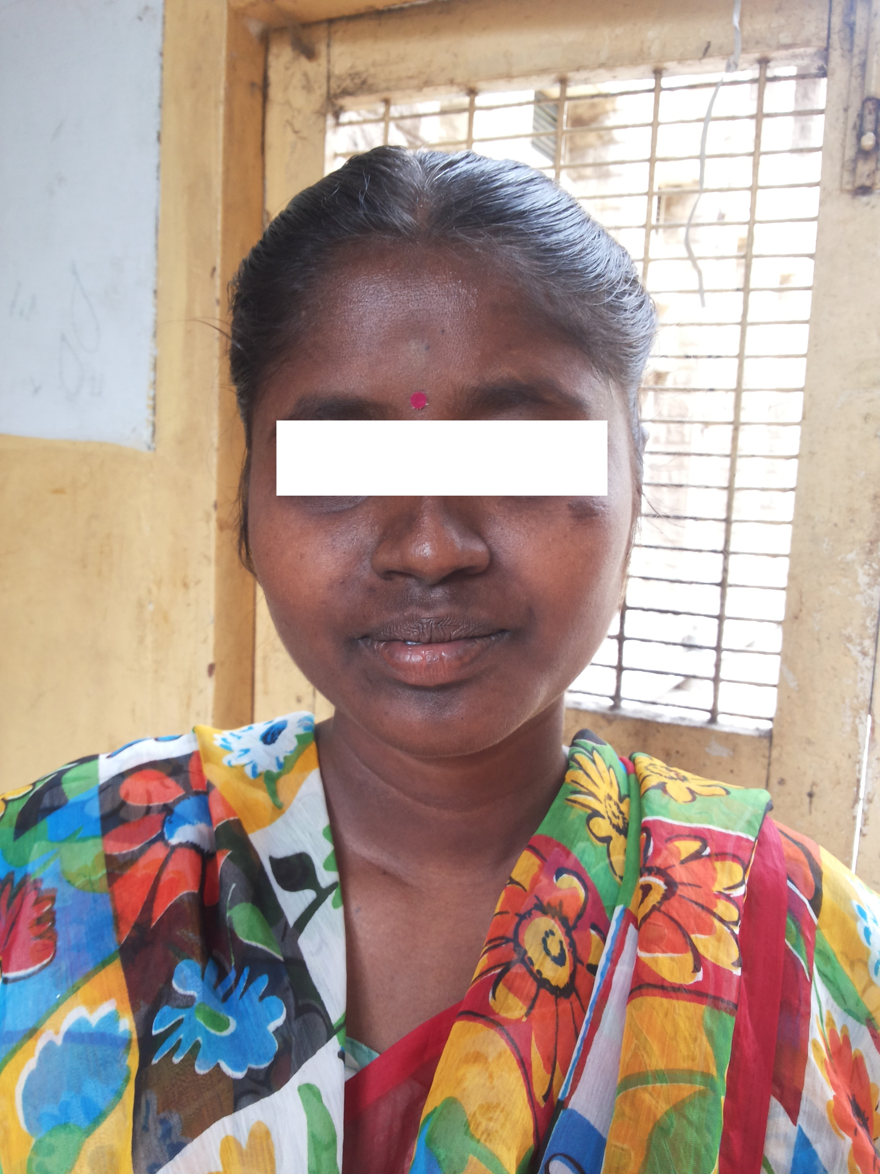
CASE HISTORY
25 YEAR FEMALE
KARUR, TAMILNADU
WORKS IN A TEXTILE INDUSTRY

Slide 3
c/o loss of appetite
Easy fatiguability
intermittently for the past 15 years

Slide 4
h/o loss of appetite
h/o easy fatiguability
h/o diffuse hyperpigmentation of skin
h/o multiple intramuscular injections
h/o sense of well being after the treatment for few months
h/o multiple similar episodes in the past 15 years
h/o bleeding gums – on and off

Slide 5
No h/o breathlessness
No h/o fever / joint pain /rashes / oral ulcers
No h/o constipation / diarrhea
No h/o steatorrhea
No h/o loss of weight
No h/o malena
No h/o recurrent infections
No h/o swelling / pain in lymph nodes

Slide 6
No h/o high coloured urine
No h/o cold intolerance
No h/o abdominal pain / distension/ swelling
No h/o leg swelling
No h/o dysphagia
No h/o pica
No h/o pruritis / jaundice/ skin lesions
No h/o giddiness

Slide 7
No h/o increased forgetfulness
No h/o stumbling while walking in the dark
No h/o paresthesia
No h/o visual disturbances

Slide 8
PAST HISTORY
Not a diabetic/ hypertensive
No h/o Tb/ epilepsy/ bronchial asthma
No h/o abdominal surgery / transplants
h/o blood transfusions + (twice)

Slide 9
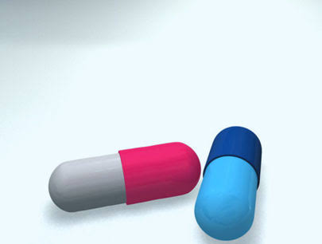
DRUG HISTORY
h/o intake of iron tablets – on and off
h/o frequent intramuscular injections
No h/o steroid abuse
No drug allergies

Slide 10
PERSONAL HISTORY
Consumes mixed diet
Sleep pattern normal
Bowel bladder habits normal
No addiction

Slide 11
FAMILY HISTORY
Born of non consanguineous marriage
2nd born child
No h/o similar illness in the family members

Slide 12
Menstrual history
Menarche at 12 years of age
3/30 regular cycles
No h/o menorrhagia

Slide 14
GENERAL EXAMINATION
Conscious
Oriented
Afebrile
Not dyspnoeic / not tachypnoeic
Pallor+
No icterus/ cyanosis/ clubbing/ pedal edema
No generalised lymphadenopathy

Slide 15
Hyperpigmentation of face, palms,knuckles, soles and buccal mucosa +
Graying of hair +
Weight 50 kg
Height 155 cm

Slide 17
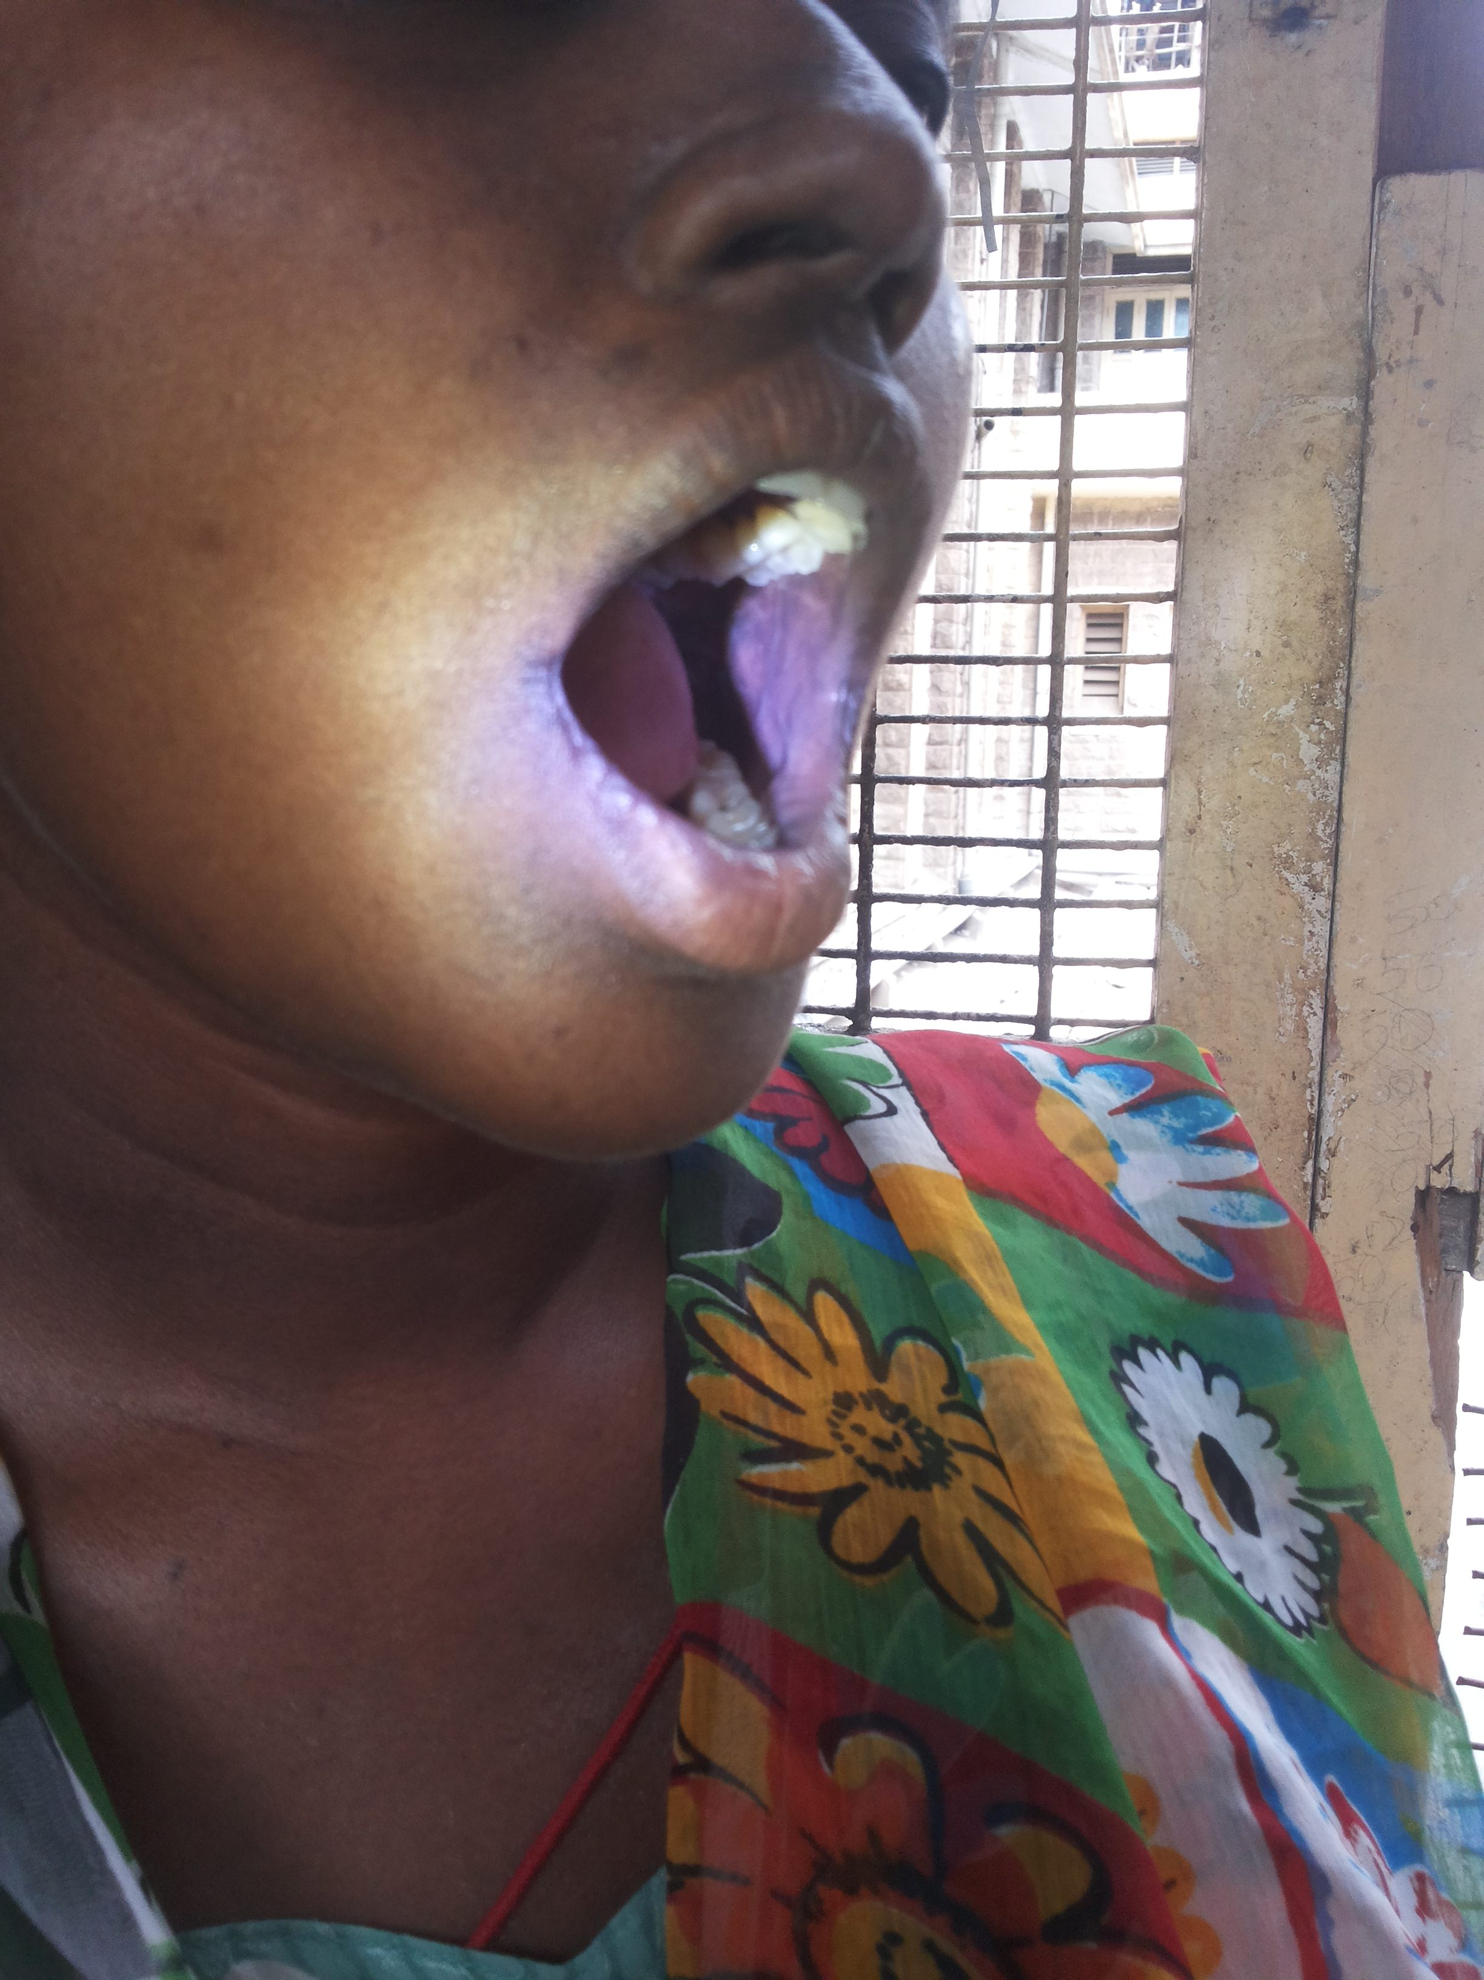

Slide 18
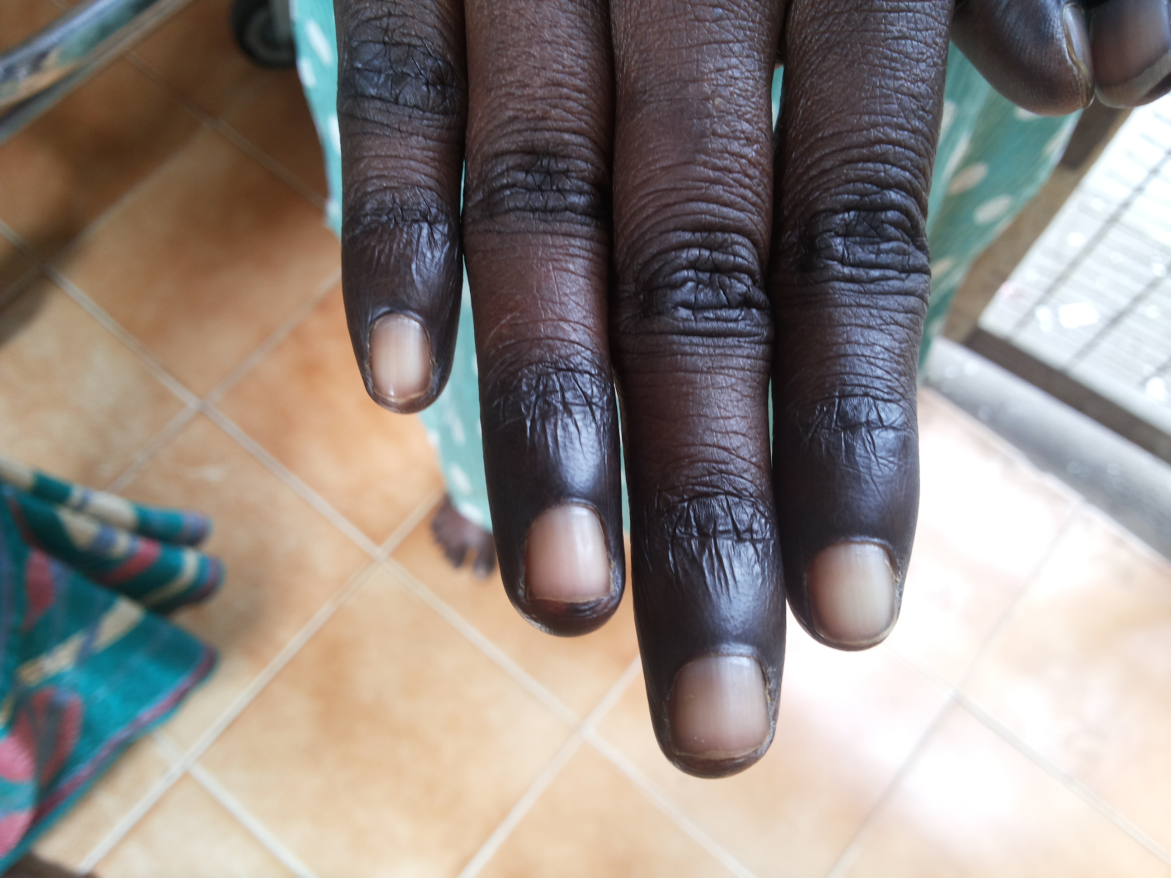

Slide 21
VITALS
PULSE – 70 per minute, regular, normal in volume and rhythm, all peripheral pulses felt, no radioradial / radiofemoral delay
RESPIRATORY RATE – 16 per minute
BLOOD PRESSURE – 120/80 mm Hg in right upper limb in supine position, 110/80 mm Hg in standing
Spo2 – 98% in room air

Slide 22
SYSTEM EXAMINATION
CARDIOVASCULAR SYSTEM
JVP not elevated
Apical impulse in left 5th intercostal space half an inch medial to midclavicular line
Mitral, tricuspid, pulmonary , aortic area – s1s2 +
no murmur

Slide 23
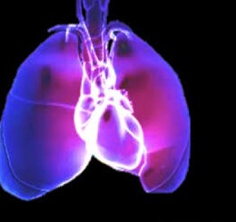
RESPIRATORY SYSTEM
Trachea in midline
bilateral air entry equal
normal vesicular breath sounds +

Slide 24
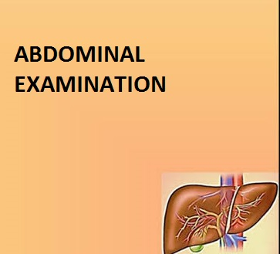
ABDOMEN
soft
umbilicus in midline
no distension
no organomegaly
no renal bruit

Slide 25
CENTRAL NERVOUS SYSTEM
Higher mental functions – normal
Cranial nerves – normal
Motor system
bulk , tone, power of all 4 limbs normal
superficial and deep reflexes +
SENSORY SYSTEM - superficial , deep and cortical sensations +

Slide 26
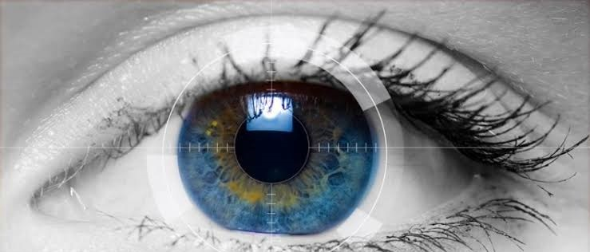
Ophthal evaluation
fundus- ? Bitemporal palor ( due to nutritional optic atropy)

Slide 27
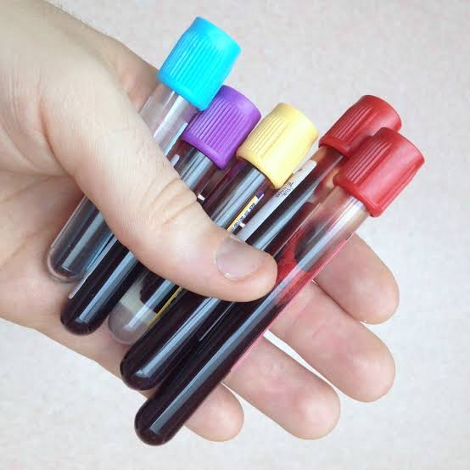
INVESTIGATIONS
COMPLETE HEMOGRAM
TC – 3200 cells/cu.mm
DC- neutrophils- 54%
lymphocytes 40%
eosinophils 4%
monocytes 2%

Slide 28
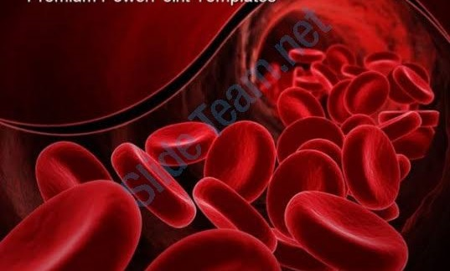
RBC – 2.19 million/cu.mm
Hb – 7.8 g/dl
Hct – 23.9%
Platelets – 1.18 lakh/cu.mm
ESR – 8 mm in 1st hour
MCV – 109 FL
MCH – 35.6 pg
MCHC – 32.6 %

Slide 29
Peripheral smear study
RBC | Microcytic hypochromic to macrocytic normochromic cells, anisopoikilocytosis, elongated cells and tear drop cells seen
WBC | Count diminished. No atypical cells
Platelets | Normal in count and morphology

Slide 30
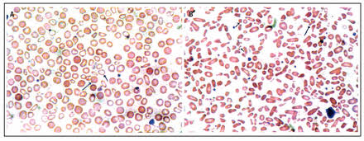
Reticulocyte count 1%
IMPRESSION – dimorphic anemia with mild leukopenia

Slide 31
Biochemistry
RBS | 60 mg/dl
Urea | 18 mg/dl
Creatinine | 0.9 mg/dl
Total protein | 6.3 g/dl
S.Albumin | 3.3 g/dl
Globulin | 3 g/dl
SGOT/SGPT | 17/9 IU/L

Slide 32
Biochemistry
Total bilurubin | 1.7mg/dl
Direct bilurubin | 0.7mg/dl
Indirect bilurubin | 1mg/dl
Serum electrolytes | Meq/l
sodium | 154
potassium | 4.4
chloride | 115

Slide 33
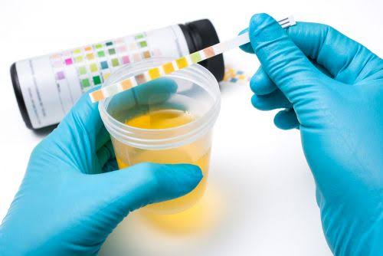
Urine - investigations
Urine albumin 4 +
sugar nil
deposits 2-4 pus cells
URINE SPOT PCR – 2.28
24 HOURS URINE PROTEIN – 750mg/day
URINE CULTURE – NO GROWTH

Slide 34
Investigations - contd….
Blood grouping – O positive
Bleeding time – 2 mins 30 secs
Clotting time – 4 mins 30 secs
PT – INR 1.1
Stool microscopy- no ova, cyst
Stool occult blood - negative

Slide 35
Fasting lipid profile | mg/dl
Serum cholestrol | 125
triglycerides | 64
HDL | 40
Serum amylase – 54 U/L

Slide 36
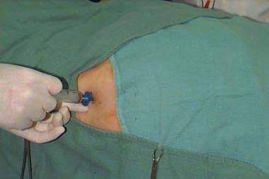
BONE MARROW
Erythroid series active with micronormoblasts and megaloblastic maturation
Leucopoiesis show normal pattern of maturation. Blasts< 3% . giant band forms seen
Megakaryocytes seen

Slide 37
Serum vitamin B12 – 97 pg/ml (211- 911pg/ml)
Serum ferritin – 358.2 ng/ml
ANA – positive
ANA profile - negative
Thyroid status – euthyroid
Viral markers for hepatitis B,C and HIV negative

Slide 38
ECG WNL
ECHO NAD
USG Abdomen and Pelvis- NAD
OGD scopy – normal study

Slide 39
Nephrologist opinion
Suggested renal biopsy

Slide 40
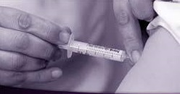
Course of treatment
Treated with inj. Vit B12 100 microgram im -
1 week

Slide 41
Follow up investigations
Complete hemogram
Total count | 5900 cells/cu.mm
RBC | 3.3 million/cu.mm
Hb | 10 gm/dl
hematocrit | 33%
platelets | 2.3 lakhs/cu.mm
DC | N 46% L 43% M 6% E 5%
ESR | 10 mm/hr
RETICULOCYTE | 8%

Slide 42
MCV 100fl
MCH 30.3 pg
MCHC 30.3 %

Slide 43
FOLLOW UP INVESTIGATIONS
URINE PROTEIN CREATININE RATIO 1.8
24 hour urinary protein 700 mg/day

Slide 44
?????

Slide 45
Anemia/hyperpimentation
Dimorphic anemia
Low vit B12
Treated with vit B12
Hematological manifestations improved
Persistent proteinuria
Associated proteinuria

Slide 46
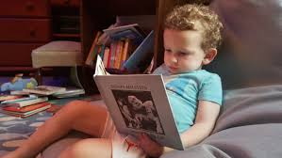
IMERSLUND
GRASBECK
SYNDROME

Slide 47
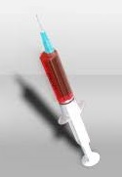
TREATMENT

Slide 48
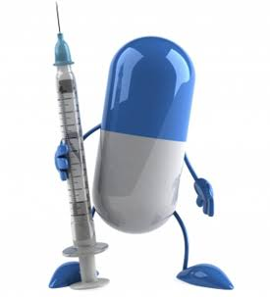
THANK U ☺☺☺

