Slide 1
AN INTERSTING CASE OF HYPERLIPIDEMIA
SECOND MEDICAL UNIT
CHIEF PROF : DR.R.BALAJINATHAN MD
ASSIST PROF : DR.V.N.ALAGA VENKATESAN MD
ASSIST PROF : DR.P.V.BALAMURUGAN MD

Slide 2
56 years old Mr. Alagarsamy, hailing from Sivagangai came with complaints of
- breathing difficulty
- decreased urine output - for one month duration

Slide 3
HISTORY OF PRESENTING ILLNESS
He is a known case of CAD/DCM for past one year on treatment, admitted with
h/o breathing difficulty –one month
NYHA class –III
h/o decreased urine output- one month
h/o swelling of both legs
h/o chest pain –left sided, exertional ,non radiating
h/o multiple swellings present in the hands ,feet ,shoulder and gluteal region for past 10 years.

Slide 4
no h/o palpitation
no h/o syncope
no h/o visual disturbances
no h/o any bleeding manifestations
no h/o fever
no h/o seizures
no h/o abdominal pain
no h/o constipation or loose stool

Slide 5
PAST HISTORY
k/c/o CAD/DCM diagnosed 1 year back ,on regular treatment
h/o multiple swellings for which surgery was done but no records were available
Not a known HT/DM/ASTHMA/TB/EPILEPSY

Slide 6
Personal history
Taking mixed diet
Not a smoker/alcoholic
Family history
No other family members are suffering from CAD or PVD

Slide 7
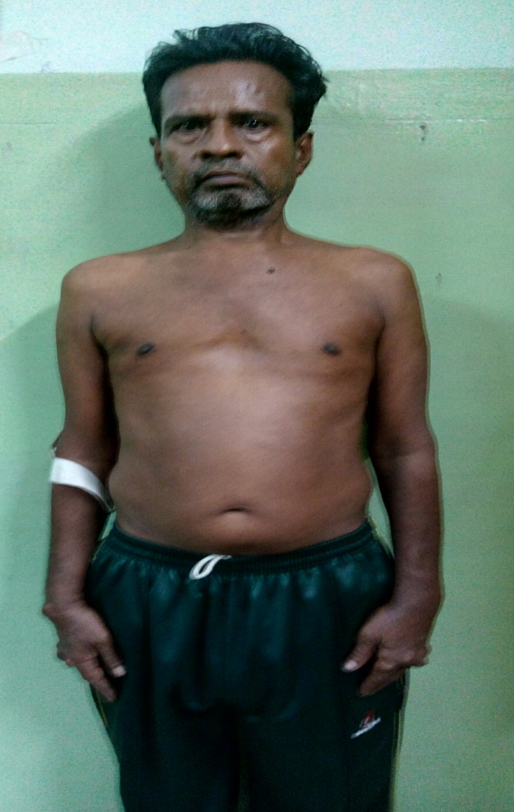
GENERAL EXAMINATION
Pt. Conscious
Oriented
Afebrile
No Pallor
Not Icteric
Arcus Senilis +
No Clubbing
Not Cyanosed
No Lymphadenopathy
B/L Minimal Edema Legs

Slide 8
15x5x4 cm pedunculated ,multilobulated firm mass with base attached over left shoulder region
10x5x4 cm pedunculated ,multilobulated ,firm mass over right shoulder
10x8x4 cm firm multilobulated lesion over lateral aspect of b/l thigh
3x3x2 cm firm multilobulated lesion over extensor aspect of b/l elbow
Multiple firm swellings present over extensor aspect of both hand and over tendo achilis & dorsal aspect of both foot

Slide 9
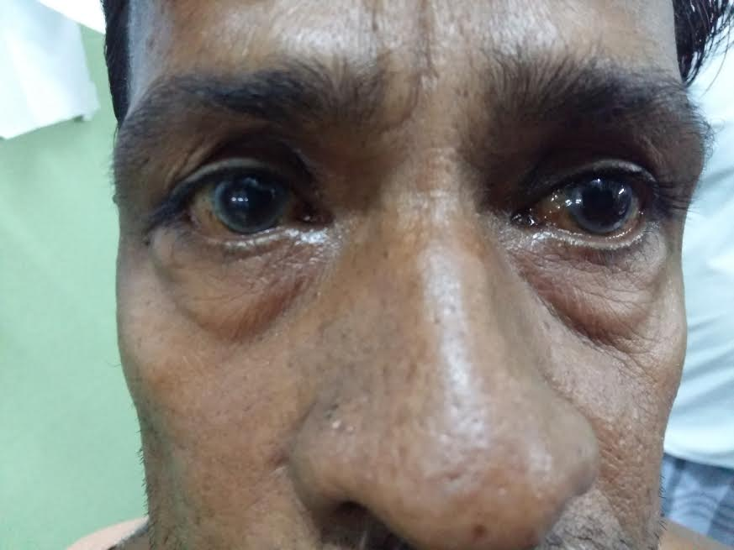
ARCUS SENILIS

Slide 10
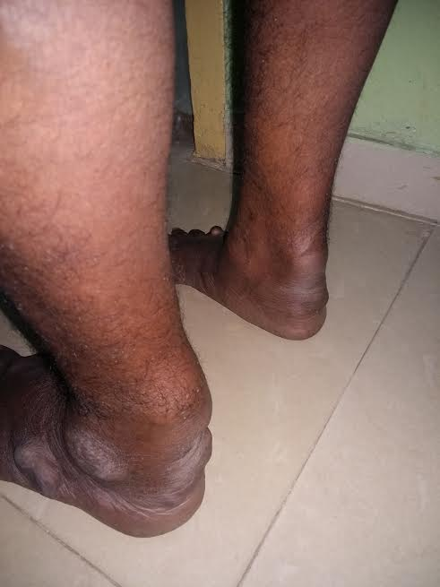
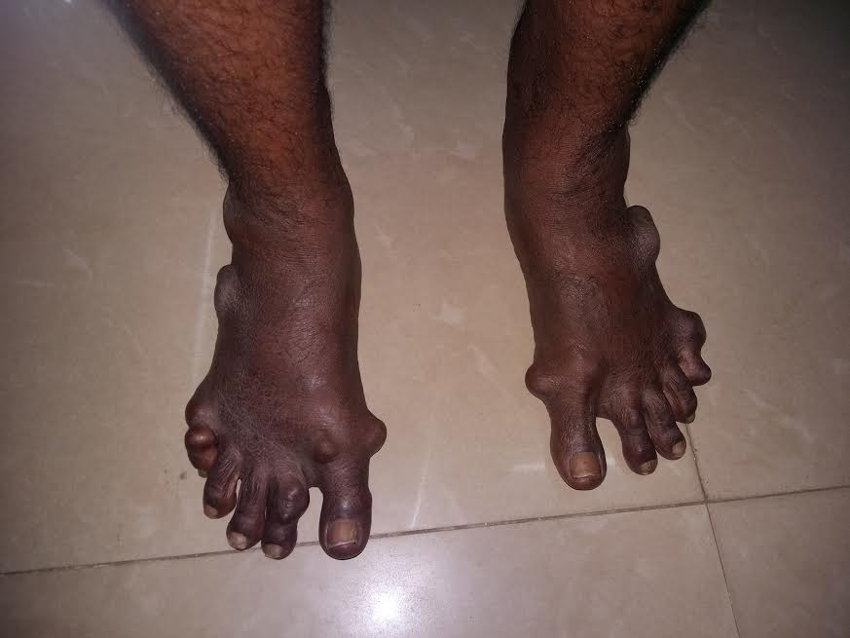
XANTHOMAS IN TENDO ACHILIS AND FOOT

Slide 11
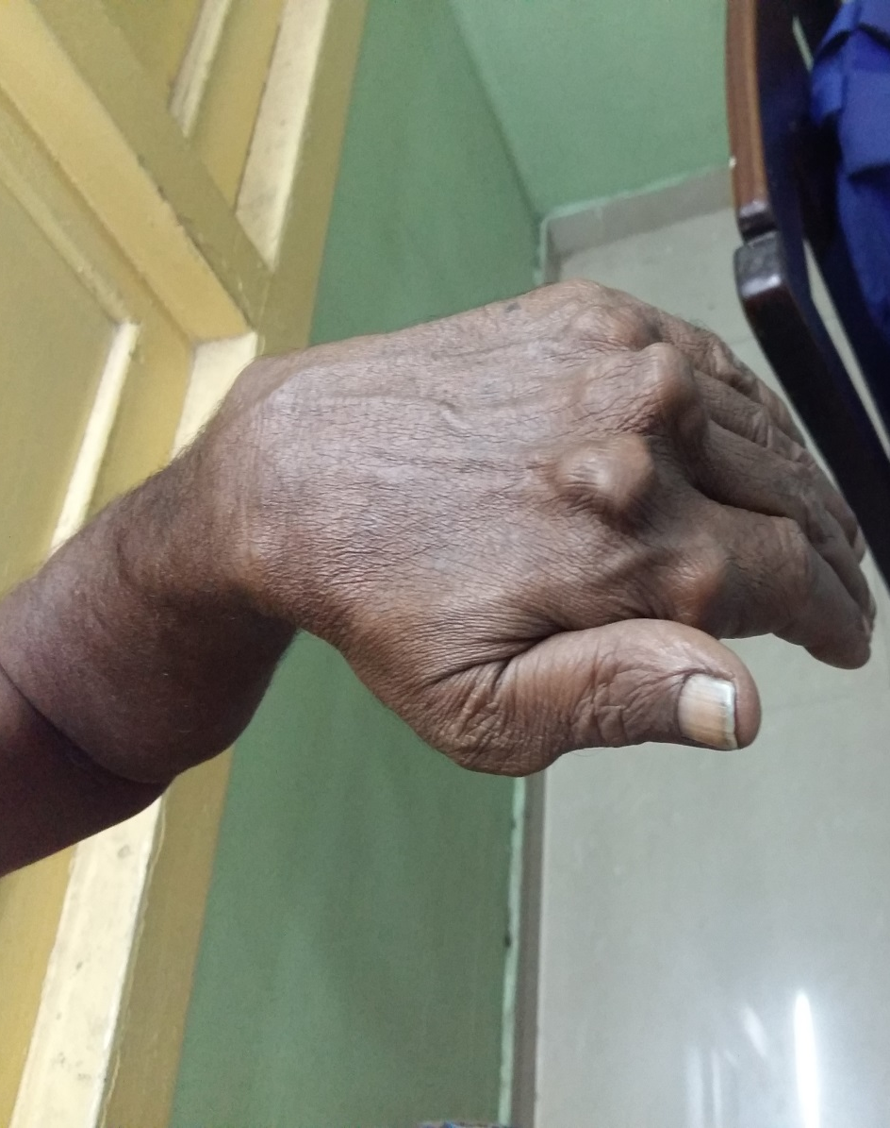
XANTHOMAS IN KNUCKLES

Slide 12
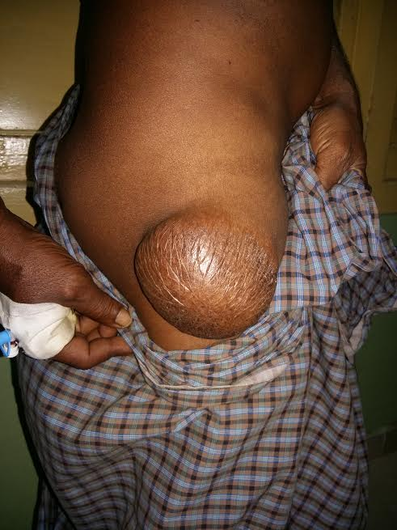

Slide 13
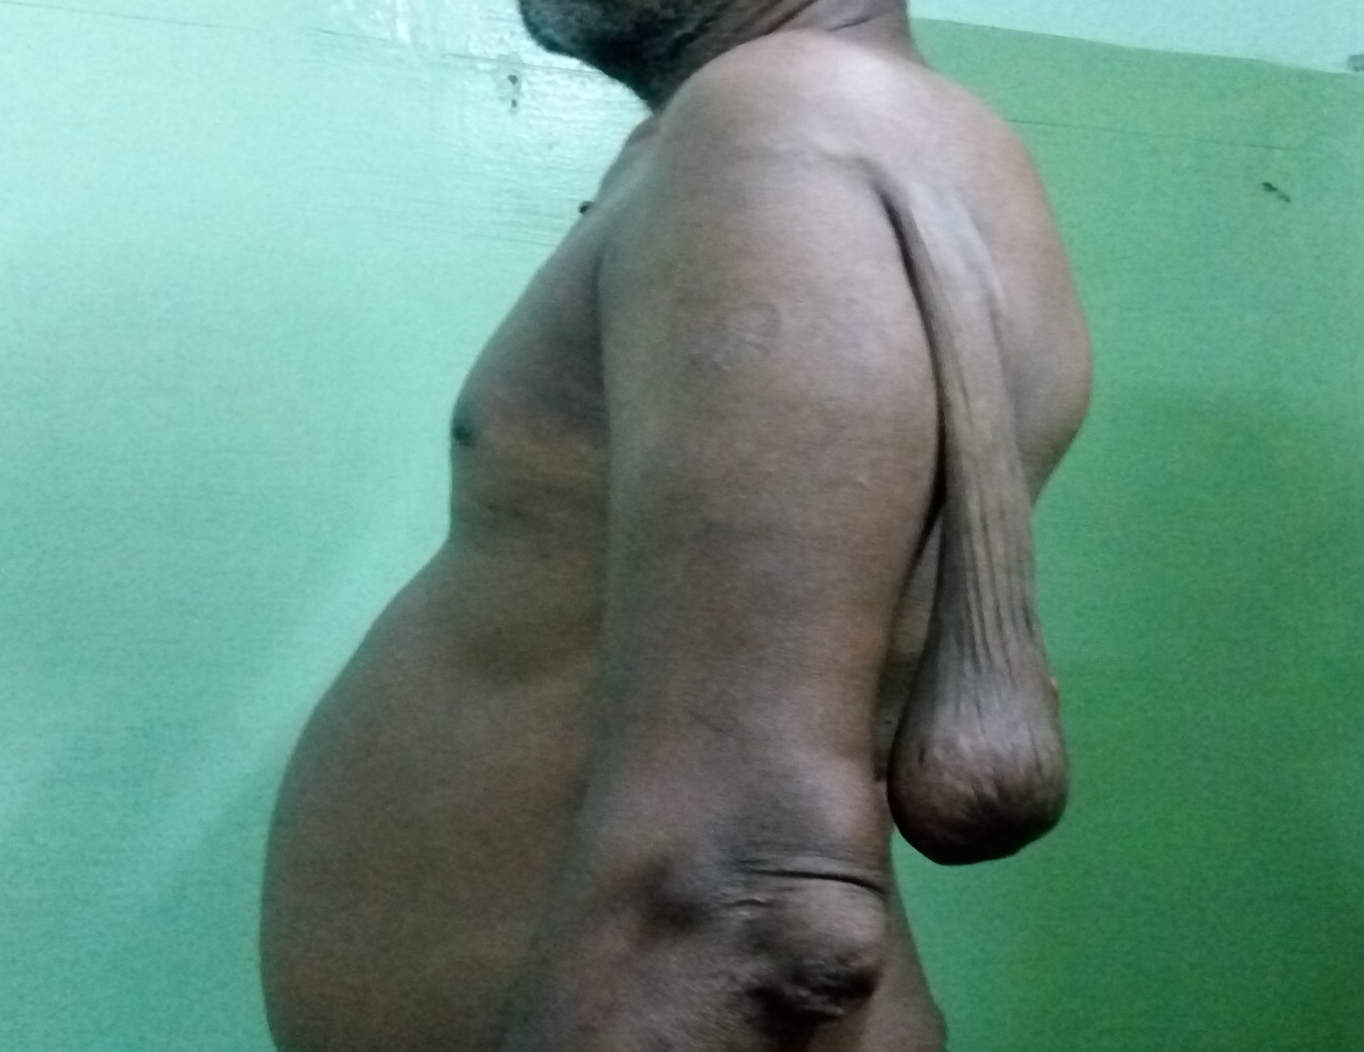
TUBEROUS XANTHOMA

Slide 14
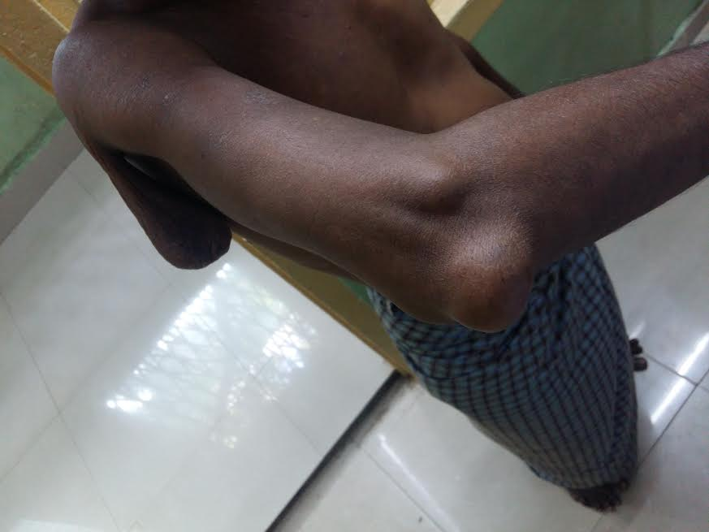
XANTHOMA IN OLECRANAN

Slide 15
VITALS
Pulse -110/min
BP -130/70 mmhg
RR -16/min
SPO2- 98%

Slide 16
CARDIOVASCULAR SYSTEM
S1S2 heard
Gr 3/6 ESM in aortic area
RESPIRATORY SYSTEM
B/L NVBS
No added sounds

Slide 17
ABDOMEN
soft
non tender
no organomegaly
bowel sounds +
CENTRAL NERVOUS SYSTEM
No FND
fundus - normal

Slide 18
INVESTIGATIONS
URINE EXAMINATION
albumin –nil
sugar –nil
deposits- 0-2 pus cells/hpf
BLOOD SUGAR – 69mg/dl
RENAL FUNCTION TEST
urea -30 mg/dl
creainine-1.0 mg/dl
Sr. Electrolytes
Na - 140 meq
k -4.8 meq
cl -90 meq
COMPLETE BLOOD COUNT
HB-14.4 g/dl
TC-8200 cells/cumm
DC –P65%,L33%,M 2%
PCV -45%
PLT -2.13 lakh/cumm
ESR -12mm in 1hr
PERIPHERAL SMEAR
Normal study

Slide 19
LIVER FUNCTION TEST
Sr.Bilirubin Total -1.5mg/dl
Direct -1.0 mg/dl
Indirect -0.5mg/dl
SGOT -20 u/l
SGPT -10 u/l
Total protein -6.5 g/dl
albumin -3.5 g/dl
globulin -3.0 g/dl

Slide 20
FASTING LIPID PROFILE
TOTAL CHOLESTROL -389 mg%
TGL -60 mg%
HDL -40 mg%
VLDL -12 mg%
LDL -337 mg%

Slide 21
FASTING LIPID PROFILE
TOTAL CHOLESTROL -420 mg%
TGL -98 mg%
HDL -84 mg%
VLDL -20 mg%
LDL -316 mg%

Slide 22
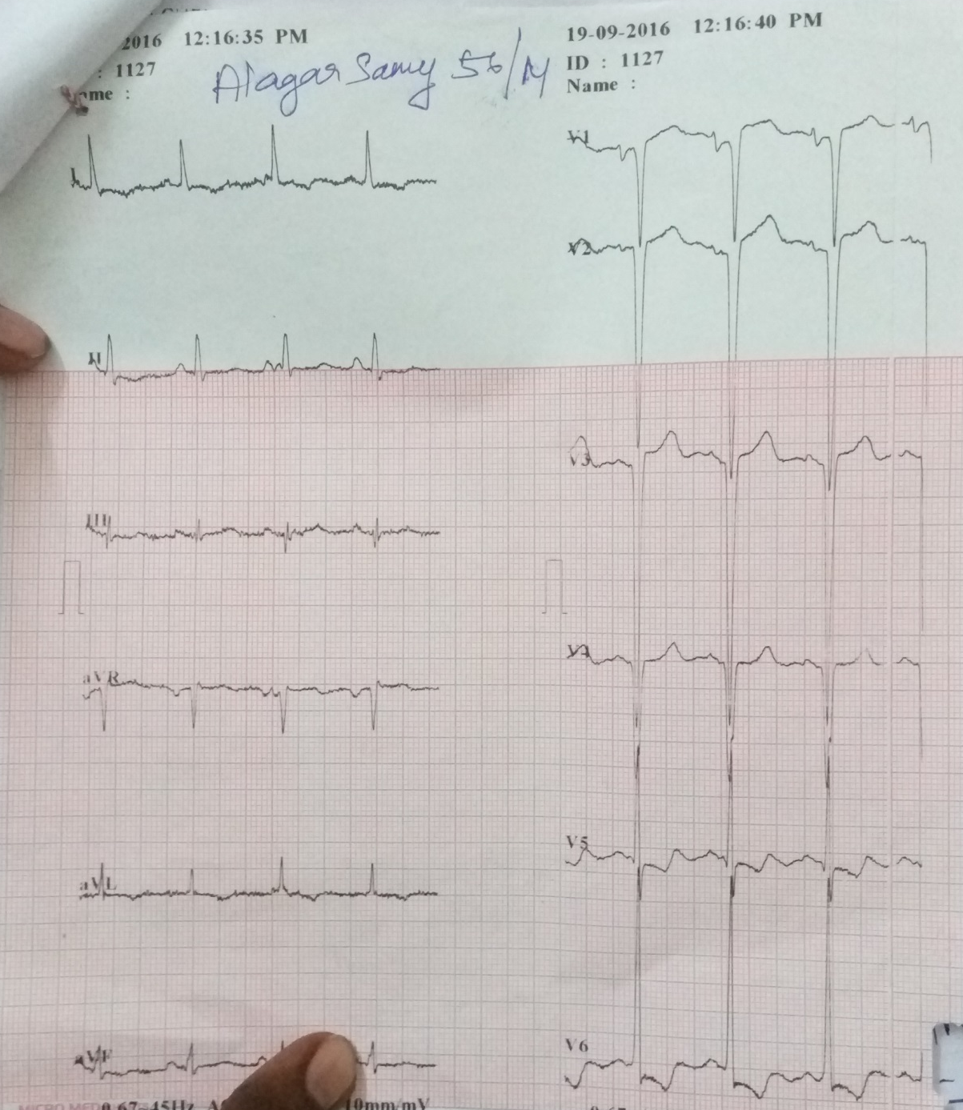
ECG
LAE
LVH
Old AWMI

Slide 23
USG ABDOMEN & PELVIS
normal study

Slide 24
Provisionally diagnosed as
HYPERCHOLOESTROLEMIA
TENDON XANTHOMA
ISCHEMIC DCM

Slide 25
CARDIOLOGY OPINION
ECHO
Global hypokinesia in LV at IW > AW
Aortic valve calcified
Moderate AS, mild AR
Moderate LV systolic dysfunction
grade III LV diastolic dysfunction
TAPSE-12mm, RV dysfunction +
EF – 38% ,LVID (d) -5.5 ,LVID (s) -4.4

Slide 26
DERMATOLOGIST OPINION
? Plexiform neurofibroma
? Tuberous tendinous xanthoma
suggested -biopsy

Slide 27
ENDOCRINOLOGIST OPINION
TSH -9.17 miu/l
?tuberous/tendon xanthoma
hypercholestrolemia
subclinical hypothyroidism
suggested
T.Atorvastatin 10 mg 4 HS
T.Thyroxin 100 mcg 1 od

Slide 28
OPTHALMOLOGY OPINION
Arcus senilis +
Fundus - normal
SURGEON OPINION
suggested- excision biopsy

Slide 29
HISTOPATHOLOGICAL EXAMINATION
Microscopic appearance:
Section show a nodular lesion with proliferation of thick band of fibrous tissue and diffuse sheets of lipid containing histiocytes and occasional giant cells. There is no malignancy
Resected ends of attached tendon appear normal
Impression
In correlation with clinical history of hyperlipidemia, the picture is suggestive of TUBEROUS XANTHOMA attached to tendon

Slide 30
FINAL DIAGNOSIS
HYPERCHOLOESTROLEMIA
TENDON & TUBEROUS XANTHOMA
ISCHEMIC DCM
ATHEROSCLEROTIC AS
SUBCLINICAL HYPOTHYROIDISM

Slide 31
TREATMENT
Life style modifications
Diet modification
T. Atorvastatin 10 mg 4 hs
T. Asprin 150 mg ½ od
T. Enalapril 2.5 mg 1bd
T. Carvedilol 6.25 mg ½ bd
T. Spironolactone 25 mg 2 od
T.Furosemide 40 mg ½ bd
T.Thyroxine 100mcg ½ od

Slide 32
THANK U

Slide 33
Clinical markers of atherosclerosis
Xanthelasma, xanthoma/giant gluteal xanthoma
Arcus juvenilis
Acanthosis nigricans
Skin tags
Premature graying and balding in smokers
Ear lobe crease
Nicotine stains
Central obesity-flabs and folds
Signs of peripheral vascular disease (pulselessness, paralysis, paresthesia, pain and pallor)
Gouty arthritis
Rheumatoid arthritis
Psoriasis

Slide 34
Xanthomas on the Achilles tendon are specific to Familial Hypercholesterolemia.
Intertriginous xanthomas are rare, but if present are pathognomonic

