Slide 1
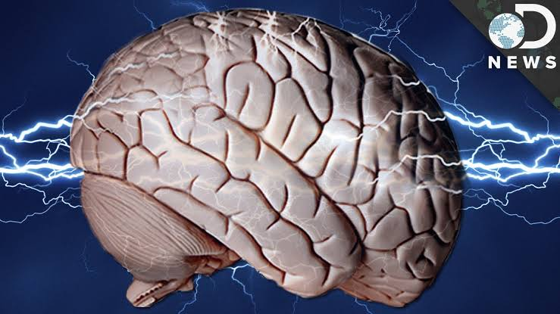

Slide 2
“THE SHOCKED BRAIN”
PRESENTOR – M.ARAVIND KUMAR

Slide 3
PRESENTATION BY I MU
CHIEF
DR.M.NATARAJAN M.D
ASSISTANT PROFESSORS
DR.P.SHRIDHARAN M.D
DR.D.VASANTHA KALYANI M.D,DCP
DR.M.SURESH KUMAR M.D

Slide 4
A 45 year old male, smoker & alcoholic , came to our GH with complaints of weakness of right upper limb and right lower limb.
Patient was apparently normal before 6 hours from admission, got up from bed went to his farm ; tried to switch on motor pump to irrigate the fields;felt shock like sensation radiating to his entire body;immediately withdrew his hand; went back home ;sat on a chair; AFTER 20 MINUTES ; started to have breakfast; He was unable to pick up food from his plate.Tried getting up from chair ;would have fell down unless his son would have not come to his rescue. The patient was brought to hospital immediately following this incident.

Slide 5
H/O weakness of right upper & lower limb (distal>proximal)sudden onset,static since the event
No h/o deviation of angle of mouth
Pt.denies h/o fall
No h/o numbness/tingling sensation
No h/o double vision
No headache/vomiting
No h/o light headedness
No h/o chest pain,palpitation,breathlessness
No h/o muscle cramps
No h/o discoloured urine
No h/o neck pain

Slide 6
Past history
Not a k/c/o DM/HTN/CAD/BA/Epilepsy
No h/o previous similar episodes in the past
Personal history
Chronic smoker (S.I-200)
Chronic alcoholic ( 90ml/day)
No other substance abuse
Mixed diet
Bowel & bladder habits normal

Slide 7
O/E pt.conscious , oriented , grade 2 clubbing + , no pallor, no pedal edema , no cyanosis,
No generalised lymphadenopathy
No entry/exit wound
Vitals
BP-130/80 mm Hg measured in left upper limb
PR- 88/min,regular in rhythm
SpO2- 100% RA

Slide 8
Systemic examination
CVS-S1S2 +
RS – BAE+, NVBS+
P/A – Soft, not tender, no organomegaly
CNS
 | Right | Left
Bulk | UL – forearm -14cm; arm- 25cm LL – leg- 32cm; thigh- 56cm | UL- forearm- 15cm; arm- 27cm LL- leg-34cm, thigh- 56cm
Tone | UL & LL- Hypertonia | UL&LL- Normal
Power | UL-3/5 LL- 2/5 | UL&LL – 5/5
Reflexes | +++ | +

Slide 9
CRANIAL NERVE EXAMINATION; Normal
SENSORY SYSTEM EXAMINATION; Normal
No cerebellar signs.
NO CAROTID BRUIT
NO NECK MUSCLE STIFFNESS

Slide 10
Blood investigations:
CBC : Hb-15.9g%, TC-7800cells/mm3, platelet- 2.5 lakhs
RFT- Urea – 26mg%,creatinine-1.0mg%
RBS ;95 mg/gl
ELECTROLYTES: Sodium : 135 meq/l Potassium : 4.5 meq/l
CPK:52 microgram/l
FASTING LIPID PROFILE; CHOLESTROL;185 mg/dl. TRIGLYCERIDES:135 mg/dl. HDL ;50 mg/dl. LDL;90 mg/dl

Slide 11
Urine pigments –Nil
VCTC – NR
VIRAL MARKERS - NEGATIVE
ECHO - EF-62% ; No RWMA; No thrombus ; no pericardial effusion, regular rhythm

Slide 12
CT BRAIN:
HYPODENSITY NOTED IN LEFT CAPSULOGANGLIONIC REGION SUGGESTIVE OF ACUTE INFARCT.
ATROPHIC CHANGES NOTED IN BILATERAL FRONTOPARIETAL REGIONS.

Slide 13
HYPODENSITY NOTED IN LEFT CAPSULOGANGLIONIC REGION SUGGESTIVE OF ACUTE INFARCT. ATROPHIC CHANGES NOTED IN BILATERAL FRONTOPARIETAL REGIONS.

Slide 14
NEUROLOGY OPINION;
DIAGNOSIS:CVA / RIGHT HEMPARESIS.
ADVICE:
T.ASPIRIN 150 MG 1-0-0
T,ATORVOSTATIN 10MG 0-0-4
MRI BRAIN WITH MRA AND MRV
LIPID PROFILE AND ECHO.

Slide 15
CV doppler done
Normal phasic flow
No stenosis
No plaques

Slide 16
Pt was treated with anti platelets & statins
Physiotherapy given
The weakness was static and the power didn’t improve till discharge
No sensory or autonomic disturbances

Slide 17
DD for weakness following electrical injury
DEHYDRATION
CERBRAL HYPOPERFUSION
ARRHYTHMIA
ELECTROLYTE IMBALANCE
RHABDOMYOLYSIS
HYPOXIC ENCEPHALOPATHY
KERAUNOPARALYSIS
VASCULAR INSULTS

Slide 18
Final diagnosis:
ACUTE ISCHAEMIC STROKE; RIGHT HEMIPARESIS POSSIBLY CAUSED OR TRIGGERED BY ELECTROCUTION.
AIM OF THE PRESENTATION:
TO DISCUSS VARIOUS NEURONAL INJURIES CAUSED BY ELECTROCUTION.

Slide 19
relevant reads:

Slide 20
THANK YOU

