Slide 1
ECG FOR DISCUSSION
PROF&HOD:DR.S.PEER MOHAMED MD
ASSOCIATE PROF . Dr.K .MURALIDHARAN MD
ASST PROF: DR.D.VASANTHA KALYANI MD
DR.V.MANIKANDAN MD DA
DR . R. JAGATHEESH MD DCH
DR.M.SURESH KUMAR,MD
DR.M.SATHEESH KUMAR MD
PRESENTOR :DR. ARUN T

Slide 2
Chief complaints:
17/M came to GRH from vadipatti gh
C/o chest pain for past 2 days
fever for past 2 days
H/o presenting illness
H/o chest pain for past two days
Sudden, sharp, stabbing chest pain that gets worse when breathing deeply , coughing or lying flat
H/o fever for past two days ,low grade , intermittent fever , not associated with chills and rigor
No h/o sweating
No h/o palpitation
No h/o cough and cold
No h/o vomiting
PAST HISTORY
Pt is a not a k/c/o SHTN/T2DM/Hypothyroidism

Slide 3
VITALS:
BP- 120/90 mm hg
PR- 86/ min
Spo2 – 98% at room air
RR – 16/min
O/E
conscious
oriented
Not dyspneic
Not tachypneic
No pallor/icterus/ cyanosis/ clubbing/
No Pedal edema

Slide 4
Systemic examination:
CVS: S1 S2 Present
No murmur
RS – BAE present, NVBS
PA - soft, bowel sound present
CNS- Conscious, oriented , NFND

Slide 5
Investigations
CBC:
LFT:
WBC | 14800
Hb | 14.6 gm/dl
Platelet | 2.7 lakhs
T.BIL | 0.9mg/dl
D.BIL | 0.2mg/dl
I. BIL | 0.7mg/dl
OT | 98 U/L
PT | 18 U/L
ALP | 95U/L

Slide 6
RFT:
Sr.electrolytes
RBS | 93
Urea | 36
creatinine | 0.9
CK | 1428
CKMB | 144
TROPONIN | POSITIVE
ASO TITRE | NEGATIVE
sodium | 125
potassium | 3.5

Slide 7
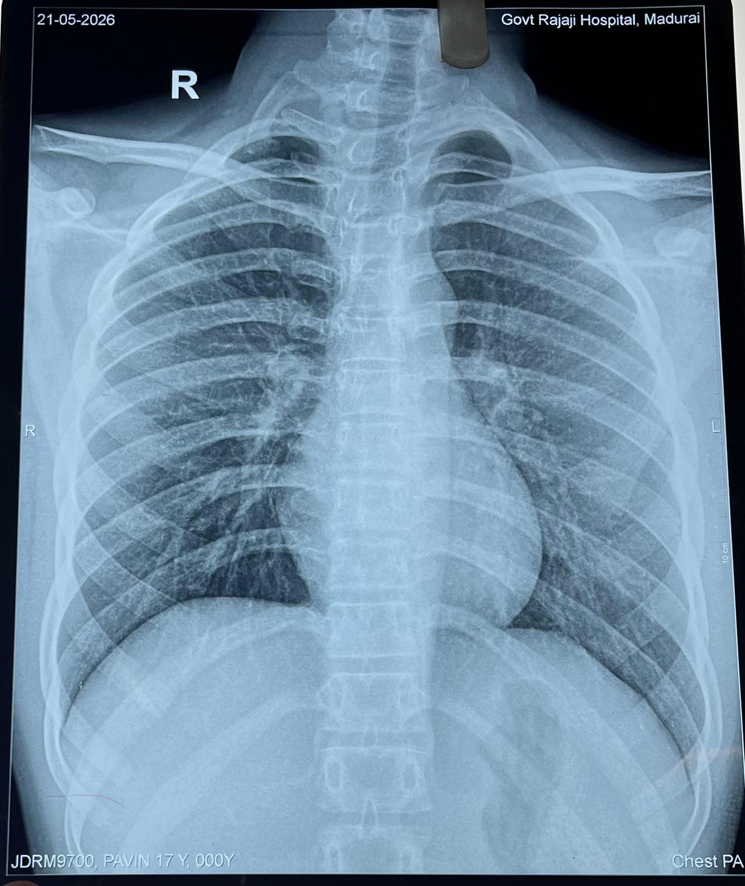
CHEST XRAY

Slide 8
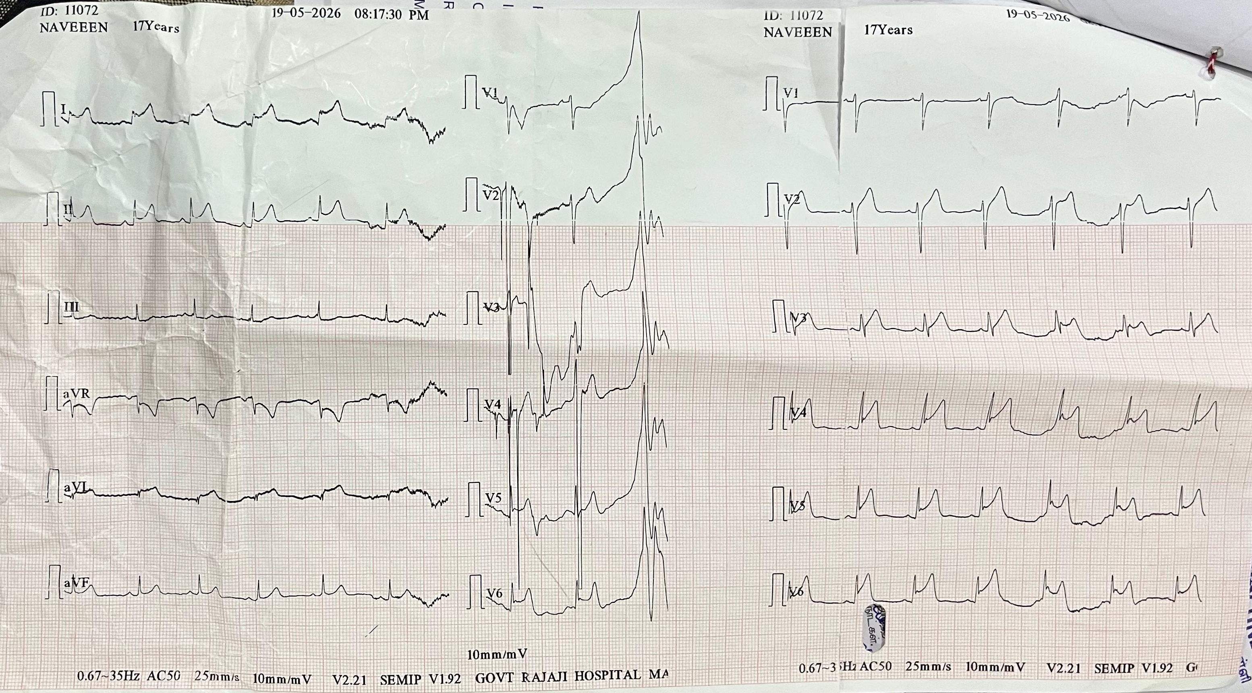

Slide 9
LET’S DISCUSS…

Slide 10
THANK YOU

