Slide 1
HEART FAILURE

Slide 2
Definitions
Heart failure is a complex clinical syndrome that results from any structural and functional impairment of ventricular filling or ejectionof blood leading to cardinal manifestations of fatigue ,dyspnea and fluid retention(American college of cardiology)
In Pathophysiological terms heart failure has been defined as a syndrome characterised by elevated cardiac filling pressure and inadequate peripheral oxygen delivery at rest or during stress caused by cardiac dysfunction

Slide 3
Chronic and Acute Failure
Chronic Failure:Patients with longstanding(months to years) of symptoms and Signs of heart failure controlled with medications or devices
Acute heart failure occurs due to worsening of chronic failure or that occurs in the setting of acute coronary syndrome,acute valvular dysfunction or hypertensive urgency

Slide 4
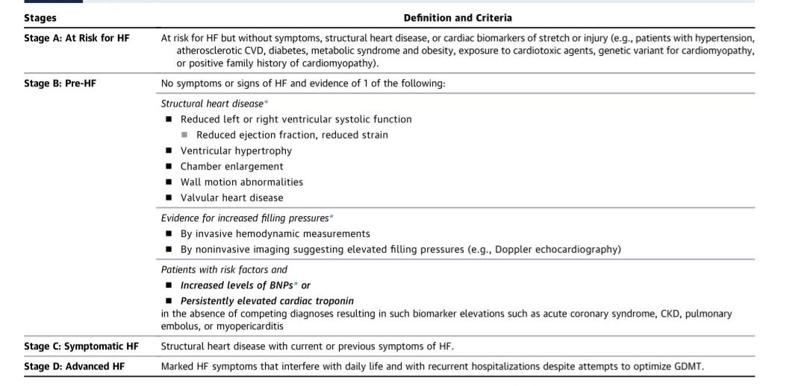

Slide 5
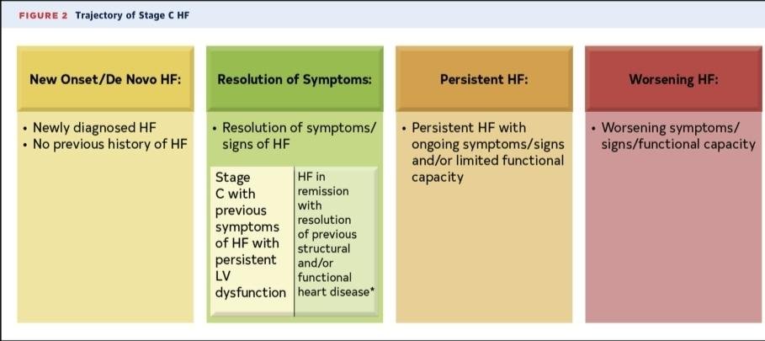

Slide 6
Phenotypes of Heart failure
Heart failure is now classified based on the ejection fraction into HFrEF(<50%) and HFpEF(>50%)
HF with recovered ejection fraction:A group of patients that recover ejection fraction Predictors of recovered ejection fraction are younger age, non-ischemic etiology,smaller ventricular volumes.examples: peripartum cardiomyopathy,reversible toxin exposures
HFmrEF:Patients with HF with an EF between 40 and 50.

Slide 7
CAUSES OF HEART FAILURE
It is important to define and diagnose the specific cause of Heart failure
In clinical practice heart failure is mostly divided into ischemic and non-ischemic cardiomyopathy
This does not acknowledge the impact of identifing specific causes on treatment
A systematic review of trials and observational evidence showed that prognosis in HF depended on the specific causes almost 85% of individuals had one risk factor that could’ve been treated in the 5 yearspreceding diagnosis

Slide 8
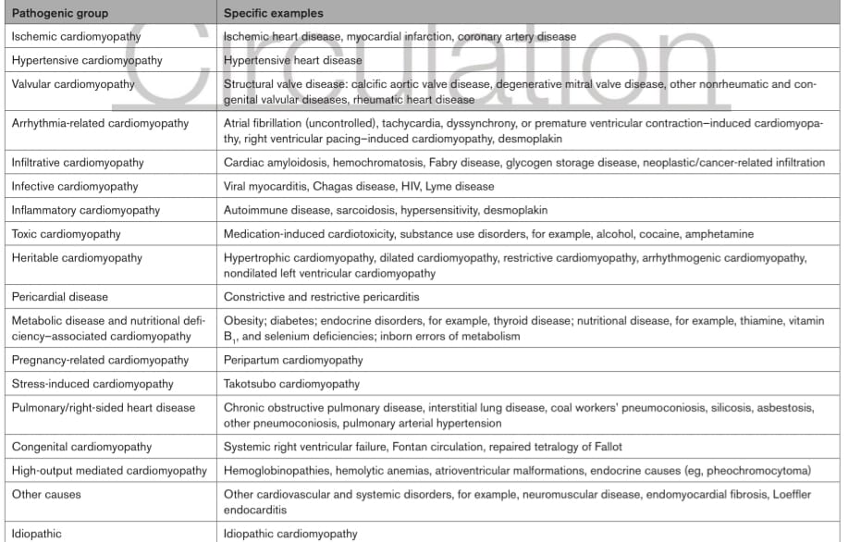

Slide 9
Patho-Physiology
HFrEF is progressive disease that typically occurs after a primary event that may be myocardial infarction or volume overload
Compensatory mechanisms ultimately lead to disease progression
1.NEUROHORMONAL ACTIVATION
Activation of the RAAS pathway and the sympathetic nervous system initially help to maintain cardiac output.Later these same mechanisms lead to volume overload
2.VASODILATORY HORMONES
ANP , BNP Prostacyclin and prostaglandin E1 are stored and released from the atria and ventricles and help in vasodilation and excretion of of sodium and water.
3.ENDOTHELIN
Endothelin is released from the pulmonary and myocardial circulation in response to
increased pressure which leads to myocyte hypertrophy and Interstitial fibrosis.

Slide 10
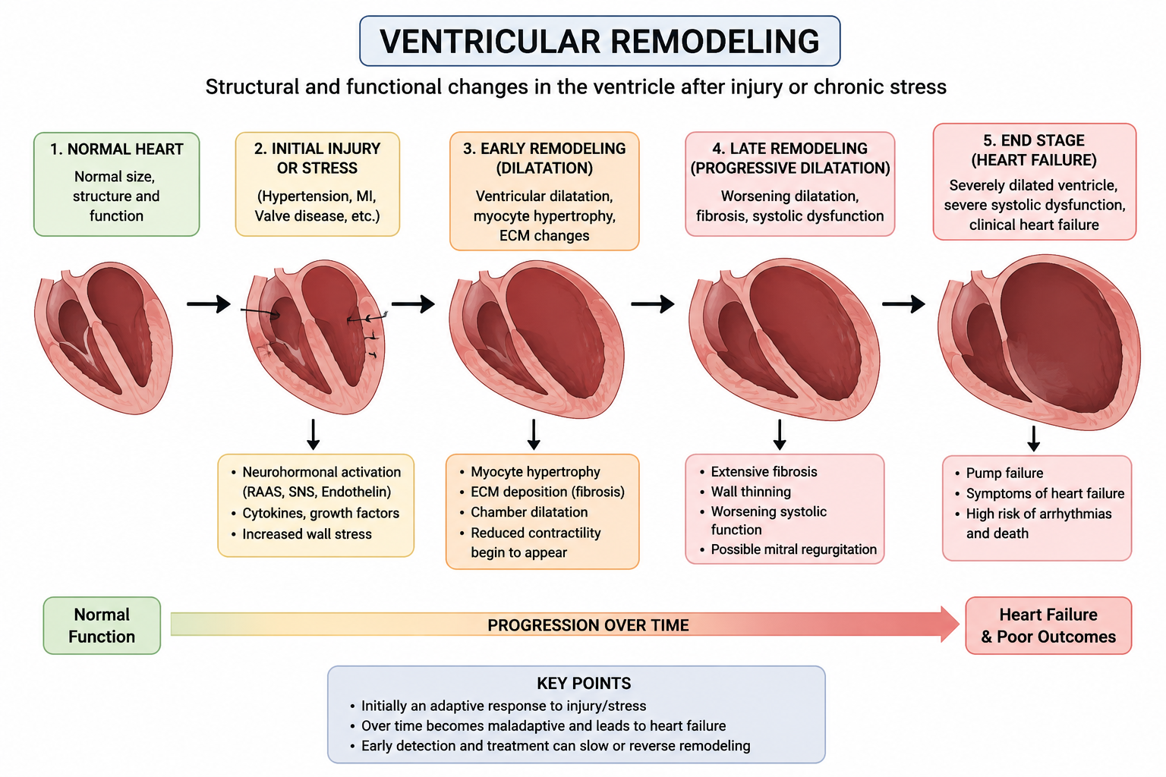
Ventricular remodelling

Slide 11
SYMPTOMS OF HEART FAILURE
SYMPTOMS OCCURING DUE TO PULMONARY CONGESTION
1.Shortness of breath is a cardinal manifestation
2.Orthopnea:Orthopnea typically occurs within 1-2 minutes of lying down
3.Paroxysmal Nocturnal Dyspnea:Usually ocurs of after prolonged recumbency and mostly requires 30 minutes in the upright position for symptoms to decrease.
SYMPTOMS OCCURING DUE TO REDUCED PERFUSION
1.Fatigue and weakness
2.In older patients with HF reduced systemic perfusion may result in mental dullness,depressed effect and confusion

Slide 12
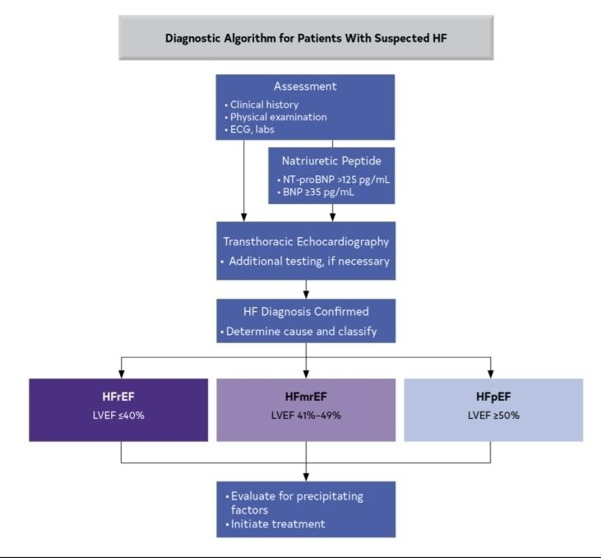

Slide 13
BNP AND IT'S ROLE IN HEART FAILURE
1. Diagnosis of HF Measure BNP or NT-proBNP in patients with unexplained breathlessness to help diagnose heart failure, especially when the clinical examination is uncertain.Low levels make HF unlikely.High levels support HF but can also occur in other heart and non-heart conditions.
2. Prognosis Higher BNP or NT-proBNP levels indicate a worse prognosis, with a higher risk of death and hospitalization.
3. Risk stratification BNP and NT-proBNP help identify high-risk patients and provide additional prognostic information beyond routine clinical assessment.
4. Screening high-risk patients In people at high risk for HF (e.g., hypertension, diabetes, vascular disease), BNP-guided screening with echocardiography and specialist follow-up can help detect early heart dysfunction and prevent HF.
5. Monitoring treatment Measuring BNP or NT-proBNP before hospital discharge helps predict the risk of readmission or death. Falling r treatment generally indicate a better response, but treatment should be guided by guideline-directed medical therapy (GDMT) rather than aiming for a specific BNP target.

Slide 14
Newer recommendations regarding clinical examination of heart failure
Every visit for a patient with heart failure (HF): Check the vital signs (blood pressure, heart rate, oxygen saturation, weight, etc.) and look for signs of fluid overload (leg swelling, raised JVP, lung crackles, edema). Use these findings to adjust diuretics and other heart failure medications.
In patients with symptoms of HF: Look for features that suggest advanced heart failure, such as severe breathlessness, frequent hospital admissions, fatigue, low blood pressure, weight loss, or poor response to treatment.
In patients with cardiomyopathy: Take or update a 3-generation family history (parents, siblings, children, grandparents, aunts/uncles, cousins if relevant) to identify inherited heart diseases.
In patients newly presenting with HF: Perform a detailed history and physical examination to identify the underlying cause of heart failure, especially causes that have specific treatments (for example, valve disease, coronary artery disease, amyloidosis, or thyroid disease).
In all patients presenting with HF: Perform a comprehensive history and examination to identify:
Cardiac causes (e.g., hypertension, coronary artery disease, valve disease)
Noncardiac conditions (e.g., diabetes, kidney disease, anemia, thyroid disorders)
Lifestyle factors (diet, alcohol, smoking, exercise, medication adherence)
Social factors (financial barriers, family support, access to healthcare) that may contribute to the development or worsening of heart failure.

Slide 15
Treatment recommendations in Stage B pre- clinical Heart failure
1. In patients with LVEF < 40%, ACEi should be used to prevent symptomatic HF and reduce mortality.
2. In patients with a recent or remote history of MI or ACS, statins should be used to prevent symptomatic HF and adverse cardiovascular events
3. In patients with a recent MI and LVEF <40% who are intolerant to ACEi, ARB should be used to prevent symptomatic HF and reduce mortality.
4. In patients with a recent or remote history of MI or acute coronary syndrome (ACS) and LVEF <40%, evidence-based beta blockers should be used to reduce mortality.
5. In patients who are at least 40 days post-MI with LVEF <30% and NYHA class I symptoms while receiving GDMT and have reasonable expectation of meaningful survival for >1 year, an ICD is recommended for primary prevention of sudden cardiac death (SCD) to reduce total mortality.
6. In patients with LVEF <40%, beta blockers should be used to prevent symptomatic HF.
7. In patients with LVEF <50%, thiazolidinediones should not be used because they increase the risk of HF, including hospitalizations (15).
8. In patients with LVEF <50%, nondihydropyridine calcium channel blockers with negative inotropic effects may be harmful.

Slide 16
Treatment of HFrEF

Slide 17
THE FOUR PILLARS OF HEART FAILURE
1. ARNI (or ACEI/ARB if ARNI not feasible)
Sacubitril/valsartan
2.Beta blocker
Carvedilol, Metoprolol succinate, Bisoprolol
3.MRA
Spironolactone, Eplerenone
4.SGLT2 inhibitor
Dapagliflozin, Empagliflozin

Slide 18
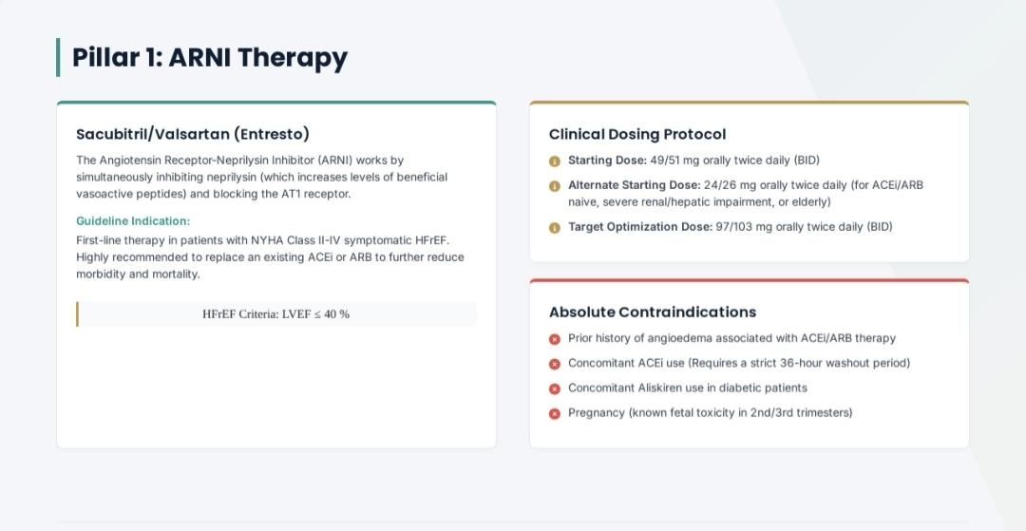
ARNI, ACEI and ARB in HFrEF
ARNI (Sacubitril/Valsartan) Preferred first-line
Combines valsartan (ARB) + sacubitril (neprilysin inhibitor).
Sacubitril increases beneficial natriuretic peptides, causing:
Vasodilation
Natriuresis
Reduced cardiac remodeling
PARADIGM-HF trial: Reduced cardiovascular death or HF hospitalization by 20% compared with enalapril.
Preferred over ACE inhibitors in symptomatic HFrEF.
Can be started even during hospitalization once the patient is stabilized (PIONEER-HF).
Do not use within 36 hours of an ACE inhibitor.
Contraindicated in patients with a history of angioedema.

Slide 19
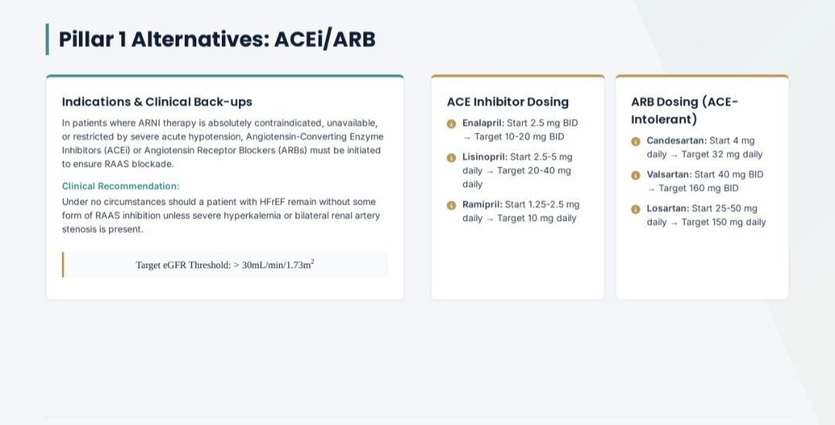
2. ACE inhibitors,
Reduce mortality and HF hospitalizations.
Start at a low dose and gradually titrate.
Side effects:
Cough
Hyperkalemia
Renal dysfunction
Angioedema
If ARNI cannot be used, ACE inhibitors remain a Class I therapy.

Slide 20
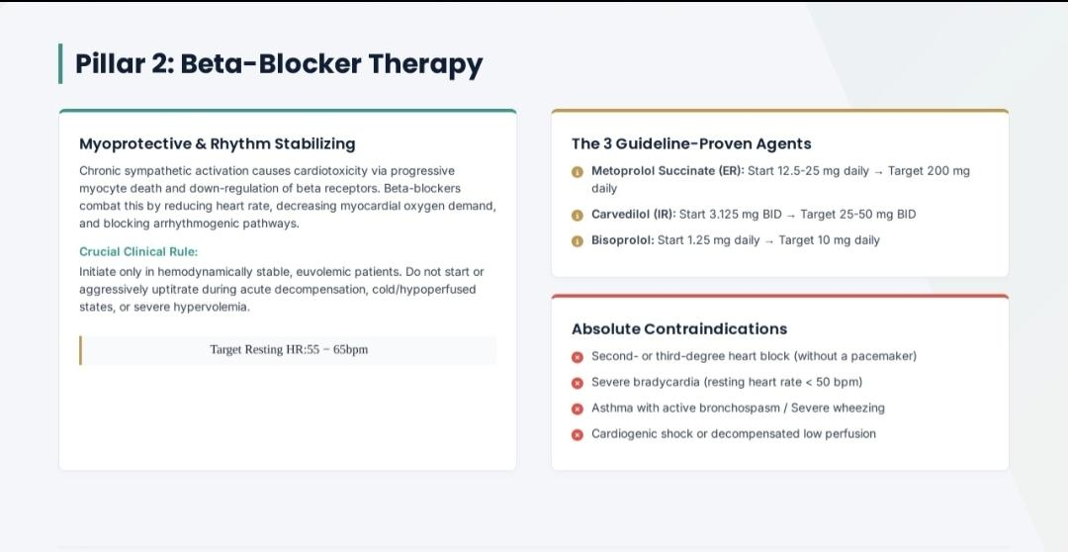
ARB’s
Used when ACE inhibitors are not tolerated (especially due to cough or angioedema).
Also reduce mortality and HF hospitalization.
Lower risk of cough than ACE inhibitors.
If neither ARNI nor ACE inhibitor can be used, choose an ARB.

Slide 21
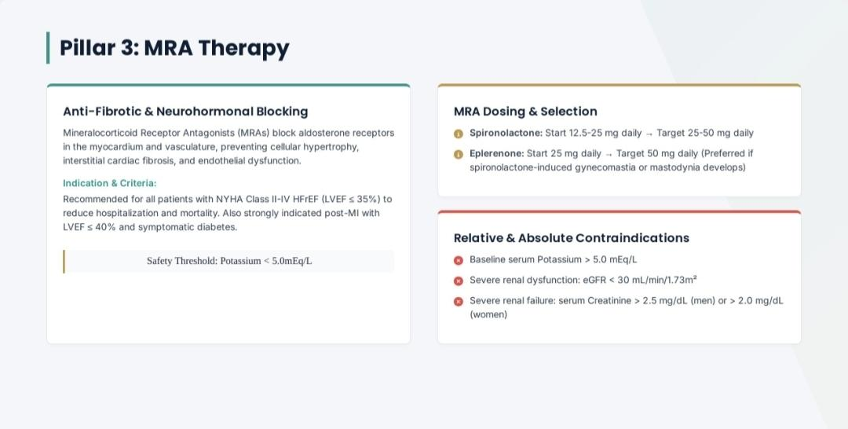
Beta blockers
Recommended beta blockers (only these 3 have proven mortality benefit):Bisoprolol
Metoprolol succinate (extended-release)
Carvedilol
Not all beta blockers improve survival in heart failure

Slide 22
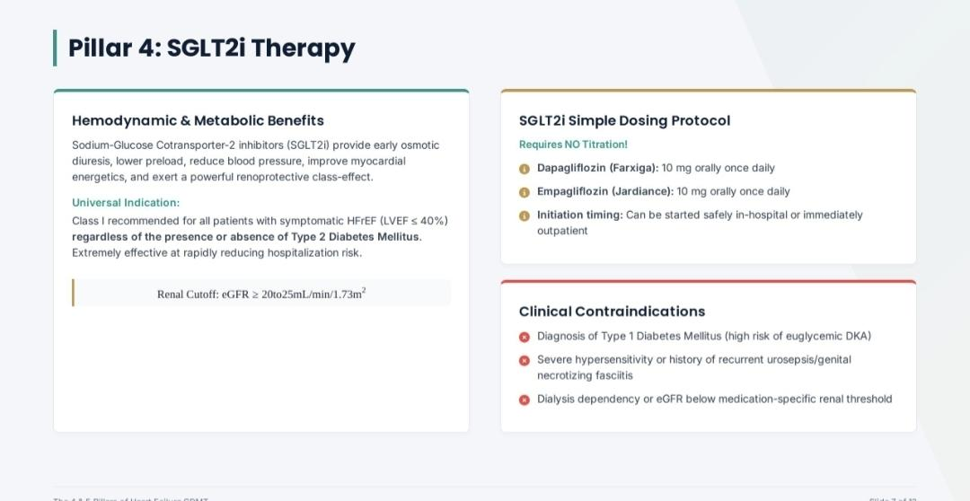

Slide 23
DIURETICS
1.In patients with heart failure diuretics are recommended to relieve congestion symptoms and prevent worsening of HF.
2. Loop diuretics are the preffered diuretic used for heart failure.Thiazide diuretics may be considered in patients with hypertension and heart failure.
3. The treatment goal of diuretic use is to eliminate clinical evidence of fluid retention

Slide 24
Titration of medications in Heart failure
Start all guideline-directed medications at low doses.
Increase the dose gradually until the target dose is reached, if tolerated.
Monitor:Blood pressure,Heart rate,Kidney function, Serum potassium and electrolytes
Delay dose escalation if the patient develops side effects. Try increasing again once the patient stabilizes.Most patients can eventually achieve target doses with careful follow-up.Higher tolerated doses of beta blockers, ACE inhibitors, and ARBs provide greater benefits, including improved EF and reduced mortality.
The order of starting medications is flexible and should be individualized based on the patient's clinical condition. Do not delay initiating GDMT while waiting to optimize one drug before starting another.

Slide 25
IVABRADINE
1.Ivabradine is a sodium funny current channel inhibitor
2.The SHIFT trial demonstrated the efficacy of ivabradine a sinoatrial node modulator that selectively inhibits the I(funny currrent)
3.The greatest benefit was a reduction in HF hospitalisations
4. The shift trial mainly included patients with HFrEF<35% who were in sinus rhyth with a resting heart >70bpm

Slide 26
DIGOXIN
The digitalis glycosides exert a mild inotropic effect attenuate carotid baroreceptor activity and are sympatho inhibitory.These lead to a decrease in serum norepinephrine levels,plasma renin levels and possibly aldosterone levels
The Digitalis Investigation Group trial demonstrated a reduction in HF hospitalisations in the treatment group but no reduction in mortality or improvement in QOL.
Lower doses of digoxin are enough to ensure beneficial outcomes

Slide 27
Soluble Guanyl cyclase Activators(Vericiguat)
On patients already optimized on GDMT and still progression of disease occurs we can consider soluble guanyl cyclase activators
cGMP production is increased that leads to beneficial effects like vasodilation,improvements in endothelial function as well as decrease in fibrosis and remodeling of the heart
The VICTORIA trial showed that HF hospitalisation and cardiovascular death occured in 35.5% with vericiguat and 38.5% in the placebo group.

Slide 28
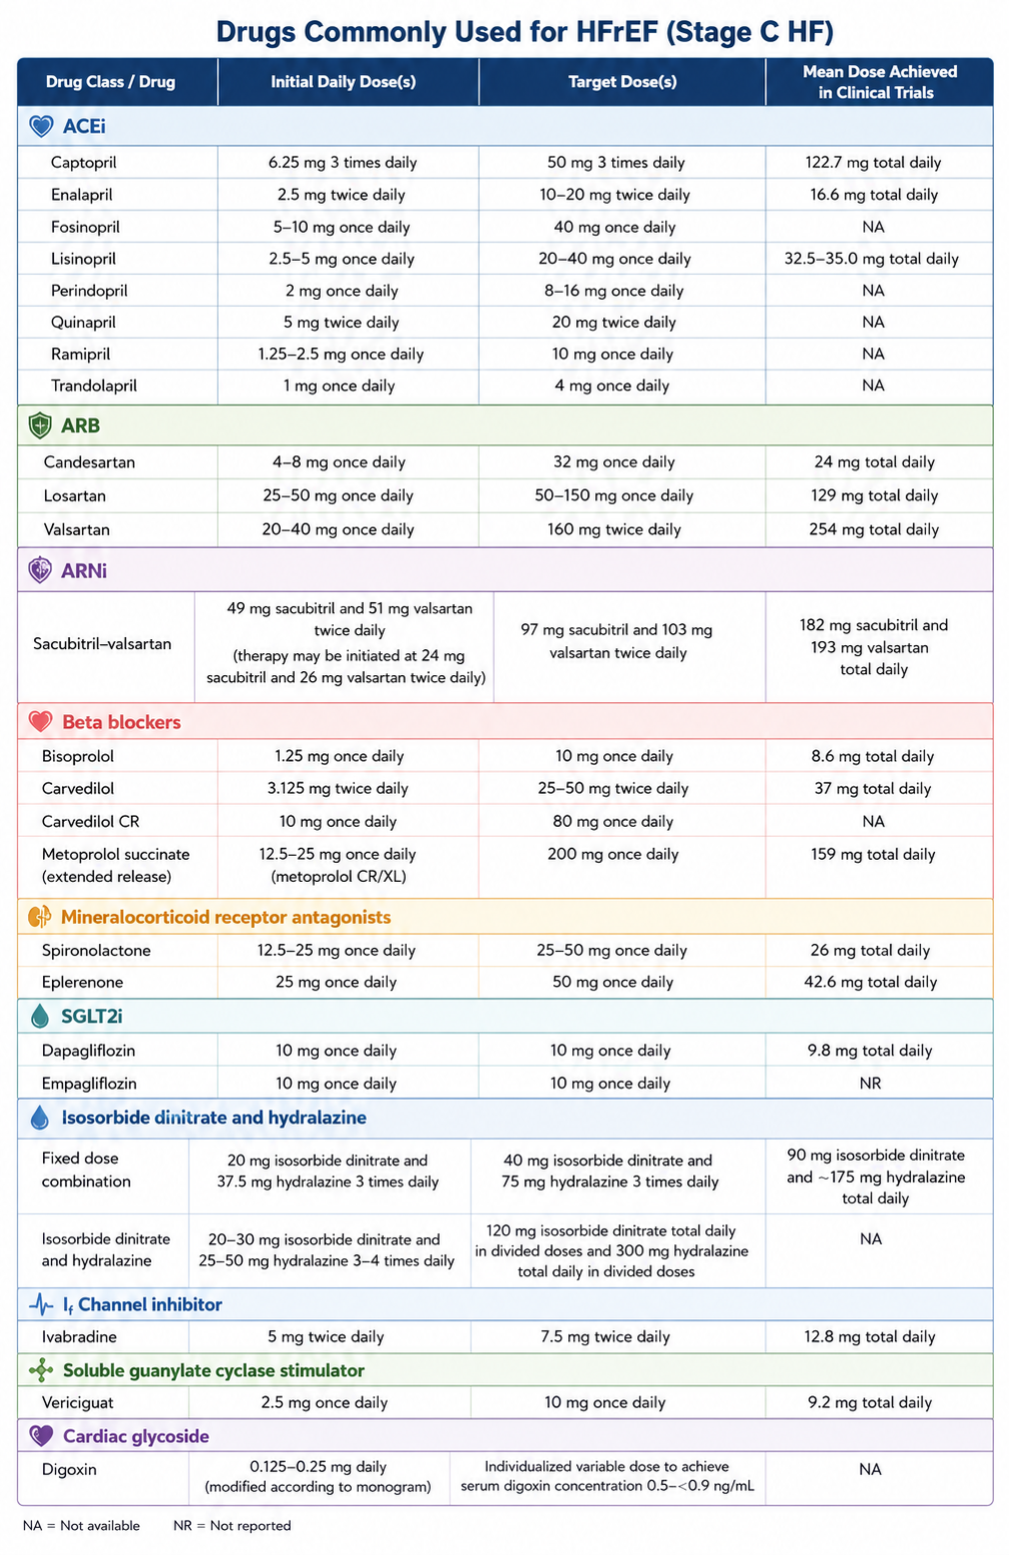

Slide 29
Device therapy in HFrEF
1.Implantable cardiac defibrillator:Prevents suddeen cardiac death and decreases mortality in selected HFrEF patients.Indications of ICD:1.LVEF<35% despite 3months of optimal Medical therapy2.NYHA 2 OR 3 3.Expected survival>1 year
2.Cardiac Resynchronisation Therapy: Indications : LVEF:<35%,sinus rhythm LBBB with a QRS duration >150ms and NYHA class 2 or 3 or ambultory class 4 symptoms on medical therapy are the best responders to CRT.
CRT is not recommended if QRS<150ms with non-LBBB pattern

Slide 30
Treatment of HFpEF
Optimal control of blood pressure in patients with HFpEF to decrease morbidity
SGLT2 inhibitors can be considered as they decrease HF hospitalisations and cardiovascular mortality(EMPOREROR-Preserved trial)
Among patients at the lower end of the spectrum it is useful to consider MRA’s as they improve diastolic function
MRA’s,ARNI’s and ARB’s show better results when they are used in patients with LVEF close to 50%.

Slide 31
Treatment of HFmrEF
There have been no specific trials done for this group
The patients at the lower end of the spectrum can be treated with the same as HFrEF
SGLT inhibtors are beneficial in decreasing HF hospitalisations and cardiovascular mortality

Slide 32
Newer Updates
1.FINEARTS-HF:Fineranone is beneficial in patients with LVEF>40%.Reduced heart failure hospitalisations and cardiovascular death
2.STEP-HFpEF(2023):Semaglutide 2.4mg improved heart failure symptoms,excercise capacity,weight loss areduced HF events
3.HEART-FID:IV Ferric carboxymaltose showed improvements in symptoms and quality of life
4.Omecamativ Mecarbil:GALACTIC-HF showed modest benefit.Limited uptake and not widely incorporated into routine practice

Slide 33
THANK YOU

