Slide 1
THE REMARKABLE IMITATOR
UNIT - II
PROF & CHIEF : DR. G. BAGIALAKSHMI.,MD.,
ASST PROF : DR. VALLIDEVI.,MD.,DCH.,
ASST PROF : DR. PONSENTHIL KUMAR.,MD.,
ASST PROF : DR. ILAMARAN,MD.,
PRESENTOR : DR. VISHNU V B

Slide 2
PRESENTATION
45 Year old male admitted with complaints of
Fever x 2 weeks
Abdominal pain x 3 days
Present illness:
He was apparently normal 2 weeks back. Then he developed Fever – low grade, intermittent, a/w evening rise in temperature, not a/w chills & rigor
h/o cough with scanty mucoid sputum x 2 weeks
h/o abdominal pain x 3 days – diffuse, dull aching, not relieved by food or medication
h/o breathlessness x 3 days – insidious, progressive, MMRC III, not a/w orthopnea/PND
h/o knee pain and swelling (L>R) x 1 day
h/o altered sensorium x 1 day

Slide 3
CONT.
vomiting / loose stools
burning micturition
yellowish discoloration of skin / eyes
bleeding manifestations
chest pain / palpitation
syncope / seizure
headache / altered vision
loss of weight / appetite
skin rashes
No h/o

Slide 4
CONT
PAST HISTORY
k/c/o T2DM x 10 years k/c/o PTB completed 6 months of ATT 1 year back not a k/c/o HT, CAD, CKD, epilepsy, thyroid disease
PERSONAL HISTORY
Mixed diet taker
Not a smoker
Occasional alcoholic
Tobacco chewer
No h/o high risk sexual behavior
No h/o exposure to pet animals
OCCUPATIONAL HISTORY
Farmer
FAMILY HISTORY
No h/o similar illness in the family

Slide 5
EXAMINATION
GENERAL EXAMINATION
Drowsy
Obeys oral commands
Febrile +
No pallor
Not icterus
Muddy conjuntiva +
No cyanosis
No clubbing
No pedal edema
No generalized lymphadenopathy
VITALS
BP – 100/80mmHg
PR – 122/min
RR – 24/min
Temp – 100.5 F
Spo2 – 94% RA
JVP – not elevated

Slide 6
SYSTEMIC EXAMINATION
CVS : S1 S2 heard in all areas. No murmur
RS – BAE + NVBS +
B/L lower lobe fine crepts +
ABDOMEN : no guarding / rigidity
tender hepatomegaly + 3 cm below RCM
mild splenomegaly
CNS : GCS - E3V4M6
terminal neck stiffness +
Kernigs sign - / Brudzinski sign -
L/E of both knee joint: warmth, tender, ROM+

Slide 7
INVESTIGATIONS
CBC
TC | 8000
DC | N:84 L:11 M:5
Hb | 11.3
PCV | 33
PLT | 23000
ESR | 57mm/hr
qCRP | 92.5
RFT
RBS | 215
Urea | 74
Cr | 0.7
Na | 135
K | 3.5
FBS | 139
Cholestrol | 100
TGL | 108
LFT
TB | 2.1
DB | 1.1
IB | 1.0
SGOT | 44
ALP | 897
PT | 20.05s
INR | 1.6
aPTT | 26.65
URINE
Albumin | Trace
Sugar | 2+
Pus cells | 4-5 cells
Acetone | Negative

Slide 8
SUMMARY
45 year Male
T2DM
Old PTB
Farmer
Alcoholic
2 weeks h/o
Low grade fever
Abdominal pain
Cough
Breathlessness
Arthritis
Patient provisionally diagnosed as fever with thrombocytopenia/sepsis/septic arthritis
Hepatosplenomegaly

Slide 9
TREATMENT GIVEN
IV Fluids
Inj. Ceftriaxone 1g iv bd
Inj. Ranitidine 50mg iv bd
Inj. H.Actrapid according to CBG
C. Doxycycline 100mg bd
T. NAC + Ambroxol tds
T. Paracetamol 500mg tds
Salbutamol nebulization Q6h

Slide 10
DAY 2
Dyspnea settles
Cough - non productive
O/E
Pt. GCS -15/15
Febrile +
Oral cavity – no thrush
Fundus – Normal
Genital examination – no ulcer
PERIPHERAL SMEAR:
Hypochromic microcytic anemia
Relative neutrophilia
Thrombocytopenia
ECHO
Normal study
No RWMA
No LV clot
SYNOVIAL FLUID
TC | 11780
Glucose | 183
Protein | 2875
USG Lt Knee
Minimal synovial thickening with surrounding inflammatory changes, thin rim of fluid noted within synovial space

Slide 11
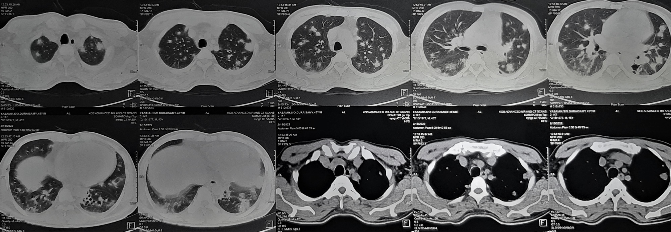
CT CHEST

Slide 12
CT ABDOMEN & PELVIS

Slide 13
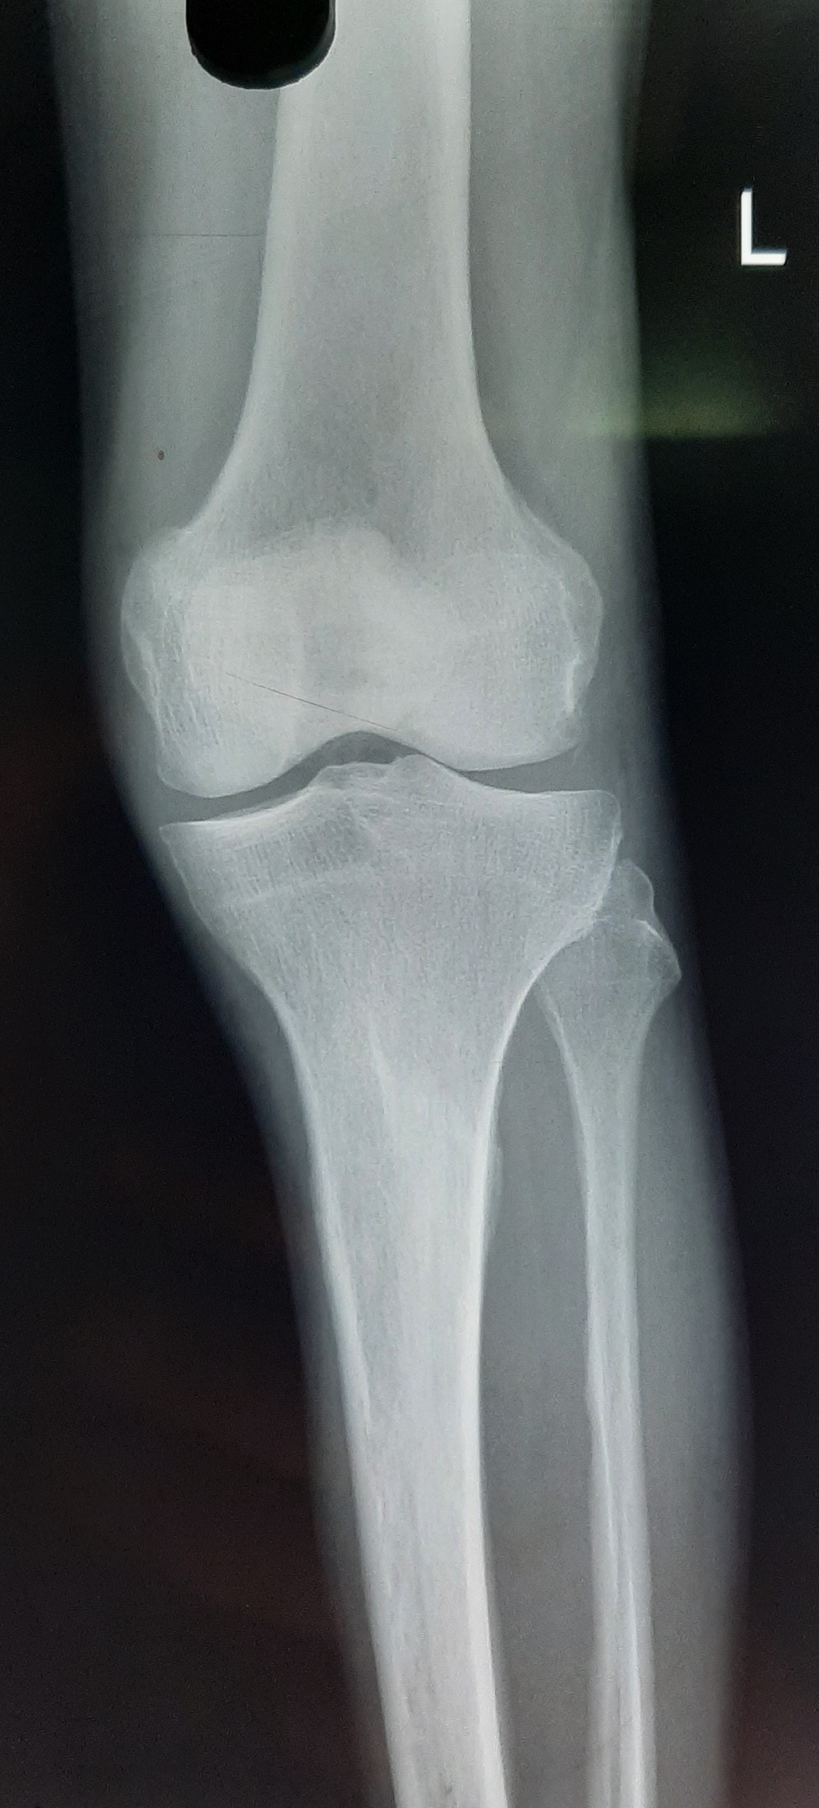
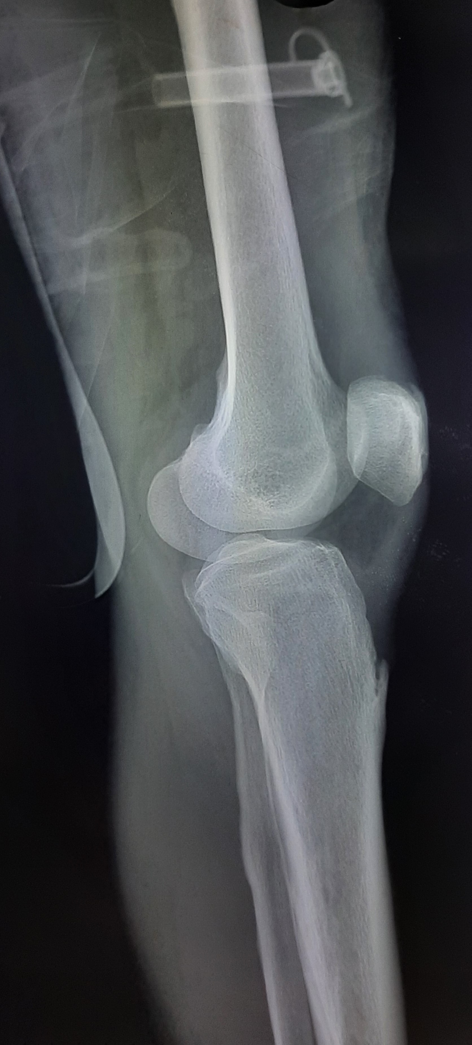
X RAY LEFT KNEE

Slide 14
MICROBIOLOGY
BLOOD C/S | NO GROWTH
URINE C/S | NO GROWTH
SPUTUM C/S | Non fermentative GNB +
VCTC | Non reactive
HbsAg/Anti HCV | Negative
VDRL | Negative
Covid RTPCR | Negative
IgM Dengue | Negative
IgM leptospirosis | Negative
IgM scrub typhus | Negative
Smear for MP/MF | Negative
Widal test | Negative

Slide 15
What next?

Slide 16
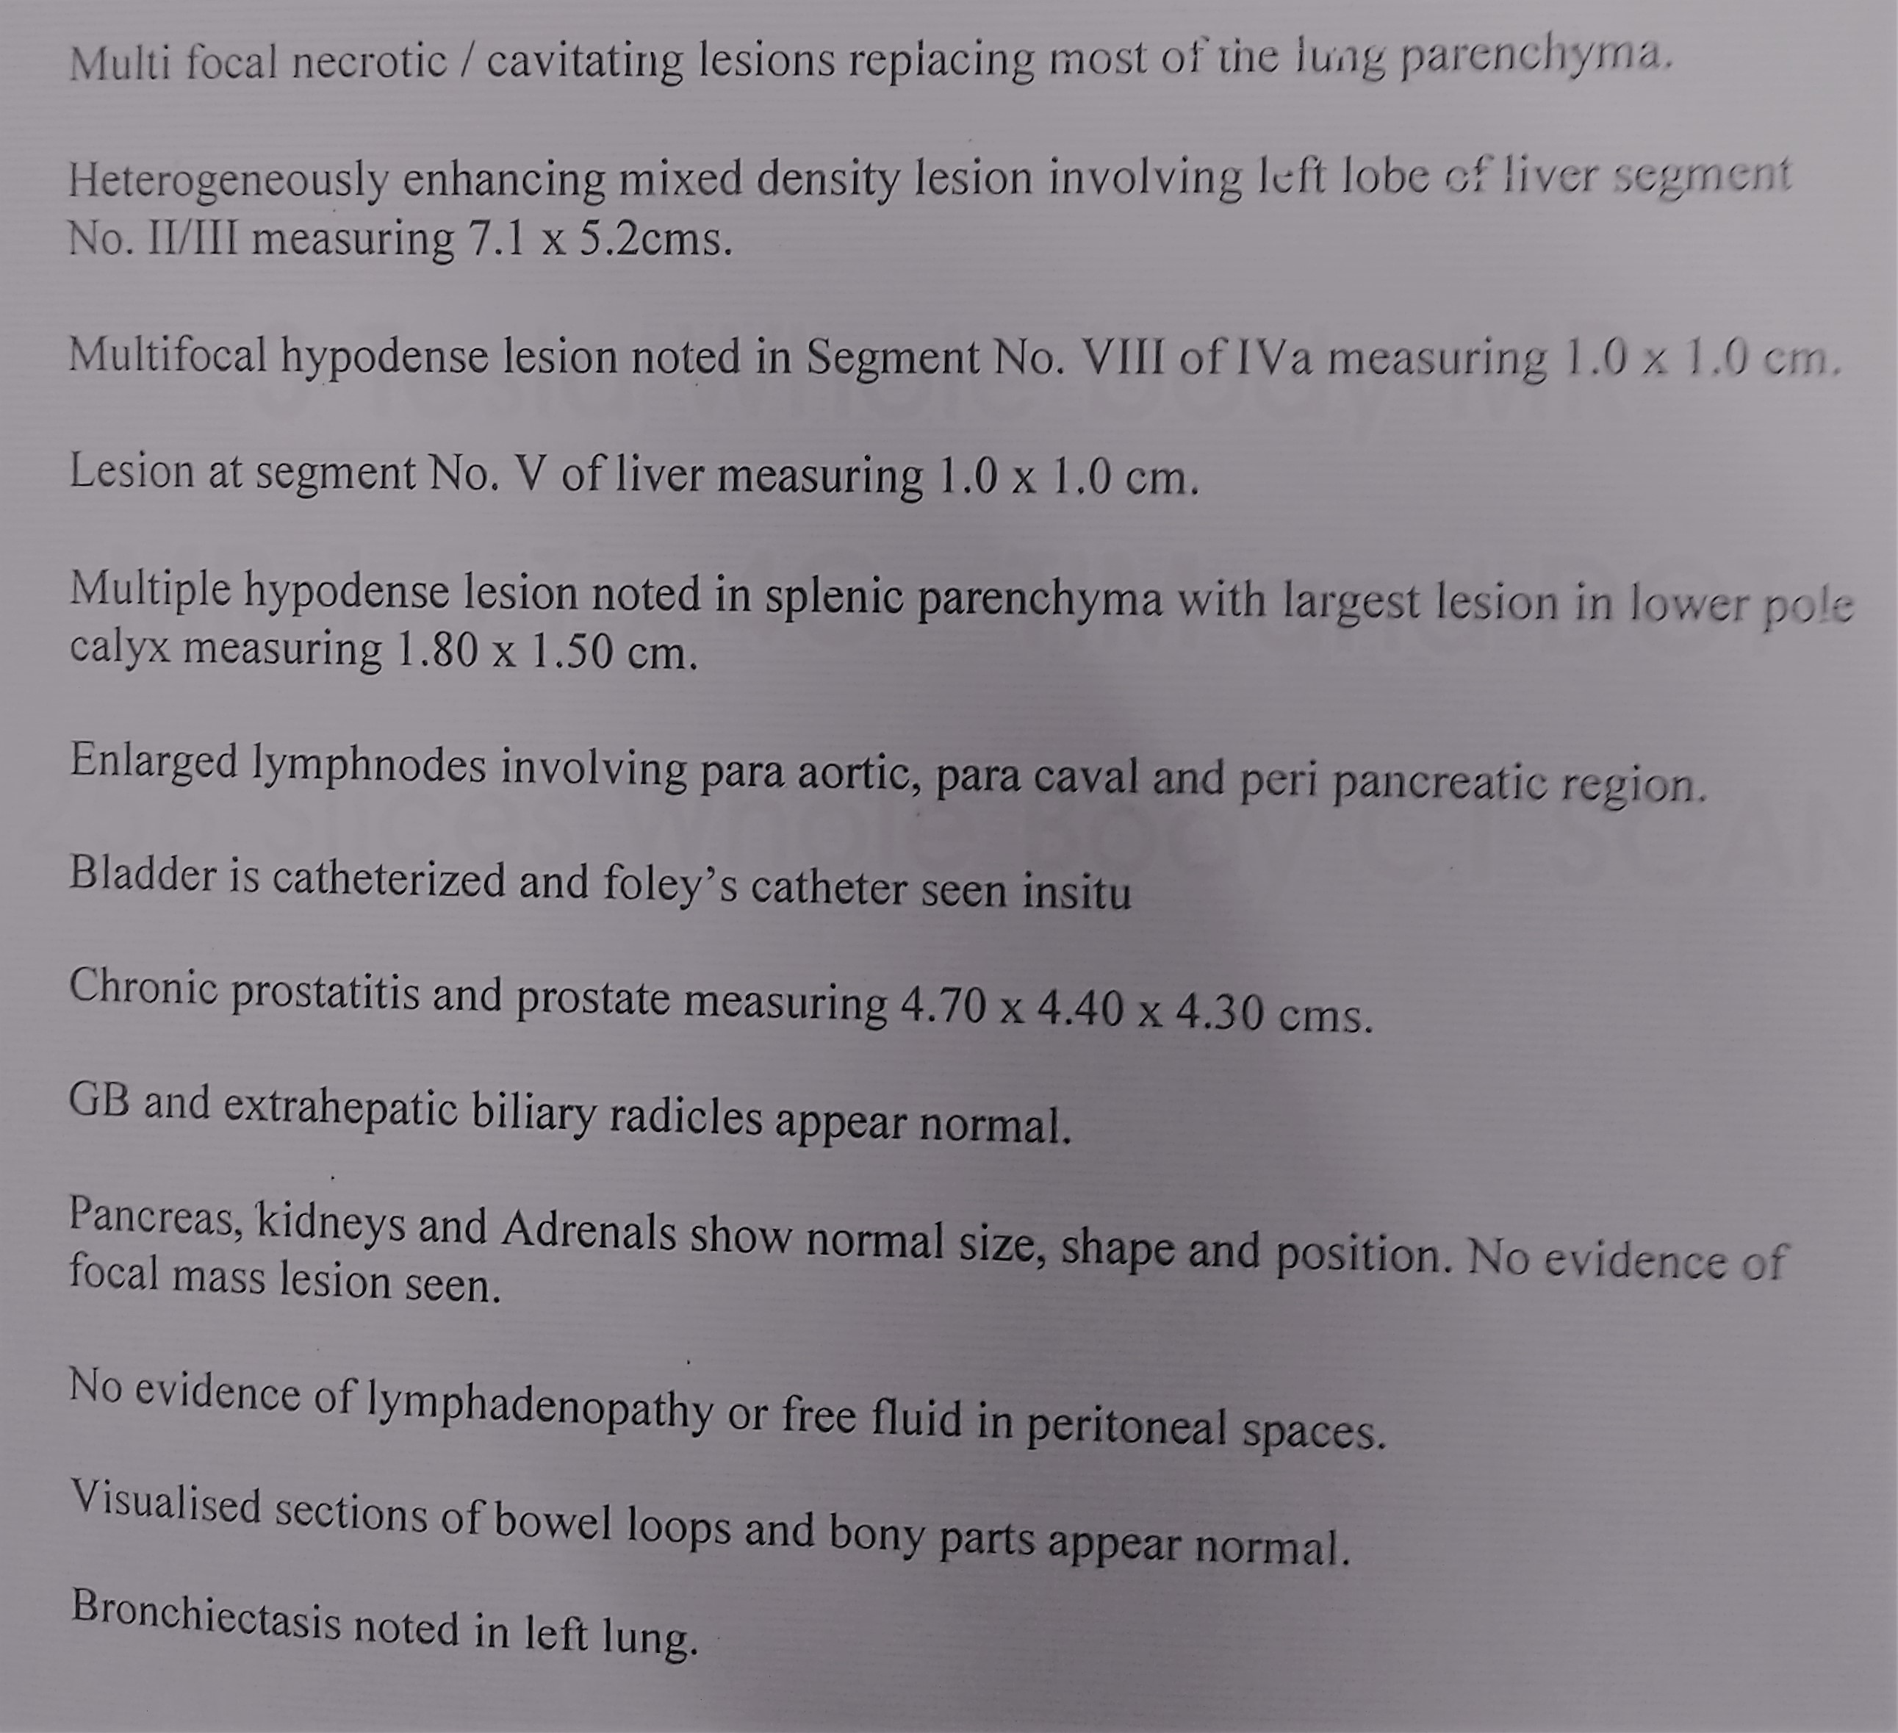
CT CHEST / ABDOMEN & PELVIS
IMP:
Disseminated TB (lung, liver, spleen)
Melioidosis with lung, liver, and splenic abscess / septic emboli
Disseminated metastasis

Slide 17
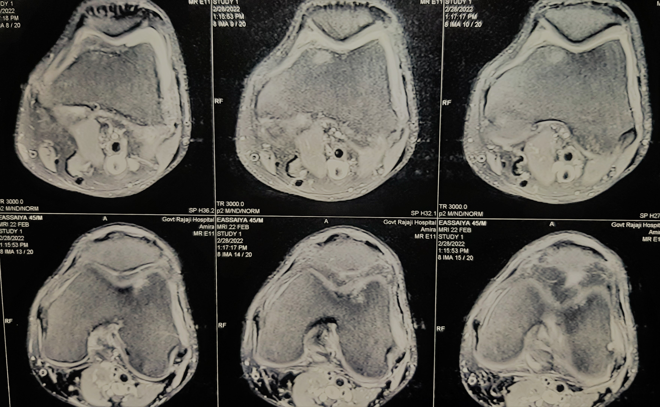
MRI LEFT KNEE
IMP:
Multifocal osteomyelitis involving bilateral, distal femur and proximal tibia (L>R) with left proximal tibia showing fragmentation and sequestrum formation and left septic arthritis

Slide 18
ON EVALUATION
CT BRAIN – Normal
For Liver abscess - Pigtail catheter drainage was done and pus was sent for analysis
Pus CBNAAT – negative
Synovial fluid C/S – No growth
Synovial fluid Cytology – cellular, thick eosinophilic protineous material
Synovial fluid CBNAAT - Negative

Slide 19
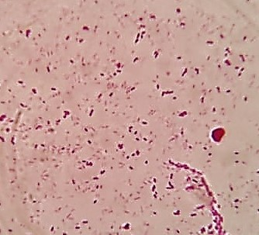
ON EVALUATION
LIGHT MICROSCOPY shows
GRAM NEGATIVE BACILLI WITH BIPOLAR STAINING

Slide 20
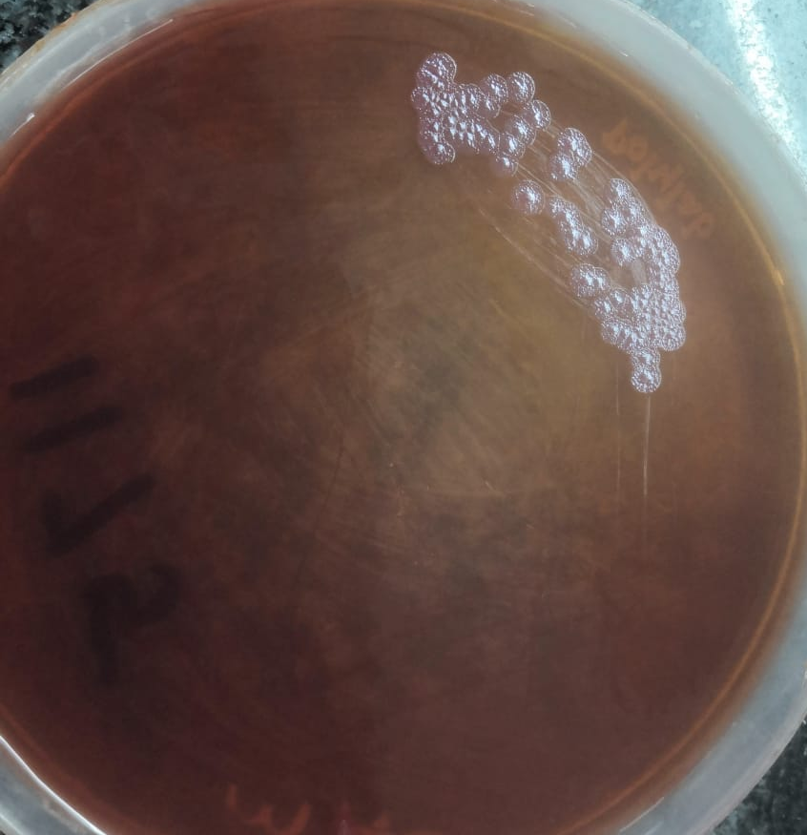
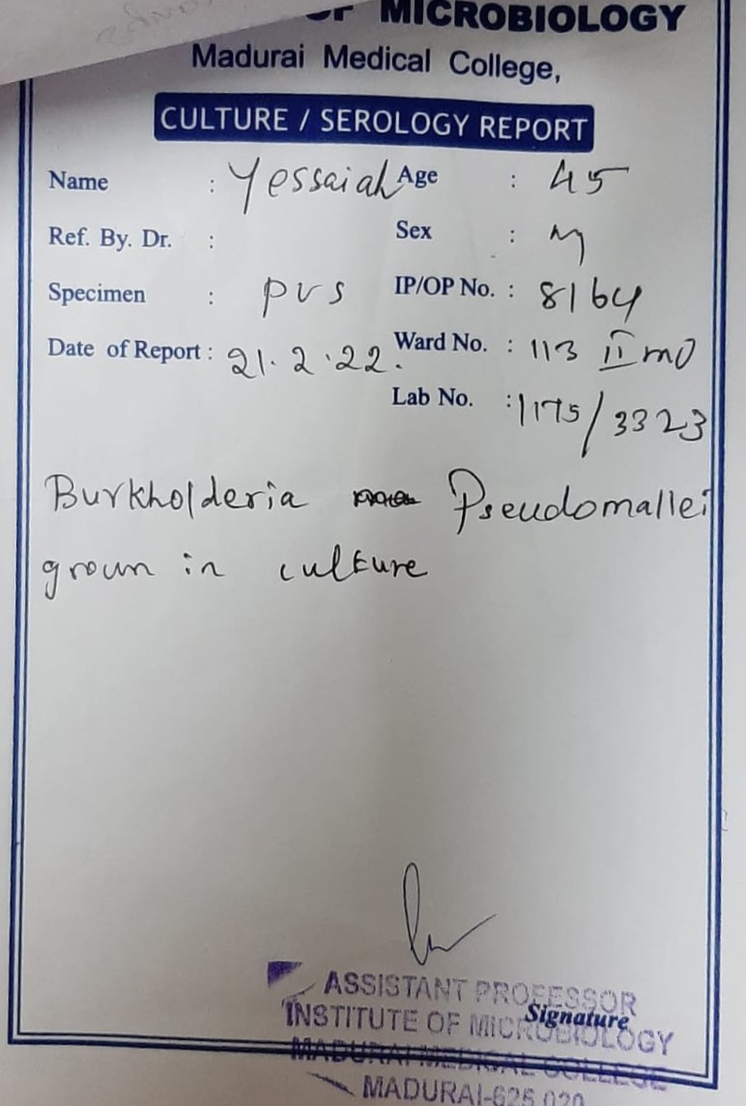
ON EVALUATION
CULTURE & SENSITIVITY
RUGOSE COLONIES

Slide 21
DIAGNOSIS & TREATMENT
Acute septicemic melioidosis with multifocal osteomyelitis and septic arthritis
IV Fluids
Inj. Meropenam 1g iv tds
Inj. Ranitidine 50mg iv bd
Inj. H.Actrapid according to CBG
T. NAC + Ambroxol tds
T. Paracetamol 500mg tds
T. Serratiopeptidase 10mg qid
Salbutamol nebulization Q6h

Slide 22
