Slide 1
JOURNAL CLUB
CHIEF : PROF DR. K.SENTHIL MD
ASSOCIATE PROFESSOR : DR.K.MURALIDHARAN MD
ASSISTANT PROFESSOR : DR.V.MANIKANDAN MD
DR.SARAVANA MADHAV MD
DR.ILAMARAN MD DM
PRESENTOR : DR.BRINDHA P

Slide 2
DESIGN AND RATIONALE OF RANDOMISED EVALUATION OF DECREASED USAGE OF BETA BLOCKERS AFTER ACUTE MYOCARDIAL INFARCTION

Slide 3
BACK GROUND
Most trials have shown a benefit of Beta blocker treatment after Myocardial Infarction included patients with large Myocardial Infarctions and were conducted in an era before modern Biomarkers based diagnosis of MI and treatment with PCI, anti thrombotic agents, high intensity statins and renin angiotensin aldosterone system antagonists.

Slide 4
AIM
The goal of the trial was to evaluate the potential benefit of beta blockade following Acute Myocardial Infarction in patients with preserved LVEF in the modern era of Coronary Revascularisation and Medical therapy.

Slide 5
STUDY DESCRIPTION
Registry based, Prospective
International, Multicentric
Randomised
Open labelled trial

Slide 6
INCLUSION CRITERIA
1.Age more than 18 yrs
2.Day 1-7 after MI
3. Coronary Angiography performed during hospitalization
4.Obstructive coronary artery disease documented by CAG i.e, stenosis >50%, FFR<0.80, Ifr< 0.89 in any segment at any time point before randomisation.
5. ECHO performed after MI showing a normal ejection fraction as defined as EF>50%

Slide 7
EXCLUSION CRITERIA
1. Any condition that may influence the patient’s ability to comply with study protocol.
2. Contraindication for beta blockers
3. Indication for beta blockade other than as secondary prevention according to the treating physician.

Slide 8
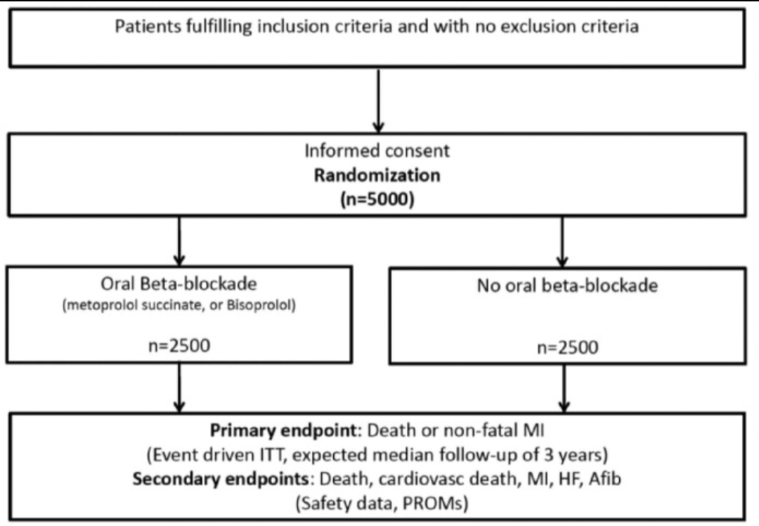

Slide 9
INTERVENTION
Patients with Acute MI without reduced LVEF were randomised in a 1:1 fashion to receive beta blockers with oral Metoprolol or Bisoprolol titrated to a target dose of >100mg daily or >5mg daily, respectively.
Beta blockers was initiated inpatient and continued after discharge.
Patients randomised to No Beta blockade are discouraged to use beta blockers as long as there is no other indication than secondary prevention after MI.

Slide 10
In patients randomised to no beta blockade group, if they were already on treatment with beta blocker, were tapered off over 2-4 weeks.
Total no. of enrollees: 5,020
Median duration of follow up: 3.5 years
Median patient age: 65 years
Percentage female: 23%

Slide 11
PRIMARY END POINT
Composite of death from any cause or New MI.

Slide 12
SECONDARY END POINT
Death from any cause
Death from cardiovascular cause, MI
Hospitalization for Atrial Fibrillation ( as a primary diagnosis)
Hospitalization for Heart Failure ( as a primary diagnosis)

Slide 13
SAFETY END POINT
Hospitalization for bradycardia, second or third degree Heart block, hypotension, syncope
Implantation of pacemaker
Hospitalization for Asthma or COPD (as a primary diagnosis)
Hospitalization for stroke

Slide 14
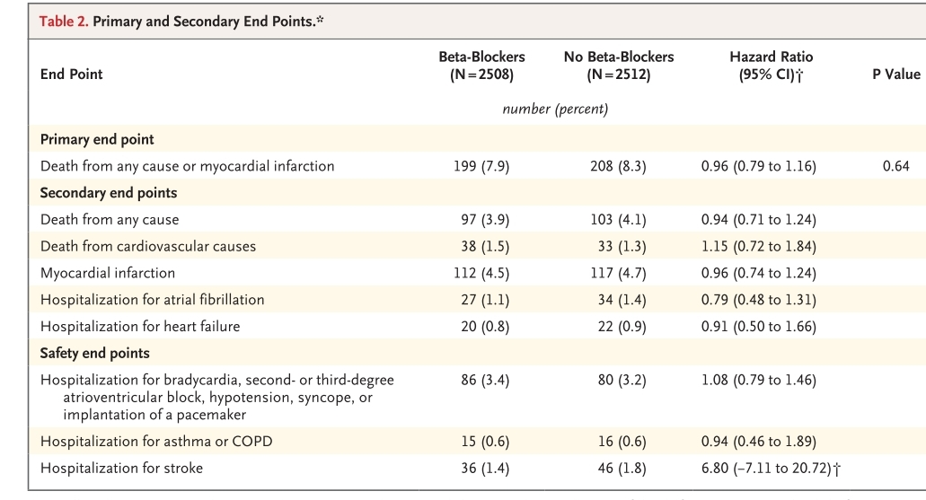

Slide 15
RESULTS
From September 2017 through May 2023, a total of 5020 patients were enrolled.
The median follow up was 3.5 yrs
A primary event occurred in 199 of 2508 patients in the beta blocker group and in 208 of 2512 patients in the no beta blocker group.
Beta blocker treatment did not led to a lower cumulative incidene of seecondary end points.
The incidence of safety end points also appeared to be similar in the two trial groups.

Slide 16
CONCLUSION
Among patients with Acute MI who underwent CAG and preserved LVEF >50%, long term beta blocker treatment did not lead to a lower risk of the composite primary end point of death from any cause or new MI than no beta blocker use…

Slide 17
THANK YOU

