Slide 1
A CT FOR DISCUSSION
-BY MU I
CHIEF :PROF.DR.M.NATARAJAN MD
ASST.PROFESSORS: Dr.P.SHRIDHARAN MD
Dr.D. VASANTHAKALYANI MD DCP
Dr. SURESH KUMAR MD

Slide 2
A 55 year old female ,
known diabetic ,
presented with severe abdominal pain and vomiting
on investigation with non invasive imaging

Slide 3
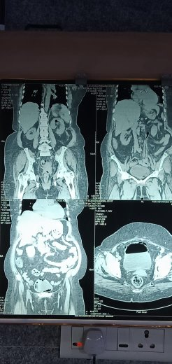

Slide 4
