Slide 1
Mississippi meningitis with major missing
-3rd unit
CHIEF PROF: Dr.DAVID PRADEEP KUMAR M.D,MRCP
ASST PROF: Dr.RAM KUMAR M.D
ASST PROF: Dr.NASEEMA BANU M.D
ASST PROF: Dr.NABIL FAYAZ M.D
PRESENTOR: Dr. REVATHI PG

Slide 2
CHIEF COMPLAINTS
A 38 year old male brought to GRH in an intubated unconscious state with
Chief complaints of fever for 1 month

Slide 3
HISTORY OF PRESENTING ILLNESS
Patient was apparently normal before 1 month .Then developed
H/O Fever × 1 month
Low grade, Intermittent
Evening rise of temperature
Associated with chills & rigor
No H/o Loose stools
No H/o head ache/vomiting/blurring of vision

Slide 4
No H/o abdominal pain
No H/o cough with expectoration/LOA
No H/o night sweats/LOW
No H/o jaundice
No H/o burning micturition

Slide 5
PAST HISTORY
No H/O previous similar episodes
Not a known case of Diabetes mellitus, hypertension, bronchial asthma, Tuberculosis, HIV, Thyroid disorder
No H/O recent vaccination

Slide 6
TREATMENT HISTORY
PT was treated with nearby local hospital for 2 weeks
Referred to dindigul MCH
Admitted for 1 week,diagnosed as diabetes
discharged with insulin
[records not available]

Slide 7
Next day he developed seizure -1 episode [GTCS]
Admitted in private hospital
In view of poor GCS Pt was intubated

Slide 8
INVESTIGATIONS-OUTSIDE
Tc 27000
CBG –HIGH
FBS >500
VCTC - Non reactive
URINE ACETONE-Negative VIRAL MARKERS - Negative
HBA1C -13 UREA - 32 mg/dl
URINE ROUTINE –Sugar 3+,2 to 4 pus cells CREATININE - 1.1 mg/dl
SR.PROCALCITONIN-11.8ng/dl Sr.Na - 139 Meq/dl
CSF ANALYSIS –TC 100/cu.mm, Sr.k - 4.1 Meq/dl
DC:P-90%,L-10%, LFT - WNL
Sugar-208mg/dl,
Protein-0.3 mg/dl

Slide 9
PS-Neutrophilic leucocytosis with shift to left and mild toxic cnanges
ECHO –Normal LVSD-53%
No Pericardial effusion
CT BRAIN PLAIN &CONTRAST –Normal
CT CHEST-Normal
CT ABDOMEN –Hypodensity noted in spleen

Slide 10
Neurophysician opinion: Subacute meningoencephalitis
Advised to start ATT & STEROIDS
Treated with – IV ANTIBIOTICS
EMPERICAL ATT × 2 DAYS
IV STEROIDS
IV INOTROPES
Referred to GRH as a case of
Newly diagnosed diabetes mellitus/
subacute meningoencephalitis/Septic shock/On MV

Slide 11
FAMILY HISTORY
No H/O similar complaints in family members
PERSONAL HISTORY
Consumes mixed diet
Occassional alcoholic
Not a smoker
Normal bowel and bladder habits
Normal sleep pattern

Slide 12
GENERAL EXAMINATION
Drowsy,responding to pain stimuli
Afebrile
No pallor
Not icteric
No cyanosis/clubbing
No pedal edema
No generalized lymphadenopathy
No neurocutaneous markers
No external markers of TB/ HIV
No skin lesions

Slide 13
VITALS
BP – 130/80 mm/hg – left upper arm in supine posture
PR – 100/min, regular rhythm, normal volume, no specific character, felt equally in all peripheral vessels, no radioradial and radiofemoral delay
SPO2 - 98% 0n MV
CBG- 221mg/dl
TEMP- 102F

Slide 14
SYSTEMIC EXAMINATIONS
CENTRAL NERVOUS SYSTEM
Drowsy
Not responding to oral commands
Responding to pain stimuli
B/L Pupil –3mm,RTL
B/L PLANTAR-EXTENSOR
Spine &Craniun Examination-Normal
Neck rigidity-Present
Kernig’s sign – negative
Brudzinski’s sign – negative

Slide 15
On 2nd day pt was extubated & Recovered from Shock
O/E
Awake,
partly responding to oral commands
moves all 4 limbs to pain
febrile
 |  | RIGHT | LEFT
TONE | UPPER LIMB | NORMAL | NORMAL
 | LOWER LIMB | NORMAL | NORMAL
POWER |  | COULD NOT BE ELICITED
DEEP TENDON REFLEX | UPPER LIMB LOWER LIMB | + + | + +
PLANTAR |  | EXTENSOR | EXTENSOR

Slide 16
OTHER SYSTEMS EXAMINATION
CVS : S1, S2 heard, no murmur
RS : Bilateral air entry (+), no added sounds
P/A : soft, BS(+), no organomegaly

Slide 17
INVESTIGATIONS-GRH
 | 24/4/24 | 25/4/24
CBC TC | 24000 | 23600
DC | 74/22/4 | 73/26/2
HB | 11.3 | 11.9
PCV | 35.8 | 38.4
PLT | 5.7 | 5.73
RBS | 92
UREA | 48
CREATININE | 0.9
Na+ | 134
K+ | 3.8

Slide 18
Smear for MP/MF-Negative
Rapid antigen test-Negative
Repeat CSF Analysis: TC-2 cells
polymorphs-1 cell
lymphocytes-1 cell
protein -85mg/dl
sugar -76mg/dl
LDH -71mg/dl
CSF ADA-1
CSF CBNAAT –MTB NOT DETECTED

Slide 19
TOTAL BILIRUBIN – 1.1
D.BILIRUBIN – 0.5
IND. BILIRUBIN – 0.6
SGOT – 36
SGPT - 27
ALP – 229
SERUM CALCIUM 8.2
URINE ROUTINE
ALBUMIN - nil
SUGAR – 3+
DEPOSITS – 2 to 3 pus cells
VDRL- Negative

Slide 20
Repeat CT BRAIN-Normal
MRI BRAIN [PLAIN & CONTRAST]
Mild cerebral shrinkage noted
Post contrast reveals diffuse dural enhancement predominantly in right parieto occipal convexities
No leptomeningeal enhancement/nodular enhancing lesions
No edidence of subdural effusion/hydrocephalus

Slide 21
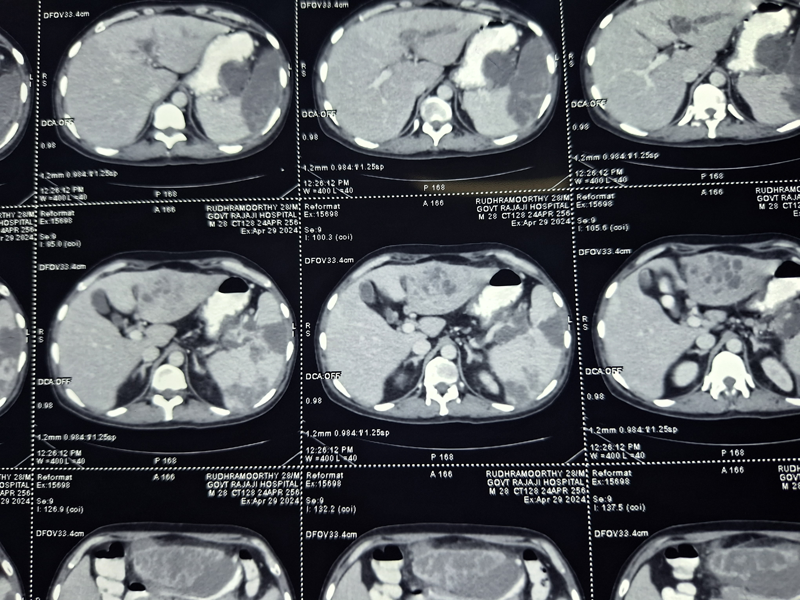
F/S/O Liver abscess with features of containted rupture into the peritoneal cavity.
Moderate splenomegaly
Altered echogenicity noted in the lower pole of spleen-splenic infarct

Slide 22


