Slide 1
venomous snake bite with a perennial scar-Lance adams syndrome
III MEDICAL UNIT
CHIEF : PROF. Dr.M.Natarajan MD
ASST PROFs: Dr. Syed Bahuvudeen Hussaini MD,DNB ,FICP
Dr. P.S.Vallidevi MD
Dr. V.Shanmuganathan MD

Slide 2
Case scenario
45/f presented with complaints of
  Involuntary movements involving all 4 limbs for
  past 3 months
H/O presenting illness:
Patient had history of neurotoxic snake bite 3 months back following which she became unconciousness . She was treated in Sivagangai GH with 20 vials ASV. She developed respiratory failure and was intubated and was in ventilator support .

Slide 3
She recovered and weaned from ventilation.
H/O involuntary movements involving all 4 limbs
* 3 months duration
- Upper limb > Lower limb
- Proximal > Distal
- Left UL > Right UL
H/O Difficulty in walking +
H/O Speech disturbance +
H/O Involuntary movements involving tongue
H/O Difficulty in lifting objects

Slide 4
H/O Difficulty in mixing food
H/O Difficulty in taking food to mouth
H/O Difficulty in combing hair
H/O Difficulty in gripping slipper
H/O Difficulty in chewing food
H/O GTCS + 3 episodes. Last episode 2 weeks back
No H/O diplopia/blurring of vision/dysphagia
No H/O weakness of limbs

Slide 5
No H/O cranial nerve involvement
No H/O sensory disturbances
No H/O bladder/ bowel disturbances
No H/O lack of sweating
No H/O trauma/fever
No H/O recent vaccinations

Slide 6
Past history
Not a k/c/o diabetes / hypertension / seizure disorder / CAD / CKD / Tuberculosis / thyroid disease
personal history
Consumes mixed diet
No H/O substance abuse / extra-marital contact
Bowel and bladder habits normal

Slide 7
Marital and menstrual history
Married
2 children
Post menopausal
family history
Nil significant

Slide 8
General examination
Concious
Oriented
Afebrile
No pallor/ icterus
No clubbing/ cyanosis
No pedal edema
No generalised lymphadenopathy

Slide 9
VITALS
Pulse – 80 /min
Blood Pressure- 130/80 mm Hg
RR-14/min
Spo2-98%

Slide 10
Systemic examination
Cardio vascular system:
S1S2+
No murmur
Respiratory system
B/L air entry +
Normal Vesicular Breath Sound +
No added sounds
P/A - Soft
No organomegaly

Slide 11
CNS
Conscious
Oriented
Higher mental functions-normal
Right handed
Slurred speech+
Titubation +
B/L Gaze evoked Nystagmus+
Motor impersistence of Tongue+

Slide 12
Motor system
BULK | RIGHT | LEFT
ARM | 22.5cm | 22cm
FORE ARM | 17cm | 17cm
THIGH | 37.5cm | 37cm
LEG | 26cm | 26cm

Slide 13
POWER | RIGHT | LEFT
UPPER LIMB | 4+/5 | 4+/5
LOWER LIMB | 4+/5 | 4+/5

Slide 14
REFLEX | RIGHT | LEFT
DTR Biceps Triceps Supinator Knee Ankle | + + + + + | + + + + +
Superficial Reflexes | + | +
Plantar | flexor | flexor

Slide 15
Sensory system – normal
Intentional tremors involving all 4 limbs +
Rapid, jerky movements of both upper and lower limbs+
  Occurs mainly during voluntary activity.
  Proximal > Distal
  Upper limb > Lower limb
  Left UL > Right UL

Slide 16
Finger Nose test – Impaired
  Finger-Nose- Finger test Impaired
  Heel-Knee test - Impaired
  Tandem Walking - Impaired
Broad based ataxic gait +
Not able to walk without support
Head Titubation +
B/L Horizontal Gaze evoked nystagmus+
Spine and cranium – normal
No neck stiffness

Slide 17
INVESTIGATONS
 | COMPLETE HEMOGRAM & PS
HB | 12.3 g%
TC | 7600 cells/cu.mm
DC | P-71% L-18% M-5% E-6%
PLATELET | 3.06 lakhs/cu.mm
PCV | 37%
RBC | 4.65 mill/cu.mm
ESR | 16 mm/hr
PERIPHERAL SMEAR | Normal study

Slide 18
RBS | 110 mg/dl
UREA | 19 mg/dl
CREATININE | 0.9 mg/dl
BILIRUBIN TOTAL | 1.1 mg/dl
DIRECT | 0.5 mg/dl
INDIRECT | 0.6 mg/dl
SGOT | 19 U/L
SGPT | 23 U/L
SODIUM | 136 meq/l
POTASSIUM | 3.7 meq/l
CHLORIDE | 104 meq/l

Slide 19
Urine routine – normal
VCTC- Non Reactive
Viral markers – negative
Sr. ceruloplasmin- 20 mg/dl
CSF analysis –
  Sugar- 58
  Protein- 26
  Cell count- 1-2 cells/HPF

Slide 20
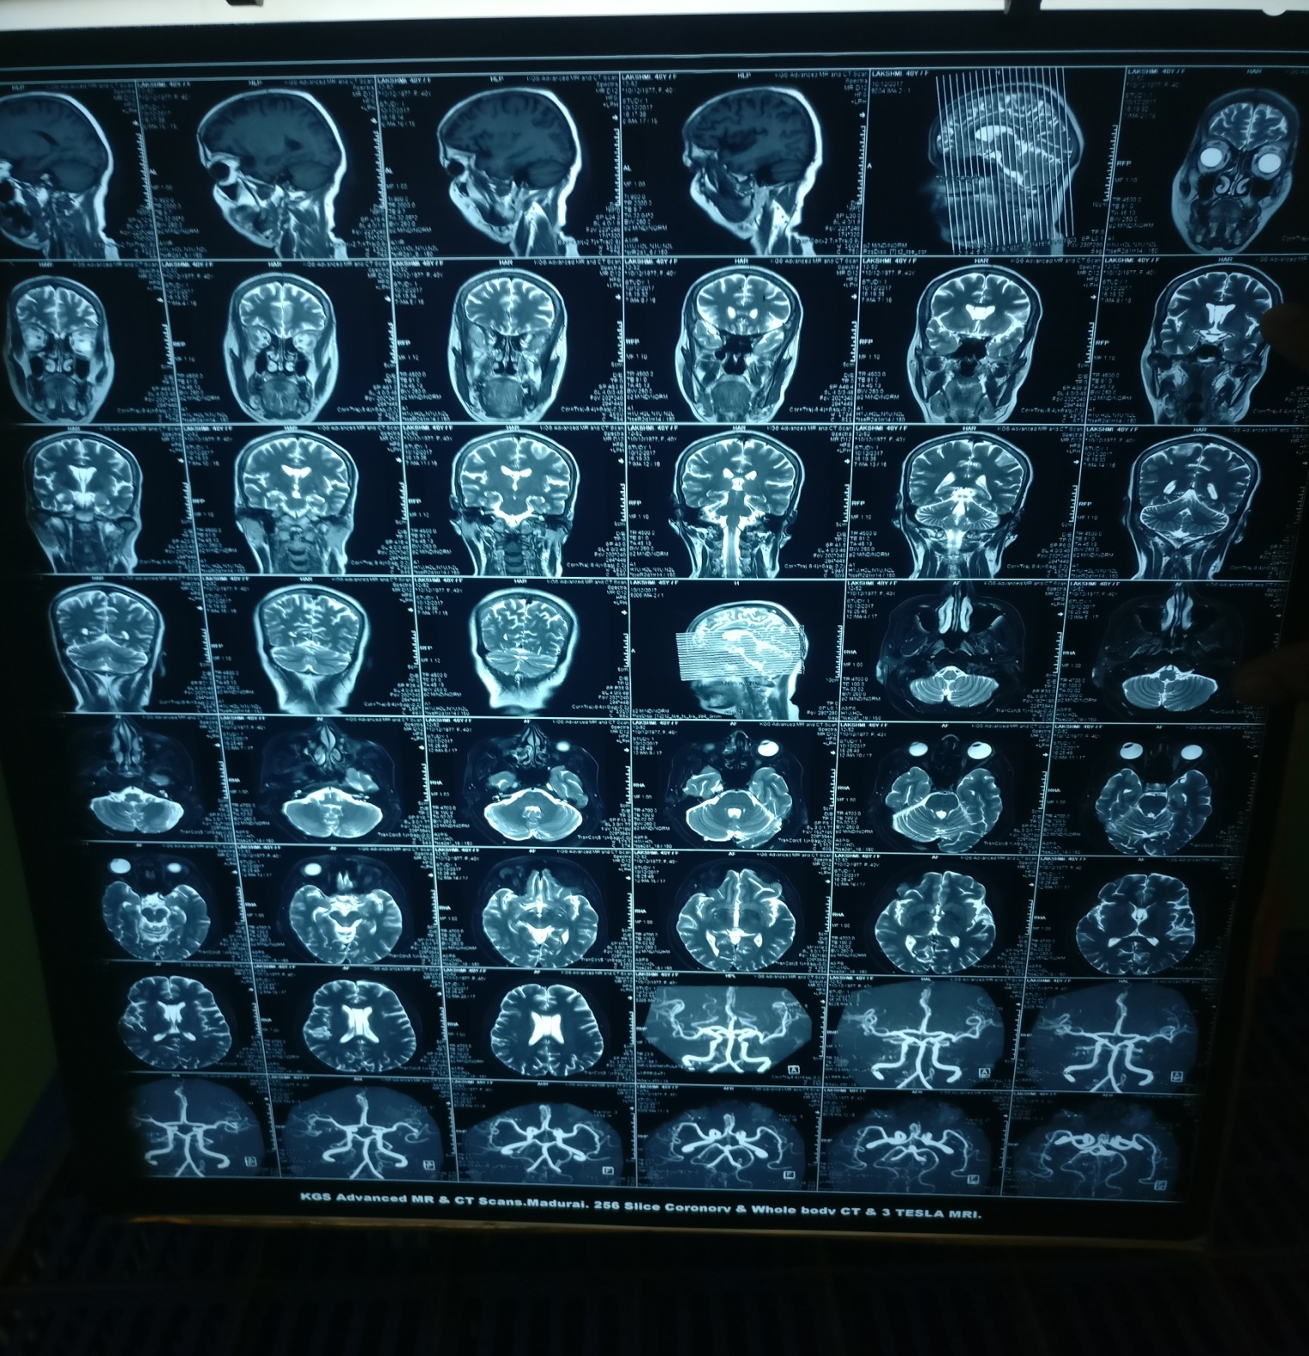

Slide 21
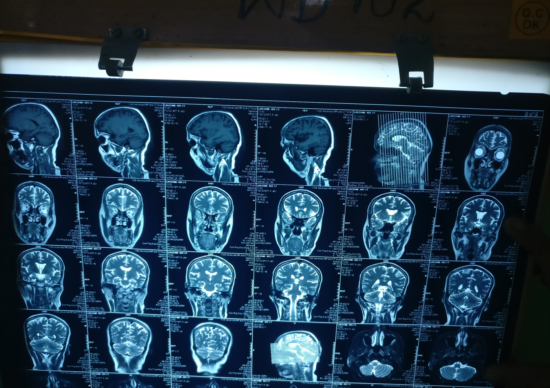

Slide 22
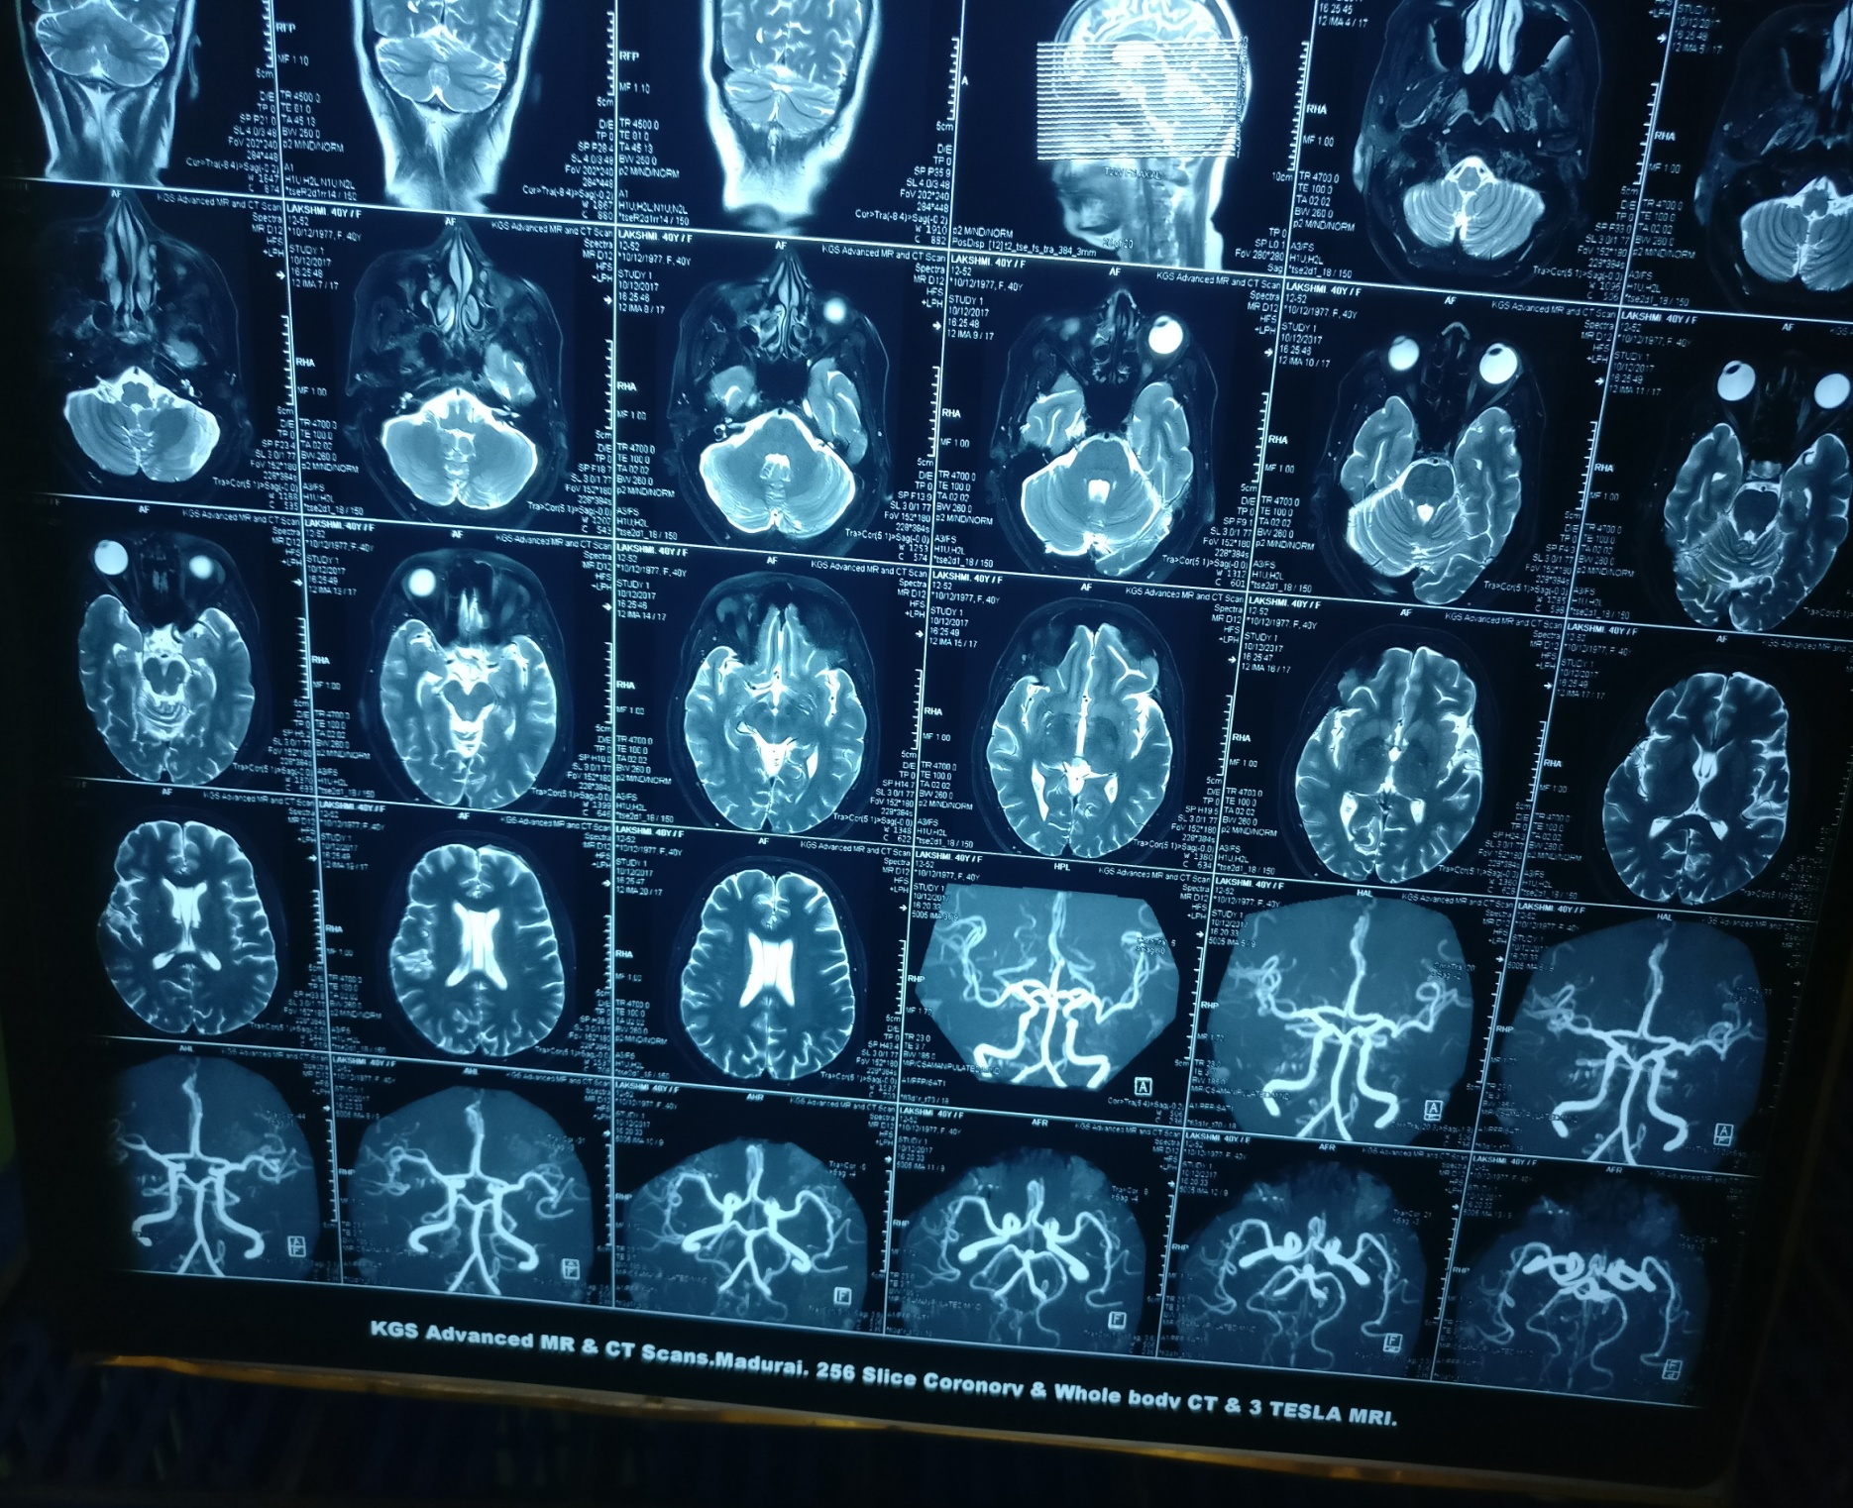

Slide 23
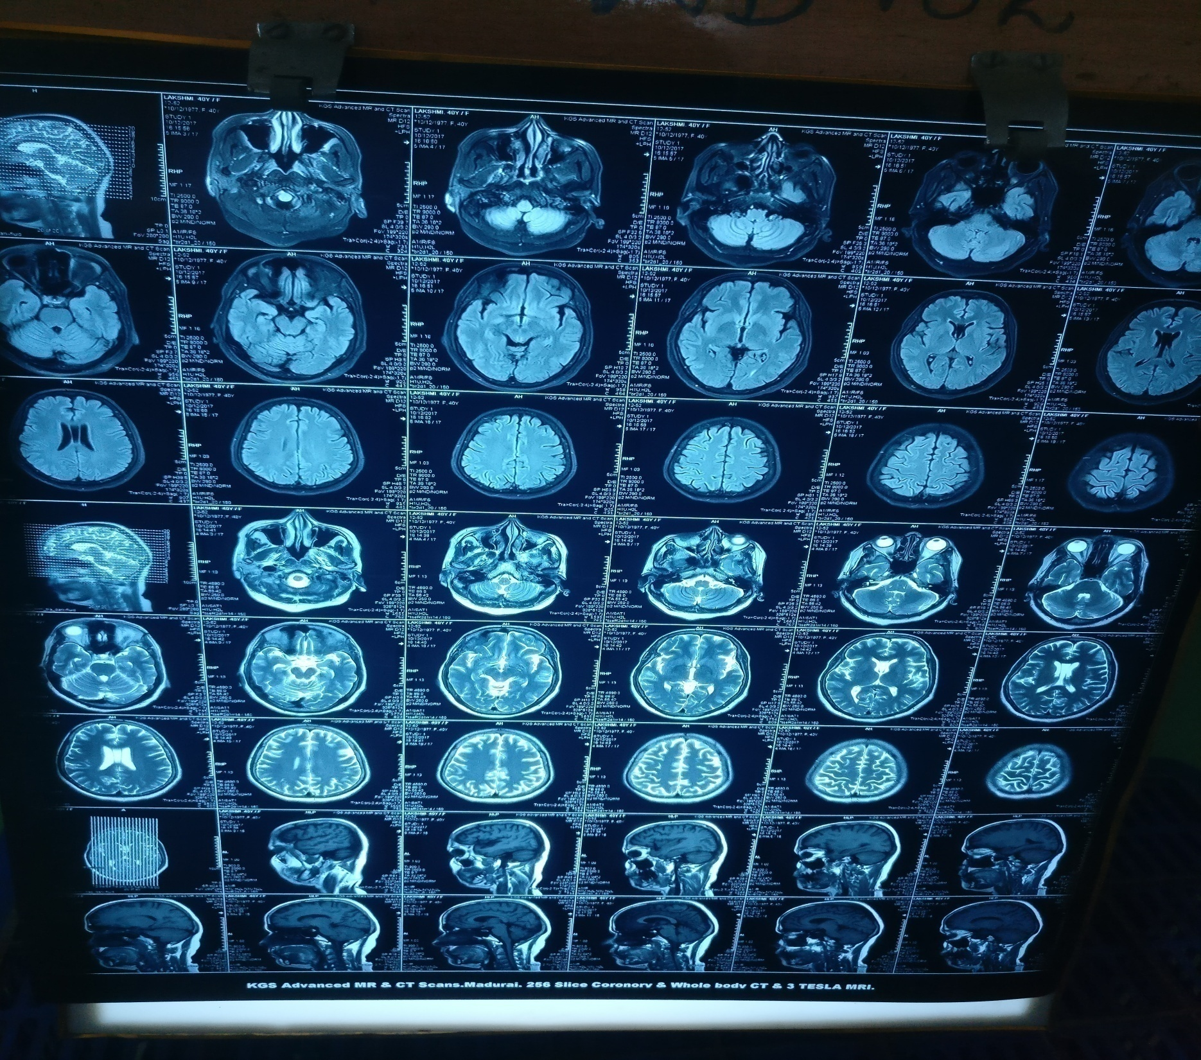

Slide 24
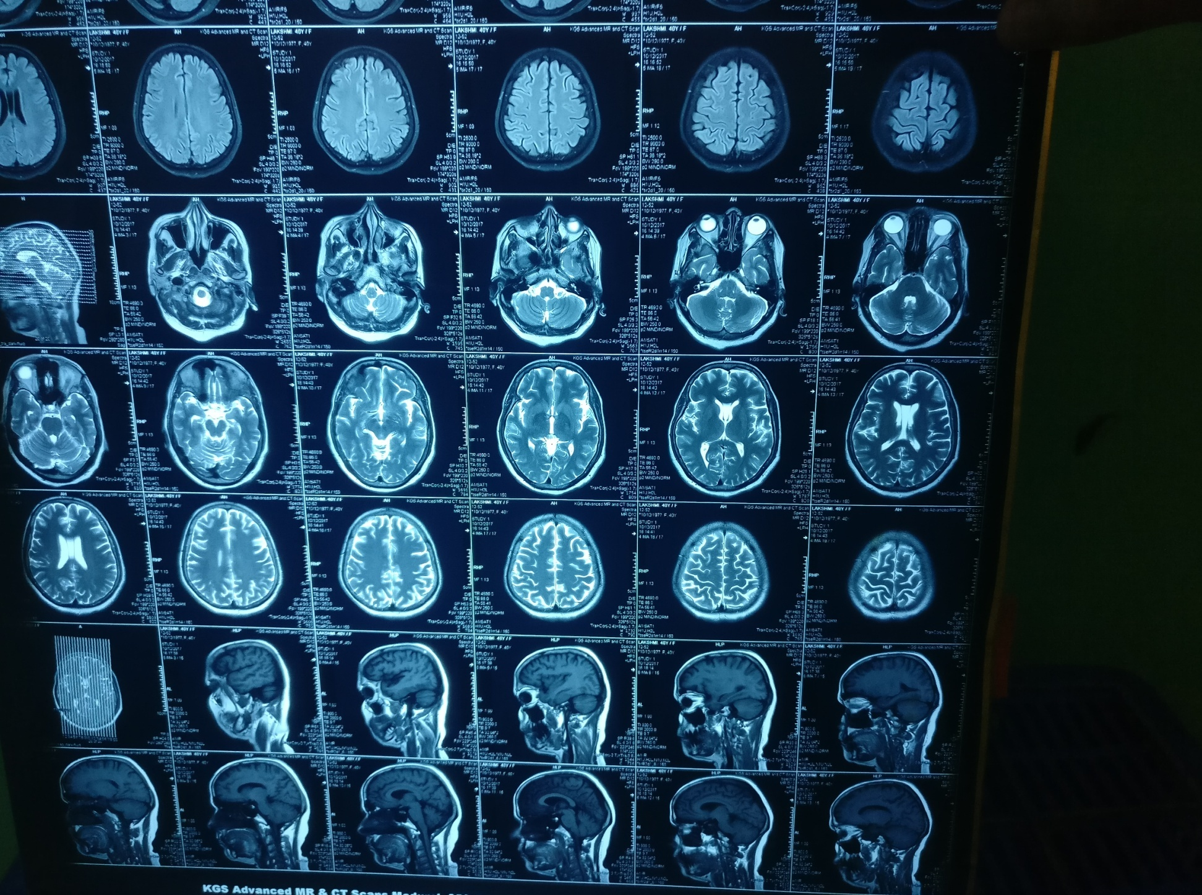

Slide 25
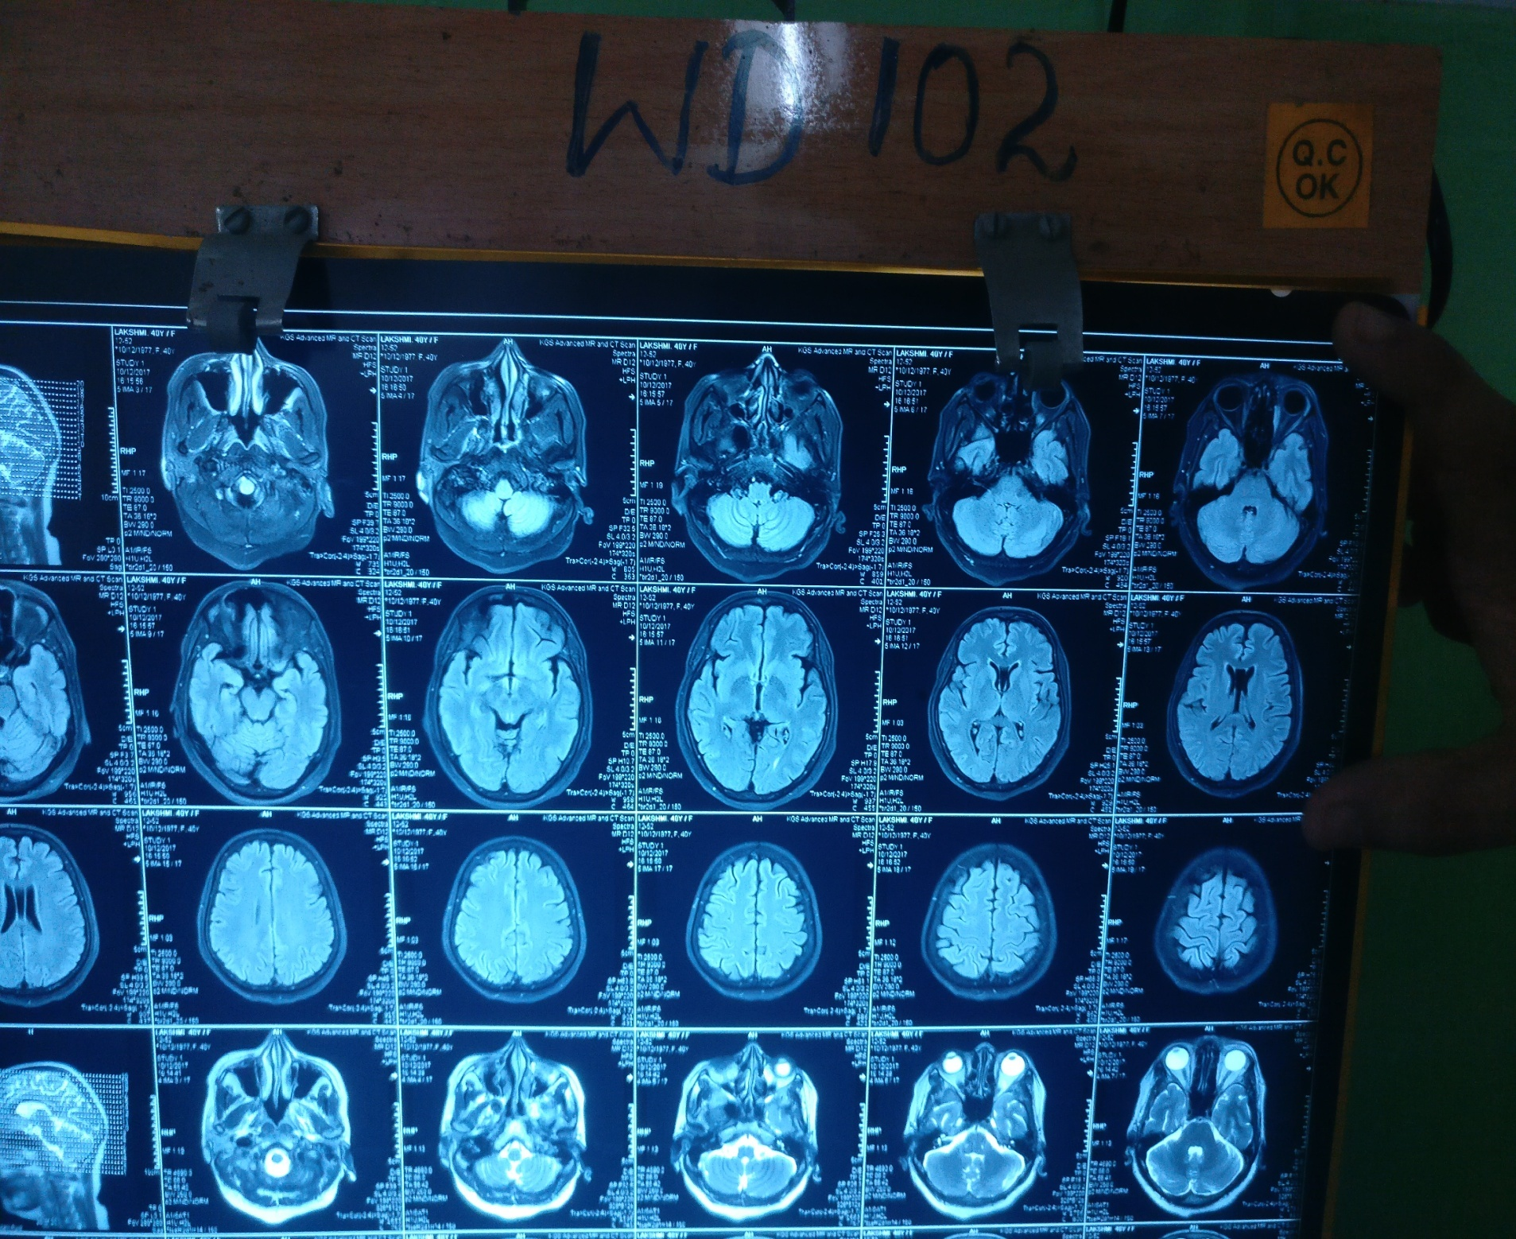

Slide 26
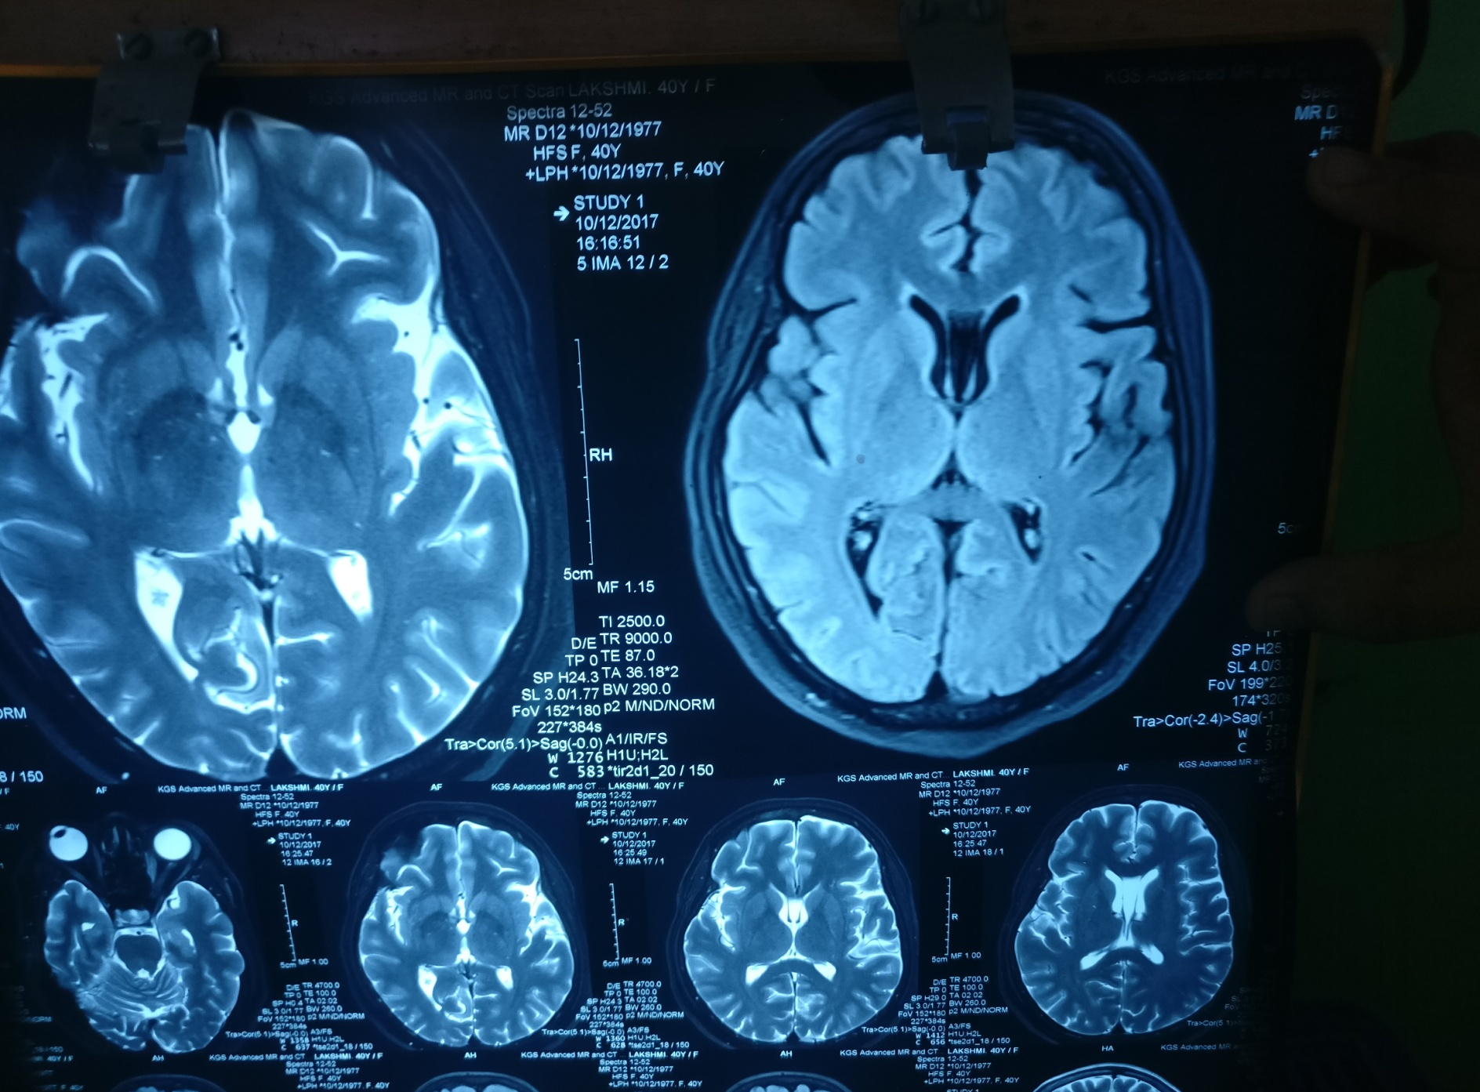

Slide 27
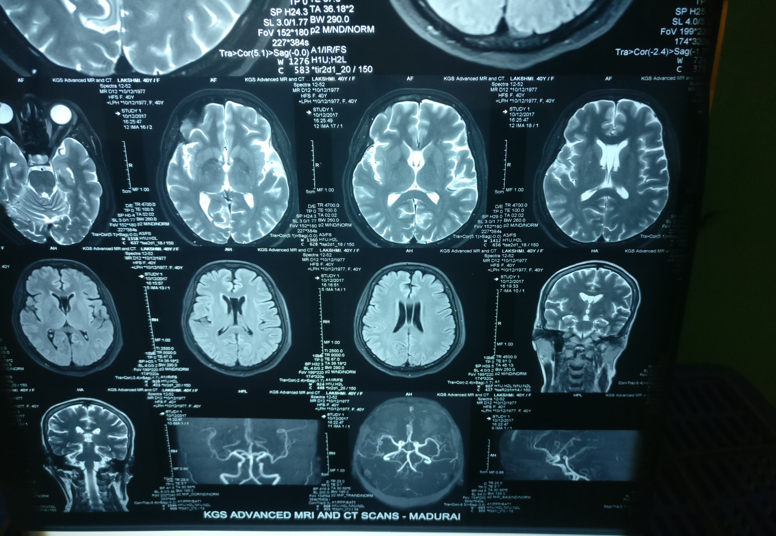

Slide 28


Slide 31
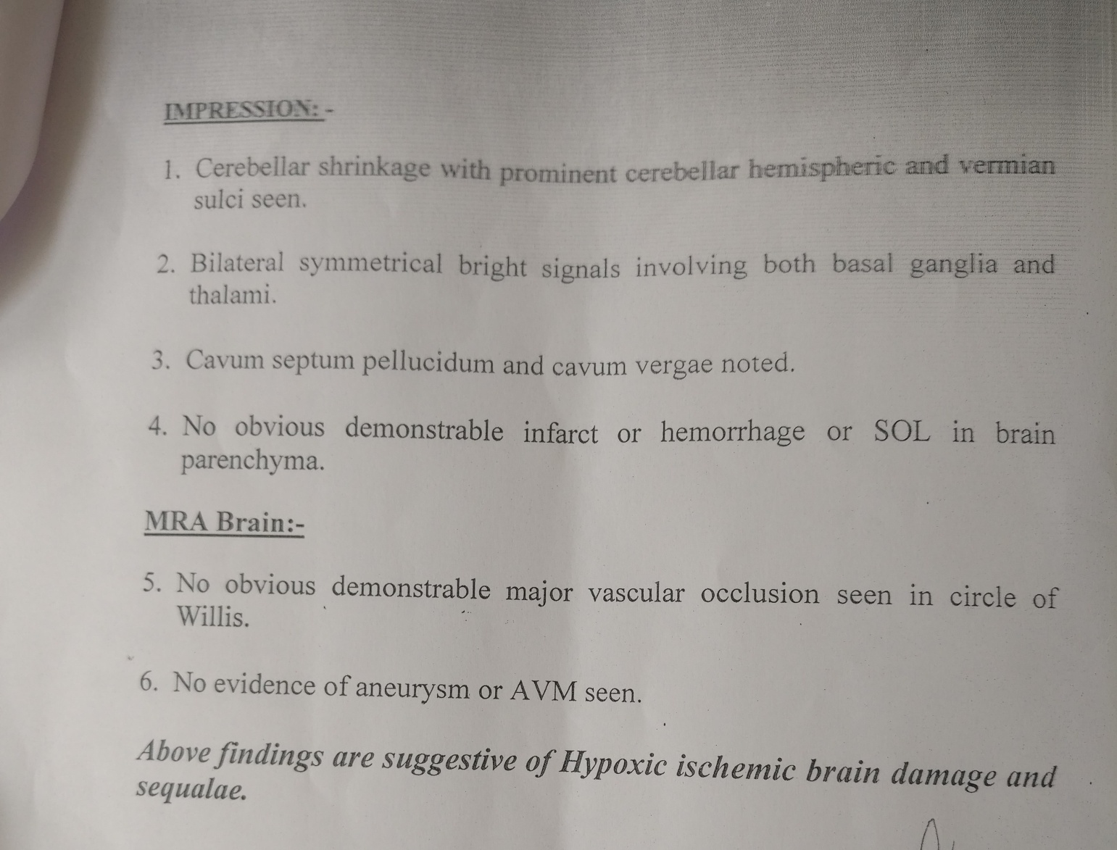

Slide 32
Constellation of symptoms
B/L cerebellar tremors
Limb + Truncal ataxia
Frequent action myoclonic jerks

Slide 33
Neurologist opinion
Post hypoxic Sequelae
Ataxia
Intentional tremors +action myoclonus
? Lance Adams syndrome
Advice
  To continue valproate and clonazepam
  T. Piracetam 800mg 1 bd

Slide 34
EEG
Back ground 9 Hertz alpha- well modulted synchronous seen over posterior head region.
HV and photic record yield normal.
Paroxysmal sharp wave discharges seen throughout the record
Impression : Epileptiform abnormality

Slide 35
Ophthalmologist opinion
No evidence of Kayser-Fleischer ring
Fundus - Normal

Slide 36
Final diagnosis
Post Hypoxia Sequelae
Myoclonic Seizures
Lance Adams syndrome

Slide 37
treatment
TREATMENT
  T. Sodium Valproate 200mg 2 bd
  T. Clonazepam 1mg 1 bd
  T. Propranolol 40 mg 1 bd
  T. Diazepam 5 mg 2 hs
  T. Piracetam 800mg 1 bd

Slide 38
Aim of presentation
Rarity of its presentation.
Post hypoxic sequelae presenting as action myoclonus (Lance Adams Syndrome) is very rare.
Only 150 cases have been documented so far in history.

Slide 39
Thank you

