Slide 1
MALARIA
CHIEF:
Dr.R.SUNDARAM M.D.,
ASSISTANT PROFESSORS:
Dr.S.SUGADEV M.D.,
Dr.P.KRISHNARAJAN M.D.,
PRESENTOR:
Dr.S.PARKAVI

Slide 2
INTRODUCTION
One of the causes of acute onset fever known to mankind for almost 5000 years
It is caused by,
Protozoan parasites - genus plasmodium
transmitted by - female Anopheles mosquito

Slide 3
EPIDEMIOLOGY
There were an estimated 249 million malaria cases in 2022 globally
India contributes to 3 % of global malaria cases and mortality
P. falciparum – most common species in India
India with the vision of malaria elimination by 2030

Slide 4
ETIOLOGICAL AGENT
Six species of the genus plasmodium cause nearly all malarial infections in humans ,these are,
P. vivax,
P. falciparum,
P. malariae,
P. ovale { curtisi and wallikeri }
P. knowlesi
Transmitted by the bite of female Anopheles mosquito - because they require protein from blood to develop their eggs.

Slide 5
However the infection may also be transmitted by,
- Transfusion of blood from a patient of malaria
- Transmission of infection to the foetus in utero through some placental defect
- By the use of contaminated syringes, particularly in drug addicts.

Slide 6
PATHOLOGY
Malarial parasite undergoes 2 cycles of development
Extraerthrocytic
Human – Asexual cycle
Erythrocytic schizogony
Mosquito- sexual cycle - Sporogony

Slide 7
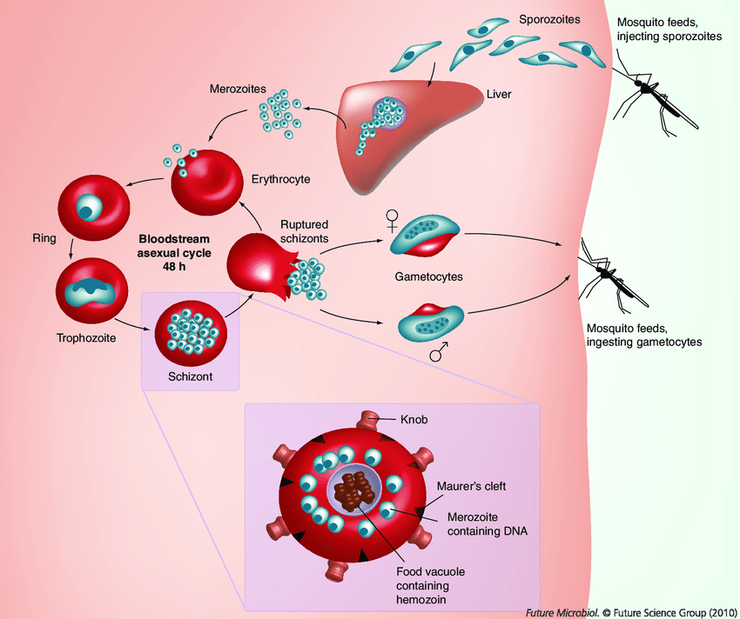
ASEXUAL CYCLE

Slide 8
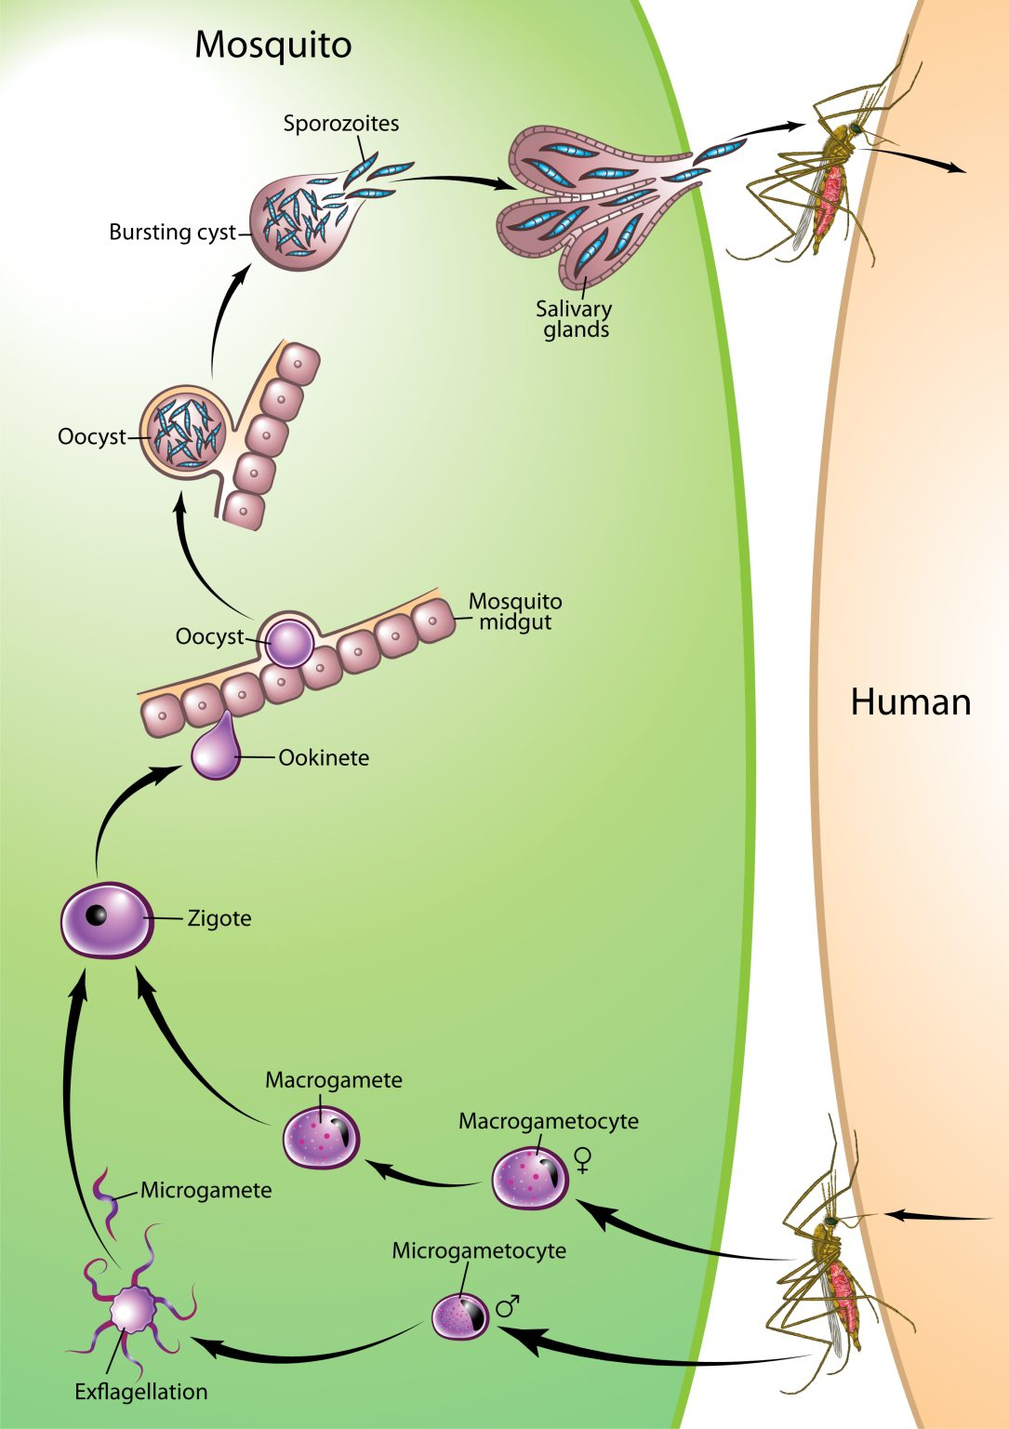
SEXUAL CYCLE

Slide 9
PATHOGENESIS
Cytoadherence
Infected RBC containing schizonts develop sticky knobs which make them adhere to the venular and capillary endothelium of brain, lungs, kidney,and gut.
Agglutination
Infected RBCs adhere to other infected RBCs
Rosseting
Infected RBCs adhere to uninfected RBCs
Proinflammatory and immunomodulatory cytokines are activated.

Slide 10
Infected RBCs lose their deformability and results in intravascular hemolysis
Because of cytoadherence, agglutination, and rosetting there is microvascular blockage resulting in tissue hypoxia & organ dysfunction
Proinflammatory cytokines evoke fever

Slide 11
IMMUNITY IN MALARIA
Through acquired and innate immunity
ACQUIRED IMMUNITY
-It is provided through both T cell B cell mediated responses
-T cells are crucial for malaria immunity, their major function seems to provide help for the production of antibodies and to activate macrophages.

Slide 12
INNATE IMMUNITY
AGE OF RBCs
P. falciparum attack RBCs of any age
P. ovale attack young RBCs
P.malariae attack older RBCs
NATURE OF HEMOGLOBIN
sickle cell, Thalassemia hb, fetal hb,HbC& HbE , G6PD deficiency persons are refractory to P.falciparum infections.
PRESENCE OF DUFFY FACTOR-
increases the susceptibility to malaria.

Slide 13
CLINICAL FEATURES
The typical picture of malaria consists of, febrile paroxysm, anemia and splenomegaly.
P.falciparum,P.vivax& p.ovale – Tertian fever
P. Malariae - quartan fever
P.Knowlesi – quotidian fever

Slide 14
MALARIAL PAROXYSMS
Cold stage(20-30mins)- intense chills with rigor
Hot stage (2- 6 hrs) – temperature upto 40*c
Wet stage(20-30 mins)- profuse sweating

Slide 15
ANEMIA
Direct RBC lysis
Splenic removal of both infected and uninfected RBCs (coated with immune complexes).
Autoimmune lysis of coated infected and uninfected RBCs.
Increased fragility of RBCs.
Decreased RBC production from bone marrow suppression.

Slide 16
SPLENOMEGALY
After a few paroxysms, the spleen gets enlarged and becomes palpable.
Splenomegaly is due to the massive proliferation of macrophages which phagocytose both parasitized and non-parasitized red blood cells.

Slide 17
Other symptoms
headache,bodyache,cough, vomiting & diarrhoea
On examination
pallor, mild jaundice, hepatomegaly, and splenomegaly

Slide 18
THANK YOU..

