Slide 1
Heat stroke
3RD MEDICAL UNIT
PROFESSOR: DR.S.PEER MOHAMED M.D.,
ASST PROFs: DR.M.SATHEESH KUMAR M.D.,
DR.C.VIGNESH M.D.,
DR.V.P.PRIYA M.D

Slide 2
Normal body temperature
For healthy individuals 18 to 40 years of age, the mean oral temperature is 36.8° ± 0.4°C (98.2° ± 0.7°F)
Low levels occur at 6 A.M. and higher levels at 4 to 6 P.M.
The maximum normal oral temperature is 37.2°C (98.9°F) at 6 A.M. and 37.7°C (99.9°F) at 4 P.M.
These values define the 99th percentile for healthy individuals.

Slide 3
MEASUREMENT OF BODY TEMPERATURE
MEASUREMENT LOCATION | ACCURACY | SPECIAL REQUIREMENTS | ADVANTAGES | DISADVANTAGES
BODY SURFACE | POOR | NONE | EASILY DONE | POOR ACCURACY
ORAL | POOR | NONE | EASILY DONE | POOR ACCURACY
AXILLA | POOR | NONE | EASILY DONE | POOR ACCURACY
TYMPANIC MEMBRANE | GOOD | SPECIAL INSULATED THERMISTOR | PRECISE,REPEATABLE AND BRAIN CORE TEMPERATURE | HIGH RISK OF MEASUREMENT ERROR

Slide 4
MEASUREMENT OF BODY TEMPERATURE
MEASUREMENT LOCATION | ACCURACY | SPECIAL REQUIREMENTS | ADVANTAGES | DISADVANTAGES
RECTUM | GOOD | RECTAL PROBE | EASILY AVAILABLE AND PRECISE | HIGH LATENCY
URINARY BLADDER | GOOD | URINARY CATHETER | PRECISE AND REPEATABLE | HIGH LATENCY
NASOPHARYNX | GOOD | NONE | EASY AND AVAILABLE | HIGH RISK OF MEASUREMENT ERROR
ESOPHAGUS | MOST PRECISE | LONG ESOPHAGEAL THERMISTOR | EASY AND WIDELY AVAILABLE AND PRECISE | HIGH LATENCY
PULMONARY ARTERY | MOST PRECISE | SWAN-GANZ CATHETER | MOST PRECISE | INVASIVE AND RESTRICTED TO ICUS

Slide 5
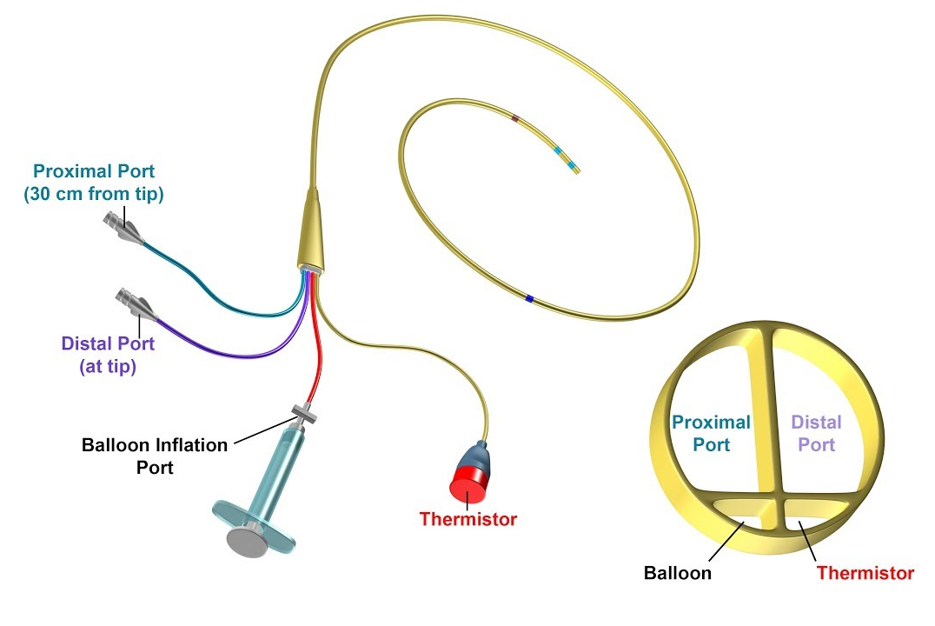
SWAN GANZ CATHETER
ESOPHAGEAL THERMISTOR PROBE

Slide 6
Thermoregulation
Heat load- metabolic heat Production + environmental heat absorption
Heat dissipation-
Evaporation of skin moisture the most efficient mechanism but ineffective when humidity > 70%
Radiation of heat
Conduction – direct transfer of heat to cooler objects
Convection – loss of heat to air currents

Slide 7
Heat dissipation pathway
Preoptic nucleus of anterior hypothalamus (thermostat)
Autonomic nervous system activation
Cutaneous vasodilation and vasoconstriction

Slide 8
HEAT RELATED ILLNESS
HEAT EDEMA
PRICKLY HEAT
HEAT SYNCOPE
HYPERVENTILATION TETANY
HEAT CRAMPS
HEAT EXHAUSTION
HEAT STROKE

Slide 9
HEAT EDEMA
Mild swelling of upper limbs and lower limbs
It is caused due to cutaneous vasodilation and pooling of interstial fluid in response to heat stress
And also due ro increased secrertion of ADH and aldosterone

Slide 10
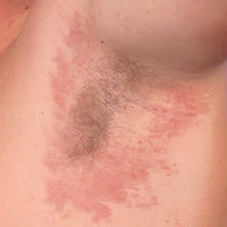
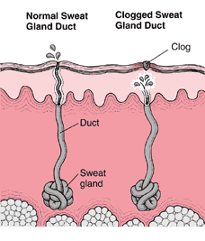
Prickly heat
maculopapular pruritic red rash in clothed areas
Due to blockage of sweatpores which ruptures and produces superficial vesicles
Rx-chlorhexidine lotion,1%salyicilic acid and light fabric usage

Slide 11
Heat syncope -exercise associated collapse on prolonged standing in heat
Hyperventilation tetany-heat exposure stimulates hyperventilation → respirtory alkalosis & carpopedal spasm

Slide 12
HEAT CRAMPS
Painful & involuntary spasmodic contractions of skeletal muscles.
Pt is profusely diaphoretic and has been replacing fluid losses with excess water
The precise pathogenesis is unclear but appears to involve a relative deficiency of sodium, potassium and fluid at the intracellular level. Coupled with copious hypotonic fluid ingestion,
large amounts of sodium in the diaphoresis cause hyponatremia and hypochloremia, resulting in muscle cramps due to calcium-dependent muscle relaxation
Rx-electrolyte rich rehydration fluids (ORS fluids)

Slide 13
Heat exhaustion
Mild-to-moderate heat-related illness
caused by exposure to high environmental heat or strenuous physical exercise;
Main difference from heat stroke is that the thermoregulatory and cns function is maintained

Slide 14
C/F of heat exhaustion
signs and symptoms include intense thirst, weakness, discomfort, anxiety, dizziness, syncope;
core temperature may be normal or slightly elevated to >37°C (98.6°F) but <40°C (104°F).
Orthostatic hypotension and sinus tachycardia is mostly common seen
Hemoconcentration can be seen and is corrected by intravenous rehydration fluids

Slide 15
Heat stroke
Total loss of thermoregulation causing the below mentioned clinical features
tachypnea,
Tachyarrythmias,
hypotension due to dehydration as well as peripheral vasodilation
a widened pulse pressure,
weakness,
dizziness,
disorientation, ataxia,
gastrointestinal or psychiatric symptoms.

Slide 16
Exposure to heat source
Core temp >40.5 ºC
Cns dysfunction

Slide 17
Pathophysiology of heat stroke
heatstroke occurs when the maintenance of adequate perfusion requires peripheral vasoconstriction to stabilize the mean arterial blood pressure.
As a result, the cutaneous radiation of heat ceases. At this juncture, the core temperature rises dramatically.

Slide 18
Predisposing factors of heat stroke
Extremes of age
Malnutrition
Lack of acclimatization
Mild dehydration
Obesity

Slide 19
HEAT STROKE
CLASSICAL
(CHS)
EXERTIONAL
(EHS)

Slide 20
CLASSICAL HEAT STROKE
Older patient
Predisposing health factors/medications
Epidemiology (heat waves)
Sedentary
Anhidrosis (possible)
Central nervous system dysfunction
Oliguria
Coagulopathy (mild) & Mild lactic acidosis
Normoglycemia/calcemia Normokalemia

Slide 21
PREDISPOSING HEALTH FACTORS AND DRUGS IN NON EXERTIONAL HEAT STROKE
HEALTH FACTORS
EXTREMES OF AGE
PREGNANCY
DIABETES
CARDIOVASCULAR DISEASES
HEAVY ALCOHOL USE
LACK OF ACCLIMATIZATION

Slide 22
DRUGS CAUSING HYPERTHERMIA
INCREASED HEAT PRODUCTION
SYMPHATHOMIMETICS LIKE COCAINE,AMPHETAMINES
ANTICHOLINERGICS
LITHIUM
CENTRAL HALLUCINOGEN(PHENCYCLIDINE,LSD,MDMA)
DRUGS CAUSING RECURRENT SEIZURES(INH,THEOPHYLLINE)
STRYCHININE
NEUROLEPTIC MALIGINANT SYNDROME
SEROTONIN SYNDROME
MAO INHIBITORS
MALIGNANT HYPERTHERMIA
IMPAIRED HEAT DISSIPATION
ANTICHOLINERGICS
ANTIHISTAMINICS WITH ANTICHOLINERGIC PROPERTY
PHENOTHIAZINES
TRICYCLIC ANTIDEPRESSANTS
INCREASED METABOLIC RATE
SALICYLAYTES
DINITROPHENOL
THYROID HORMONE EXCESS

Slide 23
EXERTIONAL HEAT STROKE
Younger patient
Healthy condition
Sporadic cases
Exercising
Diaphoresis (common)
Myocardial/hepatic injury
Acute renal failure
DiC & Marked lactic acidosis
Rhabdomyolysis Hypoglycemia/calcemia

Slide 24
Clincial features of heat stroke
If cooling is delayed, severe liver dysfunction, renal failure,DIC,and MODS can occur
S.AST will be elevated most commonly.
Decreased platelets,fibrinogen and prothrombin
Incase of EHS,rhambdomyolyis and AKI more common

Slide 25
Both types of heatstroke causes thermal cardiomyopathy
CVP may be elevated despite significant dehydration.
variety of tachyarrhythmias, nonspecific ST-T wave changes, and heat-related ischemia or infarction.
Rapid cooling—not the administration of antiarrhythmic medications—is essential.
Above 42°C (107.6° F), heat can rapidly produce direct cellular injury.
irreversible uncoupling of oxidative phosphorylation occurs

Slide 26
Initial management
Resuscitation
endotracheal intubation during which depolarizing agents are to be avoided.
CVP determination,
Continuous core-temperature monitoring
glucose infusion if hypoglycemic
for hypotension, isotonic crystalloids are Preferred Over alpha adrenergics ‘coz they cause significant vasoconstriction
There is no therapeutic role for antipyretics in the control of environmentally induced hyperthermia. Salicylate further uncouple oxidative phosphorylation.

Slide 27
Cooling mechanisms
Evaporative cooling- most efficient.
Cold water is sprayed (15 deg Celsius) on exposed skin and cold packs are kept in neck axiila and groin
Immersion cooling in cold water is an alternative option in EHS. But induces peripheral vasoconstriction and intense shivering.
Immersion cooling requires more strict monitoring and poses challenges during intial resuscitations
To avoid “overshoot hypothermia,” active cooling should be terminated at ~38°–39°C (100.4°–102.2°F).

Slide 28
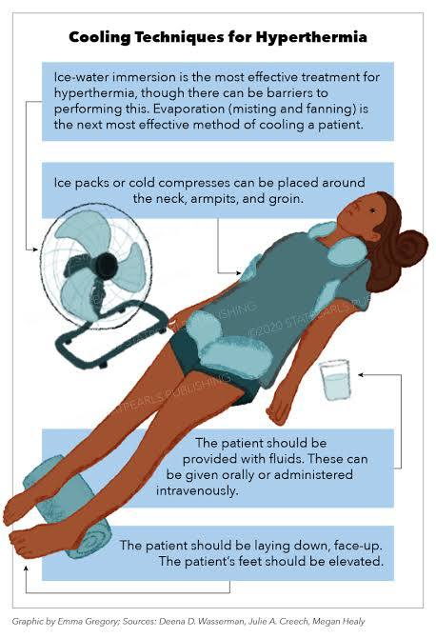
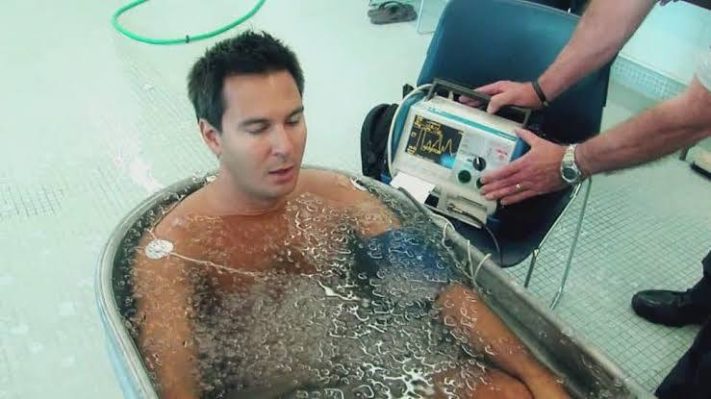
EVAPORATIVE COOLING
IMMERSIVE COOLING

Slide 30
DIFFERENTIAL DIAGNOSIS FOR HYPERTHERMIA RELATED ILLNESS
INFECTION
SEPSIS
MENINGTIS
ENCEPHALITIS
BRAIN ABSCESS
TETANUS
THYPHOID
MALARIA
DRUGS
1.MALIGNANT
HYPERTHERMIA
2.NMS
3.WITHDRAWAL
SYNROMES
4.SYMPHATHOMIMETICS(MDMA)
5.ANTICHOLINERGIC POISONING
6.SEROTONIN
SYNDROME
7.SALYCILATE
POISONING
NEUROLOGIC
HYPOTHALAMIC STROKE
STATUS EPILEPTICUS
CEREBRAL HEMMORAGE
ENVIRONMENTAL
HIGH TEMPERATURE AND HUMIDITY
ENDOCRINE
1.THYROID STORM
2.PHEOCHROMOCYTOMA
3.DIABETIC KETOACIDOSIS
ONCOLOGIC
1.LEUKEMIA
2.LYMPHOMA

Slide 31
Thank you

