Slide 1
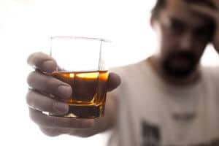
A DEADLY ALCOHOLIC SIDE ‘DIS’H
IMCU
CHIEF - PROFESSOR . DR.M.NATARAJAN.M.D.
ASST – DR.PALANIKUMARAN.M.D.

Slide 2
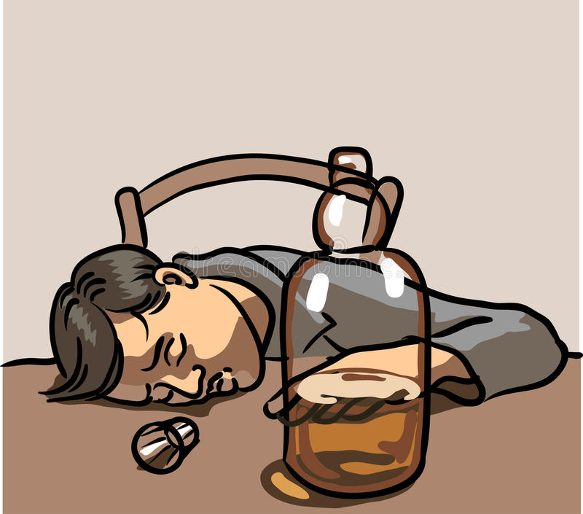
A 41 yr old male who is a chronic alcoholic referred from Pvt hopistal as CVA – R hemiparesis / Respiratory failure on MV
HOPI :
A chronic alcoholic on deaddiction with T.Disulifiram 250 mg 1 od for 2 yrs
had alcohol binge on 3.11.2021 following which he developed sweating, palpitations and Weakness of R UL and LL
Pt taken to MMMRCH where imaging revealed acute infarct of left MCA territory

Slide 3
Repeat CT on 5.11.2021 – acute watershed infarct
H/o altered sensorium since 3.11.2021
H/o reduced movements on R side of the body
H/o deviation of angle of mouth to Left
No h/o seizures/syncope
No h/o chest pain/palpitations
No h/o fever
No h/o Abdominal pain/distension
No h/o yellowish discolouration of eyes/skin
No h/o decreased urine output
No h/o Bleeding manifestations

Slide 4
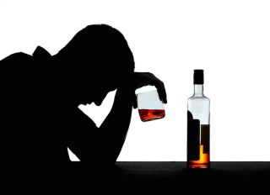
Past history :
Chronic alcoholic on abstinence taking T.Disulfiram 250 mg 1 od for the past 2 yrs
H/o previous episodes of Sweating, palpitations and breathlessness after consuming alcohol with T.dulsifiram for which pt was treated in Pvt hospital
K/C/O SHTN for 2 yrs on regular treatment
Not a k/c/o DM/TB/Epilepsy/CAD/COPD/CKD

Slide 5
Personal History :
Chronic smoker
completed 2 doses of covid vaccine
Family history :
No family history of young stroke or hypercoagulable states
Condition on admission :
Pt drowsy
irritable
partly obeys oral commands
responds to painful stimuli
No pallor
not icteric

Slide 6

no cyanosis
no clubbing
no pedal edema
no lymphadenopathy
Systemic examination :
CVS – S1,S2 present, no murmurs
RS – Bil air entry + on MV, no added sounds
PA – Soft
CNS – Drowsy
Irritable
Partly obeys oral commands
Responds to painful stimuli
Bil pupil 3.5 mm SRTL

Slide 7
Gaze preference to L side
paucity of movements on R side
power could not be elicited
tone decreased on R side
DTR absent on R side
Bil plantar extensor
Spine and cranium normal
no signs of meningeal irritation

Slide 8

INVESTIGATIONS
CBC
WBC | 21900
RBC | 4.87
HB | 14.5
HCT | 42.6
PLT | 2.77 LAKHS
RFT
RBS | 69
UREA | 38
CREAT | 1.1

Slide 9

LFT
T.B | 0.6
D.B | 0.2
I.B | 0.4
OT | 41
ALP | 179
ELECTROLYTES
NA | 136
K | 4.2
FLP
FBS | 82
CHOLESTEROL | 182
TGL | 301

Slide 10
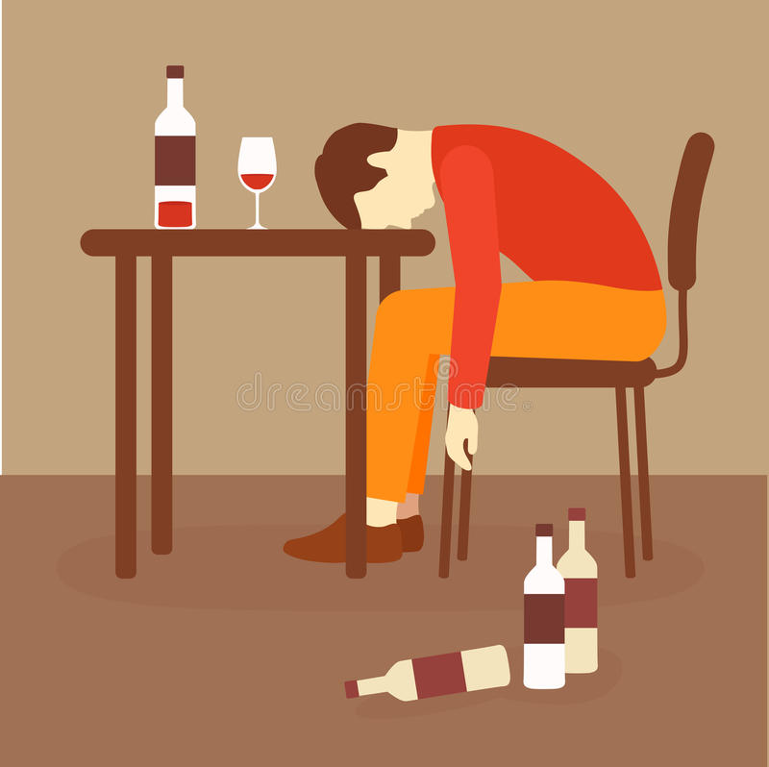
ESR | 28 mm/hr
ECHO :
MILD CONCENTRIC LVH
MILD HYPOKINETIC BASAL INFERIOR/
INFEROLATERAL WALL
NORMAL LV FUNCTION
GRADE 1 MR/TR
NO CLOT
LVEF – 55 %

Slide 11
VCTC | Non reactive
HBsAg | negative
Anti HCV | negative
COAGULATION PROFILE
PT | 13.1
INR | 1.08
Covid swab | negative

Slide 12

DOPPLER – BIL CAROTID AND VERTEBRAL ARTERIES
Normal doppler study of bil carotid and vertebral arteries
No hemodynamically significant stenosis

Slide 13
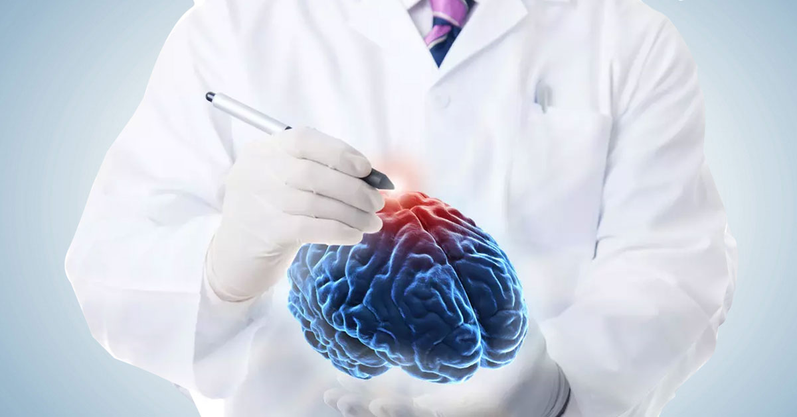
Neurophysician opinion
Diagnosis : Acute ischemic stroke with right hemiparesis ( MCA territory and PCA territory)
Advice : - Inj mannitol 100 ml iv tds
- IVF 2 packs of 500ml NS
- T. Clpidogrel 75mg 0-1-0
- T. Atorvastatin 10mg 0-0-4
- Inj. Heparin 5000 IU iv tds
- Monitor metabolic parameters

Slide 14

Treatment given
Head end elevation at 30 degrees
IVF 2 packs of 0.9 % NS
Mechanical venitilation
SRD
RTF
Inj. Mannitol 100 ml iv tds
Inj. Heparin 5000 U iv tds
T. Clopidogrel 75mg 0-1-0
T. Atorvastatin 10mg 0-0-4
T. Amlodipine 2.5mg 4-0-0
T. Enalapril 2.5 mg 2-0-2
CBD
Physiotheraphy

Slide 15
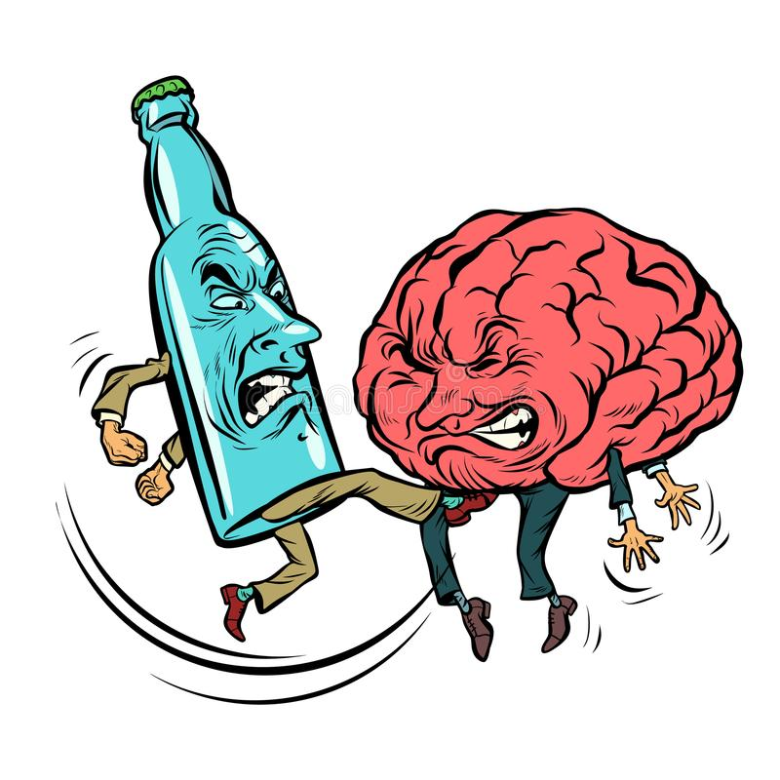
Discussion

Slide 16
DISULFIRAM ETHANOL REACTION
Disulfiram – Tetraethylthiuram disulfide – used for stabilisaztion of rubber
Then used for Alcohol dependence
Initial dose of 500mg/day for 2 wks f/b 125 - 500mg/day maintainance dose
Good oral bioavailabiltiy – 70 to 90%

Slide 17

Metabolised by liver and erythrocytes
Lipid soluble and 80% protein bound
Half life – 60 to 120 hrs
Metabolites have a half life of upto 14 hrs and excreted renally
Because of long half life – needs 1 to 2 weeks to get totally eliminated from body

Slide 18
Inhibition of enzymes
ALDH
Dopamine beta hydroxylase – increased dopa in brain and decreased nor epi and epi ( explains hypotension )
Decreased urinary conc. Of Vanillylmandelic acid – metabolite of epi and nor epi

Slide 19
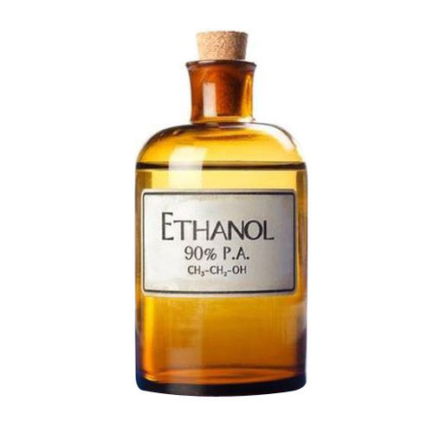
Disulfiram – ethanol reaction
Disulfiram is an avoidant and aversive treatment
Disulfiram inhibits ALDH which metabolises acetaldehyde to acetate, thus accumulating Acetaldehyde
Acetaldehyde is resposibe for the signs ans symptoms of DER

Slide 20
Recovery of enzymatic activity takes place in 6 or more days
DER can occur even upto 3 weeks after cessation if dislufiram theraphy
DER can also happen after exposure to household products containing ethanol

Slide 21

Clinical manifestations
Symptoms happen with 15 mins and peak at 30 to 60 mins resolve over several hours
Flushing, pruritis, nausea, vomiting and Abdominal pain
Other rare manifestations include MI with segment changes, methemoglobinemia, HTN, bronchospasm and myoclonus
Severe shock and hypotension requiring vasopressor support has been reported
DER can also happen with other xenobiotics

Slide 22
DER presenting as Ischemic stroke
Acetaldehyde can cause spasm of cerebral vessels due to catecholamine release from sympathetic nerve terminals resulting in ischemic stroke
Acute MI in a young man with normal coronaries has also been reported

Slide 23
Management
Duration DER varies from 30 to 60 mins to sevral hours depnds on the alcohol amount ingested
Sypmtomatic and supportive care is the mainstay of Rx
Hypotension repsonds to iv 0.9% Nacl
Refractory hypotension requires a direct acting adrenergic agonist such as Nor epinephrine

Slide 24
Antiemetics, and H1 receptor antagonists for flushing
Antagonist : Fomepizole – an inhibitor of Alcohol dehydrogenase – limits DER by blocking ethanol metabolism to Acetaldehyde

Slide 25
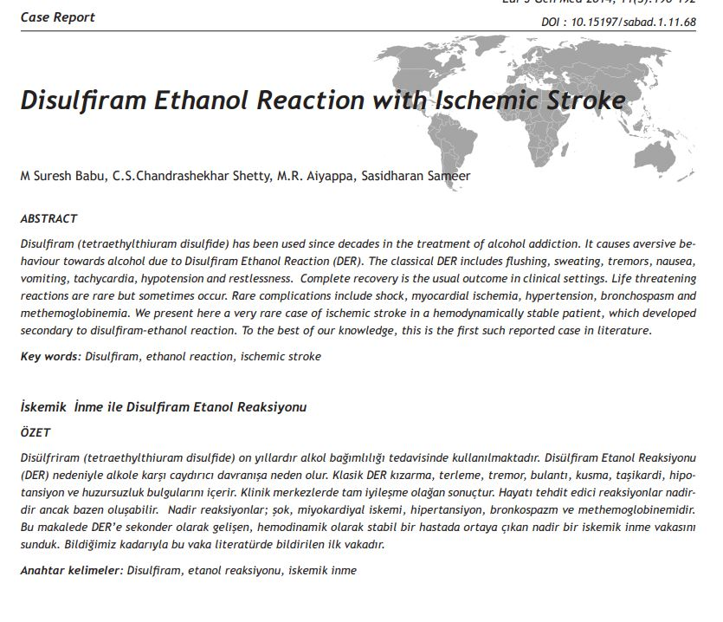

Slide 26
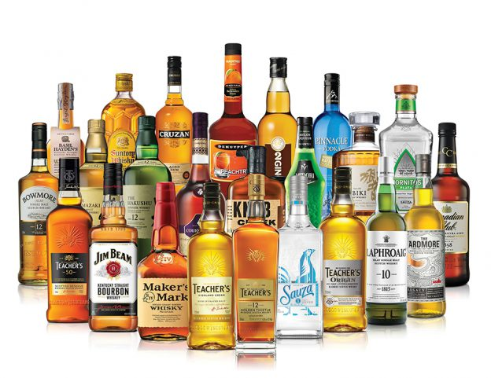
AIM OF THE PRESENTATION
Disulfiram ethanol reaction presenting as Ischaemic stroke is a rare presentaion reported very few times in literature

