Slide 1
THE DANGEROUS "ESSENTIAL"
BY FIRST MEDICAL UNIT
CHIEF: PROF.DR.M.NATARAJAN MD.,
ASST PROF: DR.PALANIKUMARAN MD.,DDIAB.,
DR.VASANTHA KALYANI MD.,DCP
DR.SURESH KUMAR MD.,
PRESENTOR: DR.V.KAVISANKAR

Slide 2
History of presenting illness
An 70 years old male Mr.Karmegam came to hospital with cheif complaints of Burning sensation of both feet for past 6 months

Slide 3
HISTORY OF PRESENTING ILLNESS
The patient was apparently normal before 6 months back then he started developing burning sensation of both feet
H/O loss of weight and loss of appetite+
No h/o Weakness of any limbs
No h/o blurring of vision
No h/o backpain

Slide 4
PAST HISTORY
Not a known case of T2DM /SHTN/CAD/TB/EPILEPSY/THYROID DISORDER
No h/o trauma

Slide 5
PERSONAL HISTORY
Consumes mixed diet
Normal bowel habits
Normal bladder habits
Sleep pattern – Normal
Known smoker for past 30 years

Slide 6
General examination
Conscious
Oriented
Afebrile
No Pallor
No cyanosis
No clubbing
No pedal edema
No icterus
No generalized lymphadenopathy

Slide 7
VITALS
BP-120/80 mmHg measured in left arm in supine posture
PR-96/min - regular rhythm, normal volume, no specific character, felt equally in all peripheral vessels, no radio radial and radio femoral delay
SPO2-97% on RA
RR-16/min

Slide 8
OTHER SYSTEMS EXAMINATION:
CVS - S1S2 +, NO MURMUR
RS - NVBS +, NO ADDED SOUNDS
ABDOMEN - SOFT, BOWEL SOUNDS +
MODERATE HEPATOSPLENOMEGALY+
CNS- NFND, ALL JERKS ARE NORMAL
L/E- BOTH SOLES ARE ERYTHEMATOUS (ERYTHROMELALGIA)

Slide 9
INVESTIGATIONS

Slide 10
CBC | 31/5
TOTAL COUNT | 36500 cells/cumm
DIFF COUNT | 90/5/1/4
HB | 11.5 g/dl
RBC COUNT | 4.61 million/cumm
PCV | 34.7%
PLT | 9,81,000
ESR | 8 MM/HR
RDW | 23.7%
MCV | 75.4fL
MCH | 25 pg
MCHC | 33.2%
ABSOLUTE EOSINOPHIL COUNT | 365 cells/cumm
RETICULOCYTE COUNT | 3.20%

Slide 11
TOTAL PROTEINS | 6.3 gm/dL
SERUM ALBUMIN | 3.7 gm/dL
SERUM GLOBULIN | 2.6 gm/dL
RBS | 93 mg/dL
SERUM URIC ACID | 14.4 mg/dL
RA FACTOR | 12.89U/mL
URINE EXAMINATION
ALBUMIN | Faint trace
GLUCOSE | NIL
DEPOSIT | NO PUS CELLS, RBCs, CASTS & CRYSTALS

Slide 12
RFT
UREA | 45 mg/dL
SERUM CREATININE | 1.57 mg/dL
eGFR | 44ml/min/1.73 square metre

Slide 13
PERIPHERAL SMEAR
ERYTHROCYTIC VIEW:
Normocytic Hypochromic as well as Microcytes and Poikilocytes seen
No Parasites seen
LECOCYTIC VIEW:
Markedly increased in count and NEUTROPHILIA
THROMBOCYTIC VIEW:
Thrombocytosis+

Slide 14
FUNDUS EXAMINATION:
B/L FUNDUS – NORMAL

Slide 15
USG ABDOMEN AND PELVIS
MODERATE HEPATOSPLENOMEGALY PRESENT.
NO FREE FLUIDS IN THE ABDOMEN AND PELVIS .

Slide 16
BONE MARROW ASPIRATION STUDY
Myeloid erythroid ratio : 8:1
Erythropoiesis -Active .seen in normoblastic maturation
Myelopoiesis -Myeloid hyperplasia.Seen in all stages of maturation
Megakaryocytes- Appear increased.Enlarged megakaryocytes- with multilobulated forms noted
Differential count: Erythroid precursor - 15%
Neutrophils- 41%
Band forms - 30%
Myelocytes and metamyelocytes -10%
Lymphocytes - 3%
Myeloblasts -1%
IMPRESSION:
Morphological features favour of chronic myeloproliferative disorder,Probably ESSENTIAL THROMBOCYTOSIS

Slide 17
PROVISIONAL DIAGNOSIS
A chronic myeloproliferative disorder
Possiblities are
1.ESSENTIAL THROMBOCYTOSIS
2.CHRONIC MYELOID LEUKEMIA
Hence proceeded with Genetic mutation studies

Slide 19
FINAL DIAGNOSIS
A case of ESSENTIAL THROMBOCYTOSIS

Slide 20
TREATMENT
Pt treated with Tab.Hydroxyurea 500mg 1-0-1
Tab.Febuxostat 40mg 0-0-1. For 1 month

Slide 21
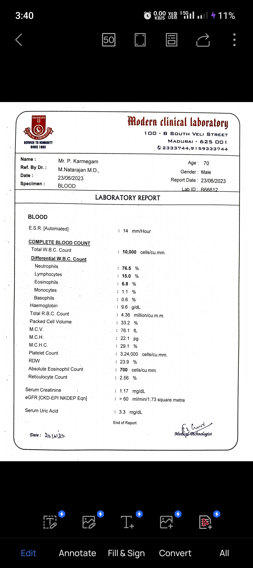
CBc repeated after 1 Month

Slide 22
Aim of the presentation
1. Rarity of the case
2. To highlight Approach to Thrombocytosis

Slide 23
Thank you!!!

