Slide 1
MYSTERIOUS UGI BLEED
BY MEDICINE UNIT 1
UNIT CHIEF - PROF DR PEER MOHAMED MD
ASSISTANT PROFESSORS - DR VASANTHA KALYANI MD
- DR MANIKANDAN MD
- DR JEGATHEESH MD
- DR SURESH KUMAR MD
- DR SATHEESH KUMAR MD

Slide 2
29year old male was referred from Dindigul GMCH with the complaints of
Easy fatigueability since 1month
Passage of black tarry stools since 10days
Vomiting with blood 2episodes

Slide 3
HISTORY OF PRESENTING ILLNESS
Patient was apparently alright until he complained of easy fatigueability since 1 month
Insidious in onset, gradually progressive. Associated with breathlessness on exertion
Passage of black tarry stools since 10days
2-3 episodes each day
Blood in vomitus 2 episodes
Approximately 50ml each episode,
Bright red coloured
Not associated with abdomen pain/ fever/ abdominal distension/ yellowish discolouration of skin & mucous membranes/ altered sensorium

Slide 4
PAST HISTORY
No h/o similar illness in the past
No h/o regular medications
No h/o SHTN/T2DM/CAD/CLD

Slide 5
PERSONAL HISTORY
Consumes mixed diet
Non smoker
Alcoholic for 6 years- consumes 250ml of Brandy 3days/week since 3years
Last intake 2months back

Slide 6
TREATMENT HISTORY
Patient received the following treatment in Dindigul GMCH from 5/7/26 to 13/7/26
6 PRBC + 2 PLT transfusion
Inj Vitamin K OD
Inj Pantoprazole 40mg IV BD
Inj Iron sucrose 100mg in 100ml NS IV
Inj Ondansetron 8mg IV BD
Syp Antacid 10ml TDS

Slide 7
INVESTIGATION REPORTS in dindigul gmch
CBC | 5/7/26 | 6/7/26 | 8/7/26 | 10/7/26
TLC | 8900/mm³ | 11,300/mm³ | 11,800/mm³ | 9600/mm³
Hb | 2.5g/dl | 3.0g/dl | 3.2g/dl | 4.2g/dl
RBC | 1.14 | 1.31 | 1.20 | 1.67
MCV | 83.3 | 80.2 | 86.7 | 81.4
PLT | 2.03L/mm³ | 3.65L/mm³ | 1.83L/mm³ | 1.41L/mm³
Peripheral smear – Severe microcytic hypochromic anaemia with reactive neutrophilia
S. Ferritin - 45.6 ng/ml
Vit B12 >2000 pg/ml

Slide 8
BONE MARROW ASPIRATION
Marrow smear partially diluted with peripheral blood
Myeloid: erythroid= 1:2
Erythroid series- predominantly micro normoblasts and few normoblasts seen – many are early normoblast
Myeloid series- normal in count, maturation and differentiation. No increase in blasts
Differential count- erythroid 70%, myeloblast 17%, promyelocyte 1%, Myelocyte 4%, metamyelocyte 5%, band form 8%, neutrophil 12%
Megakaryocytes seen
Impression: Active erythrocytosis with micronormoblast maturation. Suggested correlation with S. Iron profile studies

Slide 9
INVESTIGATION REPORTS
LFT
Total Bilirubin | 0.67
Direct bilirubin | 0.31
ALT | 14
AST | 8
Total Protein | 5.87
S. Albumin | 2.87
RFT
S. Urea | 39
S. Creatinine | 1.0
S. Electrolytes
Na | 135
K | 3.7
Cl | 104
Viral markers
HbsAg | Neg
HCV | Neg

Slide 10
Investigation reports
CT Abdomen- Chronic calcific pancreatitis with few hypodense cyst noted in tail of pancreas – likely pseudocyst
USG Abdomen and pelvis – Normal study
ECHO – Normal study, EF 70%
OesophagoGastroDuodenoscopy - not done due to very low Hb values

Slide 11
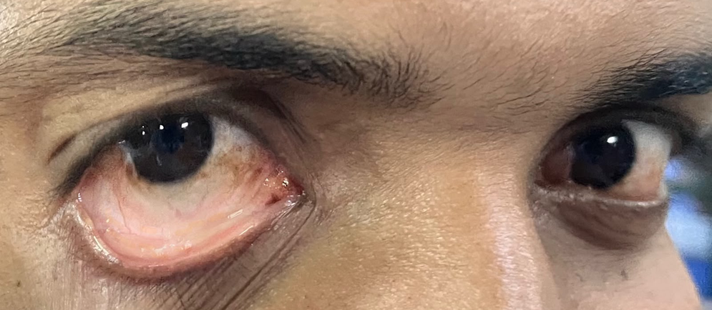
General examination on admission 13/7/26
Conscious, Oriented
Afebrile
Pallor +
No Icterus/ Edema/ Clubbing/ Cyanosis/ Lymphadenopathy
S/E:
CVS- S1S2 +, No murmur
RS- B/L AE +, Normal vesicular breath sounds
PA- Soft, Non tender, BS+, No organomegaly
CNS- Conscious, Oriented
VITALS:
BP 110/60mmHg
PR 72/min
SpO2 99% RA
RR 16/min

Slide 12
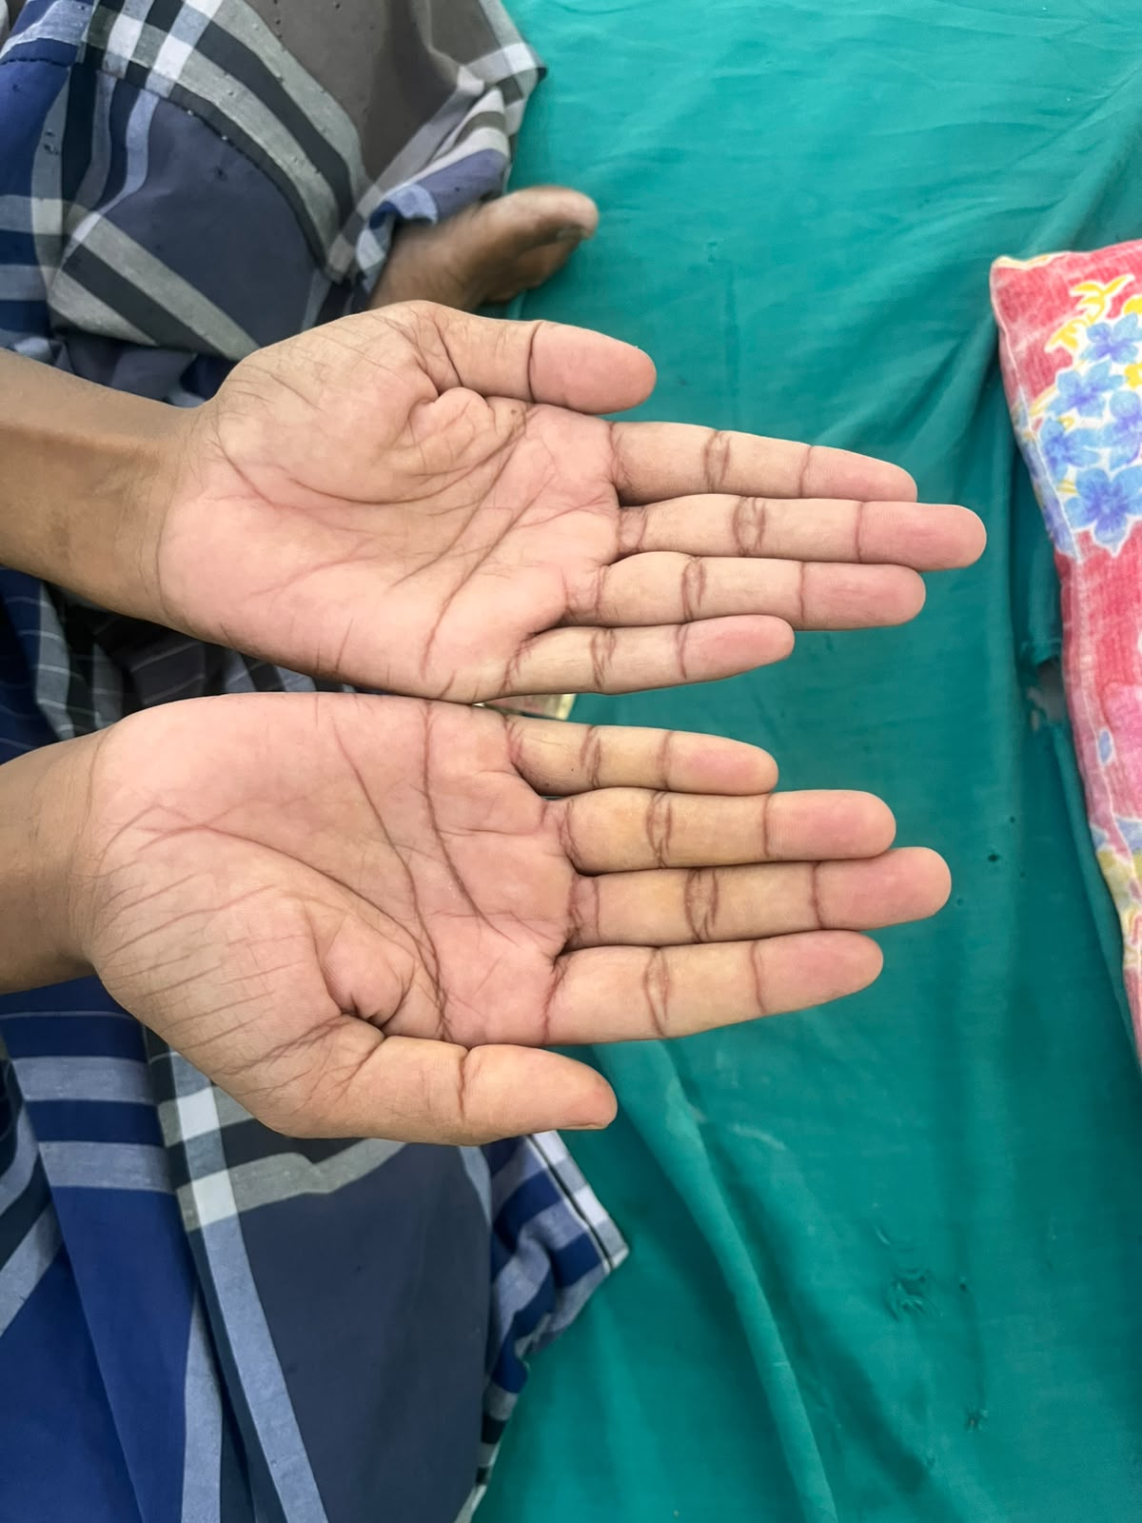
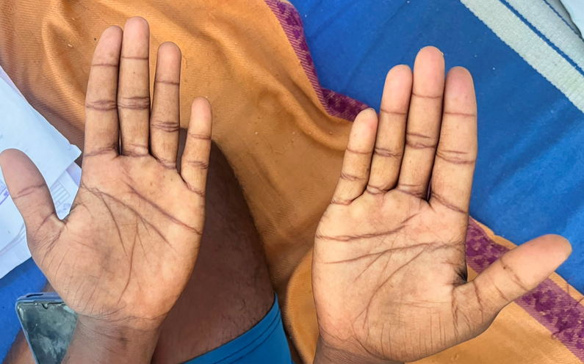
INVESTIGATION REPORTS in grh
CBC | 13/7/26 | 16/7/26 | 17/7/26 | 21/7/26 | 22/7/26 | 24/7/26
TLC | 11,700 | 9200 | 10,300 | 5600 | 8200 | 11,900
Hb | 7.0 | 7.0 | 9.0 | 8.4 | 9.1 | 9.7
HCT | 24.2 | 24.8 | 26.7 | 29.3 | 31.9 | 33.5
MCV | 82.9 | 83.2 | 78.8 | 84.9 | 85.5 | 85.7
PLT | 1.98 | 2.55 | 3.26 | 4.18 | 1.09 | 5.32

Slide 13
Investigation reports
LFT | 13/7/26 | 16/7/26 | 21/7/26
Total Bilirubin | 1.2 | 1.0 | 1.1
Direct bilirubin | 0.4 | 0.1 | 0.2
ALT/ AST | 27/ 23 | 0.9/12 | 0.9/12
ALP | 119 | 82 | 102
Total Protein | 4.3 | 5.9
S. Albumin | 2.3 | 2.8
PT | 16.2 | 13.4
INR | 1.28 | 1.05
APTT | 23.9 | 30.4

Slide 14
Investigation reports
PARAMETERS | 13/7/26 | 18/7/26
S. Amylase | 327 U/L | 33 U/L
S. Lipase | 200 U/L | 10 U/L
S. Calcium | 8.8mg/dl
S. Phosphorus | 2.6mg/dl
FBS | 72
PPBS | 116
RFT | 13/7/26 | 16/7/26
S. Urea | 18 | 16
S. Creatinine | 0.8 | 0.8
S. Electrolytes | 13/7/26 | 16/7/26
Na | 139 | 143
K | 4.4 | 4.5
Ca | 8.8
P | 2.6
Viral markers
HbsAg | Neg
HCV | Neg
VCTC | Non-reactive

Slide 15
COMPLETE HAEMOGRAM WITH PERIPHERAL SMEAR
TLC- 8200/mm³
RBC- 2.87
Hb- 6.6 g/dl
HCT- 23%
PLT 1.63L/ mm³
MCV- 80.1fl
MCH- 23.0pg
MCHC- 28.7g/dl
RBC- Anisopoikilocytosis. Hypochromic Microcytes and polychromatophils and elongated cells
WBC- normal count. No atypical cells seen
N 70% L 23% E 4% M 3%
PLT- normal in number and morphology
IMPRESSION- Hypochromic Microcytic anemia
Reticulocyte count 4.1 (RPI 1)

Slide 16
Usg abdomen and pelvis (13/7/26)
LIVER: Measures l4.5.. cm. with normal echoes. No evidence of IHBR / CBD dilatation. No focal lesion. Portal vein appears normal
GB: Distended. No evidence of calculus / Wall thickening
PANCREAS : Normal in size and echoes. Pancreatic duet not dilated
SPLEEN : Measures.11.5cms with normal echoes
KIDNEY: RK Measures 9-5 x 4.3cms. with normal echoes. CMD+
LK Measures 10 x 5cms. with normal echoes. CMD+
No evidence of calculus or calycle dilation
BLADDER: Distended. Mucosal irregularity with wall thickening. No evidence of Calculus / mass/ wall thickening
No Ascites
IMPRESSION: CYSTITIS

Slide 17
MEDICAL GASTROENTEROLOGY OPINION (14/7/26)
IMPRESSION: CCP/ UGI BLEED ?NON-VARICEAL
ADVICE:
CECT Abdomen and pelvis to r/o pseudoaneurysmal bleed
Inj Pantoprazole 40mg IV BD
OGD fixed on 15/7/26 at 8am in SSB MGE II (306)
NPO from 10:00pm on 14/7/26

Slide 18
OesophagoGastroDuodenoscopy (15/7/26)
Oesophagus- Normal mucosa
Stomach- All parts of stomach appear normal
Duodenum part I and II- Normal
Impression: Normal study

Slide 19
Cect abdomen and pelvis (16/7/26)
Mild diffuse pancreatic volume loss with diffuse coarse parenchymal calcifications, suggestive of chronic calcific pancreatitis.
No peripancreatic inflammatory changes or fluid collection.
A 4.2 × 3.9 cm partially thrombosed pseudoaneurysm arises from the distal splenic artery, located approximately 2.6 cm proximal to the splenic hilum.
Intramural nonenhancing thrombus noted, max thickness measures 17mm
Focal outpouching noted along Postero-superior aspect with mural thrombus
Liver: Normal in size (13.8 cm) and attenuation. IHBR not dilated. Left hepatic artery noted arising from left gastric artery
GB: Normal.
Spleen: Normal in size (11 cm) and attenuation.
Pancreas:
Mild diffuse pancreatic volume loss with diffuse coarse parenchymal calcifications, suggestive of chronic calcific pancreatitis.
No peripancreatic inflammatory changes or fluid collection.
A 4.2 × 3.9 cm partially thrombosed pseudoaneurysm arises from the distal splenic artery, located approximately 2.6 cm proximal to the splenic hilum.
Intramural nonenhancing thrombus noted, max thickness measures 17mm
Focal outpouching noted along Postero-superior aspect with mural thrombus
Both kidneys: Normal in size and contour. Collecting systems normal. Right kidney measures 9.0 x 4.6 cm and left kidney 9.2 × 4.8 cm.
Bladder: Normal.
No abnormal dilatation of bowel loops / wall thickening noted.
No evidence of free fluid in the abdomen and pelvis.
No evidence of lymphadenopathy in the abdomen.
Bony parts: No significant abnormality detected.
IMPRESSION:
• Known case of chronic calcific pancreatitis with partially thrombosed distal splenic artery pseudoaneurysm.
IMPRESSION:
• Known case of chronic calcific pancreatitis with partially thrombosed distal splenic artery pseudoaneurysm.

Slide 20
Case seen by interventional radiologist (18/7/26)
Diagnosis- Chronic calcific pancreatitis with distal splenic artery pseudoaneurysm
CT Angiography: Aneurysm of size 2.4x2.2cm arising from the distal splenic artery just before the hilum
USG Screening: Saccular aneurysm of size 2.4x2.2cm is noted in the distal splenic artery showing yin-yang sign
GB- No e/o calculi
LIVER- No IHBR dilatation
No e/o significant intra-abdominal collection
No e/o free fluid in pelvis
PLAN: Endovascular angio-embolization under DSA guidance
ADVICE: Serial Hb monitoring. Review with anaesthesia assessment under LA/MAC

Slide 21
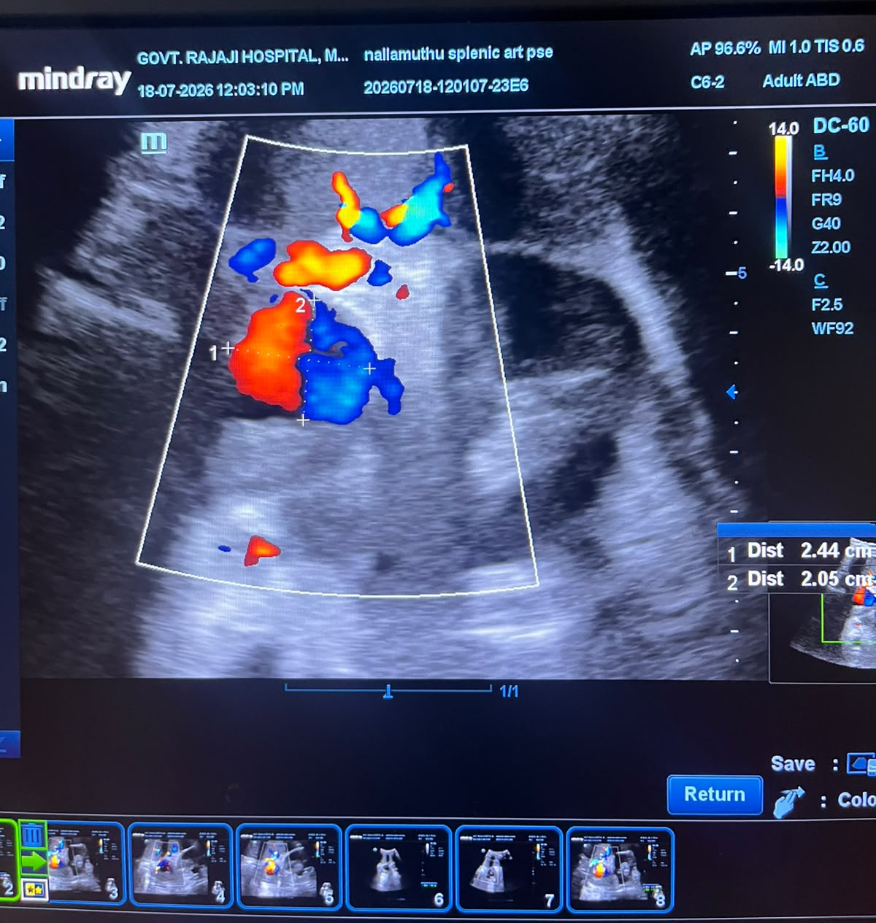
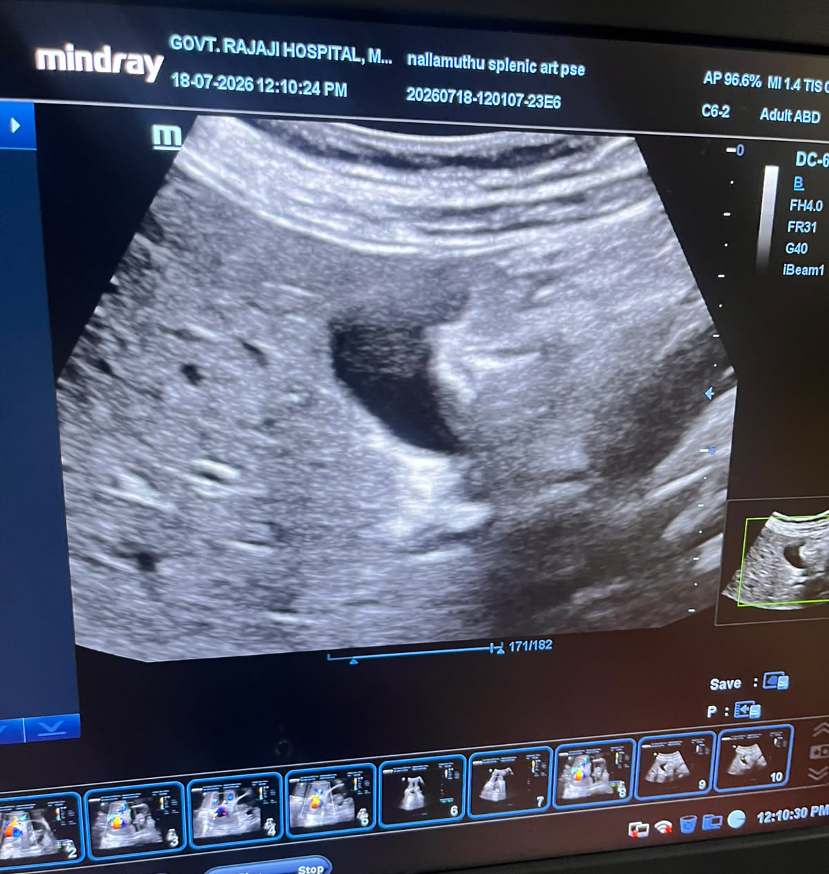

DISTAL SPLENIC ARTERY PSEUDOANEURYSM:
NORMAL GALL BLADDER:
YIN-YANG SIGN

Slide 22
TREATMENT GIVEN
2 PRBC transfusion
Inj Pantoprazole 40mg IV BD
FST OD
T Vitamin C OD
BCT OD
SELECTIVE SPLENIC ARTERY ANGIOGRAPHY AND COIL EMBOLIZATION OF DISTAL SPLENIC ARTERY PSUDOANEURYSM UNDER LA AND FLUOROSCOPY GUIDANCE

Slide 23
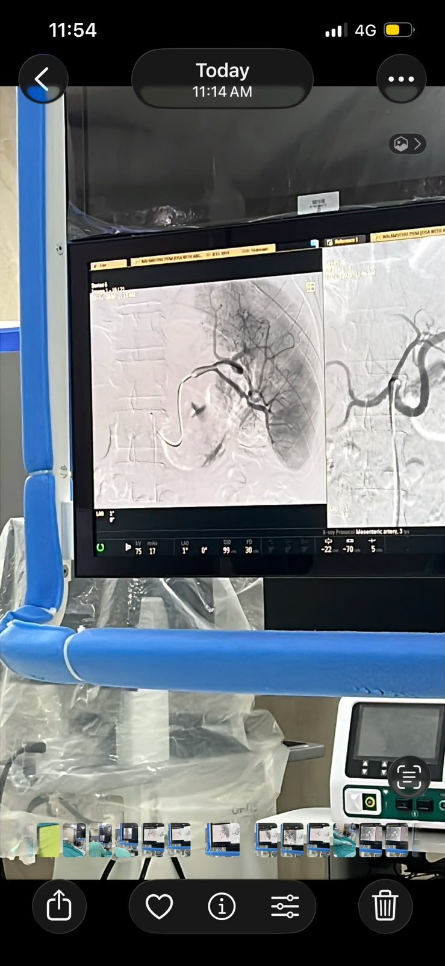
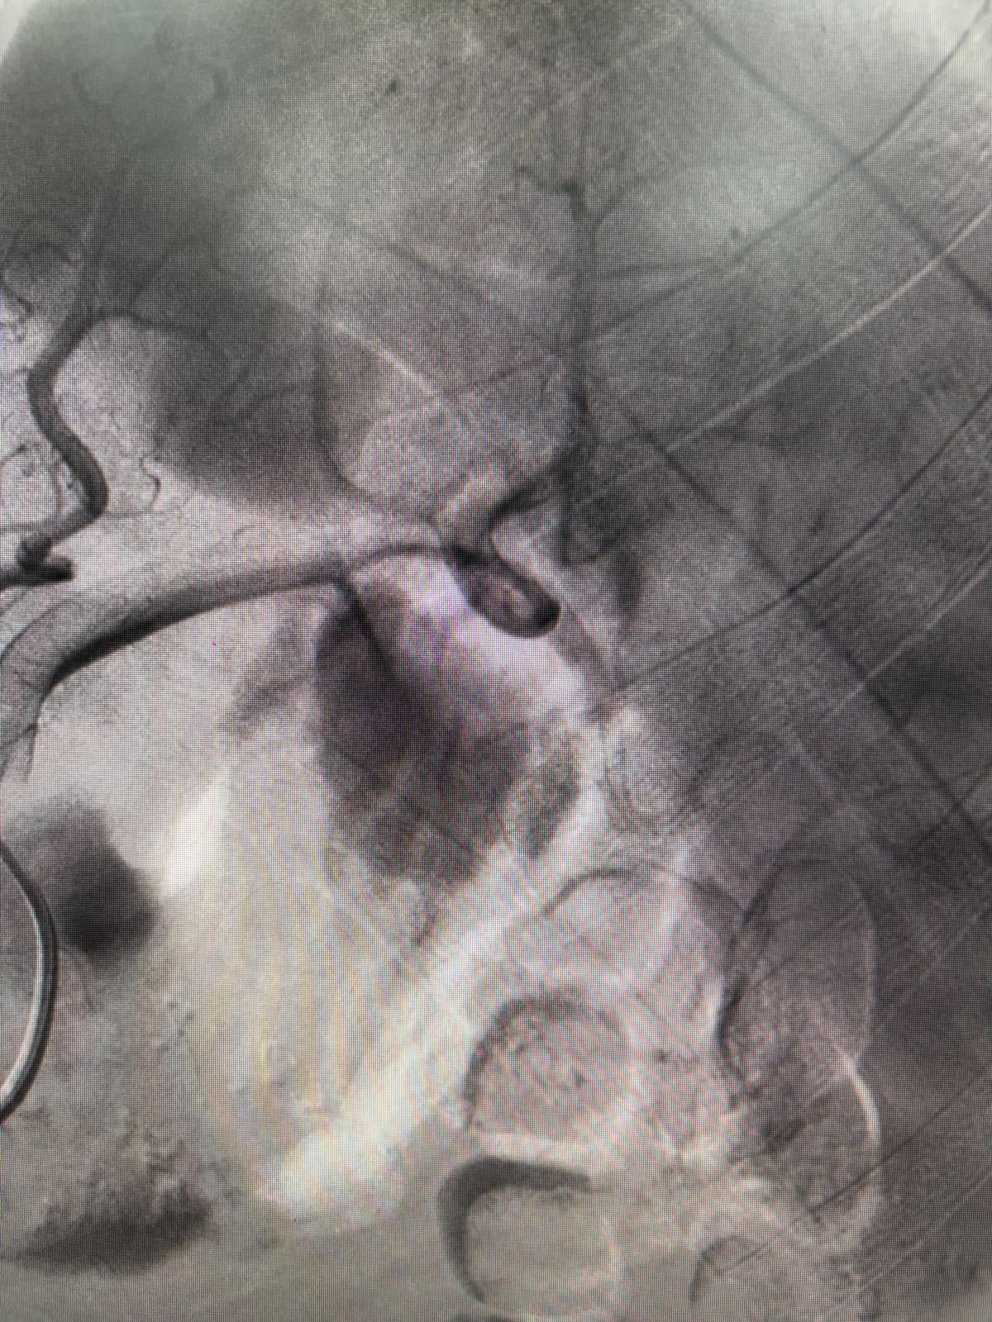
DISTAL SPLENIC ARTERY PSEUDO ANEURYSM

Slide 24
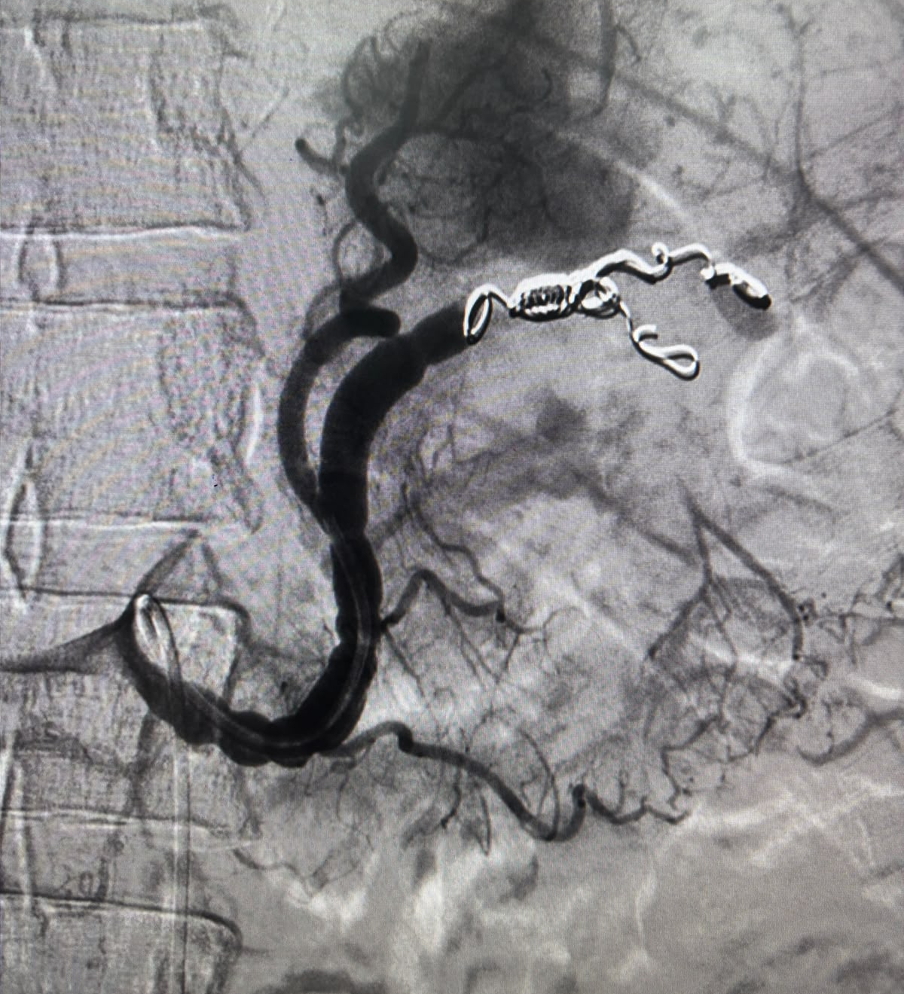
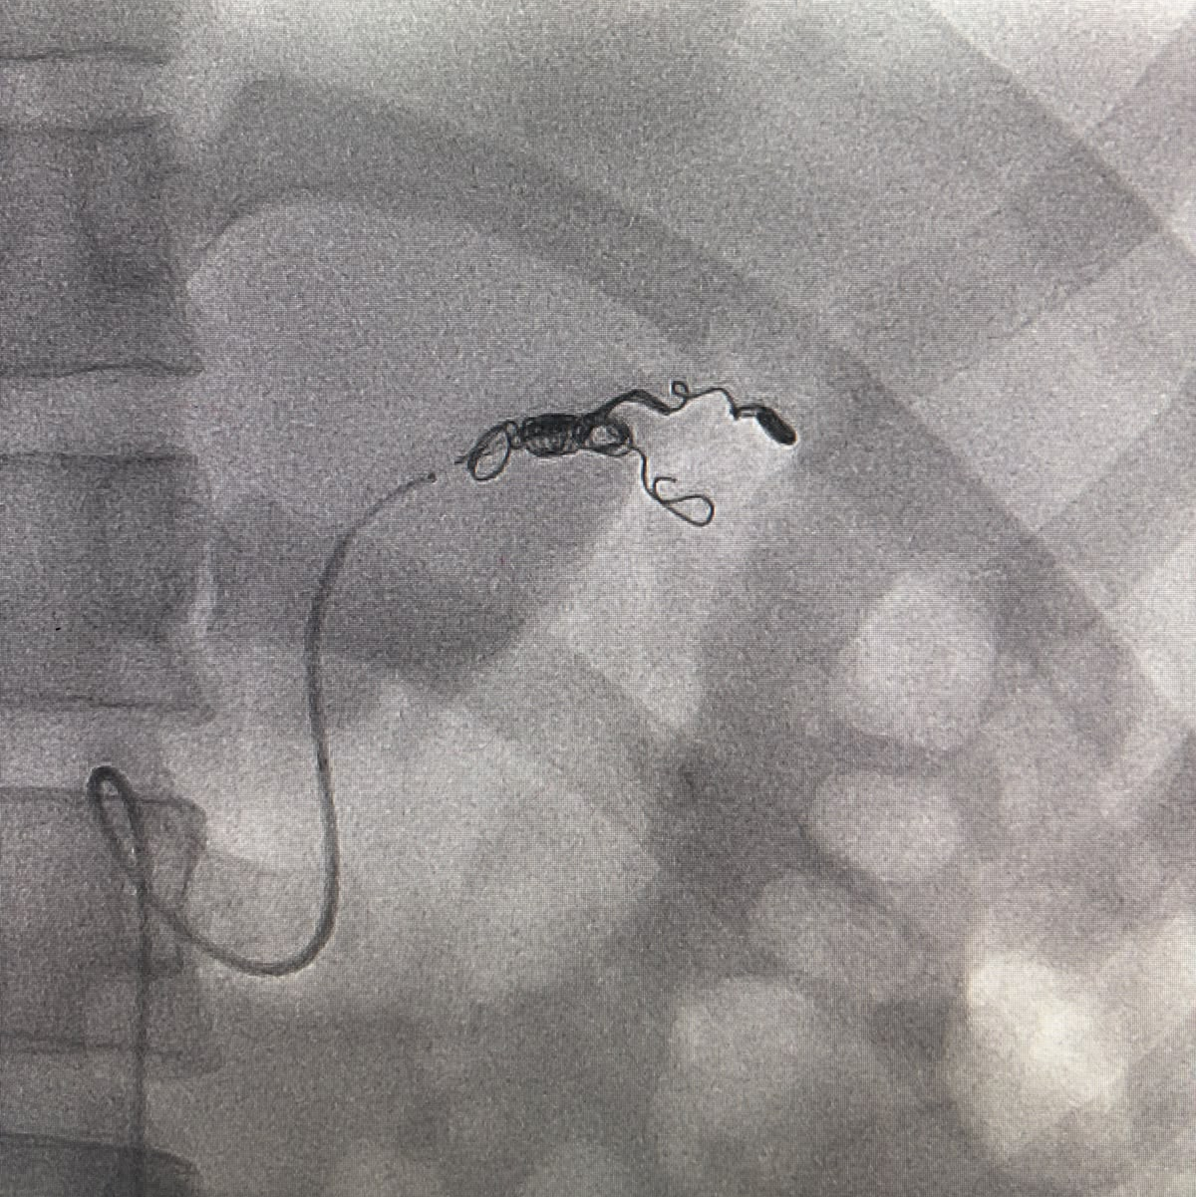
Final check angio preserving upper pole branches of spleen
Embolization using coils using anchor technique and gel foam plugging
Notes:
Complete occlusion of middle hilar, lower polar branches and distal splenic artery
Complete obliteration of the pseudoaneurysm

Slide 25
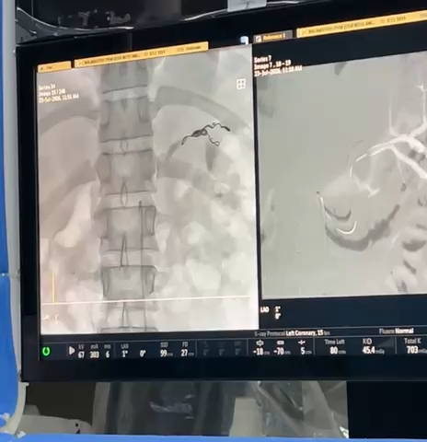

Slide 26
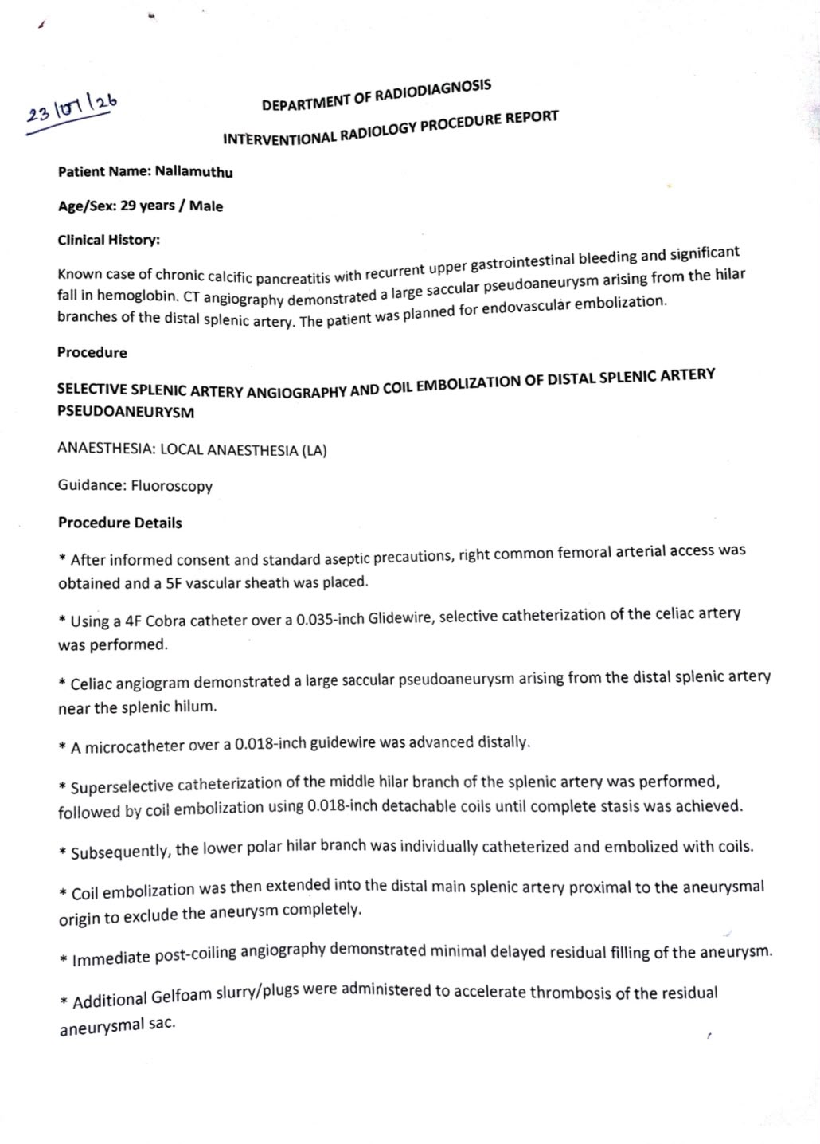
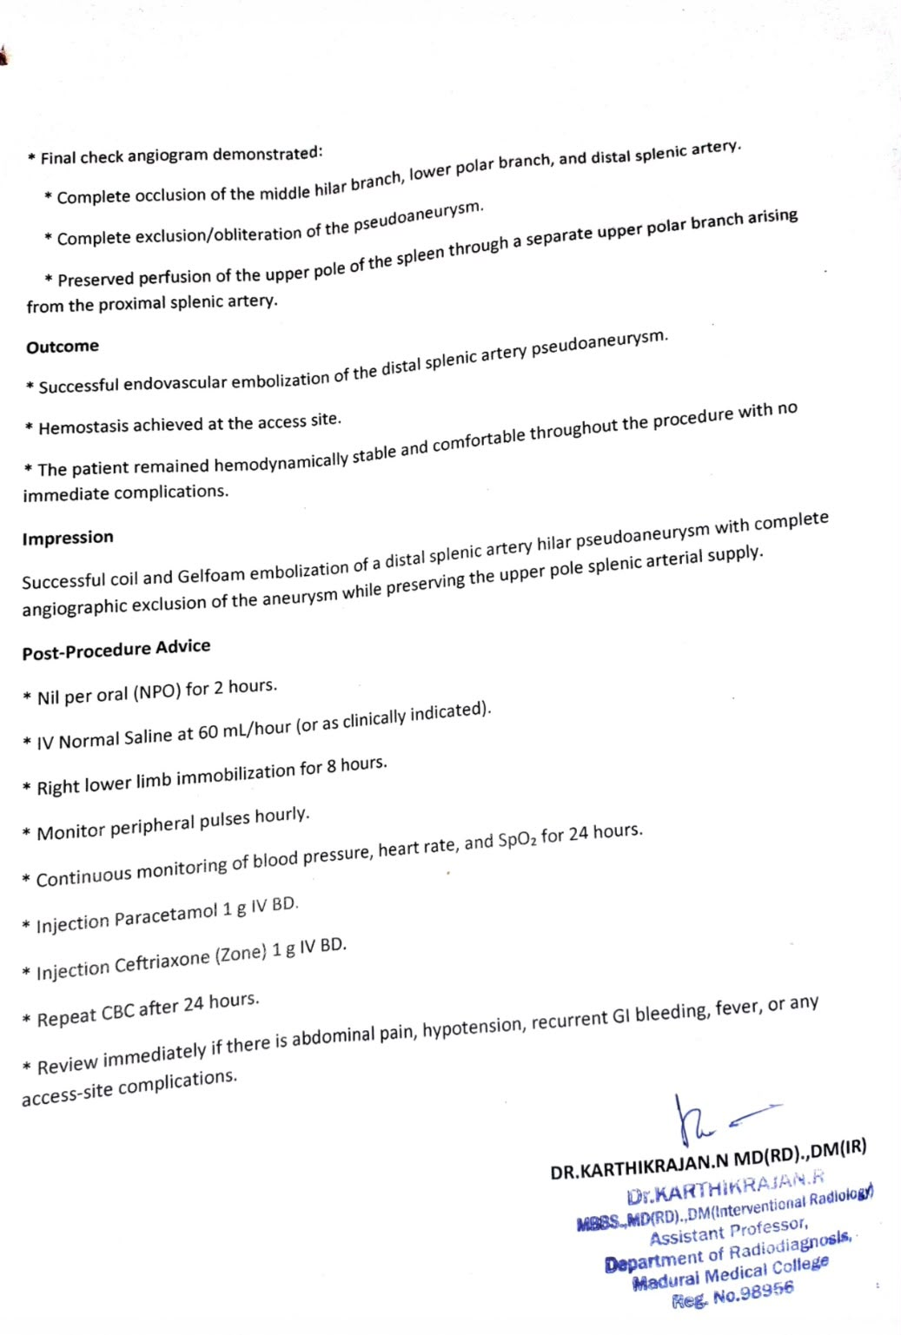

Slide 27
POST PROCEDURE STATUS OF THE PATIENT
Conscious, Oriented
Afebrile
Comfortable at rest
No Pallor/ Icterus
VITALS:
BP 110/70mmHg
PR 62/min
SpO2 99% RA
RR 16/min
S/E:
CVS- S1S2 +, No murmur
RS- B/L AE +, Normal vesicular breath sounds
PA- Soft, Non tender, BS+, No organomegaly
CNS- Conscious, Oriented
No further episodes of melaena post procedure.

Slide 28
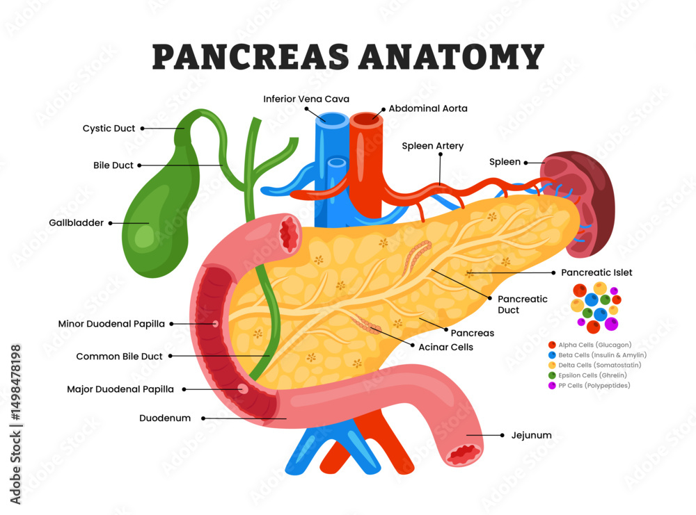
HEMOSUCCUS PANCREATICUS
Hemosuccus pancreaticus is a rare but life-threatening, obscure cause of upper gastrointestinal bleeding through the main pancreatic duct
Characterized by intermittent upper gastrointestinal bleeding from the ampulla of Vater into the duodenum
Difficult diagnosis due to its rarity, intermittent nature of the hemorrhage, and peculiar clinical presentation.
It is still considered a surgical problem but advances in medical therapy may enable clinically stable patients to undergo less-invasive angiographic embolization
It predominantly occurs in the settings of chronic pancreatitis, aneurysms of peripancreatic vessels, and pancreatic tumors

Slide 29
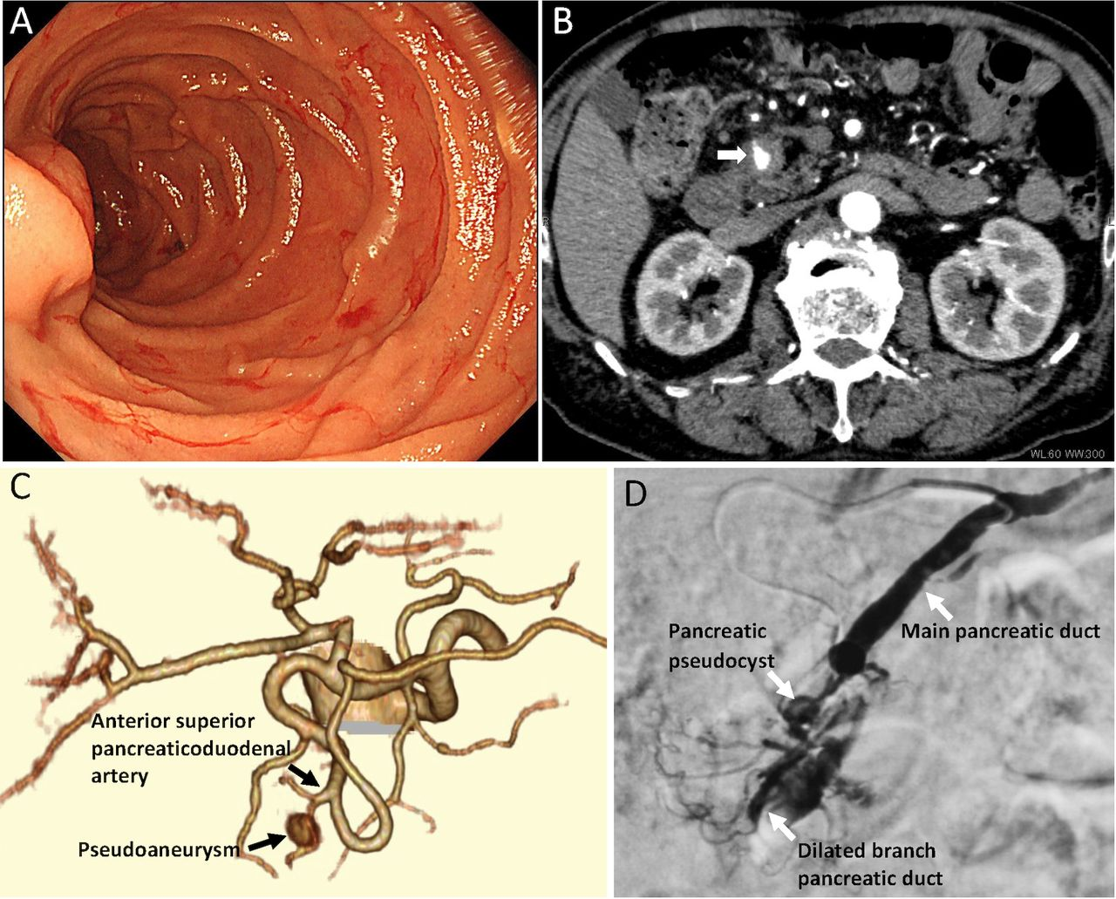

Slide 30
CLINICAL FEATURES
The clinical presentation in these patients is varied but a triad of epigastric pain, gastrointestinal bleeding and hyperamylasaemia has been encountered in a vast majority of patients
Melena is the most frequently observed form of upper gastrointestinal bleeding followed by hematemesis. The bleeding is intermittent and usually not very severe even though it has an arterial origin.
Epigastric pain predominantly results from increased pressure in the pancreatic duct due to blood clots-related obstruction. In these patients, serum amylase elevates secondary to the concurrent presence of acute pancreatitis
Nausea, vomiting, unintentional weight loss, a palpable aneurysmal mass, hemodynamic compromise, and/or jaundice due to bile duct obstruction by pancreatic head masses are among other notable clinical features

Slide 31
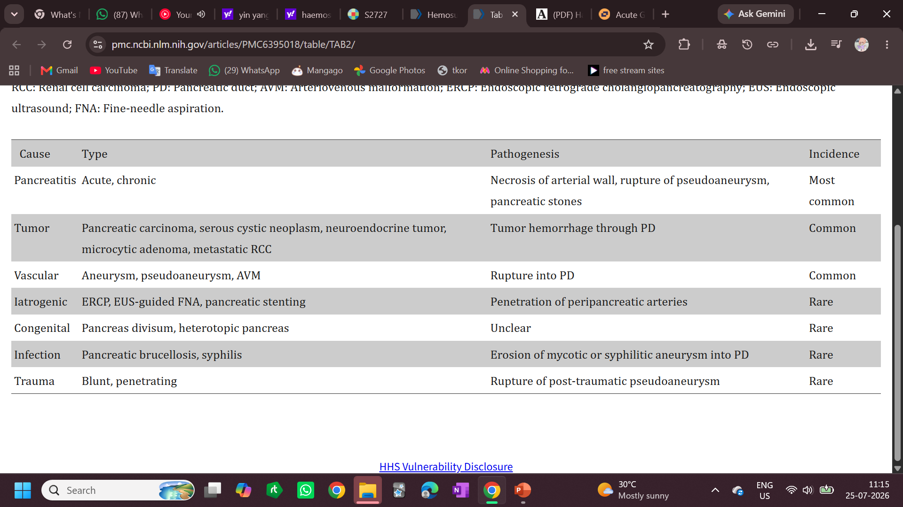
The common and uncommon associations of hemosuccus pancreaticus

Slide 32
APPROACH TO DIAGNOSIS
OGD- only about 30% cases may be diagnosed. To rule out other causes of UGI bleed
CT abdomen with contrast- identifies the pancreatic parenchymal etiology but also demonstrates radiological signs of peripancreatic cystic and aneurysmal lesions
To localize the site of bleeding:
Side viewing endoscope used in ERCP- higher yield
Endoscopic retrograde cholangiopancreatography (ERCP)
Endoscopic ultrasound (EUS)

Slide 33
TREATMENT options
The treatment is largely based on the location and size of the involved peripancreatic artery.
If the artery is localized and the size is small, stent or coil angiographic embolization is the initial therapeutic choice to achieve hemostasis, with a procedural success rate ranging from 79% to 100%.
Recently, balloon-assisted coil embolization has shown remarkable outcomes in this regard.
However, it is notable that the embolotherapy has been associated with complications such as bowel ischemia, splenic infarct, infected aneurysm, and organ ischemia.
Surgical intervention is indicated for hemorrhage from relatively large-caliber arteries, especially in cases with failed embolization, uncontrolled bleeding, and persistent hemodynamic compromise - Pancreatic duct ligature, pseudoaneurysm exclusion with arterial-end ligation, resection of the pancreas, and pancreatic pseudocyst drainage

Slide 34


