Slide 1
INTERESTING CASE OF CNS TUBERCULOSIS
II MEDICINE UNIT
PROF DR.R .BALAJINATHAN MD.,
ASST PROF
DR.V.N.ALAGAVENKATESAN MD.,
DR.P.V BALAMURUGAN MD.
DR.R.PANDISELVAM M.D

Slide 2
CASE 2
51 years old male admitted with chief complaints of
Altered sensorium for past 3 days.
HISTORY OF PRESENTING ILLNESS
He was apparently normal 3 months back after which he developed low back
pain , fever with chills and rigor, was diagnosed to have pyelonephritis and treated
with DJ stenting.
H/O difficulty in using right upper and lower limb past 1 wk
H/O difficulty in walking
H/O Headache
H/O altered sensorium – 3 days
H/O fever
Intermittent in nature
Associated with chills & rigor
H/O loss of appetite
H/O loss of weight

Slide 3
No H/O seizures
No H/O vomiting
No H/O LOC
No H/O head injury
No H/O involuntary micturition/ defecation
No H/O cough with expectoration
No H/O breathing difficulty
No H/O ear pain/ discharge in the ear
No H/O blurring of vision

Slide 4
PAST HISTORY:
K/C PTB 6 years back completed 6 months of ATT
K/C of pyelonephritis underwent DJ stenting 3 months back
K/C of TYPE 2DM on OHA
Not a k/c of SHT/ CAD/Seizure disorder
PERSONAL HISTORY:
Consumes mixed diet
Known smoker & alcoholic 15 years

Slide 5
GENERAL EXAMINATION
Patient drowsy occasionally responds to painful stimuli
Afebrile
Anaemic
Not icteric
No cyanosis
No clubbing
No lymphadenopathy
No pedal oedema

Slide 6
VITAL SIGNS:
PULSE : 86/ min regular in rhythm normal in volume felt in all accessible peripheral pulse
No radiofemoral ,radio radial delay
BLOOD PRESSURE: 150/90 mmhg taken in right upper limb in supine position
SPO2 : 94% @ room air
RR : 14 / min

Slide 7
SYSTEMIC EXAMINATION
CENTRAL NERVOUS SYSTEM
HMF - Drowsy , occasionally responds to oral commands
Language – Could not be tested
Speech
Memory

Slide 8
CRANIAL NERVE EXAMINATION
I – could not be tested
II - B/L PUPIL 3MM ERTL
FUNDUS – NORMAL
III , IV, VI- No apparent ptosis
V- No jaw deviation
Jaw jerk just present
VII -No facial asymmetry
No deviation of angle of mouth
Wrinkles +
Eye lid closure full
VIII, IX,X,XI, XII- could not be tested

Slide 9
SPINOMOTOR SYSTEM
 | RIGHT | LEFT
BULK UL | NORMAL | NORMAL
LL | NORMAL | NORMAL
TONE UL |  | NORMAL
LL |  | NORMAL
POWER | COULD NOT BE TESTED

Slide 10
SPINOMOTOR SYSTEM
DTR | RIGHT | LEFT
BICEPS | ++ | +
TRICEPS | ++ | +
SUPINATOR | ++ | +
KNEE | ++ | +
ANKLE | ++ | +
PLANTAR

Slide 11
CNS EXAMINATION
SENSORY SYSTEM
POSTERIOR COLUMN Could not be tested
CEREBELLUM
SPINE & CRANIUM - Normal

Slide 12
SYSTEMIC EXAMINATION
CVS – S1S2 +
JVP Normal
NO Murmur
RS B/L AE +
NVBS
No added sounds
PA Soft
No organomegaly, BS +

Slide 13
INVESTIGATION
Hb 10.8 gm
TC 16900 cells/ cumm
DC P- 82 L – 11 M- 7
PLT 3.25 lakhs
PCV 34%
ESR 31 mm/hr
RBS 422 mg/dl
LFT Normal

Slide 14
INVESTIGATIONS…
DAY | 1 | 3 | 5
Na | 125 | 130 | 135
K | 4 | 4.3 | 5
UREA | 62 | 52 | 55
CREATININE | 3.9 | 2 | 2.5

Slide 15
INVESTIGATIONS…
URINE ANALYSIS
ALBUMIN - TRACE
SUGAR - NIL
DEPOSITS- 2-4 PUS CELL
URINE KETONES - Negative
USG ABDOMEN- Medical renal disease
VCTC - NON REACTIVE
BLOOD & URINE C&S - No evidence of growth in culture

Slide 16
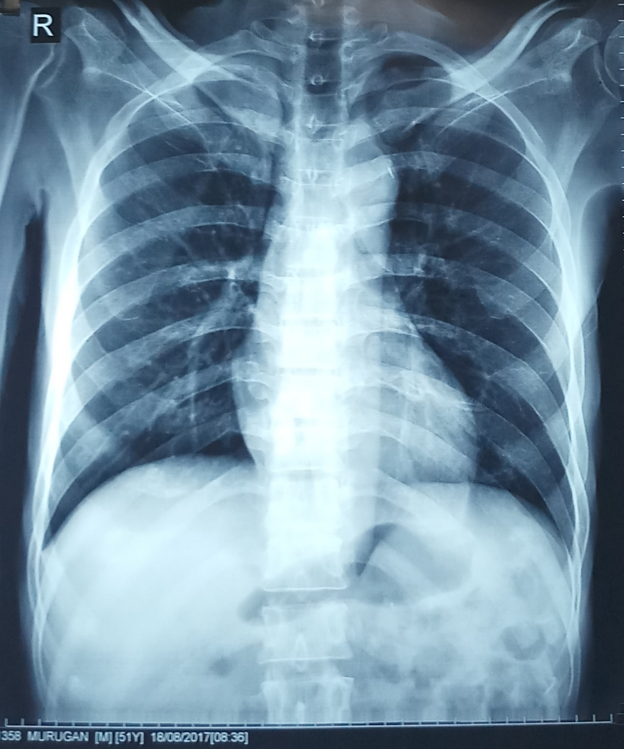
CHEST XRAY

Slide 17
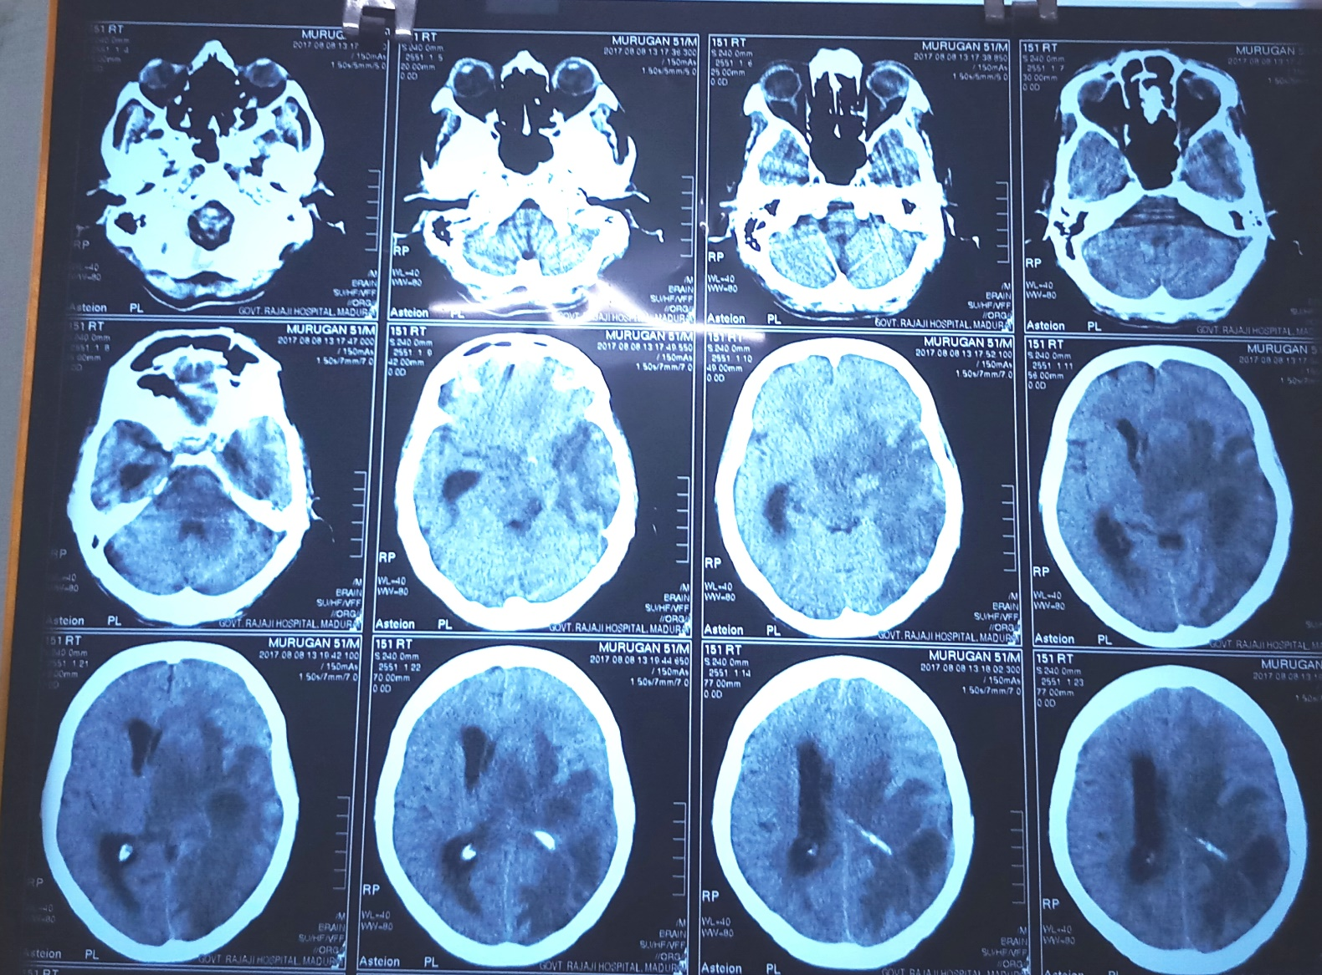
CT BRAIN

Slide 18
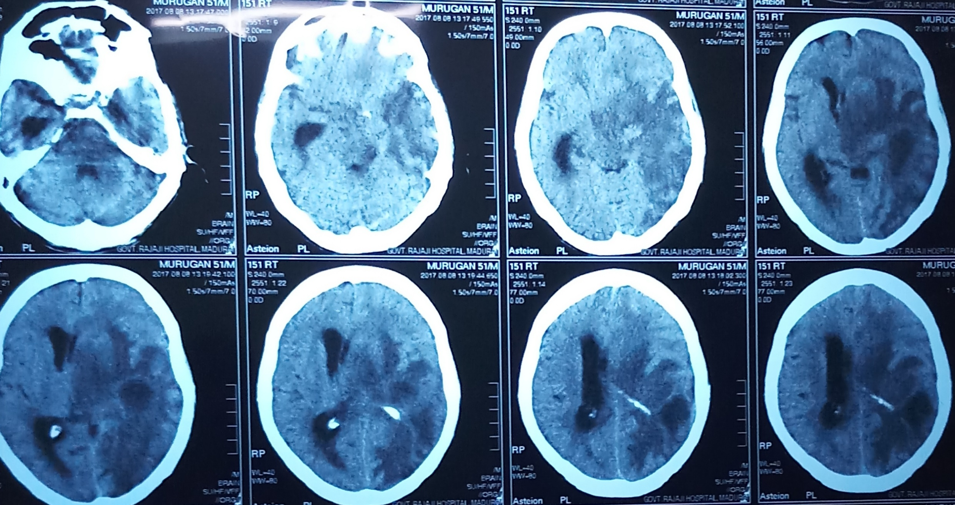
CT BRAIN

Slide 19
CT BRAIN REPORT
Mixed lesion noted in left temperoparieto occipital region causing midline shift with obstruction of third ventricles.
IMPRESSION ;
SPACE OCCUPYING LESION in the left temperoparieto occipital region
SUGGESTION
MRI BRAIN

Slide 20
DIAGNOSIS
TYPE 2 DM
SOL LEFT TEMPERO PARIETAL REGION WT RIGHT HEMIPLEGIA
OLD PULMONARY TUBERCULOSIS
CHRONIC KIDNEY DISEASE

Slide 21
TREATMENT
IV fluids
Inj. Dexamethasone 8mg iv bd
Inj ceftriaxone 2g iv bd
Inj ampicillin 2g iv qid
Inj ranitidine 50 mg iv bd
Glycerol 20ml tds by RT
Inj Phenytoin 100mg iv tds
Inj Human actrapid 8units tds

Slide 22
NEUROLOGIST OPINION
Right hemiplegia / SOL – Left Temparo Parietal Region With Midline Shift
SUGGESTION
Oral Glycerol 20ml tds
Inj Phenytoin 100 mg IV TDS
Inj dexamethasone 4mg IV BD
Neurosurgeon opinion
MRI Brain

Slide 23
NEUROSURGEON OPINION
Right hemiplegia with aphasia S/O Glioblastoma Multiforme
SUGGESTION
IVF NS 3PINT
RL 2 PINT @ 100ml/hr
Head End Elevation
Inj Ceftriaxone 2g Iv Bd
Oral glycerol 20 ml TDS
Inj Phenytoin 100 mg IV TDS
Inj Lasix 20 Mg Iv Bd
MRI Brain with DWI Plain & Contast

Slide 24
MRI BRAIN

Slide 25
MRI BRAIN

Slide 26
MRI BRAIN REPORT
Multiple well defined T2 FLAIR hyperintense with hypointense lesion
T1 hyperintense with hypointense rim noted in left temperoparieto occipital region which shows diffusion restriction on DWI with extensive perilesional vasogenic white matter edema noted
Lesion causing mSass effect in the form of midline shift of 15mm
Mass effect causing effacement of I/L lateral ventricle & temporal horn with dilatation of C/L lateral ventricle & temporal
IMPRESSION;
Multiple cerebral abscess - Tuberculous etiology
Suggested contrast study

Slide 27
DIAGNOSIS
Type 2DM
CKD
OLD PTB
MULTIPLE CEREBRAL ABSCESS TB ETIOLOGY

Slide 28
NEUROSURGEON REVIEW
MULTIPLE CEREBRAL ABSCESS
SUGGESTION;
To continue antiepileptics
To continue antiedema measures
To continue higher antibiotics

Slide 29
PULMONOLOGIST
H/O PTB 6 years back , took ATT for 6 months
SUGGESTION
Start on CAT II ATT
Ethambutol 600mg on alternative days
Inj. Streptomycin 500 mg on alternative days

Slide 30
THANK YOU

Slide 31
AIM OF PRESENTATION
Rarity of CNS TB presenting as abscess
This case highlights the diagnostic dilemma in an immunocompromised patient with multiple focal brain lesions, especially in areas where TB is endemic.
TB should be considered as a possible aetiology for any intracranial lesion with radiological appearance suggestive of an abscess and surgical treatment can be kept as an option in case of neurological deficits, hydrocephalus or treatment failure.

