Slide 1
Ecg slides
By III medical unit
CHIEF : Dr. PALANIKUMAR B MD
ASSISTANT PROFESSORS : Dr. PONSENTHIL KUMAR MD
Dr. ILAMARAN MD

Slide 2
A 52 year old female patient presented with complaints of breathlessness since one day, sudden and onset progressive in nature progressed from NYHA class II to NYHA class III
history of palpitation +
no history of chest pain
Past history
Known case of systemic hypertension for four years on tablet amlodipine
o/e patient conscious
oriented
afebrile
dyspneic + tachypneic +
no pallor normal jvp
s/e
cvs: s1 s2+
rs: bae+ Bilateral extensive crackles heard all over the lung field,
bilateral wheeze present
p/a : soft
cns: nfnd
bp: 130/80 mmhg
pr: 102 /min regular
spo2 : 98% 4l o2

Slide 3
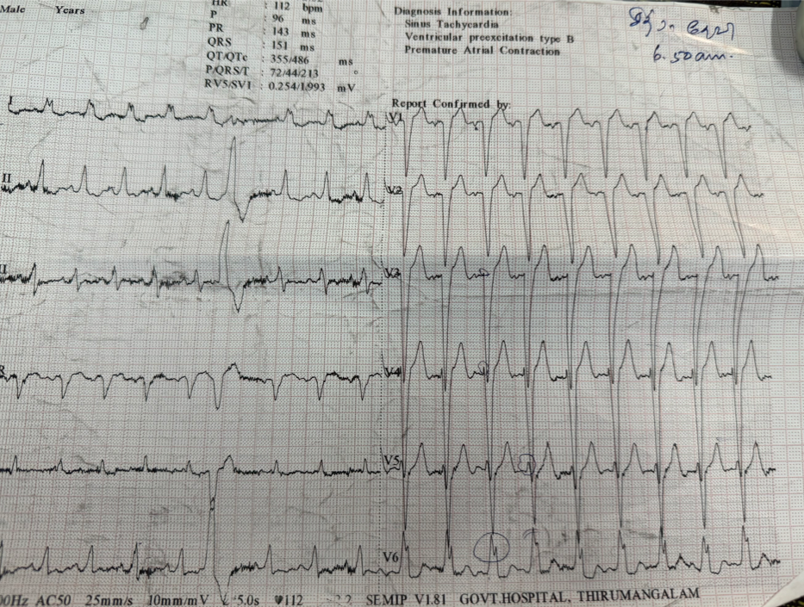

Slide 4
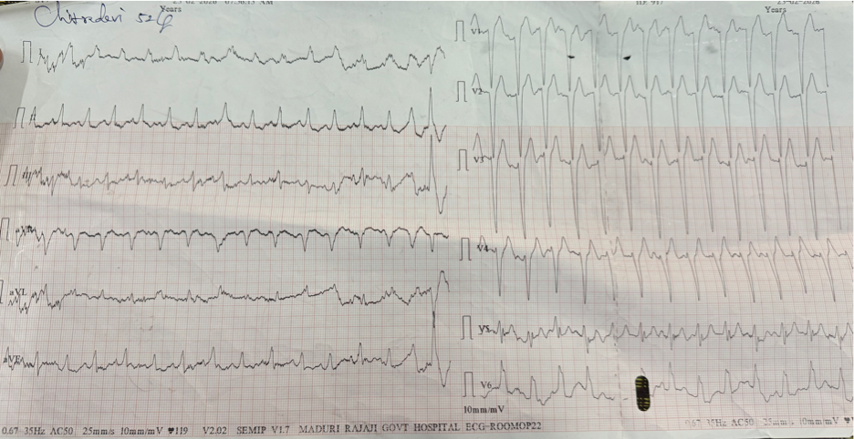

Slide 5
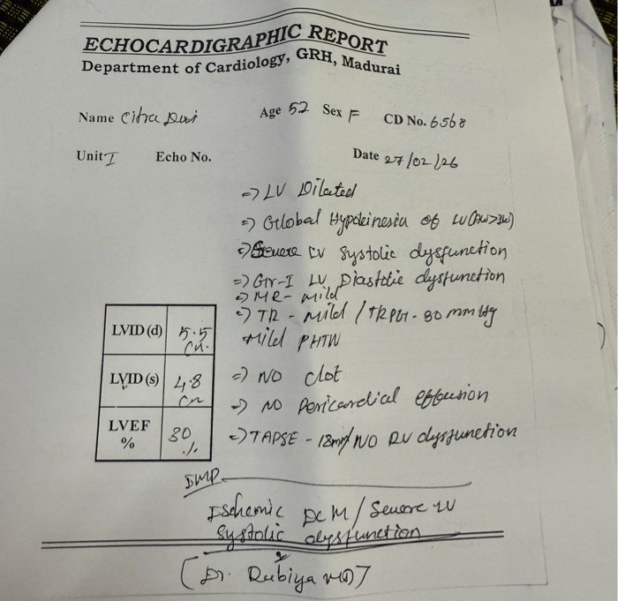

Slide 6
1. CRITERIA
2. VECTORS IN LBBB
3. MODIFIED SGARBOSSA CRITERIA
4. PSEUDONORMALIZATION
5.RATE DEPENDENT
6.LBBB AND CRT
7.BIFASCICULAR / TRIFASCICULAR BLOCK

Slide 7
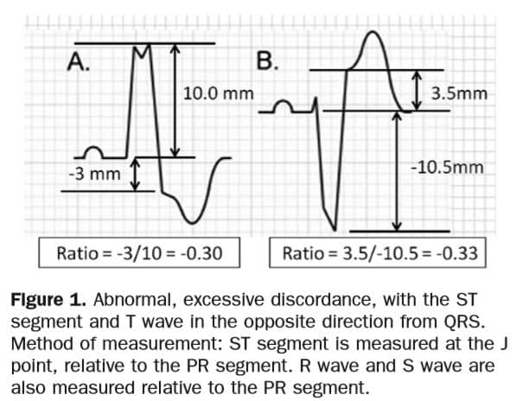

Slide 8
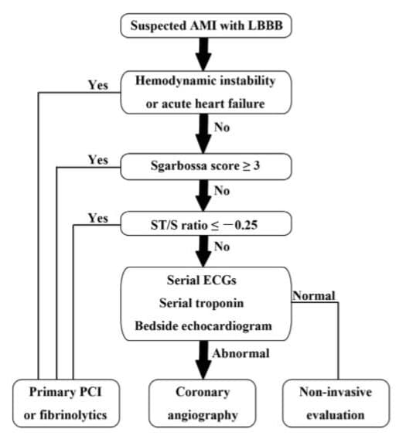

Slide 9
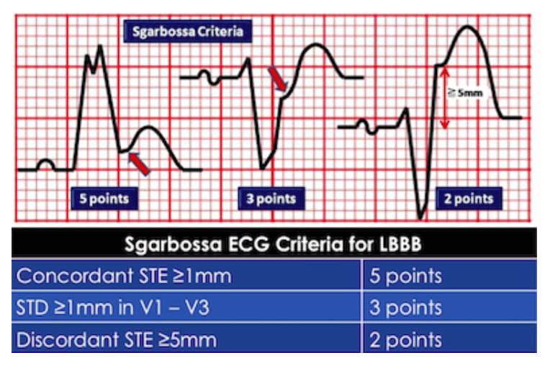

Slide 10
THANK YOU

