Slide 1
RECENT ADVANCES
IN CARDIOLOGY
CHIEF: Prof.Dr. SYED BAHAVUDEEN HUSSAINI M.D,
ASSSISTANT PROF: Dr.S.VINOTH KANNAN M.D,
Dr.V.P.PRIYA M.D,
PRESENTOR: Dr. P.GOWTHAM RAM
Post graduate

Slide 2
Advances in the Management of
Resistant Hypertension

Slide 3
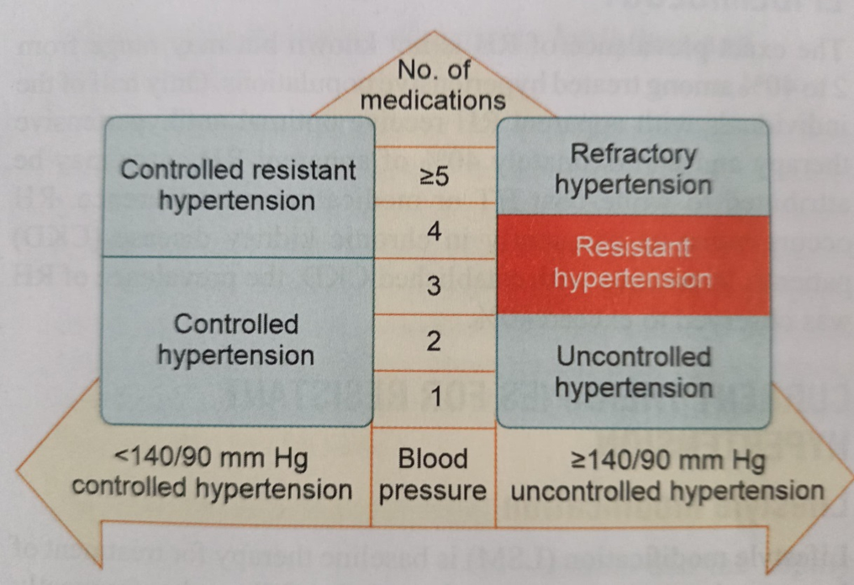
Resistant hypertension (RH) persists despite using three or more antihypertensive medications.

Slide 4
Causes of secondary hypertension
Renal:
Chronic kidney disease
Renal artery stenosis
Endocrine:
Primary hyperaldosteronism
Cushing’s syndrome
Pheochromocytoma
Hypothyroidism
Hyperparathyroidism
Acromegaly
Others:
Obstructive sleep apnea
Drugs (alcohol, hormone replacement therapy, anabolic steroids, and NSAIDs)
Coarctation of aorta
Pregnancy-related

Slide 5
Current Therapies For Resistant Hypertension
Lifestyle Modification
Chronotherapy

Slide 6
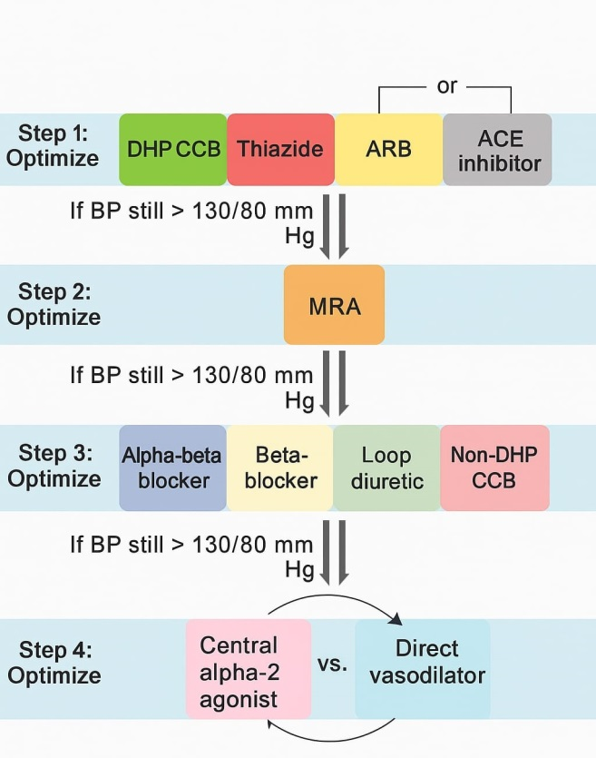
Pharmacotherapy
DHP CCB
Amlodipine, Nifedipine, Nicardipine, Nimodipine
First line
Agents
Thiazide
Hydrocholothiazide, Chlorthalidone, Indapamide
Second line
Agents
Mineralocorticoid Receptor Antagonist
Spironolactone, Eplerenone & Finerenone
Third line
Agents
Non DHP CCB
Verapamil,Diltiazem
Central Alpha 1 Agonist Clonidine or Doxazosin
Fourth line
Agents
Direct Vasodilators
Hydralazine or Minoxidil

Slide 7
Therapies Being Used for Other Indications that may Impact Blood Pressure Reduction
Finerenone (3rd Generation nonsteroidal MRA)
It has a brief half-life, its effects on SBP persisted over 24 hours. Systolic blood pressure dropped between 8 and 11 mm Hg with 10–20 mg doses of finerenone in T2DM and CKD.
Sodium-glucose Cotransporter-2 Inhibitors
Inhibition of SGLT-2 causes natriuresis in addition to the osmotic diuretic effect due to the resulting glycosuria.

Slide 8
New Agents Under Investigation
Baxdrostat – It is an inhibitor of aldosterone synthase. Without altering cortisol levels, it decreased aldosterone levels in several preclinical trials.
Aprocitentan (Dual Endothelin Antagonist)- Addition of aprocitentan to a standard antihypertensive regimen in patients with RH showed a significant decrease in SBP and DBP. Improvements were sustained after 48-week period.
Firibastat - Centrally acting APA inhibitor prodrug. it prevents the conversion of angiotensin-II to angiotensin-III, which exerts central stimulatory regulation over BP.

Slide 9
Angiotensin Receptor–Neprilysin Inhibitors
Neprilysin inhibitors prevents degradation of the peptides resulting in natriuresis ,Vasodilation, reduded sympathetic tone that lowers the BP. In combination with RAAS blockade, neprilysin inhibitors reduce BP, arterial stiffness, cardiac hypertrophy, and fibrosis.
Sacubitril/Valsartan - Dual ARNIs consist of the ARB valsartan and the neprilysin inhibitor. It will be used to a greater extent in the future not only for heart failure but also for improving BP control, especially in patients with RH.

Slide 10
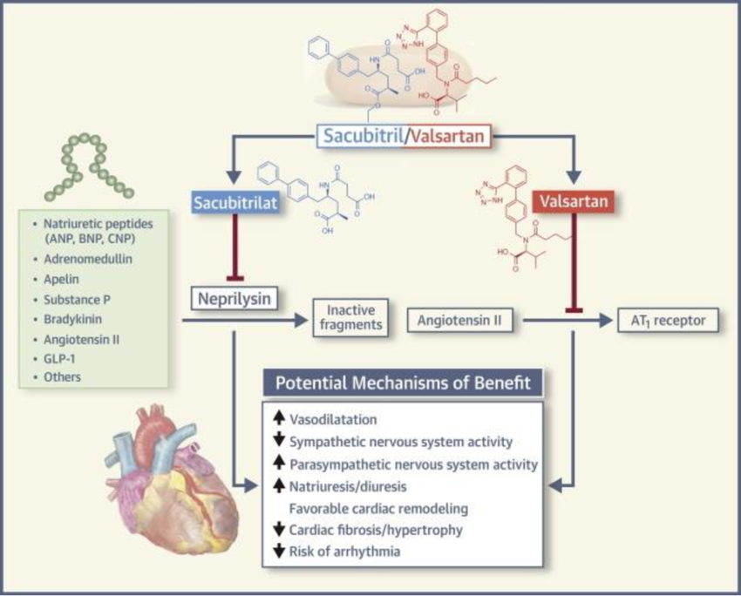

Slide 11
Continuous Positive Airway Pressure
CPAP is indicated as an adjuvant treatment for greater than 4 hours per night, improving the quality of life and probably reestablishing the dipper pattern of nighttime BP.
Central Iliac Arteriovenous Anastomosis
The ROX Medical arteriovenous coupler is a stent-like device forming an arteriovenous (AV) anastomosis in central iliac. It exhibited sustained reductions in both office and ambulatory BP.

Slide 12
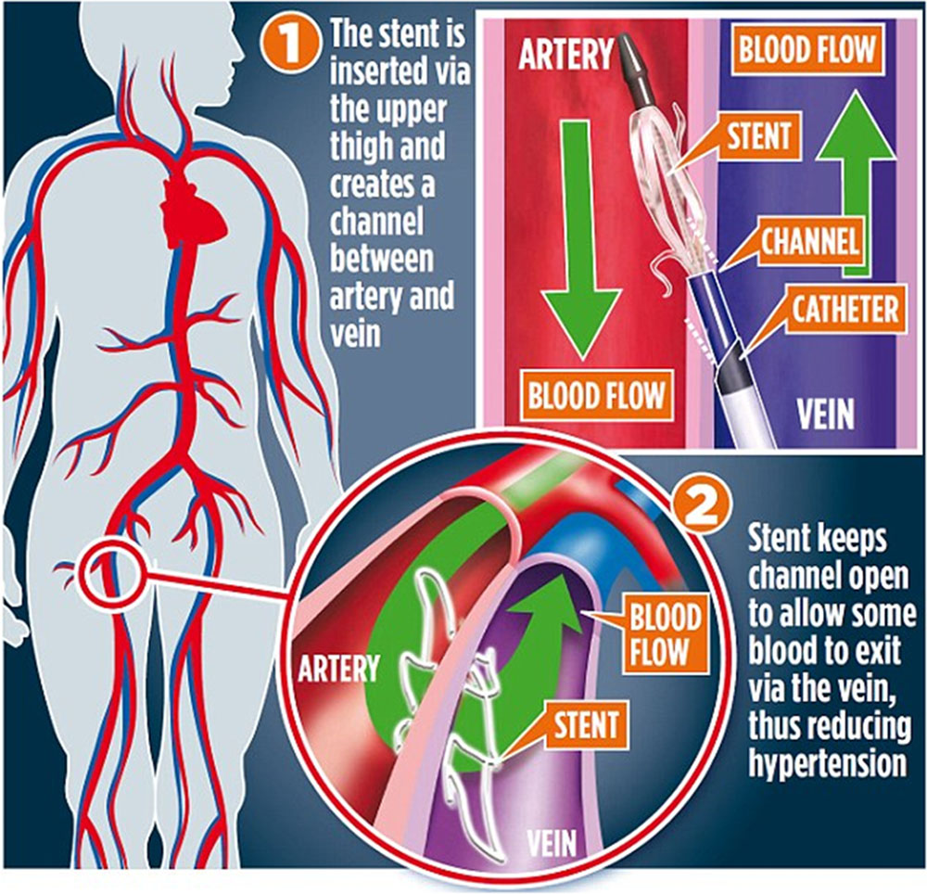

Slide 13
Pan-Antiplatelet Resistance

Slide 14
Platelets plays a pivotal role in the pathological process of thrombus formation, which lead to MI, ischemic stroke, and PVD.
Despite effectiveness and the proper intake of drugs; aspirin or Clopidogrel fails to produce proper platelet aggregation due to reduction in platelet sensitivity and thus results in recurrent adverse vascular events and this phenomenon is called antiplatelet resistance, now known as “high on treatment platelet reactivity” (HTPR).

Slide 15
Mechanisms of Antiplatelet Resistance
Pharmacogenetic factors:
Aspirin:
-Degradation of miRNA
-COX1 genetic variation
-Polymorphism of COX2, TXA2, von Willebrand factors
-Hyper expression of COX2 isoforms
Clopidogrel:
-Polymorphism of P2RY12, GP3A, and PON-1
-CYP polymorphism due to loss of function in CYP2C19
-Nonresponsiveness due to genetic variants ABCB1 of TT variants

Slide 16
Clinical factors:
-Inadequate dosing
-HTPR
-Metabolism through alternative pathway
-Drug-drug interaction (DDI) - Aspirin with NSAIDs, Clopidogrel with PPI & statins
Pharmaceutical and patient factors:
-Manufacturing defect & Poor patient compliance
Miscellaneous factors:
-Metabolic syndromes: DM, Obesity, Dyslipidaemia, Hyperthyroidism, -
-Associated comorbidities :COPD, CVS, and CKD Inflammatory conditions & Infections

Slide 17
Aspirin Resistance
Antithrombotic effect is due to the irreversible acetylation of a serine residue in the COX1 that prevents the binding of arachidonic acid to the catalytic site and blocks the production of TXA2,
The potential mechanisms of resistance include genetic variation of COX1, COX2 or TXA2, stress or infection, absorption limitation, DDI, medication non-adherence, etc.
Clopidogrel Resistance
It is an inactive prodrug which undergoes hepatic metabolism by the hepatic P450 to generate an active metabolite.
Resistance is mainly due to the CYP2C19 gene polymorphisms

Slide 18
To assess the antiplatelet function of aspirin,
-Urinary level of TXB2
-Quantification of the expression of P selectin and P selectin soluble
For the evaluation of action of aspirin in platelet aggregation,
-Optic platelet aggregation test
-Platelet function analyzer
-Aspirin rapid test on action
-Thromboelastogram
The American and European guidelines recommend three methods for assessment of platelet resistance:
VerifyNow Assay
Multiplate analyzer
VASP Assay

Slide 19
MANAGEMENT
To switch from one antiplatelet to another
To increase the dose of antiplatelet drugs
To use combination of antiplatelet drugs
To avoid DDI
To use newer antiplatelet drugs (Ticagrelor, Prasugrel)
To control comorbid conditions (such as CKD, DM, COPD)
To combine older and newer antiplatelet drugs
To use cilostazol (a PDE-3 inhibitor of platelets)

Slide 20
Is Colchicine a Game Changer in Acute Coronary Syndrome???

Slide 21
Colchicine (anti-inflammatory drug) was declared as a potently cheap and effective drug in treating atherosclerosis.
The role of colchicine is proved in ACS by lowering the levels of high CRP, decreasing low attenuation plaque volume, and stabilizing plaque
Colchicine (a lipid-soluble drug) is absorbed by the jejunum and ileum. It is a standard antimitotic drug, which freezes mitotic cells in metaphase stage.
It binds to soluble tubulin to form tubulin-colchicine complexes, which then binds to the end of microtubules to prevent the activity of inflammatory cells.

Slide 22
Anti-inflammatory Mechanism of Colchicine
1. Inhibition of Microtubule Formation
Colchicine binds to tubulin, preventing the assembly of microtubules. This disrupts various cellular functions, especially in neutrophils
2. Suppression of NLRP3 Inflammasome Activation Colchicine inhibits activation of the NLRP3 inflammasome, This reduces release of interleukin-1β (IL-1β) and interleukin-18 (IL-18).These cytokines are responsible for inflammation and plaque destabilization in cardiovascular disease.
3. Inhibition of Inflammatory Mediators
Decreases expression of E-selectin and VCAM-1 on endothelial cells, reducing neutrophil adhesion.
Suppresses TNF-α, IL-6, and other cytokines.
Interferes with leukocyte migration and recruitment at inflammation sites.

Slide 23
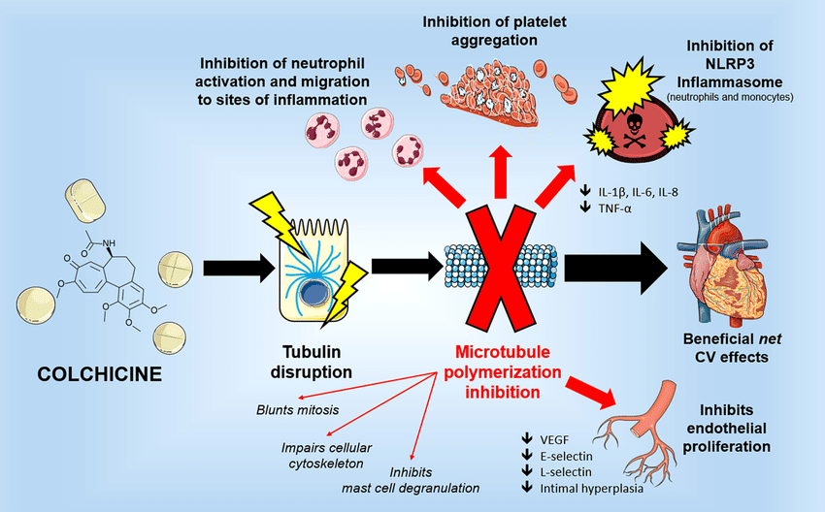

Slide 24
Dose Level | Mechanism
Low doses | Inhibits E-selectin expression, suppresses neutrophil adhesion and recruitment
High doses | Blocks neutrophil activation, cytokine release (IL-1β, IL-18), and vascular endothelial growth factor (VEGF) expression
Overall | Inhibits inflammatory pathways, reduces leukocyte migration, improves plaque stability

Slide 25
Role of Colchicine in Reducing Inflammation in ACS
Low dose colchicine can effectively reduce the levels of hsCRP(biomarker of inflammation) levels in patients with stable CAD and aid in lowering the levels of inflammation.
Adverse Effects of Colchicine
Colchicine safely employs its potent anti-inflammatory effects in targeting inflammation. It can be administered in low doses of 0.5mg/day to patients with a recent
Nausea and flatulence
Pneumonia
Diarrhea

Slide 26
Colchicine Cardiovascular Outcome Trial (COLCOT)
The results of the COLCOT showed that the colchicine group experienced a significantly lower number of primary endpoint events.
Secondary Outcomes | Cholchicine | Placebo
Deaths | 20 (0.8%) | 24 (1.0%)
Need for Urgent hospitalisation for revascularization | 1.1% | 2.1%
Incidence of Stroke | 0.2% | 0.8%

Slide 27
Endovascular Lithotripsy (EVL)

Slide 28
Minimally invasive technique that Uses acoustic shockwaves to fracture calcium in the vessel wall. Balloon-based delivery system
Mechanism of Action
Special balloon catheter emits pulsed sonic pressure waves.
Waves pass through soft tissue, preferentially fracturing intimal and medial calcium Followed by balloon dilation and/or stenting

Slide 29
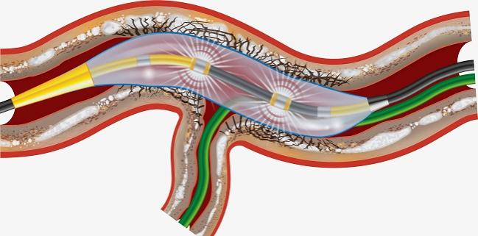

Slide 30
Advantages of EVL
Selective calcium fracture without damaging the soft tissue Lowers risk of dissection, perforation, or embolization
Safe for tortuous or distal vessels.
Does not generate heat or high pressure.
Facilitates optimal stent expansion

Slide 31
Limitations
Not suitable for thrombotic lesions
Cannot be used in severely tortuous vessels
Balloon sizing is critical
Cost and availability
Not a replacement for atherectomy in all cases

Slide 32
Trans catheter Aortic Valve Replacement (TAVR)

Slide 33
Minimally invasive alternative to Surgical Aortic Valve Replacement (SAVR)
Balloon-expandable or self-expanding prosthetic valve,
Delivered via catheter (usually femoral artery)
Approved for high, intermediate, and low-risk patients

Slide 34
Indications for TAVR
Severe symptomatic aortic stenosis
High or prohibitive surgical risk
Patients with failed bioprosthetic valves (“valve-in-valve”)

Slide 35
OUTCOME
Improved survival, especially in inoperable/high-risk patients
Reduced hospital stay, faster recovery
Valve durability: Good data for 5–8 years; long-term studies ongoing
PARTNER 3 and EVOLUT Low Risk: TAVR non-inferior or superior to SAVR in low-risk patients

Slide 36
Complications
Vascular injury
Stroke
Aortic regurgitation
Conduction disturbances → may need permanent pacemaker
Valve malposition or embolization
Paravalvular leak

Slide 37
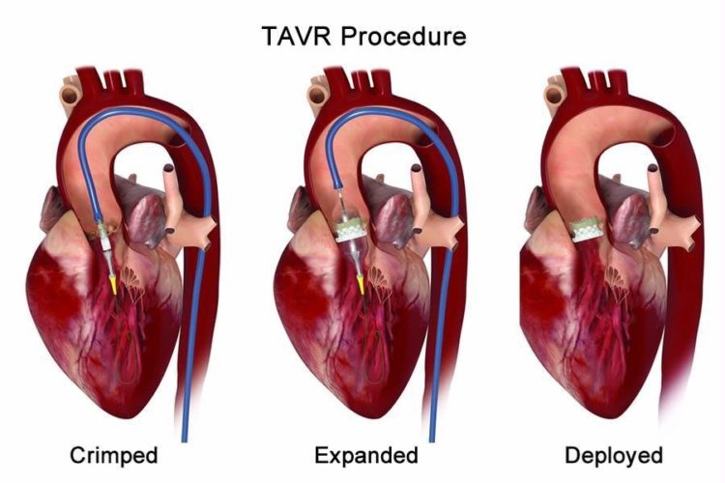

Slide 38
Evolocumab – A PCSK9 Inhibitor in Lipid Management

Slide 39
Evolocumab is a PCSK9 inhibitor Used for LDL-C reduction in high-risk patients.
Evolocumab is a fully human monoclonal antibody Binds circulating PCSK9
Prevents PCSK9 from degrading LDLR Enhances hepatic LDL clearance

Slide 40
Indications
Primary hyperlipidemia (including HeFH)
Homozygous familial hypercholesterolemia (HoFH)
Clinical atherosclerotic cardiovascular disease (ASCVD)
Inadequate LDL-C control despite statin ± ezetimibe

Slide 41
Dosage and Administration
140 mg SC every 2 weeks OR 420 mg SC once monthly
FOURIER Trial(27,000) patients with ASCVD LDL-C ↓ by 59%
Reduced MI, stroke, coronary revascularization
OSLER Trials Sustained LDL-C lowering Long-term safety

Slide 42
Cardiac MRI (CMR)
Non-invasive imaging modality
Uses magnetic fields and radiofrequency pulses
Provides functional, anatomical, and tissue characterization data
No ionizing radiation

Slide 43
Indications for Cardiac MRI
Cardiomyopathies (HCM, DCM, ARVC)
Myocarditis & pericarditis Ischemia & viability
Congenital heart disease
Valvular heart disease
Cardiac tumors & thrombi
Aortic disease (dissection, aneurysm)

Slide 44
Contraindications
Absolute: Certain metallic implants (e.g., non-MRI compatible pacemakers)
Relative:
Claustrophobia
Gadolinium allergy (rare)Renal impairment (risk of NSF)

Slide 45
MRI Sequences in CMR
Sequence Purpose
SSFP (cine) Wall motion, anatomy
T1-weighted Fat, hemorrhage
T2-weighted Edema (inflammation)
First-pass perfusion Myocardial ischemia
Late Gadolinium
Enhancement (LGE) Fibrosis/Scar
T1/T2 Mapping Quantitative tissue characterization

Slide 46
Late Gadolinium Enhancement (LGE)
Highlights scar/fibrosis
Gadolinium accumulates in extracellular space
Used in:MI (subendocardial or transmural scar)Myocarditis (mid-wall or subepicardial)
Cardiomyopathies (e.g., HCM patchy fibrosis)

Slide 47
Advantages of CMR
-Superior soft tissue contrast
-Multi-planar imaging
-Functional + anatomical + tissue characterization
-No ionizing radiation

Slide 48
Nuclear cardiology

Slide 49
Nuclear cardiology uses radioactive tracers to evaluate:
Myocardial perfusion
Viability
Function
Inflammation/metabolism

Slide 50
Myocardial Perfusion Imaging (MPI)
Compares rest vs stress perfusion
Detects ischemia and infarction
Stress types:Exercise (treadmill)Pharmacologic (adenosine, dipyridamole, regadenoson)
Normal: Homogeneous perfusion at rest and stress
Ischemia : Defect during stress, normal at rest
Infarct (scar): Fixed perfusion defect (both rest & stress)
Quantitative ejection fraction and wall motion can be assessed

Slide 51
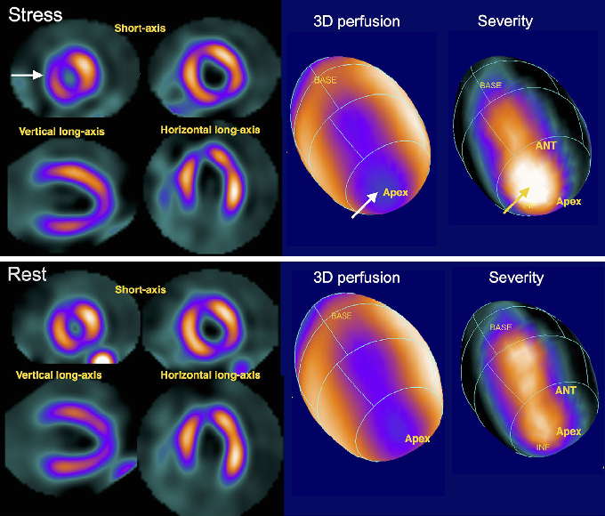

Slide 52
Viability Imaging
Thallium-201 or FDG-PET used
Hibernating myocardium: viable but underperfused
Important in decision for revascularization in ischemic cardiomyopathy
Viable = potential for recovery after revascularization
Cardiac Sarcoidosis / Inflammation Imaging
FDG-PET detects active inflammation

Slide 53


