Slide 1
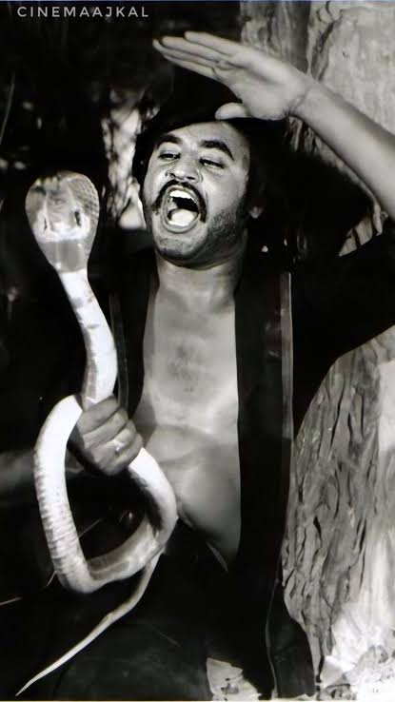
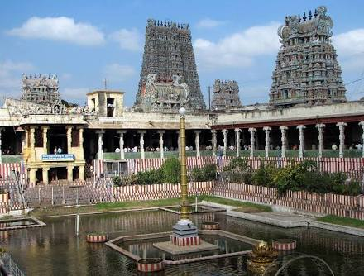
A CASE OF MAHA SNAKE BITE
1st MEDICAL UNIT
CHIEF: PROF.DR.NATARAJAN.MD
ASSISTANT PROFESSORS: DR.PALANIKUMARAN.MD
DR.VASANTHAKALYANI.MD.DCP
DR.SURESHKUMAR.MD

Slide 2
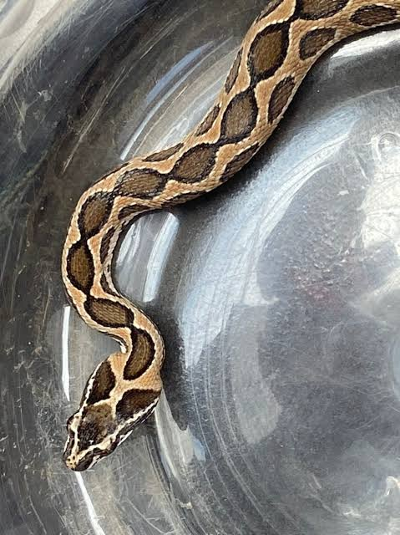
HI-FII HISTORY
36/M
Admitted with complaints of snake bite over right toe at around 7.PM in his house
H/o pain over bite site+
H/o swelling over bite site+

Slide 3
No means no – No Histories
No H/o vomiting , abdominal pain
No H/o malaise, drowsiness
No H/o double vision , restricted eye movements , drooping of eyelids
No H/o chest pain, dizziness ,faintness,altered sensorium
No H/o head drop, shortness of breath
No H/o numbness, difficulty in swallowing , aphonia, difficulty in using limbs

Slide 4
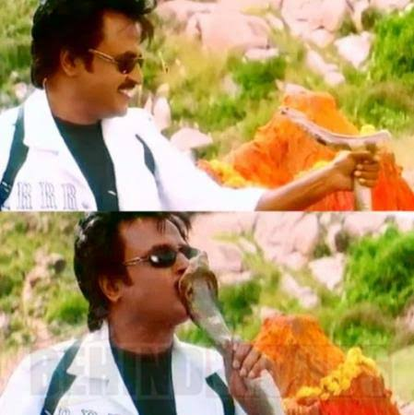
No H/o prolonged bleeding from bite site
No H/o sub conjunctival bleeding
No H/o muscle pain , stiffness
No H/o oliguria, high colored urine
No H/o loin pain ,uremia
No H/o symptoms of hypoglycemia

Slide 5
Past is not always past- its is the present and future too….
Patient has no similar complaints in past
Not a diagnosed case of diabetes , systemic hypertension , bronchial asthma , CAD,CVA,PTB
No h/o jaundice in past
No H/o recurrent fever, childhood malignancies
Not a k/c/o renal failure, nephrotic syndrome
Not a k/c/o renal tubular dysfunction

Slide 6
Personal history
Mixed diet
Sleep and appetite normal
Normal bowel and bladder habits
No h/o blood transfusions
Non smoker, non alcoholic
No sexual promisquity

Slide 7
ON EXAMINATION- WHAT U SEE IS MORE IMPORTANT THAN WHAT OTHERS SAY
Conscious, oriented, afebrile
Moves all 4 limbs
Bite mark on right toe +
No bleeding from bite site
No pallor, no icterus, no cyanosis, no clubbing ,
Popliteal lymphnodes + in right leg
Swelling over bite site + with pain
Obesity + centripetal type – acrocordans +, acanthosis +
Frank sign -, hairy pinna +

Slide 8
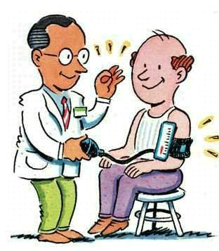
Vitals -vitality of life
Pulse 104 /min regular , normal volume , vessel wall normal , nodelay
BP- 140/80 mmHg on right upper limb . No postural hypotension
RR- 15/ min ,not dyspneic / tachypneic
Afebrile
SBC – 24
sPO2 -99% in room air

Slide 9
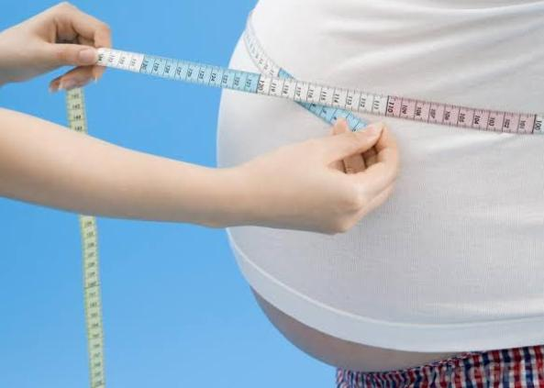
Evaluating for his extra inch !!!
Height – 172cm
Weight – 96kg
BMI –32.44
ABDOMINAL CIRCUMFRENCE -104 cm

Slide 10
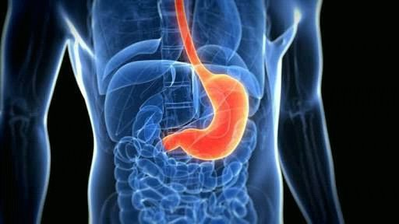
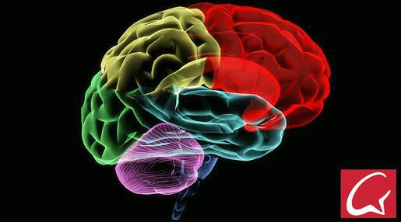
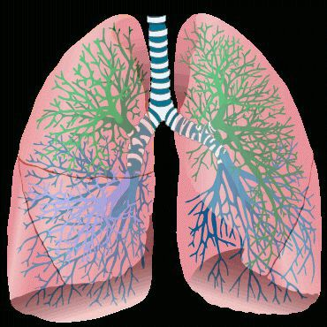
Systematic examinations of systems …
CVS- S1S2 +
RS- B/L air entry +
no use of accessory muscles of respiration , no added sounds
PA- soft , BS+
no organomegaly , no flank pain
CNS- conscious , oriented moves all 4 limbs
Pupil b/l 3mm RTL+, No ptosis , EOM full and free , NFND

Slide 11
Investigations – Better Investment for a Better life
THE INVESTIGATION OF NO OMISSION---- WHOLE BLOOD CLOTTING TIME ON ADMISSION --- PROLONGED

Slide 12
URINALYSIS – POOR MANS RENAL BIOPSY
URINE ROUTINE
ALBUMIN 1+
SUGAR NIL
DEPOSITS 2-3 PUS CELLS
URINE SPOT PCR- protein -33 mg , creat 47 mg

Slide 13
CBC- The Flow Of Life
CBC | On admission | 11/8/21 | 12/8/21 | 13/8/21
TC | 5700 | 9500 | 7200 | 7700
DC | 64/28/8 | 78/14/8 | 68/21/11 | 70/23/7
HB | 14.6 | 12.7 | 11.0 | 8.8
PLATLETS | 1.52L | 57,000 | 43,000 | 41000
PCV | 44 | 39 | 31 | 28
Reticulocyte count- 6.8%
Corrected reticulocyte count- 2.6%

Slide 14
LFT- The Metabolic Memory RFT- The Metabolic & Mental Stress Reliever
RFT | ON ADMISSION | 11/8 | 12/8 | 13/8
S.UREA | 53 73 | 62 67 | 63 65 | 43
S.CREATININE | 3 3.8 | 3.4 3.2 | 2.8 2.4 | 1.8
LFT | ON ADMISSION | 12/8 | 13/8
T.BILIRUBIN | 5.9 | 3.3 | 3.0
DIRECT | 1.4 | 1.0 | 1.1
INDIRECT | 4.5 | 2.3 | 1.9
SGOT | 37 | 23 | 33
SGPT | 40 | 28 | 45
ALKPO4 | 28 | 32 | 29
Serum LDH- 1543 U/L
Serum Fibrinogen- 286 mg/dl
PT ,INR –NORMAL
APTT- NOT PROLONGED
S.ELECTROLYTES
S,Na – 136
K – 3.8

Slide 15
ECG- The Engine , Clutch & Gear of life….

Slide 16
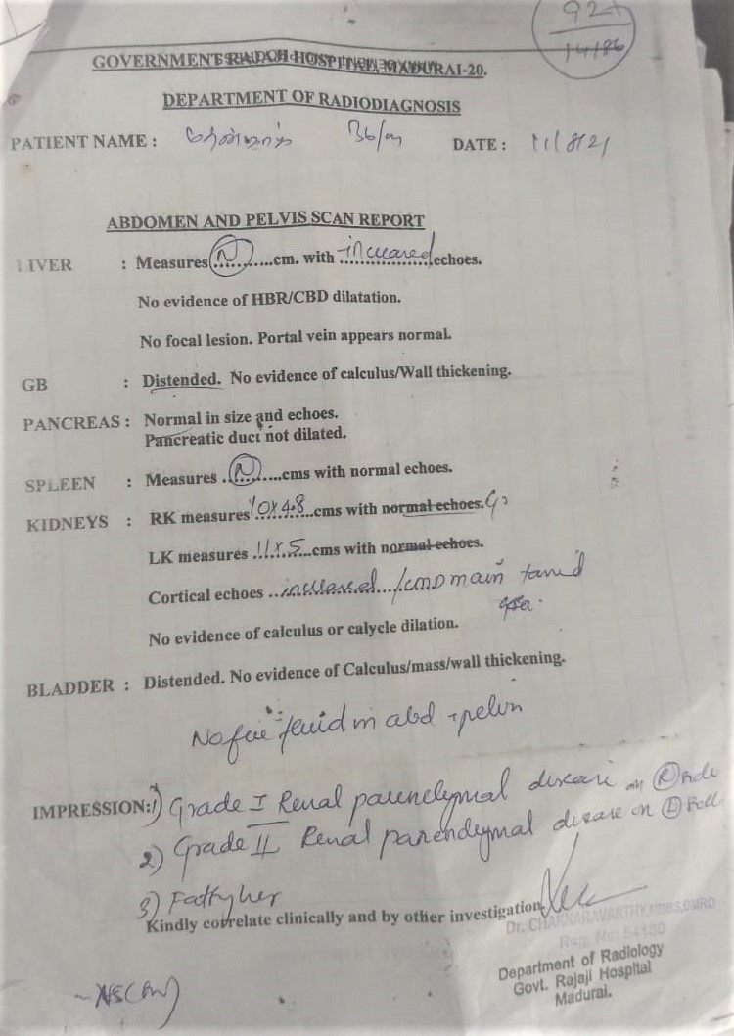
Metabolic Memory of Metabolic Disease
FASTING LIPID PROFILE
Fbs -116
S.cholesterol 198
S.triglycerides – 250
RBS -196
S.uric acid – 10.4
USG abdomen – no free fluid ,normal sized kidneys , CMD maintained
fatty liver with normal size and increased echos, Grade 2 medical renal disease on both kidneys.

Slide 17
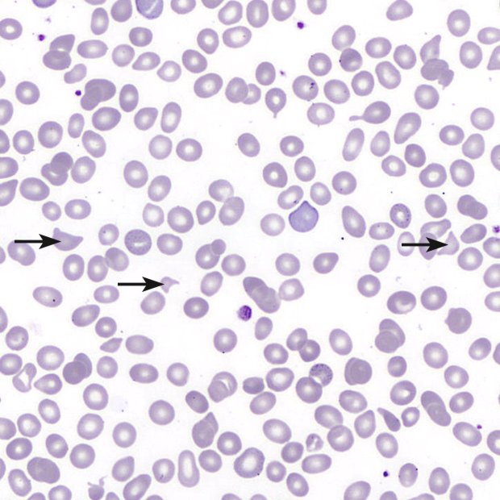
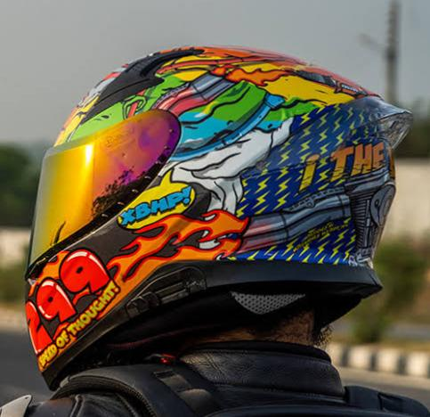
Peripheral smear- peripheral investigation for core central diagnosis !!!

Slide 18
Problems
Russell viper snake bite
Cellulitis Right foot
AKI
Rapidly progressing anemia
Neutrophilic leukocytosis
Thrombocytopenia, MICROANGIOPATHIC HEMOLYTIC ANEMIA
Indirect hyperbilirubinemia
BODERLINE PROLONGED PT- INR,aPTT, Serum fibrinogen
Reticulocytosis
Schistocytes in peripheral smear

Slide 19
Diagnosis
Poisonous snake bite with signs of envenomation
Rt lower limb cellulitis
Acute Kidney Injury
TMA -MICROANGIOPATHIC HEMOLYTIC ANEMIA
Metabolic syndrome

Slide 20
Management
Airway breathing circulation
Reassurance
Iv fluids
20 vials asv given since WBCT was prolonged
Iv antibiotics
Limb elevation after ASV

Slide 21
Why this presentation ?
To discuss various causes of AKI in snake bite
To suspect TMA MAHA in snake bite patients if they present with above clinical scenario

Slide 22
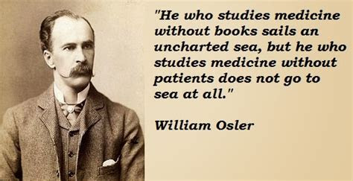
Thank you

