Slide 1
Chief: Dr. A. Senthamarai MD
Asst professor
Dr P. Sudha MD
Dr. MJ. Senthil kumar MD
Dr. S. Sugadev MD
Clinico pathological conference
Vth Medical Unit

Slide 2
HOPI
32 year female P2L1, Chronic Hypertensive, Previous NVD, referred from sivakasi GH for IUD/ Abruptio placenta
No H/O bleeding manifestation
No H/o Headache
No H/o blurring of vision
No H/o seizures
No H/o Fever
No H/o Abdominal pain

Slide 3
Details | 31/3/24 | 2.4.24 | 4/4/24 | 6/4/24 | 9/4/24 | 11/4/24
TC | 5100 | 4300 | 5900 | 6500 | 4500 | 4100
Hb | 9.1 | 8.9 | 9.7 | 10.3 | 10.5 | 9.3
Plt | 22,000 | 38000 | 35000 | 38000 | 42000 | 45000
Urea | 28 |  |  | 32
Creatinine | 0.9 |  |  | 0.8
TB | 0.6 |  |  | 0.8
D/ID | 0.3/0.3 |  |  | 0.4/0.4
OT/PT | 45/30 |  |  | 42/30
LDH | 991

Slide 4
Other investigations
Urine alb- 3+
Sugar – Nil
Pus cells- 0-2 cells
PT- 13.2
INR- 0.8
aPTT- 23.2
VCTC- Negative
Viral markers- Negative

Slide 5
Post Natal day 12
PND – 12 patient c/o blurring of vision,
No H/o headache
No H/o seizures
BP- 140/90 mmhg
MRI brain taken suggestive of Left occipital infarct and referred to GRH madurai from virudhunagar GH

Slide 6
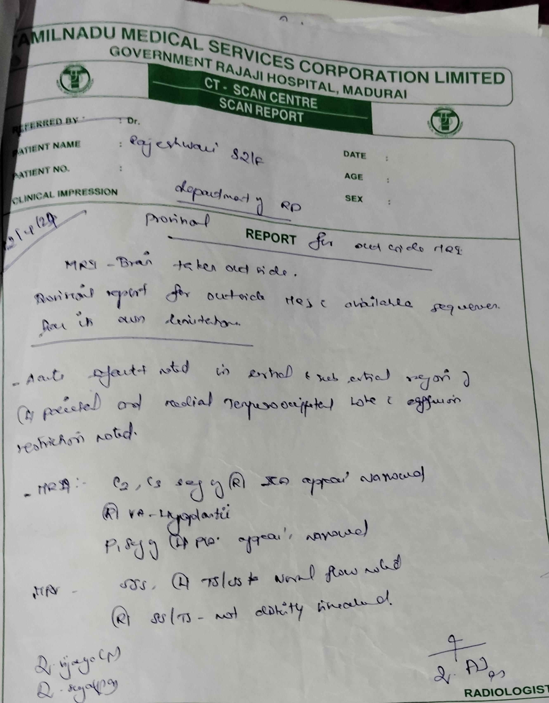
MRI brain
Acute infarct noted in left parietal and tempero-occipital lobe

Slide 7
Past history
Known case of Chronic hypertension on Tab Labetalol 100 mg BD
Not a K/c of T2dm/ BA/ Epilepsy/ TB / Thyroid/ CAD/ CKD
No H/o Previous surgeries

Slide 8
Menstrual History
Menstrual History
Marital history
Attained menarche at 11 yrs
Regular cycles
4/28
Normal flow
Married since 4yrs
Non consanguinous marriage

Slide 9
Obstetric history
G1- Female baby, FTNVD, wt-3.1 kg, Post natal period uneventful
G2- IUD at 33 wks ( Abruptio Placenta) Delivered by LN.

Slide 10
Treatment history
2 Whole blood, 2 Packed cell, 4 platelets, 2FFP transfused in virudhunagar GH

Slide 11
On examination
Patient conscious
Oriented
Comfortable at rest
Afebrile
Pallor+
No clubbing
Not cyanosed
Not icterus
No pedal edema
No generalized lymphadenopathy

Slide 12
Vitals signs
Systemic examination
CVS- S1S2 +
RS- BAE +
P/A- soft. Not tender
CNS- conscious, Oriented
No motor deficit
Right homonymous hemianopia
BP- 150/90 mmhg
PR- 84/min
SPO2 – 98% in RA

Slide 13
Details | 12/4/24 | 16/4/24 | 20/4/24 | 24/4/24 | 27/4/24
TC | 4800 | 7000 | 4600 | 1000 | 2600
Hb | 9.5 | 8.6 | 9.1 | 8.2 | 7.2
Plt | 61000 | 29000 | 35000 | 19000 | 20000
MCV | 98.1 | 102.9 | 100.2 | 100.9 | 99.0
MCHC | 33.3 | 30.5 | 31.5 | 34.9 | 31.2
Urea- | 33
Creat- | 1.3
Sodium | 136
Potassium | 4.3
PT | 16.1
INR | 1.2
aPTT | 22.2

Slide 14
Details | 12/4/24
TB | 0.3
D/id | 0.2/0.1
OT/PT | 16/22
ALP | 121
Urine alb | 2+
Urine sugar | Nil
LDH | 1116
D-dimer | 4645

Slide 15
DANP opinion
lmp- G2P1/ Chronic HTN/ IUD/ Left occipital infarct
Tone Normal on both sides
DTR- Normal on both sides
Power normal
Plantar b/l flexor
ANA
APLA
MRA &MRV
Coagulation profile

Slide 16
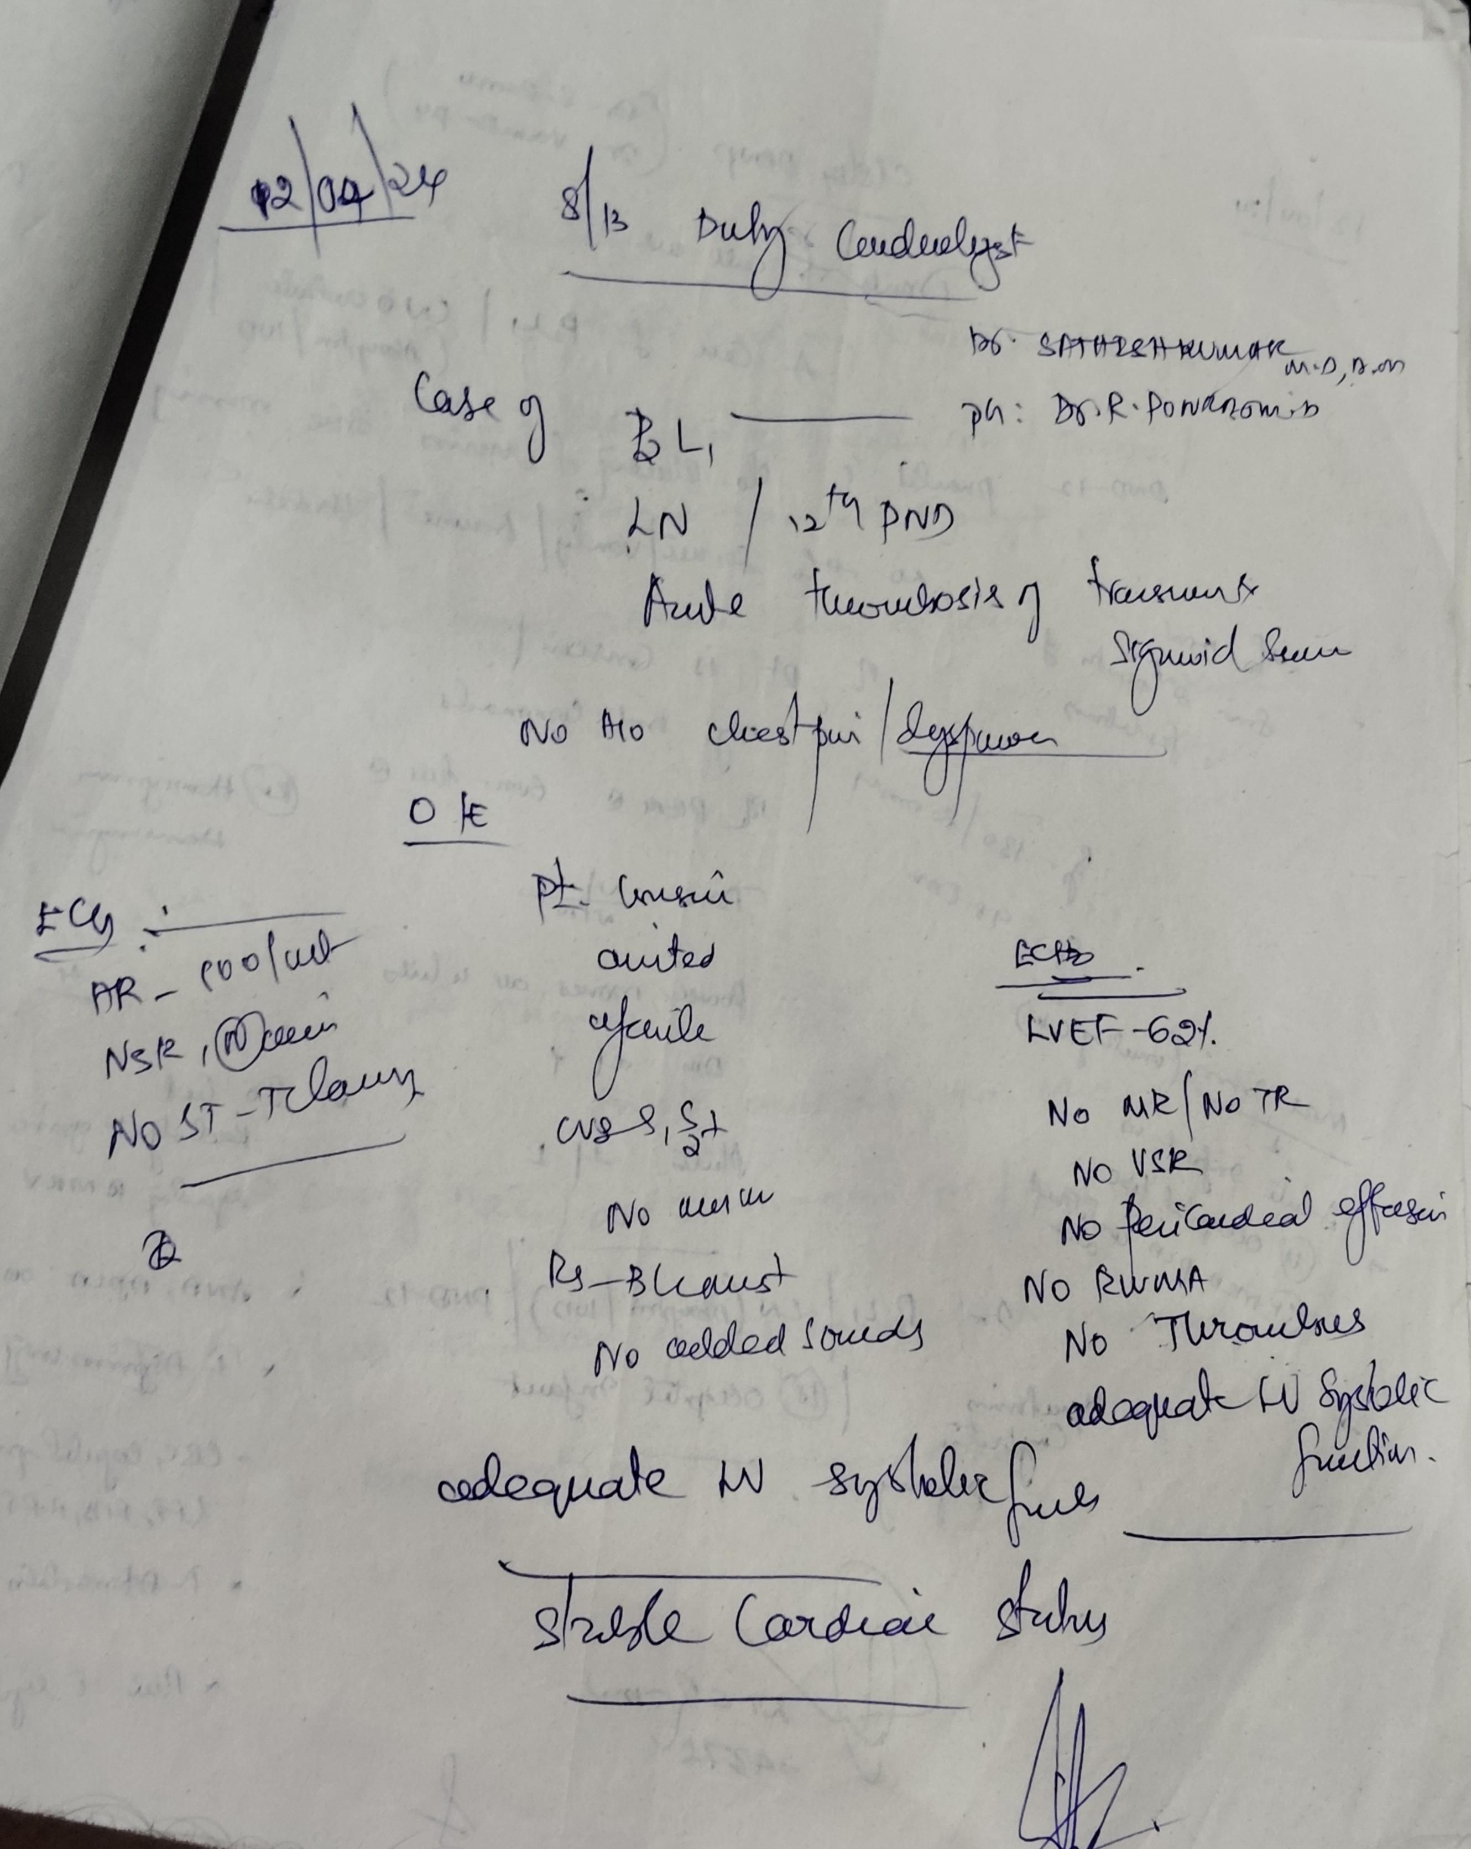
Cardiology opinion
Stable cardiac status

Slide 17
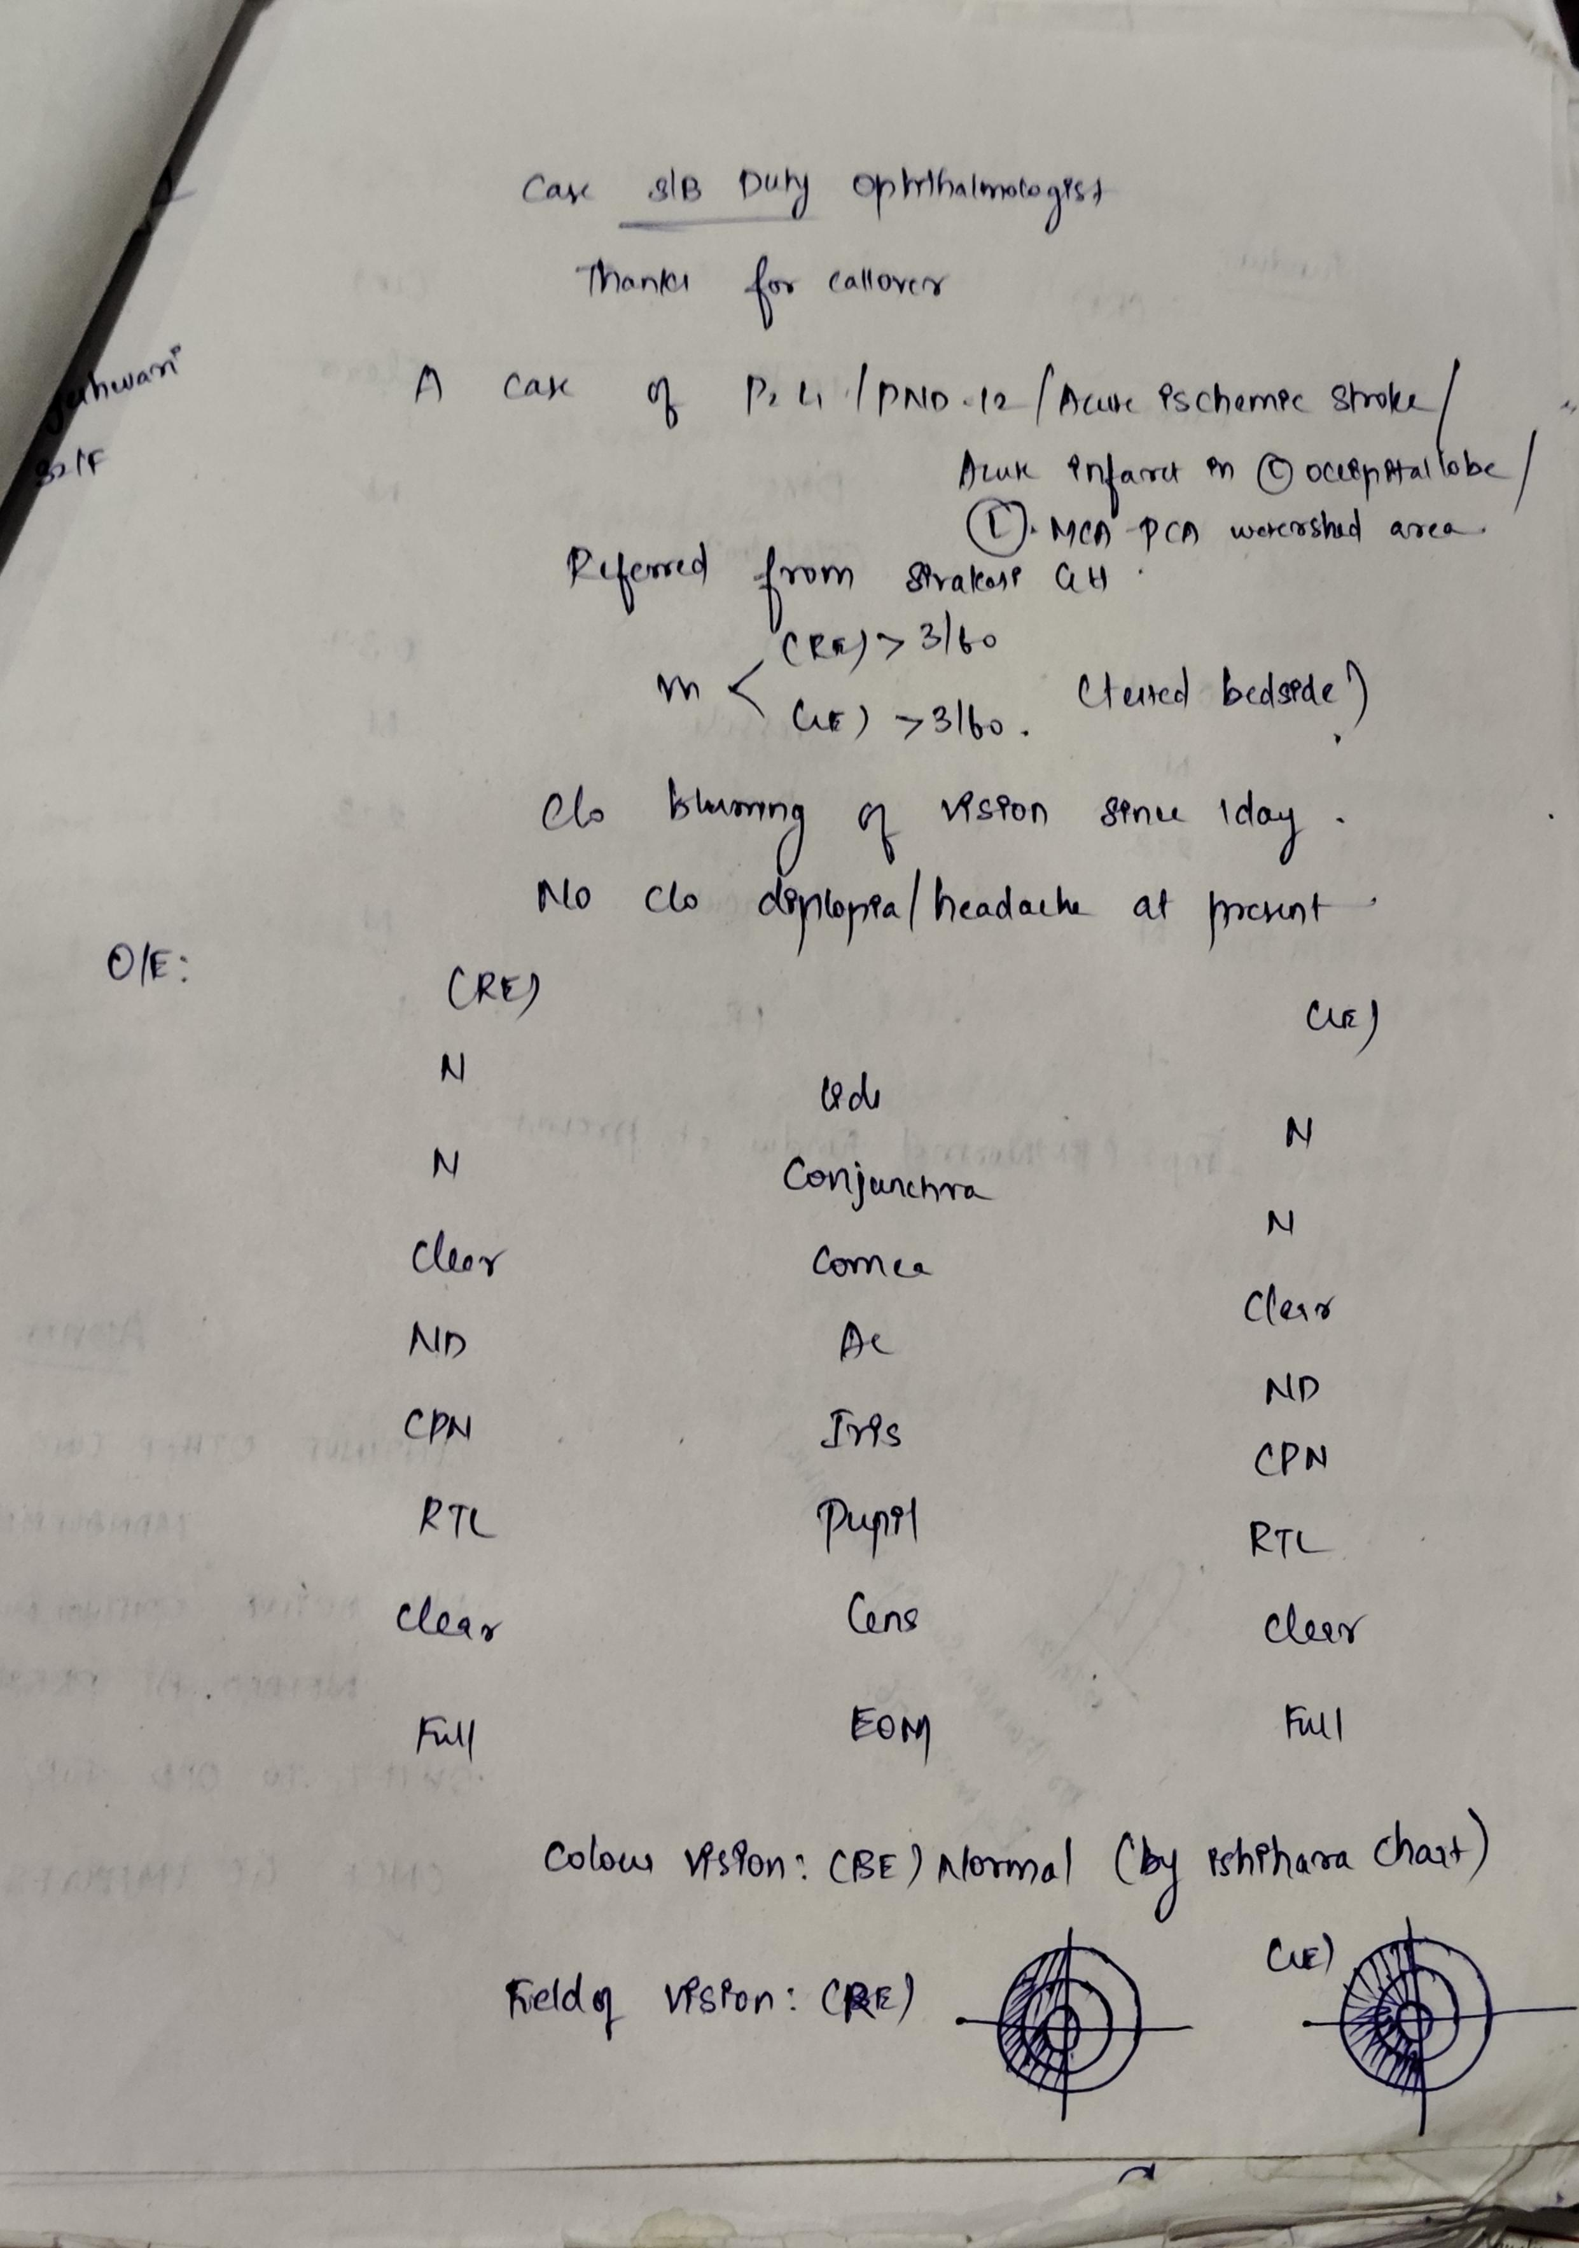
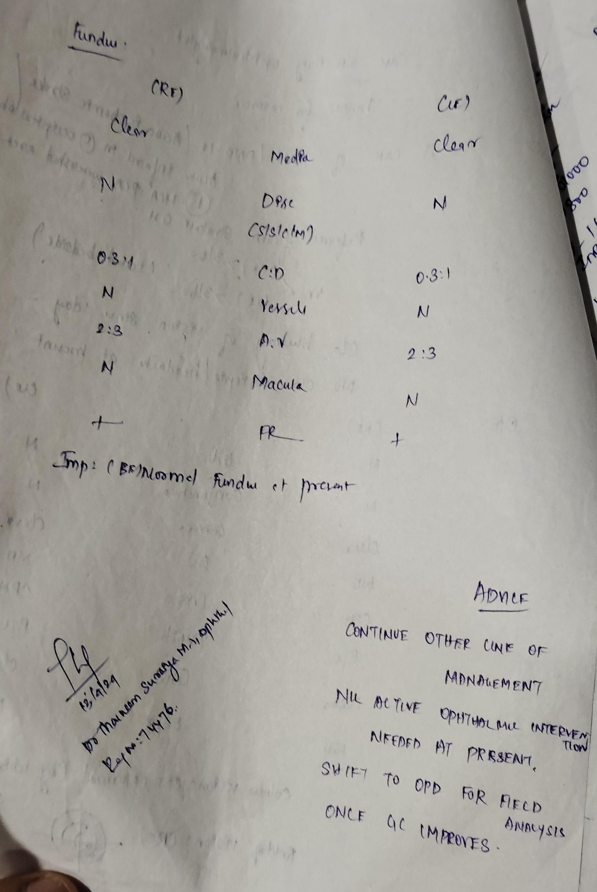
Ophthalmologist opinion

Slide 18
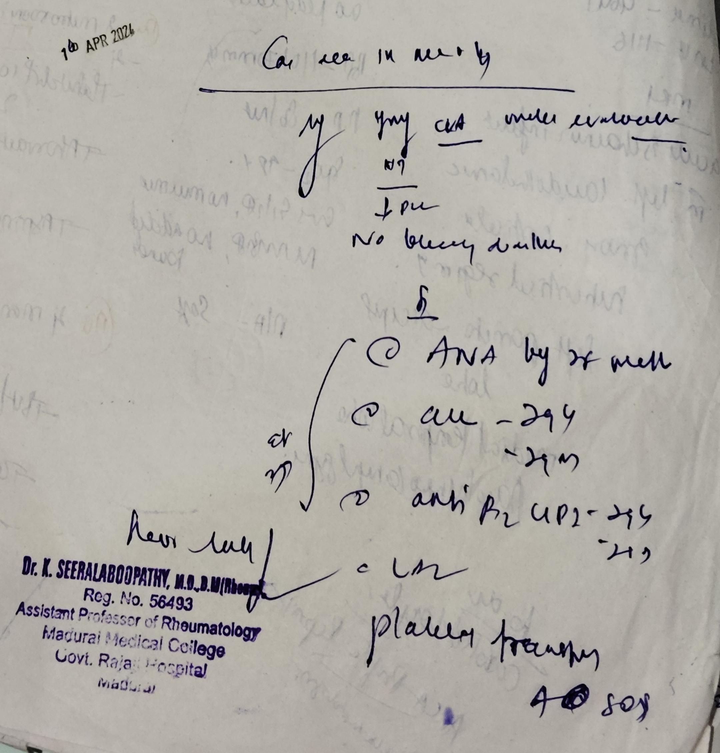
Rheumatologist opinion

Slide 19
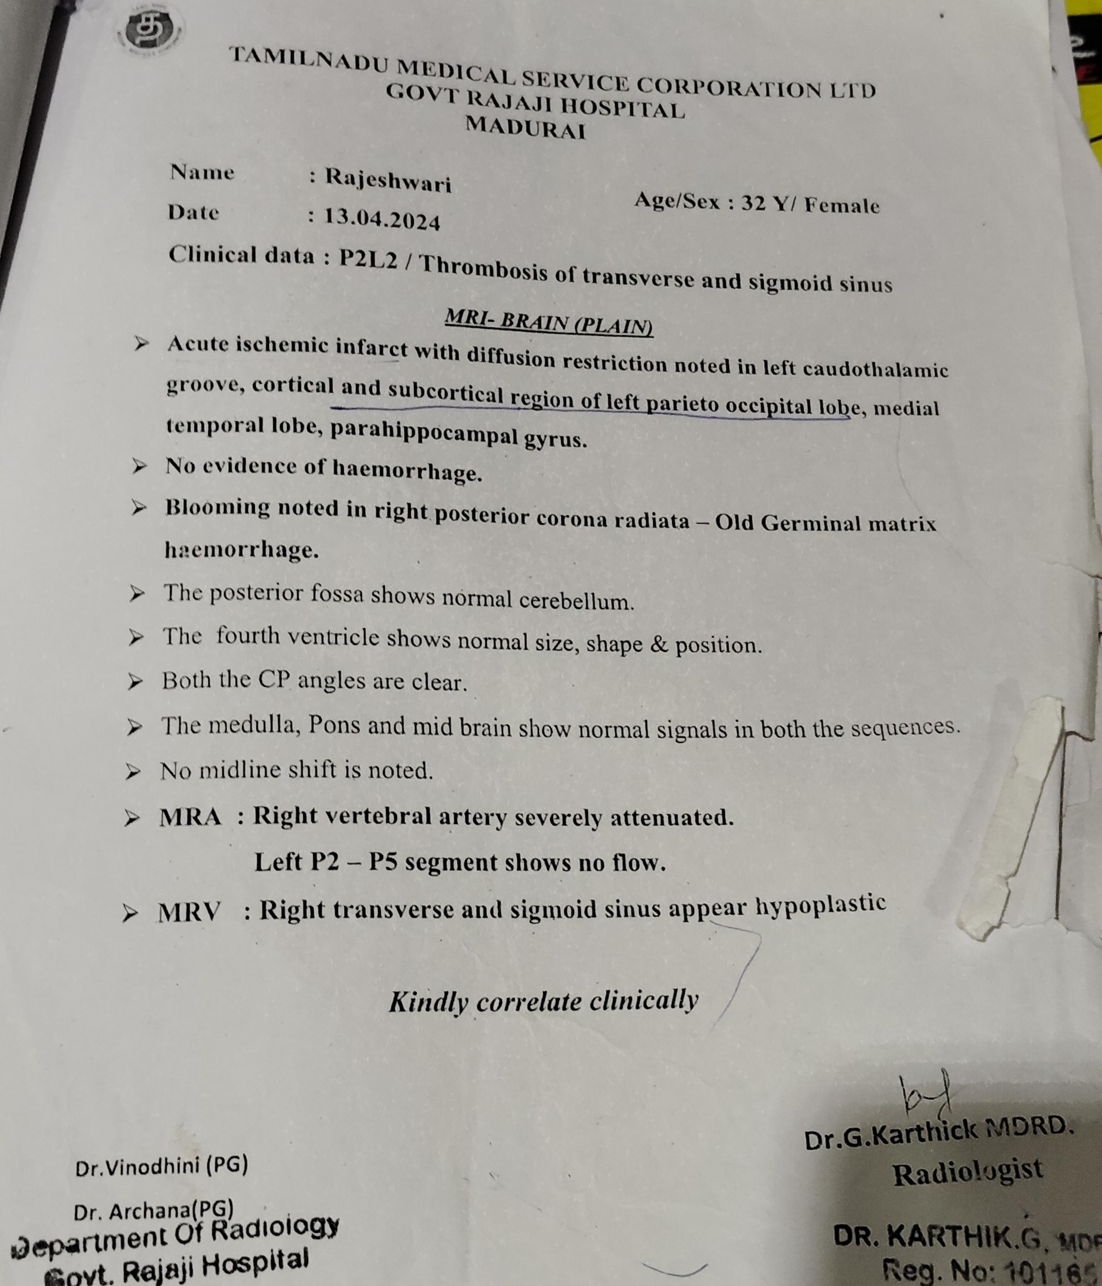
Repeat MRI brain with MRA &MRV
Acute infarct in left parieto-occipital lobe and medial temporal lobe
No e/o Hemorrhage
MRA- Right vertebral artery severely attenuated
MRV- Right Transverse and sigmoid sinus appear hypoplastic

Slide 20
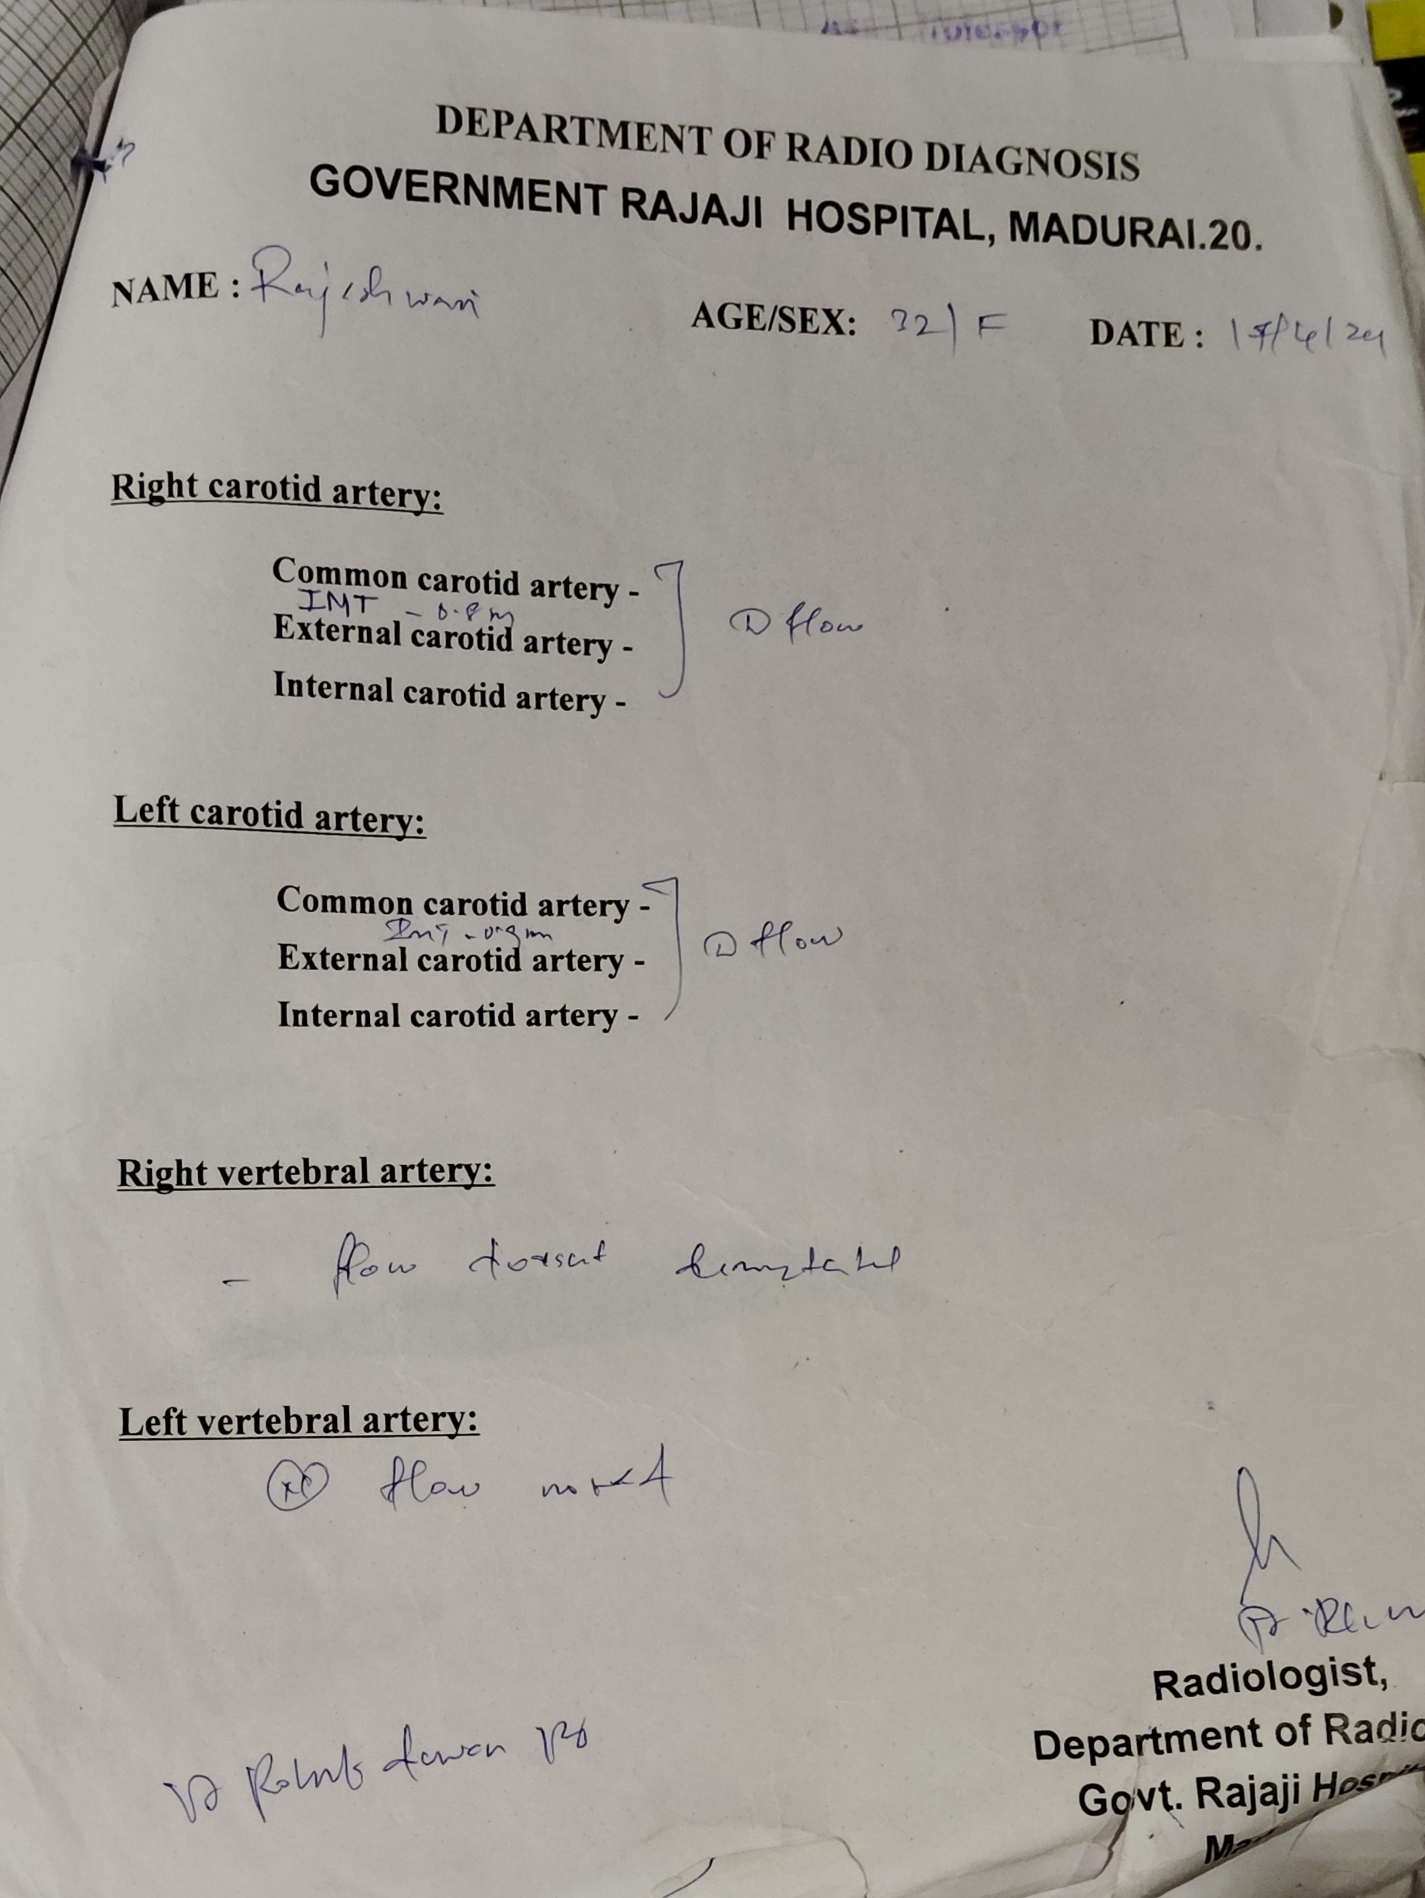
CV Doppler

Slide 21
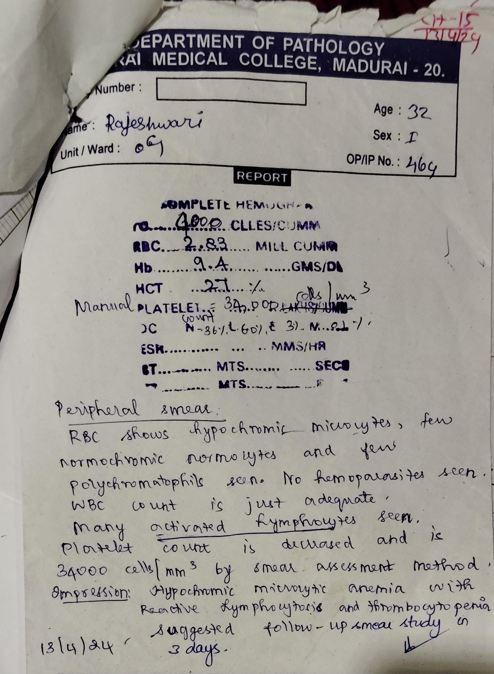
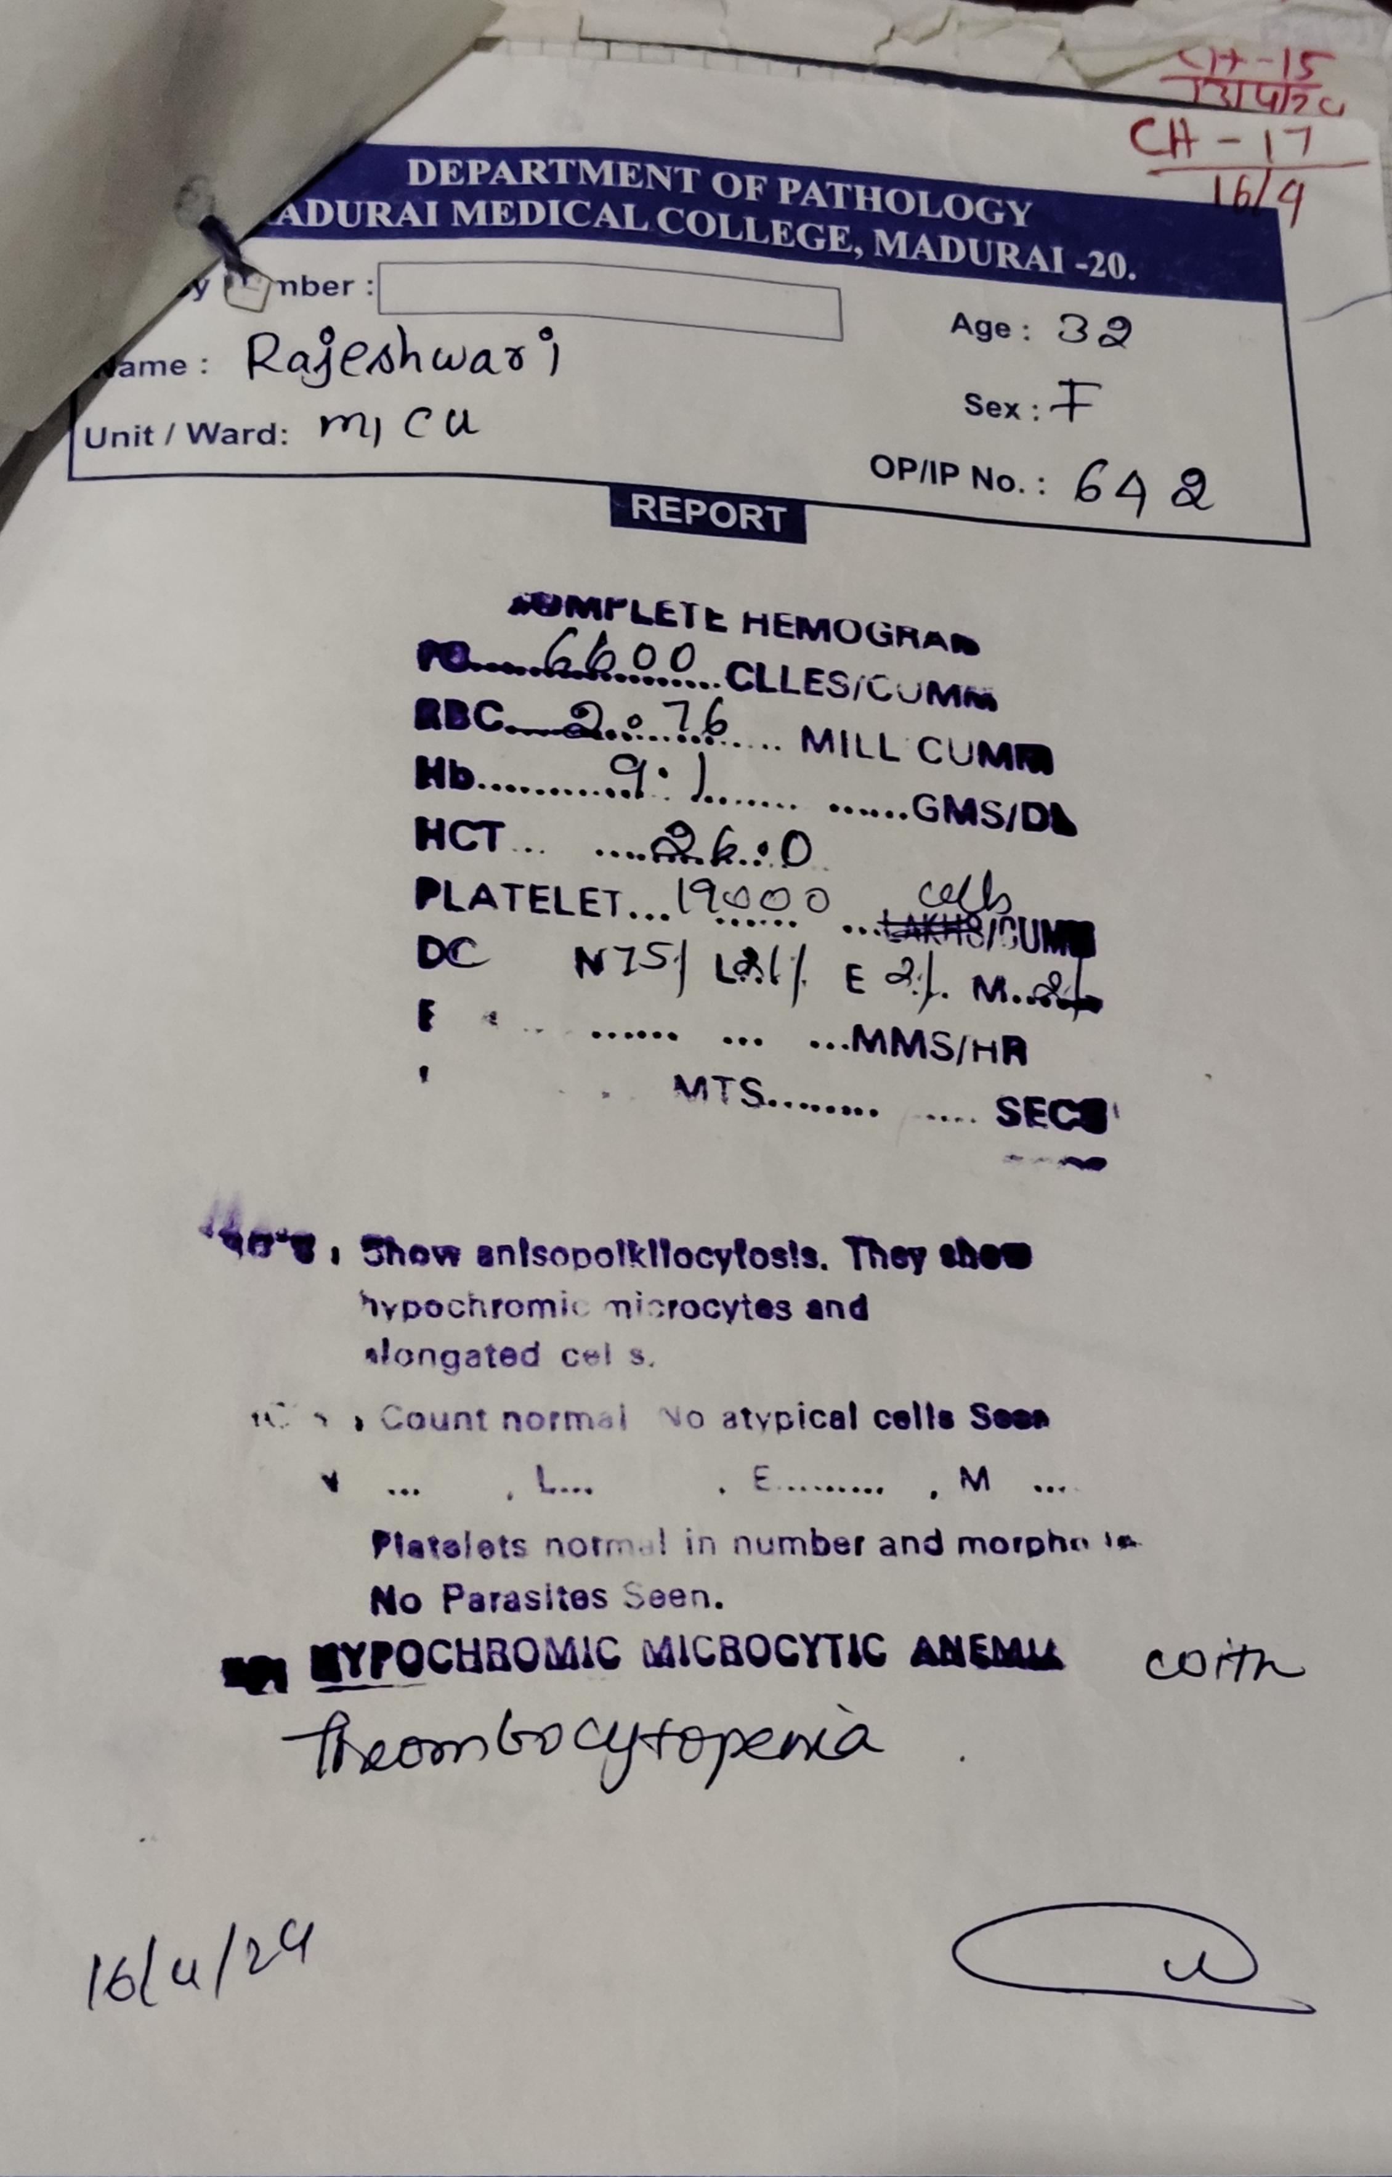
Peripheral smear study

Slide 22
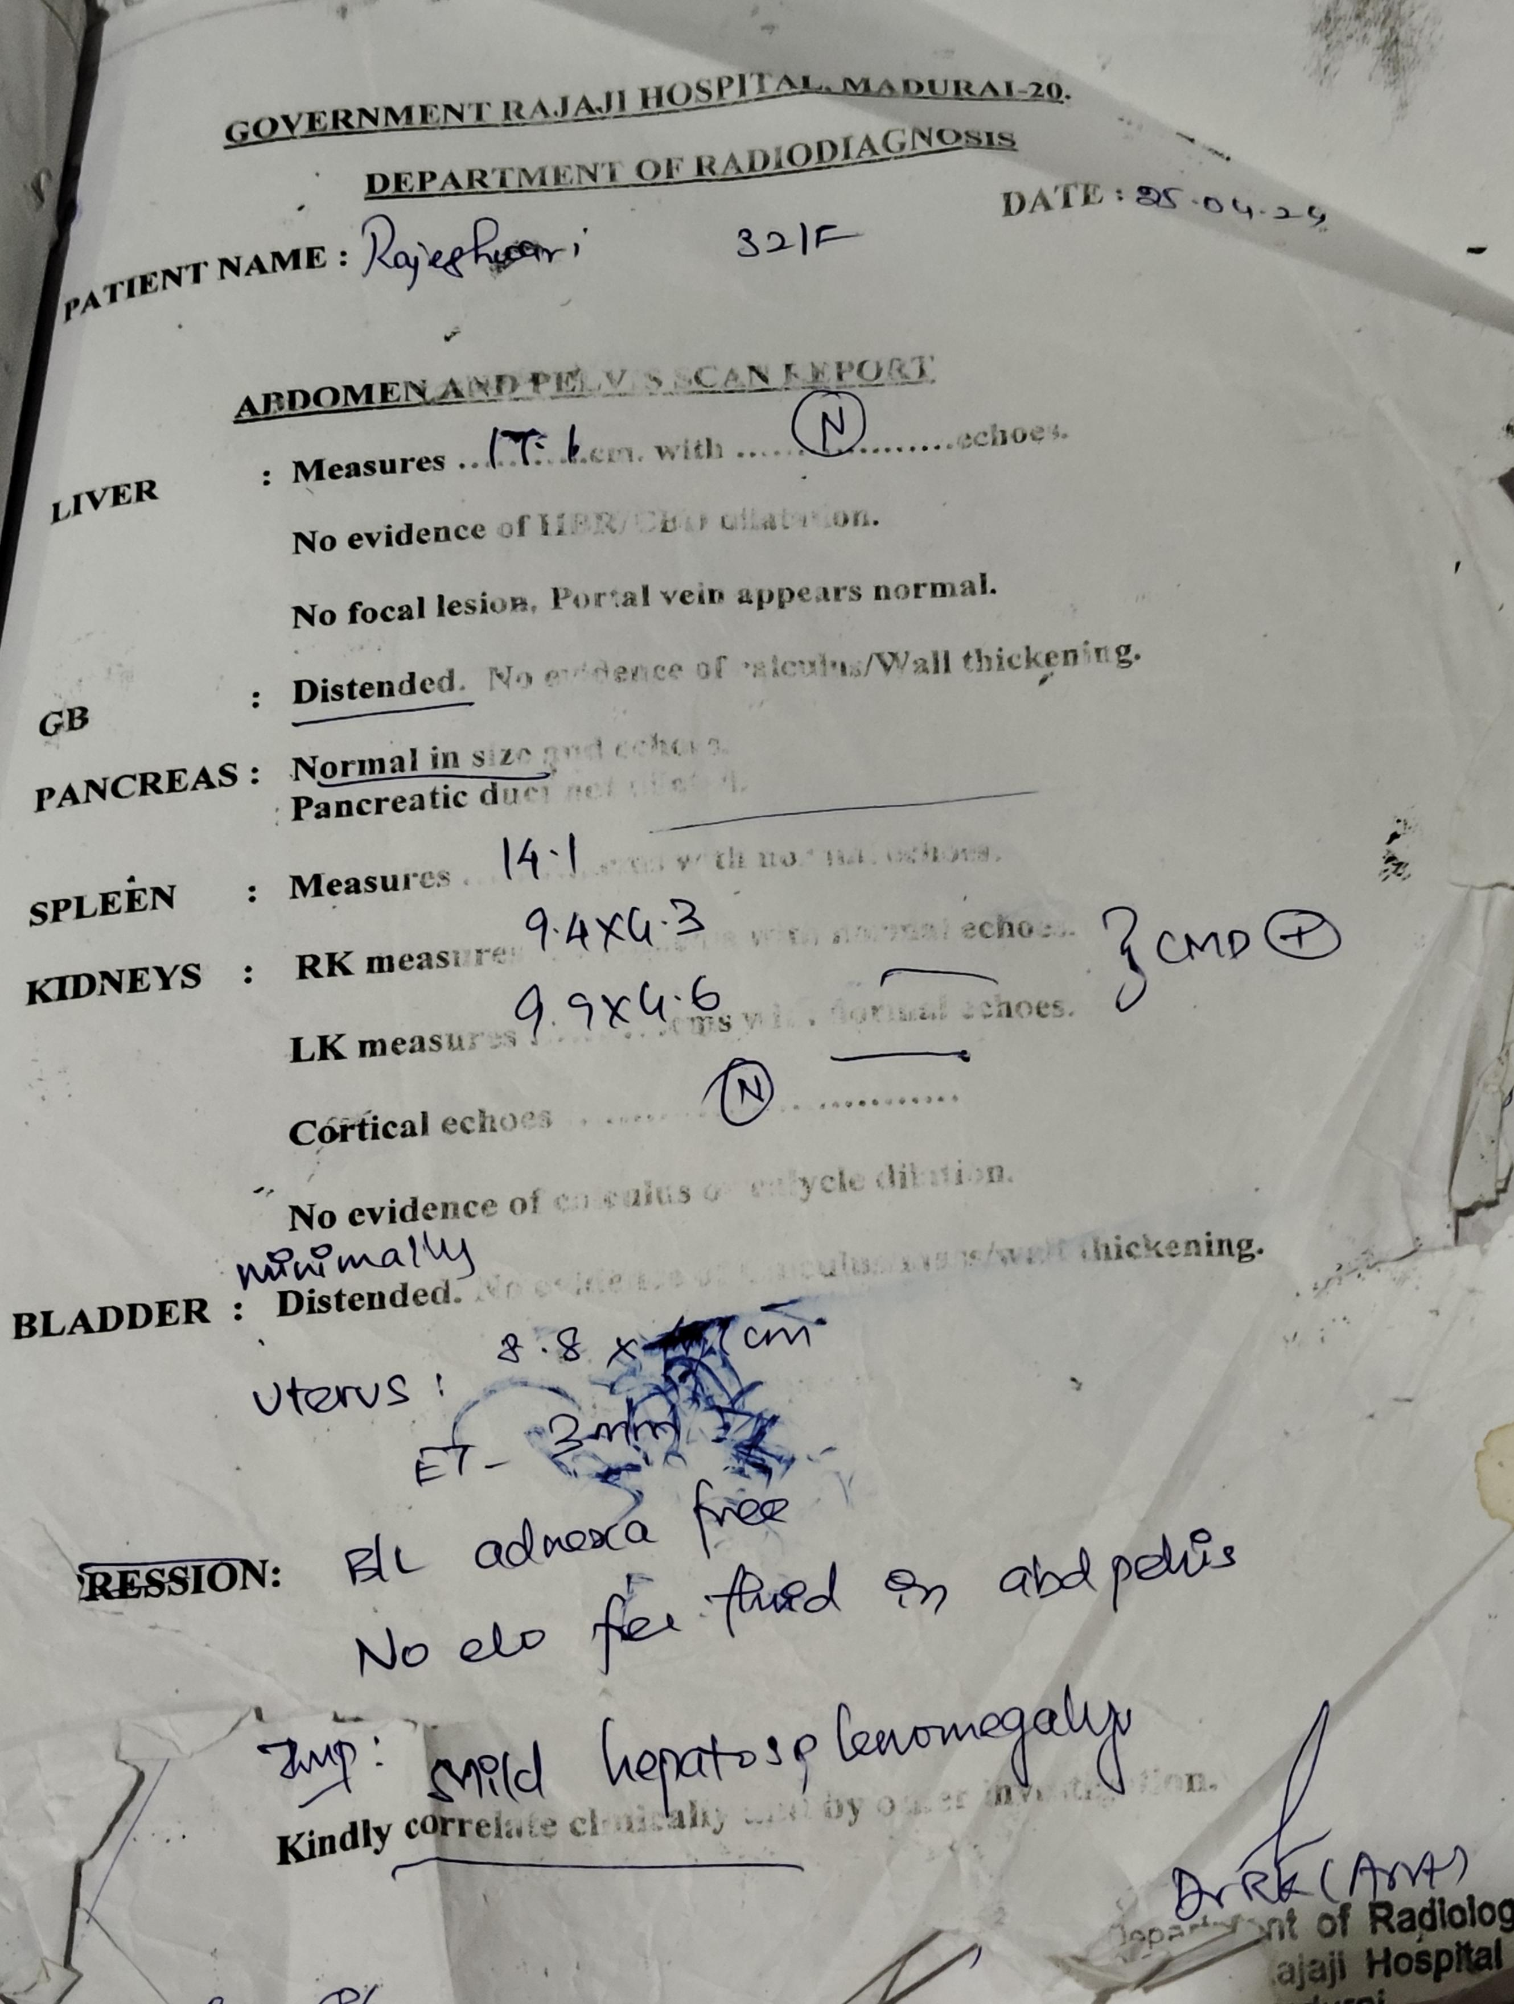
USG abdomen and Pelvis
Imp- Mild hepatosplenomegaly

Slide 23
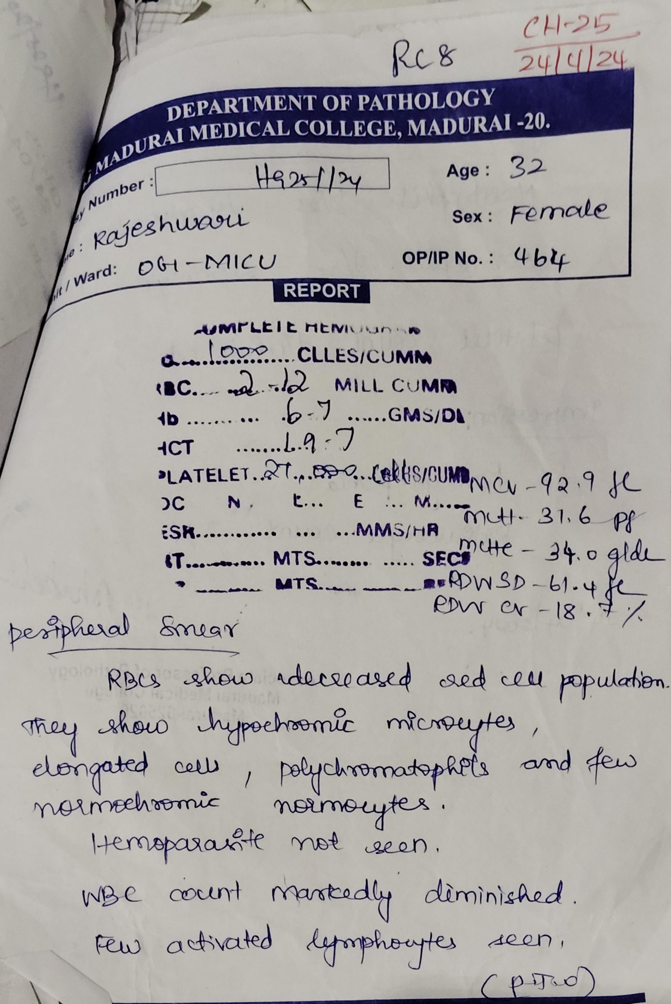
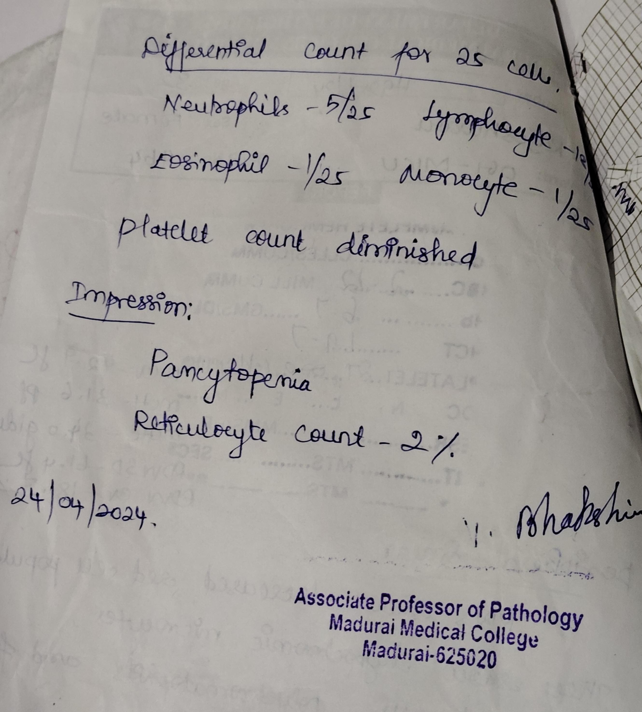
Peripheral smear study

Slide 24
Other investigations
Blood C/s – No Growth
Urine C/s – No growth
High vaginal swab- No growth
IgM dengue- Negative
IgM srcub – Negative
Anti leptospira Ab- Negative

Slide 25
What next?

