Slide 1
HEART FAILURE

Slide 2
Definition:
A state in which the heart cannot provide sufficient cardiac output to satisfy the metabolic needs of the body
It is commonly termed congestive heart failure (CHF) since symptoms of increase venous pressure are often prominent

Slide 3
Etiology
It is a common end point for many diseases of cardiovascular system
It can be caused by :
-Inappropriate work load (volume or pressure
overload)
-Restricted filling
-Myocyte loss

Slide 4
Causes of left ventricular
failure
Volume over load:
Regurgitate valve High output status
Systemic hypertension Outflow obstruction
Post MI, Chronic ischemia
Pressure overload:
Loss of muscles:
Connective tissue diseases Infection, Poisons
(alcohol,cobalt,Doxorubicin)
Pericardial diseases, Restrictive cardiomyopathy, tachyarrhythmia
Restricted Filling:

Slide 5
Main causes
Coronary artery disease
Hypertension
Valvular heart disease
Cardiomyopathy
Cor pulmonale

Slide 6
Heart Failure
Final common pathway for many cardiovascular diseases whose natural history results in symptomatic or asymptomatic left ventricular dysfunction
Cardinal manifestations of heart failure include dyspnea, fatigue and fluid retention
Risk of death is 5-10% annually in patients with mi symptoms and increases to as high as 30-40% annually in patients with advanced disease

Slide 7
Pathophysiology
Hemodynamic changes
Neurohormonal changes
Cellular changes

Slide 8
Hemodynamic changes
From hemodynamic stand point HF can be secondary to systolic dysfunction or
diastolic dysfunction

Slide 9
Neurohormonal changes
N/H changes | Favorable effect | Unfavor. effect
↑ Sympathetic activity | ↑ HR ,↑ contractility, vasoconst. → ↑ V return, ↑ filling | Arteriolar constriction → After load →↑ workload →↑ O₂ consumption
↑ Renin-Angiotensin – | Salt & water retention→↑ VR | Vasoconstriction → ↑ after load
Aldosterone ↑ Vasopressin | Same effect | Same effect
↑ interleukins &TNFα | May have roles in myocyte hypertrophy | Apoptosis
↑Endothelin | Vasoconstriction→↑ VR | ↑ After load

Slide 10
Cellular changes
Changes in Ca⁺² handling.
Changes in adrenergic receptors:
  Slight ↑ in α₁ receptors
  β₁ receptors desensitization → followed by down regulation
Changes in contractile proteins
Program cell death (Apoptosis)
Increase amount of fibrous tissue

Slide 11
Symptoms
SOB, Orthopnea, paroxysmal nocturnal dyspnea
Low cardiac output symptoms
Abdominal symptoms: Anorexia,nausea,
abdominal fullness, Rt hypochondrial pain

Slide 12
NYHA Classification of heart failure
Class I: No limitation of physical activity
Class II: Slight limitation of physical activity
Class III: Marked limitation of physical activit
Class IV: Unable to carry out physical activit without discomfort

Slide 13
Types of heart failure
Diastolic dysfunction or diastolic heart failure
Systolic dysfunction or systolic heart failure

Slide 14
Factors aggravating heart failure
•
•
•
•
•
•
•
Myocardial ischemia or infarct Dietary sodium excess Excess fluid intake Medication noncompliance Arrhythmias
Intercurrent illness (eg infection)
Conditions associated with increased metabolic demand (eg pregnancy, thyrotoxicosis, excessive physical activity)
•
Administration of drug with negative inotropic properties and fliud retaining properties[NSAID,corticosteroids]

Slide 15
Compensatory changes in heart failure
Activation of SNS
Activation of RAS
Increased heart rate
Release of ADH
Release of atrial natriuretic peptide
Chamber enlargement
Myocardial hypertrophy

Slide 16
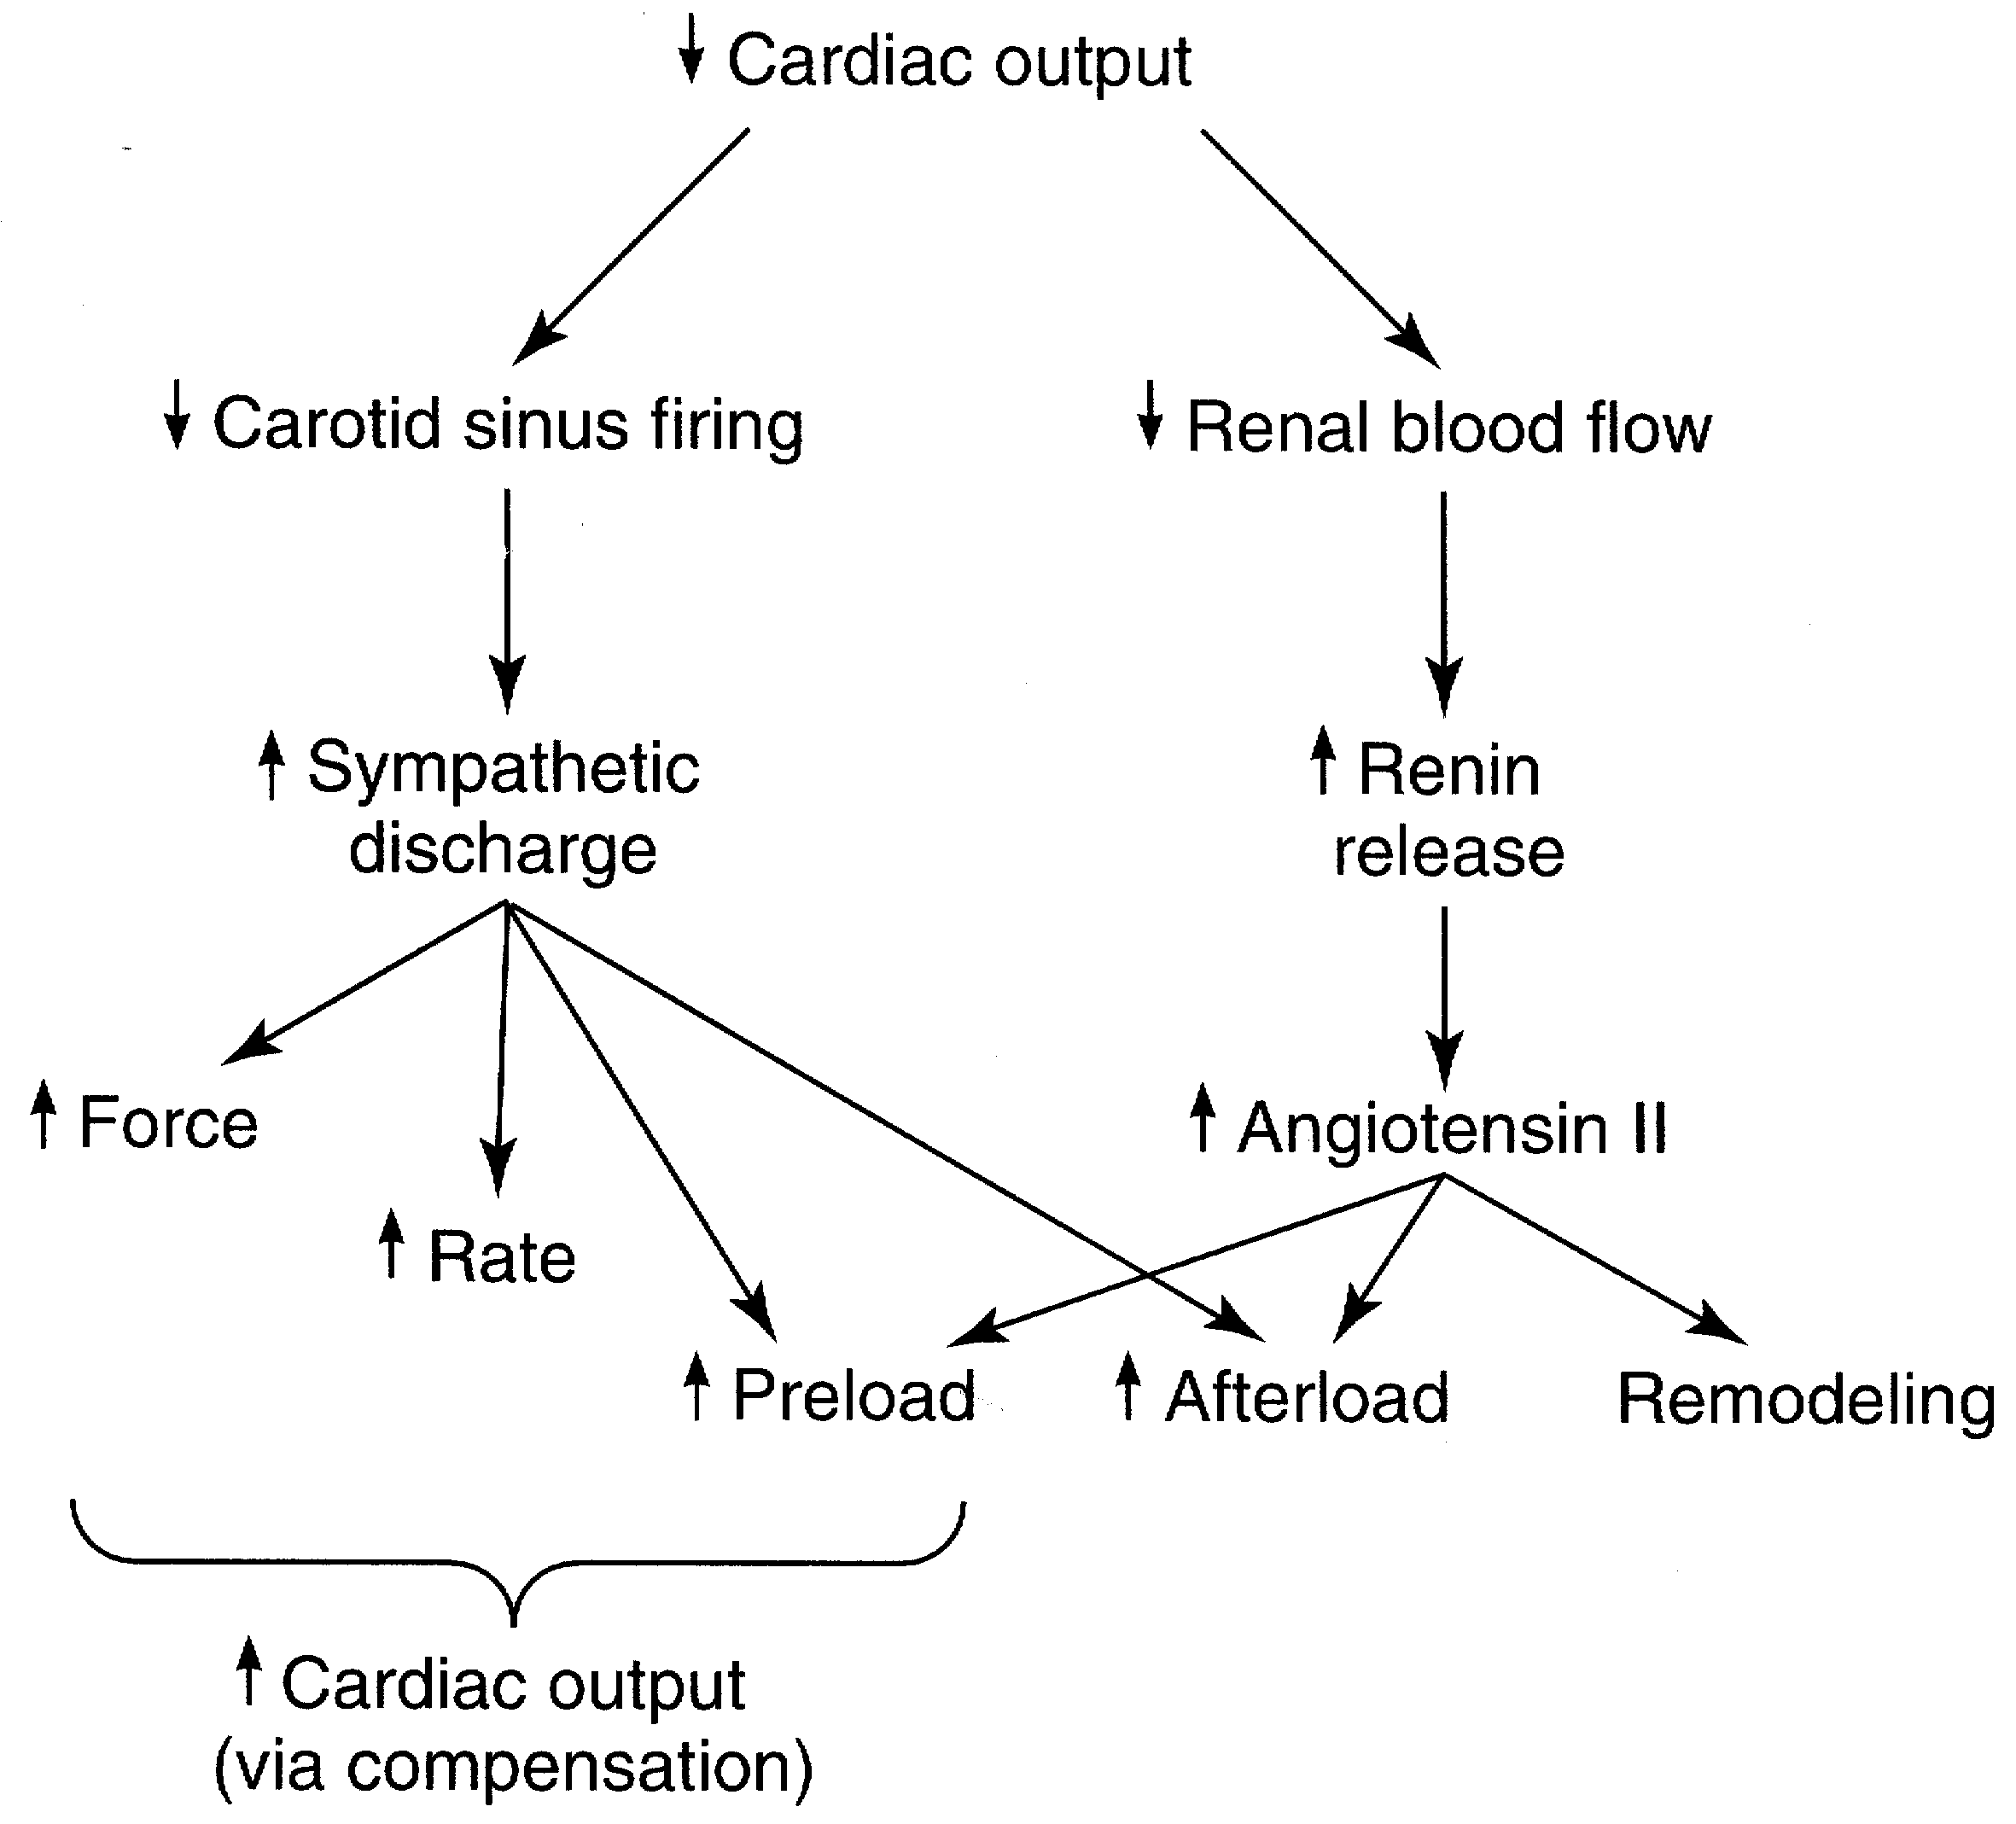
Compensatory Mechanisms in Heart Failure
Mechanisms designed for acute loss in cardiac output
Chronic activation of these mechanisms worsens heart failure

Slide 17
Physical Signs
High diastolic BP & occasional decrease in systolic BP (decapitated BP)
JVD
Rales (Inspiratory)
Displaced and sustained apical impulses
Third heart sound – low pitched sound that is heard
during rapid filling of ventricle

Slide 18
Physical signs (cont.)
Mechanism of S₃ sudden deceleration of blood
as elastic limits of the ventricles are reached
Vibration of the ventricular wall by blood filling
Common in children

Slide 19
Physical signs (cont.)
Fourth heart Sound (S₄)
  Usually at the end of diastole
  Exact mechanism is not known Could be due to contraction of atrium against stiff ventricle
Pale, cold sweaty skin

Slide 20
Framingham Criteria for Dx of Heart Failure
Major Criteria:
  PND
  JVD
  Rales
  Cardiomegaly
  Acute Pulmonary Edema
  S₃ Gallop
  Positive hepatic Jugular reflex
  ↑ venous pressure > 16 cm H₂O

Slide 21
Dx of Heart Failure (cont.)
Minor Criteria
LL edema, Night cough
Dyspnea on exertion
Hepatomegaly Pleural effusion
↓ vital capacity by 1/3 of normal Tachycardia 120 bpm
Weight loss 4.5 kg over 5 days management

Slide 22
Forms of Heart Failure
Systolic & Diastolic
High Output Failure
  Pregnancy, anemia, thyrotoxisis, A/V fistula, Beriberi, Pagets disease
Low Output Failure
Acute
  large MI, aortic valve dysfunction---
Chronic

Slide 23
Forms of heart failure
( cont.)
Right vs Left sided heart failure:
Right sided heart failure :
Most common cause is left sided failure
Other causes included : Pulmonary embolisms
Other causes of pulmonary htn. RV infarction
MS
Usually presents with: LL edema, ascites
hepatic congestion
cardiac cirrhosis (on the long run)

Slide 24
Differential diagnosis
Pericardial diseases
Liver diseases
Nephrotic syndrome
Protein losing enteropathy

Slide 25
Laboratory Findings
Anemia
Hyperthyroid
Chronic renal insuffiency, electrolytes abnormality
Pre-renal azotemia
Hemochromatosis

Slide 26
Electrocardiogram
Old MI or recent MI
Arrhythmia
Some forms of Cardiomyopathy are tachycardia related
LBBB

Slide 27
Chest X-ray
Size and shape of heart
Evidence of pulmonary venous congestion (dilated or upper lobe veins → perivascular edema)
Pleural effusion

Slide 28
Echocardiogram
Function of both ventricles
Wall motion abnormality that may signify CAD
Valvular abnormality
Intra-cardiac shunts

Slide 29
Cardiac Catheterization
When CAD or valvular is suspected
If heart transplant is indicated

Slide 30
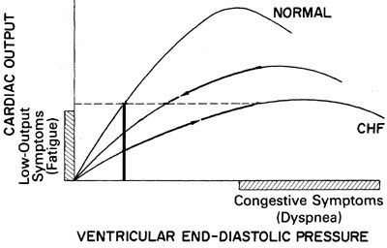
Potential Therapeutic Targets in Heart Failure
Preload
Afterload
Contractility

Slide 31
Goals of treatment
To improve symptoms and quality of life
To decrease likelihood of disease progression
To reduce the risk of death and need for hospitalisation

Slide 32
TREATMENT
Correction of reversible causes
  Ischemia
  Valvular heart disease
  Thyrotoxicosis and other high output status
  Shunts
  Arrhythmia
    A fib, flutter,
  Medications
    Ca channel blockers, some antiarrhythmics

Slide 33
Approach to the Patient with Heart Failure
Assessment of LV function (echocardiogram, radionuclide ventriculogram)
EF < 40%
Assessment of volume status
Signs and symptoms of fluid retention
No signs and symptoms of fluid retention
Diuretic
(titrate to euvolemic state)
ACE Inhibitor
Digo
β-blocker

Slide 34
Diet and Activity
Salt restriction
Fluid restriction
Daily weight (tailor therapy)
Gradual exertion programs

Slide 35
Diuretic Therapy
The most effective symptomatic relief
Mild symptoms
  HCTZ
  Chlorthalidone
  Metolazone
  Block Na reabsorbtion in loop of henle and distal convoluted tubules
  Thiazides are ineffective with GFR < 30 --/min

Slide 36
Diuretics (cont.)
Side Effects
  Pre-renal azotemia
  Skin rashes
  Neutropenia
  Thrombocytopenia
  Hyperglycemia
  ↑ Uric Acid
  Hepatic dysfunction

Slide 37
Diuretics (cont.)
More severe heart failure → loop diuretics
  Lasix (20 – 320 mg QD), Furosemide
  Torsemide (20-200mg)
Mechanism of action: Inhibit chloride reabsortion in ascending limb of loop of Henle results in natriuresis, kaliuresis and metabolic alkalosis
Adverse reaction:
pre-renal azotemia Hypokalemia
Skin rash ototoxicity

Slide 38
K⁺ Sparing Agents
Triamterene & amiloride – acts on distal tubules to
↓ K secretion
Spironolactone (Aldosterone inhibitor)
recent evidence suggests that it may improve survival in CHF patients due to the effect on renin- angiotensin-aldosterone system with subsequent effect on myocardial remodeling and fibrosis

Slide 39
Inhibitors of renin-angiotensin- aldosterone system
Renin-angiotensin-aldosterone system is activation early in the course of heart failure and
plays an important role in the progression of the syndrome
Angiotensin converting enzyme inhibitors
Angiotensin receptors blockers
Spironolactone

Slide 40
Angiotensin Converting Enzyme Inhibitors
They block the R-A-A system by inhibiting the conversion of angiotensin I to angiotensin II
→ vasodilation and ↓ Na retention
↓ Bradykinin degradation ↑ its level → ↑ PG secretion & nitric oxide
Ace Inhibitors were found to improve survival in CHF patients
  Delay onset & progression of HF in pts with asymptomatic LV dysfunction
  ↓ cardiac remodeling

Slide 41
Side effects of ACE inhibitors
Angioedema
Hypotension
Renal insuffiency
Rash
cough

Slide 42
Angiotensin II receptor blockers
Has comparable effect to ACE I
Can be used in certain conditions when ACE I are contraindicated (angioneurotic edema, cough)

Slide 43
Digitalis Glycosides (Digoxin, Digitoxin)
The role of digitalis has declined somewhat because of safety concern
Recent studies have shown that digitals does not affect mortality in CHF patients but causes significant
  Reduction in hospitalization
  Reduction in symptoms of HF

Slide 44
Digitalis (cont.)
Mechanism of Action
• +ve inotropic effect by ↑ intracellular Ca & enhancing actin-myosin cross bride formation (binds to the Na-K ATPase → inhibits Na pump → ↑ intracellular Na → ↑ Na-Ca exchange
Vagotonic effect
Arrhythmogenic effect

Slide 45
Digitalis Toxicity
Narrow therapeutic to toxic ratio
Non cardiac manifestations
Anorexia, Nausea, vomiting, Headache,
Xanthopsia sotoma, Disorientation

Slide 46
Digitalis Toxicity
Cardiac manifestations
  Sinus bradycardia and arrest
  A/V block (usually 2nd degree)
  Atrial tachycardia with A/V Block
  Development of junctional rhythm in patients with a fib
  PVC’s, VT/ V fib (bi-directional VT)

Slide 47
Digitalis Toxicity
Treatment
Hold the medications
Observation
In case of A/V block or severe bradycardia → atropine followed by temporary PM if needed
In life threatening arrhythmia → digoxin- specific fab antibodies
Lidocaine and phenytoin could be used – try to avoid D/C cardioversion in non life threatening arrhythmia

Slide 48
β Blockers
Has been traditionally contraindicated in pts with CHF
Now they are the main stay in treatment on CHF & may be the only medication that shows substantial improvement in LV function
In addition to improved LV function multiple studies show improved survival
The only contraindication is severe decompensated HF

Slide 49
Carvedilol in Heart Failure
Effective receptor-blockade approach to heart failure
Negative inotropic effect counteracted by vasodilation
Provides anti-proliferative, anti-arrhythmic activity and inhibition of apoptosis
Prevents renin secretion

Slide 50
Vasodilators
Reduction of afterload by arteriolar
vasodilatation (hydralazine) → reduce LVEDP, O₂
consumption,improve myocardial perfusion, ↑ stroke volume and COP
Reduction of preload By venous dilation ( Nitrate) → ↓ the venous return →↓ the load on both ventricles.
Usually the maximum benefit is achieved by using agents with both action.

Slide 51
Positive inotropic agents
These are the drugs that improve myocardial contractility (β adrenergic agonists, dopaminergic agents, phosphodiesterase inhibitors),
dopamine, dobutamine, milrinone, amrinone
Several studies showed ↑ mortality with oral inotropic agents
So the only use for them now is in acute sittings as cardiogenic shock

Slide 52
Anticoagulation (coumadine)
Atrial fibrillation
H/o embolic episodes
Left ventricular apical thrombus

Slide 53
Antiarrhythmics
Most common cause of SCD in these patients is ventricular tachyarrhythmia
Patients with h/o sustained VT or SCD → ICD implant

Slide 54
Antiarrhythmics (cont.)
Patients with non sustained ventricular tachycardia
  Correction of electrolytes and acid base imbalance
  In patients with ischemic cardiomyopathy → ICD implant is the option after r/o acute ischemia as the cause
  In patients wit non ischemic cardiomyopathy management is ICD implantation

Slide 55
New Methods
Implantable ventricular assist devices
Biventricular pacing (only in patient with LBBB & CHF)
Artificial Heart

Slide 56
Cardiac Transplant
It has become more widely used since the advances in immunosuppressive treatment
Survival rate
– 1 year 80% - 90%
– 5 years 70%

Slide 57
Prognosis
Annual mortality rate depends on patients symptoms and LV function
5% in patients with mild symptoms and mild ↓ in LV function
30% to 50% in patient with advances LV dysfunction and severe symptoms
40% – 50% of death is due to SCD

Slide 58
THANK YOU

