Slide 1
A case of HSV Encephalitis
IMCU- 1
HOD: Dr. M. Natarajan M.D.
Chief: Dr. Alagu venkatesan M. D
Assistant: Dr. Ilamaran M. D
Presentor: Dr. Subbiah

Slide 2
CHIEF COMPLAINTS
A 52 year old female, Ayurvedic Medical representative by occupation from madurai, admitted with complaints of fever with altered sensorium for last 3 days.

Slide 3
HISTORY OF PRESENTING ILLNESS
The patient was admitted with complaints of fever which was high grade, intermittent, not associated with chills and rigors, no Diurnal variation for 3 days
C/o headache for 3 days
H/o altered sensorium for 2days
H/o irrelevant speech for 2 days

Slide 4
HISTORY OF PRESENTING ILLNESS
No h/o fall, head trauma
No H/o cough with sputum production,
No H/o weight loss And loss of appetite
No H/o blurring of vision,
No h/o bleeding manifestation
No h/o abdominal pain
No h/o decreased urine output
No h/o polyuria, polyphagia

Slide 5
PAST HISTORY
Known case of Hypothyroidism for 1 year.
Not a known case of diabetes, hypertension, old pulmonary tuberculosis, seizure disorder
H/o Hysterectomy - 3 years back

Slide 6
PERSONAL HISTORY
Consumes mixed diet
Normal bowel habits
Normal bladder habits
Sleep pattern – Normal
Attained menopause

Slide 7
FAMILY HISTORY
No H/o similar complaints in any of the family members
ALLERGIC HISTORY
Not an allergic to any drugs and foods

Slide 8
General examination
Drowsy
Reponds to painful stimuli
Moderately built and nourished
Febrile, temperature- 102°F
Not tachypneic
Pallor- present
No cyanosis/ clubbing
No pedal edema
Not icteric
No generalized lymphadenopathy

Slide 9
Vitals:
BP-130/80 mmHg- left arm in supine posture
PR-86/min - regular rhythm, normal volume, no specific character, felt equally in all peripheral vessels, no radio radial and radio femoral delay, condition of the vessel wall normal.
SPO2-98% In room air
RR-16/min

Slide 10
Systemic Examination - CNS
Drowsy,
Responds to pain stimuli present
Neck stiffness present
Bilateral pupil- 3 mm, equally reactive to light
Cranial nerve examination – couldn’t not be assessed
Motor examination:
Right left
Tone UL normal decresed
LL normal decreased
DTR UL + -
LL + -
Plantar flexor Extensor

Slide 11
Power - couldn’t be assessed
Sensory system- couldn’t be assessed
Cerebellar system- no nystagmus
Autonomic system- no dysfunction
Spine and cranium – normal
No carotid bruit
CVS- S1, S2 heard, no murmur
RS- Bilateral air entry (+), bilateral NVBS heard
P/A: soft, Bs (+).

Slide 12
Neuromedicine opinion:(18.10.2023)
Imp: Hypothyroidism/ acute Encephalitis
Suggestion: inj. Acyclovir 750mg I. v Tds
Neuromedicine opinion￼:(26.10.2023)
Imp: ?autoimmune encephalitis
Suggestion: IVIG
Opthalmology opinion: normal fundus

Slide 13
Investigation
Date | 18.10.2023 | 20.10.2023 | 22.10.2023 | 25.10.2023 | 28.10.2023
TC | 10,900 | 10800 | 14500 | 13800 | 11500
HB | 9.8 | 10.7 | 10.1 | 9.5 | 9.2
Platelet | 314000 | 526000 | 497000 | 258000 | 220000
Urea | 23 | 28 |  | 26
Creatinine | 0.8 | 0.4 |  | 0.6

Slide 14
Date | 18.10.2023 | 22.10.2023 | 27.10.2023
T. Bilirubin | 0.6 | 0.7
Direct | 0.2 | 0.2
Indirect | 0.4 | 0.5
SGOT | 24 | 16
SGPT | 24 | 20
ALP | 50 | 55
Sodium | 131 | 121 | 131
Potassium | 3.9 | 4.1 | 3.4

Slide 15
Viral markers – negative
VCTC – non reactive
Peripheral smear- microcytic hypochromic anemia
CSF analysis:
Appearance | Clear | Normal range
Colour | Colourless
Total count | 40 cells/mm3
Neutrophil | 37 | 50- 70
Lymphocyte | 63 | 18-42
Glucose | 162 | 40-80 mg/dl
Protein | 160 | 0-40

Slide 16
Serum procalcitonin-0. 1
CRP- 16
FBS-146
PPBS- 223
HbA1c – 12.7%
T3- 0.80
T4- 7.37
TSH- 5.520
Csf culture- no growth
CSF- HSV -1 PCR – POSITIVE
HSV-2 PCR – Negative
Usg abdomen – normal study

Slide 17
Molecular biology – CSF PCR
E. Coli
Listeria monocytogenes
Neisseria meningitis
Streptococcus pneumonia
CMV
Enterovirus
VZV
Cryptococcus neoformans
Not detected

Slide 18
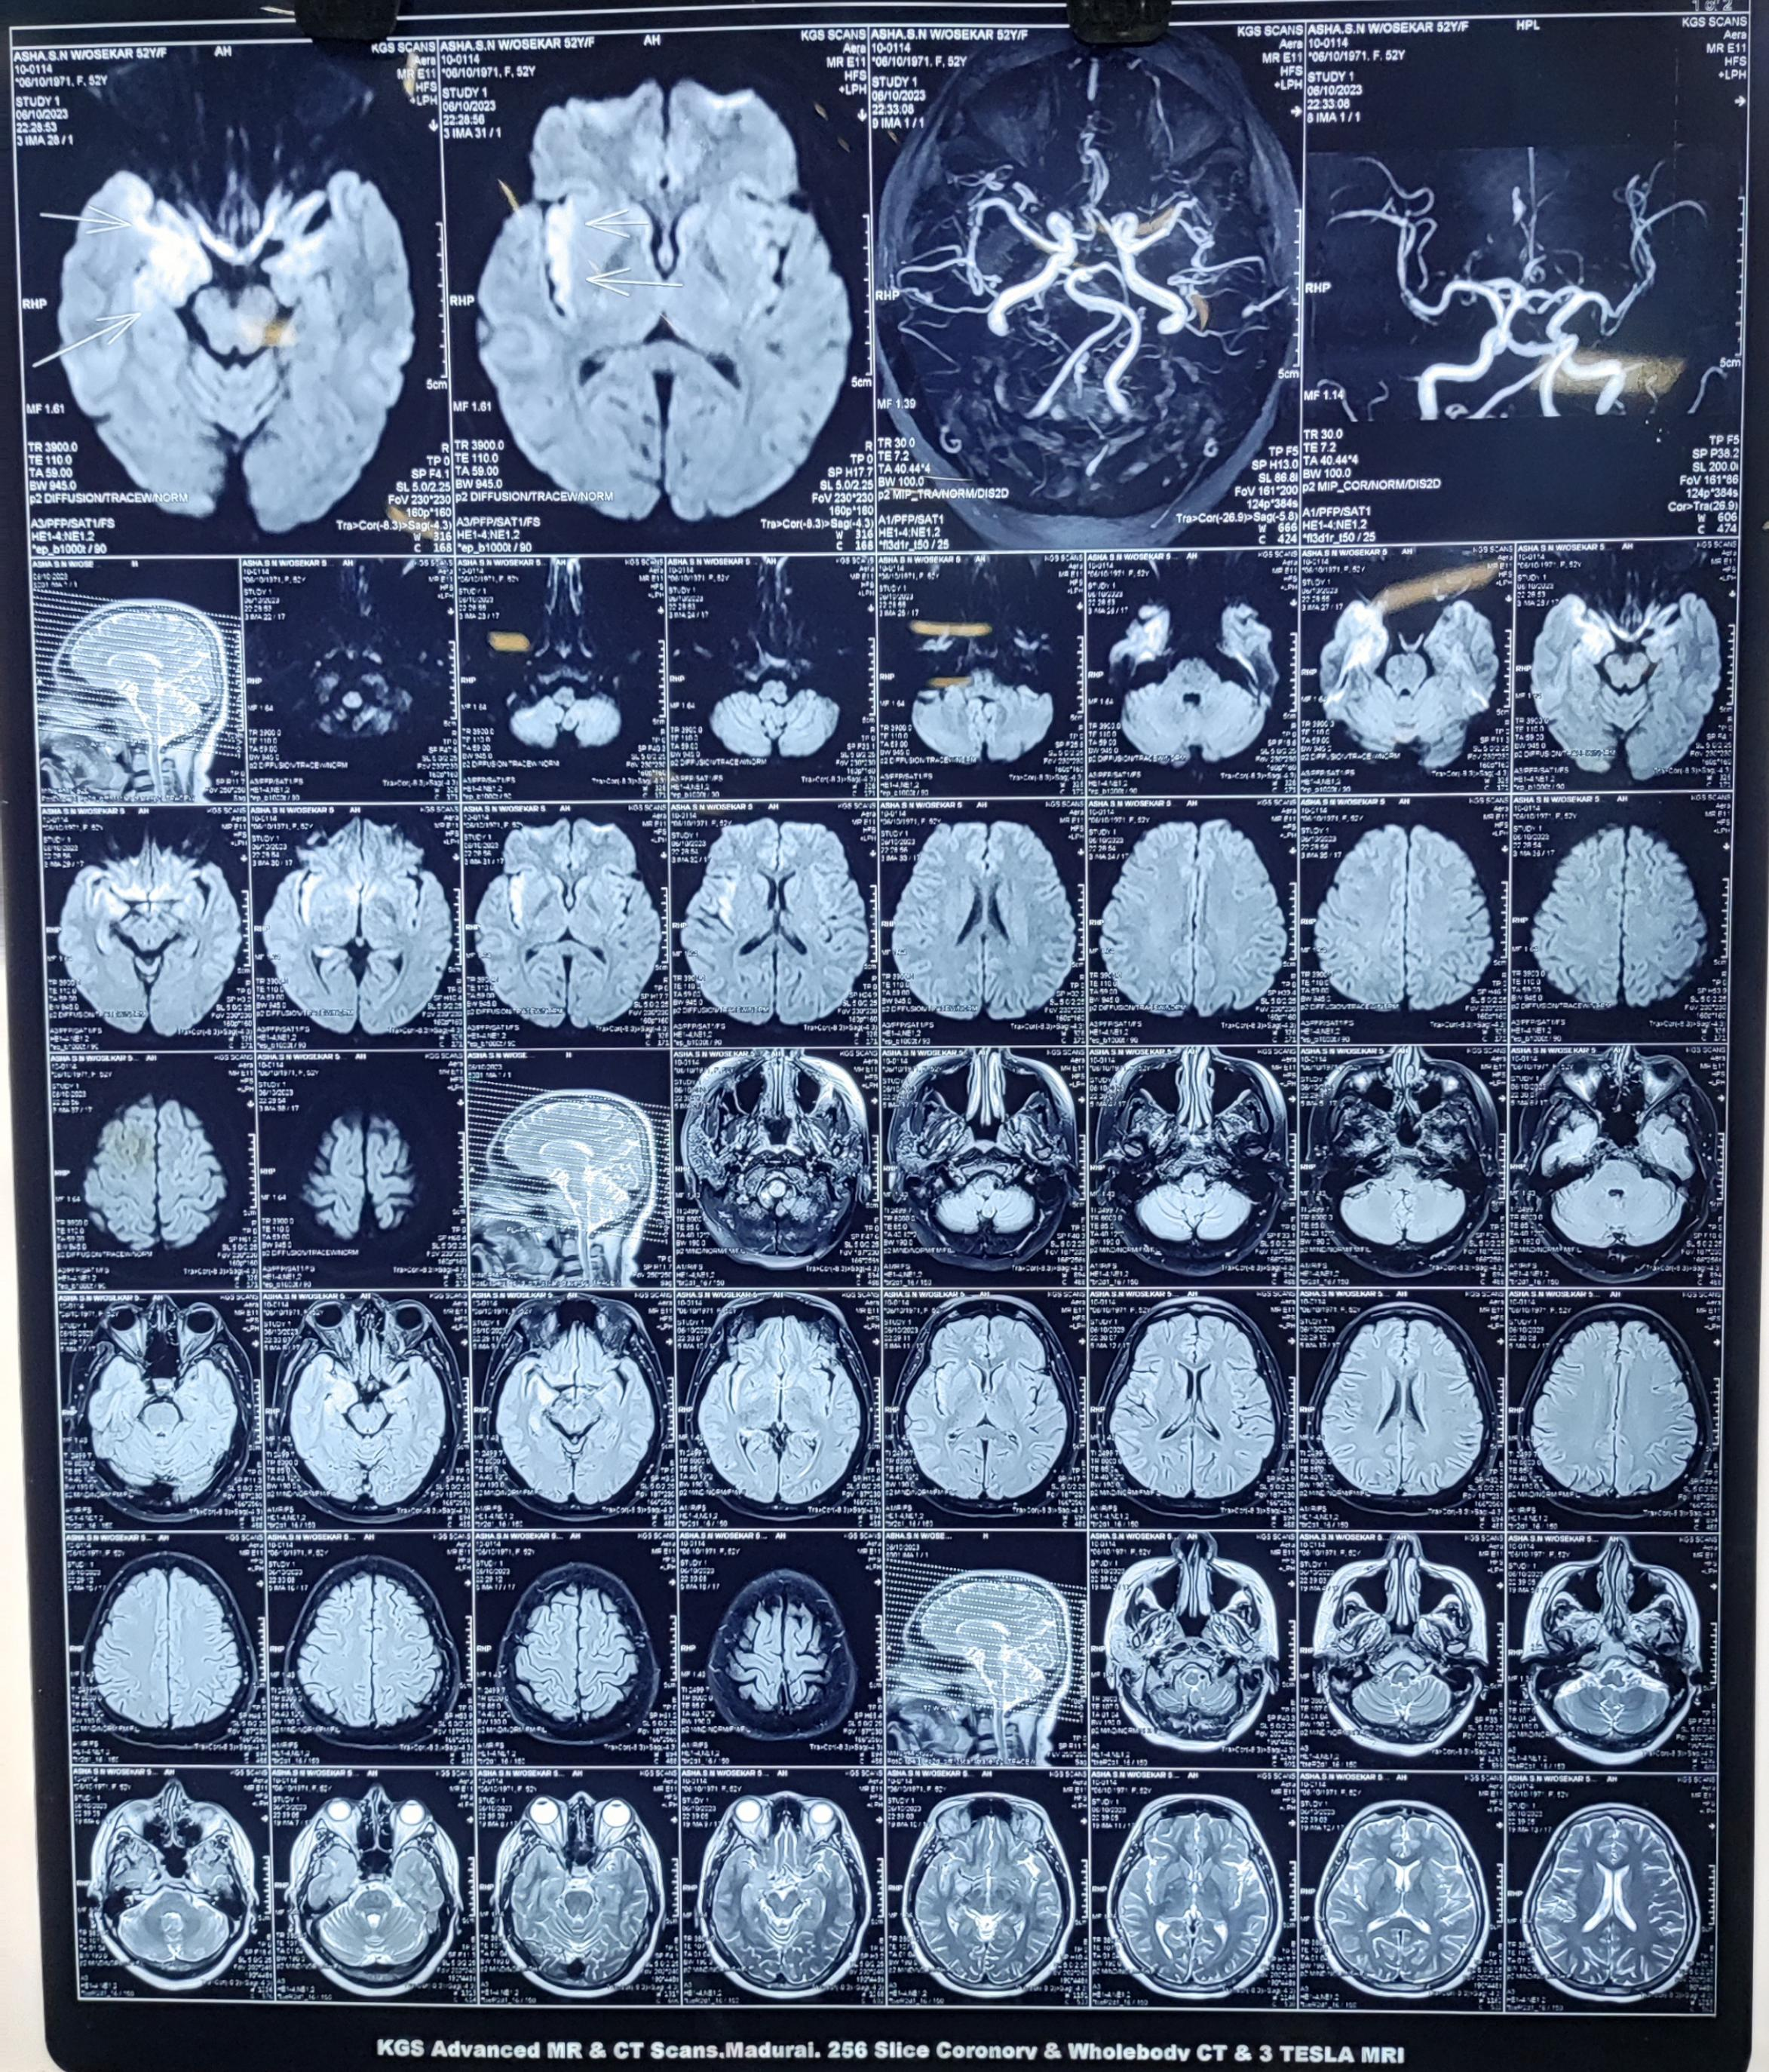

Slide 19
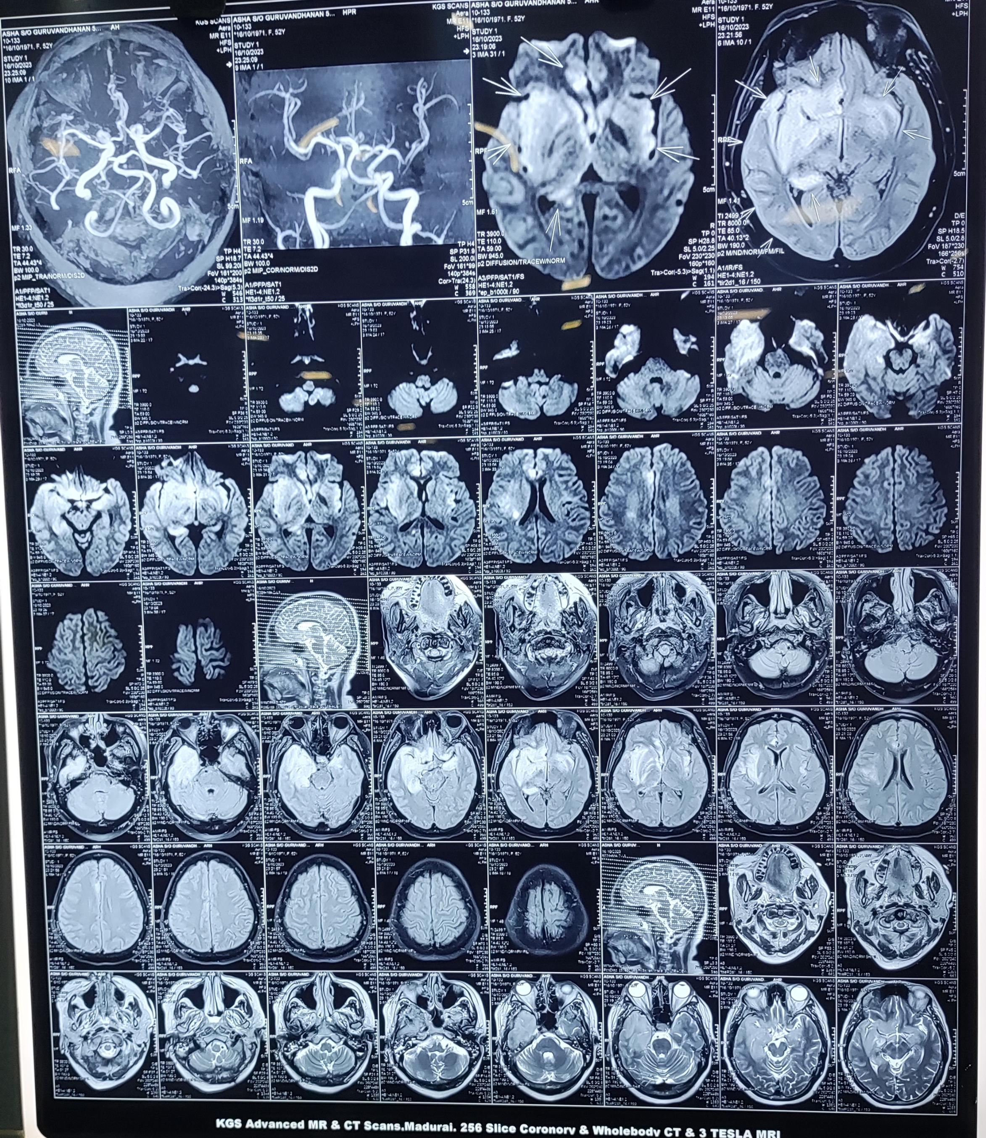

Slide 20
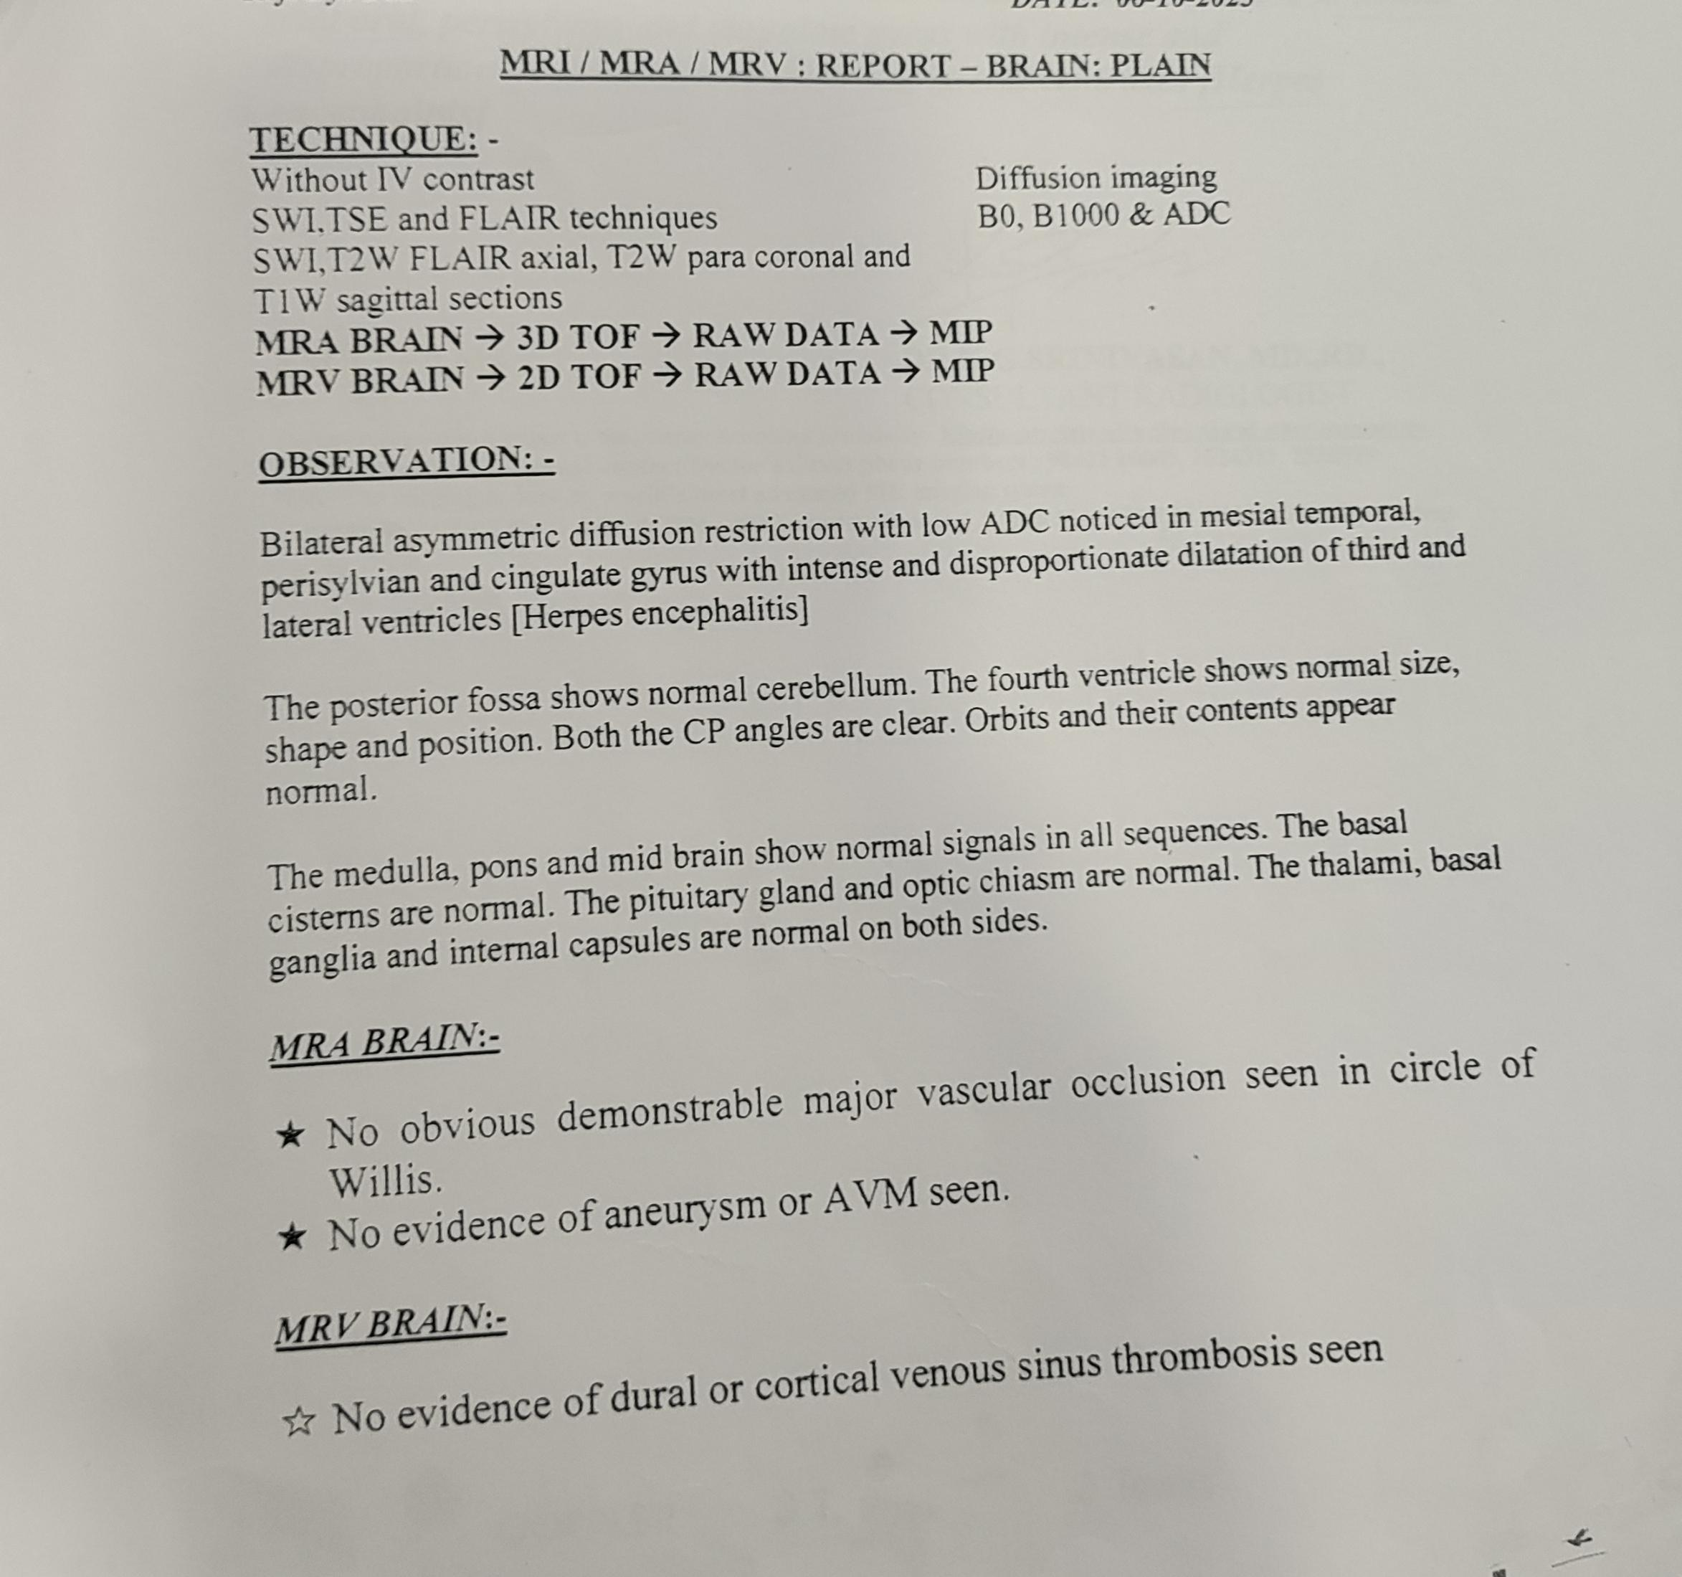

Slide 21
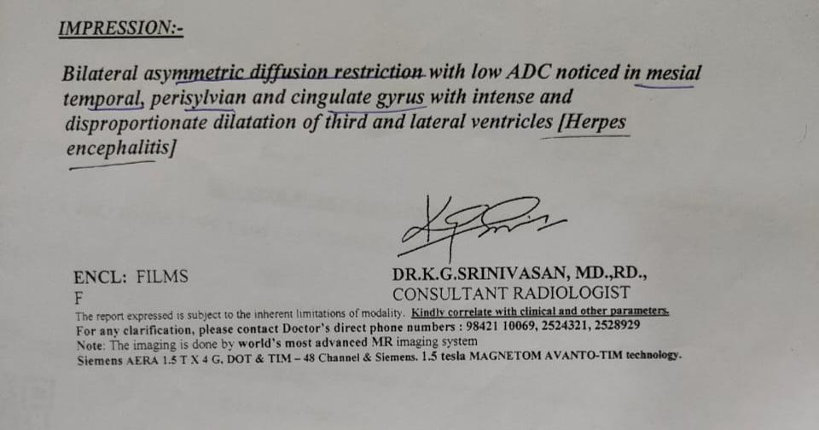

Slide 22
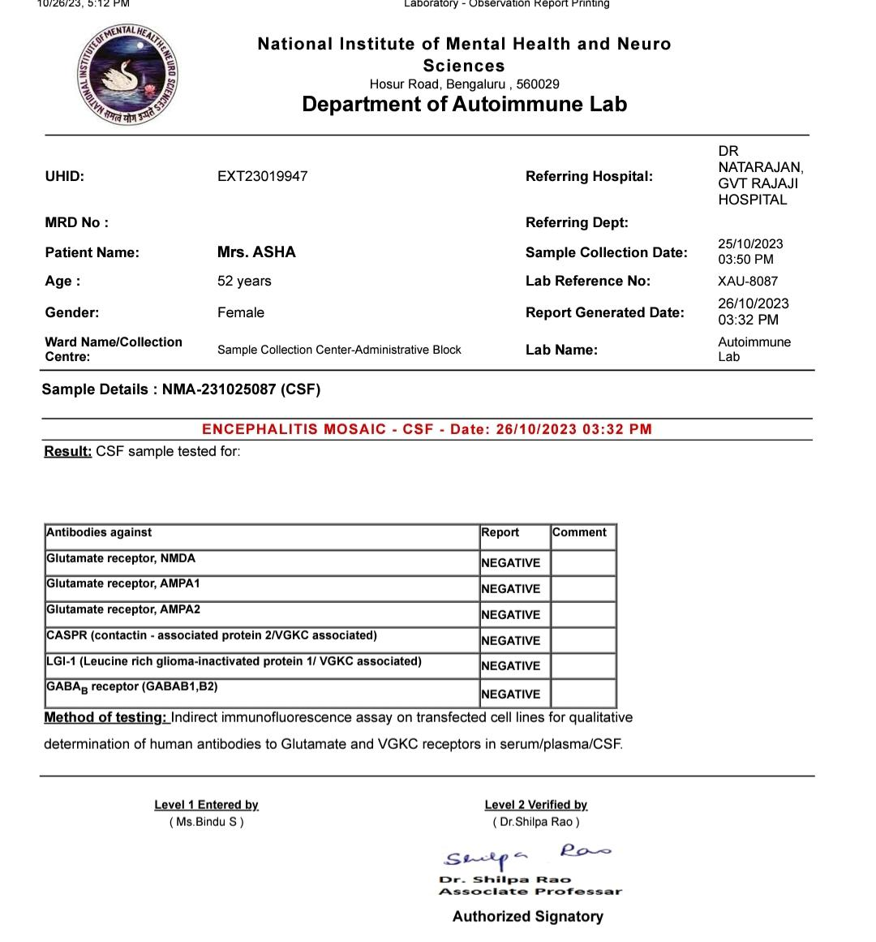

Slide 23
Treatment given
I. V antibiotics
Inj acyclovir 750 mg iv tds
Inj IVIG 2gm/ kg over 5 days
Supportive measures
Patient‘s general condition improved well and transferred out to ward.

Slide 24
Provisional diagnosis
Newly diagnosed Diabetes/ Hypothyroidism/HSV encephalitis

Slide 25
Thank you!!!

