Slide 1
THE MYSTERIOUS DYSTONIA
II-MU
PROFESSOR & CHIEF : DR G.BAGIALAKSHMI.,MD.,
ASSISTANT PROFESSORS : DR. VALLIDEVI.,MD.,
: DR. PON SENTHILKUMAR.,MD.,
: DR. ILAMARAN .M .,MD.,
PRESENTOR : DR.PALRAJ.M

Slide 2
CHIEF COMPLAINTS
A 45 year old female,home maker,admitted with
C/o Episodic burning sensation of both lower limbs for 5 months
C/o weakness of both lower limbs for 6 weeks

Slide 4
HISTORY OF PRESENTING ILLNESS
She was apparently normal 5months back after that she had
H/o Episodic burning sensation of feet , which was radiating to legs,thighs & upto genitalia , associated with stiffening of both lower limbs with flexion of both hips ( 30 degree), knee extension , ankle plantar flexion and abdominal wall contraction
This attack occurred 2-4 episodes per day which lasted for few minutes and subsided of its own .
This episode was associated with urinary incontinence

Slide 5
She was apparently normal in between the episodes with normal sensory , motor and autonomic functions
Higher mental functions were normal during and after the episode
3 ½ months later she developed,
H/o weakness of both lower limbs for 6weeks,which was sudden in onset,flail type,non progressive
H/o difficulty in holding slippers in both limbs & difficulty in getting up from squatting position+
She was bedridden ,unable to roll over & get up from the bed ,with increased frequency of muscle spasms (3-4 episodes per hour) for 6weeks

Slide 6
H/o difficulty in feeling clothes & impaired hot & cold,pain sensation below nipple for 6weeks
No h/o band like sensation over trunk
No h/o electric shock like sensation while neck flexion
No h/o difficulty in raising both arms above the head
No h/o difficulty in buttoning & unbuttoning the shirt
No h/o diurnal variation
No h/o twitching of muscles
No h/o thinning of muscles

Slide 7
No h/o breathing difficulty/cough
No h/o fever/loose stools/abdominal pain
No h/o head ache/blurring of vision
No h/o vomiting
No h/o loss of consciousness
No h/o seizures
No h/o speech disturbances

Slide 8
No h/o smell disturbances
No h/o diplopia/ loss of vision/blurring of vision
No h/o drooping of eyelids
No h/o deviation of angle of mouth
No h/o tinnitus/positional vertigo/ear discharge/hard of hearing
No h/o nasal regurgitation/dysphagia/dysarthria
No h/o deviation of tongue
No h/o chest pain/palpitation/excessive sweating
No h/o trauma

Slide 9
PAST HISTORY
H/o type 2 DM for 6months on OAD
Not a k/c/o hypertension, CKD,CAD, Seizure disorder,malignancy ,thyroid disease,STD, tuberculosis , covid infection
No h/o radiation exposure,drugs and toxin exposure,blood transfusion
No h/o recent vaccination,dog bite

Slide 10
PERSONAL HISTORY:
Consumes mixed diet
No h/o excessive carbohydrate diet,strenuous physical activity
No addictive habits
TREATMENT HISTORY:
Patient was treated with T.Metformin 500mg1-0-1
T.Amitriptyline 25mg 0-0-1
T.Gabapentin 300mg 1-1-1

Slide 11
FAMILY H/O:
No h/o similar illness in her family
MENSTRUAL H/O:
Regular menstrual cycle,3/28
OBSTETRIC H/O:
No significant obstetric history

Slide 12
ON EXAMINATION
Conscious, oriented, afebrile,
No pallor
No cyanosis
No clubbing
No icterus
No pedal oedema
No lymphadenopathy

Slide 13
VITALS
BP
120/80mmhg
SPO2-98%
RR-16/min
PR-84/min

Slide 14
CNS EXAMINATION
conscious
oriented
Right handed individual
Higher mental function - normal Speech - normal
Cranial Nerve examination – Normal
Fundus – normal ,No RAPD

Slide 15
SPINOMOTOR SYSTEM:
BULK UPPER LIMB N N
LOWER LIMB N N
TONE UPPER LIMB N N
LOWER LIMB ↓ ↓

Slide 16
POWER
SHOULDER | 5/5 | 5/5
ELBOW | 5/5 | 5 /5
WRIST | 5 /5 | 5 /5
HAND GRIP | normal | normal
HIP | 2/5 | 2/5
KNEE | 2/5 | 2/5
ANKLE | 2/5 | 2/5
TOE GRIP | WEAK | WEAK

Slide 17
REFLEXES:
Corneal reflex + +
Conjunctival reflex + +
Gag reflex + +
Abdominal reflex absent absent
Anal reflex absent
Plantar extensor extensor

Slide 18
 | DTR
Jaw jerk | - | -
Biceps jerk | ++ | ++
Triceps jerk | ++ | ++
Supinator jerk | ++ | ++
Knee jerk | - | -
Ankle jerk | - | -
No primitive reflexes

Slide 19
SENSORY EXAMINATION
Posterior column
Fine touch
vibration Impaired below T4
joint & position sense
Spinothalamic tract
Crude touch Impaired below T4
Pain & Temperature

Slide 20
Cerebellar function test – Upper limb normal,
Lower limb could not be done
Spine & cranium – normal
Spinal vibration Sense – absent below T3
Carotids – normal
No Peripheral nerve thickening
No signs of meningeal irritation
No resting tachycardia , abnormal sweating .Postural hypotension could not be elicited.

Slide 21
CVS-S1,S2 heard , No murmur
RS-NVBS , No added sounds
P/A- Soft, BS+

Slide 22
PROVISIONAL DIAGNOSIS
TYPE II DIABETES MELLITUS
ACUTE FLACCID PARAPARESIS
SYMMETRICAL,
PROXIMAL = DISTAL
WITH POSTERIOR COLUMN AND SPINOTHALAMIC TRACT INVOLVEMENT
WITH INTERMITTENT TONIC MUSCULAR SPASMS & BLADDER INVOLVEMENT
MOTOR & REFLEX LEVEL– below T1, above T6
SENSORY LEVEL- T3
CORD LEVEL – T3

Slide 23
WHAT NEXT...

Slide 24
DIFFERENTIAL DIAGNOSIS
Multiple sclerosis and NMOSD
HIV myelopathy and HTLV infection
Subacute combined degeneration
(B12& folate deficiency,copper deficiency,vit E)
Sarcoidosis
Connective tissue disorders
Vasculitis
Paraneoplastic
Spinal AV Dural fistula
Compressive myelopathy with PN

Slide 25
DD’s FOR TONIC SPASMS
Encephalitis
Tuberculosis,syphilis
Multiple sclerosis
Myelitis
Toxins,drugs
Paraneoplastic syndromes
Psychogenic
Wilsons disease
Spinal AV malformation
Epileptic seizure

Slide 26
INVESTIGATIONS
TC | 10,400
DC | 64 / 31/2/3
RBC | 4.45
HB | 12.9
PLT | 1.99 L
HCT | 36.8
MCV | 82
MCH | 29
MCHC | 35
ESR | 38
CRP | 14.5
UREA | 28
CREAT | 1.1
Na+ | 133
k+ | 4.5
CALCIUM | 8.9
PHOSPHORUS | 3.5
CPK | 204

Slide 27
BILIRUBIN | 1.3
DIRECT | 0.3
INDIRECT | 1.0
SGOT | 35
SGPT | 27
ALP | 86
T.PROTEINS | 6.6
ALBUMIN | 3.4
GLOBULIN | 3.2
URINE ALBUMIN | NIL
SUGAR | TRACE
DEPOSITS | 2-4 pus cells
SPOT PCR | 0.6
VCTC | NON REACTIVE
HBSAg | NONREACTIVE
ANTI – HCV | NONREACTIVE

Slide 28
ECG-WNL
CHOLESTROL | 170
TGL | 305
RBS | 202
FBS | 176
PPBS | 285
HbA1C | 7.5
TSH | O.724
FREE T4 | 1.29

Slide 29
PERIPHERAL SMEAR
RBC:Normochromic normocytes
WBC: Count normal , no atypical cells seen
Platelets: Normal in number and in morphology
IMPRESSION : Normal study
USG ABDOMEN
Fatty liver
Mild splenomegaly

Slide 30
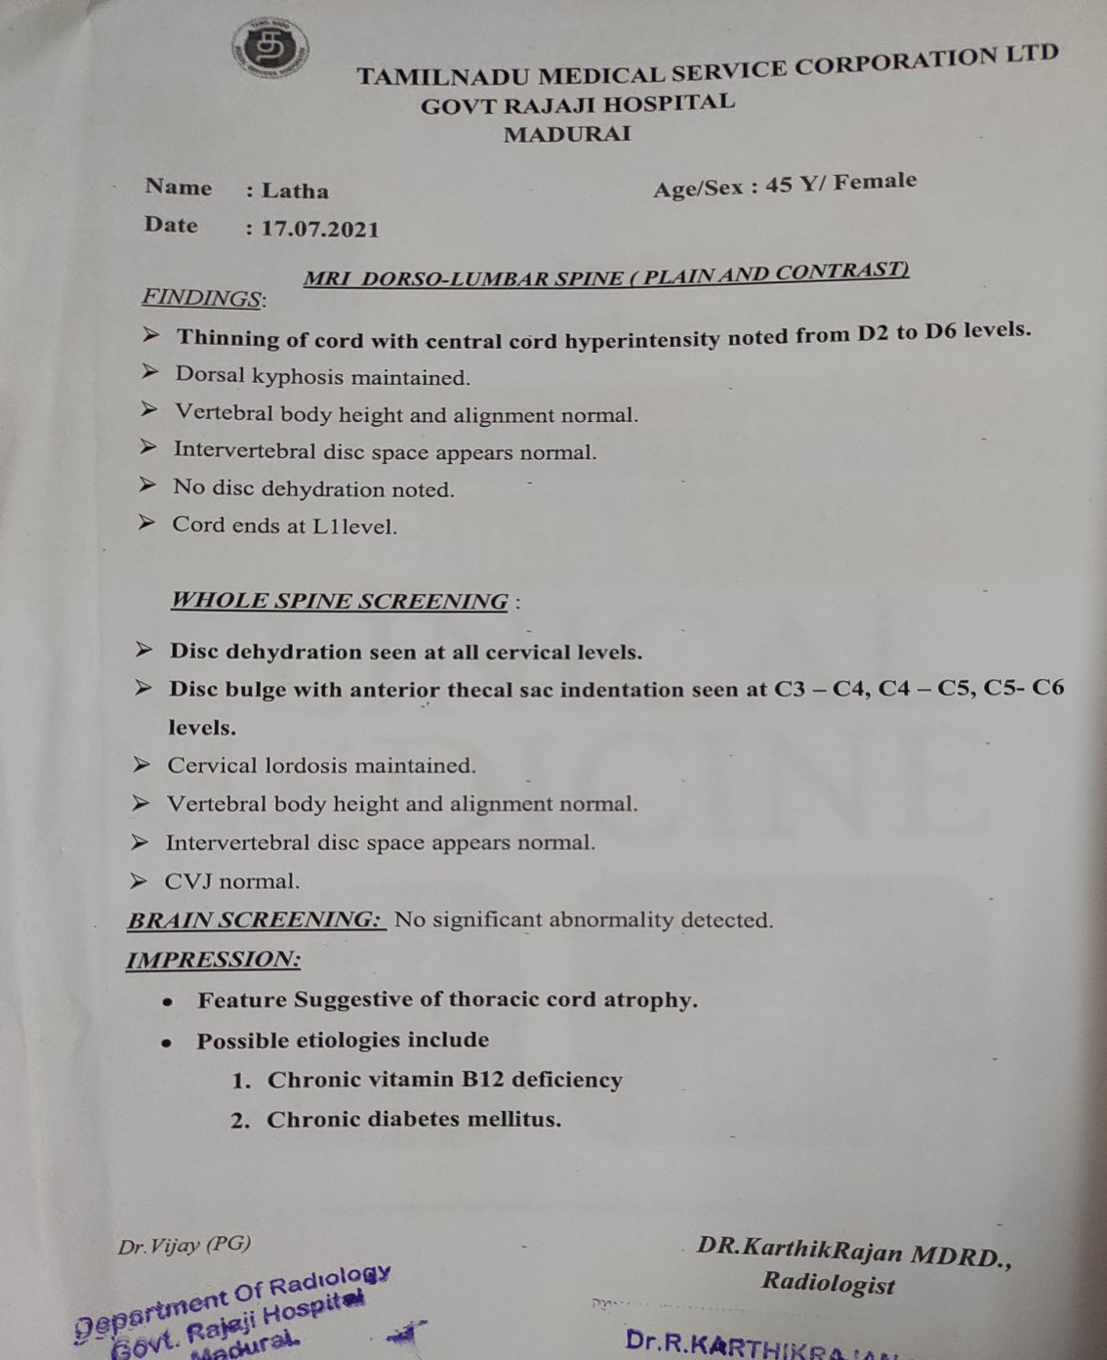
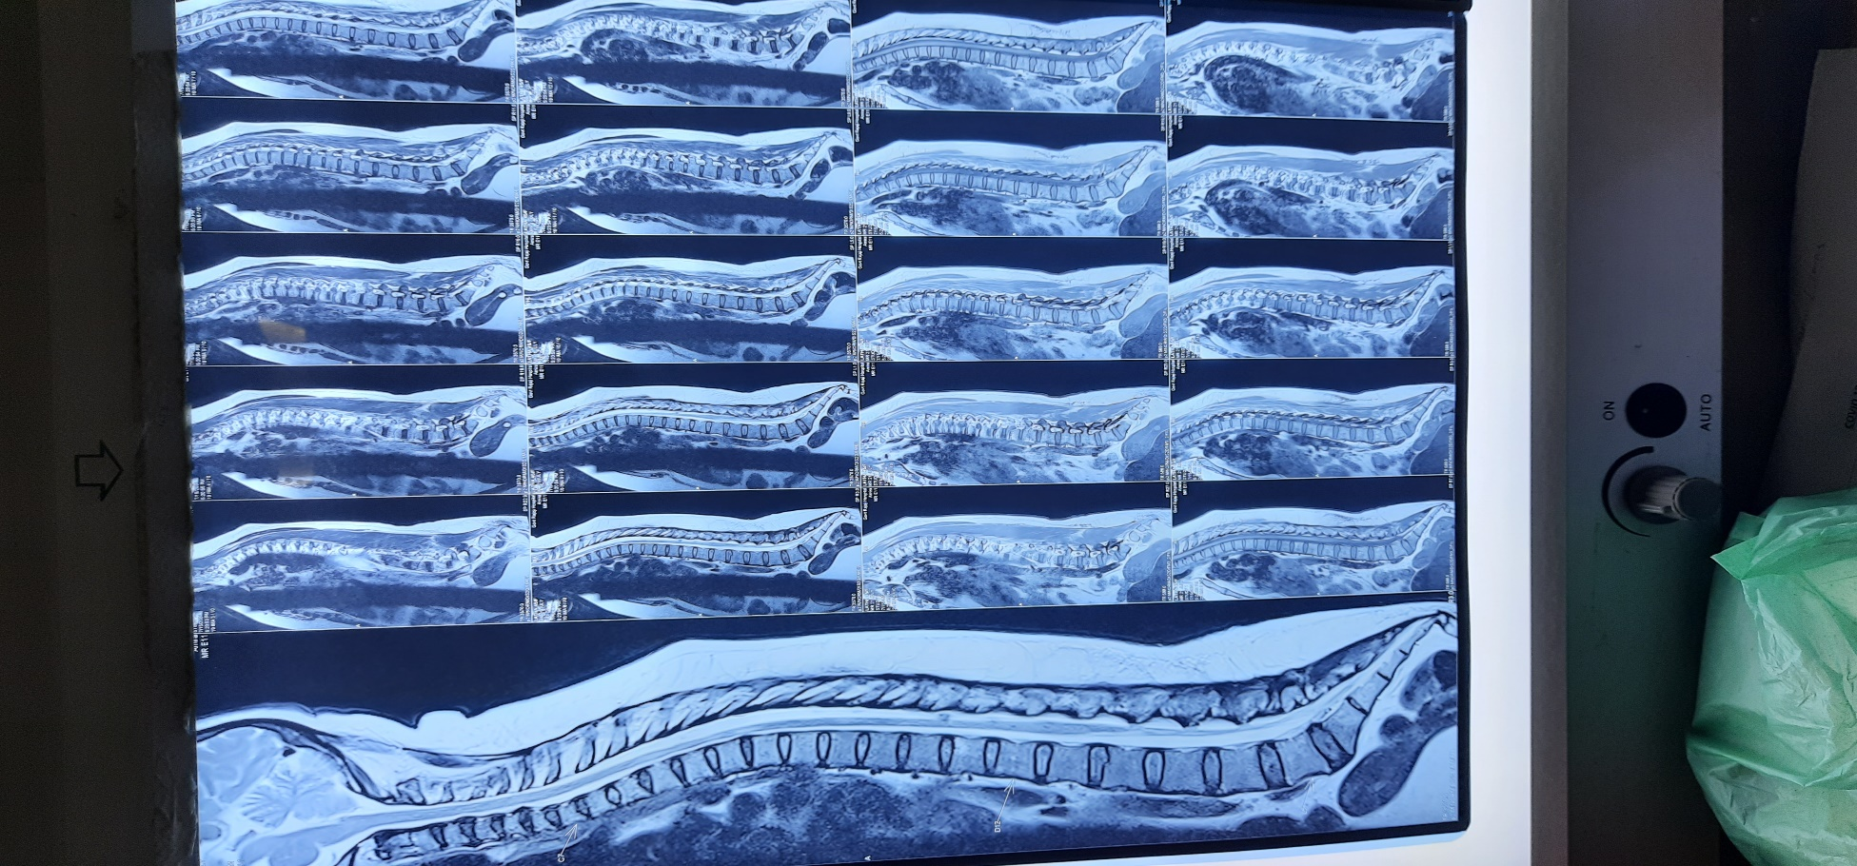
MRI SPINE WITH WHOLE BRAIN SCREENING

Slide 31
NEUROMEDICINE OPINION
IMPRESSION: Non compressive myelopathy/myeloneuropathy for evaluation
T. Carbamazepine 200mg 1bd
T.Baclofen 10mg 1bd
T.Diazepam 5mg 1HS
To do CSF analysis
To do ANA and ANCA profile
To do serum ACE

Slide 32
CSF ANALYSIS
Gross
Clear
Cells
2cells/cu.mm
Micro
biology
Gram stain- -ve
Bio
chemical
Protein -96mg/dl
Colourless
N-0%
Glucose-91mg/dl
Chloride-113mEq/l
Globulin- + VE
ADA-1.2U/L
Culture-no growth
L-100%

Slide 33
SACD
Serum B12-740pg/ml
Sr.Copper-135.41 ug/dl
Sr. Ceruoplasmin-27.90 mg /dl
Folate-
39 ng/ml

Slide 34
NEUROSARCOIDOSIS
No hilar lymphadenopathy in CT chest
Serum ACE -26U/L
Serum Calcium – 8.9 mg/dL

Slide 35
CTDs & VASCULITIS
No fever
No rashes
No arthritis
No mucosal or genital ulcers
ANA- NEGATIVE
p-ANCA &amp;c-ANCA were negative

Slide 36
INFECTIONS
Clinical
No fever , recurrent genital infection
No Lymphadenopathy , Nomeningismus
CSF
Gram stain and culture were negative
No pleocytosis
Serum
VDRL – NON REACTIVE
HIV – NON REACTIVE

Slide 37
MULTIPLE SCLEROSIS
Serum &amp; CSF Oligoclonal bands- Absent
Absence of MS specific lesion in MRI Brain
No Short segment cord lesion involving the periphery of the cord

Slide 38
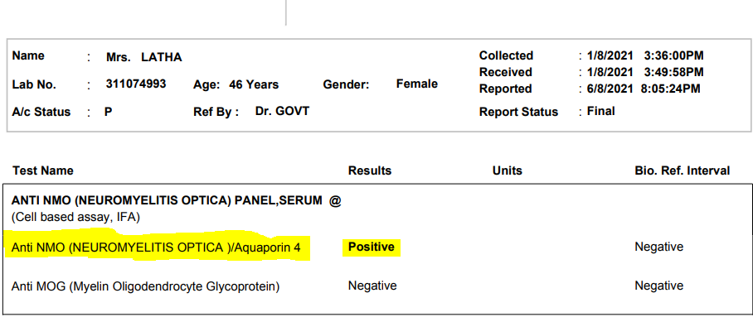
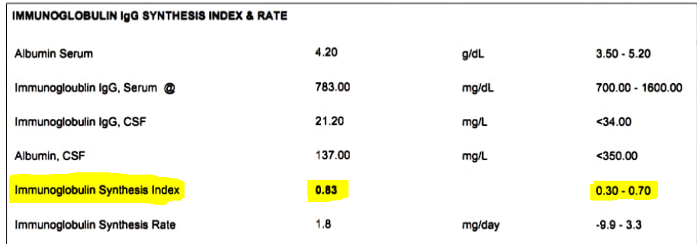

Slide 39
NEUROMEDICINE OPINION
NMO SPECTRUM DISORDER
Inj. Methylprednisolone
Inj. Rituximab
To continue CBZ , Baclofen , Diazepam

Slide 40
OPHTHALMOLOGY OPINION
Bilateral Pupil – RTL , No RAPD
Bilateral Fundus - Normal

Slide 41
FINAL DIAGNOSIS
TYPE II DIABETES MELLITUS
NMO SPECTRUM DISORDER

Slide 42
TREATMENT
Inj. Methylprednisolone 125 mg in 100 ml NS over 30 mins
Inj. Rituximab 1gm in 500ml NS over 4 hours
T.Carbamazepine 200 mg 1bd
T. Diazepam 5mg 1HS
T.Baclofen 10mg 1BD
T. Metformin 500mg 1TDS
T.Glipizide 5mg 1BD
Repeat Rituximab dose after 2 weeks and 6 months interval

Slide 43
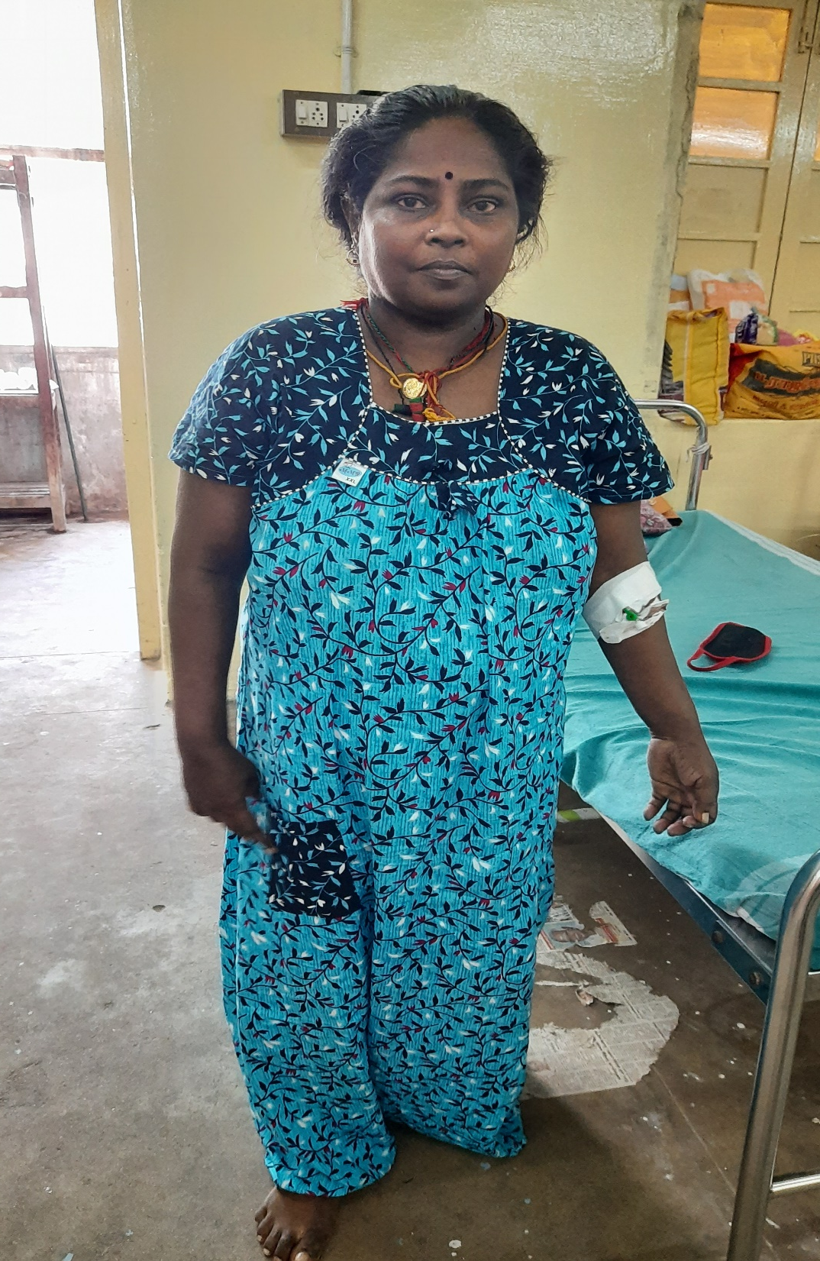

Slide 44
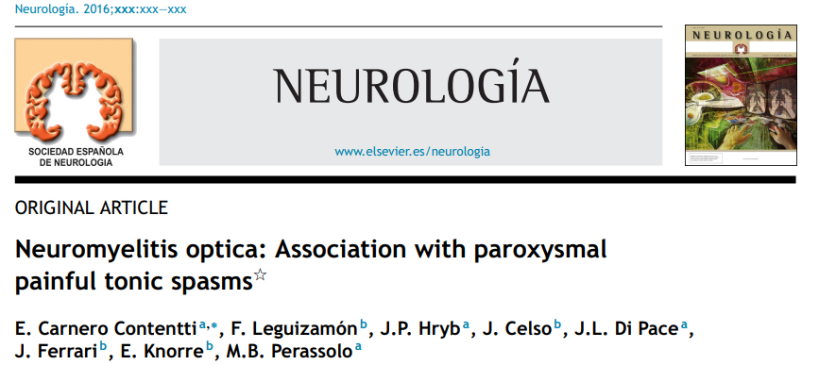
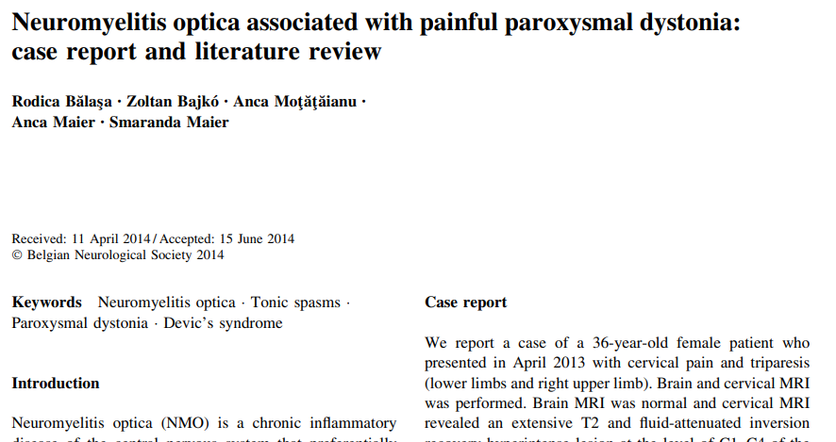

Slide 45
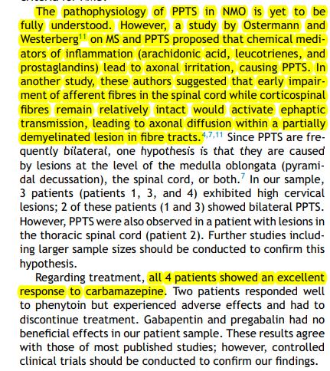

Slide 46
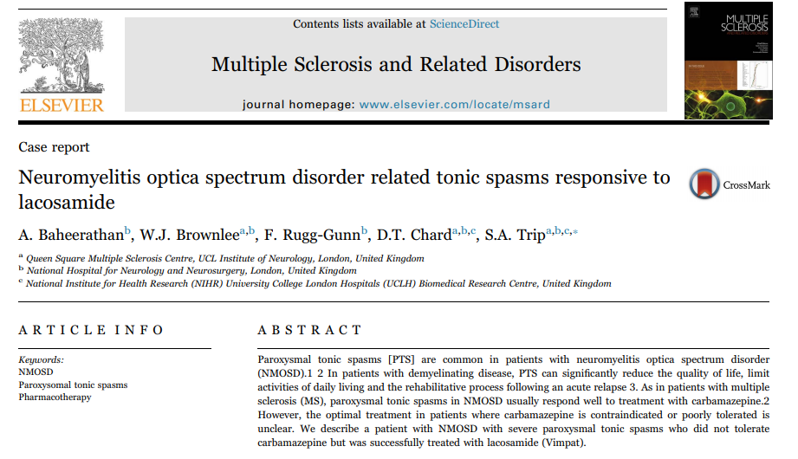

Slide 47
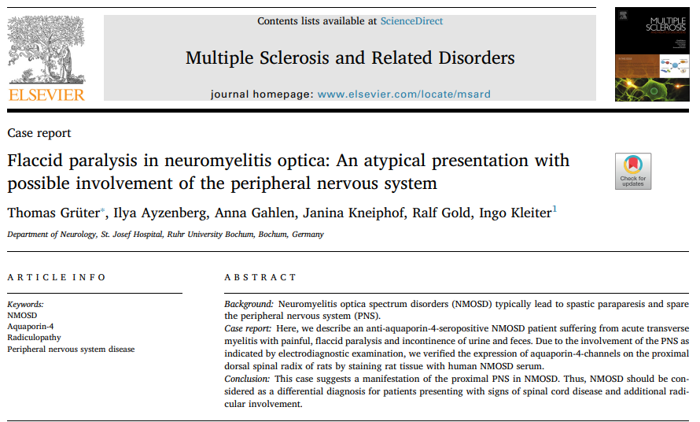

Slide 48
AIM OF THE PRESENTATION
To discuss about an approach to flaccid paraparesis
To discuss about various presentation of NMO
NMOSD as Tonic Spasms –an unseen presentation

Slide 49
THANK YOU…

