Slide 1
X RAY KUB for Discussion
Dept. Of Nephrology

Slide 2
Case Scenario
A 50 year old man, K/C/O T2DM, SHTN was admitted with ACS, AWMI- cardiogenic shock.
Taken up for thrombolysis
Thrombolysis failed
Urea- 48
Creat – 1.2

Slide 3
Taken up for PTCA
Patient condition stabilised, weaned off ventillator
Day II Day III
S. Creat 2.4 4.2
USG Abdomen – WNL
Urine output -700 ml/day
XRAY KUB taken 48 hours after the procedure

Slide 4
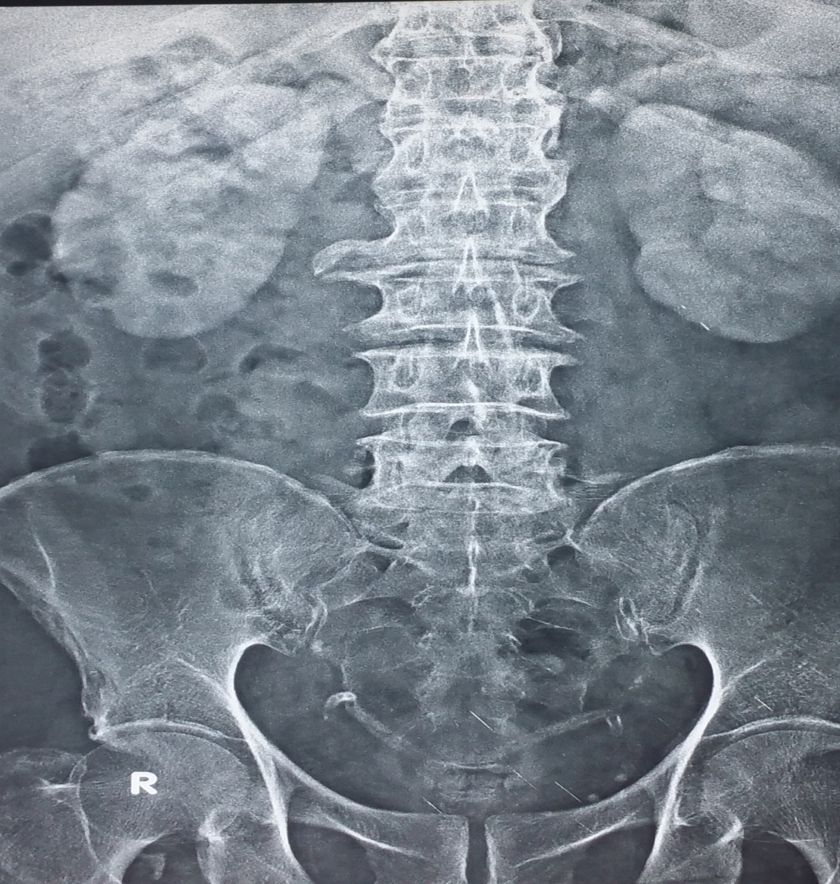
XRAY KUB PLAIN

Slide 5
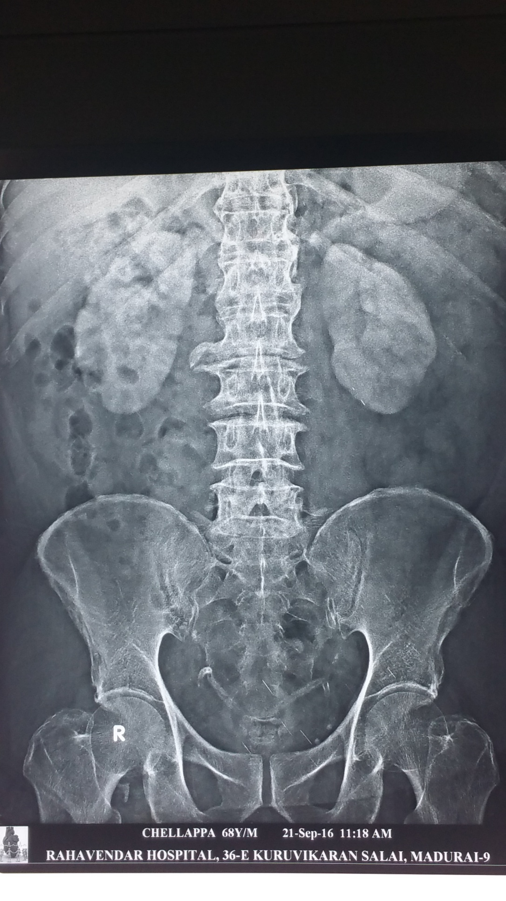
Xray plain

Slide 6
?????

Slide 7
PROLONGED NEPHROGRAM DUE TO CIAKI

Slide 8
CIAKI
Acute decline in renal function that develops within three days, peaks in three to five days and returns to baseline in 7 – 10 days
Usually non oliguric
Form of ATN
Vasoconstriction and medullary hypoxia, Direct tubular toxicity and generation of ROS

Slide 9
Risk Factors
Patient related
Procedure related
Renal impairment
DM
Absoloute intravascular volume depletion
Effective intravascular volume depletion
Use of nephrotoxic medications
High Osmolal contrast
Large volume contrast
Multiple sequential procedures
Intraarterial administration

Slide 10
Types of contrast
Ionic, High osmolality- cystografin
Ionic, low osmolality- Eovist
Non ionic, Iso osmolality- Iodixanol
Non ionic, low osmolality-Feridex,Primovist

Slide 11
DD
Ischemic ATN
Renal Atheroembolic disease

Slide 12
Prevention
Choice Of Contrast Agents
Minimum volume of contrast required should be used
Iso osmolal or non ionic low osmolal contrast
Other than iohexol or ioxaglate should be used

Slide 13
Pharmacological Agents
Ineffective
Indeterminate efficacy
Loop Diuretics
Dopamine
Fenoldopam
CCB s
ANP
Statins
Aminophylline
N acetyl cysteine
Bosentan
Allopurinol

Slide 14
Oral NAC administered at a dose of 1200 mg twice daily before and after the procedure

Slide 15
Intravascular Volume expansion
Counteract the direct toxicity of contrast on tubular cells by decreasing its concentration and viscosity
Suppress the vasoconstrictive effect of contrast by suppressing vasopressin and RAAS
Isotonic saline at 1 mg/kg/hr for 6-12 hours before and after the procedure

Slide 16
RIPC
Remote ischemic preconditioning is the phenomenon whereby brief episodes of ischemia reperfusion applied in distant tissues render renal tissues resistant to a subsequent sustained ischemia.
Has been found to reduce the incidence of CIAKI

Slide 17
THANK YOU

