Slide 1
ECG OF THE WEEK

Slide 2
50 year old male, not a known case of type 2 DM and hypertensive,
Not a smoker and alcoholic
Has been treated for post herpetic neuralgia
He was on
T.amitriptyline 25 mg HS
T.methyl cobalamin
No other specific compliants

Slide 3
Examination
General examination- normal
Vitals stable
CVS-s1 s2 + no murmur
RS-NVBS+ no added sounds
Abdomen –soft
CNS- no FND

Slide 4
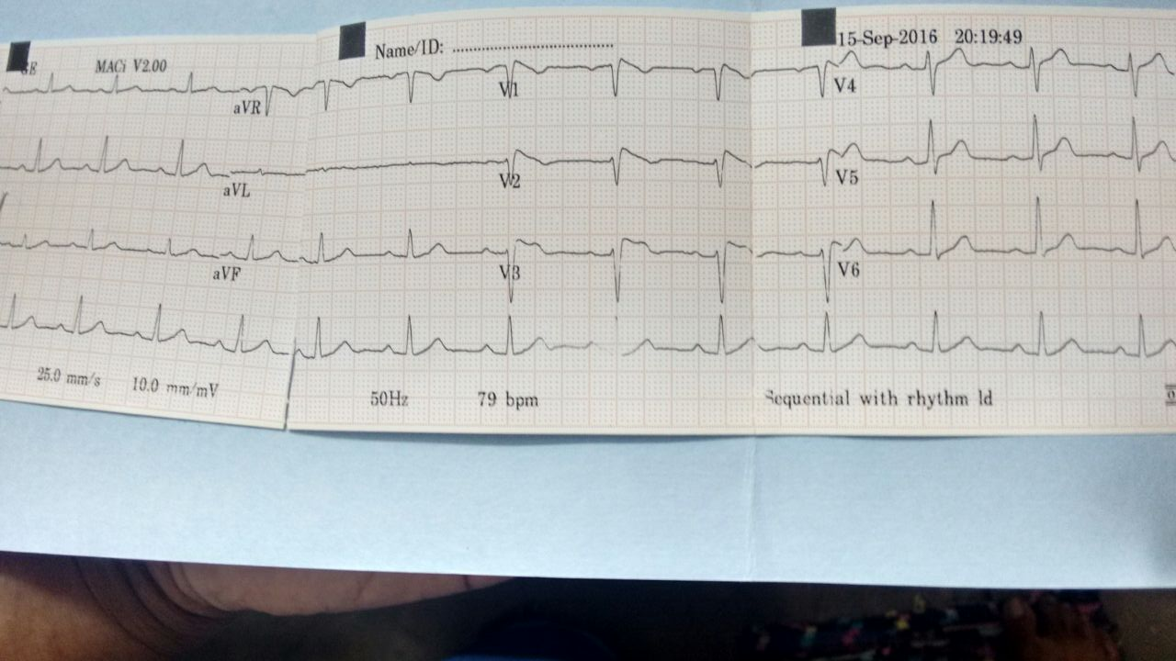

Slide 5
?????

