Slide 1



INVISIBLE THREAD
FIRST MEDICAL UNIT

Slide 2
A 31 YEARS FEMALE WAS BROUGHT TO GRH WITH
COMPLAINTS
DIFFICULTY IN USING BILATERAL LOWER LIMBS X 2DAYS

Slide 3
HISTORY OF PRESENTING ILLNESS
PATIENT WAS APPARTENTLY NORMAL BEFORE 20 DAY FOLLOWING WITH SHE DEVELOPED C/O
-ABDOMINAL PAIN
SUDDEN ONSET PROGRESSIVE
DIFFUSE NO SPECIFIC CHARACTER
NO AGGARTAVTING/RELIVING FACTOR
-ASSOCIATED WITH VOMITING
6-7 EPISODES PER DAY
COTAINING UNDIGESTED FOOD PARTICLE/WATERY
NON-PROJECTILE
NON BLOOD STAINED
-NO C/O FEVER

Slide 4
PATIENT Sort treat the above complaints in near by hospital diagnosed with calculus cholecystitis for with lap cholecystectomy was done.
c/o vomiting still persisted
Patient was discharged while patient tried to take a seat in auto had difficult in using her both the lower limbs and has a fall
Patient c/o heaviness of B/L lower limbs SUDDEN onset
Difficult in moving both lower limbs
Slowly patient also had difficulty in rolling over the bed
over few days patient also had difficulty in using raise her upper limbs over her head
No c/o difficulty in swallowing/diplopia/
No h/o fever /loose stools
No bowel /bladder involvement

Slide 5
No h/o similar illness in past
No known co-morbidities previously
At presentation
Vitals
Bp 100/60 mmhg
PR -82/min
RR-16/min
SPO2 96% RA
CBG-140mg/dl

Slide 6
O/E
Conscious
Oriented
Moderately build and nourished
Comfortable – no tachypnoea
No pallor/icterus/cyanosis/clubbing/pedal oedema/lymphadenoapthy
Hydration-poor
S/E
cvs:s1s2 + no murmurs
Rs: b/L AE+, no added sounds
PA : soft , bowel sounds +

Slide 7
CNS
Higher mental function – normal
Cranial nerve intact
Sensation –
Motor
No apparent muscle wasting
B/L PLANTAR WITHDRAWAL
TONE | right | Left
Upper limb | decreased | decreased
Lower limb | decreased | decreased
DTR | RIGHT | LEFT
UPPER LIMB | + | +
LOWER LIMB | - | -
POWER | RIGHT | LEFT
UPPER LIMB | 3/5 | 3/5
LOWER LIMB | 0/5 | 0/5

Slide 8
NO CEREBELLAR SIGNS
NO MENIGEAL SIGNS

Slide 9
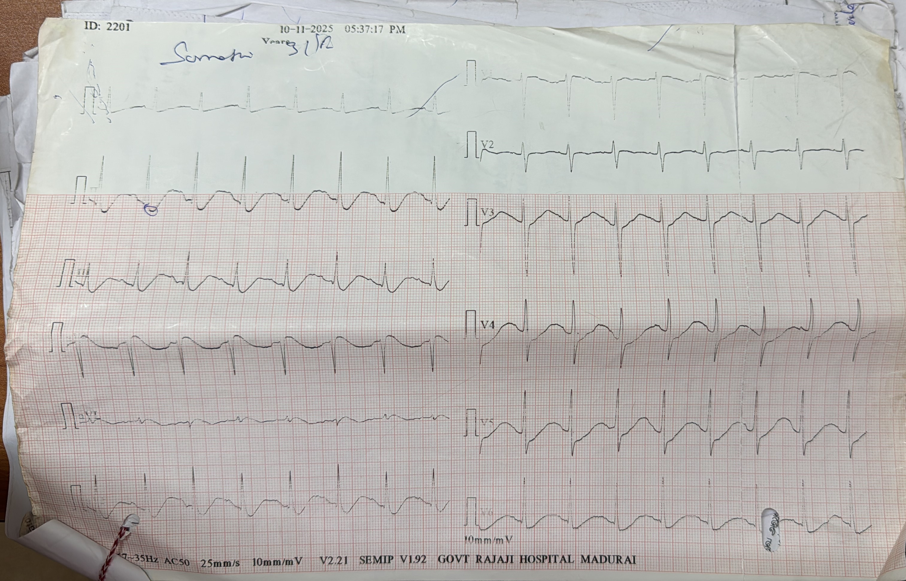

ECG
12LEAD STANDARDIZED ECG
SINUS RHYTHM HR 90/min
AXIS-60 degree
GLOBAL ST DEPRESSION
U WAVE
QTc-637msec prolonged

Slide 10
BLOOD INVESTIGATIONS
UREA | 168 mgs%
CREATININE | 8.6mgs%
Sr.NA | 120meq/L
Sr.K | 2.0 meq/L
S.Ca | 6.4 mg/dl
Crct ca | 8.2 mg/dl
Sr.protein (A/G) | 4.9 (2.2/2.7)
Sr.Mg | 2.9 mg/dl
Sr.TSH | euthyroid
Sr.CPK | 678
ESR | 54
qCRP | 28.8
TC | 35,100
HB | 13.1
PLT | 5,39,000
PH | 7.30
PCO2 | 19
HCO3 | 9.3
LAC | 1.7
Metabolic acidosis with compensation respiratory acidosis

Slide 11
Urine investigations
Ur.K | 15.2 meq/l
Ur.Na | 38 meq/l
Ur.protein | 167mg
Ur.creatinine | 32mg
Ur.pcr | 5.2
U.Ca/C | 4.8/13 (0.3)

Slide 12
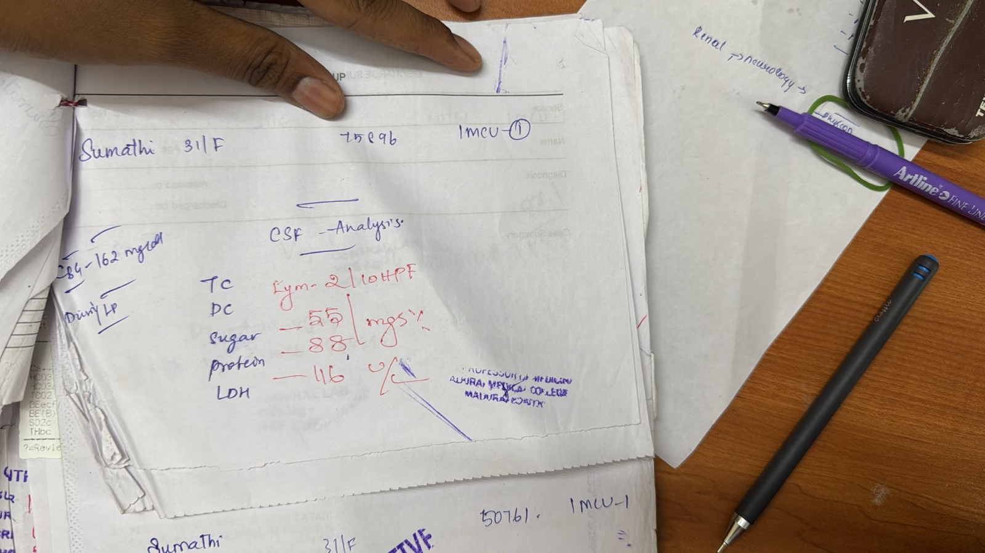
CSF
INTERPRETATION
albuminocytological dissociation

Slide 13
IMAGING
USG abdomen and pelvis – KIDNEYS N size / CMD +
CT A&P –TINY MICROLITH NOTED IN LK UPPER POLE
MRI C-SPINE
FOCAL HYPERINTENSE LESION – MIDLINE PONS
MRI -BRAIN
T2/FLAIR HYPERINTENSE LESION WITH DIFFUSION RESTRICTION NOTED IN CENTRAL PONS WITH SPARING OF PERIPHERAL FIBRES
BLOOMING NOTED WITHIN THE LESION (ACUTE RENAL FAILURE / HAEMORRHAGE)
-- POSSIBILITY OF OSMOTIC DEMYELINATION SYNDROME—

Slide 14
Nerve conduction study
11/11/2025
Impression :
MOTOR AXONAL NEUROPATHY WITH RADICULOPATHY ASYMMETRICAL OF BOTH UPPER LIMB AND LOWER LIMB
POST RECOVERY REPEAT NCS
BOTH MOTOR AND SENSORY CONDUCTION STUDY NORMAL

Slide 15
OPTHAL EXAMINATION
VISION B/E 3/60
BE ESOTROPIA
STRUCTURE NORMAL
COLOR VISION NORMAL
FIELD OF VISION NORMAL
FUNDUS BE NORMAL
SCHIMERS TEST IN 5 MINS
TBT – B/E 9 second
RIGHT EYE | 7MM
LEFT EYE | 5MM

Slide 16
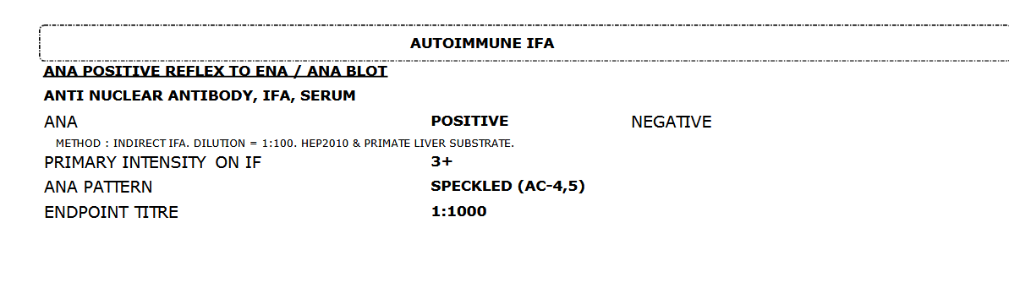
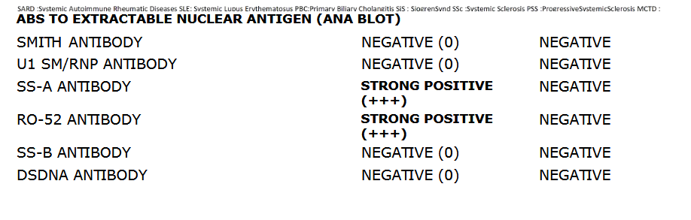
ANA

Slide 17
Course in hospital
HYPOKALEMIA INITAILLY PERSISTED WITH POSSTAIUM SUPLEMENTATION WEAKNESS RECOVERED
01
RENAL FAILURE RECOVERED -CONSERVATIVE MANAGEMENT
02
TOTAL COUNTS RECOVERED – IV ANTIBIOTICS
03
STEROIDS AND IMMUNOSUPRESSANT S INITIATED

Slide 18
SPECIALITY OPINION
NEUROLOGY
POSSIBILITY
ACUTE FLACCID QUADRIPLEGIA
AIDP / HYPOKALEMIC PERIODIC PARALYSIS
REVISED DIAGNOSIS
SJOGRENS SYNDROME/RTA TYPE-1/ODS
QUADRIPARESIS - RECOVERED
RHEUMATOLOGY
PRIMARY SJS / DISTAL RTA

Slide 19
Condition at discharge
PATIENTS WEAKNESS RECOVERED OVER 2 WEEKS
TONE INCREASED IN B/L LOWER LIMB
POWER 5/5 IN ALL FOUR LIMBS
PLANTAR B/L WITHDRAWAL

Slide 20
DISCHARGE ADVISE
STEROIDS IMMUNOSUPRESANT
ORAL POSSTASIUM SUPLEMTATION

Slide 21
INFERENCE
PRIMARY SJOGREN’S SYNDROME PRESENTING WITH DISTAL RENAL TUBULAR ACIDOSIS
CAUSING HYPOKALEMIC PEROID PARALYSIS,METABOLIC ACIDOSIS,RENAL FAILURE, AUTOIMMUNE NEUROPATHY MIMICKING GBS COMPLICATED BY CENTRAL PONTINE DEMYELINATION

Slide 22

DISCUSSION…

